Slide 1

Sendai virus: Illuminating parainfluenza virus dynamics in living animals
Charles J. Russell, PhD
postdoc: Crystal Burke, PhD
Funding: NIAID R01AI083370

Slide 2
Human parainfluenza viruses
HPIV1, HPIV2, HPIV3
  leading cause of pediatric hospitalization (21,000/yr in USA)
  virtually all infected by age 5; reinfections common but usually less severe
  no available anti-PIV drugs or vaccines
Paramyxoviruses replicate in epithelial cells that line the respiratory tract, causing inflammation in the nasopharynx, larnyx, trachea & lungs
Important causes of croup (laryngotracheobronchitis) and pneumonia

Slide 3
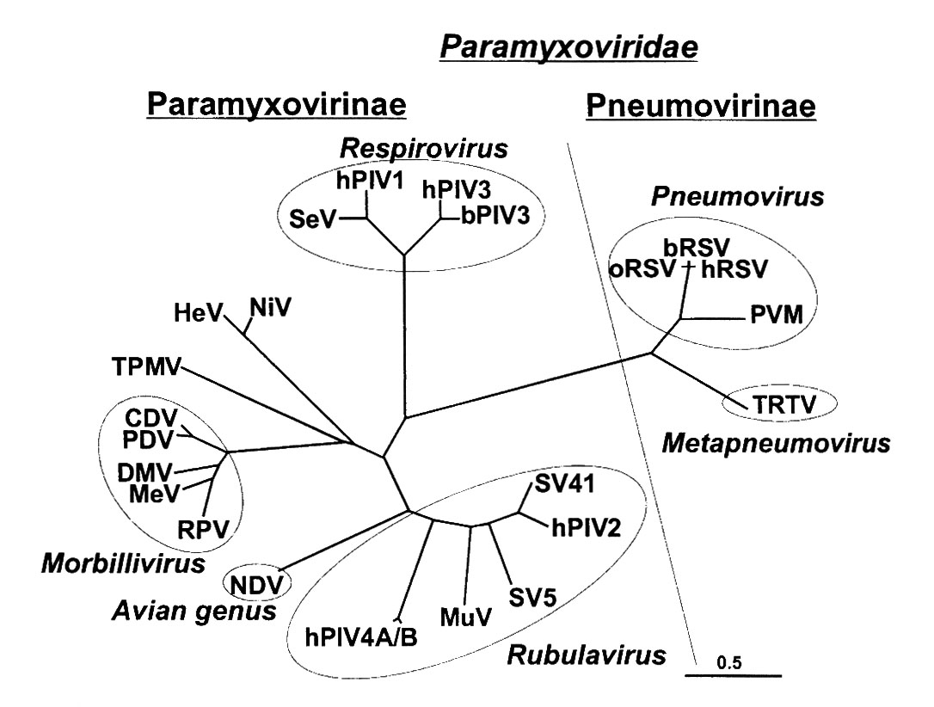
Sendai virus: murine counterpart of HPIV1
Cross-protective immune responses (Jennerian vaccine)
Tracheal infection/inflammation (croup)
Efficient contact transmission
Reinfection can occur
Majority of healthy hosts do not suffer severe LRT infection
Lamb & Kolakofsky, 2001 Fields Virology

Slide 4
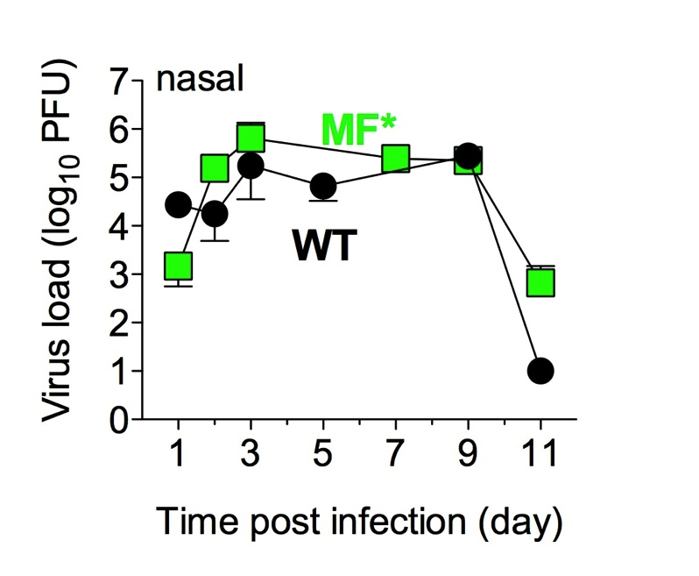
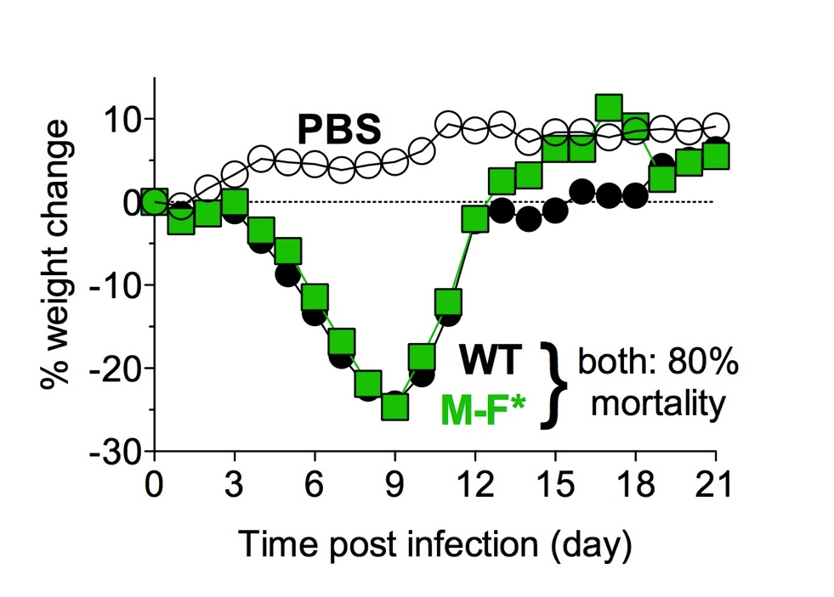
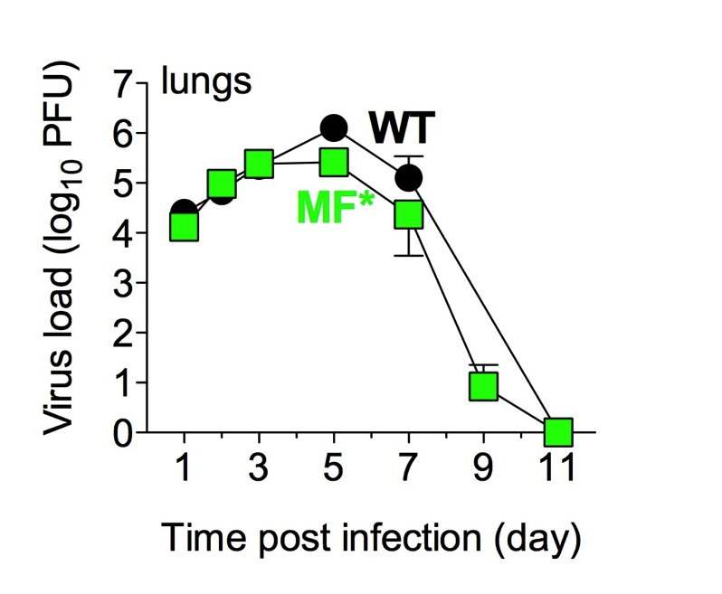
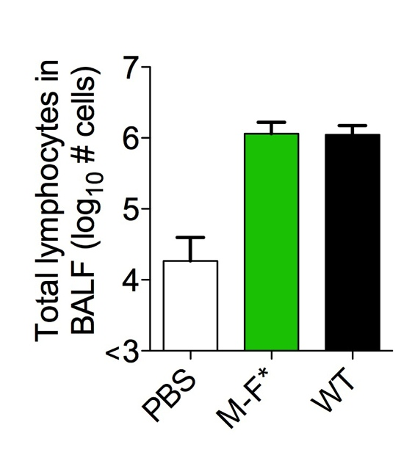
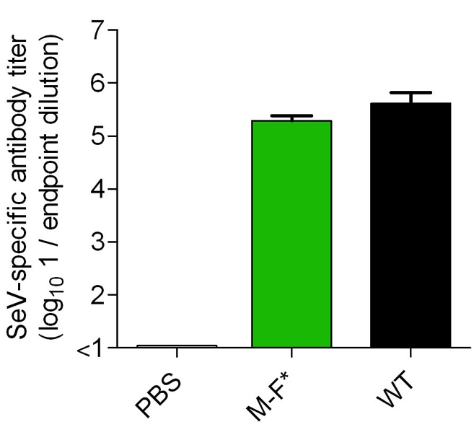
WT-like reporter virus: MF*
optimize gene start sequence
N
P
M
luciferase
F
HN
L
Burke…Russell 2011 PLoS Pathogens

Slide 5
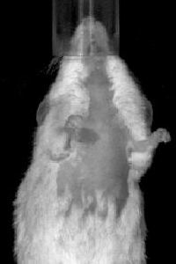
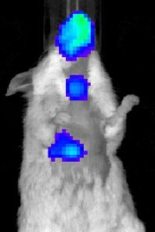
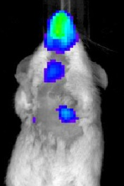
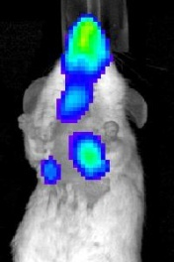
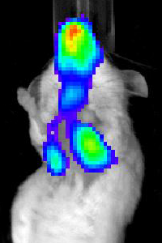
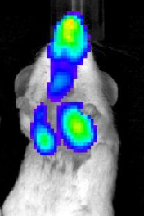
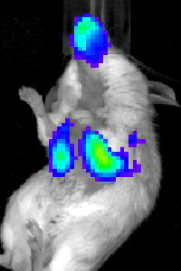
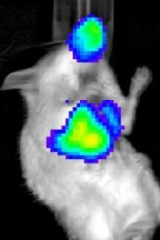
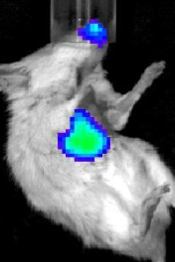
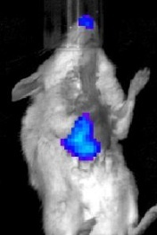
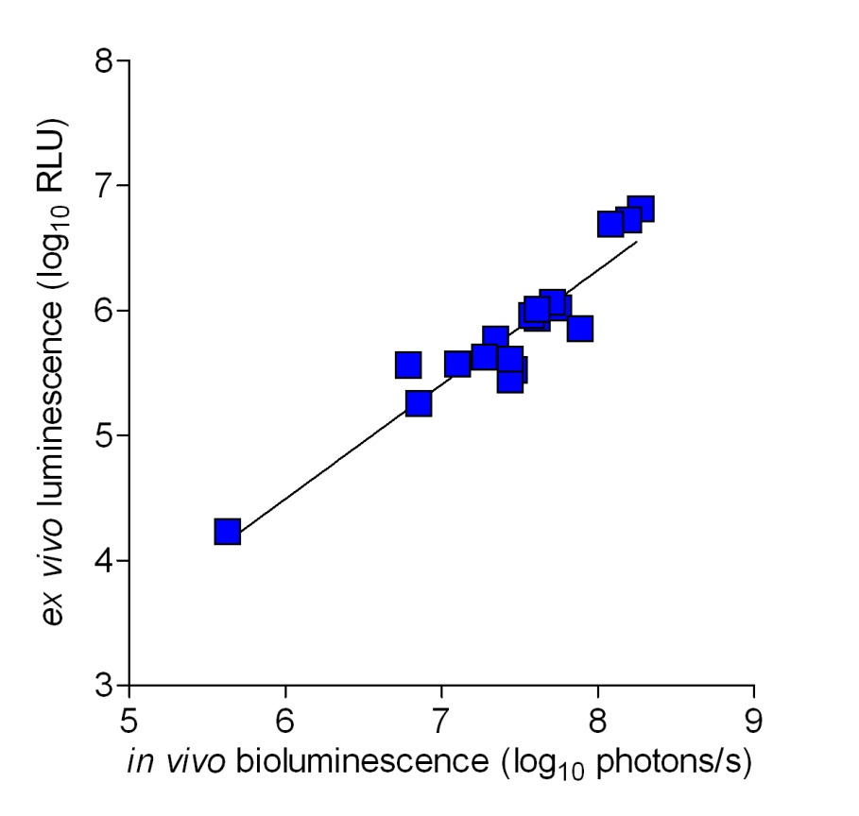
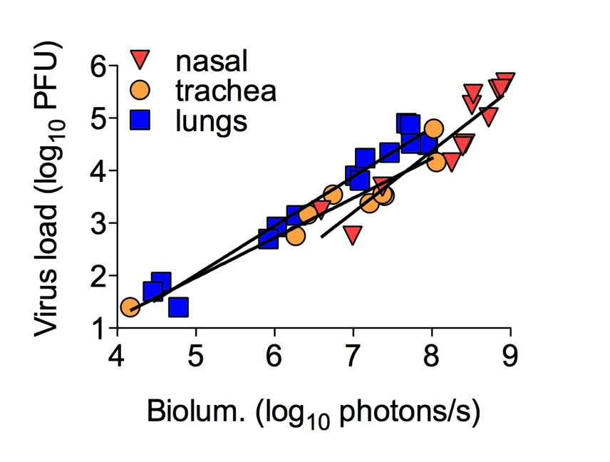
Imaging infection daily in a living mouse
day:
1
2
3
4
5
6
7
8
9
10
highest
7000
PFU
M-F*
in 30
μl
lowest
lungs
Burke…Russell 2011 PLoS Pathogens

Slide 6
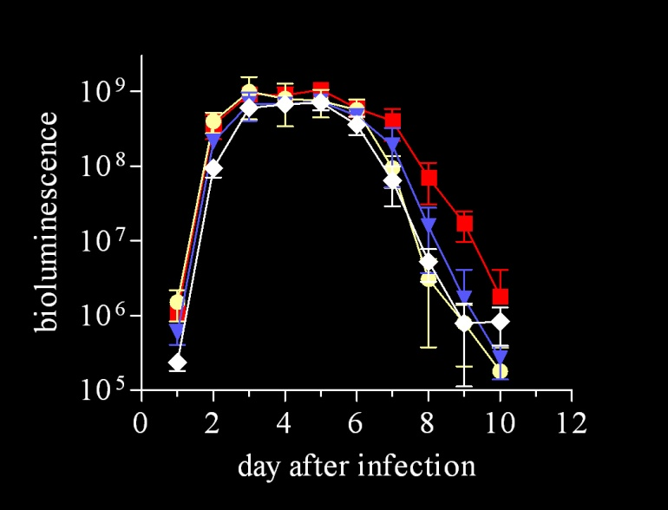
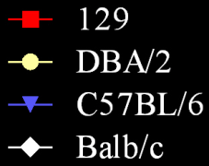
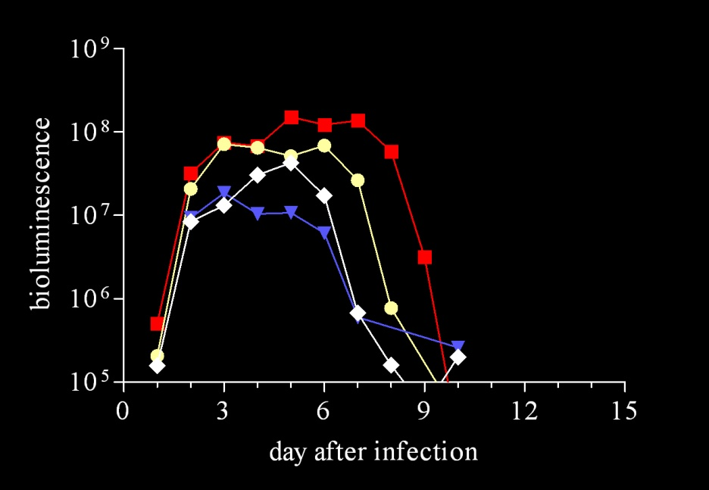
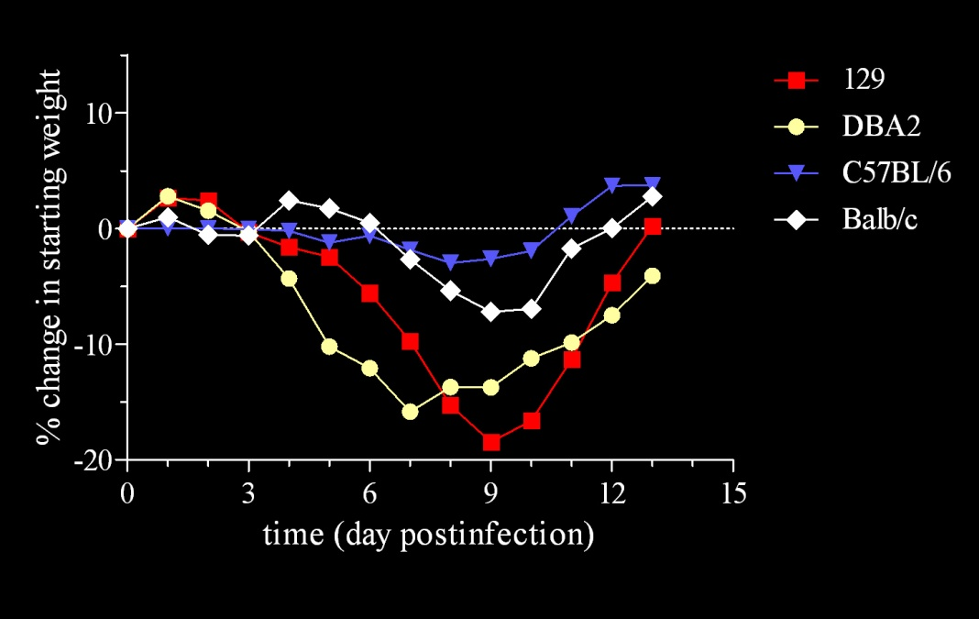
Resistant in lungs but susceptible in URT
Bioluminescence in Nasopharynx
Bioluminescence in Lungs
Weight Change
Burke…Russell 2011 PLoS Pathogens

Slide 7
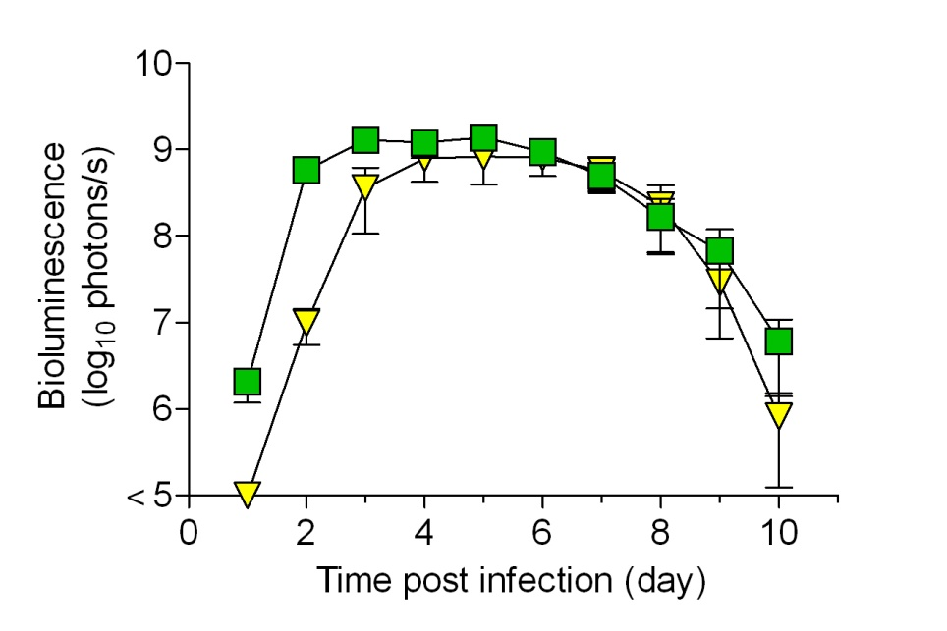
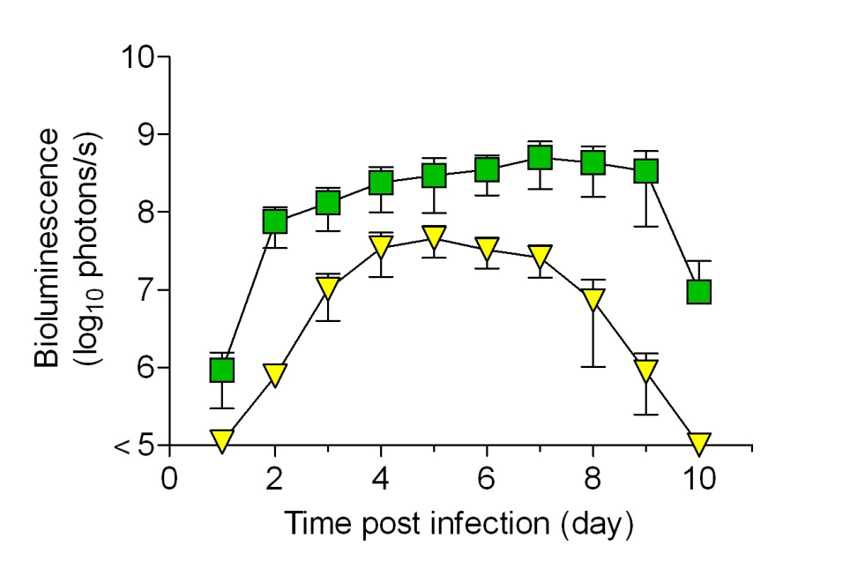
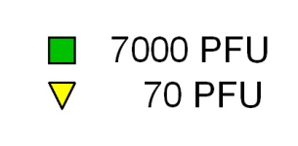
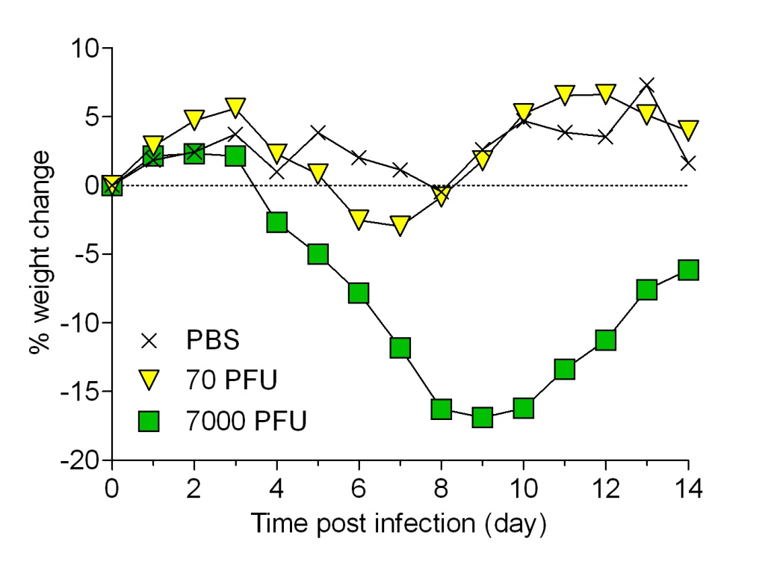
Low-dose inoculation grows to high level in URT
Nasopharynx
Lungs
7000 PFU
70 PFU
Weight loss
Burke…Russell 2011 PLoS Pathogens

Slide 8
Contact transmission
70 or 7000 PFU,
BALB/c or 129 mice
3x10⁶ PFU
challenge
day
post
infection
0
70
1
14
30
71
76
luminescence
1º infection or
transmission
luminescence
reinfection

Slide 9
Contact transmission
70 PFU or
7000 PFU virus
“resistant” BALB/c
“susceptible” 129 mice
100% contact transmission
similar-looking URT-biased infection in recipients
protects from lethal challenge

Slide 10
Progression of 1° infection in contact recipient mice
highest
1. Nasopharynx
2. Trachea (~0.8 days later)
lowest
3. Lungs (~1.0 days later)
For both 129/SvJ and BALB/c mouse strains
and 70- or 7,000-PFU inoculations into donors

Slide 11
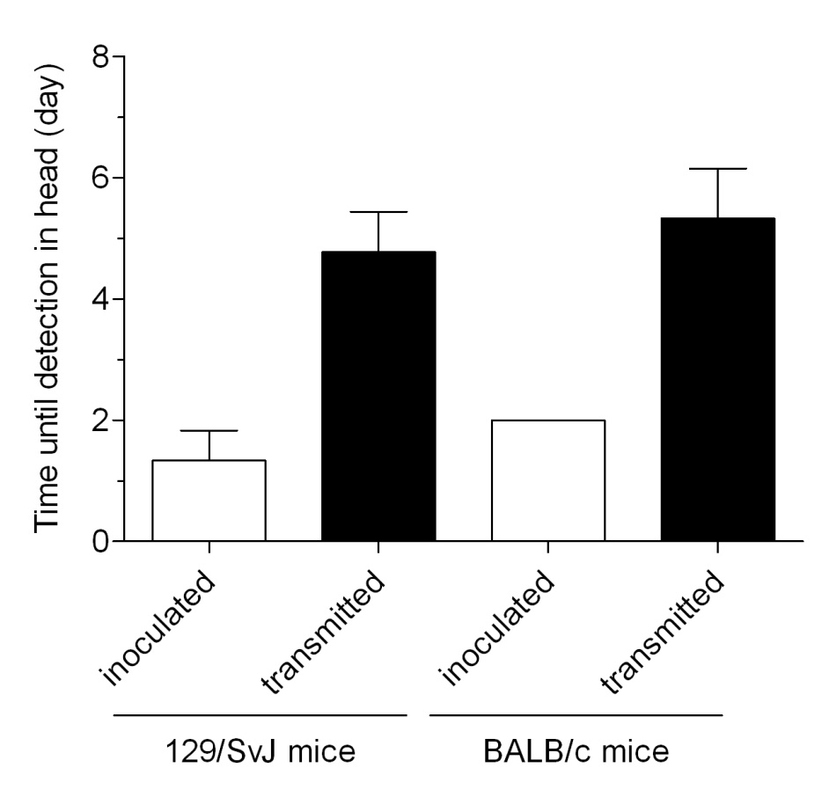
Time until detection in nasopharynx
3.4 days
3.3 days
7,000 PFU inoculation
Susceptibility to lung infection does not affect contact transmission.
Nasal virus shedding in inoculated mice => contact transmission.

Slide 12
Contact transmission
Looks like a low-dose, low-volume, URT-biased infection
70 PFU in 5 μL
Contact transmission
nasopharynx
trachea
lungs
Burke…Russell 2013 PLoS Pathogens

Slide 13
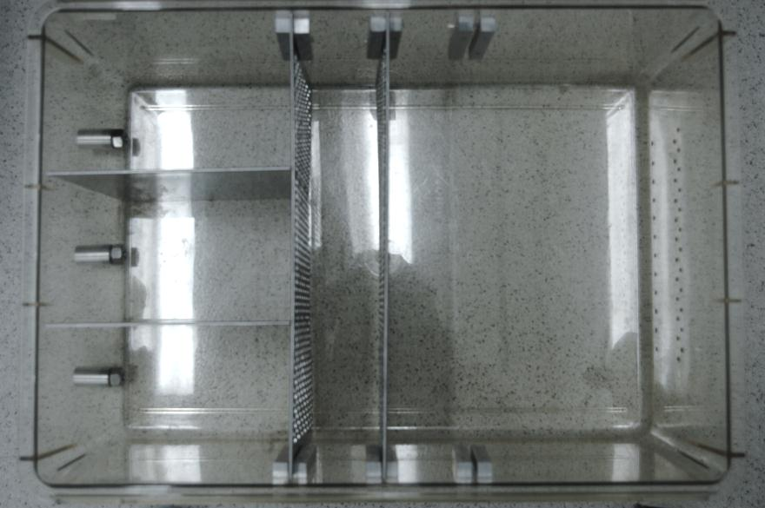
Airborne transmission
Air flow
isolated
recipients
donors
7.6
or
15
cm
3x10⁶ PFU
129-strain
“susceptible”
mice
0
70
day
of
expt.
1
14
30
71
76
Burke…Russell 2013 PLoS Pathogens
primary
challenge

Slide 14
Diverse dynamics of primary infection after airborne transmission
day: 1 2 3 4 5 6 7 8 9 10 11 12 13 14 15
(4/21)
(5/21)
(8/21)
Working hypothesis: Dynamics of infection determined by the site of inoculation & infectious dose
Burke…Russell 2013 PLoS Pathogens

Slide 15
1° infection inversely correlates with reinfection
Nasal first
4/21
Tracheal first
5/21
Tracheal dominant
8/21
No
transmission
3/21
Burke…Russell 2013 PLoS Pathogens

Slide 16
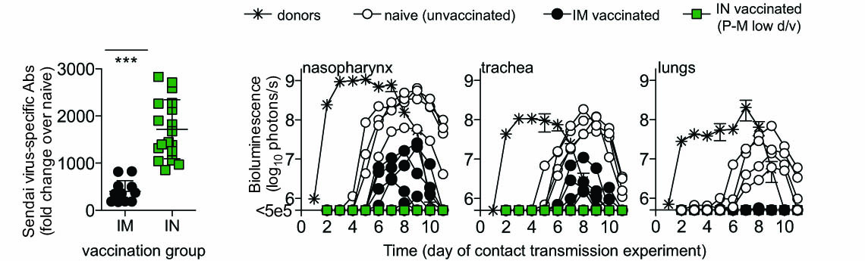
Protection from natural reinfection by contact transmission
Intranasal vaccination with a low dose/volume of attenuated virus: no reinfection.
Intramuscular vaccination: reinfection in the nasopharynx and trachea.
Burke…Russell 2014 submitted

Slide 17
Major Findings
Decoupling of Sendai virus infection in upper versus lower respiratory tract
  Lung infection and concomitant host response determines pathogenesis
  Upper respiratory tract infection determines transmission & induces protective immunity even under suboptimal conditions
    Clinical diagnosis: titers from nasal washes not same as lung titers
    Vaccine development: attenuated or lower-dose I.N. live-virus vaccines
Paradigm for respiratory virus infection: for a virus matched to its host, ‘natural’ infection after transmission elicits immunity without pathology
    Robust upper respiratory tract infection benefits both virus and the host
Mode of transmission determines the tropism and magnitude of primary infection, which is in turn inversely correlated with reinfection
ANISOTROPIC INFECTIONS: Dynamics of natural respiratory infections can vary. Compartmentalization of immune response contributes to protection from reinfection

Slide 18
Sendai virus: Illuminating parainfluenza virus dynamics in living animals
Charles J. Russell, PhD
postdoc: Crystal Burke, PhD
Funding: NIAID R01AI083370

