Slide 1
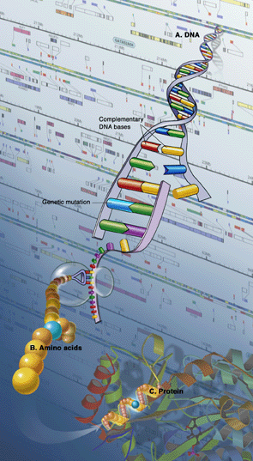
“Nutritional Sciences Keynote Presentation”
Valencia, Spain September 23, 2014
Nutrigenomics:
Let food be your medicine
Charles C. Muscoplat, PhD
McKnight Presidential Professor.
Professor of Food Sciences and Nutrition
Professor of Medicine
Dean Emeritus, College of Food, Agricultural and
Environmental Sciences
University of Minnesota
Minneapolis, MN, USA

Slide 2
Educational Goals for Today
Understand how foods and/or nutrients can affect your health by mechanisms other than as providing simple nutrients, vitamins or energy
Some foods or food products can treat and/or prevent major human diseases by altering gene expression or through existing genetic polymorphisms
Agriculture and medicine will partner for human health promotion and disease prevention by utilizing Foods as Medicine
Use foods to alter or complement gene expression in a dose and time dependent manner to prevent, ameliorate or cure serious human diseases.

Slide 3
Today’s Medicine and Nutrition.
One size does not fit all. Not everyone responds similarly to medications or food:
Patients are “Different” by Polymorphisms

Slide 6
Diet and Chronic Diseases
Chronic diseases account for 75% of all health care expenditures; (e.g., coronary heart disease, diabetes, cancer, stroke, mental illness), which may be related to diet and/or lifestyle factors)
Costs for chronic diseases------$$trillions
Some factors are important:
Modifiable factors; diet, lifestyle, exercise, alcohol, tobacco, certain foods and chemicals
Not modifiable factors; age, sex, genotype, family history
Many chronic diseases can be prevented or treated with modifiable changes in diet and lifestyle:

Slide 8
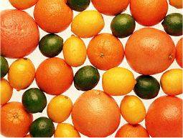
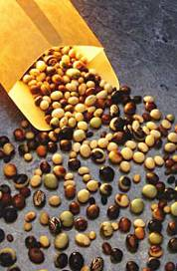
Genetic Variability Exists in our Food: Alleles, Regulation, Epigenetics
If you want health, which varieties do you choose? Why?
CITRUS
Oranges, Grapefruits, Mandarin Orange, Lemons, Limes, Citrons, Shaddocks, Pummelos, Osbecks, Sour Oranges. Do they share common genes or are some genes on or off? Which alleles are healthful and which are not?
LEGUMES
Soybeans have several important nutrients but levels vary among varieties. Ancient varieties have higher levels of cancer preventing compounds than modern varieties
TOMATOES
Tomatoes, Cherry tomatoes, yellows, heirloom, fried green, Roma, Sun Gold, Big Boy, Plum, Purple. Is yellow lycopene as healthy as red lycopene?
BRASSICA
Broccoli and Cauliflower share ancestral genes of origin, including nutrient constituent genes, but are they equally healthful to you? Which on is more healthful?

Slide 9
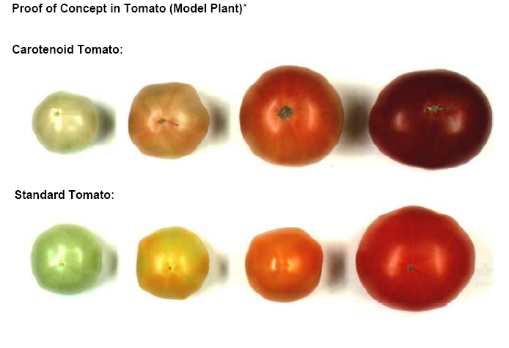
Example: These tomatoes do not each have the same health benefits!

Slide 10
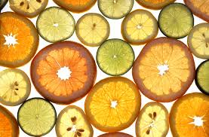
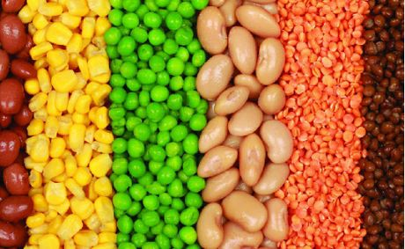
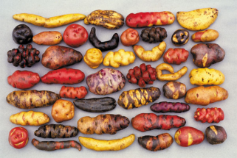
Citrus
Carrots?
Are these carrots different?
Do they have different genes?
Are different genes expressed?
Are some genes methylated?
Are they equally healthy?
Do they grow the same?
To they taste the same?
What is the advantage?
Legumes
Potatoes

Slide 11
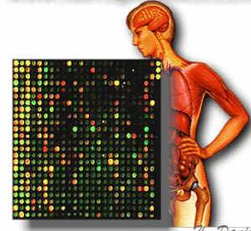
Nutrigenomics
The science of nutrigenomics seeks to provide a molecular understanding for how common dietary chemicals (i.e., nutrients) affect health by altering the expression and/or conformational structures of an individual’s genetic makeup. Turning on and off your genes that control diseases!

Slide 12
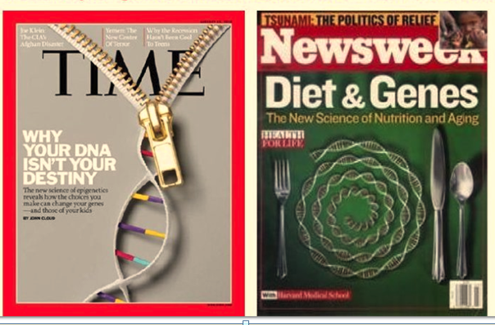
DNA is not your destiny

Slide 13
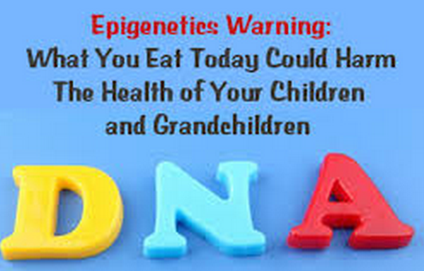
You Can Eat to Regulate Your Genes and also those of your children and grandchildren

Slide 14
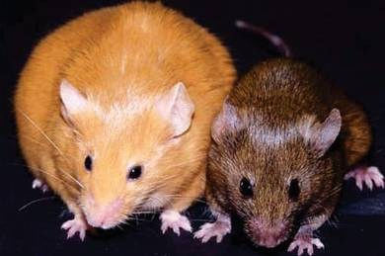
Example: These two genetically identical mice were born of genetically identical mothers who were fed differently in pregnancy and they will have very different lives
These identical mothers who were fed different amounts of acetylating nutrients or soy genistein during pregnancy
Randy L. Jirtle, Ph.D. 2014 Linus Pauling Award

Slide 15
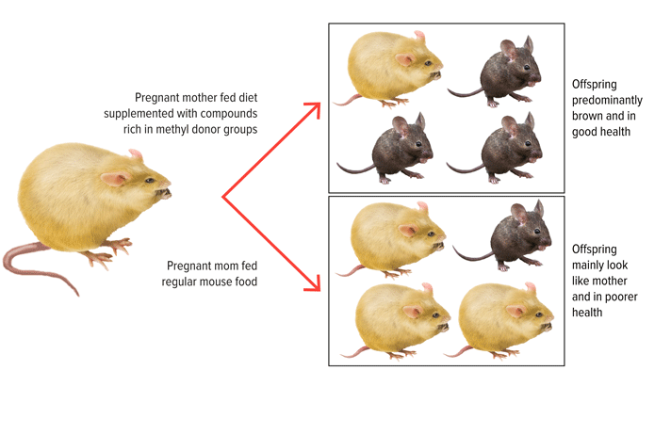
Example: Change in offspring by supplementing maternal diet with methyl donors

Slide 16
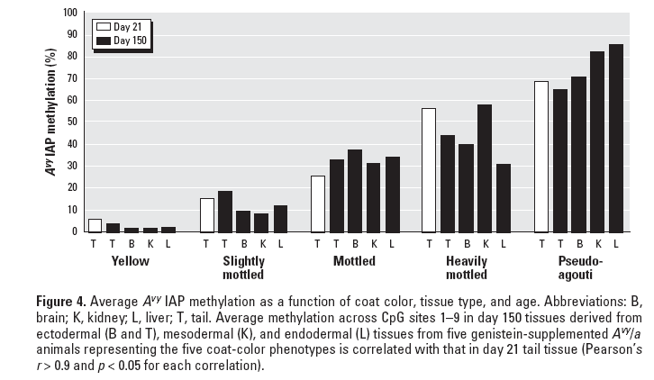
Pseudo-agouti predicts long-term methylation: Sites methylated at day 21 were likely to remain methylated at day 150 conferring a lifelong effect. Methylation in tail tissue correlates with other tissues. T= Tail; L=Liver; B=Brain; K=Kidney. The extent of methylation was endoderm, mesoderm and ectoderm meaning methylation occurred early in gestation

Slide 17
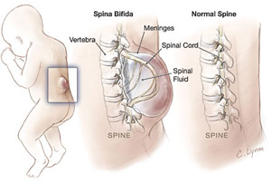
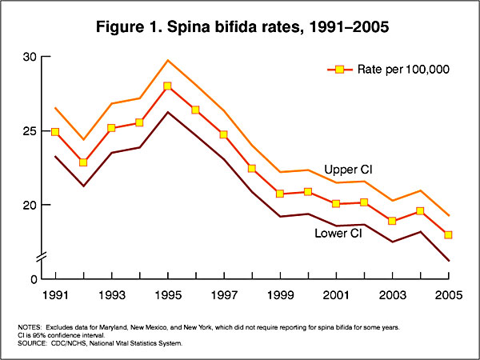
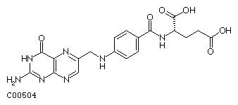
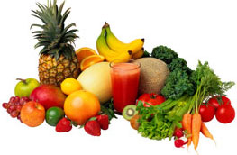
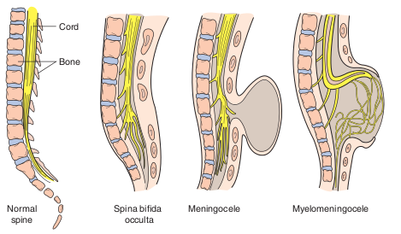
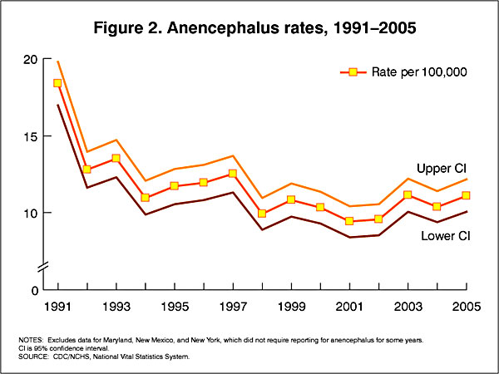
Example: Folic Acid Prevents Neural Tube Defects (spina bidida & anencephalus) by providing methyl/acetyl donors in diet

Slide 18
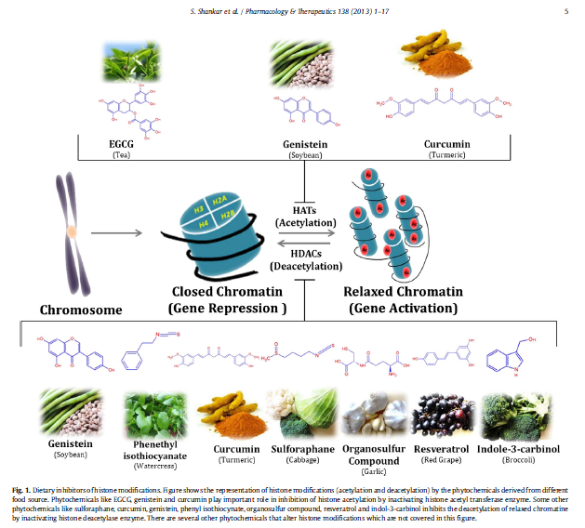
Example: Acetylation- Deacetylation. Some dietary components inhibit DNA methyltransferases and alter acetylation
Some foods alter acetylation and deacetylation; thus alter gene activation
Green tea
Soybean
Garlic
Tomato
Watercress
Turmeric
Cabbage
Red Grape
Acetylate – activate
Deacetylate - repression
S. Shankar et al. / Pharmacology & Therapeutics 138 (2013) 1–17

Slide 19
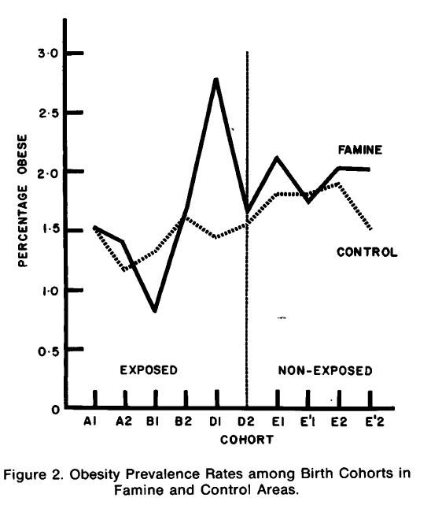
Example: Correlation of Low Birth Weight and IGT and Type 2 Diabetes at age 50 and obesity
Dutch famine in 1944 was followed by major illnesses; but delayed by 50 years
FINDINGS:
Exposure to famine during gestation resulted in increases in impaired glucose tolerance, obesity, coronary heart disease, atherogenic lipid profile, hypertension, microalbuminuria, schizophrenia, antisocial personality and affective disorders. Exposure to famine during childhood resulted in changes in reproductive function, earlier menopause, changes in insulin-like growth factor-I and increases in breast cancer.
SUMMARY:
Exposure to famine during gestation and childhood has life-long effects on health, and these effects vary depending on the timing of exposure as well as evolution of the recovery period.

Slide 20
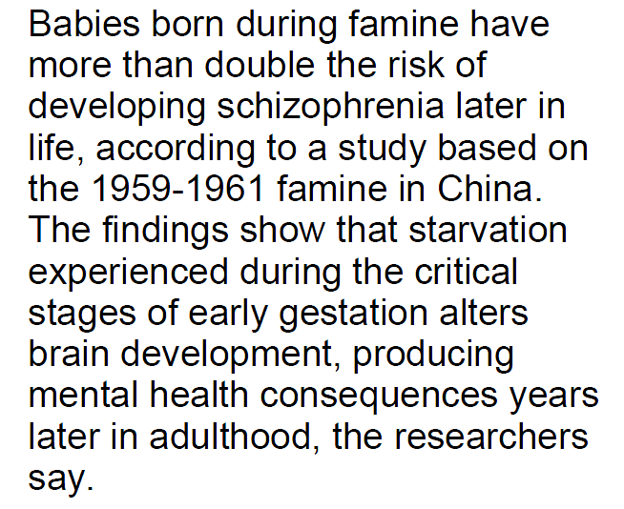
Famine in China 1959-1961
Babies born during famines have double the risk of schizophrenia…..

Slide 21
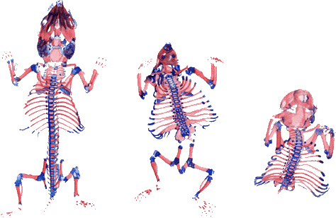
Example: Control of Homeotic Hox Genes During
Embryonic Development. Gene Expression and Birth Defects: Vitamin A Effect -- Turning on genes normally turned off during gestation
*****Malformations caused by high doses of vitamin A, which was given to mothers on day 8 of pregnancy. Vitamin A has caused the homeotic HOX genes 1-4 to become expressed in groups of cells that usually do not express these genes.

Slide 22
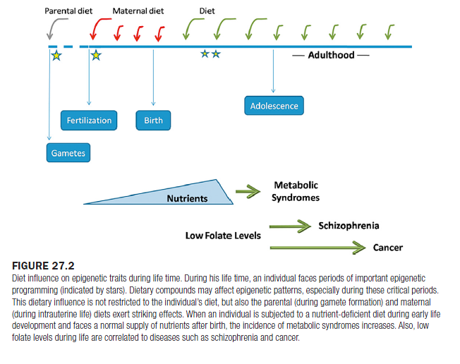
Example: Dietary changes in grandmothers, mothers and children has differential impacts depending upon timing. Intrauterine diets, nutrient deficient diets in utero; schizophrenia and metabolic syndrome

Slide 23
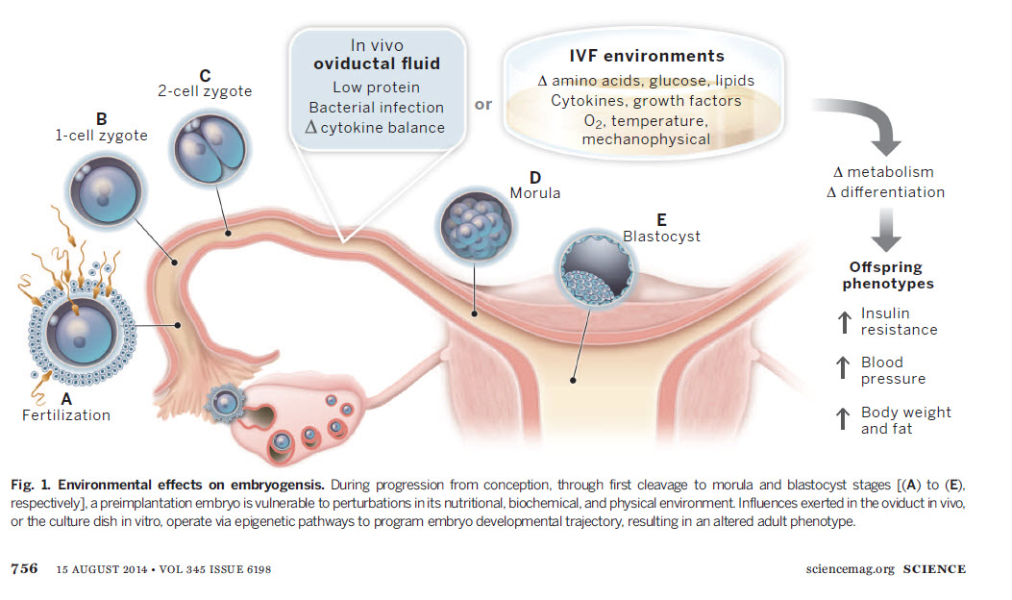
Example: Environmental effects on embryogenesis
From conception through blastocyst A thru E the pre-implant embryo is vulnerable to nutritional, biochemical, physical environmental and other influences exerted in the oviduct in vivo, which alter epigenetic pathways

Slide 24
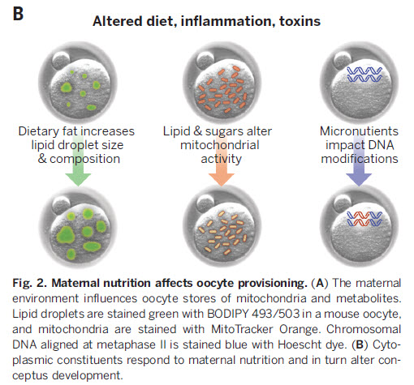
Example: Altered diet, inflammation and exposure to toxins. Maternal nutrition affects oocyte provisioning

Slide 25
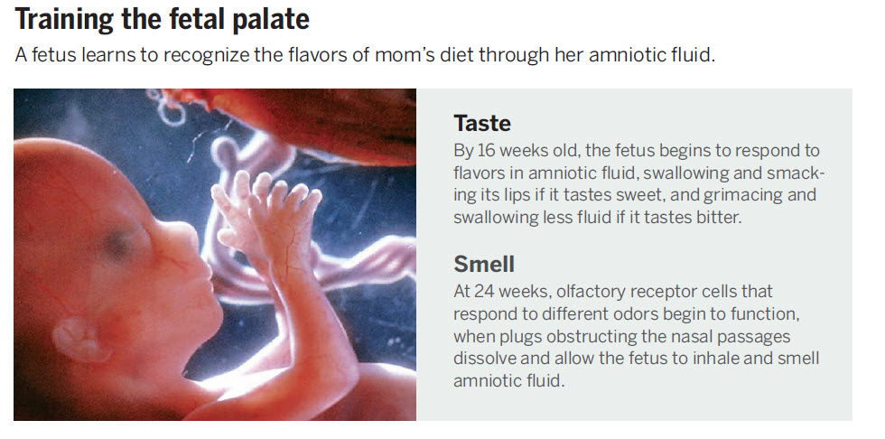
Example: Training the fetal palate to enjoy sweet, sour, salty, bitter tastes.

Slide 26
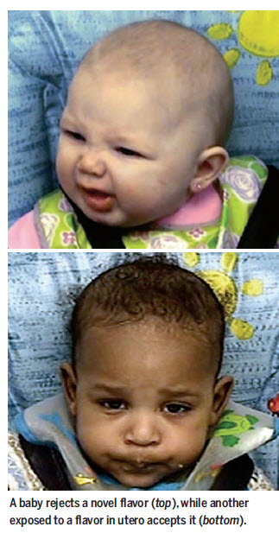
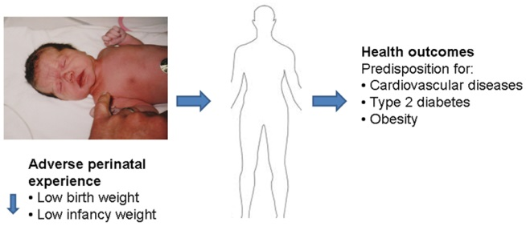
Example: Babies enjoy or reject flavors they enjoyed while exposed in utero
Example: Babies born with caloric deprived mothers have lifetime risks of obesity, cardiovascular disease, and type 2 diabetes

Slide 27
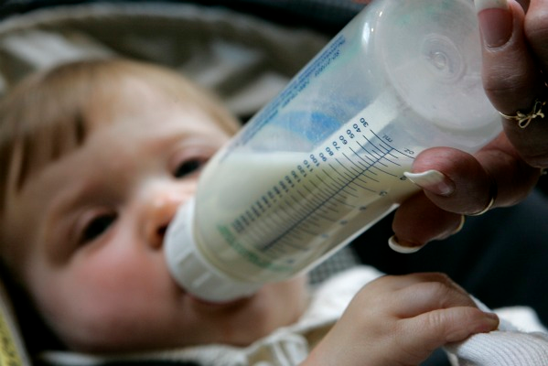
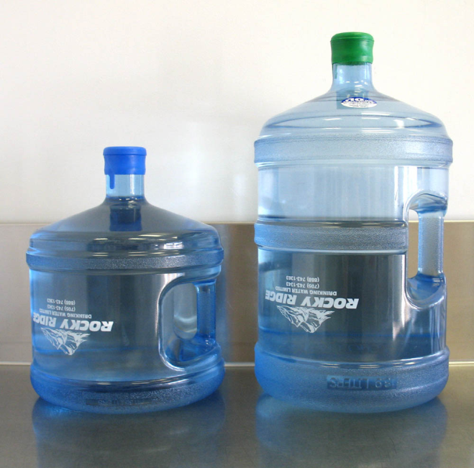
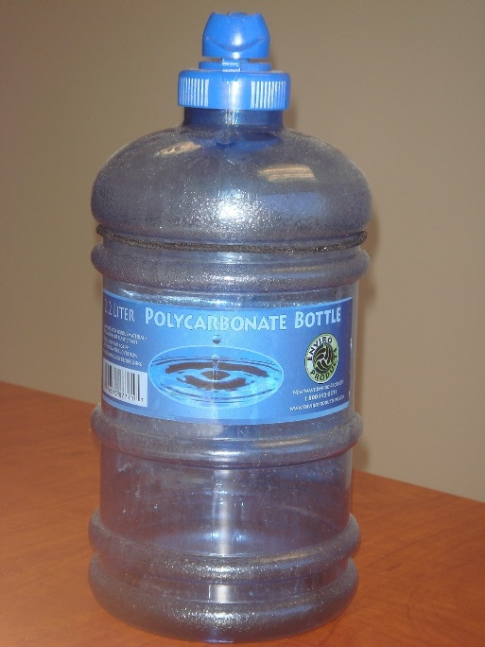
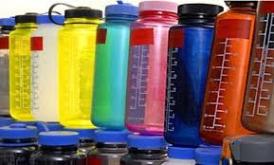
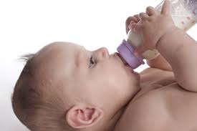
Example: BPA or bisphenol A gene altering plastic alters the epigenome. Environmental toxicants alter your genome and the effect is transgenerational

Slide 28
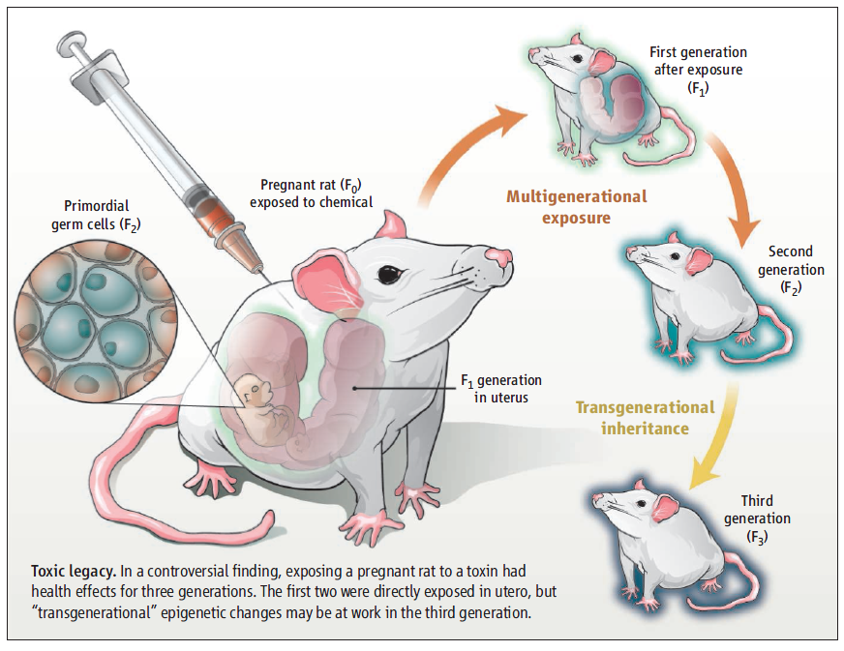
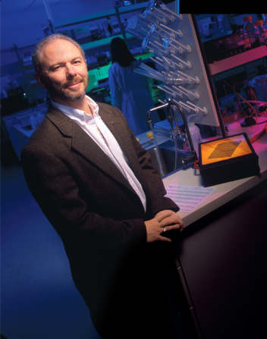

Slide 29
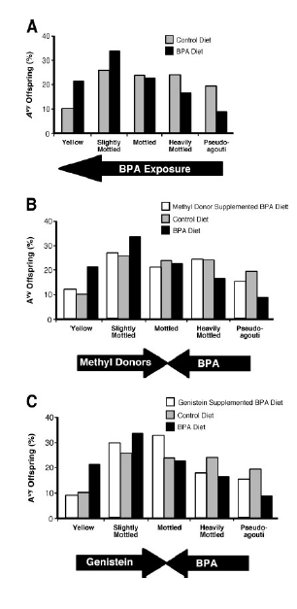
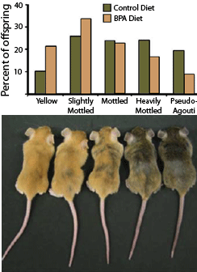
Environmental toxicants can alter the epigenome and cause disease; and can also be reversed by certain foods

Slide 30
The hypothesis of fetal origins of adult disease posits that early developmental exposures involve epigenetic modifications, such as DNA methylation, that influence adult disease susceptibility. In utero or neonatal exposure to bisphenol A (BPA), a high-production-volume chemical used in the manufacture of polycarbonate plastic, is associated with higher body weight, increased breast and prostate cancer, and altered reproductive function.
………………………………………………Moreover, maternal dietary supplementation, with either methyl donors like folic acid or the phytoestrogen genistein, negated DNA hypomethylating effect of BPA. Thus, we present compelling evidence that early developmental exposure to BPA can change offspring phenotype by stably altering the epigenome, an effect that can be counter-acted by maternal dietary supplements.

Slide 31
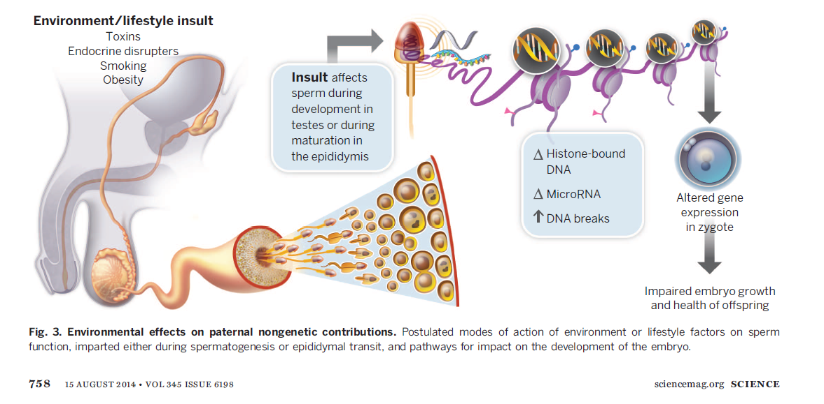
Lifestyle factors can perturb sperm during spermatogenesis, epididymal transit and impact the development of the embryo

Slide 32
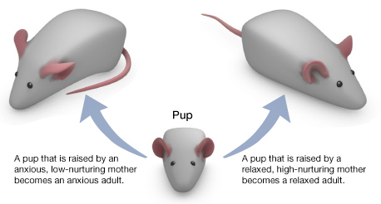
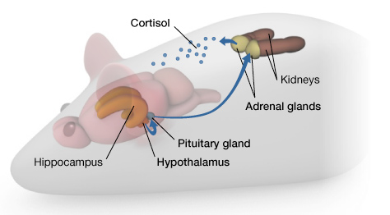
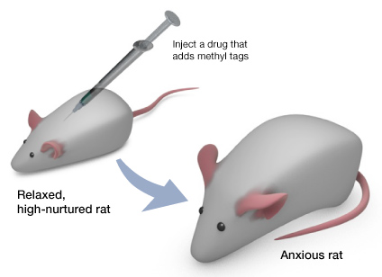
The Glucocorticoid Receptor (GR) Helps Shut Down the Stress Response
1
Licking mothers demeythlate DNA in pups; abusive mothers methylate DNA and produce anxious pups
3
2

Slide 33
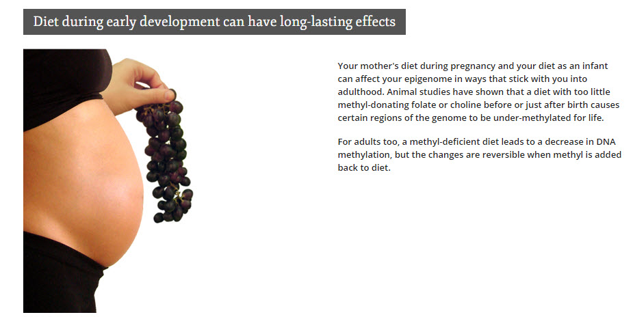
Diet during early development can have long-lasting effects

Slide 34
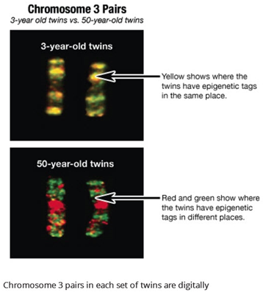
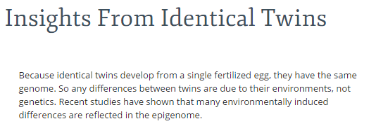
Identical Twins

Slide 35
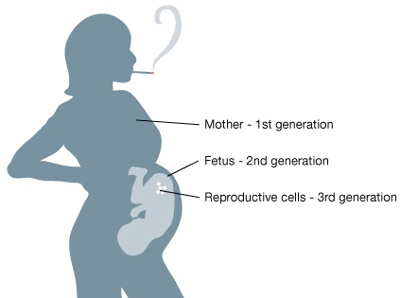
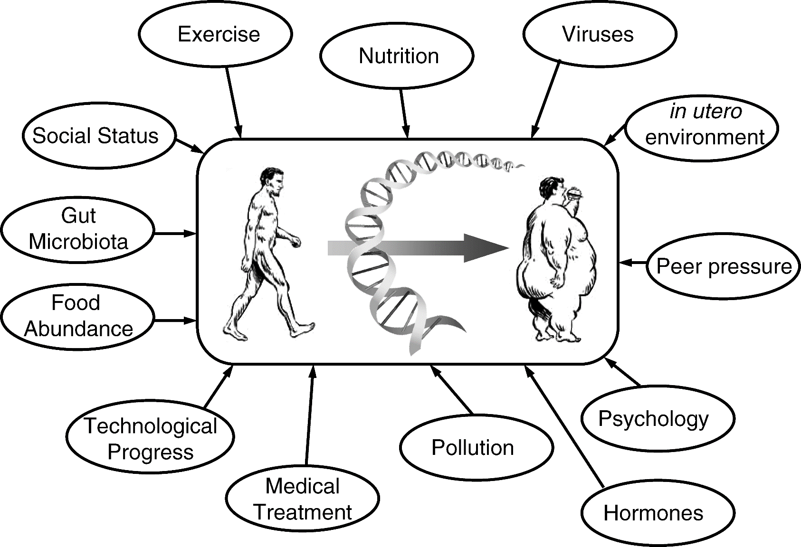
Many epigenetic influencers; many generations

Slide 36
Test Today
Foods and/or nutrients can affect our health by mechanisms other than as providing simple nutrients or energy
Some foods or food products can treat and/or prevent major human diseases by altering gene expression or through existing genetic polymorphisms
Agriculture is a full partner in human health promotion and disease prevention by utilizing foods as Medicine
Foods to alter or complement gene expression a dose and time dependent manner to prevent, ameliorate or cure serious human diseases.

Slide 37
Thank you…...

