Slide 1


Slide 2

Challenges in Real-Life Implementation of Public Vaccination Programs in Developing Countries and Strategies to Increase Immunization Coverage

Slide 3
CONFLICTS OF INTEREST
X | No, nothing to display
 | Yes, please specify:
Company Name | Honoraria/ Expenses | Consulting/ Advisory Board | Funded Research | Royalties/ Patent | Stock Options | Ownership/ Equity Position | Employee | Other (please specify)

Slide 4
Agenda
Characterize the health care network in Brazil – The Unified Health System
Present challenges in real life implementation of public vaccination programs and the most valuable answers
Present a vaccination experience in the municipality of Campos dos Goytacazes, State of Rio de Janeiro, Brazil

Slide 5
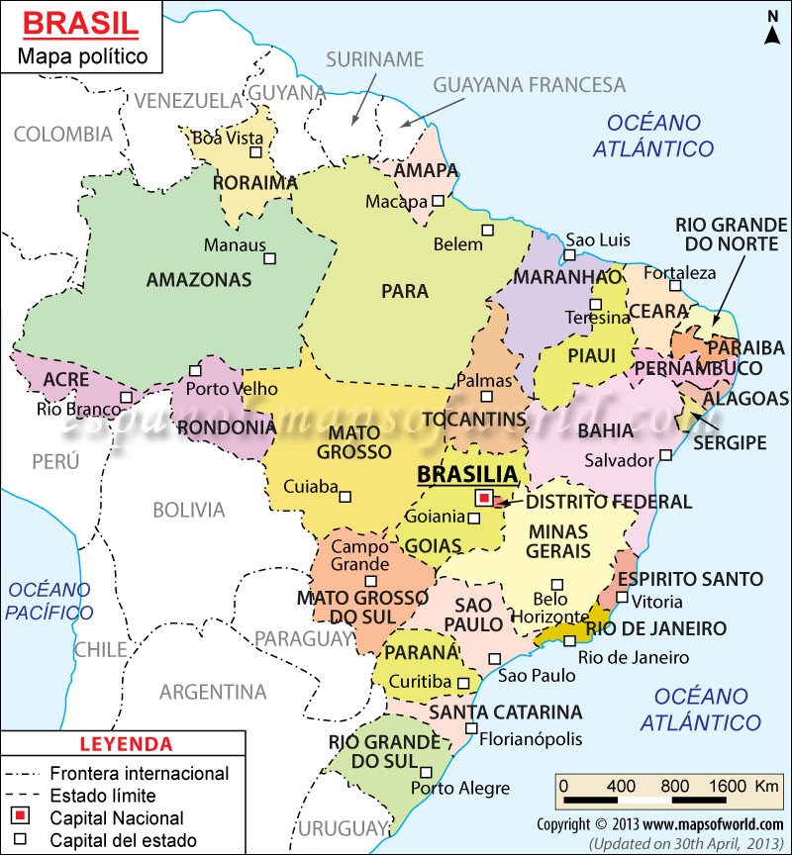
BRAZIL
200.000.000 inhabitants
Great cultural and economic diversity
The Primary health care assistance is based on prevention
Vaccination is the leading strategy of prevention

Slide 6

Unified Health System (SUS)
Implemented In October / 1988
It’s a health plan totally free of charge in all levels of complexity.
It carries one of the largest immunization programs in the world - 40 years of success
The immunization program displays high rates of immunization coverage and elimination of various diseases (eg. polio, measles)

Slide 7



Slide 8

The largest immunization Program in Brazil
(Use of financial resources of oil royalties)

Slide 9
INCLUSION OF NEW VACCINES
IN CAMPOS DOS GOYTACAZES*
INCLUSION OF NEW VACCINES
BY THE MINISTRY OF HEALTH
2009 – Pneumococcus conjugated 7-valent vaccine (PCV-7)
2010 – (PCV-13 and quadrivalent HPV vaccine for girls 11-15 years.
2011 – Hepatitis A vaccine (< 2y)
2012 – Vaccines room for travelers
2012 – Varicella-zoster vaccine (< 3y)
2014 – quadrivalent HPV vaccine for boys – 11-13 years old.
2010 – Pneumococcus conjugated 10-valent vaccine (PCV-10)
2010 – Meningococcus C conjugated vaccine
2013 – varicella zoster-vaccine (15 months)
2014 – HPV quadrivalent vaccine in girls 11-13 years
2014 – Hepatitis A vaccine
* The inclusion of new vaccines in Campos dos Goytacazes with own resources occurs before the Ministry of health, so when it becomes available in all over the country, we use our own financial resources to buy a new vaccine that was not yet introduced by the ministry of health

Slide 10
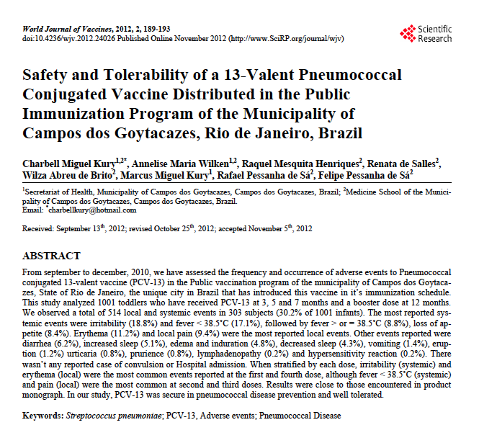

Slide 11

This study is being conducted by the municipality of Campos dos
Goytacazes and Pfizer®

Slide 12
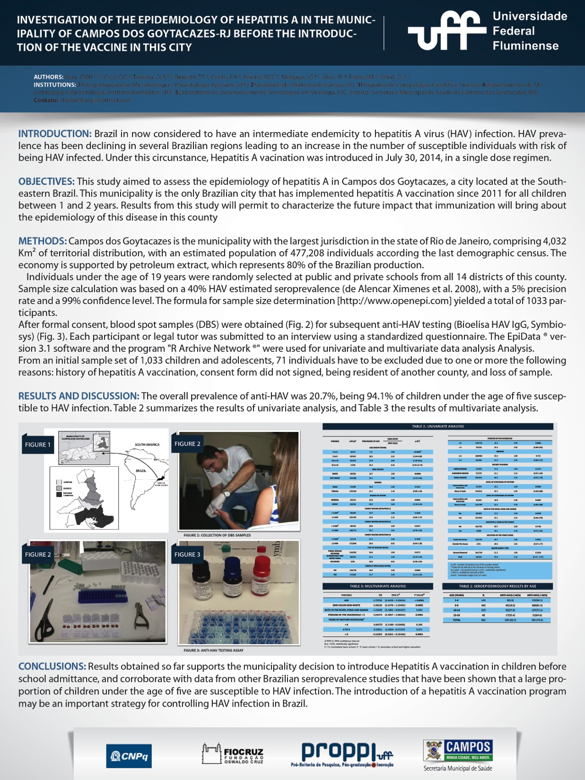
Hepatitis A study, the first one in Brazil in a municipality that introduced the vaccine
Circulation of Hepatitis A vaccine was reduced in 80%

Slide 13
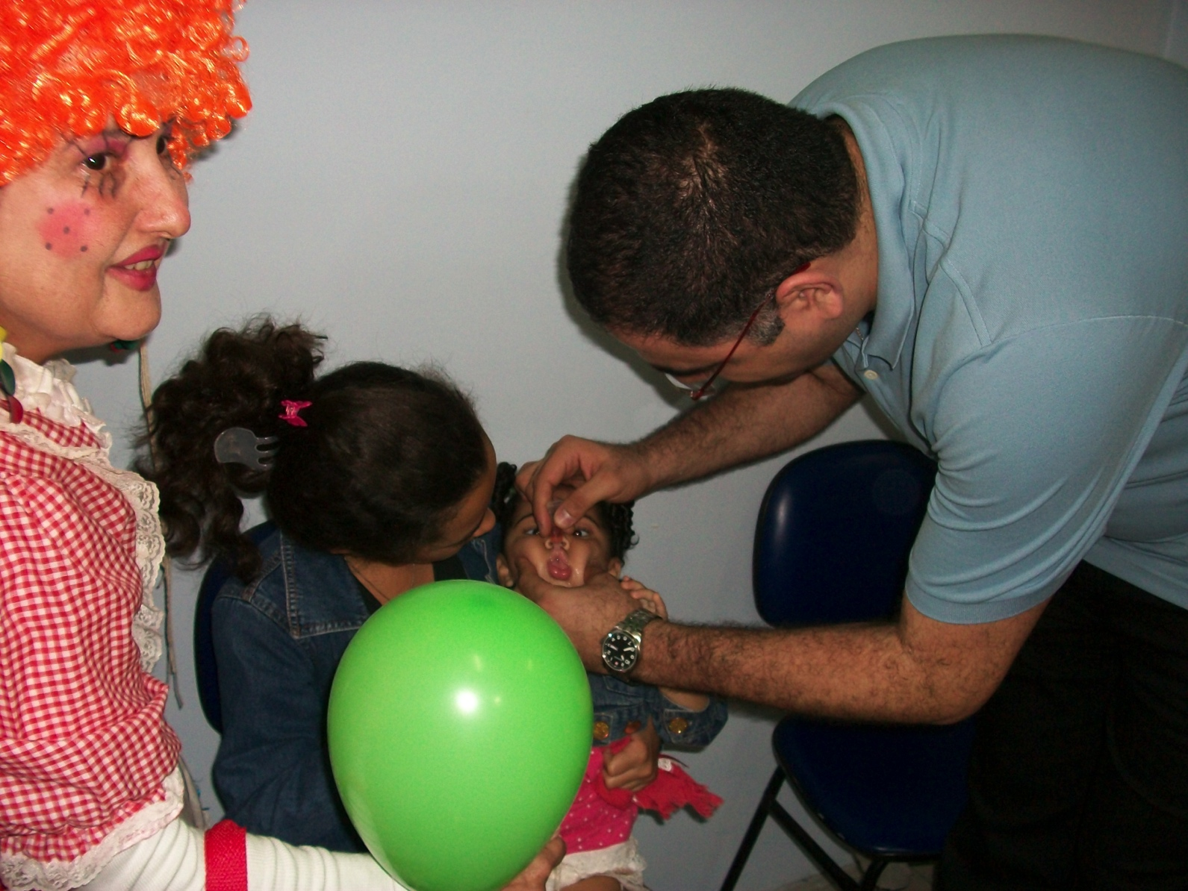
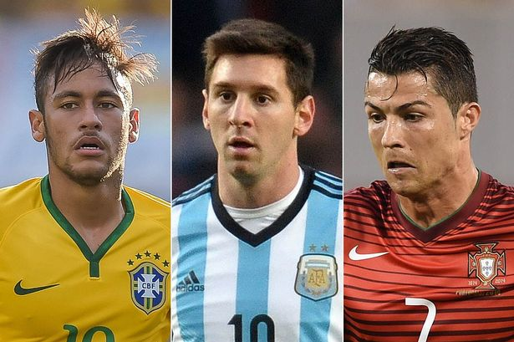

WHAT IS THE BEST CHALLENGE?

Slide 14
Challenge 1 – The Political Decision
The main challenge
Experts, researchers and appointed directors have to be able to convince their government representatives to the financial and political returns in vaccination
Without political support, no project can be implemented

Slide 15
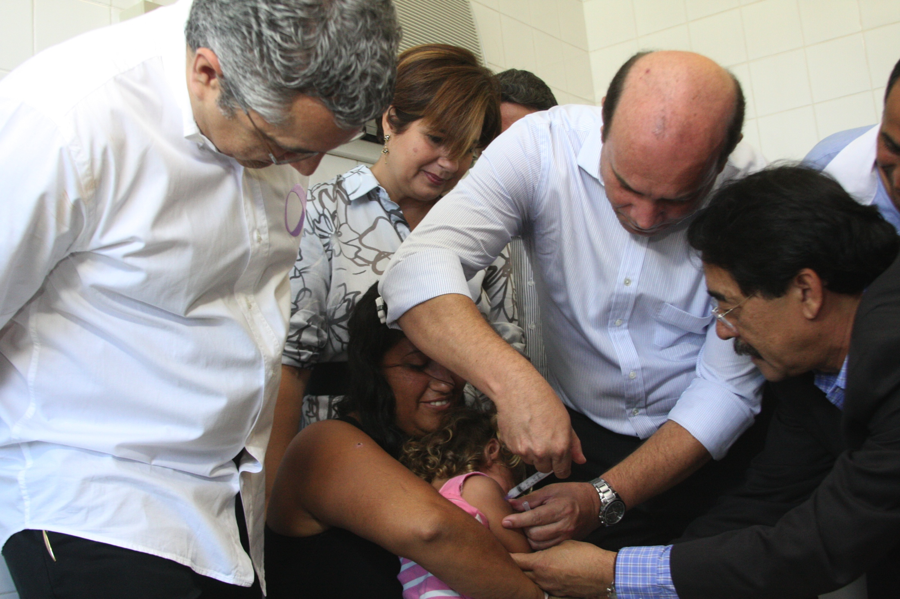
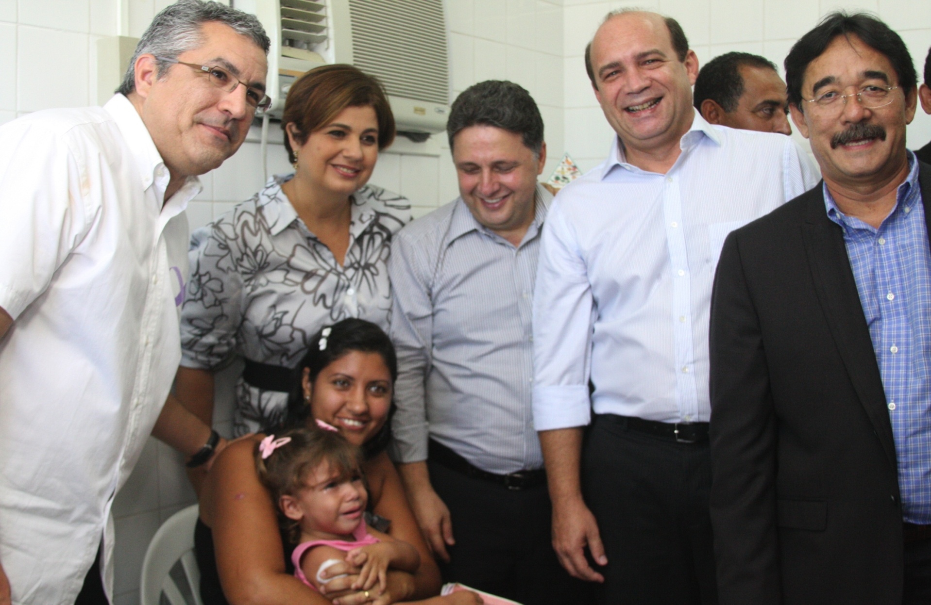
The Brazilian Minister of Health visiting Campos dos Goytacazes, when this municipality introduced the Hepatitis A vaccine, in 2011

Slide 16
Challenge 2 – Provide Education in Health
Consider the schools the most important place to learn about health
Introduce programs and provide health inside the school.
Provide advertising Campaign, mainly in schools
“Health in school programs”

Slide 17
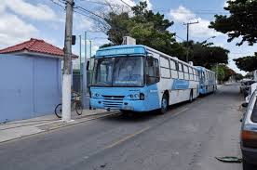
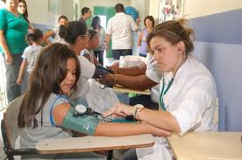
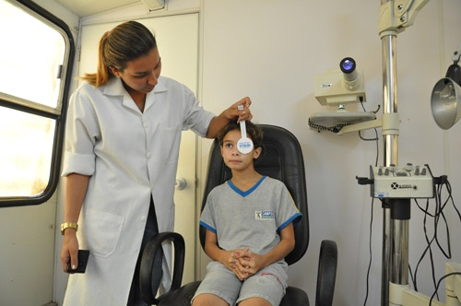
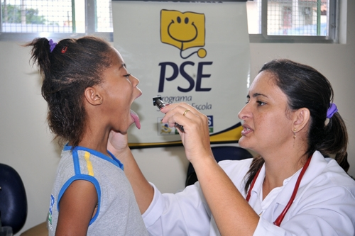
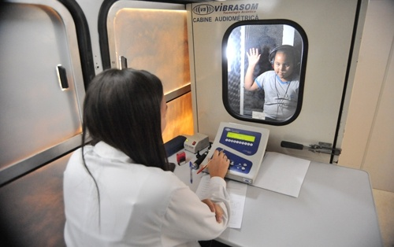
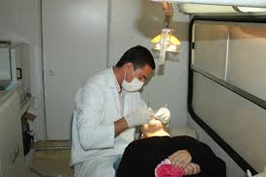
Mobile units

Slide 18


Advertising Campaign
  Sensitization and mobilization of the importance of the vaccine

Slide 19
Challenge 3 – Supply Epidemiological data
Essential for the introduction of new vaccines
Used to evaluate several questions, like vaccine coverage, reduction on the incidence of a disease
Vaccination records on the Web are being used for us since 2010.
It allows calculation of immediate vaccination coverage

Slide 20
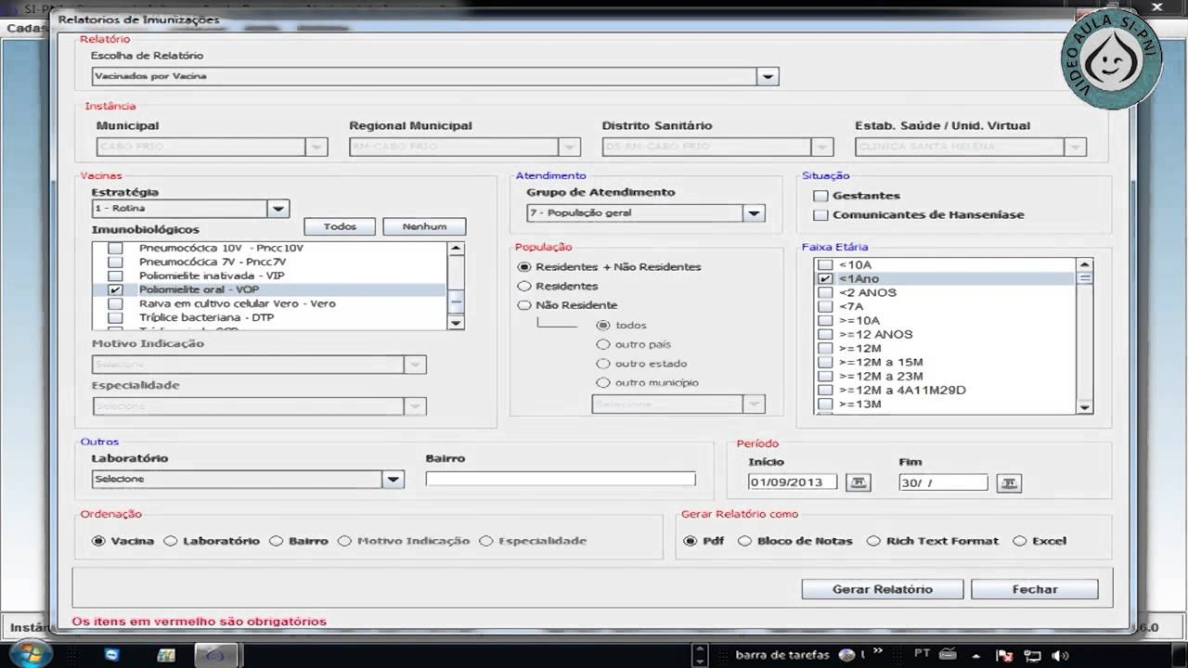
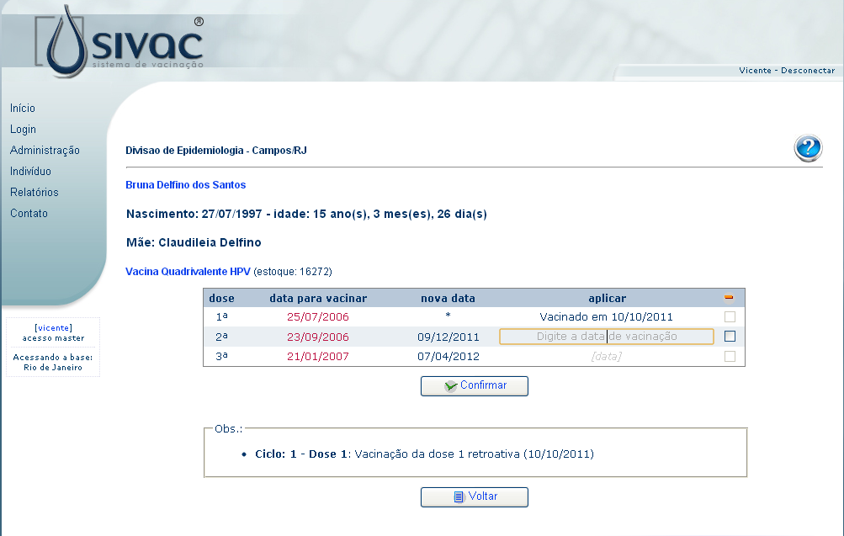
Created by our Municipality in 2010

Slide 21
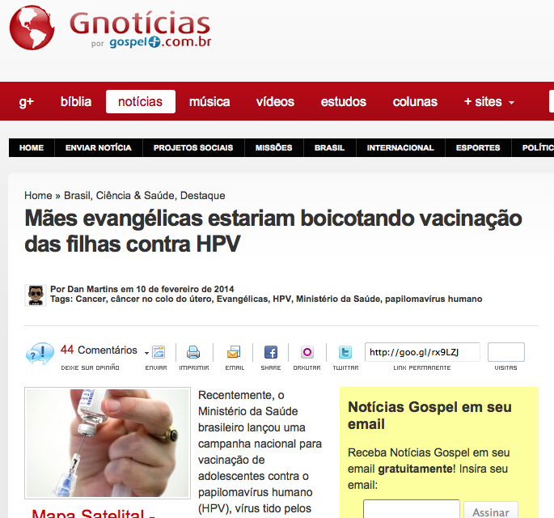
Challenge 4 – separate what is myth and reality
Dispel myths such as the HPV vaccine only for virgin girls
Resolve religious issues
Evangelical mothers were boycotting HPV vaccination

Slide 22
Radical groups against vaccinations¹
The best weapon is the INFORMATION
“Generally, vaccines are among the safest biological products for human use, providing undoubted benefits for public health¹”
“The public should be properly informed about the occurrence of adverse events following vaccination, avoiding sensationalized news and precipitates that can undermine confidence in the vaccine and provide disastrous results at the population level¹”
1. Brasil. Ministério da Saúde. Secretaria de Vigilância em Saúde. Departamento de Vigilância Epidemiológica. Manual de vigilância epidemiológica de eventos adversos pós-vacinação. Brasília: Ministério da Saúde, 2008.

Slide 23
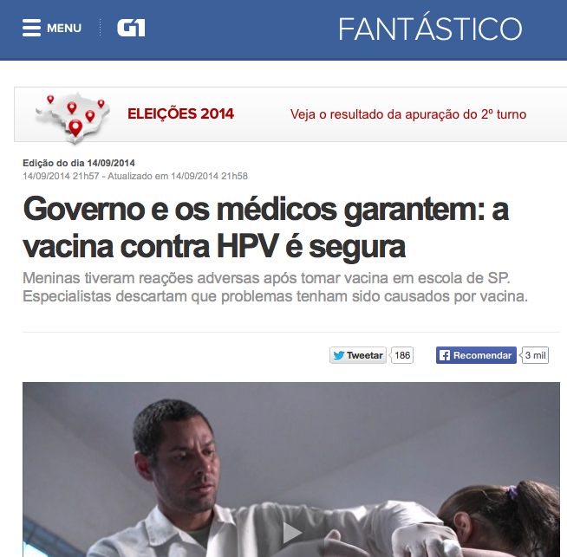
The most popular TV Show of Brazil reported In september, 2014 that 3 girls were admitted to a hospital in the munmicipality of Bertioga, State of Sao Paulo with flaccid paralysis following vaccination against HPV. Both were from the same school and took the vaccine together.
All examinations ruled out any relationship to the vaccine
Authorities said there was a collective stress
The girls recovered without any sequela

Slide 24
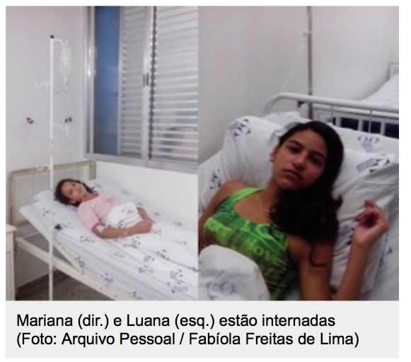
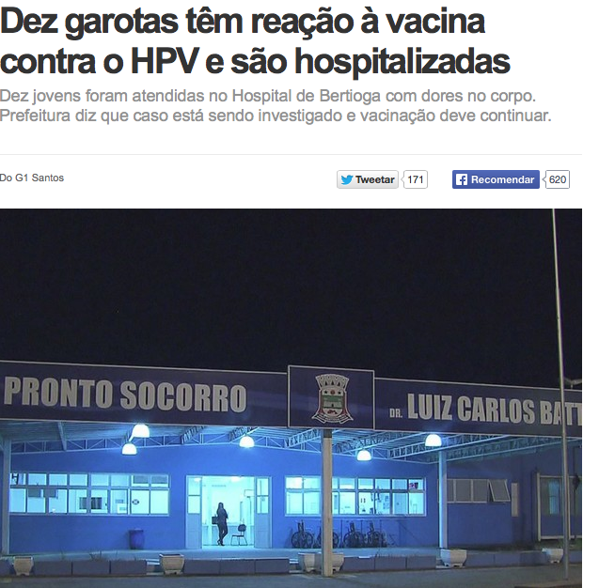
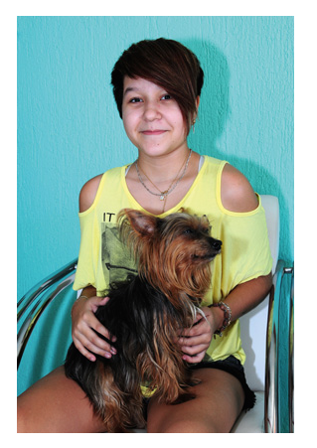
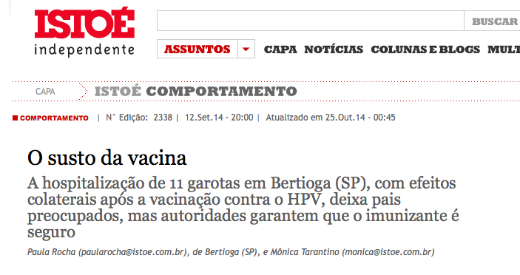
The media and the sensationalism
September 2014

Slide 25
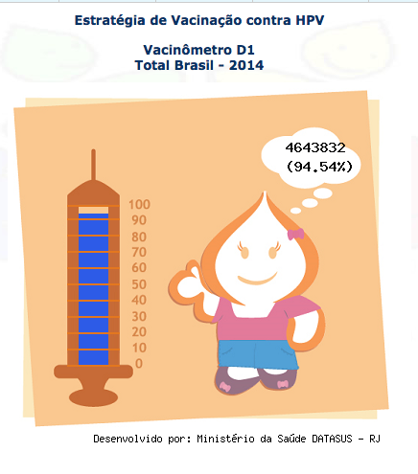
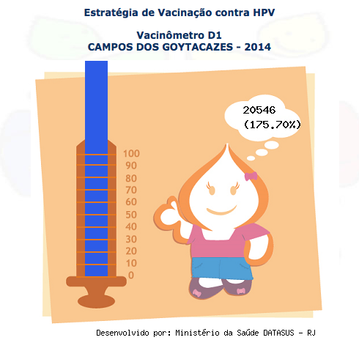
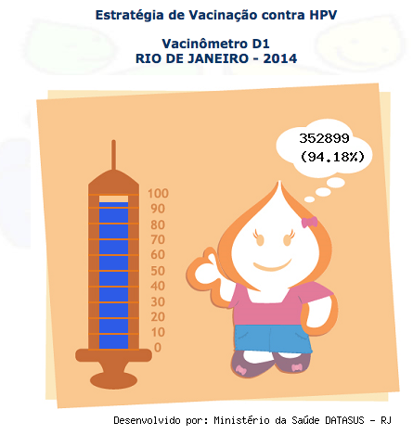
HPV vaccination Coverage before the TV Show (1st in March)

Slide 26
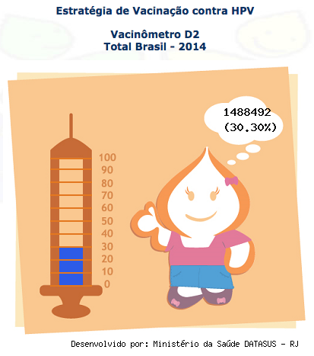

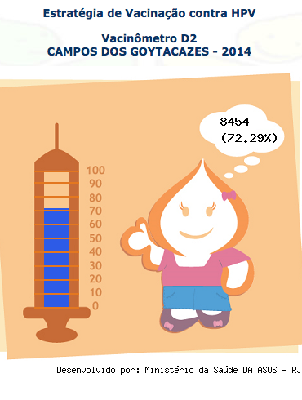
HPV vaccination Coverage after the TV Show (2st in september)
The coverage is greater than all the national and state averages

Slide 27
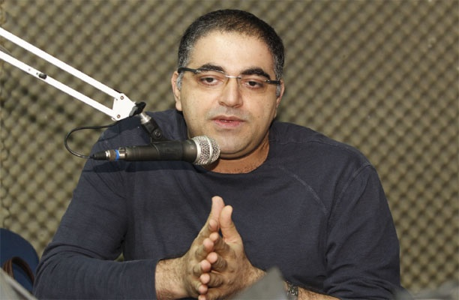

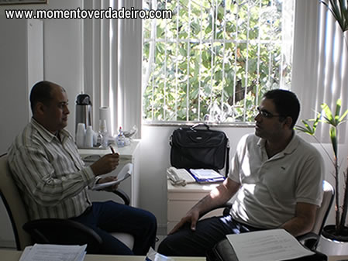
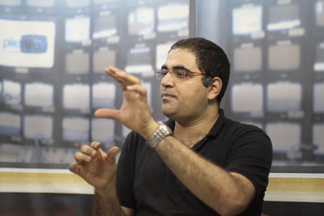

Slide 28
Challenge 5 – cold chain
More quantity of vaccines require a better cold chain structure
Provide adequate cold chain to maintain the quality of vaccines
Government have to supply money to cold chain investments and training

Slide 29
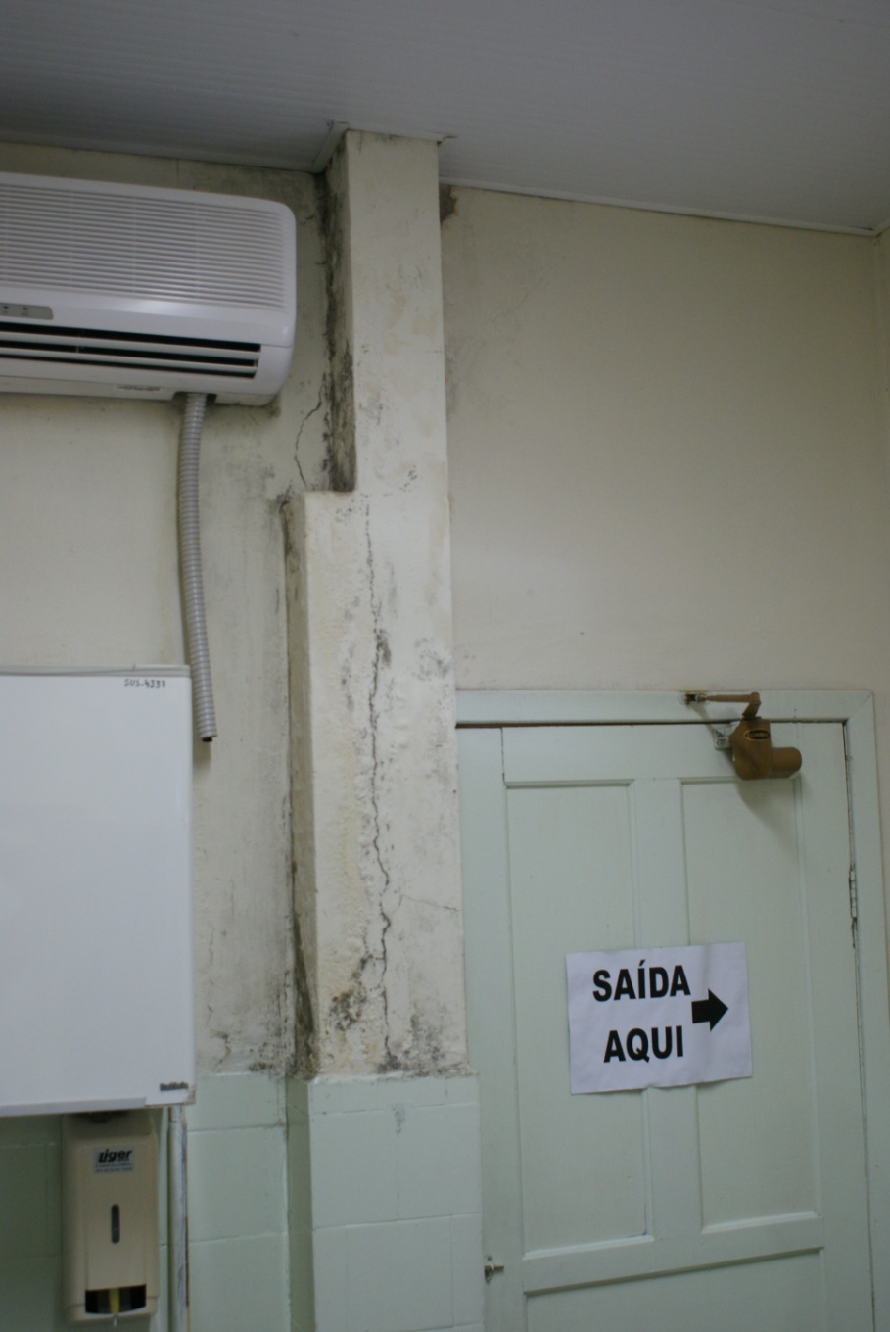
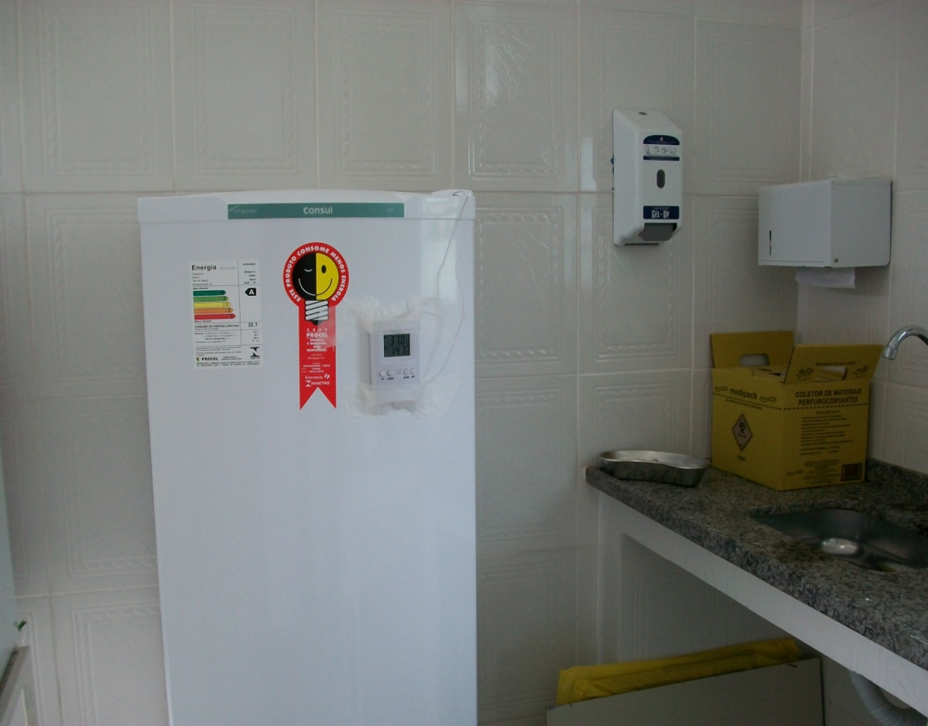
Before
After

Slide 30
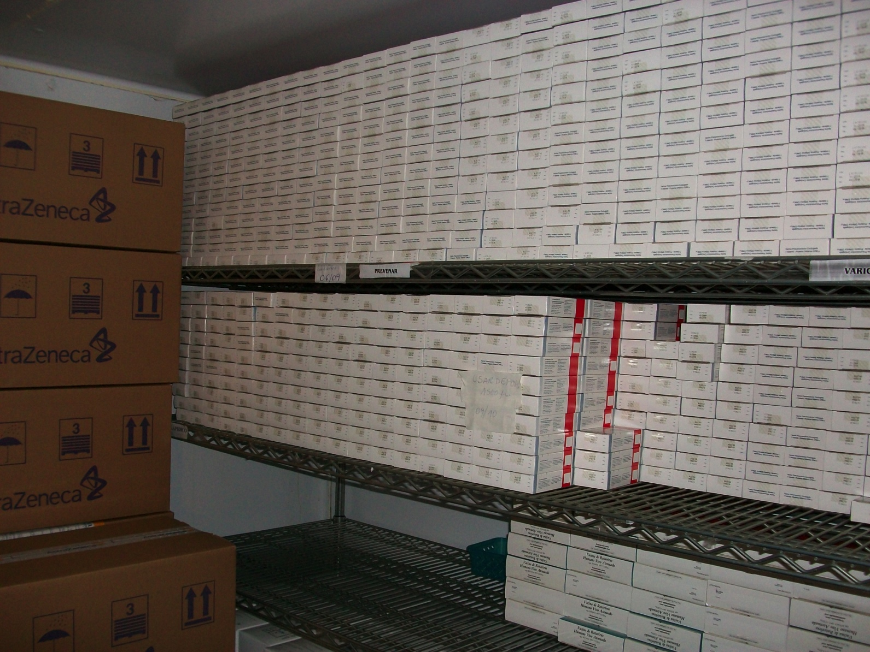
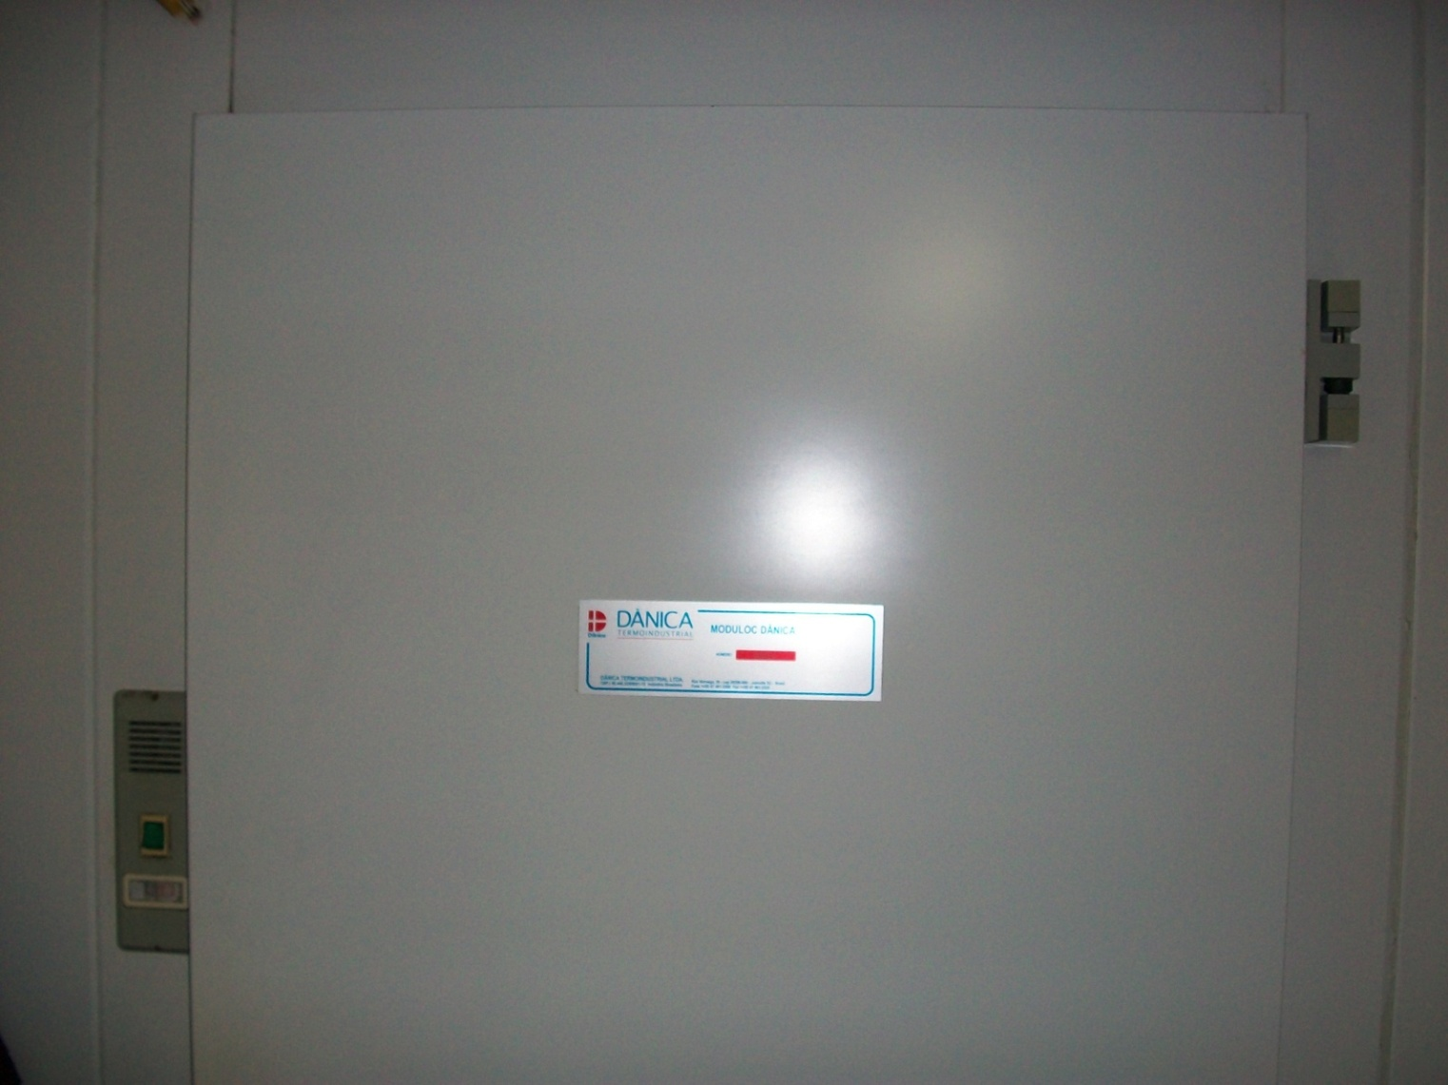
Cold Storage

Slide 31
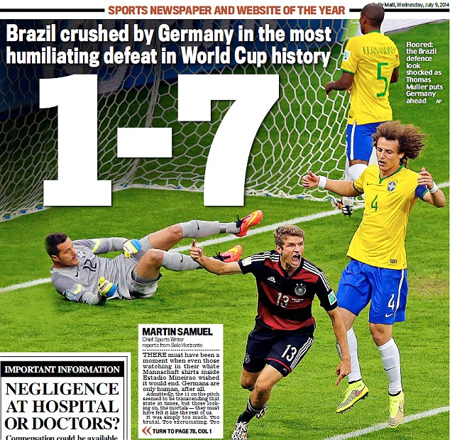
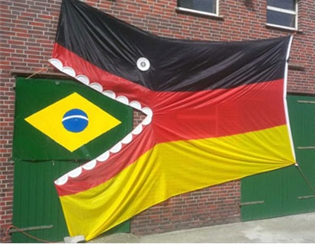
What we don’t want anymore

Slide 32
Conclusions – What we cannot forget?
Vaccination is always in constant changes
Government and the health care workers have to supply information to population
The pediatrician are extremely important in the convincement of the importance of vaccination
health professionals must respond quickly against the sensationalism of the media and internet
We cannot do public health without current epidemiological data
Political support is essential

Slide 33
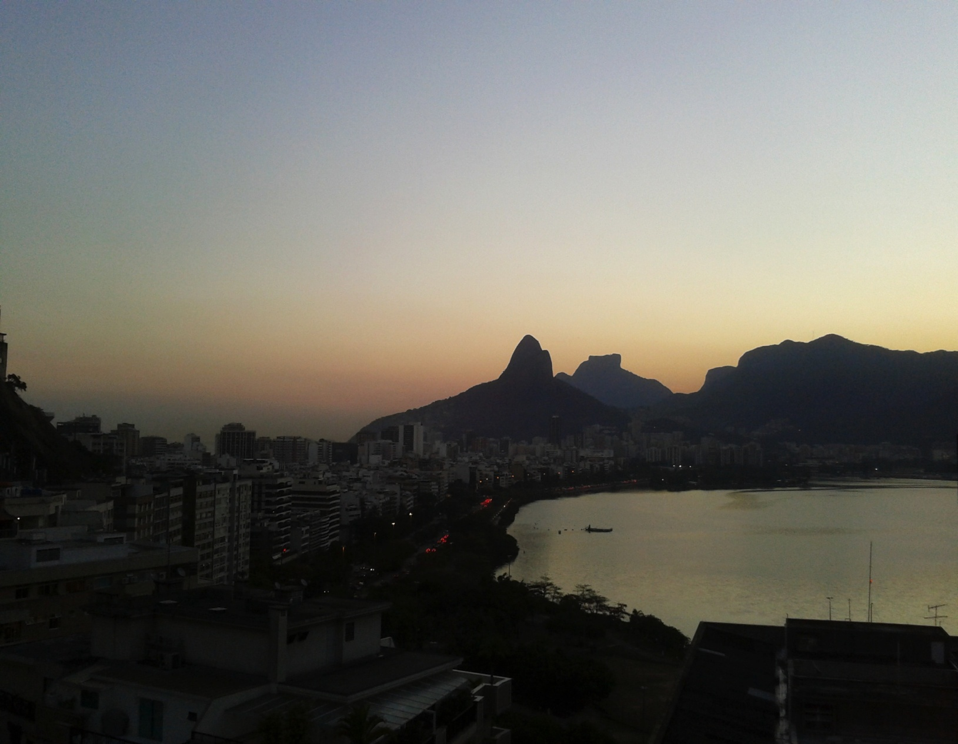
Thank you!!
charbellkury@hotmail.com

