Slide 1
Bovine trichomoniasis in beef cattle in Wyoming, USA
Chaoqun Yao
Department of Biomedical Sciences and One Health Center for Zoonoses and Tropical Veterinary Medicine
Ross University School of Veterinary Medicine
Basseterre, St. Kitts, West Indies
09/24/2014

Slide 2
Bovine trichomoniasis
Prevalence in bulls
Infection in females with abortion
Risk factors associated with positive herds

Slide 3
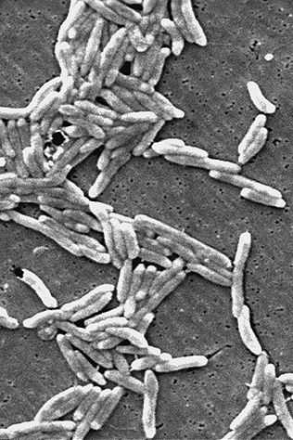
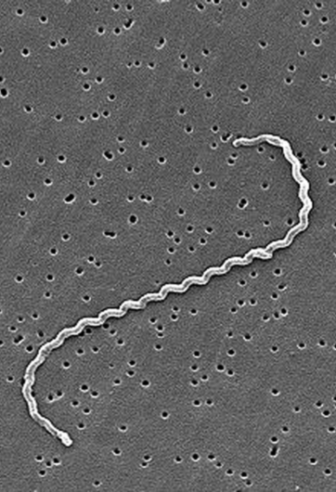
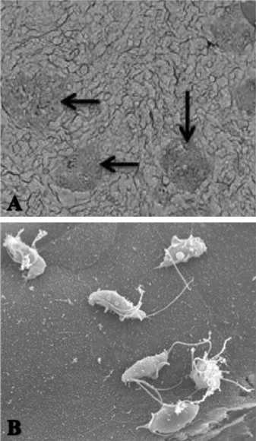
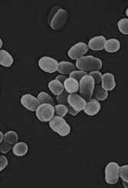
Reproductive diseases of cattle
Disease | Causative agent
Vibriosis | Campylobacter fetus
Leptospirosis | Leptospira pomona
Trichomoniasis | Tritrichomonas foetus
Brucellosis | Brucella abortus
$441-502 million
annual loss for beef producers
http://www.nature.com/news/2008/080206/full/451618b.html
http://en.wikipedia.org/wiki/Image:Leptospira_interrogans_strain_RGA_01.png
http://dx.doi.org/10.1016/j.vetpar.2012.10.019
http://phil.cdc.gov/phil/home.asp Public Health Image Library
Notes:
There are several reproductive diseases in cattle. Major economic threatening diseases include: Brucellosis, Leptospirosis, Trichomoniasis, and Vibriosis. Trichomoniasis is the only one that caused by a protozoan parasite, while others are all caused by bacteria. We estimate the total yearly cost of female infertility, abortions/stillbirths, dystocia, retained placentas, and metritis/pyometra to be $441 to $502 million for beef producers and $473 to $484 million for dairy producers with an aggregate national total of approximately $1 billion annually. This loss is over six times more costly than that resulting from respiratory diseases. Three-fourths of the cost for reproductive diseases and conditions can be attributed to female infertility and dystocia and the failure to produce a healthy calf that will survive the first 24h of life. Aggregate national costs are roughly evenly divided between beef and dairy; per cow costs are more than three times greater for dairy cows ($52.60) than for beef cows ($14.00). Our interests are mainly focused on bovine trichomoniasis.

Slide 4
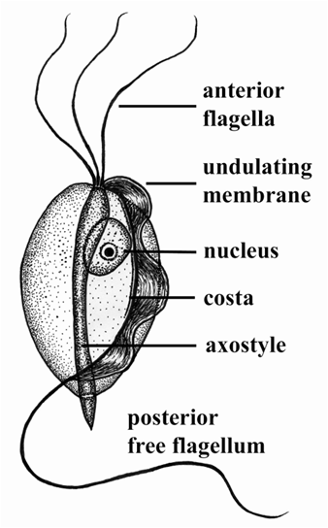
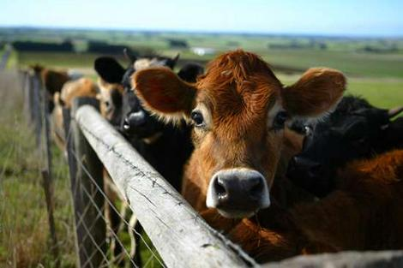
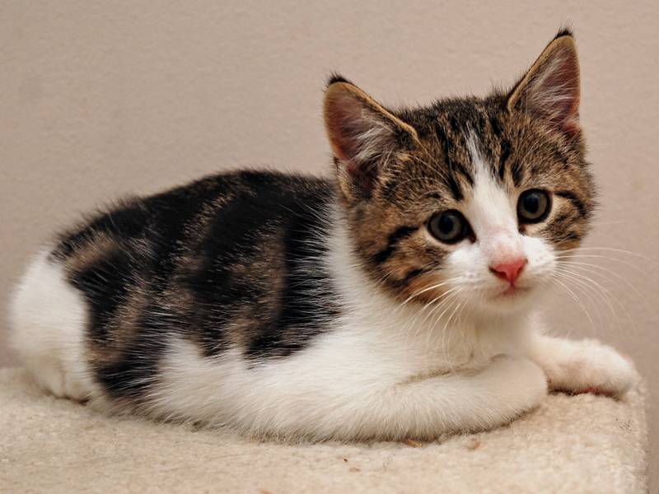
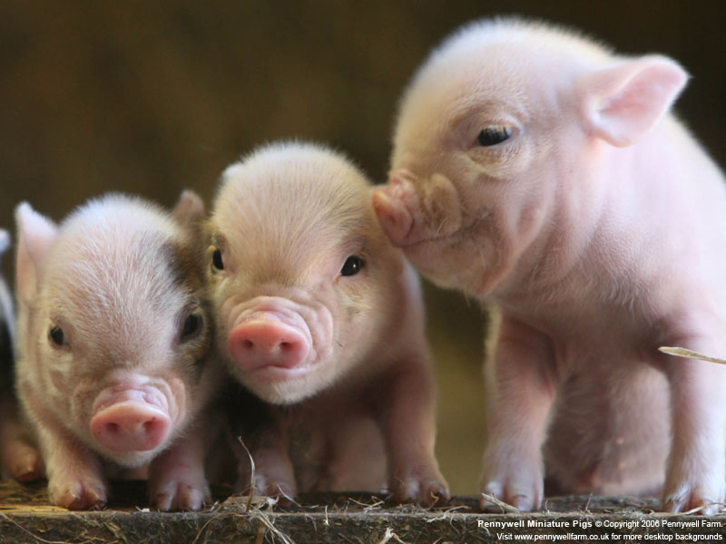
Tritrichomonas foetus
Wood, 2009
Notes:
The causative agent of bovine trichomoniasis is a protozoan parasite names Tritrichomonas foetus. Morphologically, it has a pear-shaped body with three anterior flagella near the single large nucleus and one posterior free flagellu. A tubular axostyle extends from the anterior end of the body. Internally it serves as an ianteroposterior spindle. Externally, axostyle resents as a posterior spine. T. foetus has an undulating membrane which waves as the organism moves. Besides cattle, the organism also can be found from cats and pigs. It causes chronic large bowel diarrhea especially in young cats and shows no clinical signs in infected pigs.

Slide 5
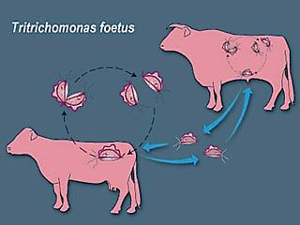
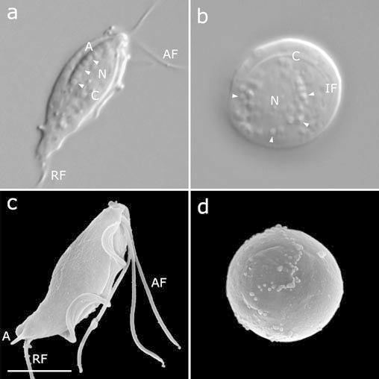
Life cycle and transmission
Tropohozoite
Pseudocyst
Mariante et al., 2004
Bulls: long term carriers
Heifers and cows: Self-clear
Up to 95% transmission rate
Notes:
Unlike most parasites, T. foetus represents relatively simple lifecycle. It resides in the host as the trophozoite form which is the normal pear shaped form as shown previously. However, scientists found that the organism also has a pseudocyst form which is more resistant to adverse environment. It is not a true cyst form since T. foetus pseudocysts does not have the true cyst wall. T. foetus reproduces by the binary fission and is sexually transmitted between female and male cattle. Sometimes it can be transmitted indirectly by using contaminated artificial insemination tools or semegma. Transmission through direct contact may result in up to 95% transmission rate. Infected males are highly likely to be long term carriers, however, they do not show significant symptoms. Rather, infected males are the asymptomatic carriers serve as reservoirs in a herd. Females suffer the consequences of T. foetus infection. Unlike the males, females can clean up the infection within few months with a short-lived immunity.

Slide 6
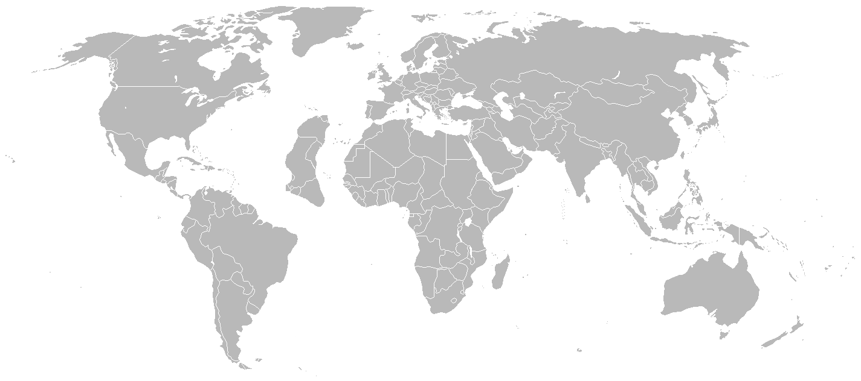
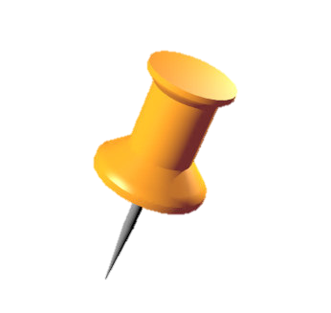
World distribution of bovine trichomoniasis
Notes:
Bovine trichomoniasis was first reported in France in 1888, and 12 years later in 1900, it had been found in Italy. Until that time, bovine trichomoniasis was not given enough attention due to the Bang’s disease which was believed to be the exclusive reason for cattle infertility. However since 1925, the disease had been identified in almost 30 countries all over the world. In most European countries, the disease has been eliminated through artificial insemination, except some extensive cattle raising area such as northern Spain. And it is still endemic in North and South america, Australia, and several countries in Asia and Africa.

Slide 7
Current control strategies
Control
Testing
(Regulation)
Animal selection
Vaccination
No drugs approved
Notes:
Current control policies in many trichomoniasis endemic areas are mainly focused on testing bulls that are used for importation, grazing in public allotments. Positive bulls are required to be culled and replaced. Vaccines are available for cows not for bulls. It does not prevent the infection, however, the vaccines does improve the calving rate. It is suggested to use bulls younger bulls for reproductive purpose and maintain the average age of bulls in a herd less than 3 years old. Currently no drugs are approved by FDA for bovine trichomoniasis treatment. One main reason is that the clinically effective drugs are not allowed to use in animals for food.

Slide 8
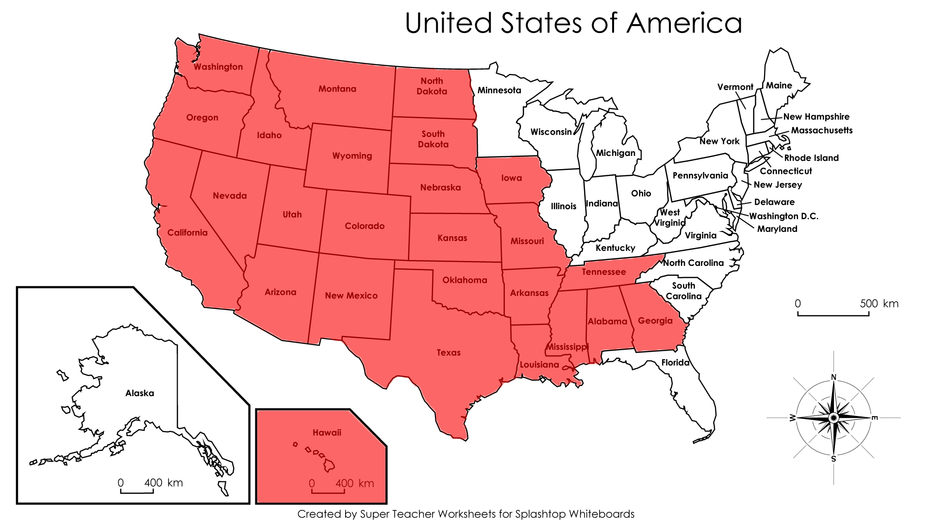
States with trichomoniasis programs

Slide 9
Prevalence in bulls
Data – Wyoming State Veterinary Laboratory (WSVL) and
Wyoming Livestock Board between January 1, 1997 and December 31, 2010
Testing for T. foetus – culture in Diamond’s medium & PCR to amplify a 347bp fragment of 5.8S ribosomal RNA and the internal transcribed spacer region using primer pairs TFR3 and TFR4 (Felleisen RS et al., 1998. J Clin Microbiol 36: 513)

Slide 10
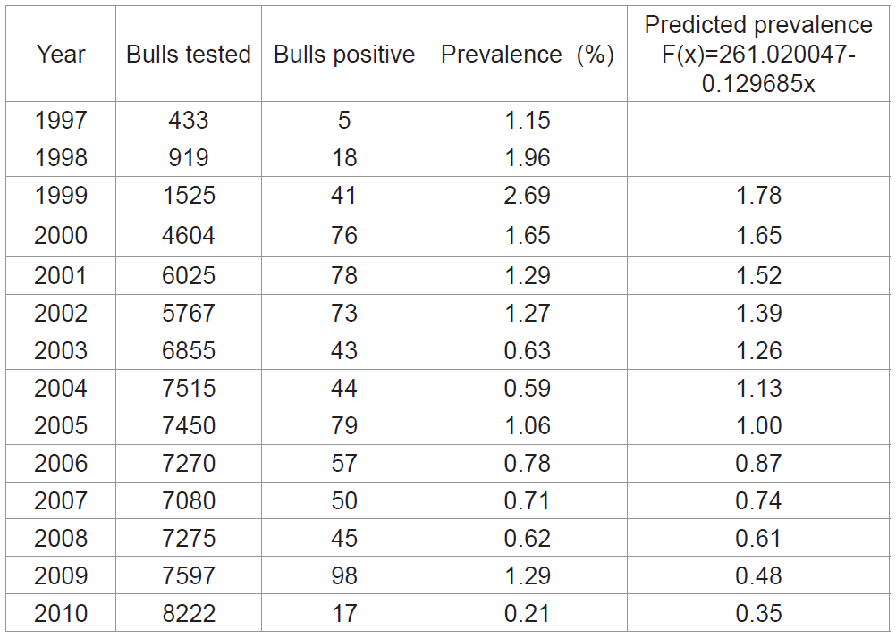
Prevalence in Wyoming beef cattle – bull
Yao et al., 2011 JBP 2:117

Slide 11
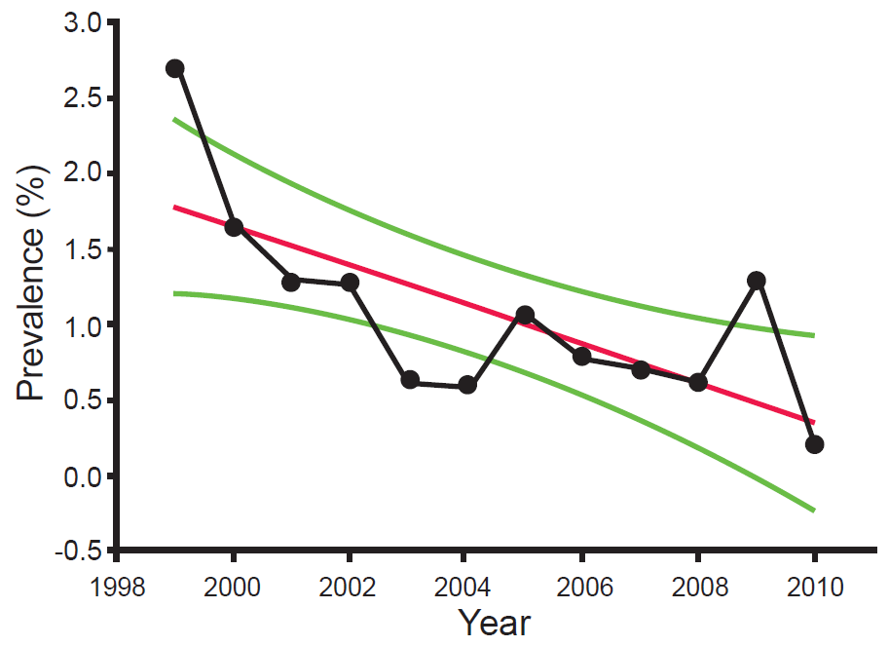
Herd prevalence (2007-2010)
Yao et al., 2011 JBP 2:117

Slide 12
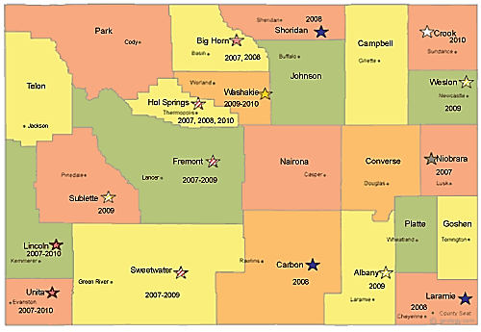
Expansion of geographic distribution
Yao et al., 2011 JBP 2:117
Notes:
Geographical distribution
is a good indicator of whether or not an infectious disease is under
control. A reduction in distribution often signals control whereas
expansion indicates the spread of a disease. Between 2007 and 2010,
both Uinta and Lincoln counties, in southwest Wyoming, had positive
herds identified in consecutive years; Sweetwater, Fremont, and Hot
Springs had positive herds in three years; Big Horn and Washakie in
two years; Sublette, Sheridan, Carbon, Albany, Laramie, Niobrara,
Weston and Crook in one year. A total of 15 of 23 Wyoming counties
had positive herds in the last four years (Figure 3). Furthermore, three
(Sublette, Albany and Weston) and one county (Crook) were found
positive in 2009 and 2010, respectively, suggesting the disease was
spreading out, even though individual prevalence was decreasing. The
data affirm the above conclusion that eradication of the disease in the
state in 2013 is very unlikely

Slide 13
Infection in females with abortion
Data – Wyoming State Veterinary Laboratory (WSVL) between January 1, 2000 and December 31, 2010
Testing for T. foetus – culture in Diamond’s medium & PCR to amplify a 347bp fragment of 5.8S ribosomal RNA and the internal transcribed spacer region using primer pairs TFR3 and TFR4 (Felleisen RS et al., 1998. J Clin Microbiol 36: 513)

Slide 14
Testing in beef cows/heifers in Wyoming with abortion
Year | Ntot of accessions | Ntot of bull samples | PCR Ntot of cows/heifers (Npos) | Culture Ntot of cows/heifers (Npos) | PCR Ntot of fetus (Npos) | Culture Ntot of fetus (Npos)
2000 | 193 | 1530 | 0 | 0 | 0 | 0
2001 | 707 | 6337 | 0 | 8 (0) | 0 | 0
2002 | 693 | 6750 | 0 | 12 (2) | 0 | 0
2003 | 624 | 5587 | 0 | 14 (7) | 0 | 1 (0)
2004 | 720 | 6246 | 0 | 9 (0) | 0 | 1 (0)
2005 | 771 | 8226 | 0 | 9 (0) | 0 | 1 (0)
2006 | 834 | 8336 | 0 | 2 (0) | 0 | 0
2007 | 777 | 7657 | 4 (0) | 7 (0) | 2 (0)† | 2 (0)
2008 | 755 | 8627 | 1 (0) | 2 (0) | 3 (0) | 1 (1)#
2009 | 802 | 8454 | 4 (0)* | 2 (0) | 2 (0) | 2 (0)‡
2010 | 943 | 10059 | 17 (0) ¥ | 14 (0) | 3 (0) | 4 (0)
Total | 7819 | 77809 | 26 (0) | 79 (9) | 10 (0) | 12 (1)

Slide 15
Testing results for T. foetus among samples collected in Wyoming from the genital tract of cows/heifers with abortion and aborted fetuses
Sample | Npos | Ntot | %pos
Aborted fetus | 1 | 22 | 4.5
Placenta⁺ | 1 | 4 | 25.0
Cows/heifers
Uterus | 8 | 53 | 15.1
Vagina | 1 | 11 | 9.1
Cervix | 0 | 29 | 0.0
total | 9 | 93 | 9.7

Slide 16
Risk factors associated with positive herds
Aim
To identify risk factors associated with herds infected with T. foetus in Wyoming beef cattle.
Notes:
Here again, presenting project aimed at identifying risk factors that associated with T. foetus infection in Wyoming beef cattle, so that we can provide the beef cattle producers with valuable information and useful suggestions on how to reduce the risks of T. foetus infection and better control the bovine trichomoniasis, a disease that silently reduce the economic income from the beef cattle industry.

Slide 17
Study design
Producer
Education, income, trich knowledge etc.
Herd
Size, bull age, breeding source, method, vaccination, testing etc.
Allotment
Type, neighboring herds, fencing status etc.
Study Population:
All beef cattle herds
Notes:
To rich the goal, Our target population is all the beef cattle herds in Wyoming, which is approximately 5000 based on NASS agricultural census data. The number is manageable thus we do not need a random selection process. We sought detailed information on producer themselves, their herds, as well as the allotments they were using.

Slide 18
Survey conduction
Send out the questionnaires
Design the questionnaire
USDA NASS
WSVL
Producers
Return the questionnaire
Complete, send back the survey
Confidential
Notes:
Survey conduction was processed through USDA NASS. Designed questionnaires were sent to USDA NASS. Based on the producer information saved in USDA NASS, they send out the questionnaires to all the Wyoming cattle herd owners. After the completion of the questionnaires, producers could send them back to WSVL with the prepaid return postages and envelopes.

Slide 19
Proportion of respondents
Total: 5,498
Response proportion 23.4%
Valid respond: 863
Invalid respond: 425
Unanswered form
Steers only
No cattle
Notes:
After sending out 5,498 questionnaires in total, we consequently received response either by phone call or returned questionnaire. We had 1,243 questionnaires sent back, and 45 phone call respond, together, they led to a response rate of 23.4%. However, some of them were not eligible for our study purposes. The invalid responses include unanswered form, producers who possessed steers only, and forms from responders with no cattle at all. Only valid responses were included in the further analysis

Slide 20
Analytical methods
Software
Microsoft office Excel
Quality control
Data confirmation
Exclusion of unqualified data
Statistical method
Frequency analysis
IBM SPSS19
SISA (online tool)
Refinement
Pearson’s chi-square
Fisher’s exact test
Notes:
Microsoft office excel was used for data input and refining. For the statistical analysis, SPSS software and an online tool SISA were used. To ensure the quality of our data, we confirmed data input by multiple random checking. Besides the basic frequency analysis, Person’s chi-square and fisher’s exact test were performed to find associations between various factors and the T. foetus infection status.

Slide 21
Feedback
Feedback by geographic regions
Geographic region
(χ²=0.769, p>0.94)
(χ²=7.860, p<0.05)
Represents bigger sized herds (cow number ≥50)
Jin Y et al., 2014 JMM 63:896-902
Notes:
We analyzed the feedback by herd size and geographic regions to test if the responses are representative of the true population. The blue bars represents the true percentages of each categories based on the USDA census data. Red bars represent the percentages of each categories based on our survey data. On the left figure, the sizes of herds were estimated by number of cows per herd. And Census population and our survey population were compared by the herd sizes. We found that there was a big difference between herd size compositions in the true population and the survey population. On the right figure, when we look at the two populations by their geographic distributions. We didn’t find any statistically significant difference between two populations regarding the geographic regions. Therefore when explaining the survey result, one should keep in mind that the results are more representative of bigger sized herds.

Slide 22
Producer’s awareness of bovine trichomoniasis
Jin Y et al., 2014 JMM 63:896-902
Notes:
We asked the producer’s knowledge on bovine trichomoniasis prior to this survey. More than half of the producers had moderate knowledge of bovine trichomoniasis, and about 12 percent of producers were very familiar with this disease, and their herds highly likely to be exposed to the infection before. However, more tan 30 percent of the producers only has slight knowledge about the disease or no knowledge at all. This part of population may be potential concerns because they probably possess the untested herds.

Slide 23
Trichomoniasis testing
304 negative,
8 positive
Jin Y et al., 2014 JMM 63:896-902
Notes:
Among the 863 valid respondants, 312 actually tested their bulls. 304 producers reported that their bulls were tested as negative, and 8 producers reported their bulls were tested as positive during the past three years, which is 2.56% of the total tested herds. Two in northeast, two in northwest, two in southwest, and one in southeast. We should keep in mind that untested and non-respondents were not included here. When we were identifying the risk factors associated with the infection, these 312 tested herds were included in the analysis.

Slide 24
T. foetus Vaccination
Jin Y et al., 2014 JMM 63:896-902
Notes:
The usage of vaccines against T. foetus is relatively low, only 14.2% producers had their animals vaccinated at least yearly. Though not statistically significant, vaccination is adversely associated with the T. foetus infection. Herds with T. foetus infection are more likely being vaccinated. It can be explained by a temporal bias, where the herds are tested positive of T. foetus first, and the owners adjust their management polocies to get herds vaccinated to prevent further infection.

Slide 25
Average bull age
Notes:
Many studies have already shown the correlation between bull age and T. foetus infection. Bulls older than 3 years old has higher risks to get the infection. So we were interested in bull usage status in beef cattle herds. Bulls younger than 3 years old were mostly selected at purchase. However, the average age maintained were over 3 years old and less than 5 years old in the more than half of the herds.

Slide 26
Breeding source
Jin Y et al., 2014 JMM 63:896-902
Notes:
Now let’s look at the breeding method used in Wyoming beef cattle. It has been proven by many European countries that artificial insemination is the most effective way to ultimately eliminate the disease. Currently, live cover is the major breeding method in the US. And over 80% Wyoming producers use natural breeding versus only 2.1% use artificial insemination. 60% producers responded that they would consider AI in the future, while the rest wouldn’t. It won’t be easy to change the major breeding type among the US beef cattle ranches based on current study.

Slide 27
Allotment type
Jin Y et al., 2014 JMM 63:896-902
Notes:
Using a privately owned allotment or an opened public have different chances to be exposed to T. foetus. Generally speaking, opened public allotments may contaminated with infected bulls or cows although the state laws enforce the testing before entering a public allotment. Based on the survey, almost 60% of the herds were using family owned allotments, and 11.4% herds were using open or public allotments. The association between the allotment type and t. foetus infection will be discussed later.

Slide 28
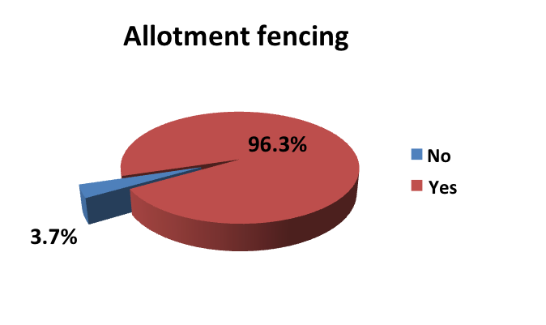
Fencing
Jin Y et al., 2014 JMM 63:896-902
Notes:
Majority of the allotments were fenced, where on ly 3.7% did not do so. And broken fences seem to occur frequently, more than half of the fences were broken during the past 3 years. Allotments with broken fences are also considered as a potential risk factor since it may increase the chance of comingling with unknown source cattle.
Since there are more than half of chance that a allotment fence will be broken. Checking fences and getting broken fences fixed on time are also important to maintain a safe allotment than just hat the allotments fenced. Most of producers were able to check their fence at least monthly, followed by seasonally and yearly basis checking. Over 80% of owners could be able to fix the broken fences within a week after finding.

Slide 29
Risk factors associated with bovine trichomoniasis
Neighboring a positive herd(s)
p=0.0003
OR=18.3 (4.1-81.1)
Using public allotment
p=0.003
OR=2.9 (0.7-12.1)
Comingling with neighbor herd(s)
p=0.026
OR>999.99
Elapsed time to fix broken fence(s)
p=0.078
OR=4.3 (0.9-20.2)
Jin Y et al., 2014 JMM 63:896-902
Notes:
Based on chi-square and fisher’s exact test, we identified three most significant factors that are associated with T. foetus infection. Sharing fences with T. foetus positive neighbors led to 18 times higher odds to be infected. Using public allotment rather than privately owned ones had almost 3 times higher odds of getting the infection Comingling with neighbor herds found to be another risk factor, where all the 8 positive herds had histories of comingling with neighbor herds, resulting in an infinite odds ratio. When the cut-off line was adjusted to 0.1, elapsed time to fix broken fences was associated with the infection with a p value of 0.078. Those who delayed the fixing more than one week had 4.3 times higher odds of getting the infection.

Slide 30
Herd sizes and infection chance
χ²= 1.834, p=0.18
χ²= 1.266, p=0.30
Jin Y et al., 2014 JMM 63:896-902
Notes:
Although not identified as statistically significant risk factors, it’s still worthwhile to mention the relationship between the herd size and prevalence. On the left figure, it shows the herd prevalence increases as the number of bulls per herd increases. Similarly, on the right figure, it shows that the herd prevalence increases as the number of cows per herd increases. The p-value of the association is 0.18 and 0.3 respectively. Herds with bulls more than 20 or herds with cows more than 100 were more likely to have infection.

Slide 31
Conclusion
Allotment management
Build good fences
Check and fix fences regularly
Prevent comingling with other herds
Use private allotments
Jin Y et al., 2014 JMM 63:896-902
Notes:
Putting together, from this survey, we identified that allotment management was the major component that associated with T. foetus infection in Wyoming beef cattle ranches. We didn’t find any significant correlations between T. foetus infection and vaccines or animal selections. All the risk factors we identified indicated a good maintenance of the allotments might be the management strategy to be improved by Wyoming beef producers.

Slide 32
A comprehensive approach to control and eradicate bovine trichomoniasis
Jin Y et al., 2014 JMM 63:896-902
Notes:
Here is a proposed comprehensive approach to control and eradicate bovine trichomoniasis. Current control polices are mainly focused on testing bulls and use infection free bulls only for reproductive purpose. Any bulls that tested positive are required to be culled. Young bulls should always be used when possible. As explained previously, bulls younger than 3 years old have been shown to be less susceptible and also less likely to become carriers. It should be pointed out that the use of young bulls on infected cows probably will not have much effect on prevalence long-term, and will certainly increase costs. To minimize infection of bulls, open cows in positive herds should be regularly tested or be impregnated by artificial insemination. A more progressive approach is to cull open cows/heifers. This will minimize the bull’s risk of infection, although it will come at a price that some ranchers may be not willing to pay. In the case of the 64 % conception rate mentioned above, ranchers would be culling one-third of their herd, an unacceptable rate. In the context of management, a closed herd and fencing are suggested, which is based on findings that commingling on public lands contributes significantly to bovine trichomoniasis in a herd. A closed herd further indicates no introduction of cattle of unknown T. foetus status into a herd. Maintaining a good fence probably will not only prevent comingling but also minimize losses due to runaway cattle, yet this effective method is often overlooked by ranchers.

Slide 33

Acknowledgment
University of Wyoming:
Yinzhu Jin Mark R. Davidson
Brant Schumaker Katherine D. Bardsley
Ross University School of Veterinary Medicine
  A. Lee Willingham

