Slide 1
About OMICS Group
OMICS Group International is an amalgamation of Open Access publications and worldwide international science conferences and events. Established in the year 2007 with the sole aim of making the information on Sciences and technology ‘Open Access’, OMICS Group publishes 400 online open access scholarly journals in all aspects of Science, Engineering, Management and Technology journals. OMICS Group has been instrumental in taking the knowledge on Science & technology to the doorsteps of ordinary men and women. Research Scholars, Students, Libraries, Educational Institutions, Research centers and the industry are main stakeholders that benefitted greatly from this knowledge dissemination. OMICS Group also organizes 300 International conferences annually across the globe, where knowledge transfer takes place through debates, round table discussions, poster presentations, workshops, symposia and exhibitions.

Slide 2
About OMICS Group Conferences
OMICS Group International is a pioneer and leading science event organizer, which publishes around 400 open access journals and conducts over 300 Medical, Clinical, Engineering, Life Sciences, Pharma scientific conferences all over the globe annually with the support of more than 1000 scientific associations and 30,000 editorial board members and 3.5 million followers to its credit.
OMICS Group has organized 500 conferences, workshops and national symposiums across the major cities including San Francisco, Las Vegas, San Antonio, Omaha, Orlando, Raleigh, Santa Clara, Chicago, Philadelphia, Baltimore, United Kingdom, Valencia, Dubai, Beijing, Hyderabad, Bengaluru and Mumbai.

Slide 3
A Metabolomics Approach to Study Chardonnay Wine Fermentation Chandra Richter, PhD E&J Gallo Winery
Metabolomics
March 24, 2014

Slide 4
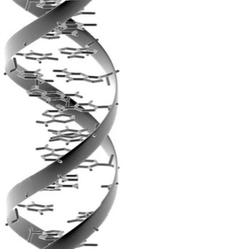
Winemaking at the Molecular Level
O
O
AAA
AAA
R
AAA
Glu
OH
OH
S
R

Slide 5
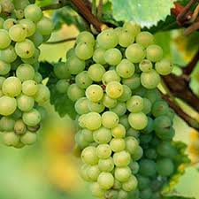
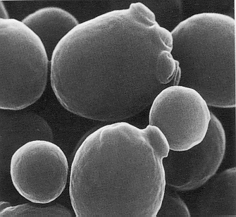
Winemaking
Water
Sugar
Acids
Minor Components
Water
Ethanol
Glycerol
Acids
Minor Components

Slide 6
Yeast Metabolism
Sulfate
Sulfite
Sugar
H2S
Mercaptans
Glycerol
Amino Acids
Pyruvic Acid
Diacetyl
Keto Acids
TCA Cycle
Acetaldehyde
Acetic Acid
Aldehydes
Acetyl CoA
Ethanol
Monoterpenes
Fatty Acid CoA
Higher Alcohols
Esters
Fatty Acids
Glycosides
Aglycones
Cysteines Conjugates
Volatile Thiols

Slide 7
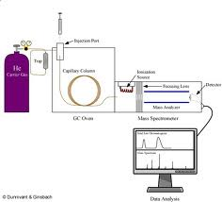
Identify metabolites present at three stages during fermentation
PDM
Chardonnay Juice
Look for metabolic patterns
GC-MS, LC-MS-MS

Slide 8
Winemaking Process
Chardonnay juice
10 gallon
65F
Agitation
PDM yeast
Triplicate
Sampled Daily

Slide 9
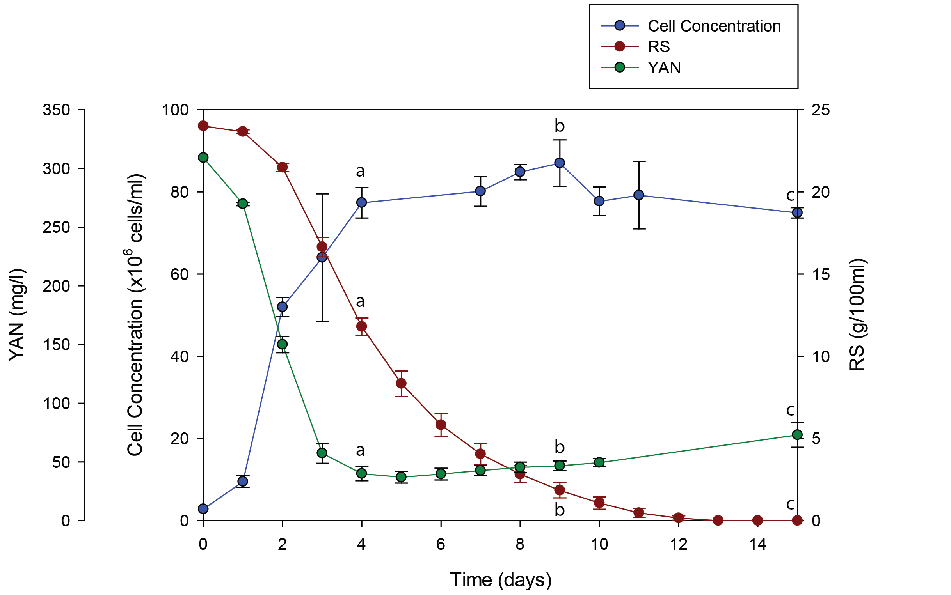
Fermentation Timecourse

Slide 10
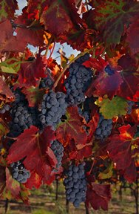
Endo- and Exo-Metabolome
Endo-Metabolome
Exo-Metabolome

Slide 11
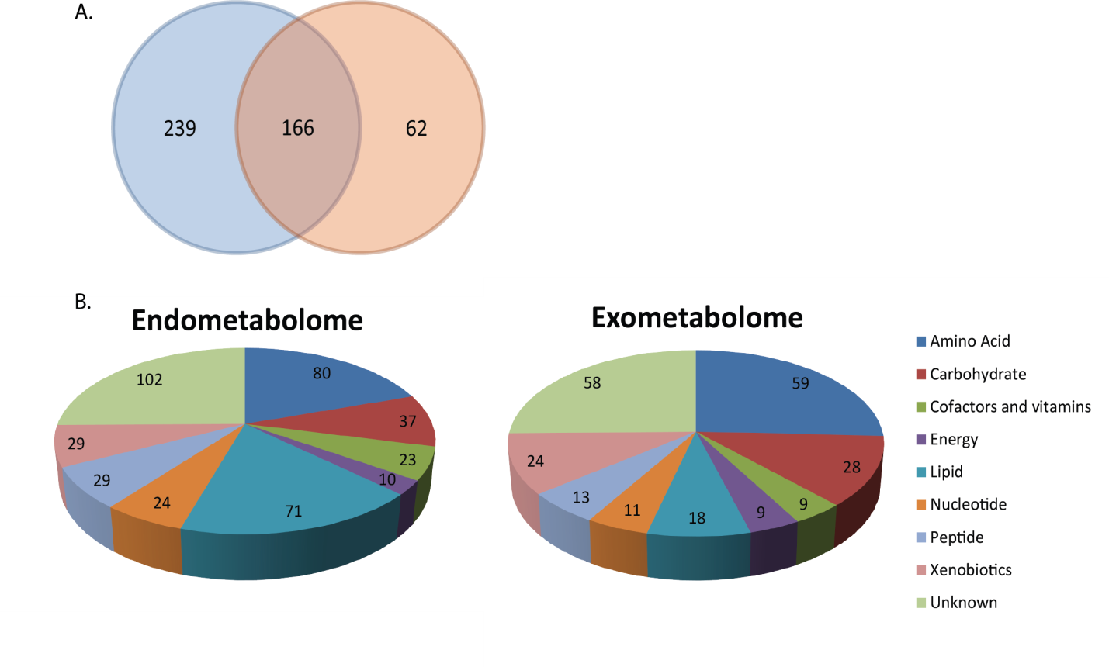
Summary of Metabolites

Slide 12
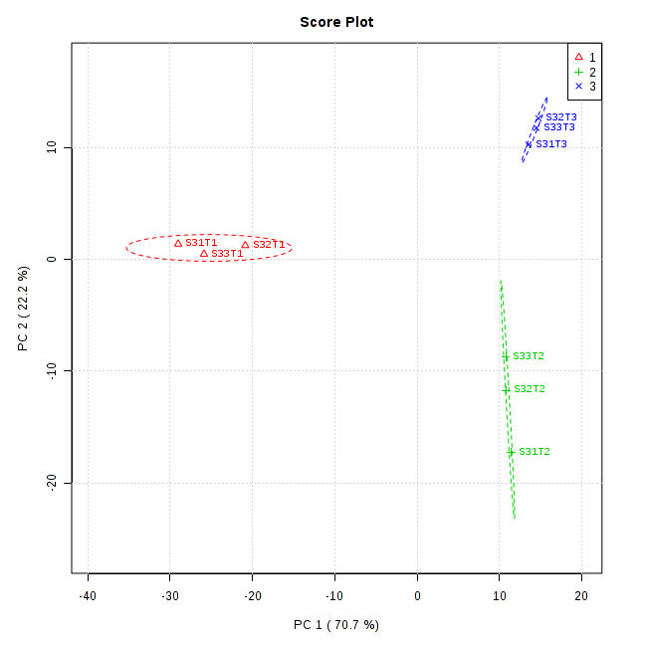
PCA Separates Time
C
A
B

Slide 13
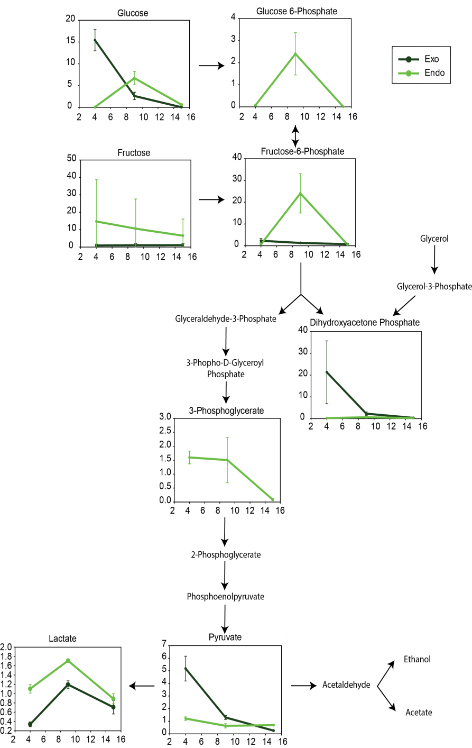
Glycoloysis
Early stages of fermentation: sugars are high in the juice and low in the cell.
Cells are rapidly producing biomass.
Later stages in fermentation: cells reduce uptake of sugar and glycolysis slows.

Slide 14
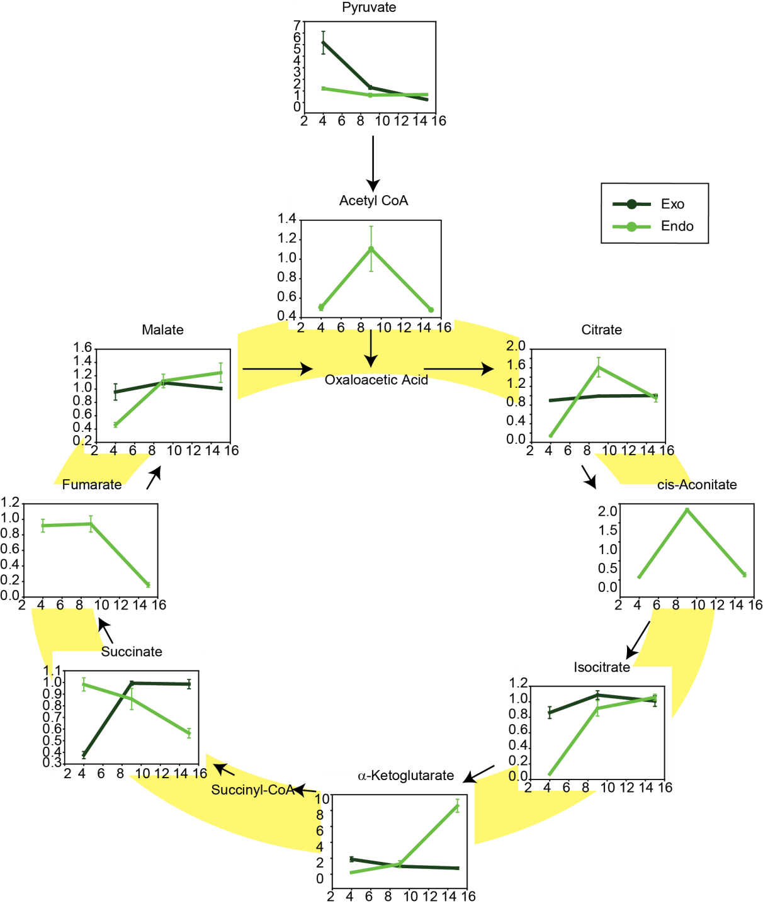
TCA
Similar pattern seen in the TCA cycle intermediates.
α-ketogluterate shows a unique profile
Deamination of glutamine

Slide 15
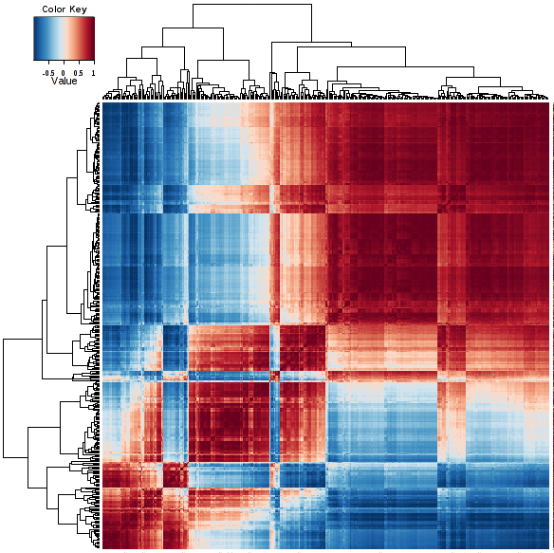
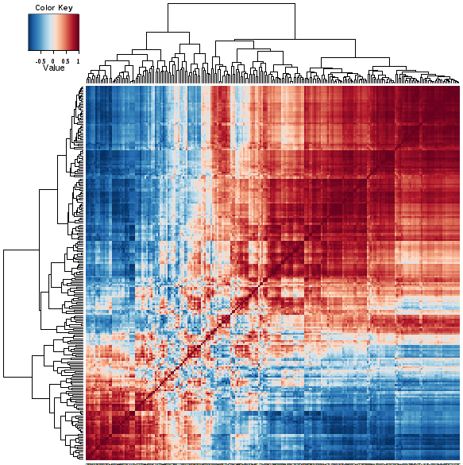
Correlation Profiles
Endometabolome
Exometabolome

Slide 16
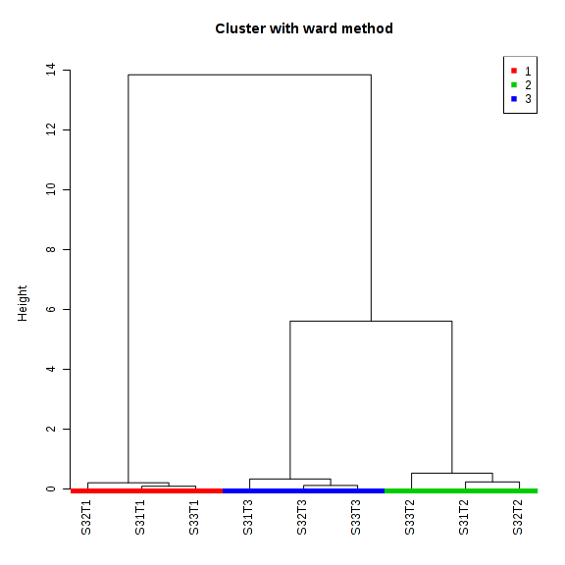
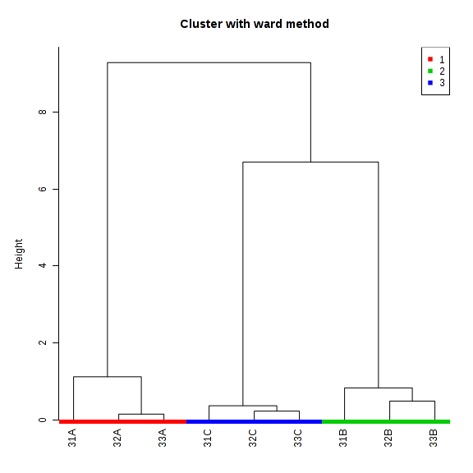
Hierarchichal Relationship
Endometabolome
Exometabolome

Slide 17
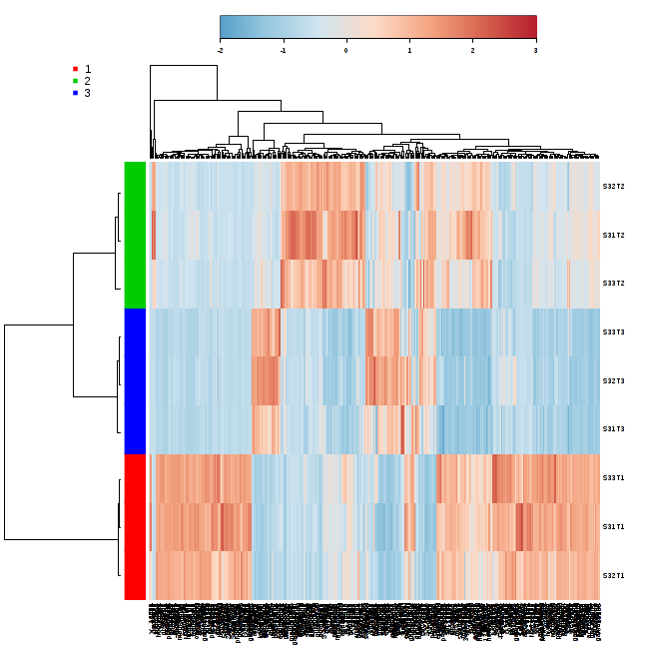
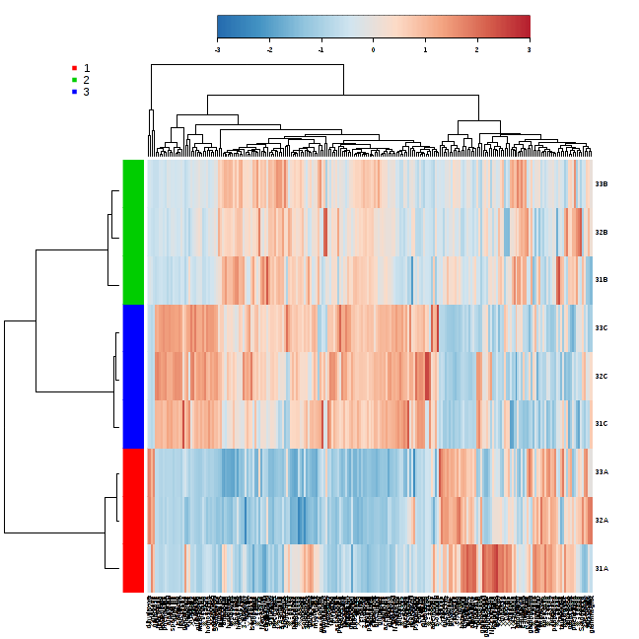
Metabolic Flux
Endometabolome
Exometabolome

Slide 18
Regulation of Metabolism
Sugar
Glycerol
Amino Acids
TCA Cycle
Pyruvic Acid
Keto Acids
Acetaldehyde
Acetic Acid
Aldehydes
Acetyl CoA
Ethanol
Higher Alcohols
Esters
Fatty Acids

Slide 19
Conclusions
Identified the endo- and exo-metabolome over the course of a wine fermentation
Metabolic pathways are differentially regulated through fermentation
Glycolysis, TCA active during early stages
Amino acid catabolism increases activity at later stages
Provides understanding of key primary and secondary metabolites

Slide 20
Acknowledgements
Dave Santino
Steven Kukesh
Nick Dokoozlian
Metabolon
Adam Kennedy
Lining Guo

Slide 21
Let Us Meet Again
We welcome you all to our future conferences of OMICS Group International
Please Visit: www.omicsgroup.com
www.conferenceseries.com
www.metabolomicsconference.com

