Slide 1
Open Locked Nailing The St Ann’s Bay Experience
C. Fletcher
M.B.B.S. DM Ortho

Slide 3
Disclosures
Nil affiliation with Disc-o-tech or the local distributer

Slide 4
OUTLINE
Biomechanics of an intramedullary nail
Features of the Fixion expanding nail
Indications/contraindications
Study of 57 patients undergoing the open locked nailing procedure

Slide 5
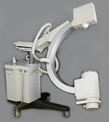
Intramedullary (IM) Nailing
Closed intramedullary interlocking nailing is the standard of care for treatment of long bone fractures which requires surgical care

Slide 6
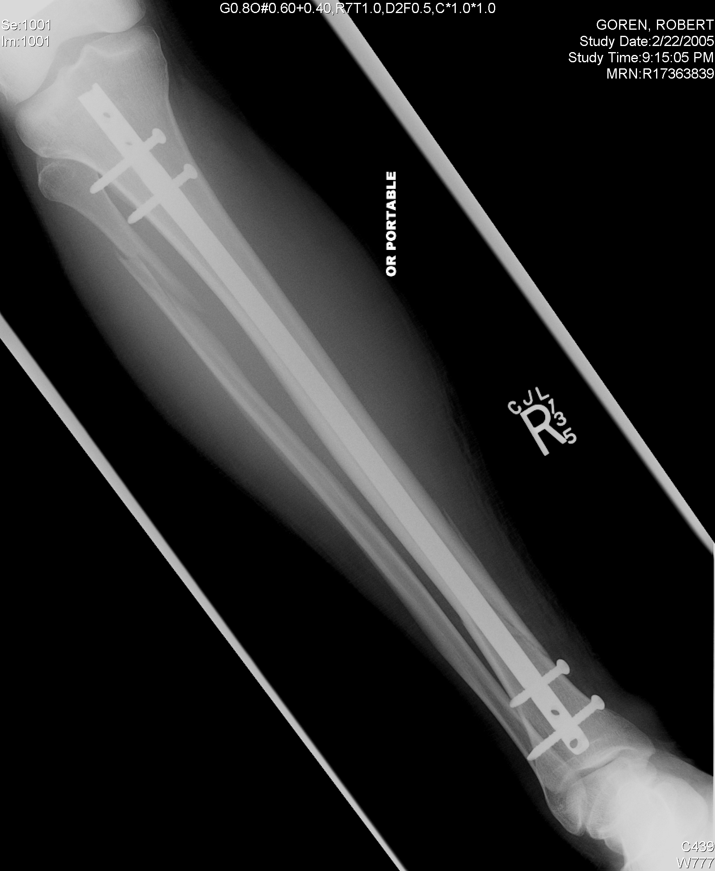
Requirements of an IM Nail
Maintain alignment, length and rotation
Resists bending forces
Allows contact compression forces at fracture surfaces → stimulus for union
Accessible if removal is necessary

Slide 7
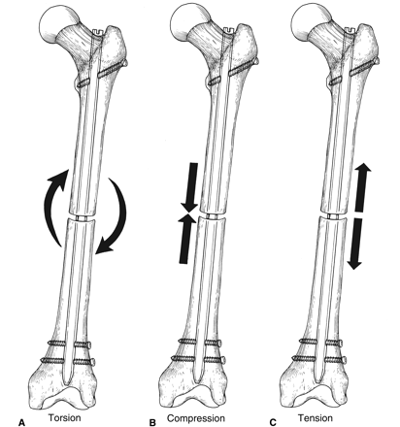
Biomechanics of IM Nailing
Internal splint with load sharing characteristics
Amt of load bourne by nail depends on the fracture/implant construct
Gradual transfer to bone as healing occurs

Slide 8
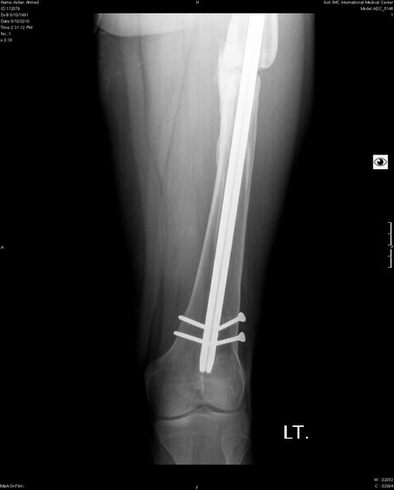
There is a race between bone healing and implant failure

Slide 9
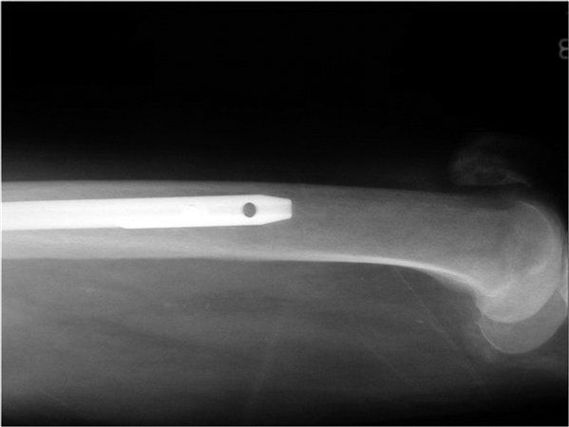
Biomechanics of IM Nailing
Friction of the nail within the canal determined by:
Curvature of nail
Cross sectional shape
Nail diameter
Canal characteristics
Size,
shape,
bone quality
Notes:
Mismatch of nail and femur canal increases friction and thus stability

Slide 10
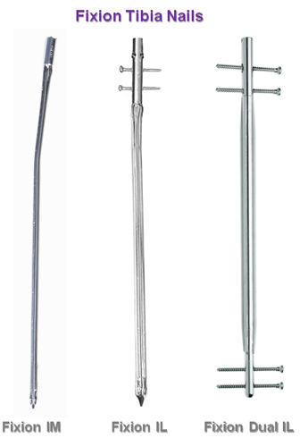
Expanding Fixion Nail
Stainless steel
Solid cylindrical core
1 way valve at proximal end to maintain pressure
Distal conical tip

Slide 11
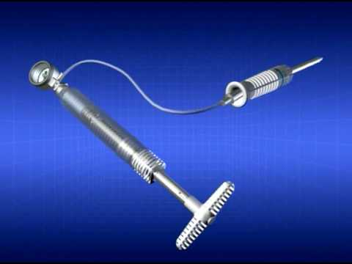
Fixion Nail
Connected to driver handle during insertion
Inflated with saline via pump connected to the driver handle
Notes:
Manual hand cranked pump mallik 08, conical tip→insertion ease (closed). Expands to 160% of orig diam . Procedure: lepore 2001

Slide 12
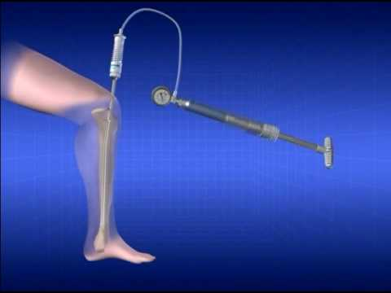
Fixion Nail

Slide 13
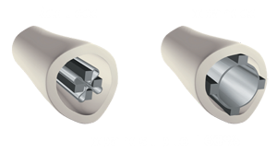
Fixion Nail
Consists of 4 longitudinal bars connected radially to 4 thin membranes
On inflation: abutment of the bars to the endosteum throughout its length
Reduced radiation time for closed techniques
Depends on intrinsic stability of #
Notes:
Intrinsic stability >50% blomquist 2008, mallik 2008 ease of insertion—malleable when uninflated. Ben-galim:nail cetralises during expansion causing # ends to be precisely aligned.expands and fills hourglass shaped canal.only logit bars compress endos bl supp. Can be used for AO a/b1-3 tibial #. Ben-galim: less complic/decr union times compared to interlocking nails

Slide 14
Indications for Fixion Nail
Acute fractures which are 5cm below the surgical neck, and 5cm proximal to the distal end of the medullary canal.
Osteotomy.
Nonunions , malunions.
Reconstruction following tumor resection/ prophylactic nailing of impending pathological fractures.
Revision procedures where other treatments and devices have failed

Slide 15
Contraindications for Fixion
Very proximal or distal fractures.
Highly comminuted fractures.
Longitudinal splits
Active and/or latent infection.
Insufficient quantity or quality of bone, conditions that retard healing (not including pathological fractures) and conditions causing poor blood supply or obliteration of the medullary canal.
Foreign body sensitivity.

Slide 16
Materials and Methods
From 2008 to 2012, we treated 57 patients with the fixion expandable nail at SABH.

Slide 17
Materials and Methods
98% of the injuries were closed
Mean age 38 yrs (18-90)
Mean follow up time 44.6 mths (6-70)

Slide 18
Mechanism of Injury
MVA 30 patients (53%)
Fall 17 patients (30%)
Majority low energy
Blunt trauma- miscellaneous
19 patients had concomitant injuries

Slide 19
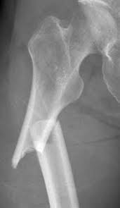
RADIOGRAPHS
Independent radiologist
AO classification
X-rays-27 patients
Femur: 21 patients
A2-six, A3-five B2-one, B3-7 C3-two
Humerus: 3 patients
A2-one, C1-two
Tibia: 3 patients
A2-one, A-3-one, C3-one

Slide 20
Procedure
Single dose antibiotic
Spinal anaesthesia
No fracture table
No fluoroscopy
All performed open
Hand reaming
Notes:
Reduce transfer rates to overburdened type A facilities, more timely surgery with acceptable results

Slide 21
Results
Time between injury and surgery 17.8 days (2-213)
Time between surgery and discharge 4.8 dys (1-26)

Slide 22
Results
Mean operation time (mins)
Femur ( 102 →36pts*)
Tibia (66.4 →5 pts*)
Humerus (94* → 4pts)
Mean blood loss (mls)
Femur 400 (min-1.8l)
Tibia 120
Humerus 250
Notes:
Lepore 03-shorter time that interlocking nail,no diff with bl loss,transfusion and hosp but increased cost.

Slide 23
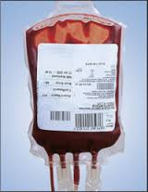
Blood Transfusions
Preoperative
Postoperative
8 patients
Avg 2.25 units
6 patients
Avg 2.8 units
3 were transfused preop
Notes:
All comminuted with circlage wiring

Slide 24
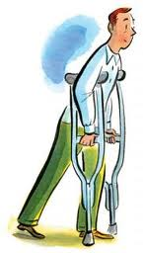
Results
PWB
FWB
FEMUR 7.8 wks
TIBIA 9.5wks
FEMUR 14.2 wks
TIBIA 16 wks
Notes:
Lepore 01 consolidation 12wks-hum,9.5 femur,10-tib.all healed,no inf,fat emb disorders of union.no diff with reaming. Beazley 2011 tib healed 12.2 wks, avr op time 54 mins.eliminated complic and reop assocd with screws

Slide 25
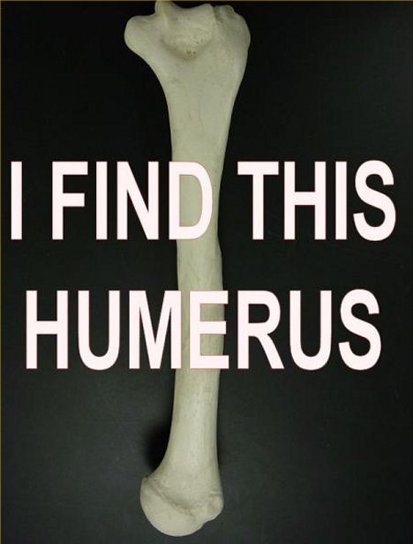
Results
Humerus:
(acute #, nonunions) healing time 12.3wks

Slide 26
Complications
Nil broken tips
Atraumatic passage
Nil iatrogenic fractures
Nil Failure to expand
Nil malrotation*,shortening or angulation deformities
1 nerve palsy
Nil disorders of union
3 infections (2 superficial, 1 deep)
1 PE
Notes:
Zoccali 08 thought the high contact pressure retards healing 6mnths cf screws offloading #site.but no deformities seen. Tip prone to injury→ must protect expansion system. Expansion also accomodates for varying procurvatum canals in femur.for transv and sh obl #

Slide 27
Pain
Femur
5
Tibia
3
Humerus
1
5 patients had nail removal

Slide 28
Conclusions
Use is possible for #’s 5cm below surgical neck and 5cm proximal to end of medullary canal
An option to treat nonunions
Acceptable operative times, blood loss and complication rates
Excellent union rates
Good axial, rotational and bending stability
Notes:
* Often undereported kapoor 2009, zocalli 08-→ faster sx time than interlocking avg 55 vs 74mins

Slide 29
Conclusion
Type A hospitals are overburdened with trauma cases
Acceptable results justifies non transfer

Slide 30
Citation:Fletcher CK, McDowell D, Naparla C (2014) Open Locked Nailing Using an Expandable Nail - An Alternative Approach. MOJ Orthop Rheumatol 1(1): 0004

Slide 31
THANK YOU

Slide 32
References
J Am Acad Orthop Surg2007;15:97-106
Campbell’s Operative Orthopaedics 1oth edpp2704-2706
J Am Acad Orthop Surg 1993;1:95-105
Panidis G et al. the use of an innovative… osteo trauma care 2003; 11:S108-s112
Kapoor SK, Kataria H, Boruah T, Patra SR, Chaudhry A, Kapoor S. Expandable self-locking nail in the management of closed diaphyseal fractures of femur and tibia. Indian J Orthop [serial online] 2009 [cited 2013 Nov 21];43:264-70.

Slide 33
References
Blomquist J. Are inflatable nails an alternative to tibial locking nails? Clin Orthop Relat Res (2008) 466:1225–1231
Mallik et al .Fixion nailing in humeral fratures.Acta Orthopædica Belgica, Vol. 74 - 3 – 2008
C. Zoccali et al. J Orthopaed Traumatol (2008) 9:123–128
Ben-Galim P Clin orthop and rel res2006 Number 455, pp. 234–240
S. Lepore et al Preliminary clinical and radiographic results with the Fixion® Intramedullary Nail. Folia Traumatologica Lovaniensia 2001
Lepore S. et al 2003 Intramedullary nailing of the femur with an inflatable self-locking nail: comparison with locked nailing. J Orthop Sci (2003) 8:796–801
J. Beazley et al. / Injury, Int. J. Care Injured 42 (2011) S11–S16

