Slide 1
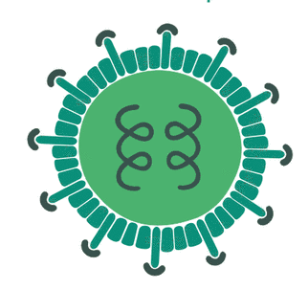



Advances in molecular analysis in HTLV infection
Carolina Rosadas
MSc, PhD Student
Universidade Federal do Rio de Janeiro
Cerebrospinal Fluid Laboratory

Slide 2
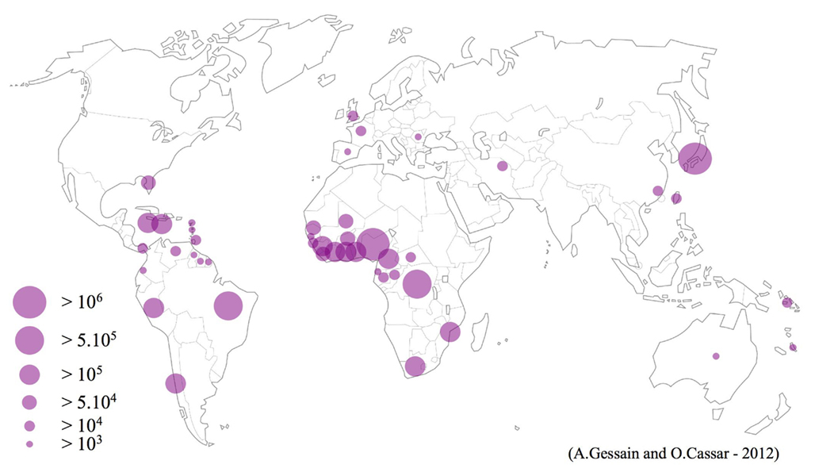
HTLV: Introduction
First Retrovirus described in humans
HTLV-1, HTLV-2, HTLV-3, HTLV-4
Transmission
  IDUs
  HIV/HTLV
Prevalence

Slide 3

HTLV: clinical presentation
Asymptomatic infection
1-5% disease
  HAM/TSP
  ATL
  Other clinical presentation
HAM/TSP
Chronic progressive incapacitating neurologic disease
There is no treatment
HAM/TSP patient

Slide 4
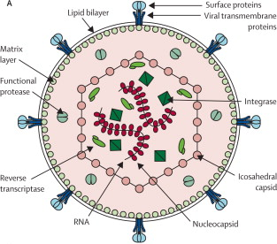
HTLV morphology
Verdonck et al., 2007

Slide 5
HTLV replication cycle
Clonal expansion of
Infected T-cell
Lairmore et al., 2012

Slide 6
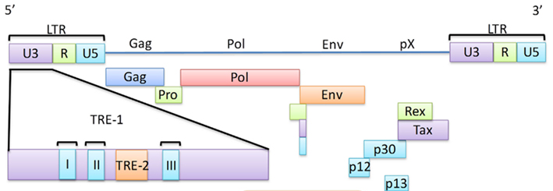
HTLV proviral genome
Low mutation rate
Currer et al. Front. Microbiol., 30 November 2012 | doi: 10.3389/fmicb.2012.00406

Slide 7
Molecular analysis in HTLV infection
Diagnosis
Prognosis
Epidemiology
Pathogenesis

Slide 8
Diagnosis
WHO
(OSAME, 1990)
HAM/TSP Classical symptoms
Abs in blood and CSF
Castro-Costa (2006)
HAM/TSP Classical symptoms
Abs in blood and CSF or PCR positive
Abs detection:
ELISA: screening test
WB: Confirmatory and typing test
Indeterminate WB

Slide 9
Detection of proviral DNA
Recent infection
Passive transfer of Abs
Indeterminate WB
Abs in blood and not in CSF in symptomatic patients (HAM/TSP)
Identification of HTLV types and subtypes

Slide 10
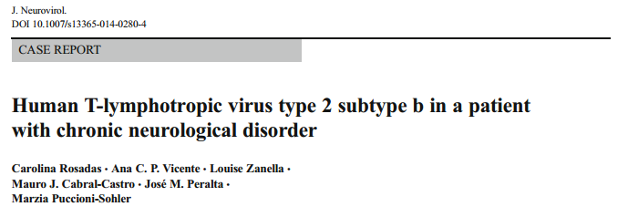
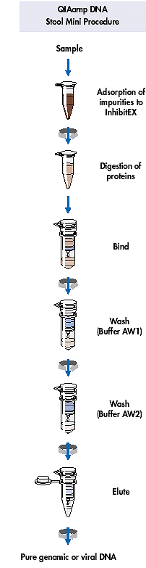
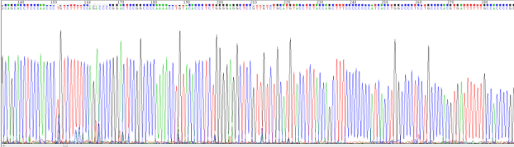
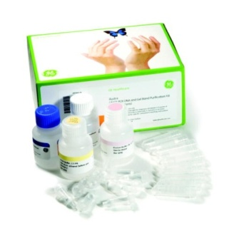
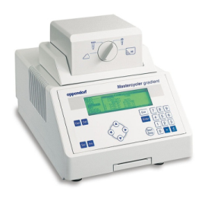
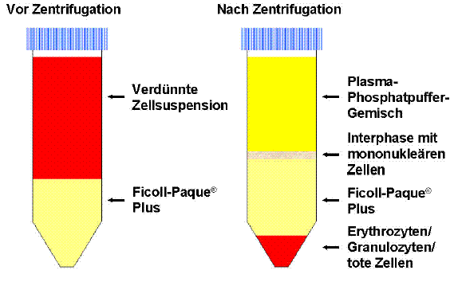
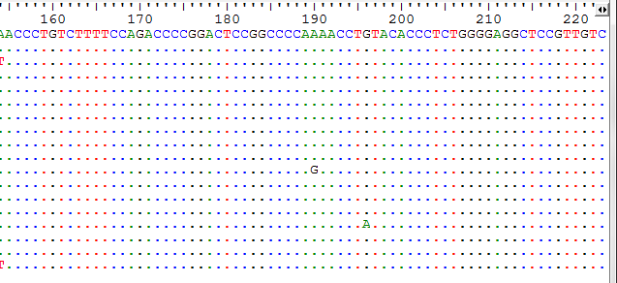

Slide 11
Nucleotide identity
HTLV-2 LTR and Tax region nucleotide identity in percentage between the patient isolate and differents HTLV prototypes
 | Prototypes (% similarity )
Versus patient isolate | NRA (HTLV-2b) | MoT (HTLV-2a) | Kayapo (HTLV-2c) | ATK1 (HTLV-1)
LTR region | 99% | 93% | 95% | 81%
Tax gene | 99% | 96% | 97% | 77%

Slide 12
HTLV-2b
LTR (623 nucleotides)
HTLV-2b
HTLV-2a
HTLV-2a
HTLV-2c
HTLV-2c
HTLV-2d
HTLV-2d

Slide 13
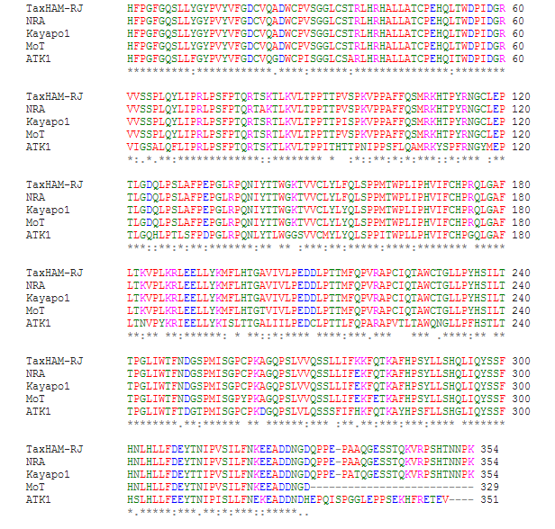
Tax protein
82
Ser
Ala
ClustalW2

Slide 14
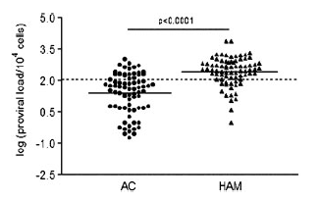
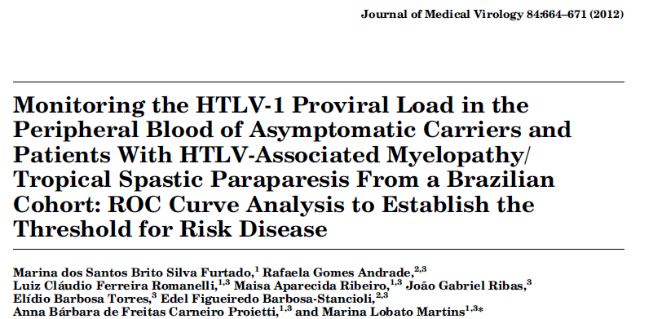
Prognosis
  Determination of proviral load in PBMCs

Slide 15
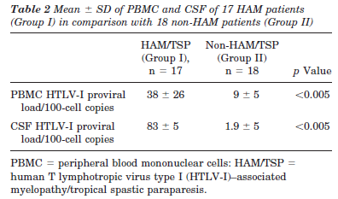
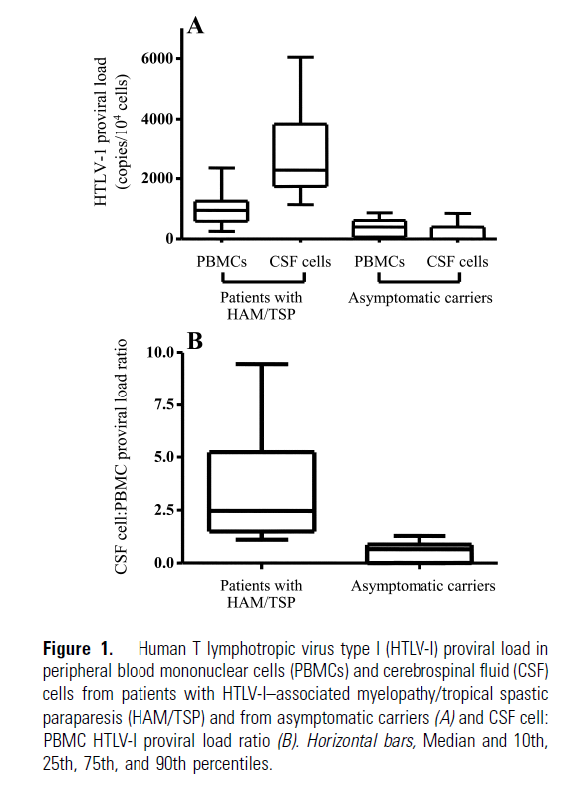
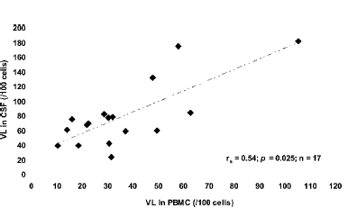
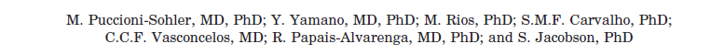
Prognosis
Determination of proviral load in CSF
VALIDATION IS ESSENCIAL

Slide 16
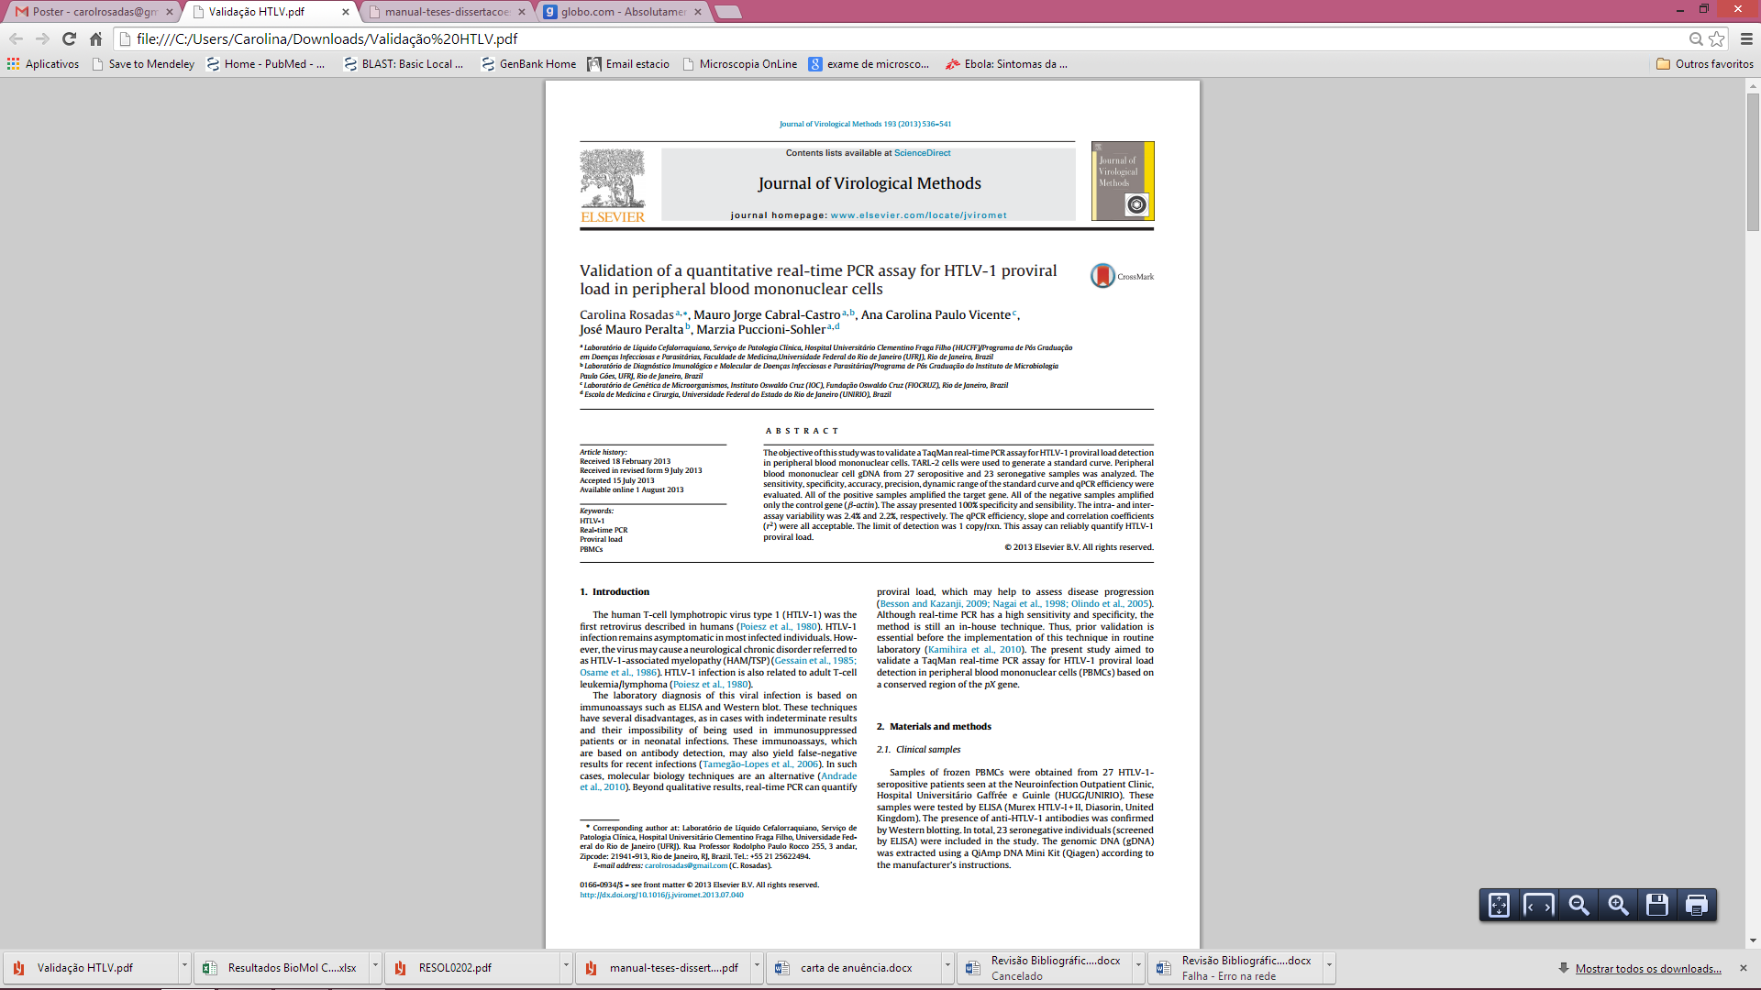

Slide 17
Validation of qPCR for HTLV-1 proviral load in PBMCs
Actin
Actin-F | CACATCgTgCCCATCTACgA
Actin-R | CTCAgTgAggATCTTCATgAggTAgT
Probe | FAM-ATgCCCTCCCCCATgCCATCCTgCgT-TAMRA
Tax (HTLV-1)
Tax-F | ACAAAgTTAACCATgCTTATTATCAgC
Tax-R | ACACgTAgACTgggTATCCgAA
Probe | FAM-TTCCCAgggTTTggACAgAgTCTTCT-TAMRA
      100ng DNA
      Standard curve
      PBMC DNA
      TARL-2 DNA
Number of HTLV-I (pX) copies/100 cels = (number of copies of pX)/(number of copies of ß-actin/2) x 100 (Nagai et al., 1998)

Slide 18
Validation of qPCR for HTLV-1 proviral load in PBMCs
    Sensibility and specificity
    Limit of detection
    Intra- and inter-assay variability

Slide 19
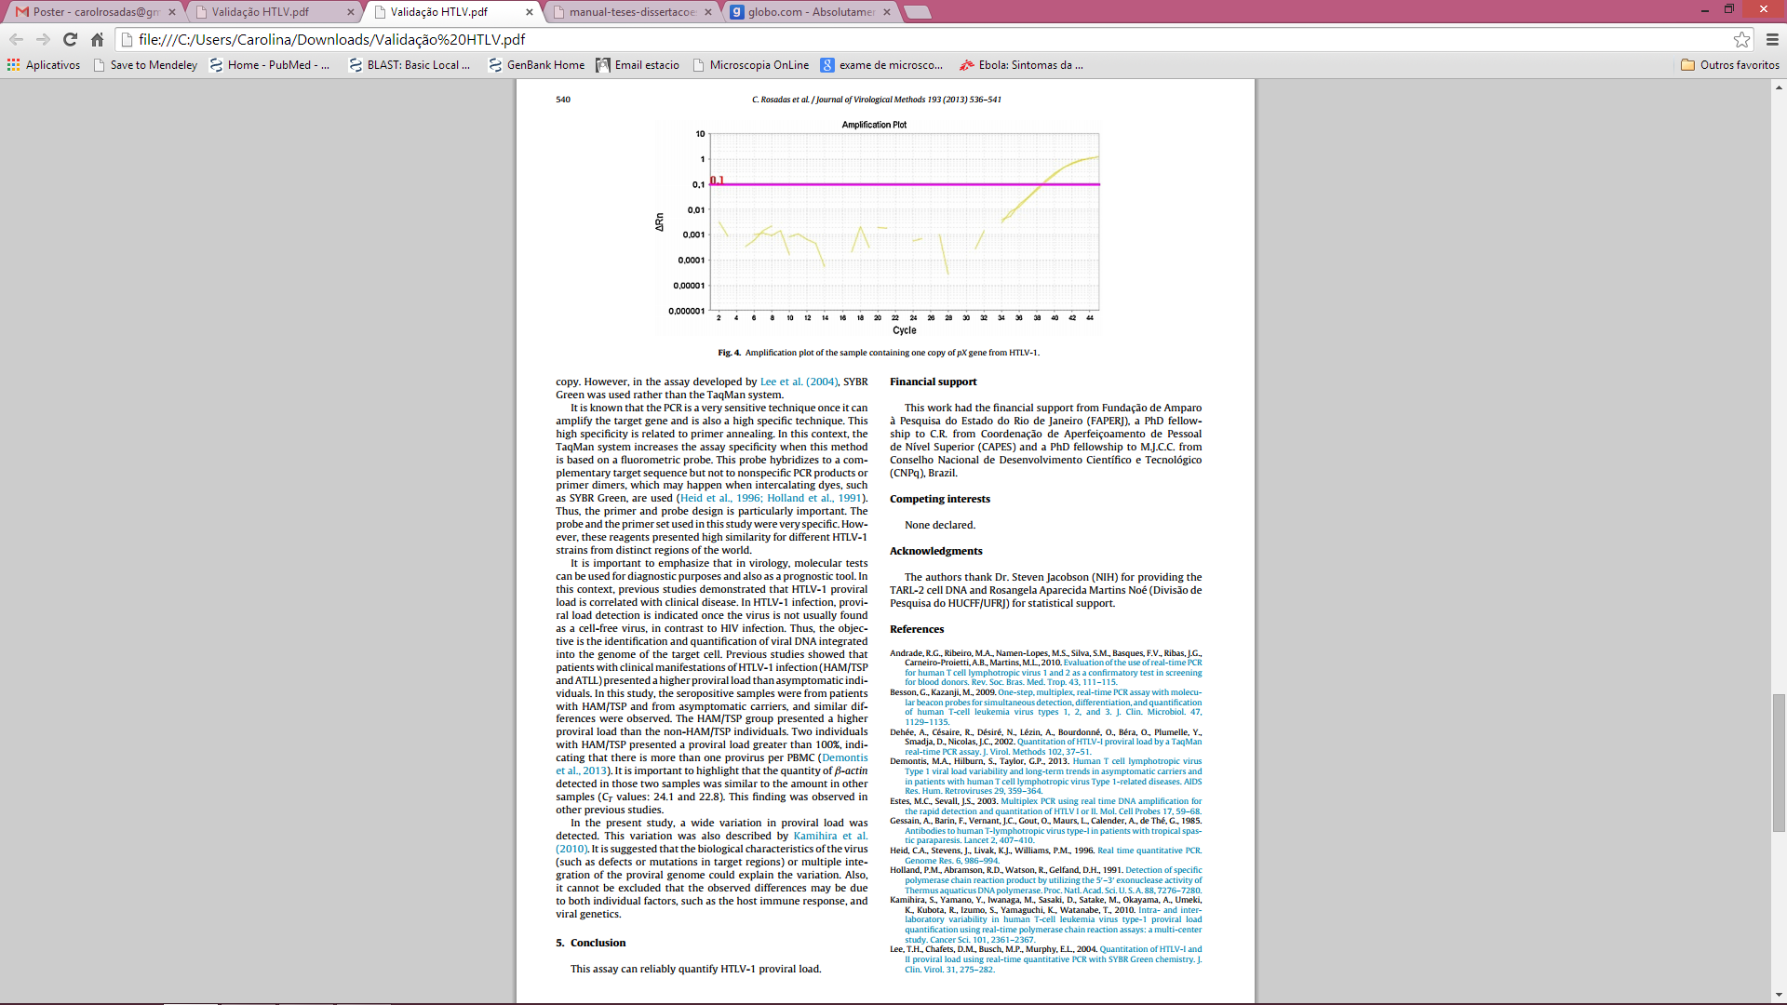
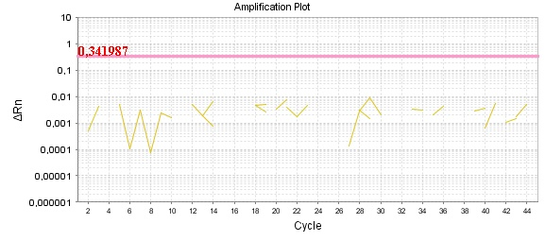
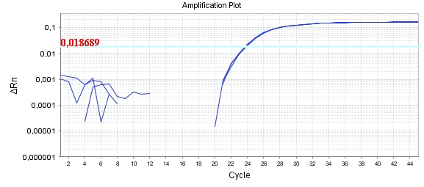
Validation of qPCR for HTLV-1 proviral load in PBMCs
All seropositive samples (ELISA) presented gene amplification (both genes: actin e pX)
Negative samples (ELISA):
Not amplify pX gene
Amplification of actin Figure

Slide 20
Validation of qPCR for HTLV-1 proviral load in PBMCs
  Limit of detection: 1 copy/rxn.
  qPCR efficiency, slope and r²: 98,58%, -3,298 e 0,993 respectively.

Slide 21
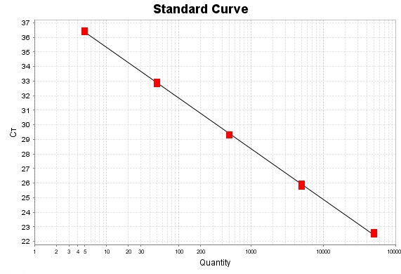
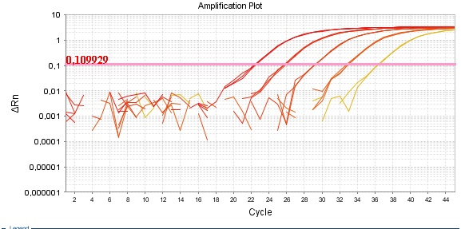
Validation of qPCR for HTLV-1 proviral load in PBMCs
pX

Slide 22
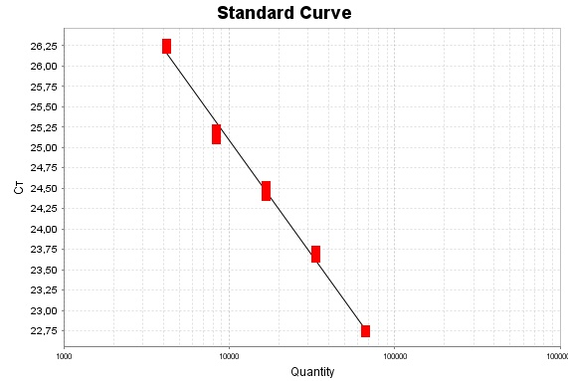
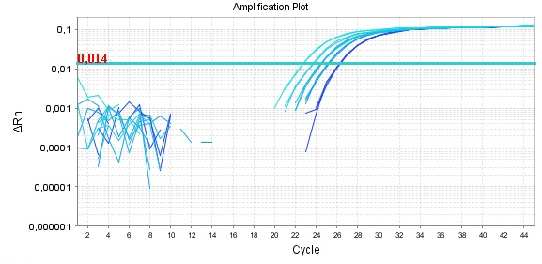
Validation of qPCR for HTLV-1 proviral load in PBMCs
Actin

Slide 23
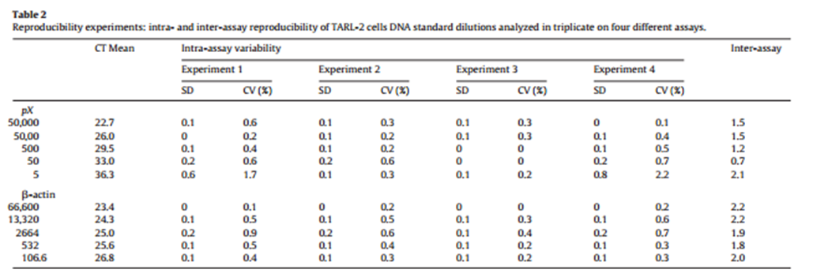
Validation of qPCR for HTLV-1 proviral load in PBMCs

Slide 24
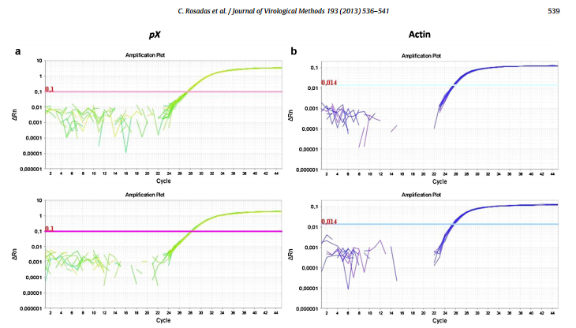
Intra-assay: CV = 0.4%
Inter-assay: CV = 2%
Experiment 1. Same sample 15 times
Experiment 2. Same sample 15 times

Slide 25
Validation of qPCR for HTLV-1 proviral load in PBMCs
The assay can reliably quantify HTLV-1 proviral load.
PVL of patients (mean ± SD = 36.3 ± 40.2; SE: 9.5) was higher than in the non-HAM/TSP group (mean ± SD = 6.9 ± 8.8; SE: 2.9;p < 0.005).

Slide 26
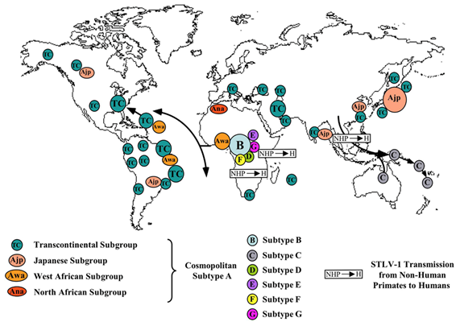
Epidemiology
Subtypes
Associated with geographic distribution
No association with clinical progression
Gessain & Mahieux, 2012

Slide 27
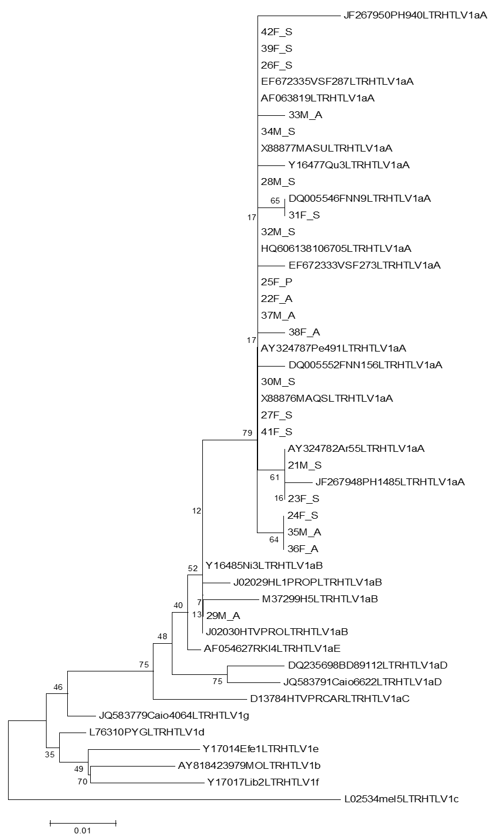
Epidemiology
HTLV-1 subtypes in Rio de Janeiro, Brazil

Slide 28
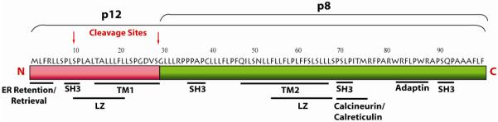
Pathogenesis
p12
G29→S
Immune evasion of HTLV-1 infected cells
↓ MHCI expression
ICAMI e ICAMII
Infected T-cell proliferation:
↑STAT activation,
↑ cytoplasmatic
calcium→ activation
of NFAT
↑ p12
Bind to IL-2 promoter, ↑ IL-2 expression

Slide 29
Important remarks
Importance of HTLV-1 screening
Molecular assays can be used for different purposes in HTLV infection
Prior validation is essential before the implementation in laboratorial routine

Slide 30







Acknowledgments
Laboratório de líquido cefalorraquiano:
Marzia Puccioni Sohler, MD, PhD
Mauro Jorge Cabral Castro, MSc, PhD Student
Laboratório de Diagnóstico imunológico e molecular de doenças infecciosas e parasitárias
José Mauro Peralta, MD, PhD
Laboratório de Genética Molecular de Microorganismos
Ana Carolina Paulo Vicente, PhD
Louise Zanella, MSc, PhD Student
Financial support

Slide 31

Thank you!
CAROLROSADAS@GMAIL.COM

