Slide 1
3rd International Conference on Forensic Research & Technology, October 06-08, 2014, San Antonio, USA
3th International Conference on Forensic Research & Technology, October 6-8, 2014
About OMICS Group
OMICS Group International is an amalgamation of Open Access publications and worldwide international science conferences and events. Established in the year 2007 with the sole aim of making the information on Sciences and technology ‘Open Access’, OMICS Group publishes 400 online open access scholarly journals in all aspects of Science, Engineering, Management and Technology journals. OMICS Group has been instrumental in taking the knowledge on Science & technology to the doorsteps of ordinary men and women. Research Scholars, Students, Libraries, Educational Institutions, Research centers and the industry are main stakeholders that benefitted greatly from this knowledge dissemination. OMICS Group also organizes 300 International conferences annually across the globe, where knowledge transfer takes place through debates, round table discussions, poster presentations, workshops, symposia and exhibitions.
CAMERON BROWN - Cybercrime, Criminal Justice and the Funnel Effect: Challenges for Investigators, Prosecutors, and Criminal Justice Officers, 2014
CAMERON BROWN - Cybercrime, Criminal Justice and the Funnel Effect: Challenges for Investigators, Prosecutors, and Criminal Justice Officers, 2014
Notes:
*

Slide 2
3rd International Conference on Forensic Research & Technology, October 06-08, 2014, San Antonio, USA
3th International Conference on Forensic Research & Technology, October 6-8, 2014
About OMICS Group Conferences
OMICS Group International is a pioneer and leading science event organizer, which publishes around 400 open access journals and conducts over 300 Medical, Clinical, Engineering, Life Sciences, Phrama scientific conferences all over the globe annually with the support of more than 1000 scientific associations and 30,000 editorial board members and 3.5 million followers to its credit.
OMICS Group has organized 500 conferences, workshops and national symposiums across the major cities including San Francisco, Las Vegas, San Antonio, Omaha, Orlando, Raleigh, Santa Clara, Chicago, Philadelphia, Baltimore, United Kingdom, Valencia, Dubai, Beijing, Hyderabad, Bengaluru and Mumbai.
CAMERON BROWN - Cybercrime, Criminal Justice and the Funnel Effect: Challenges for Investigators, Prosecutors, and Criminal Justice Officers, 2014
CAMERON BROWN - Cybercrime, Criminal Justice and the Funnel Effect: Challenges for Investigators, Prosecutors, and Criminal Justice Officers, 2014
Notes:
*

Slide 3
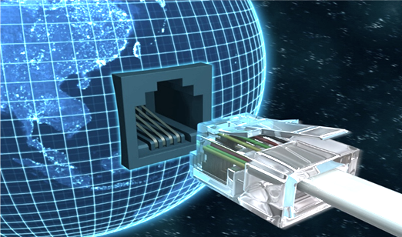
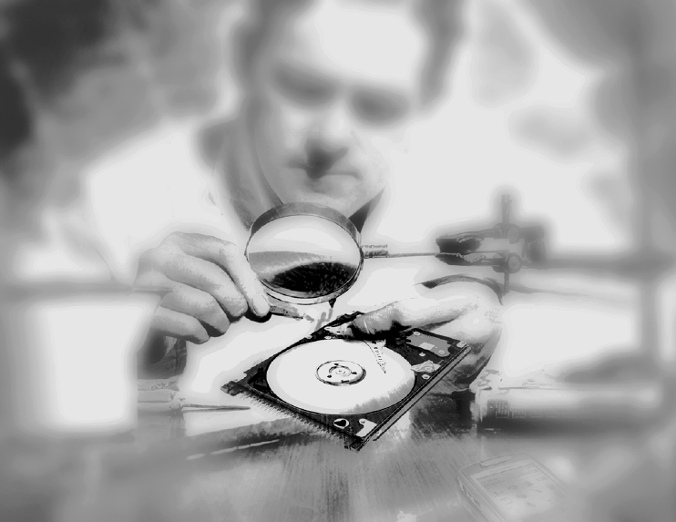
Cybercrime, criminal justice and the funnel effect: Challenges for forensic investigators, prosecutors and criminal justice officers
3rd International Conference on Forensic Research & Technology, October 06-08, 2014, San Antonio, USA
3th International Conference on Forensic Research & Technology, October 6-8, 2014
- Cameron Brown
Notes:
*

Slide 4
Significance of subject matter
3rd International Conference on Forensic Research & Technology, October 06-08, 2014, San Antonio, USA
3th International Conference on Forensic Research & Technology, October 6-8, 2014
The seriousness of the ‘funnel effect’ in the case of cybercrime demands an inquiry into factors impeding the administration of criminal of justice to raise awareness, identify blockages, and find solutions.
Identify the most commonly used investigative measures by police.
Identify how cybercrime comes to the attention of police and what measures can be taken to increase reporting.
Identify the main impediments to quantifying cybercrime incidents.
Identify problems associated with obtaining electronic evidence.
Identify the obstacles that impede successful adjudication and prosecution.
CAMERON BROWN - Cybercrime, Criminal Justice and the Funnel Effect: Challenges for Investigators, Prosecutors, and Criminal Justice Officers, 2014
CAMERON BROWN - Cybercrime, Criminal Justice and the Funnel Effect: Challenges for Investigators, Prosecutors, and Criminal Justice Officers, 2014
Notes:
*

Slide 5
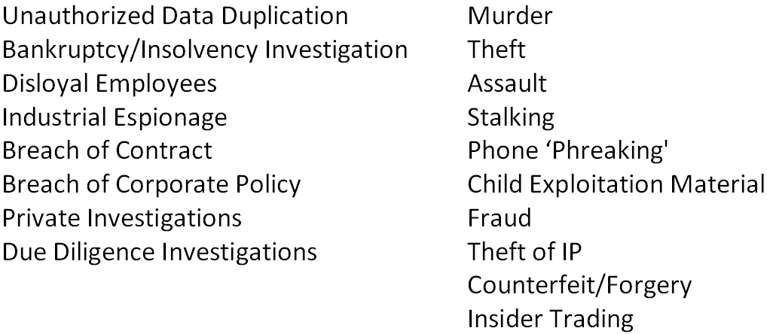
3rd International Conference on Forensic Research & Technology, October 06-08, 2014, San Antonio, USA
3th International Conference on Forensic Research & Technology, October 6-8, 2014
Digital forensics
Probative value for investigators and prosecutors in proving the 'mental aspect' / 'intent element' of various offences.
Increasingly an integral element of high-tech investigations but also traditional civil and criminal investigations:
CAMERON BROWN - Cybercrime, Criminal Justice and the Funnel Effect: Challenges for Investigators, Prosecutors, and Criminal Justice Officers, 2014
CAMERON BROWN - Cybercrime, Criminal Justice and the Funnel Effect: Challenges for Investigators, Prosecutors, and Criminal Justice Officers, 2014
Notes:
*

Slide 6
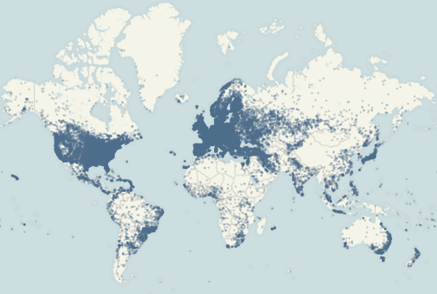
3rd International Conference on Forensic Research & Technology, October 06-08, 2014, San Antonio, USA
3th International Conference on Forensic Research & Technology, October 6-8, 2014
The global challenge
Geo-Location of Internet Protocol Addresses
CAMERON BROWN - Cybercrime, Criminal Justice and the Funnel Effect: Challenges for Investigators, Prosecutors, and Criminal Justice Officers, 2014
CAMERON BROWN - Cybercrime, Criminal Justice and the Funnel Effect: Challenges for Investigators, Prosecutors, and Criminal Justice Officers, 2014
Notes:
*

Slide 7
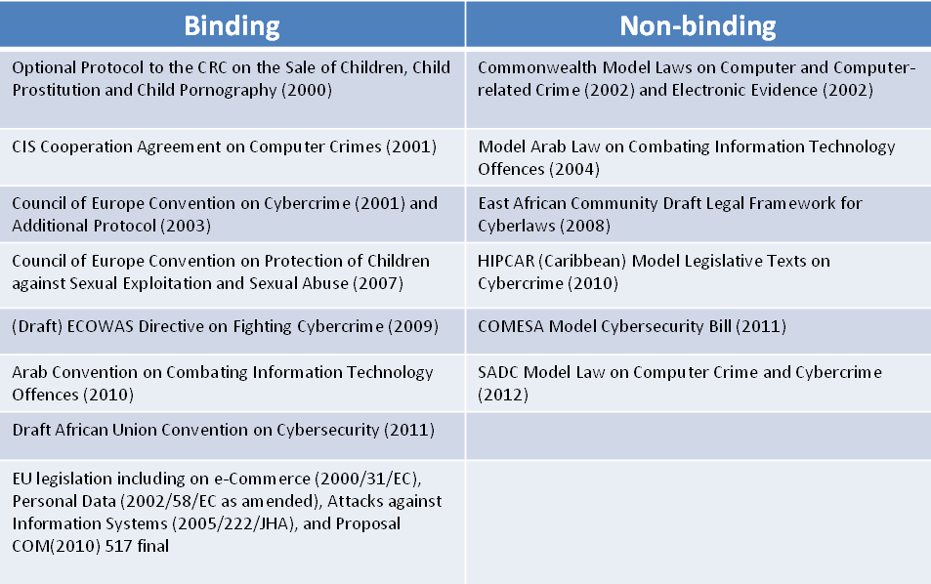
3rd International Conference on Forensic Research & Technology, October 06-08, 2014, San Antonio, USA
3th International Conference on Forensic Research & Technology, October 6-8, 2014
The challenge for the law
CAMERON BROWN - Cybercrime, Criminal Justice and the Funnel Effect: Challenges for Investigators, Prosecutors, and Criminal Justice Officers, 2014
CAMERON BROWN - Cybercrime, Criminal Justice and the Funnel Effect: Challenges for Investigators, Prosecutors, and Criminal Justice Officers, 2014
Notes:
*

Slide 8
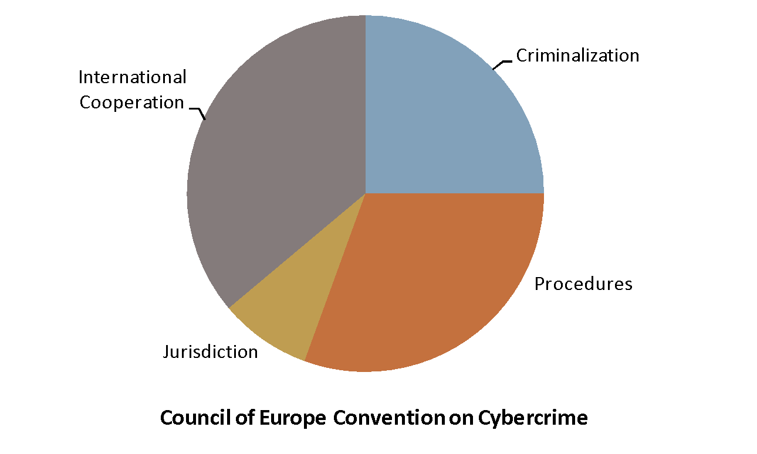
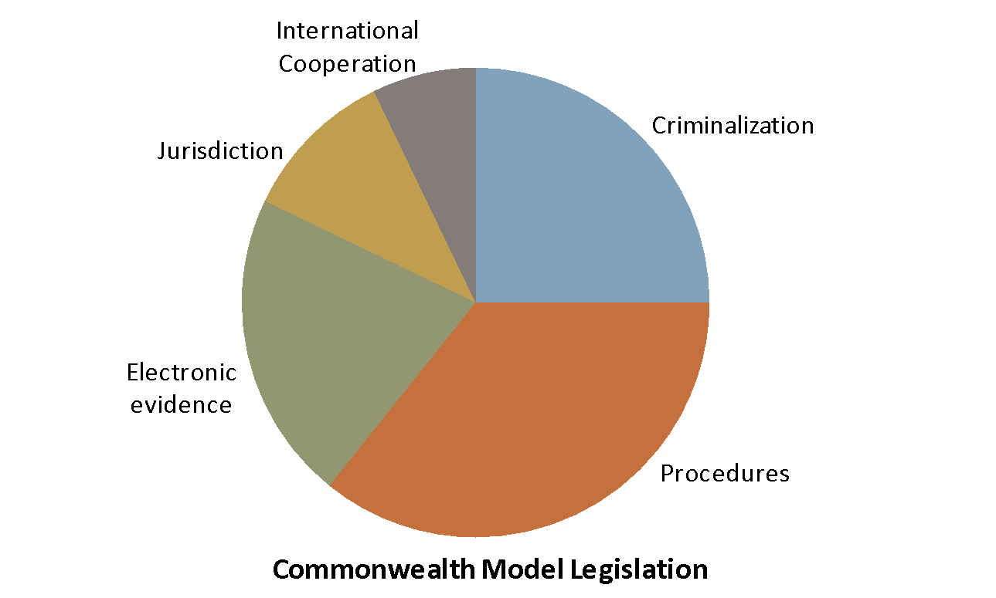
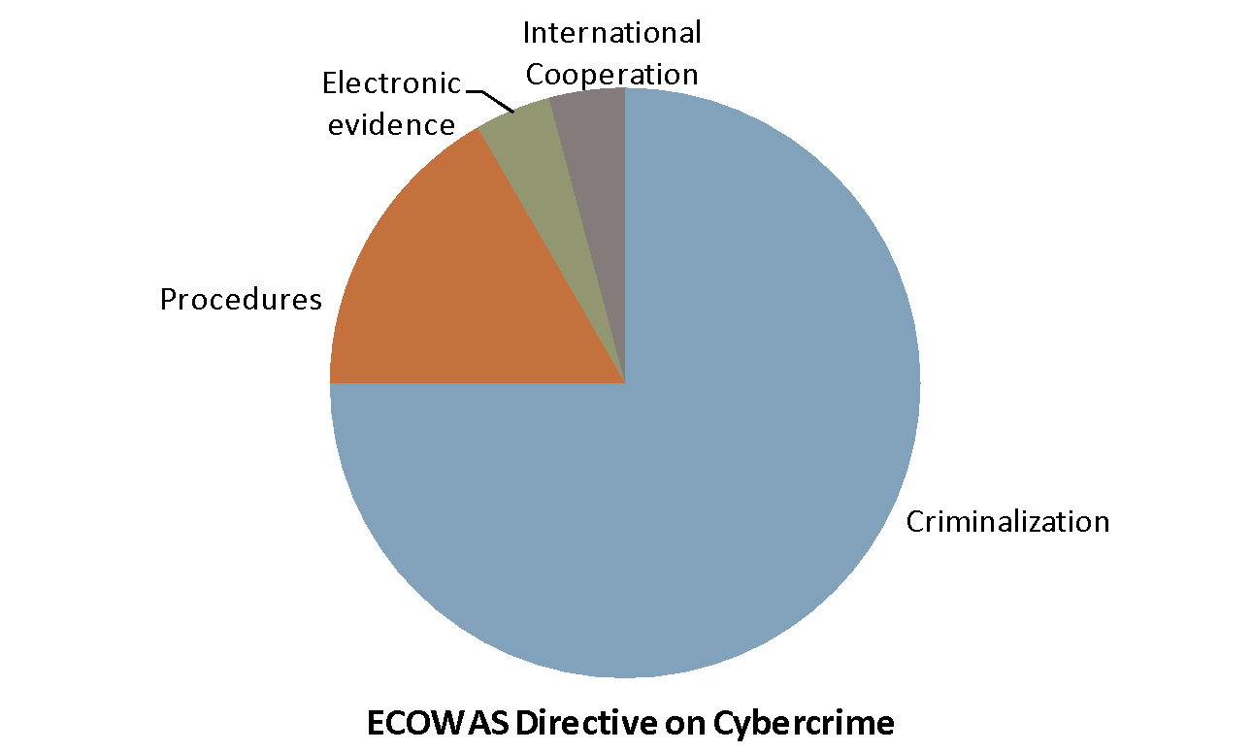
3rd International Conference on Forensic Research & Technology, October 06-08, 2014, San Antonio, USA
3th International Conference on Forensic Research & Technology, October 6-8, 2014
Diversity in legal approaches
Criminalization
Procedures
Electronic evidence
Jurisdiction
Service Provider Liability
International Cooperation
CAMERON BROWN - Cybercrime, Criminal Justice and the Funnel Effect: Challenges for Investigators, Prosecutors, and Criminal Justice Officers, 2014
CAMERON BROWN - Cybercrime, Criminal Justice and the Funnel Effect: Challenges for Investigators, Prosecutors, and Criminal Justice Officers, 2014
Notes:
*

Slide 9
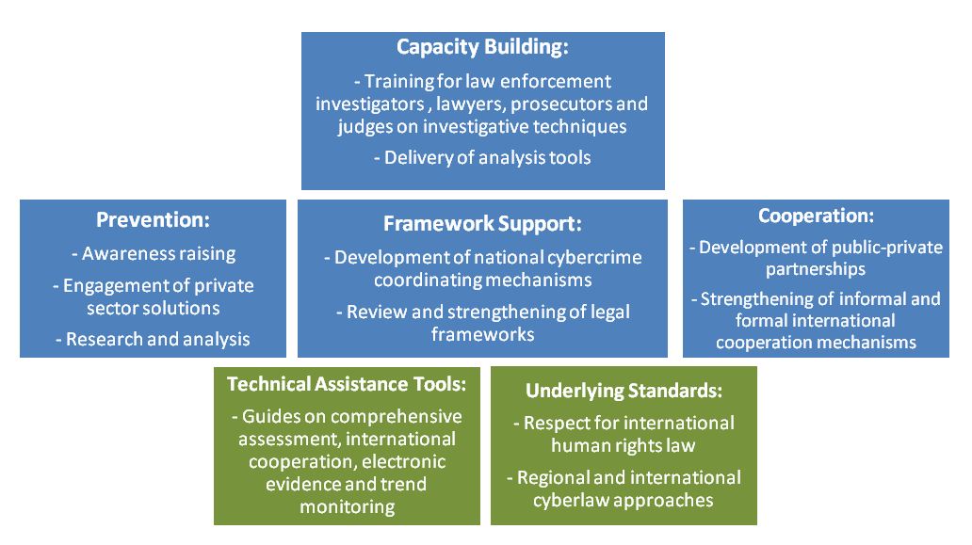
3rd International Conference on Forensic Research & Technology, October 06-08, 2014, San Antonio, USA
3th International Conference on Forensic Research & Technology, October 6-8, 2014
Enhancing capacity
CAMERON BROWN - Cybercrime, Criminal Justice and the Funnel Effect: Challenges for Investigators, Prosecutors, and Criminal Justice Officers, 2014
CAMERON BROWN - Cybercrime, Criminal Justice and the Funnel Effect: Challenges for Investigators, Prosecutors, and Criminal Justice Officers, 2014
Notes:
*

Slide 10
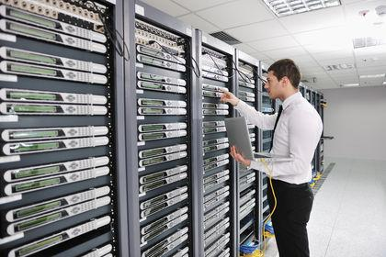
3rd International Conference on Forensic Research & Technology, October 06-08, 2014, San Antonio, USA
3th International Conference on Forensic Research & Technology, October 6-8, 2014
Tracing an IP - back in the day
INTERNET USER ATTEMPTS TO LOG ON VIA A MODEM
ISP HAS RIGHTS TO IP RANGE
203.64.125.0 TO
203.64.125.255
INTERNET SERVICE PROVICER
IP NUMBER
E.G. - 203.64.125.1
DYNAMICALLY SELECTED BY ISP SERVERS
INTERNET USER SENDS EMAIL OR SURFS THE INTENET AND CAN BE TRACED TO THE IP NUMBER
IP NUMBER
203.64.125.1 ASSIGNED TO USER on 08/11/12 at 10:15:19 CEST
CAMERON BROWN - Cybercrime, Criminal Justice and the Funnel Effect: Challenges for Investigators, Prosecutors, and Criminal Justice Officers, 2014
CAMERON BROWN - Cybercrime, Criminal Justice and the Funnel Effect: Challenges for Investigators, Prosecutors, and Criminal Justice Officers, 2014
Notes:
*

Slide 11
3rd International Conference on Forensic Research & Technology, October 06-08, 2014, San Antonio, USA
3th International Conference on Forensic Research & Technology, October 6-8, 2014
Evasive criminal techniques
Dead dropping
Cryptography
Use of codes / aliases for communication
Anonymity networks and proxy services
Steganography
Compromised intermediaries
Spoofing
Hiding in safe jurisdictions
CAMERON BROWN - Cybercrime, Criminal Justice and the Funnel Effect: Challenges for Investigators, Prosecutors, and Criminal Justice Officers, 2014
CAMERON BROWN - Cybercrime, Criminal Justice and the Funnel Effect: Challenges for Investigators, Prosecutors, and Criminal Justice Officers, 2014
Notes:
*

Slide 12
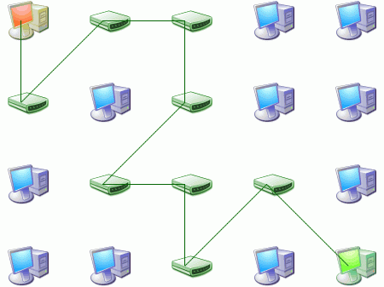
3rd International Conference on Forensic Research & Technology, October 06-08, 2014, San Antonio, USA
3th International Conference on Forensic Research & Technology, October 6-8, 2014
Anonymity networks
CAMERON BROWN - Cybercrime, Criminal Justice and the Funnel Effect: Challenges for Investigators, Prosecutors, and Criminal Justice Officers, 2014
CAMERON BROWN - Cybercrime, Criminal Justice and the Funnel Effect: Challenges for Investigators, Prosecutors, and Criminal Justice Officers, 2014
Notes:
*

Slide 13
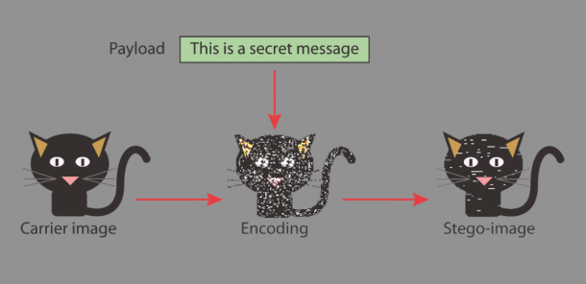
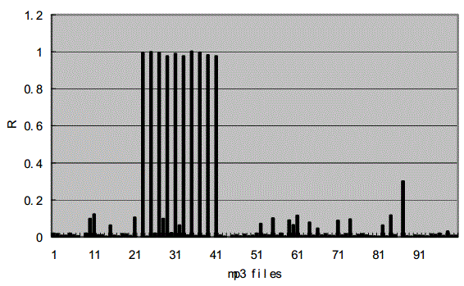
3rd International Conference on Forensic Research & Technology, October 06-08, 2014, San Antonio, USA
3th International Conference on Forensic Research & Technology, October 6-8, 2014
Steganography
Concealed in a graphic image file
Concealed in a sound file
CAMERON BROWN - Cybercrime, Criminal Justice and the Funnel Effect: Challenges for Investigators, Prosecutors, and Criminal Justice Officers, 2014
CAMERON BROWN - Cybercrime, Criminal Justice and the Funnel Effect: Challenges for Investigators, Prosecutors, and Criminal Justice Officers, 2014
Notes:
*

Slide 14
Incentives Cybercriminals
3rd International Conference on Forensic Research & Technology, October 06-08, 2014, San Antonio, USA
3th International Conference on Forensic Research & Technology, October 6-8, 2014
Making money through fraud or from the sale of valuable information.
Realising gains on the stock market by obtaining information prior to announcement of official transactions.
Extorting money from private entities by holding data to ransom or interfering with online transactions of a commercial nature.
Indulging in depravity by disseminating abusive material and satisfying predatory urges.
CAMERON BROWN - Cybercrime, Criminal Justice and the Funnel Effect: Challenges for Investigators, Prosecutors, and Criminal Justice Officers, 2014
CAMERON BROWN - Cybercrime, Criminal Justice and the Funnel Effect: Challenges for Investigators, Prosecutors, and Criminal Justice Officers, 2014
Notes:
*

Slide 15
Incentives Industrial competitors
3rd International Conference on Forensic Research & Technology, October 06-08, 2014, San Antonio, USA
3th International Conference on Forensic Research & Technology, October 6-8, 2014
Stealing intellectual property and trade secrets.
Gaining advantage in the marketplace by acquiring commercially sensitive data, such as key negotiating positions.
Furthering privatization strategies by discrediting counterparties to a transaction.
CAMERON BROWN - Cybercrime, Criminal Justice and the Funnel Effect: Challenges for Investigators, Prosecutors, and Criminal Justice Officers, 2014
CAMERON BROWN - Cybercrime, Criminal Justice and the Funnel Effect: Challenges for Investigators, Prosecutors, and Criminal Justice Officers, 2014
Notes:
*

Slide 16
Incentives Foreign intelligence agencies
3rd International Conference on Forensic Research & Technology, October 06-08, 2014, San Antonio, USA
3th International Conference on Forensic Research & Technology, October 6-8, 2014
Obtaining sensitive research and development information from leading manufacturers, governments, and defense contractors.
Toppling hostile regimes.
Sabotaging the technical developments of enemy states.
CAMERON BROWN - Cybercrime, Criminal Justice and the Funnel Effect: Challenges for Investigators, Prosecutors, and Criminal Justice Officers, 2014
CAMERON BROWN - Cybercrime, Criminal Justice and the Funnel Effect: Challenges for Investigators, Prosecutors, and Criminal Justice Officers, 2014
Notes:
*

Slide 17
Incentives State sponsored operatives
3rd International Conference on Forensic Research & Technology, October 06-08, 2014, San Antonio, USA
3th International Conference on Forensic Research & Technology, October 6-8, 2014
Advancing homeland security through ubiquitous surveillance.
Collaborating with likeminded nation-states to solve shared problems.
Monitoring political speech online and silencing dissidents.
Sabotaging international deals to safeguard and enhance domestic commercial interests, or to give local industries an economic advantage.
CAMERON BROWN - Cybercrime, Criminal Justice and the Funnel Effect: Challenges for Investigators, Prosecutors, and Criminal Justice Officers, 2014
CAMERON BROWN - Cybercrime, Criminal Justice and the Funnel Effect: Challenges for Investigators, Prosecutors, and Criminal Justice Officers, 2014
Notes:
*

Slide 18
Incentives Hackers
3rd International Conference on Forensic Research & Technology, October 06-08, 2014, San Antonio, USA
3th International Conference on Forensic Research & Technology, October 6-8, 2014
Interfering with computer systems as an intellectual challenge or to earn respect among peers.
Penetration testing to identify vulnerabilities.
Reverse engineering systems to gain knowledge.
CAMERON BROWN - Cybercrime, Criminal Justice and the Funnel Effect: Challenges for Investigators, Prosecutors, and Criminal Justice Officers, 2014
CAMERON BROWN - Cybercrime, Criminal Justice and the Funnel Effect: Challenges for Investigators, Prosecutors, and Criminal Justice Officers, 2014
Notes:
*

Slide 19
Incentives Non-state actors
3rd International Conference on Forensic Research & Technology, October 06-08, 2014, San Antonio, USA
3th International Conference on Forensic Research & Technology, October 6-8, 2014
Disrupting government services and impeding capacity of industry to function.
Exploiting information security weaknesses to raise awareness, exact revenge or expose wrongdoing.
Attacking critical infrastructure for political or ideological reasons.
Circulating graphic material to traumatize adversaries and defacing digital resources to further a political agenda.
CAMERON BROWN - Cybercrime, Criminal Justice and the Funnel Effect: Challenges for Investigators, Prosecutors, and Criminal Justice Officers, 2014
CAMERON BROWN - Cybercrime, Criminal Justice and the Funnel Effect: Challenges for Investigators, Prosecutors, and Criminal Justice Officers, 2014
Notes:
*

Slide 20
Incentives Employees and end users
3rd International Conference on Forensic Research & Technology, October 06-08, 2014, San Antonio, USA
3th International Conference on Forensic Research & Technology, October 6-8, 2014
Accidental or deliberate system misuse by users who have legitimate access or escalated privileges.
Punishing an employer for perceived grievances.
Monitoring or stalking a significant other.
Planting insiders within a department to gain access to information.
CAMERON BROWN - Cybercrime, Criminal Justice and the Funnel Effect: Challenges for Investigators, Prosecutors, and Criminal Justice Officers, 2014
CAMERON BROWN - Cybercrime, Criminal Justice and the Funnel Effect: Challenges for Investigators, Prosecutors, and Criminal Justice Officers, 2014
Notes:
*

Slide 21
3rd International Conference on Forensic Research & Technology, October 06-08, 2014, San Antonio, USA
3th International Conference on Forensic Research & Technology, October 6-8, 2014
Case study
Initial Event
Incident Report
Police Response
Investigation
Jurisdictional Complexities
Forensic Inquiry
Legal Counsel
Mandatory Disclosure
Pre-trial
Trial
Evidence
Experts
Defence
Adjudication
CAMERON BROWN - Cybercrime, Criminal Justice and the Funnel Effect: Challenges for Investigators, Prosecutors, and Criminal Justice Officers, 2014
CAMERON BROWN - Cybercrime, Criminal Justice and the Funnel Effect: Challenges for Investigators, Prosecutors, and Criminal Justice Officers, 2014
Notes:
*

Slide 22
Challenges for administering justice Identification
3rd International Conference on Forensic Research & Technology, October 06-08, 2014, San Antonio, USA
3th International Conference on Forensic Research & Technology, October 6-8, 2014
Attributing ownership and authorship of electronically stored information (ESI) and identifying individuals in control computer systems.
Expediently locating relevant information amongst voluminous sets of data.
Tracing criminal activity where data anonymisation and obfuscation techniques are employed.
Widespread availability of sanitisation and data wiping software leading to destruction of evidence.
CAMERON BROWN - Cybercrime, Criminal Justice and the Funnel Effect: Challenges for Investigators, Prosecutors, and Criminal Justice Officers, 2014
CAMERON BROWN - Cybercrime, Criminal Justice and the Funnel Effect: Challenges for Investigators, Prosecutors, and Criminal Justice Officers, 2014
Notes:
*

Slide 23
Challenges for administering justice Access
3rd International Conference on Forensic Research & Technology, October 06-08, 2014, San Antonio, USA
3th International Conference on Forensic Research & Technology, October 6-8, 2014
Inability to obtain authorisation for search and seize of data stored remotely, particularly in relation to Cloud Service Providers.
Bureaucracy causing delays in processing requests for mutual legal assistance.
Lack of technical resources and absence of legal authority required to compel data production.
Rapid advancements in strong consumer security on personal devices and ease of access to anti-forensics.
CAMERON BROWN - Cybercrime, Criminal Justice and the Funnel Effect: Challenges for Investigators, Prosecutors, and Criminal Justice Officers, 2014
CAMERON BROWN - Cybercrime, Criminal Justice and the Funnel Effect: Challenges for Investigators, Prosecutors, and Criminal Justice Officers, 2014
Notes:
*

Slide 24
Challenges for administering justice Human resources
3rd International Conference on Forensic Research & Technology, October 06-08, 2014, San Antonio, USA
3th International Conference on Forensic Research & Technology, October 6-8, 2014
Lack of qualified digital forensic personnel required to operate equipment, discover evidence, and assist investigators and prosecutors in the preparation of reports, delivery of expert testimony, and the demystification of the technical underpinnings and probative value of ESI.
Scarcity of law enforcement officers and prosecutors with technical expertise and mindset to investigate and prosecute cybercriminals.
CAMERON BROWN - Cybercrime, Criminal Justice and the Funnel Effect: Challenges for Investigators, Prosecutors, and Criminal Justice Officers, 2014
CAMERON BROWN - Cybercrime, Criminal Justice and the Funnel Effect: Challenges for Investigators, Prosecutors, and Criminal Justice Officers, 2014
Notes:
*

Slide 25
Challenges for administering justice Wellbeing
3rd International Conference on Forensic Research & Technology, October 06-08, 2014, San Antonio, USA
3th International Conference on Forensic Research & Technology, October 6-8, 2014
Performance pressure and stressful working conditions for criminal justice officers.
Prolonged exposure to obscene material throughout the course of an investigation.
Inexperienced supervisors who lack capacity to provide for the welfare of first responders and technical personnel.
CAMERON BROWN - Cybercrime, Criminal Justice and the Funnel Effect: Challenges for Investigators, Prosecutors, and Criminal Justice Officers, 2014
CAMERON BROWN - Cybercrime, Criminal Justice and the Funnel Effect: Challenges for Investigators, Prosecutors, and Criminal Justice Officers, 2014
Notes:
*

Slide 26
Challenges for administering justice Liability
3rd International Conference on Forensic Research & Technology, October 06-08, 2014, San Antonio, USA
3th International Conference on Forensic Research & Technology, October 6-8, 2014
Interruption of business operations during warrant activity.
Disclosure of private or legally privileged information during the course of an investigation.
Inadvertent damage to information systems whilst seizing exhibits and during forensic analysis, leading to criminal, civil, and/or administrative liability.
CAMERON BROWN - Cybercrime, Criminal Justice and the Funnel Effect: Challenges for Investigators, Prosecutors, and Criminal Justice Officers, 2014
CAMERON BROWN - Cybercrime, Criminal Justice and the Funnel Effect: Challenges for Investigators, Prosecutors, and Criminal Justice Officers, 2014
Notes:
*

Slide 27
Challenges for administering justice Internal policies
3rd International Conference on Forensic Research & Technology, October 06-08, 2014, San Antonio, USA
3th International Conference on Forensic Research & Technology, October 6-8, 2014
Disinclination to commit time and money towards investigating cybercrime offending that is not congruent with existing policy preferences or public priorities.
Absence of police standard operating procedures for handling electronic evidence.
CAMERON BROWN - Cybercrime, Criminal Justice and the Funnel Effect: Challenges for Investigators, Prosecutors, and Criminal Justice Officers, 2014
CAMERON BROWN - Cybercrime, Criminal Justice and the Funnel Effect: Challenges for Investigators, Prosecutors, and Criminal Justice Officers, 2014
Notes:
*

Slide 28
Challenges for administering justice Retrieval and retention
3rd International Conference on Forensic Research & Technology, October 06-08, 2014, San Antonio, USA
3th International Conference on Forensic Research & Technology, October 6-8, 2014
Failure to collect ephemeral sources evidence from live systems.
Failure of service providers to respond to authorised requests for production and preservation of data.
Failure to action data retention and preservation requests in a timely manner, leading to loss of evidence.
CAMERON BROWN - Cybercrime, Criminal Justice and the Funnel Effect: Challenges for Investigators, Prosecutors, and Criminal Justice Officers, 2014
CAMERON BROWN - Cybercrime, Criminal Justice and the Funnel Effect: Challenges for Investigators, Prosecutors, and Criminal Justice Officers, 2014
Notes:
*

Slide 29
Challenges for administering justice Admissibility and fairness
3rd International Conference on Forensic Research & Technology, October 06-08, 2014, San Antonio, USA
3th International Conference on Forensic Research & Technology, October 6-8, 2014
Failure to maintain chain-of-custody documentation or demonstrate evidence integrity.
Inability to demonstrate the reliability or authenticity of computer generated and computer stored information.
Defendants unable to afford to engage forensic services to test findings or challenge opinions.
Analytical subject matter is predominately submitted by the prosecution, and evidence is produced almost exclusively on behalf of the prosecution.
CAMERON BROWN - Cybercrime, Criminal Justice and the Funnel Effect: Challenges for Investigators, Prosecutors, and Criminal Justice Officers, 2014
CAMERON BROWN - Cybercrime, Criminal Justice and the Funnel Effect: Challenges for Investigators, Prosecutors, and Criminal Justice Officers, 2014
Notes:
*

Slide 30
Challenges for administering justice Technical resources and funding
3rd International Conference on Forensic Research & Technology, October 06-08, 2014, San Antonio, USA
3th International Conference on Forensic Research & Technology, October 6-8, 2014
Inadequate analytical tools for acquiring, processing and presenting electronic evidence, such as dedicated crime laboratories and forensic facilities.
Court rooms not equipped with modern technology for presenting electronic evidence.
Failure to maintain updated forensic equipment for gathering and extracting electronic evidence.
CAMERON BROWN - Cybercrime, Criminal Justice and the Funnel Effect: Challenges for Investigators, Prosecutors, and Criminal Justice Officers, 2014
CAMERON BROWN - Cybercrime, Criminal Justice and the Funnel Effect: Challenges for Investigators, Prosecutors, and Criminal Justice Officers, 2014
Notes:
*

Slide 31
Challenges for administering justice Underreporting and uncertainty
3rd International Conference on Forensic Research & Technology, October 06-08, 2014, San Antonio, USA
3th International Conference on Forensic Research & Technology, October 6-8, 2014
Low proportion of cybercrime offending brought to the attention of police due to widespread underreporting.
Problems for investigators and prosecutors in identifying and obtaining appropriate legal authority for gathering electronic evidence caused by gaps in legislation and administrative delays owing to judicial uncertainty vis-à-vis manifestations of cybercrime.
Defence lawyers creating confusion with novel legal arguments and experts overstating or understating findings.
CAMERON BROWN - Cybercrime, Criminal Justice and the Funnel Effect: Challenges for Investigators, Prosecutors, and Criminal Justice Officers, 2014
CAMERON BROWN - Cybercrime, Criminal Justice and the Funnel Effect: Challenges for Investigators, Prosecutors, and Criminal Justice Officers, 2014
Notes:
*

Slide 32
Challenges for administering justice Privacy and privilege
3rd International Conference on Forensic Research & Technology, October 06-08, 2014, San Antonio, USA
3th International Conference on Forensic Research & Technology, October 6-8, 2014
Investigative powers transgressing fundamental rights of suspects and accused persons.
Doctrine of legal professional privilege delaying investigations and adding complexity to legal process and data analysis.
CAMERON BROWN - Cybercrime, Criminal Justice and the Funnel Effect: Challenges for Investigators, Prosecutors, and Criminal Justice Officers, 2014
CAMERON BROWN - Cybercrime, Criminal Justice and the Funnel Effect: Challenges for Investigators, Prosecutors, and Criminal Justice Officers, 2014
Notes:
*

Slide 33
Challenges for administering justice Cooperation
3rd International Conference on Forensic Research & Technology, October 06-08, 2014, San Antonio, USA
3th International Conference on Forensic Research & Technology, October 6-8, 2014
Lack of cooperation by private sector entities in responding to requests for assistance from law enforcement.
Delays attributable to strict formal cooperative mechanisms and ineffectual international instruments that impede capacity to combat cybercrime originating outside national borders.
CAMERON BROWN - Cybercrime, Criminal Justice and the Funnel Effect: Challenges for Investigators, Prosecutors, and Criminal Justice Officers, 2014
CAMERON BROWN - Cybercrime, Criminal Justice and the Funnel Effect: Challenges for Investigators, Prosecutors, and Criminal Justice Officers, 2014
Notes:
*

Slide 34
Challenges for administering justice Legal frameworks and due process
3rd International Conference on Forensic Research & Technology, October 06-08, 2014, San Antonio, USA
3th International Conference on Forensic Research & Technology, October 6-8, 2014
Lack of harmony between legal frameworks.
Data protection and privacy laws putting high value information beyond the reach of law enforcement.
Failure of legislative provisions to keep pace with advancements in technology and practical realities of conducting cybercrime investigations.
Unrealistic legislative time constraints related to processing electronic evidence with the consequence that a large volume of data is never analysed.
CAMERON BROWN - Cybercrime, Criminal Justice and the Funnel Effect: Challenges for Investigators, Prosecutors, and Criminal Justice Officers, 2014
CAMERON BROWN - Cybercrime, Criminal Justice and the Funnel Effect: Challenges for Investigators, Prosecutors, and Criminal Justice Officers, 2014
Notes:
*

Slide 35
Challenges for administering justice Training
3rd International Conference on Forensic Research & Technology, October 06-08, 2014, San Antonio, USA
3th International Conference on Forensic Research & Technology, October 6-8, 2014
Insufficient understanding among investigators, prosecutors, and the judiciary concerning:
Trans-jurisdictional complexities
Diplomatic and legal processes
Conflicts between the laws of disparate nation- states
Sovereignty issues
Information communication technology (ICT)
Sources of electronic evidence
CAMERON BROWN - Cybercrime, Criminal Justice and the Funnel Effect: Challenges for Investigators, Prosecutors, and Criminal Justice Officers, 2014
CAMERON BROWN - Cybercrime, Criminal Justice and the Funnel Effect: Challenges for Investigators, Prosecutors, and Criminal Justice Officers, 2014
Notes:
*

Slide 36
3rd International Conference on Forensic Research & Technology, October 06-08, 2014, San Antonio, USA
3th International Conference on Forensic Research & Technology, October 6-8, 2014
Thoughts and questions
“The justice system’s inability to prosecute cybercrime cases is a sign that it is not functioning effectively in this area” – Susan Brenner, 2004.
CAMERON BROWN - Cybercrime, Criminal Justice and the Funnel Effect: Challenges for Investigators, Prosecutors, and Criminal Justice Officers, 2014
CAMERON BROWN - Cybercrime, Criminal Justice and the Funnel Effect: Challenges for Investigators, Prosecutors, and Criminal Justice Officers, 2014
Notes:
*

Slide 37
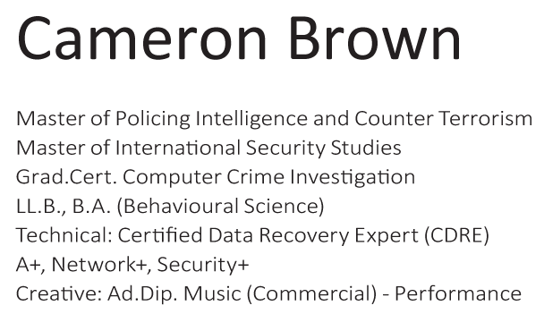
3rd International Conference on Forensic Research & Technology, October 06-08, 2014, San Antonio, USA
3th International Conference on Forensic Research & Technology, October 6-8, 2014
Pursuing the root causes of crime will never cease because our understanding of the origins of criminality will have to be continuously revised as society evolves and technology marches forward.
CAMERON BROWN - Cybercrime, Criminal Justice and the Funnel Effect: Challenges for Investigators, Prosecutors, and Criminal Justice Officers, 2014
CAMERON BROWN - Cybercrime, Criminal Justice and the Funnel Effect: Challenges for Investigators, Prosecutors, and Criminal Justice Officers, 2014
Notes:
*

Slide 38
3rd International Conference on Forensic Research & Technology, October 06-08, 2014, San Antonio, USA
3th International Conference on Forensic Research & Technology, October 6-8, 2014
Let Us Meet Again
We welcome you all to our future conferences of OMICS Group International
Please Visit: www.omicsgroup.com
www.conferenceseries.com
CAMERON BROWN - Cybercrime, Criminal Justice and the Funnel Effect: Challenges for Investigators, Prosecutors, and Criminal Justice Officers, 2014
CAMERON BROWN - Cybercrime, Criminal Justice and the Funnel Effect: Challenges for Investigators, Prosecutors, and Criminal Justice Officers, 2014
Notes:
*

