Slide 1
The Future of Health Information Systems
HITC2014 Keynote
C. Peter Waegemann
Thought leader, Visionary, HIT Expert
Past Chair, mHealth Initiative
Past Chair, ANSI HISB (National Standards Coordination)
Past CEO, Medical Records Institute
Cited as one of the 20 selected people “who make US healthcare better” (HealthLeader magazine)
… and Healthcare

Slide 2
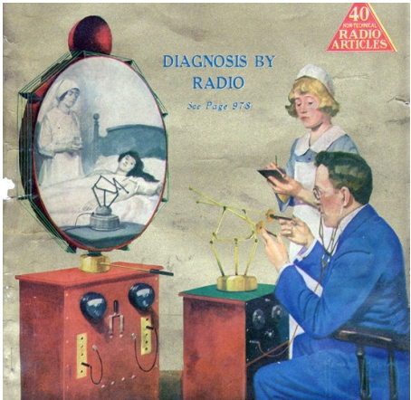
Forecasting the Future in HITC: The vision may be right but the technologies change. Will it take another 100 years to realize how healthcare must change in the digital society?
How Telemedicine was envisioned 100 years ago
© C. Peter Waegemann

Slide 3
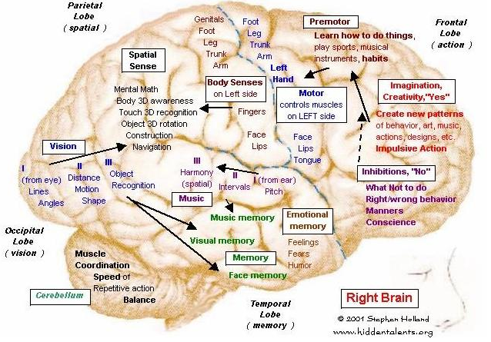
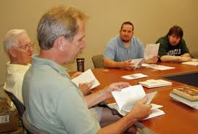
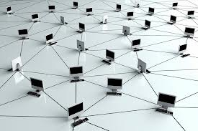
We live through an historic intersection: The Emerging Digital Society
Wealth of knowledge changes communication and social behavior
Economy
Banking
Education
Science
Knowledge is not brain-centric anymore. Knowledge is system-centric.
This means that no doctor can rely on what (s)he learned decades ago. The quality of care depends how your doctor manages the information system.
© C. Peter Waegemann

Slide 4
What Does This Mean For Healthcare?
Internet
New digital devices and apps will improve decision making
Patients will be researching health issues the same way as consumers research product/service information
Digital Communication with patients and colleagues
New apps will replace the doctor’s intuition
Physician’ skills will depend increasingly on their way to research/manage information/communicate
Quality of care will be more closely monitored
Communication
New Software
© C. Peter Waegemann

Slide 5
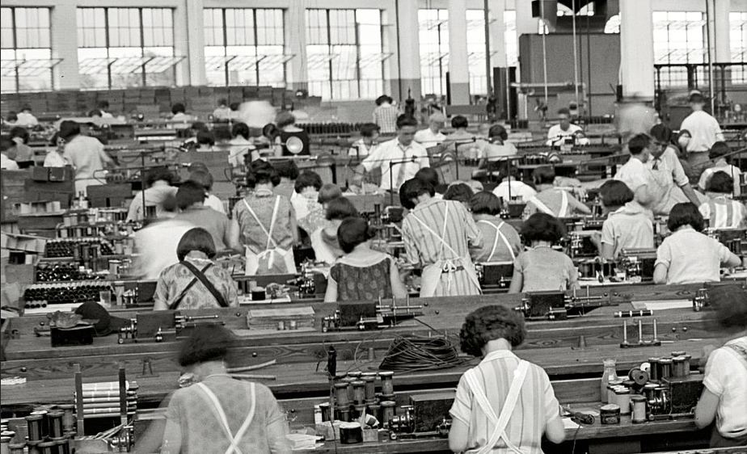
Automation Will Reach Healthcare
Factories will be run by machines
Very few people will be needed in offices
In Healthcare:
Patients will check themselves from home into hospitals
Robots do more and more surgery
Apps will guide the care process
Many healthcare tasks will be automated
Patient identification, interoperability, and privacy will finally be solved
© C. Peter Waegemann

Slide 6
21st Century Medicine
Nanotechnologie
Medical Devices
BioTech
Genetics
Neuromodulation
Electric underwear to fight bed sores
Personalized Medications
I Immune system improvement with articial lymph nodes
Anti-Bleeding Gel
Magnetic Levitation
Speech restorer
HITC
Artificial Cell Mimicry
Artificial Brain Cell Creation
Artificial nerve generator
Muscle stimulator
Pollen vaccines
Smart pill
Cancer spit test
Printed bones and other body parts
Decay-fighting microbes
Smart contact lens
Human powered equipment
Asthma sensors
Absorbable heart stent
DNA building block developments
Artificial self-powered limbs
Liver scanner
Stabilizing insoles to avoid falls

Slide 7
The Promise of HITC
HITC will be at the center of the health delivery service
Communication
Cost reduction
Patient participation
Connected Health
End to clinical silos!
Personalized Health
Participatory Health
Non-episodic Health: Continuous Health (24x7) Observations of Daily Living
Financially responsible healthcare
Coordinated Healthcare
Healthcare beyond the Doctor’s knowledge
New doctors’ roles: Advisors, concierge medicine, etc.
All these concepts have been in the works for some time. It is time to include all of them in a new approach.
© C. Peter Waegemann

Slide 8
Healthcare Systems Changes
Patients must become active participants in the healthcare process through digital technologies
Clinical and Financial Transparency: Transparent clinical processes and reduction of costs
The examination and care process are moving to the ”virtual care space” between patient’s home, doctors’ offices, hospitals and clinics, as well as other fitness and health providers
The collective expertise of care and wellness providers must be brought to the care process
A system based on episodic or periodic evaluation must migrate to one that provides continuous assessment
© C. Peter Waegemann

Slide 9
HITC-driven Healthcare
Approx. 90% of treatment activity takes place during the encounter
Approx. 10% of treatment activities takes place during the encounter
Provider-centric
activities
Orchestrated healthcare: Every professional involved in a person’s health is playing a part just like every musician in an orchestra

Slide 10
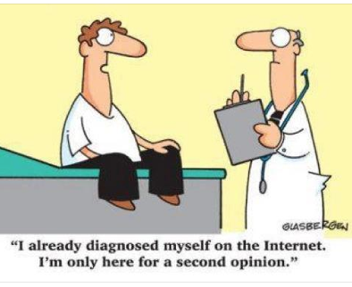
Medical Knowledge
Over 70% of patients are getting clinical advice from the Internet
But the system should tell the provider what the patient learned on the Internet and from whom
The concept of patients advising each other has been very helpful and has great promise.
Shouldn’t the patient be able to ask the doctor by email or text message? Or better: in a secure app?
© C. Peter Waegemann

Slide 11
What is needed for E-care Systems?
20
Algorithm Apps for diagnostic decision support: Holographic Input-home diagnostics-augmented reality-personal genomics-concept-based digital diagnostics
AI-based Diagnostic Support
Automatic financial systems: Real-time financial transactions-cost estimates for providers and patients –”all-digital communication”
15
Electronic Streamlined Financial Functionalities
5
mHealth: Medical Knowledge Apps
Increased use of medical apps – optimized app management
5
Digital Communication with Patients
Laws-Data Protection-Financial- Professional
?
Health and Fitness Cooperation
Interdisciplinary care -professional Issues
10
Better Systems Documentation
Solving the current documentation riddle
10
Electronic Streamlined Administrative Functionalities
Online: appointments – registration - referrals and orders – administrative management tasks
© C. Peter Waegemann
00
= expected number of years until mainstream use may be achieved

Slide 12
Dictation
Transcription
Coding
Indexing
Sorting
Health Data Management
Correct
Dictation
SR/CLP
Coding
Easy
Direct Input
System Check
Coding
App Capture
System Check
Coding
Transfer
System Check
Coding
Proper Healthcare Documentation
Information Capture
Information Management
Goal: Change from storytelling to future automatic functional documentation
Documentation is the bottleneck of the healthcare process costing billions of dollars and causing many errors. Solving this problem will be the key to future HITC.
Sorting, assembling, indexing, fact checking, dispersing data and solving discrepancies (particularly in coding).
VERY DIFFERENT FROM CURRENT HIM
Automatic fact checking

Slide 13
Hurdles
Professional and Legal
Patients
Technologies/Systems
Telemedicine Laws
Privacy Laws
Financial Changes
Customs and Habits
Financial Crisis
Documentation Issues
Patient Motivation and Education
Gamification of Health
User friendliness
Interoperability
New systems for providers with better functionalities and easier use
From EHR systems and MU to e-care functionalities
Open Digital Systems

Slide 14
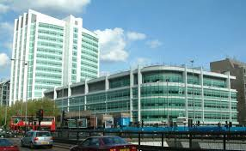
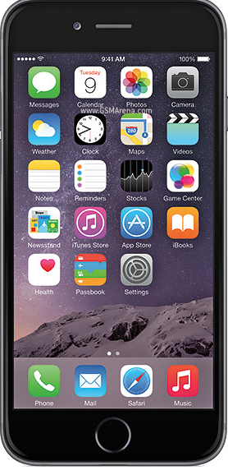
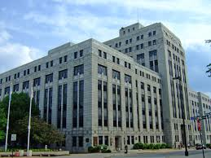
Patient’s complete health history
Medication history and communication with several pharmacy options
Hospital/Clinic
Appointment management and home check-in
Communication with hospitals and clinics
All communication in secure app mode:
No X12, HL7 or other outdated standards
Preferred Health Info Resources
Payer/Insurance
Apps:
Capturing patient data at home
Fitness and wellness (integrated)
Provider Management
Patient Identification, complete PHR and many other applications
Virtual visit app

Slide 15
This means:
Communication
ID
EHR
PHR
No standards work on
patient ID systems
as the device will be the ID with biometric Identification
New EHR strategies should replace Exististing EHRs
MU goals must be adjusted to the new infrastructure of discrete data and the new data ecosystem
New strategy:
HIEs
(less centralized communication hubs such as
RHIOs, etc.)
Reduction of outdated messaging standards.
The PHR must be integrated into the data ecosystem of a patient’s information base – note: a turn from previous efforts

Slide 16
The revolution of HITC
HIS/Hospital and legacy systems have to be adjusted or replaced
Existing standards organizations from the 20th century do not fit well into this picture
Small companies and developers have to be integrated (think of 12 million Apple developers, for instance)
When this infrastructure is in place, there is lots of room for additional functionalities (apps)

Slide 17
In summary
Such a system could be implemented today
But in the US, legislation and stakeholder interests will make the transition difficult
It is likely that other countries will first reap the benefits of the HIT system of the future

Slide 18
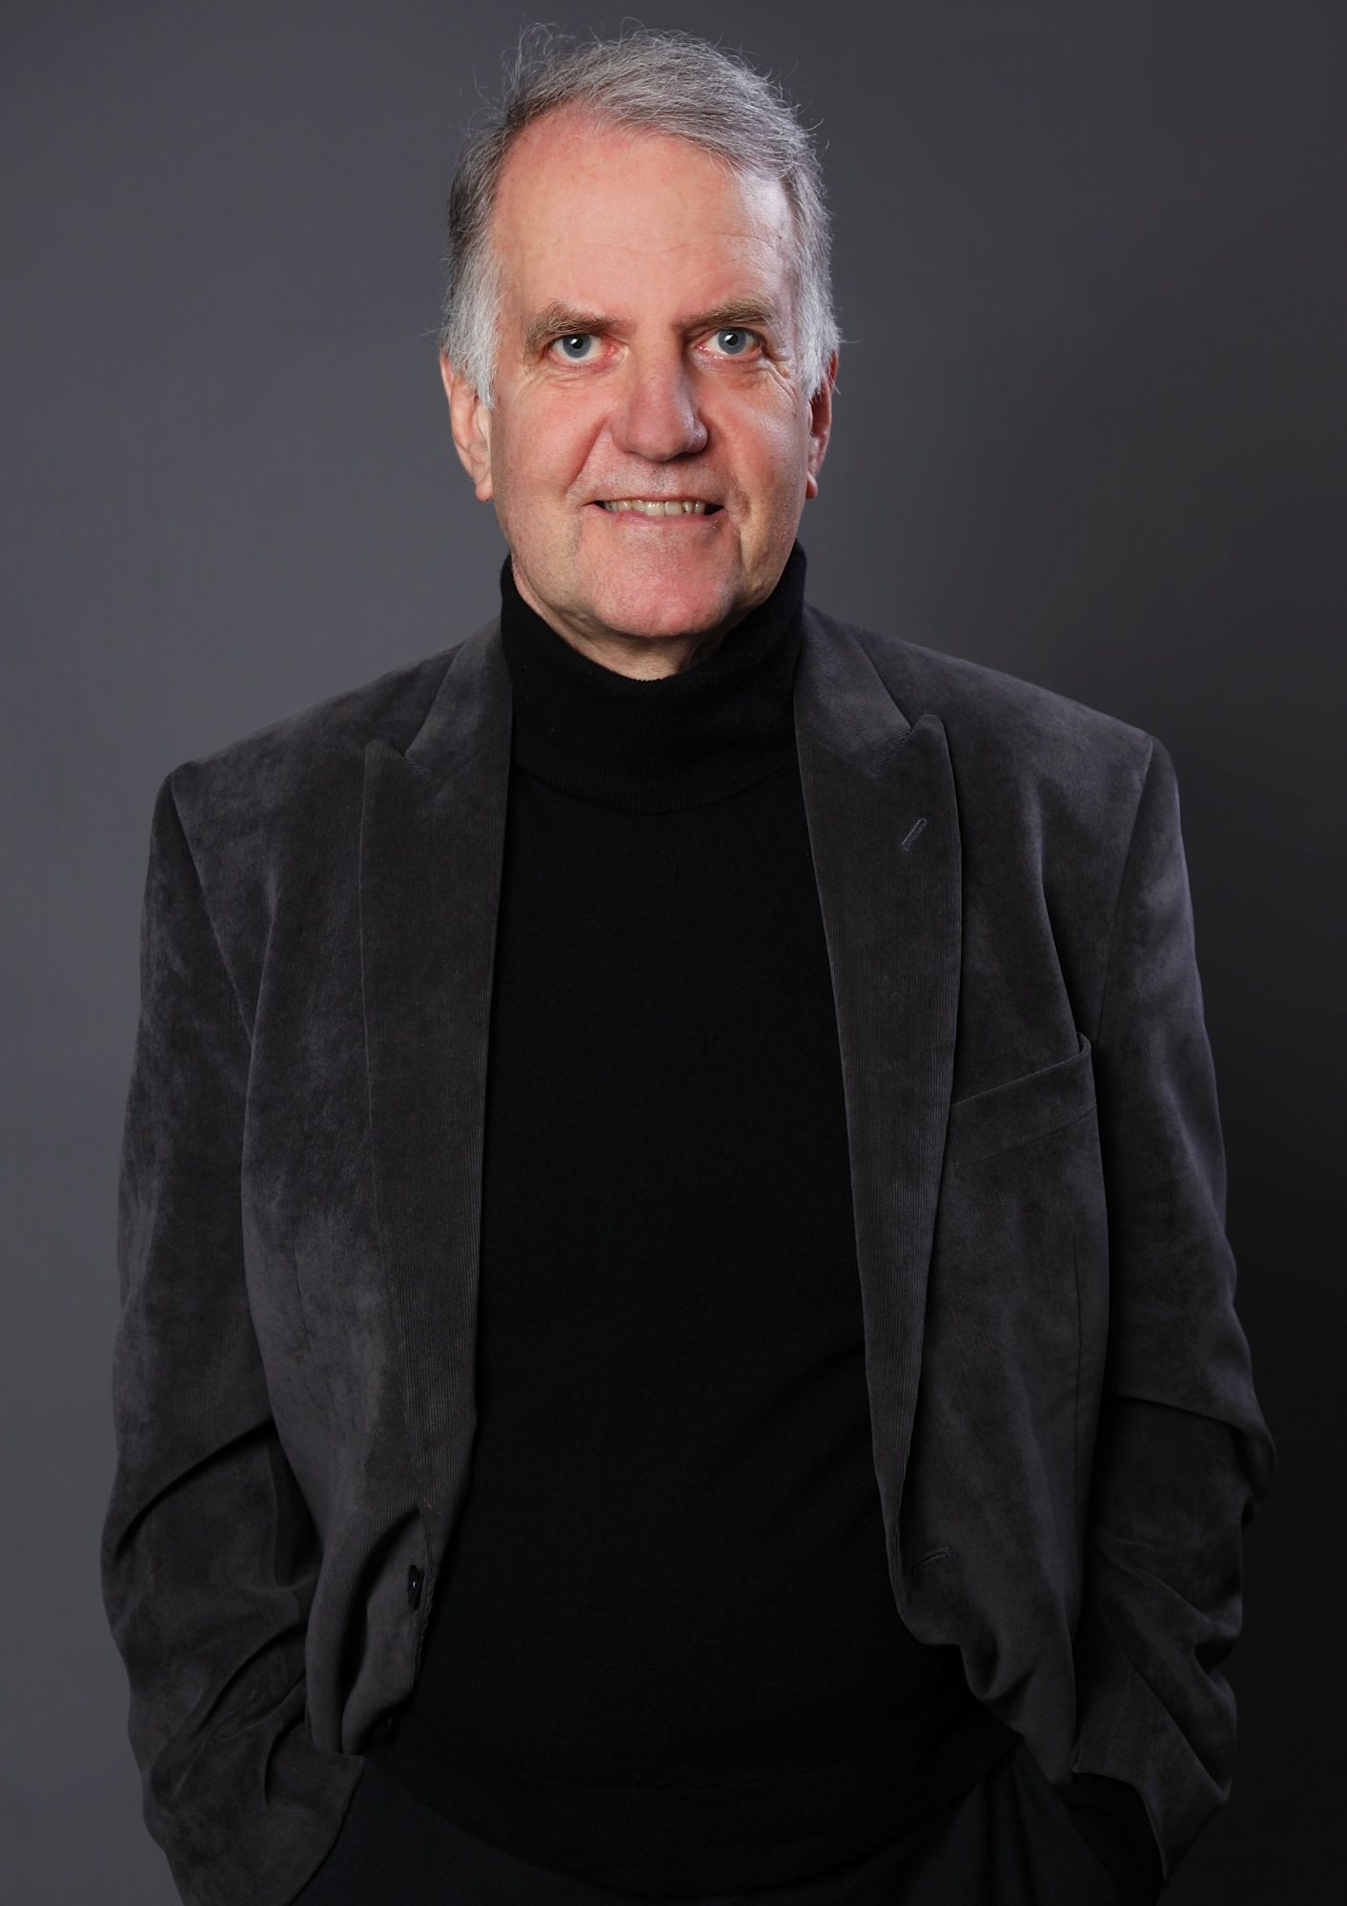
Thank You!
I can be reached at pwaegemann@gmail.com
“I predicted such systems 15 years ago. It is good to see the emergence of some systems. I have great hope for the next couple of years!”
My latest book is available from Amazon as paper book or eBook

