Slide 1

GaAs band gap engineering by colloidal PbS quantum dots
Bruno Ullrich
Instituto de Ciencias Físicas, Universidad Nacional Autónoma de México, Cuernavaca, Morelos C.P. 62210, Mexico

Slide 2
Acknowledgements
Joanna Wang (WPAFB)
Akhilesh Singh (UNAM)
Puspendu Barik (UNAM)
DGAPA-UNAM PAPIIT project TB100213-RR170213 (PI Bruno Ullrich)

Slide 3
Motivation
Work in 2009 showed that PbS quantum dots (QDs) notably alter the emission of GaAs
Tailored photonic applications?
Ullrich et al., J. Appl. Phys. 108, 013525 (2010)

Slide 4
Presentation’s outline
Essentially, two points will be covered:
a) Optical properties of colloidal PbS QDs on GaAs
b) Absorption edge engineering of GaAs with PbS QDs

Slide 5
Sample preparation
Oleic acid capped PbS QDs are dispersed on GaAs either by a supercritical CO₂ method*⁾ or by spin coating.
*⁾Wang et al., Mat. Chem. Phys. 141, 195 (2013).

Slide 6
Why PbS, why GaAs?
PbS possesses a large Bohr radius (∼20 nm). Emission covers the attractive range for optical fibers
GaAs is “fast” and meanwhile a main player in optoelectronics

Slide 7
SEM image of a typical sample
Particle size:
2.0±0.4 nm
20 nm

Slide 8
We are dealing with a size-hybrid
Sample can be considered – to a certain extend – as free standing (regularly arranged) energy confinement potentials with similarities to superlattices.
Indeed, electronic states of the QDs are coupled via tunneling.

Slide 9
Photoluminescence

Slide 10
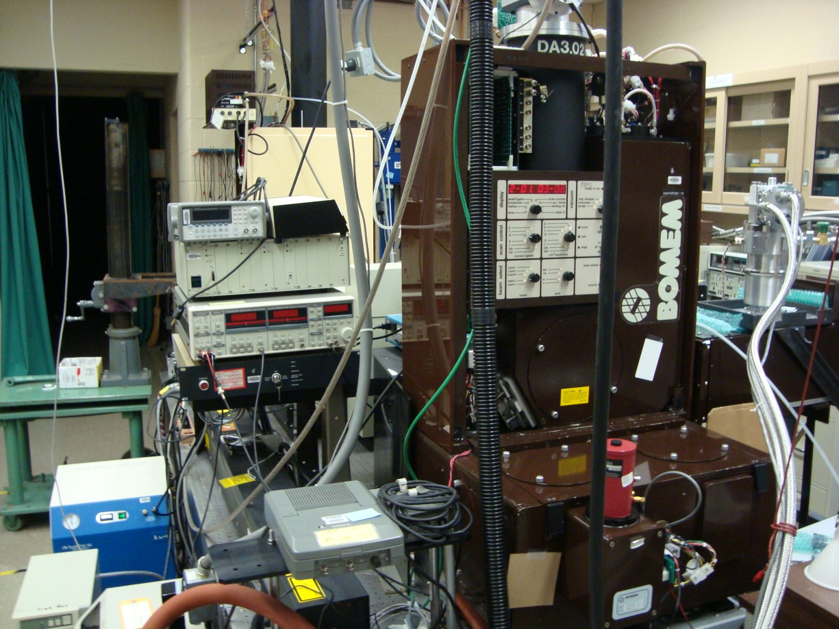
Experimental setup

Slide 11
Photo-doping

Slide 12
Burstein-Moss effect
Doping by excited charge carriers increases the QD band gap
Generation of at least one electron-hole pair per QD
Reversible band gap alteration proportional to I_{ex}^{2/3}
Ullrich et al., J. Appl. Phys. 115, 233503 (2014)

Slide 13
Transmittance

Slide 14
Absorption edge manipulation

Slide 15
Slope of the edge

Slide 16
Band gap shift

Slide 17
?Reasons?
Charge transfer (Urbach tail alteration)
Superposition of absorption spectra
Interfacial impurities
Vibronic mode manipulation
Influence of preparation method and doping of the substrate (currently ongoing studies)
Change of reflectance

Slide 18
Conclusion and future
QDs alter the optical properties of the host
Concentration on the emission properties for technological applications (emission from the interface?)
Possible influence of the QD size on the optical properties of the host
Formation of opto-electronically active junctions

Slide 19
Thank you! bruno@fis.unam.mx

