Slide 1
An intraosseous blood transfusion in a critically ill child African Journal of Emergency Medicine (2014) 4, 83–85
E. Chansa, Mpongwe District Health Office, Mpongwe, Copperbelt, Zambia,
Hansen K, Department of Infectious Diseases, Skane University Hospital, Malmo¨, Sweden,
Gustafsson B, Astrid Lindgren Children’s Hospital and Karolinska University Hospital-Huddinge, Department of Clinical Science, Intervention and Technology, CLINTEC, Karolinska Institutet, Stockholm

Slide 2
………intraosseous infusions
Safe and simple method to administer fluid in an emergency situation
Gains rapid vascular access in a critically ill child.
Fluids and drugs can be infused as well as
Blood boluses, but very few cases describe the infusion of blood products.

Slide 3
Case report
A successful transfusion of fluid and blood by IO
31 months old child, suffered severe epistaxis for 12 hours.
The child was unconscious at time of admission
The hemoglobin (Hb) level was measured to 3.6g/dl.
Through an IO in the proximal tibia, 300 ml of fluid was first infused,
Followed by 200 ml of blood.

Slide 4
…………….case report
The child was playing and drinking fluid 3 hours after the blood transfusion was stopped
The child was supplied with folic acid and iron supplements
3 days later the Hb was 6.0 g/dl
3 months later the Hb was 9.4 g/dl.

Slide 5
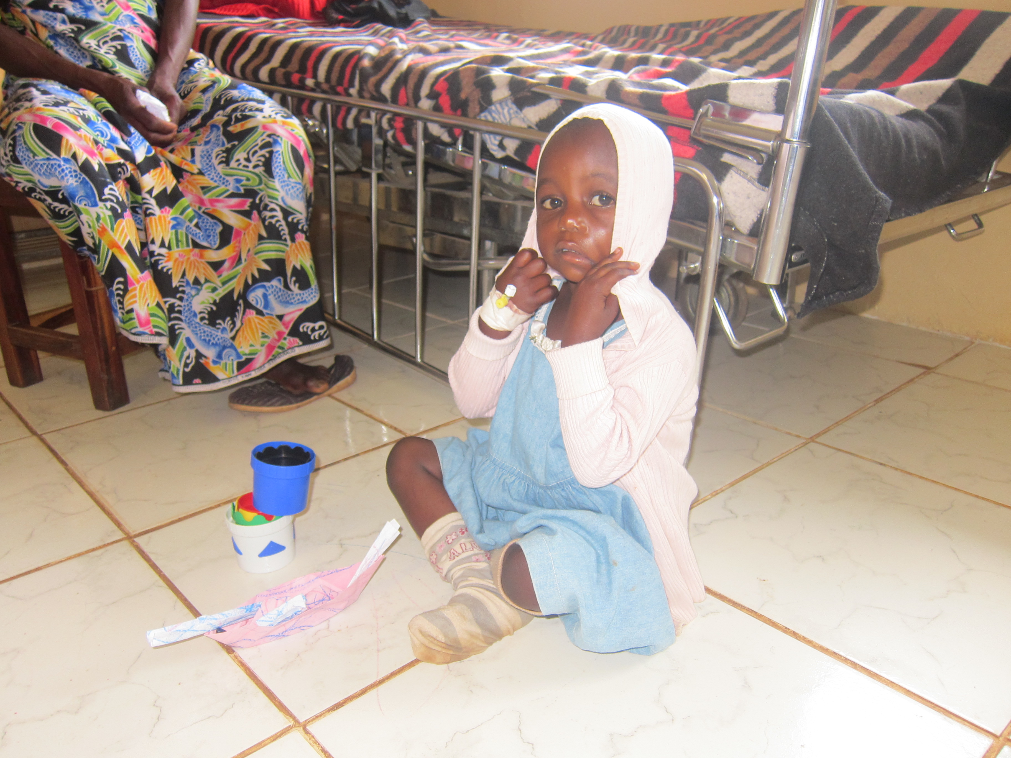

Slide 6
History
Widely used in World War II and then re-emerged as an option for fluid and drug resuscitation
Critically ill child in the 1980’s, following the famous editorial by JP Orlowski “My kingdom for an intravenous line”

Slide 7
……..intraosseous transfusions
The most common site used in children is the anteromedial surface of the proximal tibia.
The technique of insertion can easily be taught.
The goal is to remove the IO needle within 3-4 hours, but as soon as an iv access is established it should be removed.
The risk of infection increases after 72-96 hours .

Slide 8
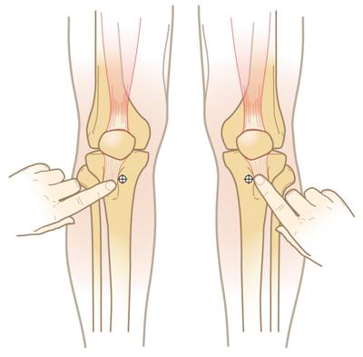
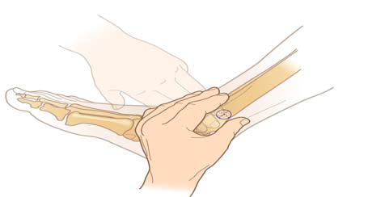
Where to make your puncture

Slide 9
The bone marrow consists of a network of vessels
Empties into a central vein, functions as a non-collapsible vein during hypovolemia or shock.
Any intravenous fluid, blood products or routine resuscitation drugs can be administered through the IO route.
Complications for short term use are scarce

Slide 10
The bone marrow consists of a network of vessels

Slide 11
Complications
Extravasation of fluid, avoid too much movement during insertion: hold the leg straight throughout the procedure.
Bone marrow and fat emboli in the venous circulation and the lungs due to the open blood vessels in the medullary cavity, have been described, but no pediatric cases reported .
Intravascular gas after intraosseous infusion was observed in a 4-month-old boy who died from Sudden Infant Death Syndrome (SIDS); this complication can be avoided by ensuring that intraosseous needles are never disconnected.
Compartment syndrome:use proper technique, ensuring the needle remains in the marrow and does not pass through the other cortex as well as only making one attempt at insertion per bone.

Slide 12
………complications
Extravasation of hypertonic or specific medications can result in necrosis of the muscle.
Infection and osteomyelitis, rare complications but can occur if an aseptic technique is not followed during insertion.
Injuries to the growth plate is a possible complication correlated with incorrect placement of the needle.

Slide 13
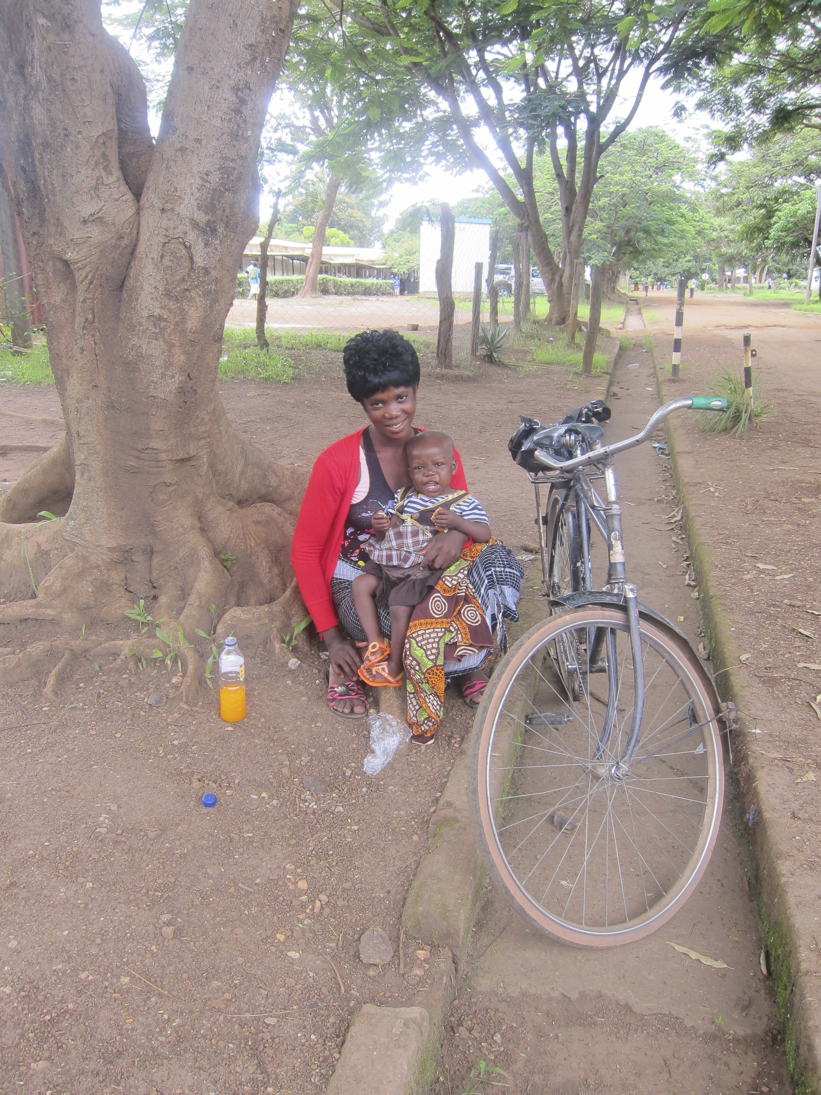
Transports and communication……
In situations where

Slide 14
Conclusion
Our patient was admitted unconscious to the Mission hospital, where the cannulation of both a peripheral and central vein failed due to vascular circulation collapse.
The primary infusion of Ringer lactate stabilized the circulation, but there was still no possibility to infuse the blood through the veins.
Intraosseous blood transfusion was the only option in this very urgent situation.
We conclude that performing an intraosseous blood transfusion should be the immediate intervention in a life-threatening situation

Slide 15
Thank you for your attention!

