Slide 1
The management of violence and aggression against staff in mental health work: responding effectively through a co-production approach to issues for service users, carers, staff and agencies
Prof Brian Littlechild
University of Hertfordshire
b.littlechild@herts.ac.uk

Slide 2
The management of violence and aggression against staff in mental health work
KEY ISSUES:
Level of co-production
360 degrees
Patient’s involvement in own treatment and policies- for example, Critical Incident Analysis/own case records/plans
Restorative approaches
External input/good governance
All health and care services, not just mental health

Slide 3
The management of violence and aggression against staff in mental health work
New 2015 National Institute for Health and Care Excellence (NICE) Guideline ‘Violence and Aggression: The short-term management of violent and physically threatening behaviour in mental health, health and community settings’ https://www.nice.org.uk/guidance/ng10
Key Features of the Guideline:
Consequences of violence from mental health patients on workers, clients/patients themselves, and others in their formal and informal networks
Addresses how we might respond most positively to workers and patients/service users before, during and after such incidents.

Slide 4
Implementing the New NICE Guideline in practice
Inpatient psychiatric care
Emergency and urgent care, secondary mental health care (such as care provided by assertive community teams, community mental health teams)
Community healthcare, primary care, social care and care provided in people’s homes

Slide 5
Implementing the New NICE Guideline in practice
Definition:
Violence and aggression:
“a range of behaviours or actions that can result in harm, hurt or injury to another person, regardless of whether the violence or aggression is physically or verbally expressed, physical harm is sustained or the intention is clear”.

Slide 6
Implementing the New NICE Guideline in practice
Effects:
Holmes et al (2012:3)- the consequences of workplace violence in the health care sector are far–reaching: including absenteeism, injury, high staff turnover, lower quality of service, and decreased satisfaction at work.
Costs to agency…….
Holmes D. Rudge, T. and Peron, A. (eds) (2012) Rethinking violence in health care settings, Ashgate, Farnham

Slide 7
Implementing the New NICE Guideline in practice
Emotional and physical effects- effects on staff professional and/or personal life, effects on subsequent work
In addition, the patient and the patient’s network, e.g. partners, family members or the wider patient/service user group may be negatively affected (Holmes et al., 2012)

Slide 8
Implementing the New NICE Guideline in practice
Harris and Leather (2012) found in their research that as exposure to service user violence increases, so does
reporting of stress symptoms
reduction of job satisfaction
fear as a consequence of exposure to such behaviour.
Harris, B, and Leather, P. 2012. Levels and Consequences of Exposure to Service user violence: Evidence from sample of UK Social Care staff, British Journal of Social 42, 851-869

Slide 9
Implementing the New NICE Guideline in practice
Extent:
Violence and aggression are relatively common and serious occurrences in health and social care settings.
Between 2013 and 2014 there were 68,683 assaults reported against NHS staff in England: 69% of population in mental health or learning disability settings, 27% in ambulance staff, 25% involving primary care staff and 26% involving acute hospital staff.

Slide 10
Implementing the New NICE Guideline in practice
Mental health settings
Violence and aggression in mental health settings occur most frequently in inpatient psychiatric units and most acute hospital assaults take place in emergency departments.
Less well-researched in primary and community settings- but deaths of 8 social workers since 1978 in community settings
Isolation a key issue in community based work

Slide 11
Implementing the New NICE Guideline in practice
Health and social care provider organisations should have up-to-date policies on the management of violence and aggression for people with mental health problems, and on lone working, in community and primary care settings.

Slide 12
Implementing the New NICE Guideline in practice
Causes:
Personality characteristics
Intense mental distress
Attitudes and behaviours of surrounding staff and service users
The physical setting
Restrictions that limit the service user's freedom- in community, service user experience of power/control of staff/agency

Slide 13
The management of violence and aggression against staff in mental health work
Risks -audit-
Where? Who? When? Why? How?
Isolation
General Practitioners/Health Visitors/Community Psychiatric Nurses
Mental health /drug misuse co-occurrence
Dementia
Poor recording of risk assessments-need know previous behaviour in similar circumstances

Slide 14
The management of violence and aggression against staff in mental health work
Responses:
Prospective Hazard Analysis/Safer Systems Analysis
Ban?/Prosecute?
Restorative approaches/mediation
SafeWards- http://www.mentalhealthforum.org.uk/uploads/file/Len%20Bowers%20-%20Safewards%20final%20results%20force%20free%20futures.pdf

Slide 15
Implementing the New NICE Guideline in practice
Ensure physical restraint should used as a last resort only
Other restrictive/invasive interventions- include observation, seclusion, manual restraint, mechanical restraint and rapid tranquillisation-least restrictive alternatives?
Primary care settings?

Slide 16
Implementing the New NICE Guideline in practice
De-escalation and Prevention the Priority:
De-escalation The use of techniques (including verbal and non-verbal communication skills) aimed at defusing anger and averting aggression.
P.r.n -as the situation arises- medication can be used as part of a de-escalation strategy but p.r.n medication used alone is not de-escalation.

Slide 17
Implementing the New NICE Guideline in practice
‘Positive engagement: An intervention that aims to empower service users to actively participate in their care. Rather than ‘having things done to’ them, service users negotiate the level of engagement that will be most therapeutic.’

Slide 18
Implementing the New NICE Guideline in practice
Health and social care provider organisations should consider training staff in avoiding violence, including:
Anticipation
Prevention
De-escalation and breakaway techniques

Slide 19
Implementing the New NICE Guideline in practice
Multiple studies confirm that services can reduce the frequency and level of restrictiveness of their interventions without compromising staff safety. The root causes of the problematic cultures that can develop within mental health settings can be identified and addressed
(Paterson B., McIntosh I.,Wilkinson D., McComish S. and Smith I. (2013) Corrupted cultures in mental health inpatient settings. Is restraint reduction the answer? Journal of Psychiatric and Mental Health Nursing. 20(3):228-35)

Slide 20
Implementing the New NICE Guideline in practice
A number of complex interventions have now been tested and disseminated that have delivered such reduction.
(National Registry of Evidenced-Based Programs and Practices. (2012). Six Core Strategies to prevent conflict and violence: Reducing the use of seclusion and restraint. National Association of State Mental Health Program/
Bowers L. et al. (2015) Reducing conflict and containment rates on acute psychiatric wards: The Safewards cluster randomised controlled trial. International Journal of Nursing Studies 52(9),1412-1422)

Slide 21
Implementing the New NICE Guideline in practice
Professor Tim Kendall, Director of the National Collaborating Centre for Mental Health:
“We now want to see a culture of tolerance towards people with mental health problems, helping health and social care professionals to de-escalate difficult situations and help service users get the support they need when circumstances in the health service can make things worse.

Slide 22
Implementing the New NICE Guideline in practice
..We also want to develop a culture of learning, such that service users and professionals together can review every time we restrain or restrict a person’s freedom; and give as much attention to human rights as we do to safety. …a major step forward for people with mental health problems, especially in institutional settings, but also in the community and across health and social care.”

Slide 23
Implementing the New NICE Guideline in practice
De-escalation: Staff training
Recognise the early signs of agitation, irritation, anger and aggression
Understand the likely causes of aggression or violence, both generally and for each service user
Recognise the importance of personal space
Respond to a service user’s anger in an appropriate, measured and reasonable way, and avoid provocation.

Slide 24
Implementing the New NICE Guideline in practice
Use a wide range of verbal and non-verbal skills and interactional techniques to avoid or manage known 'flashpoint' situations

Slide 25
Implementing the New NICE Guideline in practice
Encourage service users to recognise their own triggers and early warning signs of violence and aggression and other vulnerabilities
Include this information in care plans and advance statements and give a copy to the service user.

Slide 26
Implementing the New NICE Guideline in practice
Involving service users in decision-making
‘Involve service users in all decisions about their care and treatment, and develop care/risk management plans jointly with them. If a service user is unable give opportunity to review and revise the plans as soon as able or willing (and involve their carer)’.

Slide 27
Implementing the New NICE Guideline in practice
Evaluate the physical and emotional impact on everyone involved, including witnesses; help service users and staff to identify what led to the incident and what could have been done differently (joint critical incident analysis, for example).
The learning organisation

Slide 28
Implementing the New NICE Guideline in practice
In looking at how we move towards co-production from just taking into account the views of service users about their services, we can make use of Arnstein’s ladder of participation (Arnstein, 1969).

Slide 29
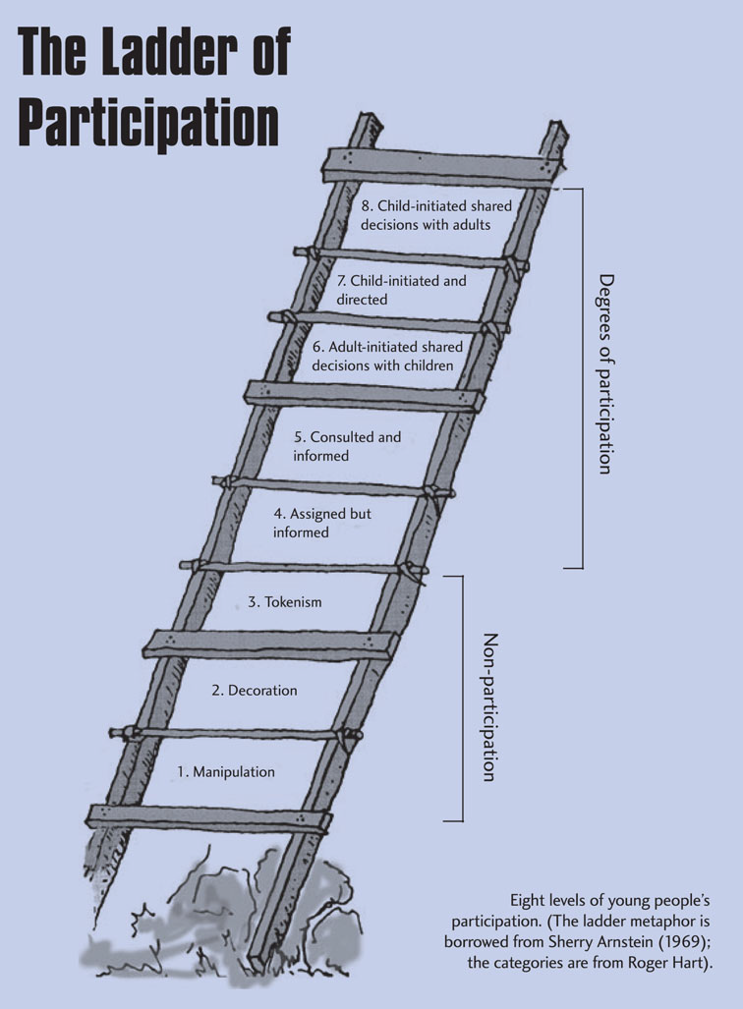

Slide 30
Implementing the New NICE Guideline in practice
Research study into risk assessment tools used within NHS Mental Health Trusts in England - wide variability in the content of such tools: service users and/or carers were not involved in their risk assessments and plans.
Littlechild, B. and Hawley, C. “Risk assessments for mental health service users: Ethical, valid and reliable?”, Journal of Social Work, first published online on August 4, 2009 as doi: 10.1177/1468017309342191, then in print April 2010, 10(2) 211-229

Slide 31
Implementing the New NICE Guideline in practice
Safer systems approach/human factors (Health Foundation funded project in closing the gap programme in UK)
Local project in UK on service user led critical incident analysis- to include all perspectives at all levels

Slide 32
Implementing the New NICE Guideline in practice
Level of co-production
360 degrees
Patients involved in their own risk assessments and records
Restorative Justice/Mediation
External input

Slide 33
THANK YOU FOR YOUR ATTENTION
Prof Brian Littlechild
University of Hertfordshire
b.littlechild@herts.ac.uk

