Slide 2

C3 component deposition on Salmonella O48 cells characterized by sialylated lipopolysaccharide
and different pattern of outer membrane proteins
Bożena Futoma-Kołoch Ph.D
Department of Microbiology
Institute of Genetics and Microbiology
University of Wrocław
POLAND

Slide 3
Introduction
Mechanisms employed by pathogens to evade host immunological defenses are not entirely understood
No direct correlation between the C3 protein deposition pattern and bacterial resistance has been observed
This is the first analysis of C3 activation on Salmonella isolates belonging to the O48 serogroup and their surface antigens: sialylated lipopolysaccharide (LPS) and outer membrane proteins (OMPs)
Sialylated LPS of other bacteria is described in the context of molecular mimicry connected to the onset of autoimmunity in humans. Sialylation enhances ability to bind human factor H
The mechanisms of OMPs-mediated complement activation are currently intensively investigated, because of principal antigen vaccine potential

Slide 4
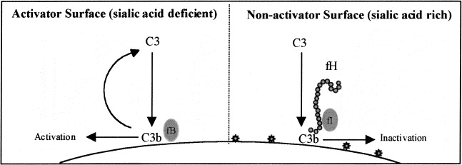
Introduction
WHY SALMONELLA?
Salmonella infections are among the most common food-borne infections affecting humans in the European Union
Elderly and otherwise weak patients are more prone to developing severe blood infection
Post-infectious complications, such as reactive joint inflammation occur in about 10% of the cases
(European Centre for Disease Prevention and Control)
WHY SALMONELLA OF SEROTYPE O48 ?
Salmonella O48 is the only group possessing sialylated LPS among all known Salmonella bacteria

Slide 5
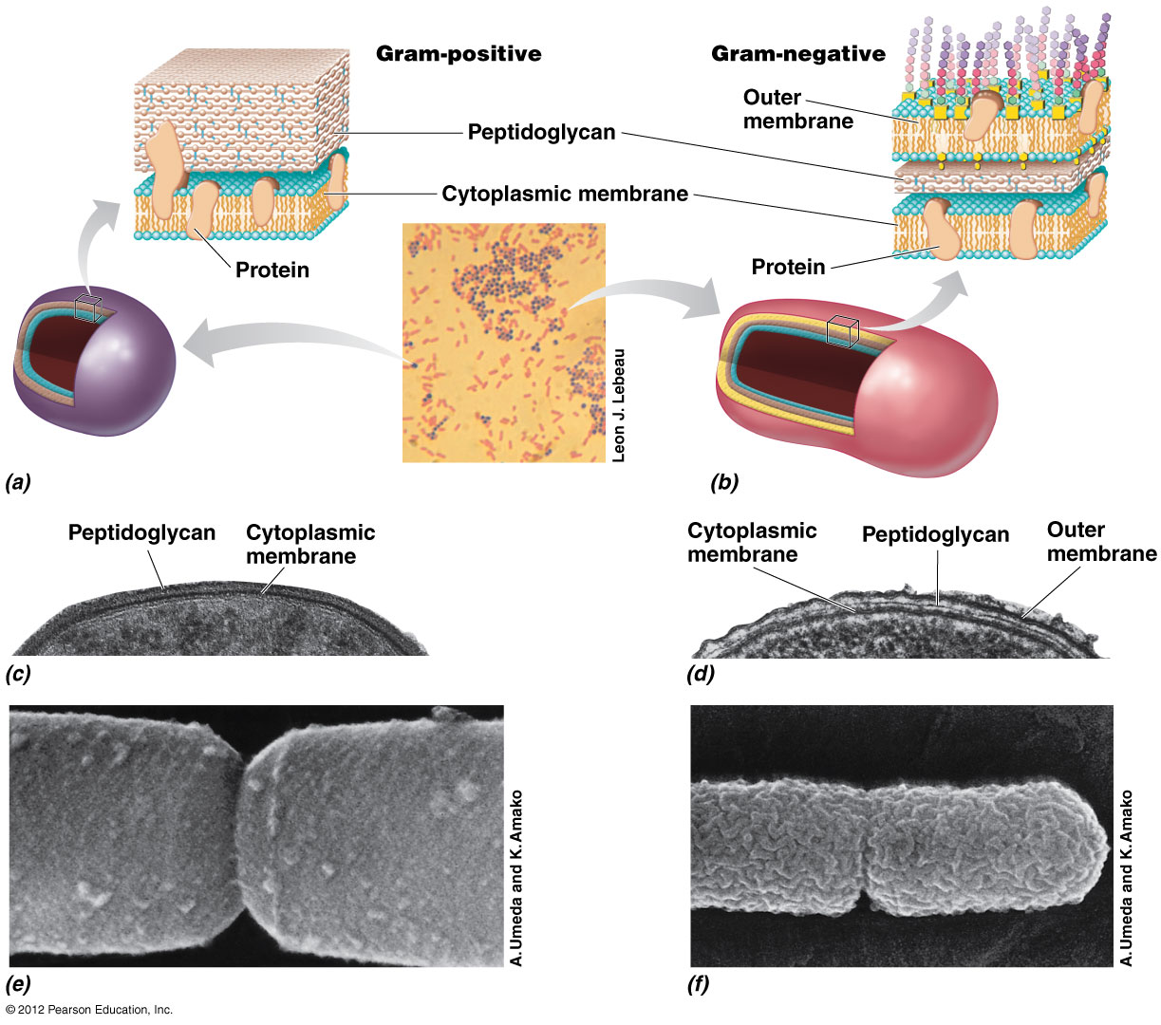
Introduction: characterization of Salmonella O48 LPS and OMPs
No protection against alternative pathway activation
58, 45, 42 kDa
58, 46, 42, 23, 22, 20 kDa
Brock Biology of Microorganisms, 13th Edition, Pearson
60, 48, 45 kDa
Futoma-Kołoch B. Bacterial outer membrane proteins - dependent complement activation. J Mol Immunol (2016) 1:1
Futoma-Kołoch B. Immune response against bacterial lipopolysaccharide. J Mol Immunol (2016) 1:1
Futoma‐Kołoch et al. Presumable role of outer membrane proteins of Salmonella containing sialylated lipopolysaccharides serovar Ngozi, sv. Isaszeg and subspecies arizonae in determining susceptibility to human serum. Gut Pathog (2015) 7:18.
Futoma-Kołoch B. et al. Searching for outer membrane proteins typical of serum-sensitive and serum-resistant phenotypes of Salmonella. InTech, Croatia, Ch 14, 265-290

Slide 6
Materials and methods
nonimmune HS was taken from 20 healthy donors in Regional Centre of Transfusion Medicine and Blood Bank the name of Prof. T. Dorobisz in Wrocław, Poland. It was conducted according to the principles expressed in the Declaration of Helsinki.
was estimated with radial immunodiffusion method using specific antibodies (The Binding Site, UK).
Enzyme-linked immunosorbent assay for bacterial cells was carried out by indirect ELISA according to Alberti et al. (1996). Complement C3 activation assay for LPS was performed by indirect sandwich ELISA (Holmskov-Nielsen, 1986).
was performed according to Doroszkiewicz (1997).The number of colony-forming units (CFU/ml) at time 0 was taken as 100%. Strains with survival rates below 90% after 45 min of incubation were classified as serum sensitive.

Slide 7
Materials and methods
Isolation of lipopolysaccharides (LPSs) was performed with an LPS Extraction Kit according to the manufacturer’s instruction (Intron Biotechnology, Korea).
Isolation of outer membrane proteins (OMPs) was performed with the detergent Zwittergent Z 3–14 (Calbiochem, USA) according to Murphy and Bartos (1989).
OMPs quantifications were done with a bicinchoninic acid (BCA) Protein Assay Kit (Pierce, USA).
Data for the bactericidal activity of HS were analyzed using the ANOVA Kruskal–Wallis test. In the ELISA tests the ANOVA Friedman and Kendall rank correlation coefficient test was used (Statistica.pl v. 9.0, Statsoft, Kraków, Poland).
Electrophoresis of OMPs under reducing conditions (SDS-PAGE) by method of Laemmli (1970) and in native (nonreducing) conditions (BN-PAGE) according to Swamy et al. (2006). OMPs were transferred to PVDF membranes and immunoblotted to detect C3 fragments bound to OMPs.

Slide 8
Results: susceptibility of Salmonella strains to the antibacterial activity of human serum (HS)
*
*
*
Figure 1 Log-phase cultures of the bacteria (1 × 10⁵ CFU/ml) were incubated in 50% human serum (HS), in 50% heat inactivated serum (56°C for 30 min, HS-IN, control 1) or PBS (control 2) for 45 min. Serial dilutions were performed to calculate colony forming units (CFU/ml). The average number of colonies was estimated from three plates. The CFU/ml at time 0 was taken as 100%. Sensitivity to HS differs significantly if p values are less than 0.05 (*).

Slide 9
Results: C3 complement protein depositions on immobilized LPS
Sialic acid/Kdo# ratio (%) in LPS
239
200
<1
# 3-deoxy-D-manno-octulosonic acid
Similar level of C3 protein binding to Salmonella O48 LPSs
Figure 2 Sandwich ELISA. Microtiter plate wells coated for 2 h at 37°C with polyclonal rabbit anti-C3c diluted 1/500 in 0.1 M sodium carbonate buffer (pH 9.6). Mixtures of LPSs and 80% HS were incubated for 15 min at 37°C. Mixtures transferred into titration plates and incubated for 45 min at 37°C. C3c detection with polyclonal rabbit anti-C3c (Dako) antibodies diluted 1/2000 in 1% BSA in PBS (pH 7.4). Adding of polyclonal goat anti-rabbit immunoglobulins/HRP diluted 1/2000 in 1% BSA in PBS (incubation 1 h, 37°C). Reading: OPD substrate tablets, at 492 nm.

Slide 10
Results: C3 complement protein depositions on Salmonella cells
*
*
The highest C3 deposition rate was noted for Salmonella
sv. Isaszeg
Figure 3 Indirect ELISA. Bacterial cells in log-phase (1 × 10⁷ CFU/ml) were incubated in 50% HS, 50% HS-IN (control 1) or PBS (control 2) for 30 min at 37°C. The same antibodies as were in Sandwich ELISA. Activation of C3 differs significantly if the p values are less than 0.005 (*).

Slide 11
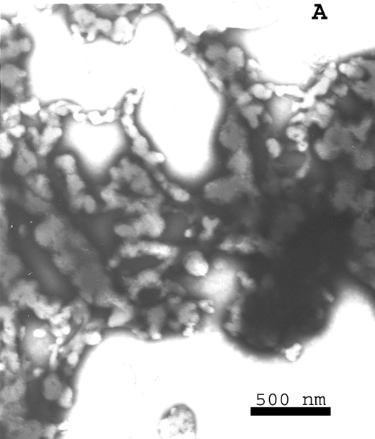
Results: immunoblot detection of C3c fragments on native (non-denaturated) OMPs
A
#
# Futoma-Kołoch B. et al. Searching for outer membrane proteins typical of serum-sensitive and serum-resistant phenotypes of Salmonella. InTech, Croatia, Ch 14, 265-290
OMPs interacted with C3 serum components but it was not possible to point out on bands
Figure 4 OMPs isolated with Zwittergent Z 3–14 detergent®. OMP patterns were determined by blue native polyacrylamide gel electrophoresis (BN-PAGE) and C3 binding confirmed by Western blotting. Electrotransfer conducted at 100 V for 1 h. Lane 1 molecular-weight marker 26625 (Thermo Scientific). The OMPs concentrations were 10 μg/well.

Slide 12
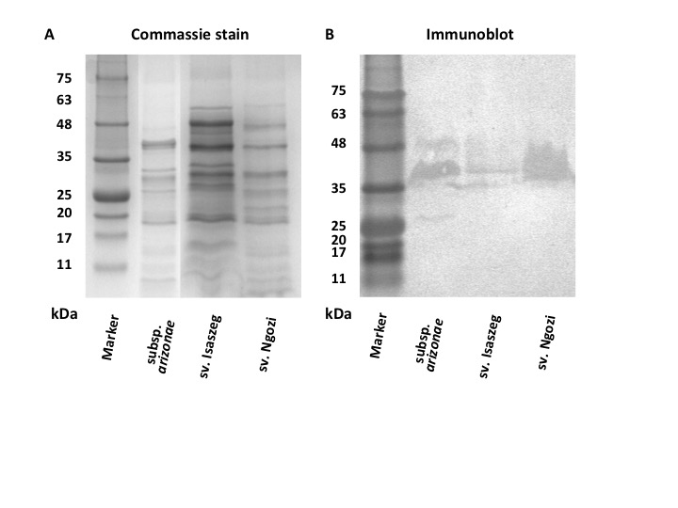
Results: immunoblot detection of C3c fragments on OMPs under reducing conditions
OMPs in the range of molecular masses of
35-48 kDa bound C3 fragments
58, 45, 42 kDa
45, 42 kDa
58, 46, 42, 23, 22, 20 kDa
46, 42 kDa
60, 48, 45 kDa
48, 45 kDa
Figure 5 Z 3–14 detergent® OMPs patterns were determined by sodium dodecyl suphate-polyacrylamide gel electrophoresis (SDS–PAGE) (10 μg/well) (A) and C3 binding confirmed by Western blotting, (20 μg/well) (B). Electrotransfer conducted at 50 V for 1 h. Lane 1 molecular-weight marker A8889 (AppliChem).

Slide 13
Results: detection of C3c fragments bound to Salmonella O48 cells using TEM microscopy
-
Figure 6 TEM micrographs of negatively stained Salmonella cells. Bacteria in different stages of growth were incubated in human serum (A, B) were labelled with polyclonal anti-human C3c complement antibodies (Dako, Denmark) and then with protein A- gold. Finally, the specimens stained with 2% aqueous uranyl acetate. The samples were examined under a Tesla BS 540 electron microscope. A: labelled cell during the division process, B: labelled and not labelled cells not divided, C: bacteria not cultured in serum (negative control). Bar indicates 500 nm (data not published).

Slide 14
Conclusions
I
No association between C3c deposition on the Salmonella O48 cells and their susceptibility to HS was found
II
C3 activation by LPS was not dependent on the amount of sialic acid in LPS
III
OMPs of molecular masses: 42, 45, 46, 48 kDa probably determine Salmonella O48 sensitivity to HS through C3 activation

Slide 15
Applications
Gram-negative bacteria with their potential to change the chemical structure of LPS may become distinct strains containing the unique surface antigens patterns. It may generate serious clinical problems of global interest to eliminate bacteria occurring systemic infections with current available drugs
LPS characterization supports the development of a new vaccine against non-typhoidal Salmonellae for Africa
Finding factors that control C components deposition on bacterial cells is the way to explain the sophisticated mechanism of bacteraemia leading to sepsis
The phenomenon of mimicry as a cause of autoimmune diseases is unknown. In the future, the premises like those presented may be helpful to construct antibacterial vaccines against autoimmune-connected infections

Slide 16
Acknowledgements
For co-authors of the main manuscript
“Presumable role of outer membrane proteins of Salmonella containing sialylated lipopolysaccharides serovar Ngozi, sv. Isaszeg and subspecies arizonae in determining susceptibility to human serum”.
Gut pathogens 7: 18 (2015)
Urszula Godlewska, Department of Microbiology, University of Wrocław, Poland
Katarzyna Guz-Regner, Department of Microbiology, University of Wrocław, Poland
Agata Dorotkiewicz-Jach, Department of Pathogens’ Biology and Immunology, University of Wrocław, Poland
Elżbieta Klausa, Regional Centre of Transfusion Medicine and Blood Bank, Wrocław, Poland
Jacek Rybka, Ludwik Hirszfeld Institute of Immunology and Experimental Therapy, Polish Academy of Sciences, Wrocław, Poland
Gabriela Bugla-Płoskońska, Chief of Department of Microbiology, University of Wrocław, Poland
Acknowledgments to:
Prof. Andrzej Gamian (Ludwik Hirszfeld Institute of Immunology and Experimental Therapy, Polish Academy of Sciences, Wroclaw, Poland) for Salmonella serotype O48 strains
Dr Jerzy Kasner (Ludwik Hirszfeld Institute of Immunology and Experimental Therapy, Polish Academy of Sciences, Wroclaw, Poland) for support in transmission electron microscopy technique
We also thank Prof. Sanjay Ram (University of Massachusetts School of Medicine, Worcester, MA, USA)
and Prof. Conrad Firling (University of Minnesota, Duluth, USA) for suggestions and comments to the main manuscript
Thank you
This work was supported by a “Academy of Development as the key
to strengthening human resources of the Polish economy” Grant No. BPZ.506.50.2012.MS co-financed by the European Union under the European Social Fund.

