Slide 1

Welcome

Slide 2
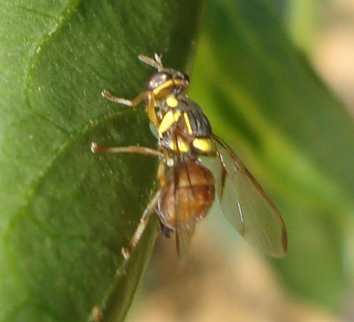
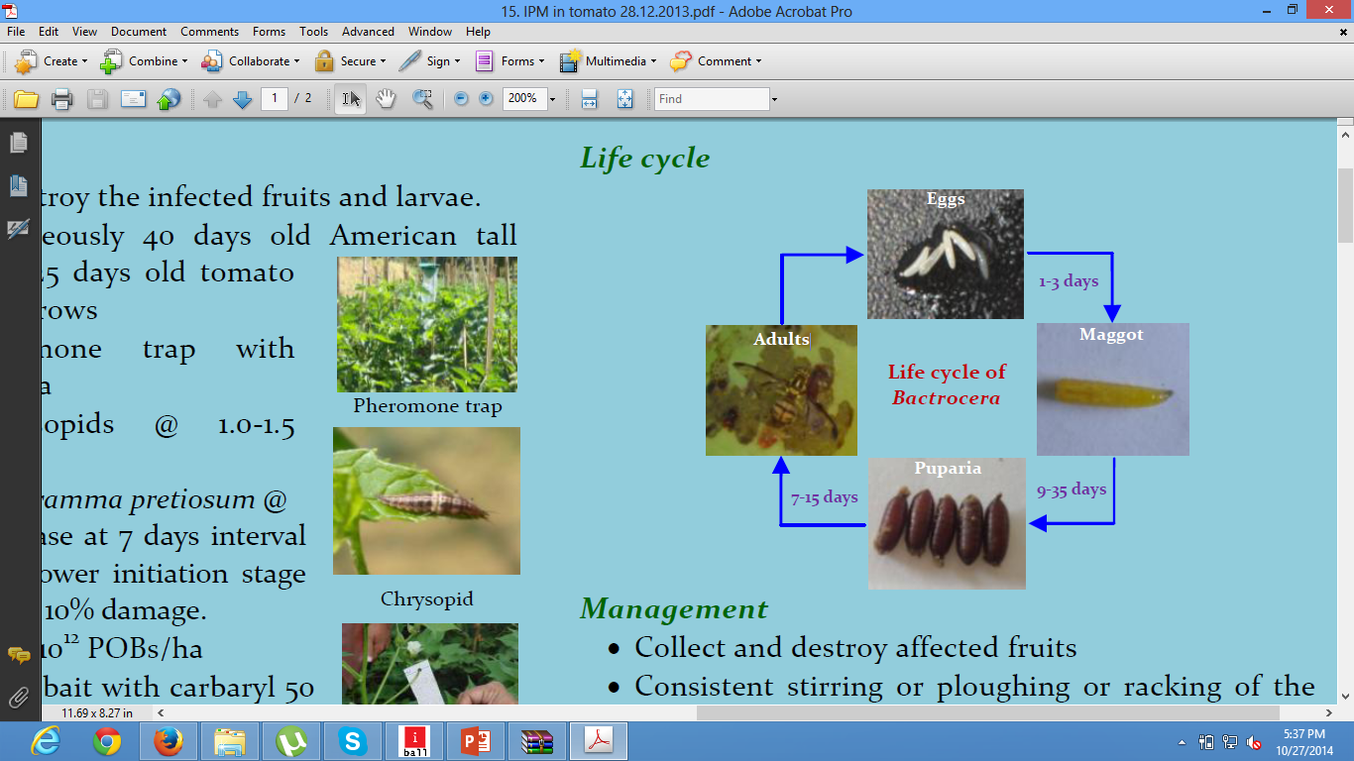
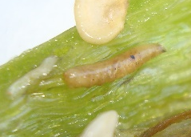
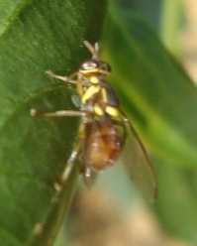


Relative Abundance of Tephritid Fruit Flies on Capsicum Ecosystem in North Eastern Hill Region of India
T. Boopathi, S.B. Singh,
T. Manju, S.K. Dutta,
AK.R. Singh and S.V. Ngachan
ICAR Research Complex for NEH Region
(Indian Council of Agricultural Research)
Mizoram Centre, Kolasib – 796081, Mizoram

Slide 3
Introduction
Capsicum is a popular vegetable in Mizoram
Area of 29,140 ha. during 2012-2013
Adapted to variable climatic conditions
Production and productivity limited by pests
Yield loss can approach 30-40%.
Production: 153350 MT during 2012-2013

Slide 4
Objectives
1. Per cent infestation
2. Life cycle
4. Monitoring with para-pheromone traps
3. Development of para-pheromone traps
5. Development of prediction model

Slide 5
Material and Methods
Cultivars: Indra and Picador
Spacing: 60 × 60 cm
Standard agronomy practices followed
No plant protection measures

Slide 6
1. Per cent infestation
Studied in both cultivars, Indra and Picador
% infestation: 200 fruits of both cultivars

Slide 7
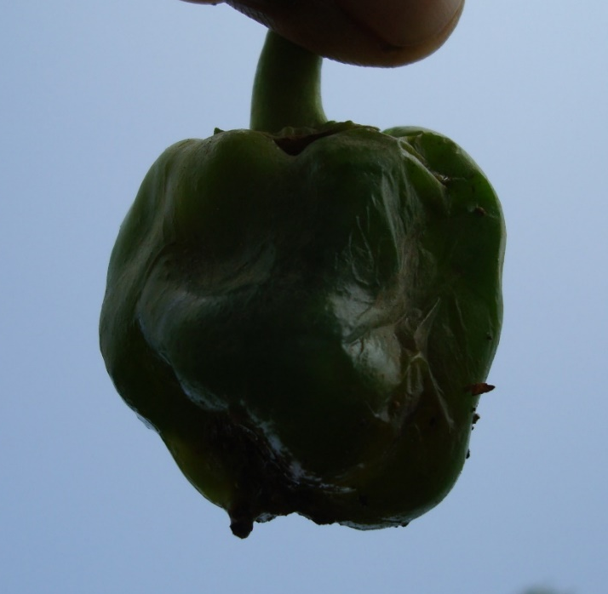

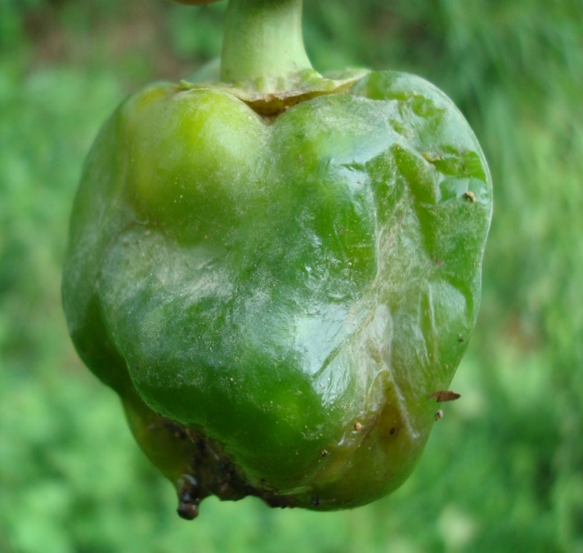
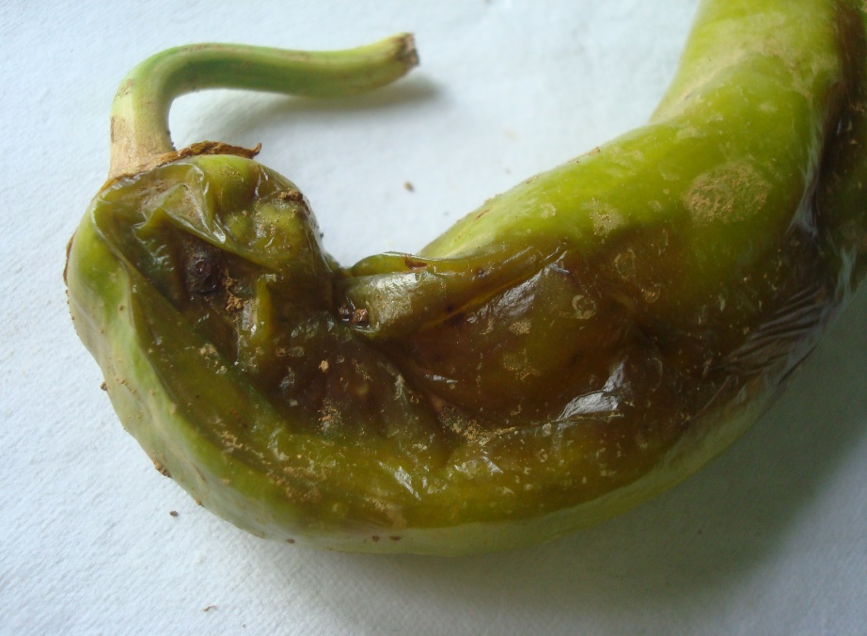
Per cent Infestation
Picador
Indra
55 to 60%
70 to 75 %

Slide 8
2. Life cycle
% adult emergence
Sex ratio (Male : Female)
% Pupal mortality

Slide 9
Abundance of Tephritid fruit flies in different cultivars of capsicum
Cultivars | Pupa | Emerged | Male | Female
Indra | 103 | 52 | 30 | 20
Picador | 67 | 30 | 14 | 16
Cultivars | % adult emergence | % pupal mortality | Sex ratio (M : F)
Indra | 50.5 | 49.5 | 1 : 0.75
Picador | 44.8 | 55.2 | 1 : 1.25

Slide 10

Life cycle

Slide 11
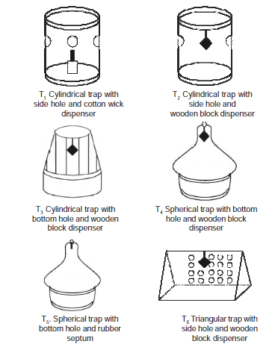
3. Development of
para-pheromone traps
1. Trap designs:
Cylindrical, spherical and triangular
2. Dispensers:
Wooden block, cotton wick & chalk piece

Slide 12
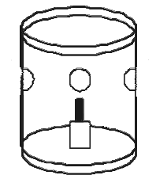
Development of Para-pheromone Traps
Use and through type
Permanent type

Slide 13
4. Monitoring and Mass Trapping with Para-pheromone Traps
Three traps were maintained
Traps height: 1.5 m above ground level
Traps loaded with a cotton wick
16 ml of methyl eugenol and malathion (3:1)
Solution changed once in three months
Catches were recorded weekly for five months

Slide 14
Weekly tephritid fruit flies catches in capsicum ecosystem

Slide 15
5. Prediction model
Correlation analysis: Average weekly weather data and fruit flies catches
Measured the present variability in fruit flies catches
A step-wise regression procedure applied to select the most crucial weather factors
Goodness-of-fit, co-efficient of determination (R²) helps in development of models

Slide 16
Relationships Between Weekly Weather Parameters and Fruit Flies Catches
Meteorological parameters | Correlation coefficient (r)
Minimum temperature (⁰C) | -0.398ns
Maximum temperature (⁰C) | 0.457*
Minimum relative humidity (%) | -0.257ns
Maximum relative humidity (%) | 0.074ns
Rainfall (mm) | -0.290ns
Rainy days | -0.173ns

Slide 17
Results of statistical models along with goodness of fit statistics
Model types | Multiple regression
Full regression model (All weather parameters) | Standard Error : 22.59 (X₁), 22.066 (X₂), 2.67 (X₃), 3.177 (X₄), 0.838 (X₅), 23.74 (X₆) T-value : -1.81ns (X₁), 3.14** (X₂), -0.00ns (X₃), 0.76ns (X₄), -1.73ns (X₅), 0.21ns (X₆) F value : 3.08* R² : 0.59* Regression equation : Y= -1088.03 - 41 (X₁) + 69 (X₂) - 0.01 (X₃) + 2 (X₄) - 1.5 (X₅) + 5.03 (X₆)
Optimized model (using minimum and maximum temperature only) | Standard Error : 13.93 (X₁) and 16.93 (X₂) T-value : -3.43** (X₁) and 3.13** (X₂) F value : 7.41** R² : 0.47** Regression equation : Y= -346.35 - 48 (X₁) + 53 (X₂)
ns,*,** non-significant or significant at P<0.05 or P<0.01 Y = Mean number of fruit flies, X₁ = minimum temperature (⁰C), X₂ = maximum temperature (⁰C), X₃ = morning relative humidity (%), X₄ = evening relative humidity (%), X₅ = rainfall (mm), X₆ = rainy days

Slide 18
Summary
New records of fruit flies infesting capsicum
Model can be used for decision making in IPM
Future validation is needed
This model predicted fruit flies catches

Slide 19
Future
Species identification
DNA Barcode
Validation of model for 3 years data
Species diversity

Slide 20
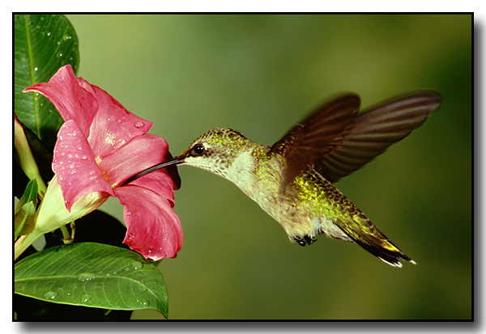
Thank U

