Slide 1
AN ALTERNATIVE TREATMENT OPTION FOR ANTERIOR CANAL BENIGN PAROXYSMAL POSITIONAL VERTIGO
BONNI KINNE, PT, MSPT, MA
GRAND VALLEY STATE UNIVERSITY

Slide 2
BACKGROUND AND PURPOSE

Slide 3
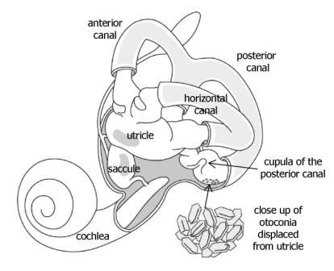
BENIGN PAROXYSMAL POSITIONAL VERTIGO (BPPV)

Slide 4
ANTERIOR CANAL BPPV
SUBJECTIVE FINDINGS
OBJECTIVE FINDINGS
“spinning” sensation while:
(1) lying down in bed (2) rolling over in bed (3) looking upward (4) bending over

Slide 5
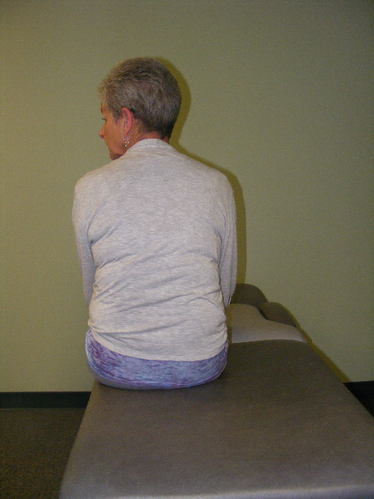
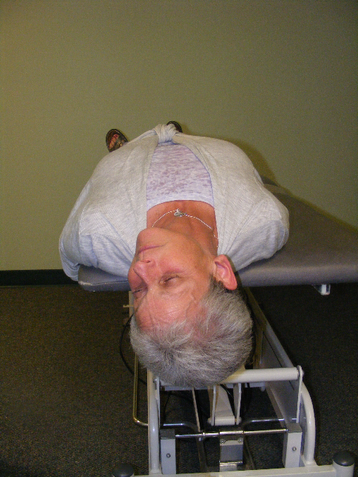
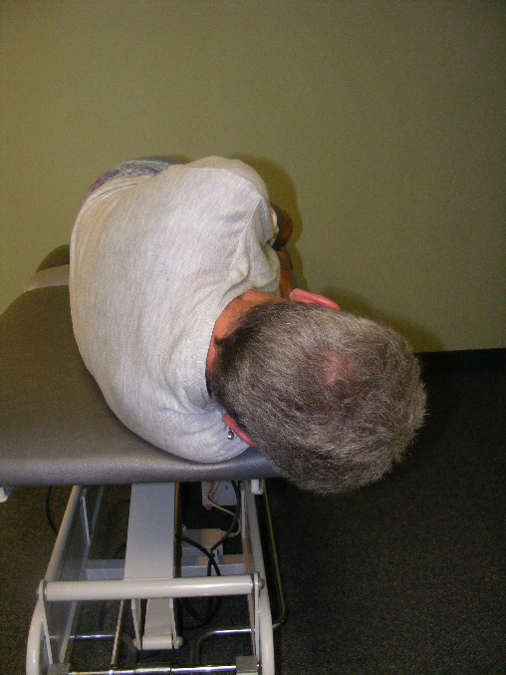
TREATMENT OPTIONS
anterior canal BPPV techniques [1]
posterior canal BPPV techniques [2]

Slide 6
The purpose of this case report
was to describe the treatment of
anterior canal BPPV using a
“reverse” Parnes particle
repositioning maneuver.

Slide 7
CASE DESCRIPTION

Slide 8
SUBJECTIVE EVALUATION
93-year-old female
“spinning” sensation whenever she would bend over or lie on her left side
previous medical history of a brain aneurysm, hypertension, arthritis, osteoporosis, and recurrent back pain

Slide 9
OBJECTIVE EVALUATION
ambulated without the use of an assistive device
demonstrated a staggering gait pattern and a slow gait velocity
reported a “spinning” sensation during the left Dix-Hallpike test (could not visualize the possible nystagmus because she closed her eyes)

Slide 10
INITIAL TREATMENT APPROACH
The patient was initially treated with the Parnes particle repositioning maneuver secondary to suspected left-sided posterior canal BPPV.
This maneuver was unsuccessful after two attempts.
After the second attempt, the patient demonstrated a negative Dix-Hallpike test bilaterally.
However, she demonstrated downbeating right torsional nystagmus when she rolled over onto her left side.
Therefore, the patient was diagnosed with suspected right-sided anterior canal BPPV.

Slide 11
SUBSEQUENT TREATMENT APPROACH
The Crevits maneuver [3] was not attempted, because it required a bedside pulley system.
The Lorin maneuver [4] was not attempted, because it required a vertical rotatory chair.
The Kim maneuver [5] was attempted, but it was unsuccessful.

Slide 12
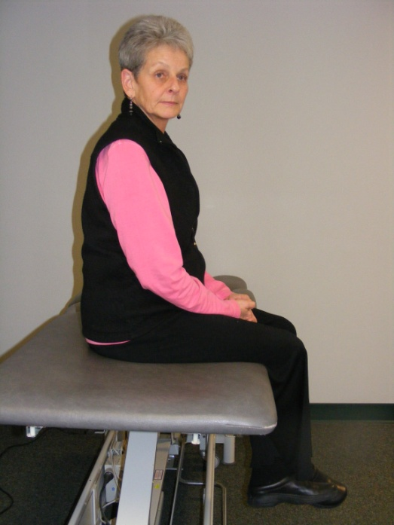
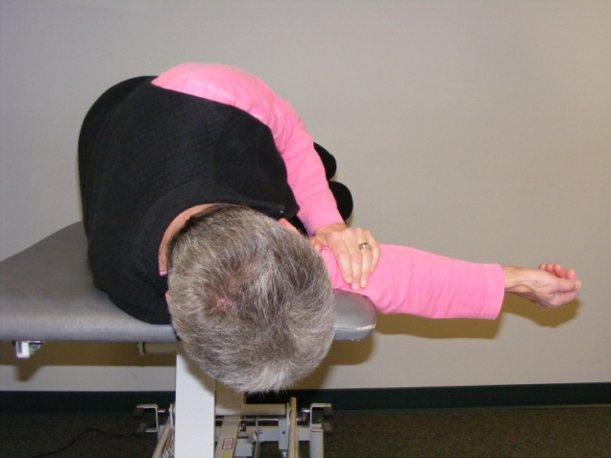
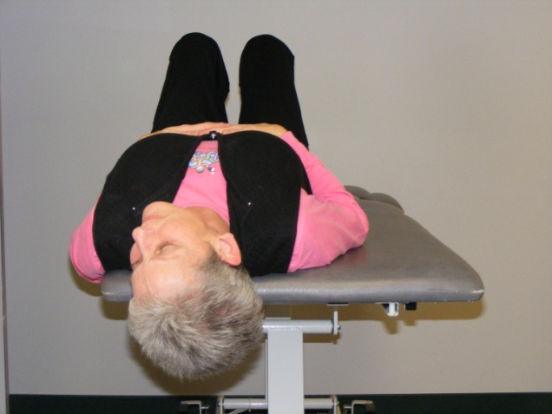
“REVERSE” PARNES PARTICLE REPOSITIONING MANEUVER

Slide 13
OUTCOMES

Slide 14
3 DAYS POST-TREATMENT
no vertigo during her everyday life, even when she would bend over or lie on her left side
slight antalgic gait secondary to a recent orthopedic issue
negative Dix-Hallpike test bilaterally

Slide 15
3 MONTHS POST-TREATMENT
never returned to physical therapy
contacted over the telephone
continued to experience no vertigo or functional problems during her everyday life

Slide 16
DISCUSSION

Slide 17
“REVERSE” PARNES PARTICLE REPOSITIONING MANEUVER
a viable alternative in the management of anterior canal BPPV
useful as the first treatment option or when other appropriate techniques have been unsuccessful
a safe and effective treatment technique despite a patient’s advanced age and/or preexisting health concerns

Slide 18
REFERENCES

Slide 19
[1] Kinne, B. L., Crouch, N. A., & Strace, C. L. (2014). Anterior canal benign paroxysmal positional vertigo treatment techniques. Physical Therapy Reviews, 19, 79-84.
[2] Parnes, L. S., & Price-Jones, R. G. (1993). Particle repositioning maneuver for benign paroxysmal positional vertigo. Annals of Otology, Rhinology and Laryngology, 102, 325-331.
[3] Crevits, L. (2004). Treatment of anterior canal benign paroxysmal positional vertigo by a prolonged forced position procedure. Journal of Neurology, Neurosurgery and Psychiatry, 75, 779-781.
[4] Lorin, P. (2007). Treatment of anterior semi-circular canalithiasis by a sedimentation procedure in a vertical rotatory chair. Annales d’Otolaryngologie et Chirurgie Cervico-Faciale, 124, 184-188.
[5] Kim, Y. K., Shin, J. E., & Chung, J. W. (2005). The effect of canalith repositioning for anterior semicircular canal canalithiasis. ORL: Journal for Oto-Rhino-Laryngology and its Related Specialties, 67, 56-60.

Slide 20
To obtain further information about
this presentation or a vestibular
rehabilitation continuing education
course, you may contact Bonni at:
kinneb@gvsu.edu

