Slide 1
Compression of hepatoduodenal ligament by sponges during perihepatic packing for liver trauma leading to difficult maneuvering of angiography catheter through common hepatic artery: ‘Mishra Phenomenon’
Dr. Biplab Mishra Additional Professor of Surgery, AIIMS, New Delhi. biplabaiims@gmail.com

Slide 2
Hepatic Trauma
JPN Apex Trauma Center, New Delhi.
All India Institute of Medical Sciences (AIIMS), New Delhi, India
Workload (annually)
ED footfall - >55000, Red area – 5%
Sx admissions (N) - >1600
- RTI – 60%
- Torso trauma – 50%
- Liver trauma (n) - >115 (7%), grade IV +V – 40 (33% of n)
- Hepatic angioembolization – 29 (25% of n)
- OM – 23 (20% of n)
- Mortality – 9 (8% of n)

Slide 3
Hepatic Trauma
Most frequently injured abdominal organ
Mx : NOM, OM, AE
OM : surgical challenge : anatomical position, size, vascularity & difficult access to venous drainage
Goal of OM : control bleeding from liver (simple to complicated techniques)
Damage control principles in unstable patients.

Slide 4
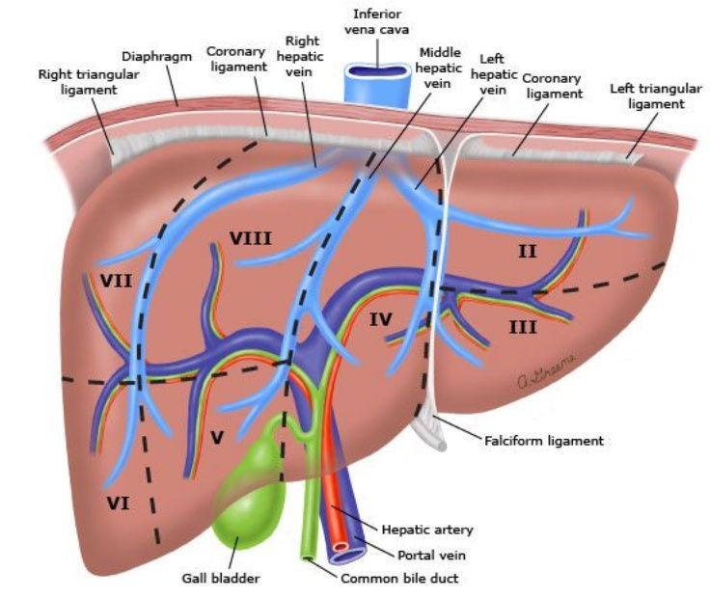
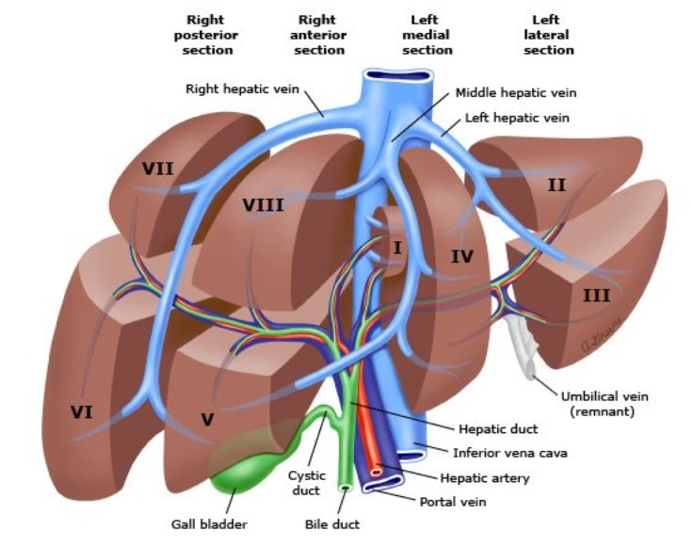
Anatomy of liver
Photos courtesy : UpToDate/David G Jacobs

Slide 5
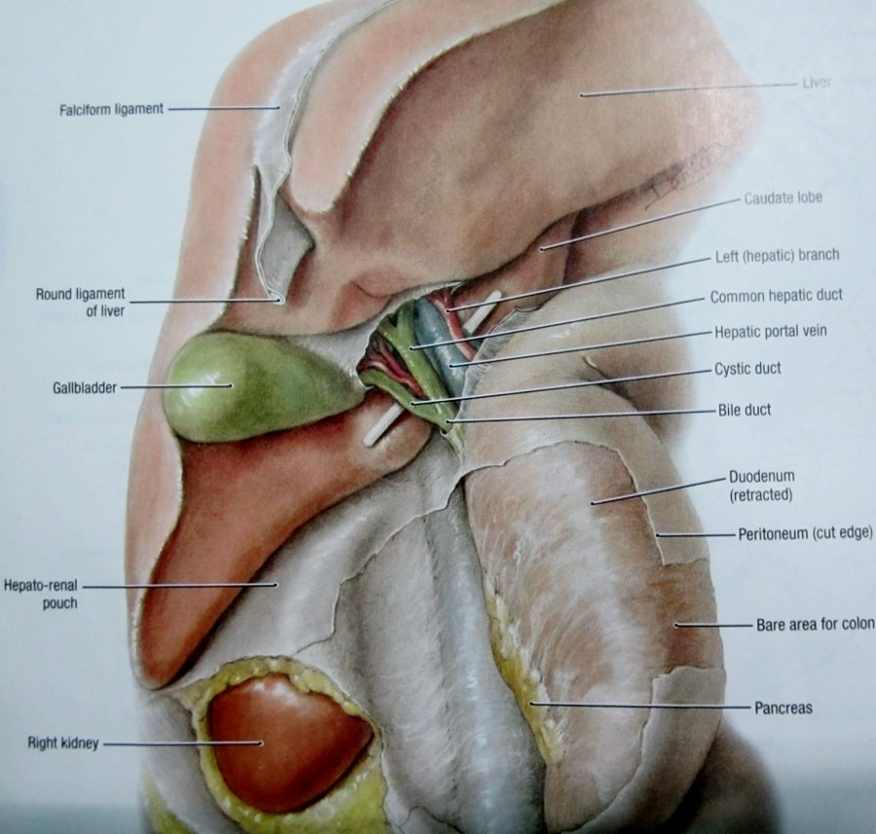
Hepato-duodenal ligament
Photos courtesy : Grant’s atlas of anatomy

Slide 6
Perihepatic packing (PHP) & selective hepatic artery angioembolization (AE)
Two important hemostatic maneuvers, established as very effective measures in controlling bleeding from liver trauma.
Liver hemostasis
PHP
AE
Venous bleed
Arterial bleed

Slide 7
Management of liver trauma
Trauma
ABCDE (ATLS)
FAST (+) FAST (-)
stable vitals unstable vitals
CECT abd OR for damage control laparotomy
NOM OM AE perihepatic packing
Satisfactory Hemostasis Unsatisfactory
ICU AE If AE NA
Pack removal 24-48hrs
Rebleed repacking (PHP)
Notes:
Mx algorithm blunt and penetrating. FAST negative = abdomen unlikely cause of H shock, FAST is considered with abdominal examination also
Perihepatic packing for hepatic hemostasis

Slide 8
Management of liver trauma
Trauma
ABCDE (ATLS)
FAST (+) FAST (-)
stable vitals unstable vitals
CECT abd OR for damage control laparotomy
NOM OM AE Perihepatic Packing
Satisfactory Hemostasis Unsatisfactory
ICU AE If AE NA
Pack removal 24-48hrs
Rebleed Repacking (PHP)
Notes:
Mx algorithm blunt and penetrating. FAST negative = abdomen unlikely cause of H shock, FAST is considered with abdominal examination also
Perihepatic packing for hepatic hemostasis

Slide 9
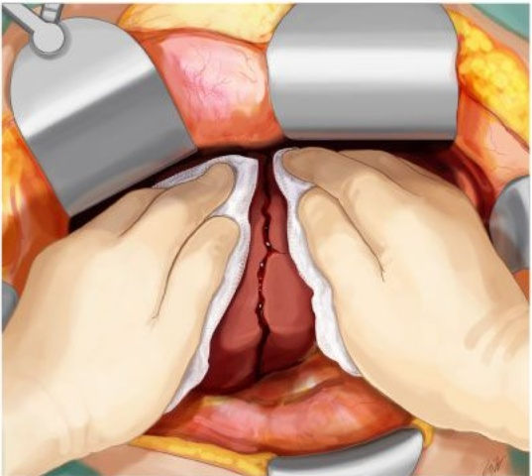
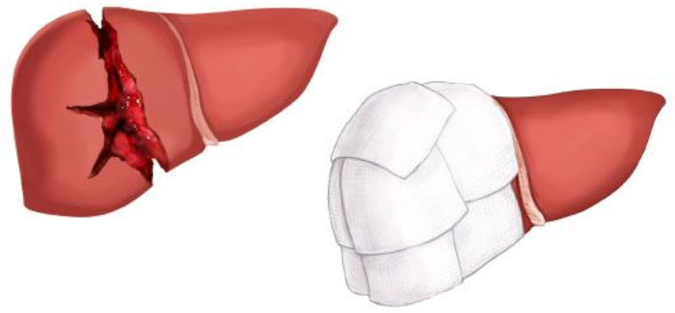
Perihepatic packing (PHP)
Technique : Manual compression
Pringle maneuver
Surgical sponge packing
Courtesy: Uptodate
Notes:
Surgical sponge packing – tamponading liver from different directions, surgical sponges between diaphragm & liver, between anteriolateral abdominal wall & liver and between hepatic flexure of colon (retroperitoneal area posteriorly ) & liver.

Slide 10
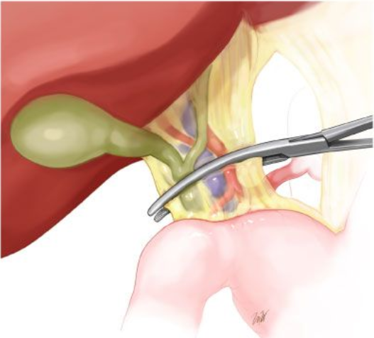
Pringle maneuver
Clamping the hepatoduodenal ligament / Porta
Photo coutesy: Uptodate
Notes:
Photo from anatomy

Slide 11
Perihepatic packing (PHP)
Effective especially for venous bleed (80%).
Give time to manage arterial bleed also.
Relatively simple with respect to other complicated hemostatic techniques.
Reduces rate of rebleeding and mortality.
Notes:
80% cases of hemorrhage from liver is from veins.

Slide 12
Perihepatic packing - disadvantages
Fails to control arterial / major venous bleed
Excessive pressure → hepatic necrosis, abd compart.
Re-bleed after pack removal.
Sepsis / infective complications.
False assurance of hemostasis.
Only a temporary measure.
‘May not be that simple!’

Slide 13
Angioembolization (AE)
Relatively recent advancement (Interventional Radio).
Technique : Angiography suite → Catheterization:Femoral A → External Iliac A→ Common Iliac A→ Aorta→ Celiac Axis→ Common Hepatic A →Hepatic A → Selective branch
Indications :
post PHP bleed (arterial)
CT showing vascular blush/Pseudoaneurysm
‘Failed’ NOM
Notes:
Angioembolization in hepatic trauma angiosuit indications advantage videos disadvantages future role

Slide 14
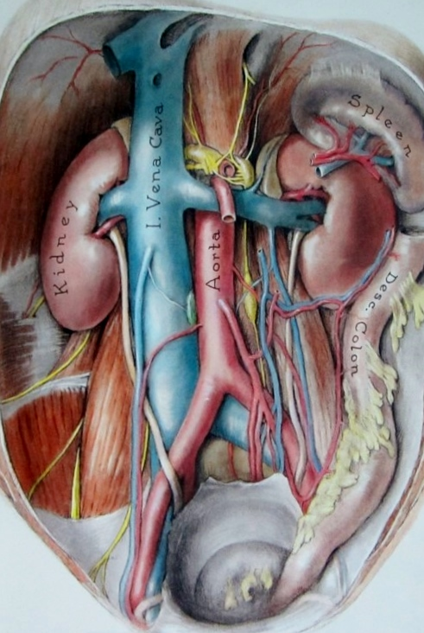
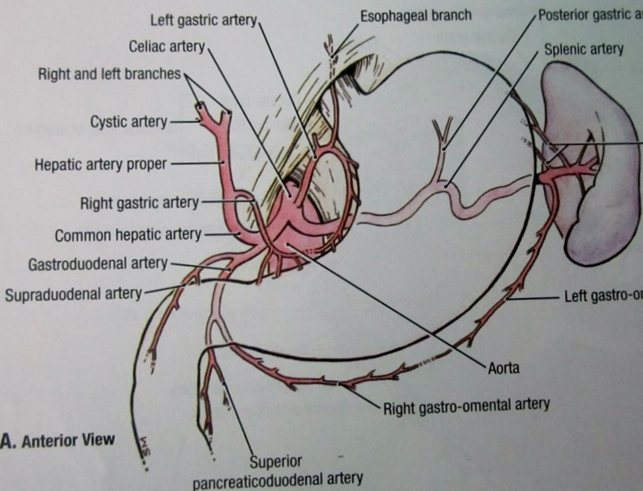
Vascular anatomy
Photos courtesy : Grant’s atlas of anatomy

Slide 15
Disadvantages
Hepatic necrosis (?)
Need expertise and facility.
Need contrast injection (nephrotoxicity).
Cannot treat large vein / retro hepatic vein injuries.
Patient needs transport to angiography suite.

Slide 16
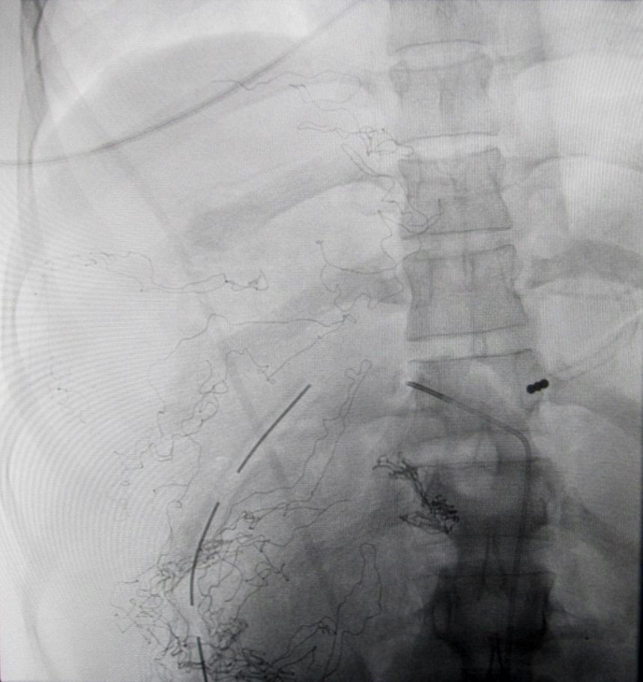
Catheterization of the hepatic artery
Notes:
Sponges, drain & NG can be seen. Hepatic artery just catheterized.

Slide 17
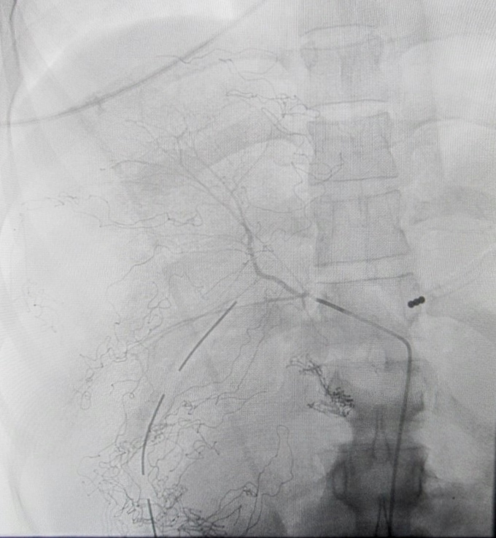
Angiography of the hepatic artery
Notes:
Contrast run taken.

Slide 18
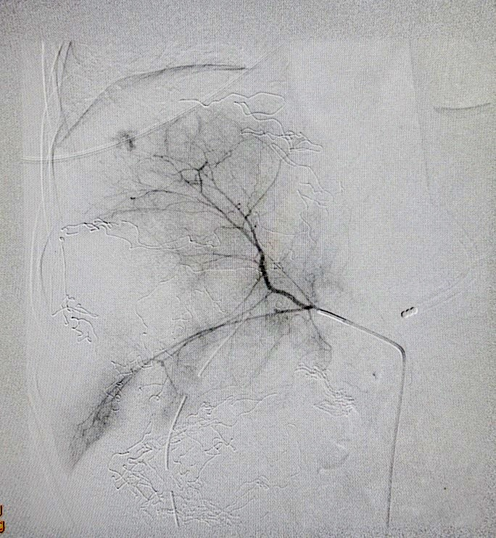
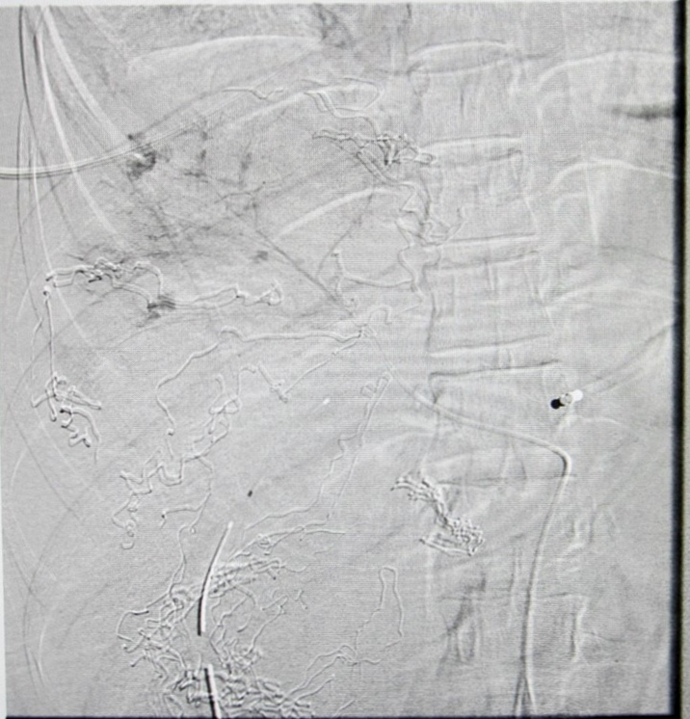
Hepatic angiography showing vascular blush
Notes:
On catheter advancement further into hepatic artery, more contrast extravasation seen from liver.

Slide 19
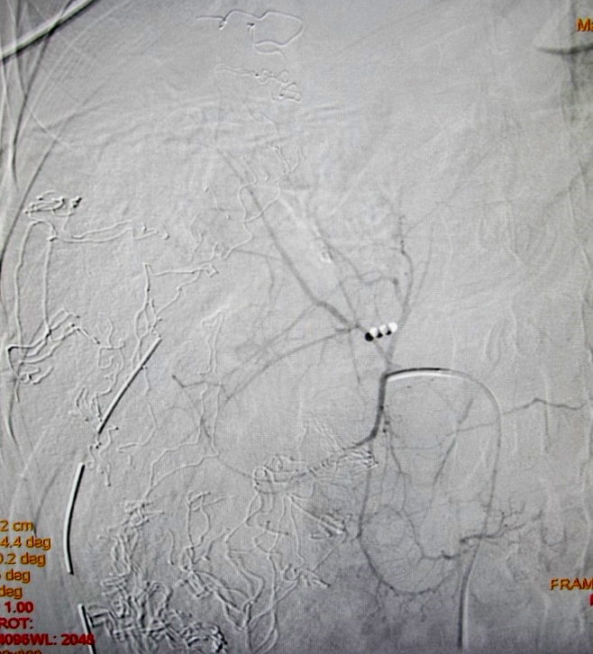
After angioembolization, vascular blush vanished
Notes:
AE done.

Slide 23
Peri-hepatic packing → Hepatic Angioembolization
PHP
Hemostasis
Satisfactory Unsatisfactory
ICU AE Re-exploration
- repacking
- sx hemostasis
Notes:
PHP – AE is better than PHP- reexploration. Why? 1. minimal invasive. 2. the very fact that arterial bleed is not controlled by PHP is more suggestive of failure of PHP in reexploration. 3. the very problem i.e arterial bleed is addressed in such cases by AE.

Slide 24
Our observation 5 yrs back….
2 cases of hepatic trauma → PHP →
Bleeding continued with unstable vitals.
Hepatic AE tried, but catheter couldn’t be negotiated through the hepatic artery though flow of blood through the same was demonstrated. Team was puzzled!

Slide 25
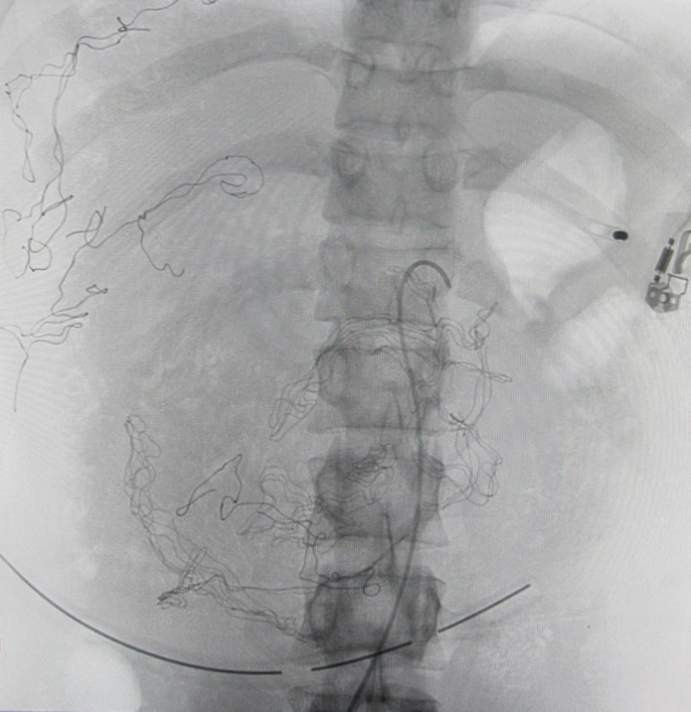
Catheterization of the celiac axis

Slide 26
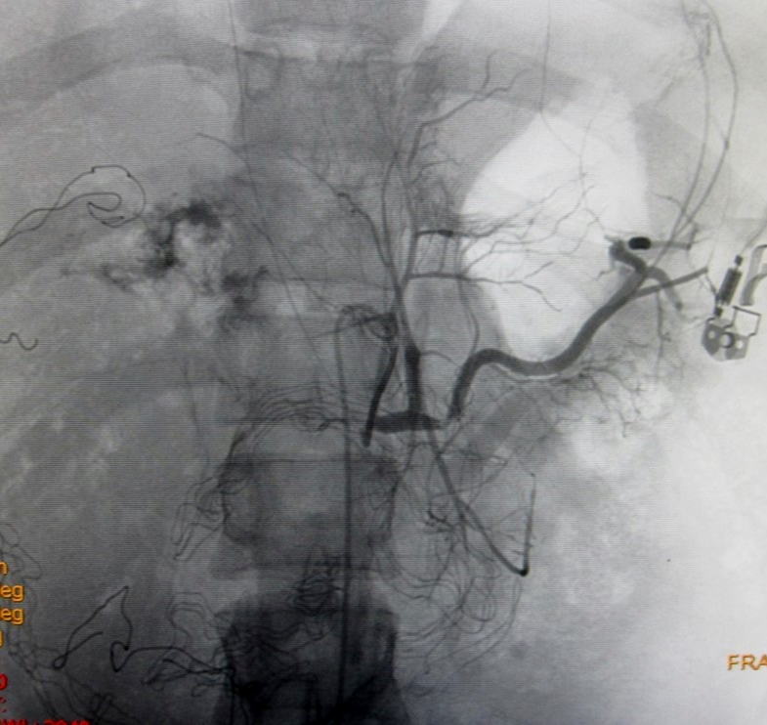
Angiography of the celiac axis
Notes:
Hepatic artery canulated just at the beginning but severely attenuated after that. Whole celiac axis is pushed to the left side by sponges distorting the anatomy. Contrast extravasation seen in the liver. Catheter is seen coursing through the aorta and celiac axis.

Slide 27
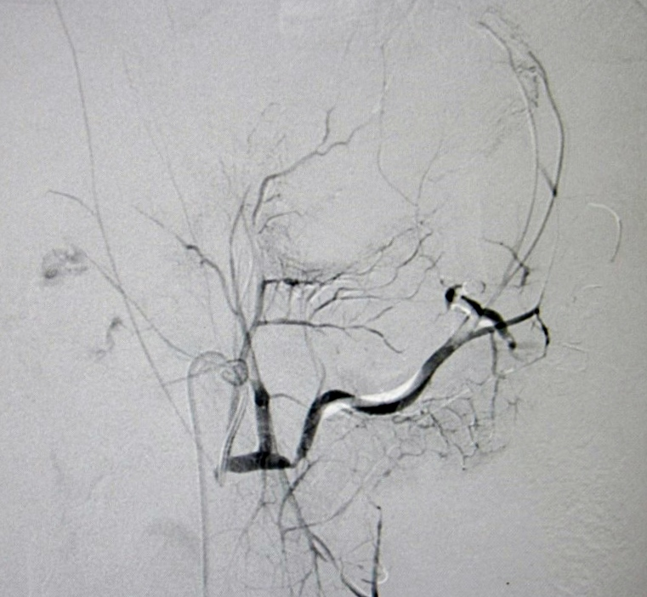
Angiography showing vascular blush
Notes:
Substracted image. Bone and sponges not seen. Contrast extravasation seen.

Slide 28
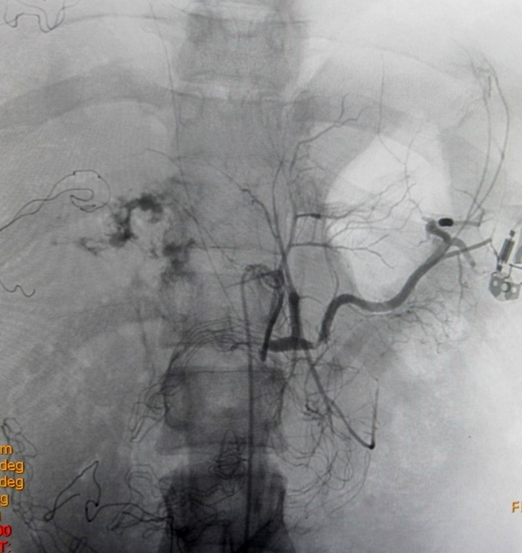
Angiography showing vascular blush
Notes:
Non subtracted image. Sponges seen.

Slide 31
MOST PLAUSIBLE CAUSE: surgical sponges used for PHP compressing upon the hepatoduodenal ligament through which the hepatic artery was coursing.
Management policy was established : not to pack around hepatoduodenal ligament / porta.
No such failure observed after this in our Institution.
Literature review did not reveal any such phenomenon /complications or failure of angiography catheter negotiation.
Notes:
Keywords – hepatic trauma, complications of hepatic trauma, hepatic angioembolization, PHP, complications of PHP.why bl flow not stopped but cath did? Flow is pulsatile with pressure of systole bp ie 100 mm hg,flow is dereased but not completely, catheter cant have so much force to negotiate ext pressure especialy thorough bends..

Slide 32
Last five years…..
82 cases of hepatic angioembolization
42 post PHP + 40 without PHP
No failures were observed after the change of policy!!

Slide 33
‘Mishra Phenomenon’ vs ‘Sponge Pringle’
Pringle- Complete obstruction to vascular inflow
Mishra Phenomenon- Vascular inflow may not be compromised but catheter negotiation will be difficult/unsuccessful

Slide 34
Significance of Mishra Phenomenon
Prevention of failure of hepatic AE.
? Prevention of hepatic necrosis by ensuring vascularity to the liver.
? Prevention of excessive bile leak from injured liver.
Notes:
Add photo of liver with porta

Slide 35
Summary
Post PHP hepatic angiography / AE is one of the best strategy following failure of PHP.
In coming years with increased availability of angiography and expertise, such practices are going to increase significantly.
Awareness of Mishra Phenomenon will avoid failure of selective hepatic artery AE and other complications.

Slide 37
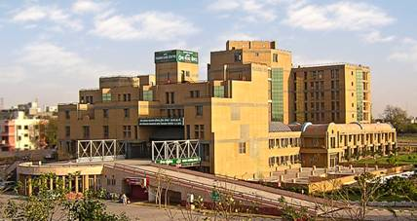
Thank You

