Slide 1
About OMICS Group
OMICS Group International is an amalgamation of Open Access publications and worldwide international science conferences and events. Established in the year 2007 with the sole aim of making the information on Sciences and technology ‘Open Access’, OMICS Group publishes 400 online open access scholarly journals in all aspects of Science, Engineering, Management and Technology journals. OMICS Group has been instrumental in taking the knowledge on Science & technology to the doorsteps of ordinary men and women. Research Scholars, Students, Libraries, Educational Institutions, Research centers and the industry are main stakeholders that benefitted greatly from this knowledge dissemination. OMICS Group also organizes 300 International conferences annually across the globe, where knowledge transfer takes place through debates, round table discussions, poster presentations, workshops, symposia and exhibitions.

Slide 2
About OMICS Group Conferences
OMICS Group International is a pioneer and leading science event organizer, which publishes around 400 open access journals and conducts over 300 Medical, Clinical, Engineering, Life Sciences, Pharma scientific conferences all over the globe annually with the support of more than 1000 scientific associations and 30,000 editorial board members and 3.5 million followers to its credit.
OMICS Group has organized 500 conferences, workshops and national symposiums across the major cities including San Francisco, Las Vegas, San Antonio, Omaha, Orlando, Raleigh, Santa Clara, Chicago, Philadelphia, Baltimore, United Kingdom, Valencia, Dubai, Beijing, Hyderabad, Bengaluru and Mumbai.

Slide 3

Translating multidimensional cancer omics data into biological insights
Bing Zhang, Ph.D.
Department of Biomedical Informatics
Vanderbilt University School of Medicine
bing.zhang@vanderbilt.edu

Slide 4

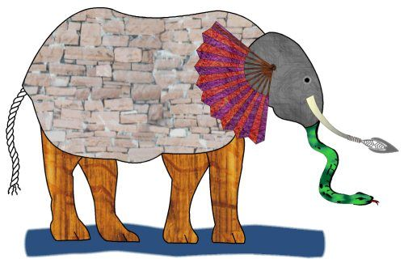

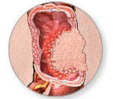

Omics opportunities and challenges
DNA
CNV
mutation
methylation
Elephant
Risk
Diagnosis
Prognosis
Therapeutics
mRNA
expression
splicing
Protein
expression
modification

Slide 5
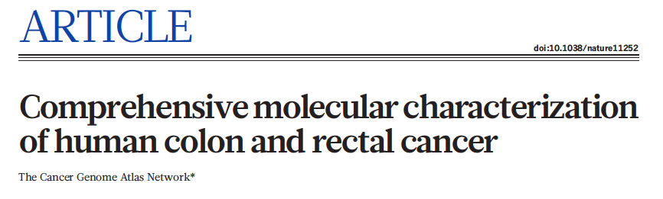
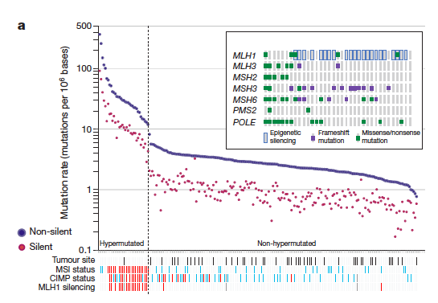
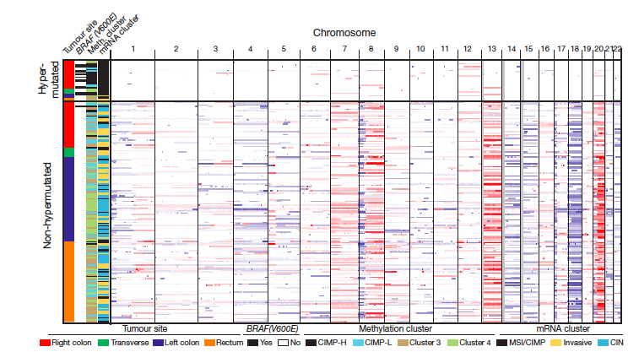
The Cancer Genome Atlas (TCGA)
Colon and Rectal Cancer (CRC) Project
Nature (2012) 487: 330-337
Hypermutator genotype
Somatic mutations
Copy number alterations
Translocations
Transcriptomic subtypes
How genomic alterations drive cancers?
Clinical Proteomic Tumor Analysis Consortium (CPTAC)

Slide 6
Global proteomics analysis:
Samples
Clinical characteristics of the 90 colorectal cancer (CRC) samples

Slide 7
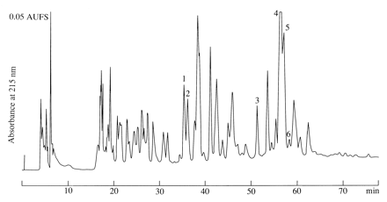
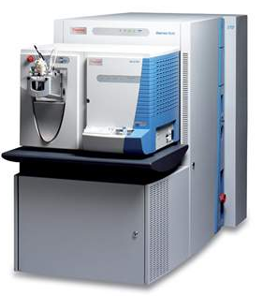
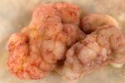
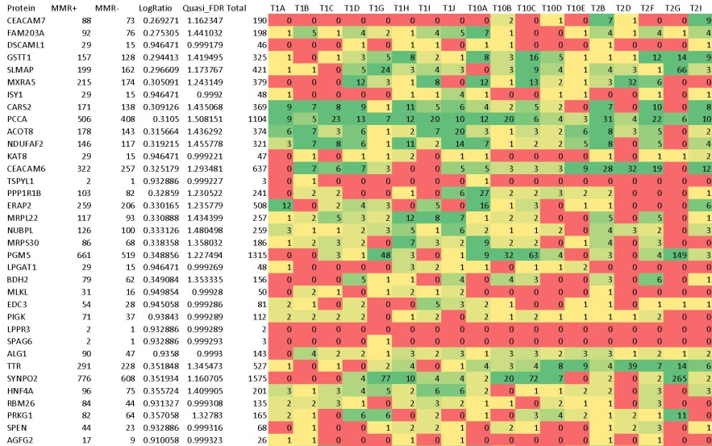
Global proteomics analysis:
Vanderbilt shotgun proteomics platform
tissue
peptides
Digestion
(TFE, trypsin)
bRPLC
15 concatenated fractions
LC-MS/MS
Thermo Orbitrap-Velos
MS/MS spectra
Preprocessing
MSConvert
Peptide identification
Myrimatch
Pepitome
MS-GF+
Protein assembly
IDPicker

Slide 8
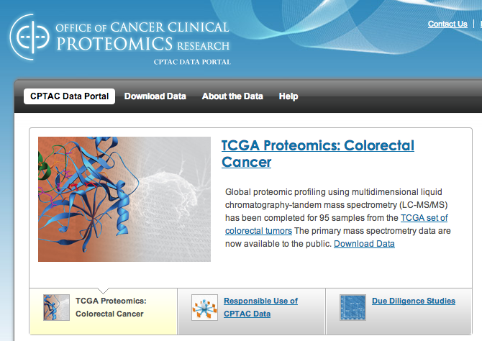
Global proteomics analysis:
Summary of the proteomics data
90 tumors
6,299,756 identifiable spectra
124,823 distinct peptides (1% FDR)
7,526 proteins (2.6% FDR)
3,899 quantifiable proteins (0.43% FDR)
684 GB
https://cptac-data-portal.georgetown.edu

Slide 9

What is the added value of proteome profiling in human cancer studies?
Cancer biomarker discovery
Oncogenic driver prioritization
Molecular subtype classification

Slide 10
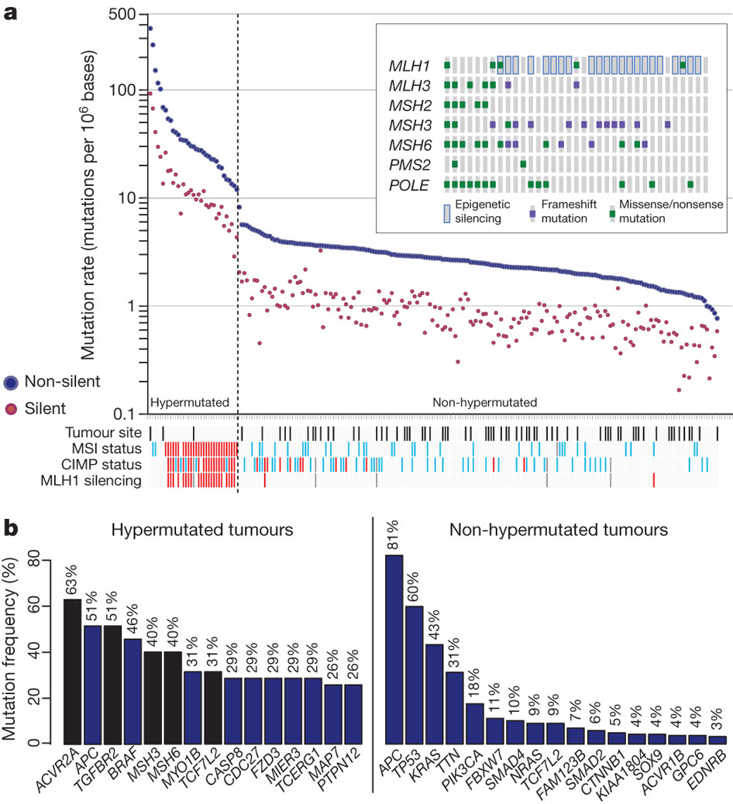
Mutant proteins as cancer biomarkers
Proteins resulting from somatic mutations are ideal cancer biomarkers
  Specificity
    Unlike CEA and PSA
  Possible drivers
    Not only association
  Established targeted proteomics technologies
    Selected Reaction Monitoring (SRM)
    Multiple Reaction Monitoring (MRM)
Many somatic mutations have been identified in the TCGA studies
Can we prioritize somatic mutations for targeted analysis?
TCGA. Nature, 2012
Notes:
Prostate-specific antigen (PSA)
Carcinoenbryonic antigen (CEA)

Slide 11
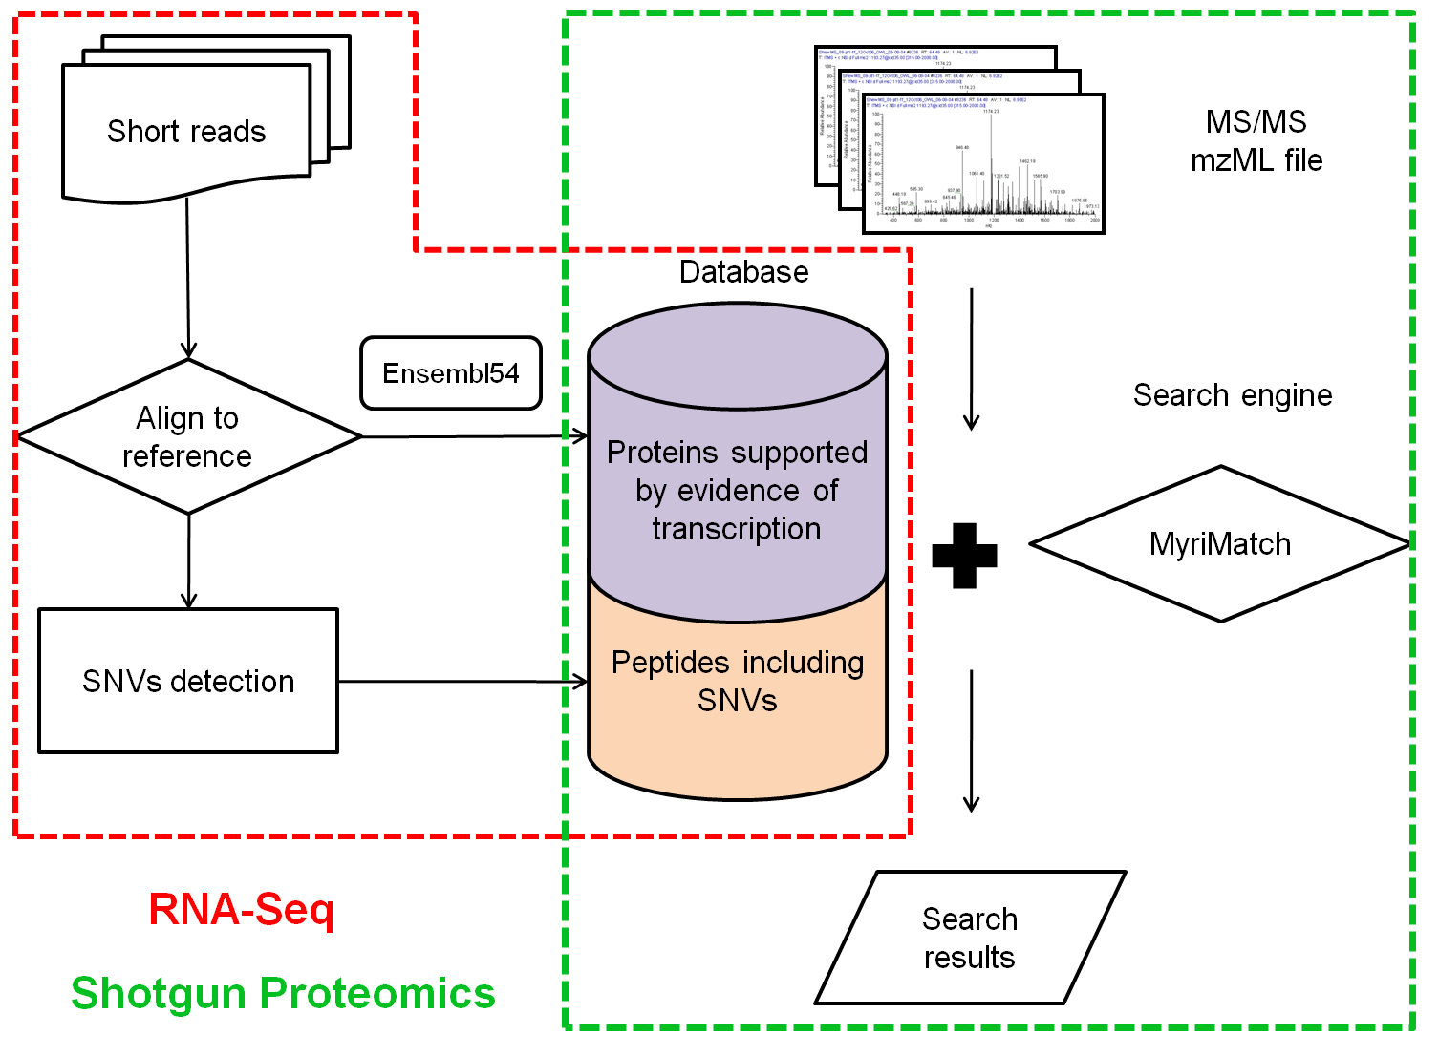

Personalized protein database from RNA-Seq data
Increased sensitivity
Reduced ambiguity
Variant peptides
customProDB is available in Bioconductor
Wang et al., J Proteome Res, 2012
Wang & Zhang, Bioinformatics, 2013

Slide 12
Personalized database search results
1,065 variant peptides
796 unique Single Amino Acid Variants (SAAVs)
  64 in TCGA reported somatic variations
  101 in the COSMIC database
  526 in the dbSNP database
647 variant proteins
  Known cancer genes: KRAS, CTNNB1, SF3B1, ALDH2, FH, etc.
  Targets of FDA approved drugs: ALDH2, HSD17B4, PARP1, P4HB, TST, GAK, SLC25A24, SUPT16H, etc.

Slide 13
What is the added value of proteome profiling in human cancer studies?
Cancer biomarker discovery
Oncogenic driver prioritization
Molecular subtype classification

Slide 14
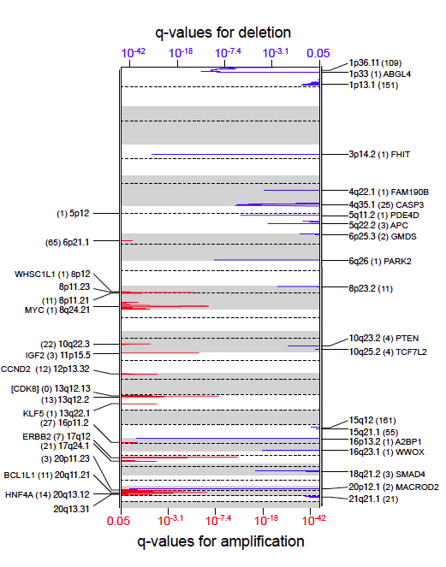

Candidate drivers in regions of copy number alteration (CNA)
The TCGA study identified 17 focal amplification regions and 28 focal deletion regions
CNA-mRNA correlation has been widely used for the prioritization of candidate drivers
  Wang et al. Clin Cancer Res, 2013
What can proteomics tell us about these regions and candidate drivers?
TCGA. Nature, 2012

Slide 15
Proteomics data enables prioritization of CNA regions and candidate drivers
CNA-mRNA correlation
CNA-protein correlation
3,764 genes
20q
20q
23,125 genes
23,125 genes
Notes:
Although copy number alterations showed strong cis- and trans-effects on mRNA abundance, relatively few of these extend to the protein level. Thus, proteomics data enabled prioritization of candidate driver genes.

Slide 16
Proteomics data help narrow down candidate oncogenic drivers
HNF4A
CNA
0.79
Cor = 0.51
mRNA
0.43
protein
STK4
CNA
0.67
Cor = -0.02
mRNA
0.065
protein
Two genes in the focal amplification region 20q13.12

Slide 17
Higher HNF4A dependency in CRC cell lines
Data from the Achilles project
http://www.broadinstitute.org/achilles

Slide 18
What is the added value of proteome profiling in human cancer studies?
Cancer biomarker discovery
Oncogenic driver prioritization
Molecular subtype classification

Slide 19
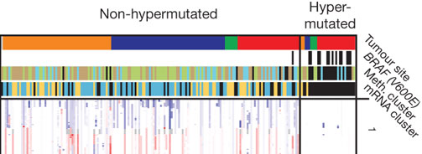
TCGA transcriptomic subtypes
The TCGA study identified three transcriptomic subtypes: MSI/CIMP (Microsatellite instability/ CpG island methylator phenotype), Invasive, and CIN (Chromosome Instability)
The MSI/CIMP subtype is enriched with hypermutated tumors
TCGA. Nature, 2012

Slide 20
mRNA level does not reliably predict protein level
Can we rediscover or redefine CRC subtypes using proteomics data?

Slide 21

Five proteomic subtypes
Protein expression
-2 2
Wound response
Proteomic subtype
A B C D E
Transcriptomic subtype
MSI/CIMP Invasive CIN
Genomic features
Percentage of survival
yes no
NA
Methylation subtype
CIMP-H CIMP-L
Cluster 3 Cluster 4
Proteomic subtype
Transcriptomic subtype
Survival months
Hypermutation
MSI-high
TP53 mutation
18q loss
Methylation subtype

Slide 22
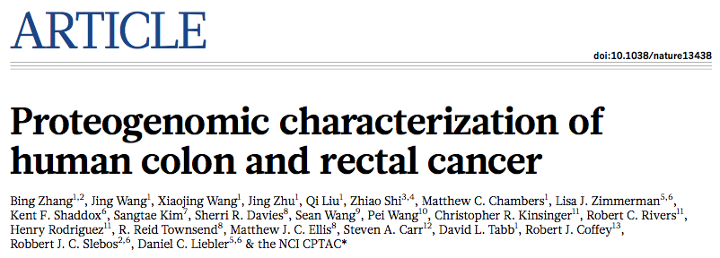
Summary
Integrated proteogenomic analysis may enable new advances in cancer biology and management.
  Identifying mutant peptides as candidate cancer biomarkers
  Prioritizing oncogenic drivers in focal amplification regions.
  Revealing molecular subtypes that cannot be distinguished using mRNA expression data.

Slide 23
Making data accessible and reusable
NetGestalt CRC portal (http://crc.netgestalt.org)
Shi et al. Nature Methods, 2013

Slide 24
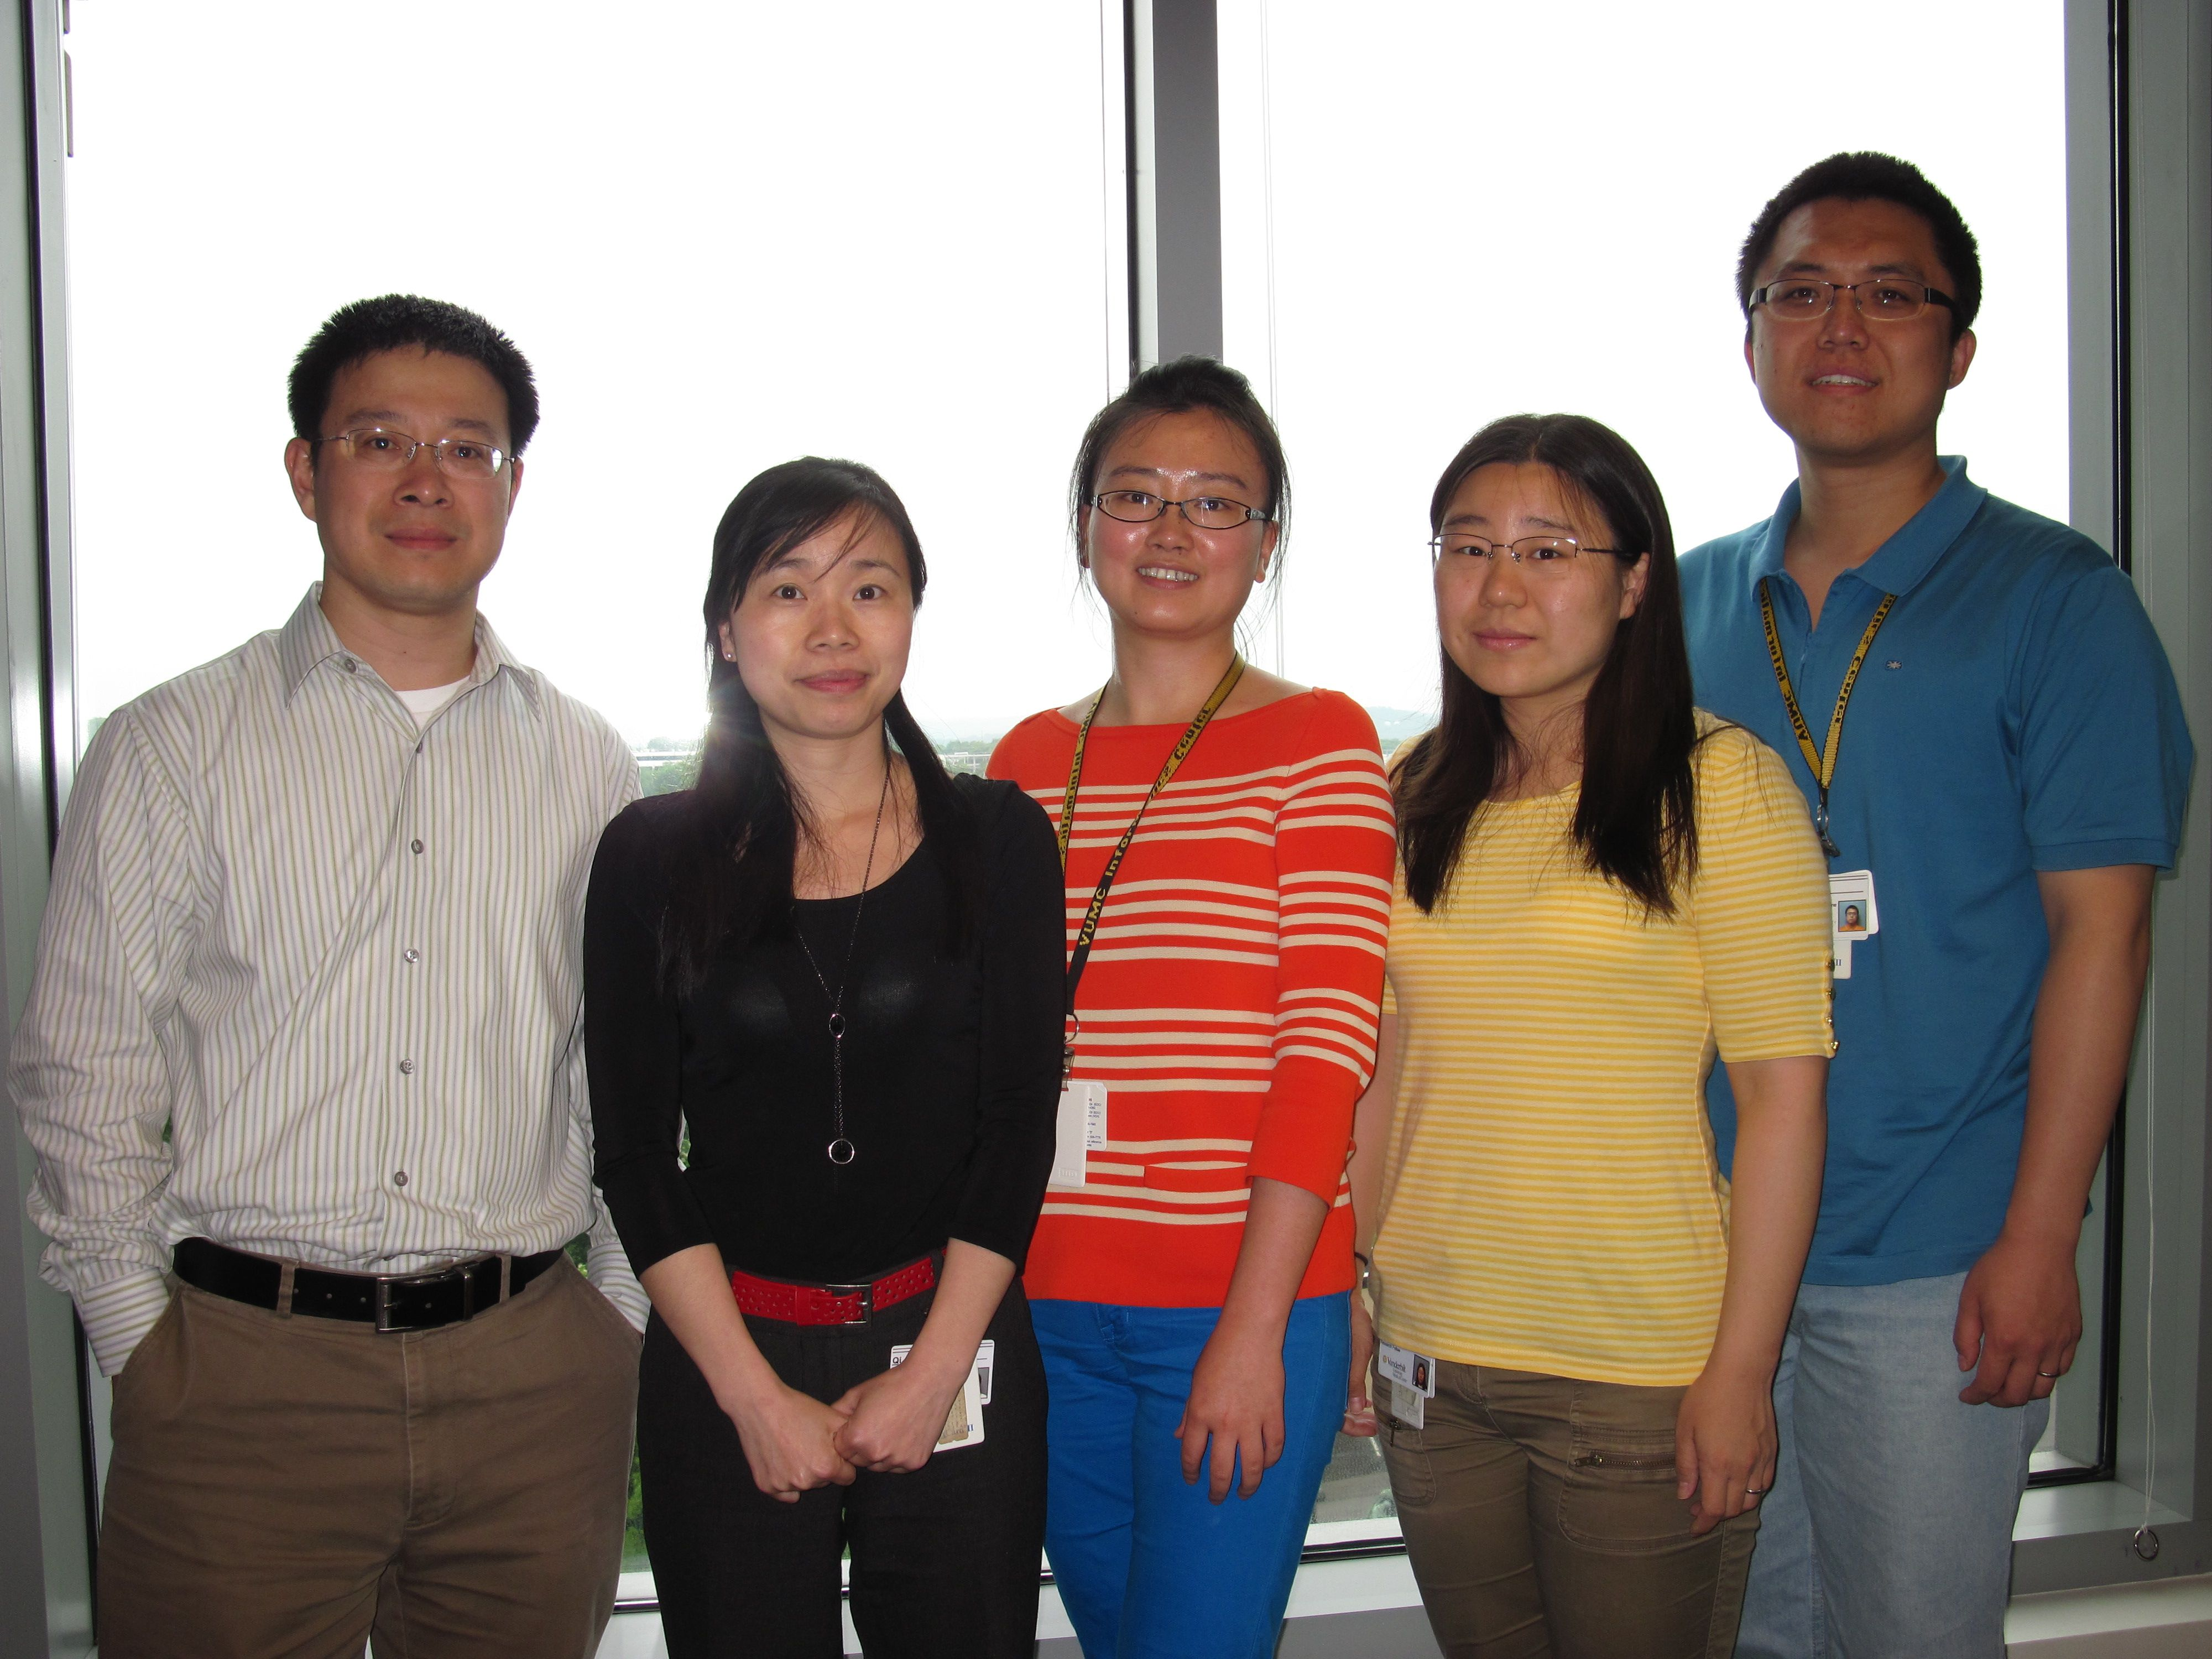
Acknowledgement
Jing Wang
Qi Liu
Xiaojing Wang
Jing Zhu
Dan Liebler
Rob Slebos
Dave Tabb
Zhiao Shi
CPTAC Network
TCGA Network
Funding:
SAIC RFP S13-029
NCI U24 CA159988
NIGMS R01 GM088822
NCI P50 CA095103
NIMH P50 MH096972

Slide 25
Let Us Meet Again
We welcome you all to our future conferences of OMICS Group International
Please Visit:
www.omicsgroup.com
www.conferenceseries.com
www.pharmaceuticalconferences.com

