Slide 1
The Pursuit of Prevention of Renal failure in an imperfect world-Is it possible in the 21st century?
By: Baskar , WDHB, Renal Service Auckland New Zealand
Presented at : “4th International Conference on Nephrology and Therapeutics” – Baltimore USA

Slide 2
International Society of Nephrology (ISN) and the International Federation of Kidney Foundations (IFKF) .
World Kidney Day is a joint initiative between ISN & IFKF.
World Kidney Day started in 2006 and has not stopped growing ever since.
^{They didn’t do this for fun}
Its not a single day prevention programme

Slide 3
Diabetes in New Zealand
257,776 New Zealanders have been diagnosed with diabetes
Every day, around 50 more people are diagnosed-that’s 2 every hour
Diabetes currently costs the health system around $600 million per year
Those most at risk of diabetes are Maori, Pacific Islanders and South Asians
Diabetes is a major contributors to heart disease, stroke, and kidney disease
^{Diabetes NZ 2014}

Slide 4
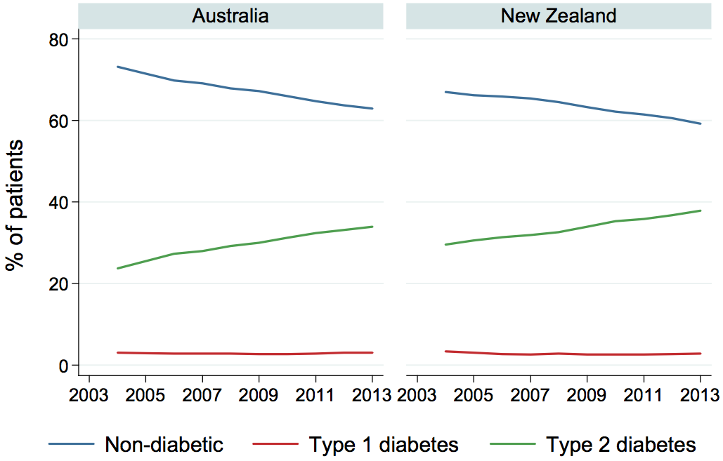
Diabetic status at end of year
Source : ANZDATA REGISTRY 2014

Slide 5
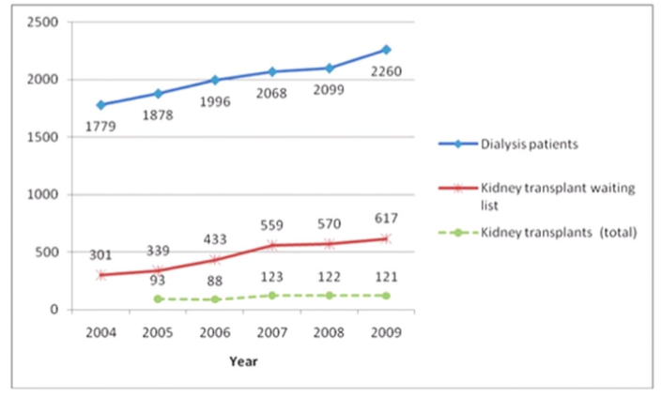
Dialysis Numbers - ANZDATA

Slide 6
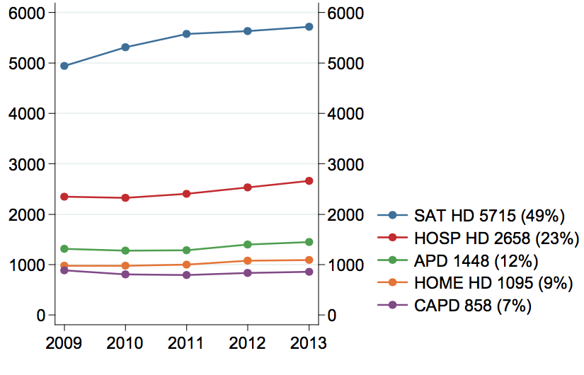
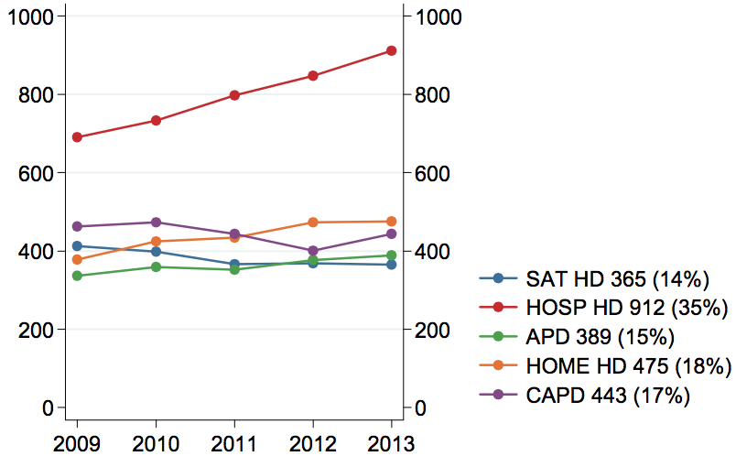
Method and location of dialysis Australia & New Zealand, 2009 - 2013
Australia
New Zealand
Source : ANZDATA REGISTRY 2014

Slide 7
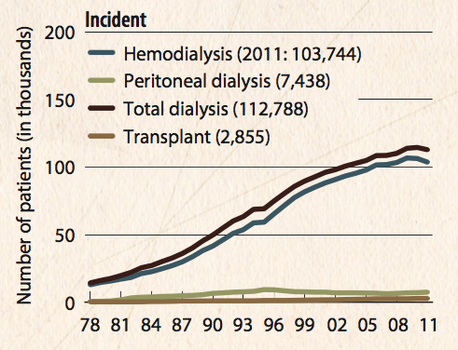
Incident counts (USRDS), by modality

Slide 8
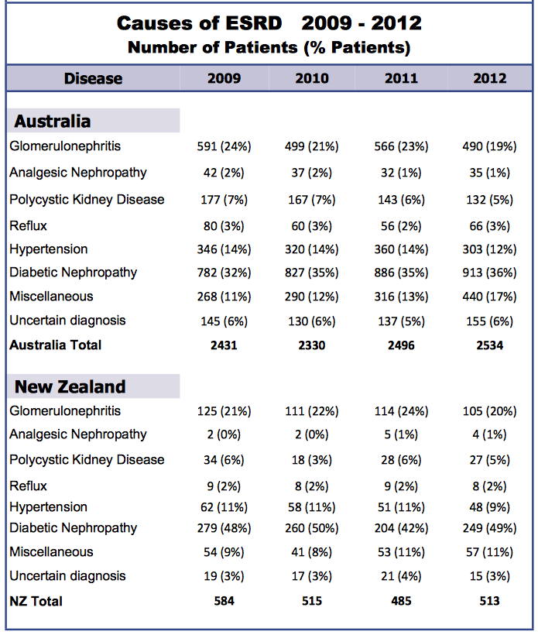
Causes of ESRD in Australia & New Zealand
Source : http://www.anzdata.org.au/anzdata/AnzdataReport/36thReport/ANZDATA_36th_Annual%20_Report.pdf

Slide 9
Causes of ESRD in NZ. These are the diseases which can be prevented
Disease | 2009 | 2010 | 2011 | 2012
New Zealand
Glomerulonephritis | 125 (21%) | 111 (22%) | 114 (24%) | 105 (20%)
Analgesic Nephropathy | 2 (0%) | 2 (0%) | 5 (1%) | 4 (1%)
Ploycystic Kidney Disease | 34 (6%) | 18 (3%) | 28 (6%) | 27 (%)
Reflux | 9 (2%) | 8 (2%) | 9 (2%) | 8 (2%)
Hypertension | 62 (11%) | 58 (11%) | 51 (11%) | 48 (9%)
Diabetic Nephropathy | 279 (48%) | 260 (50%) | 204 (42%) | 249 (49%)
Miscellaneous | 54 (9%) | 41 (8%) | 53 (11%) | 57 (11%)
Uncertain Diagnosis | 19 (3%) | 17 (3%) | 21 (4%) | 15 (3%)
NZ Total | 584 | 515 | 485 | 513
Source : http://www.anzdata.org.au/anzdata/AnzdataReport/36thReport/ANZDATA_36th_Annual%20_Report.pdf

Slide 10
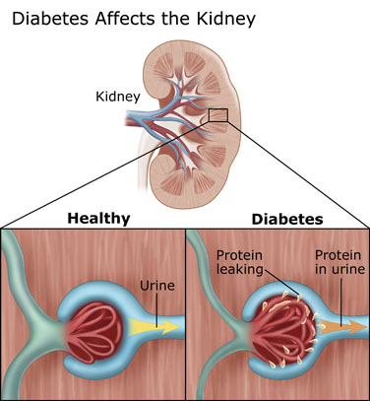
Diabetic Nephropathy
Disease | 2009 | 2010 | 2011 | 2012
New Zealand
Diabetic Nephropathy | 279 (48%) | 260 (50%) | 204 (42%) | 249 (49%)
Source : Google images

Slide 11
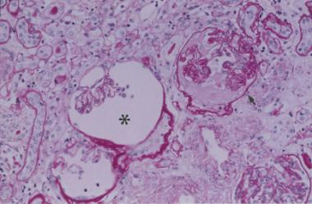
Nephrosclerosis - (Hypertension)
Disease | 2009 | 2010 | 2011 | 2012
New Zealand
Hypertension | 62 (11%) | 58 (11%) | 51 (11%) | 48 (9%)
Source : Google images

Slide 12
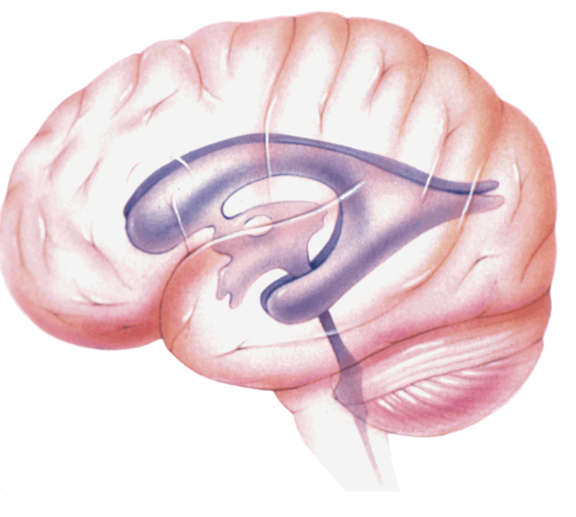
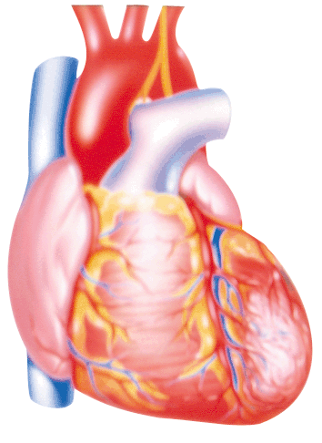
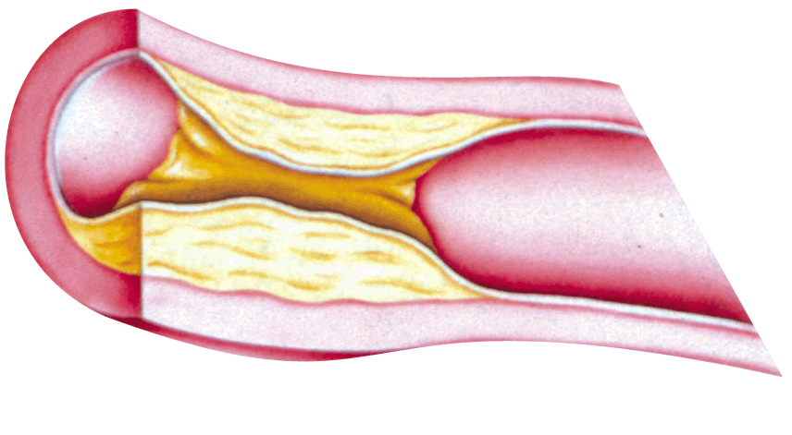
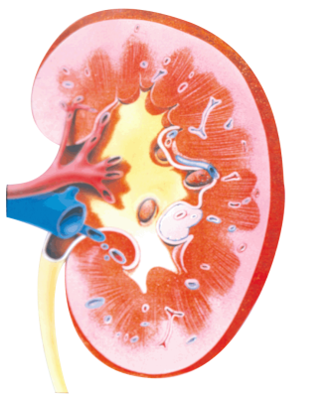
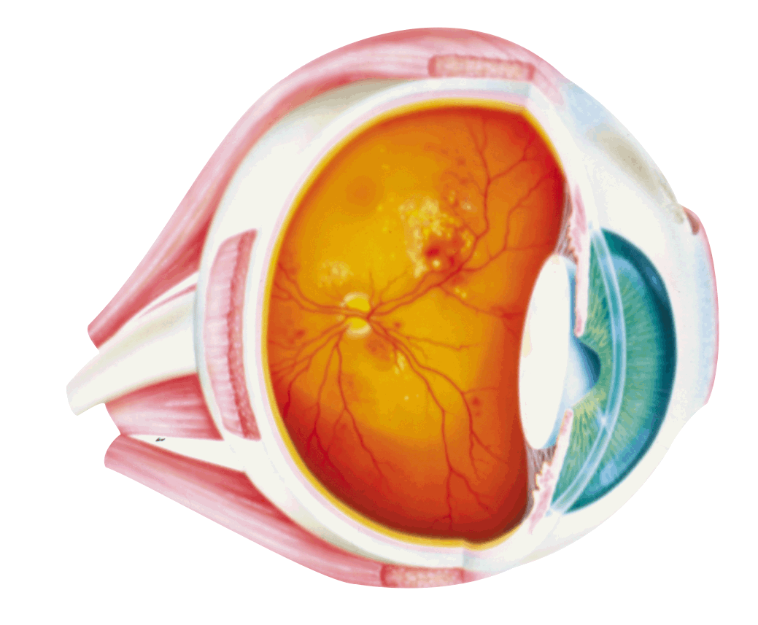
Complications of Hypertension:
End-Organ Damage
Hypertension
Hemorrhage,
Stroke
LVH, CHD, CHF
Peripheral
Vascular
Disease
Renal Failure,
Proteinuria
Retinopathy
CHD = coronary heart disease
CHF = congestive heart failure
LVH = left ventricular hypertrophy
Chobanian AV, et al. JAMA. 2003;289:2560-2572.
Notes:
12

Slide 13
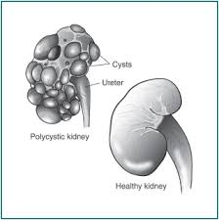
Polycystic Kidney Disease
Disease | 2009 | 2010 | 2011 | 2012
New Zealand
Ploycystic Kidney Disease | 34 (6%) | 18 (3%) | 28 (6%) | 27 (%)
Source : Google images

Slide 14
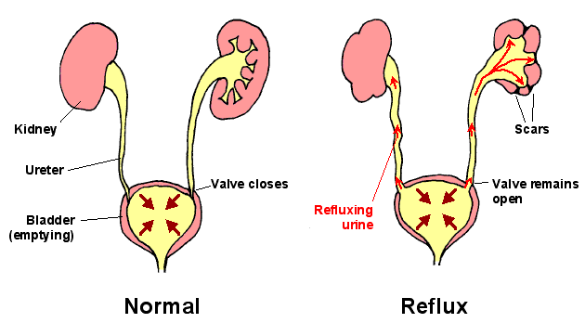
Reflux Nephropathy
nephrosclerosis
Disease | 2009 | 2010 | 2011 | 2012
New Zealand
Reflux | 9 (2%) | 8 (2%) | 9 (2%) | 8 (2%)
Source : Google images

Slide 15
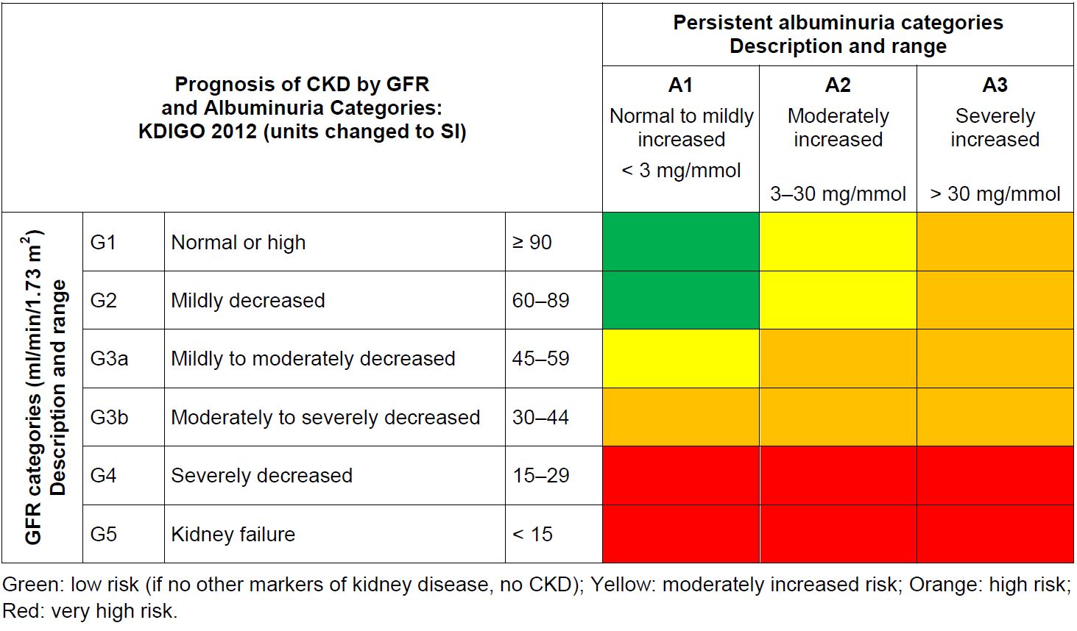

Slide 16
Important work done by Kidney Health New Zealand
Education Manager, Carmel Gregan-Ford and KHNZ Team:
Community education targeting groups at high risk of kidney disease.
Support for education of kidney health professionals.
Kidney Awareness Week and World Kidney Day activities.
KHNZ, funded by Ministry of Health, has developed 15 web-based patient information resources – 5 for children and their families
Working with other groups
Diabetes New Zealand, Christchurch & Auckland Diabetes Societies.

Slide 17
Guide to CKD management in general practice
Most CKD is managed in primary care.
Most people with CKD do not know they have the condition.
Groups at high risk of CKD can be screened with simple blood and urine tests.
KHNZ has developed a GP Guide for the Management of Chronic kidney Disease16 and a number of DHBs have guidelines for patient referral for specialist care.
Source : Kidney Health NZ

Slide 18
Goals for best practice in managing CKD
Those people with, or at risk of, progressive CKD are identified and effectively managed.
Cardiovascular risk is reduced through optimal lifestyle modification, smoking cessation, blood pressure control, glycaemic control, and use of statins.
Effective blood pressure control reduces albuminuria and slows the rate of decline of eGFR in many patients.
The incidence and prevalence of CVD, progressive CKD and ESKD, and their associated morbidity and mortality rates, fall over time.
Source : Ministry of Health

Slide 19
A community-based model of care improves blood pressure control and delays progression of proteinuria, left ventricular hypertrophy and diastolic dysfunction in Māori and Pacific patients with type 2 diabetes and chronic kidney disease: a randomized controlled trial

Slide 20
Maori, Pacific People, and Renal Failure
Diabetes as a primary cause of new ESRD
Maori 63%
Pacific 65%
European 17%
Compared to people of European origin
The diabetes prevalence in Maori 2.5 x
ESRD incidence in Maori secondary to Diabetes is 13.6 x and GN is 1.9 x
ESRD incidence in Pacific people secondary to diabetes is 14.7 x and GN 2.3 x
Ministry of Health. Tatau Kahukura: Maori health Chartbook.2006 ANZDATA

Slide 21
DEFEND Study
All had baseline and 1 year evaluation
All patients had standard GP, Diabetic clinic and Renal Clinic care
Half of the patients were randomised to the Community Care group.
They had monthly home visits by a Health Care Assistant (polynesian) to check BP and compliance and in concert with the study nurse and Research Fellow change meds according to a simple algorithm (single daily dosing –ACEi/diuretic/CCB/other-doses optimised)
Source :April 6th Nephrology Dialysis Transplantation 2010

Slide 22
DEFEND
Source :April 6th Nephrology Dialysis Transplantation 2010

Slide 23
Summary of the study
Frequent home visiting led to improved BP control with associated reduction in proteinuria and stabilisation of LV mass
This occurred because of improved medication prescribing and adherence.
We could not demonstrate an effect on renal function (small numbers)

Slide 24
Preventive measures by Kidney Help trust
Co-operated for survey 89.61%
Disease known earlier 30.34%
Preferred private therapy 24.60%
Co-operated for treatment 78.91%
Hypertension controlled to 140/90 95.77%
Hb A1 C reduced 10% or more 76.79%
New diabetes each year 0.32%
New hypertension each year 0.55%

Slide 25
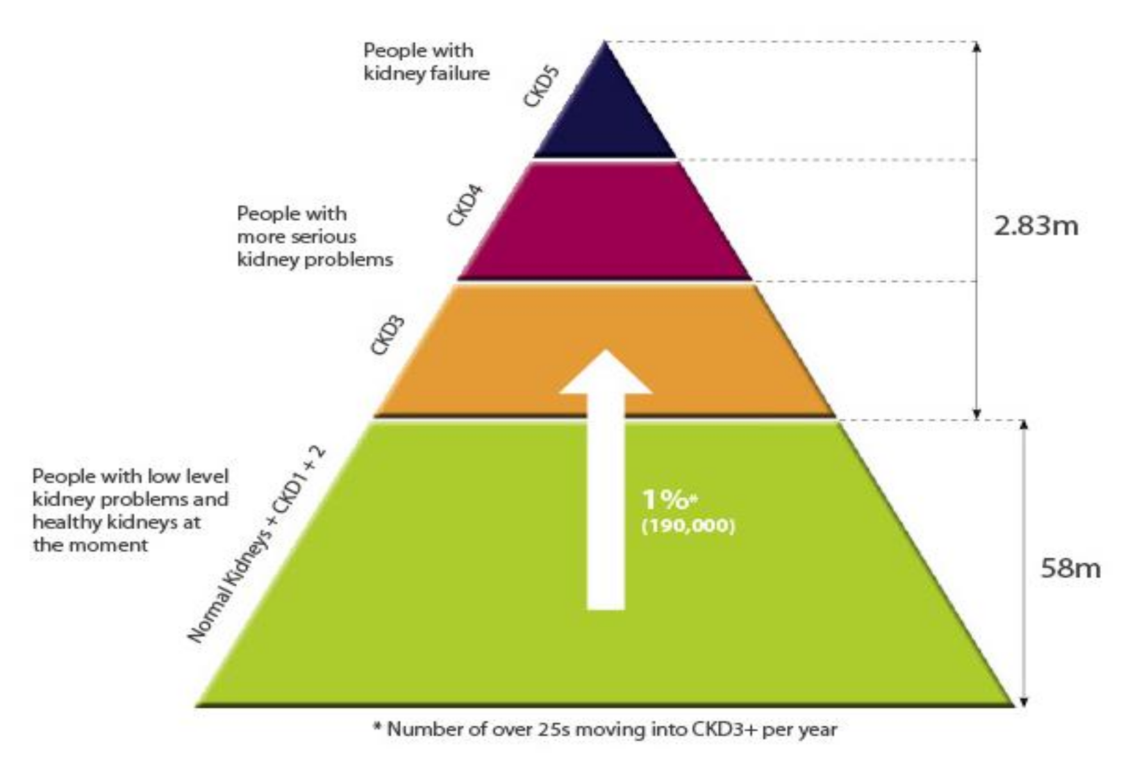
Probable number with CKD in NZ
(adapted from various sources)
2011 5,200
14,700
343,000
323,000
42,000*
4.17 m

Slide 26
CKD Nurse Specialist in NZ
Transplant Dialysis
ESRD preparation
Prevent Progression172:000 CKD Nurse Specialist
Initiator / Injury Protein leakage, Proteinuria
Locate people at Risk DIABETES.
HYPERTENSION, ELDERLY, Screening High Risk Population

Slide 27
Solutions to our problem
Education
Prevention & screening in community
Early detection in the community
Early treatment in primary care supported by specialists
Awareness in the community
All renal staff must take responsibility to promote prevention.

Slide 28
What changes we need
Television, print media and social media adds to raise awareness national wide
Create Apps for awareness and prevention
Free or affordable GP service for those who can’t afford
Screening renal functions starting from the age 25.
Participation in screening programs
More funds should be allocated for prevention programme

Slide 29
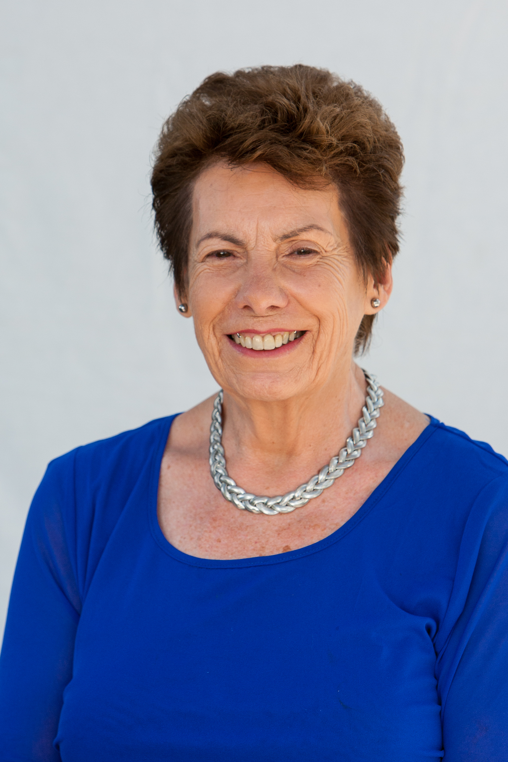
Auckland Kidney Society
Nora Van der Schrieck , Executive Director, Kidney Society
23 years Home haemo partner for husband
Transformed a small support group into a professional organisation providing free community support for 3000 families living with kidney failure
Encouraging people with CKD and their families to adopt a healthier lifestyle and avoid dialysis
Partnering with a District Health Board to promote Live Kidney Donation

Slide 30
Acknowledgements
WDHB, CEO and GM
WDHB, Renal service CNM
WDHB, Nephrologist’s and all staff
John Collins, Associate Prof Nephrology
Kidney Health NZ, Education Manager and team
Auckland Kidney society, Executive Director
Diabetes NZ
NZBDP
Organizing committee of - 4th international conference on Nephrology
Thank my family

Slide 31

Treating Renal failure in NZ is the state of the art
But
Pursuit of prevention of renal failure in 21st century is the art of Possible

