Slide 1
3rd International Conference on Agriculture and Horticulture
Identification of Sources of Resistance against Fusarium Wilt of Castor
Bharati N Bhat, M. Rajasri and P. Bindupriya
Professor Jayashankar Telangana State Agricultural University
(formerly ANGRAU)

Slide 2
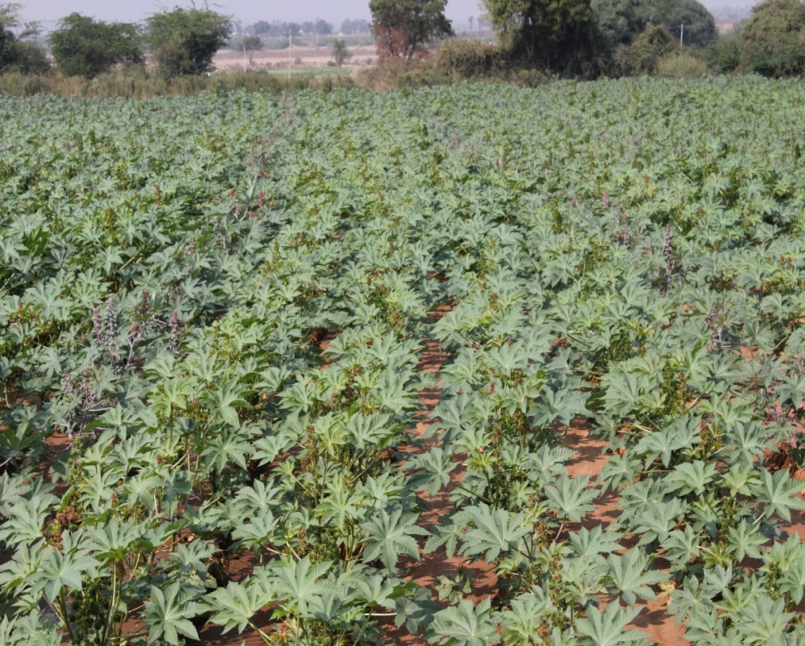
Castor (Ricinus communis L.) is an important industrial non- edible oilseed crop, which plays a vital role in Indian vegetable oil economy. It is particularly suitable for resource poor farmers located in marginal areas due to its ability to thrive under low rainfall and soil fertility conditions.

Slide 3
Castor oil uses :
Lubricants, paints, soap making, nylon ropes, cosmetics, plastics, textiles, leather industry, transport and pharmaceuticals
Area - 10.96 lakh ha.
Production - 11.43 lakh tons
Productivity - 1261 kg / ha
(source: INDIASTAT, 2013)

Slide 4
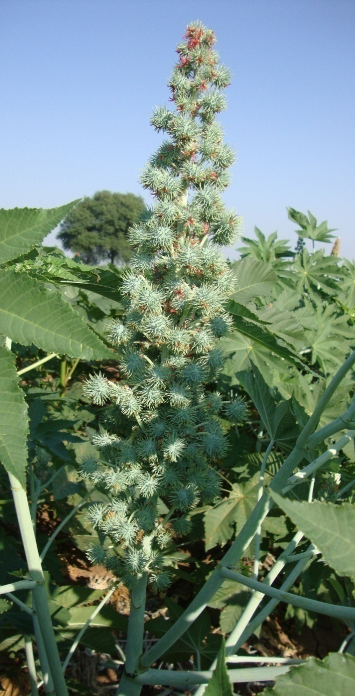
Major constraints in castor production
Abiotic constraints
Prolonged dry spells at vegetative and flowering stages
Growing of castor in marginal/sub-marginal lands having shallow depth and poor fertility
Biotic constraints
Botrytis grey rot, Fusarium wilt
Castor semi-looper, Spodoptera, Capsule borer
Other constraints
Lack of Quality seed of high yielding varieties/hybrids
Lack of improved management

Slide 5
Castor diseases
Name of the Disease | Causal organism
Fungal Diseases
Seedling blight | Phytophthora parasitica
Damping-off | Pythium aphanidermatum
Root rot | Macrophomina phaseolina
Rust | Melampsora ricini
Anthracnose | Colletotrichum ricini
Collar rot | Rhizoctonia solani
Capsule rot | Cladosporium oxysporum
Alternaria leaf spot /blight | Alternaria ricini
Cercospora leaf spot | Cercospora ricinella
Phyllosticta leaf spot | Phyllosticta basensis
Powdery mildew | Leveillula taurica
Wilt | Fusarium oxysporum f.sp. ricini

Slide 6
Verticillium wilt | Verticillium alboatrum
Botrytis grey rot | Botrytis ricini
Fruit rot | Phytophthora colacasiae
Nematodes | Aphelenchoides Meloidogyne sp., Pratylenchus sp., Radopholus similis, Rotylenchulus reniformis
Bacterial Diseases
Bacterial leaf spot | Xanthomonas axonopodis pv. ricinicola
Bacterial wilt | Pseudomonas solanacearum
Crown gall | Agrobacterium tumefaciens
Viral Diseases
Tobacco ring spot | Tobacco ring spot virus

Slide 7
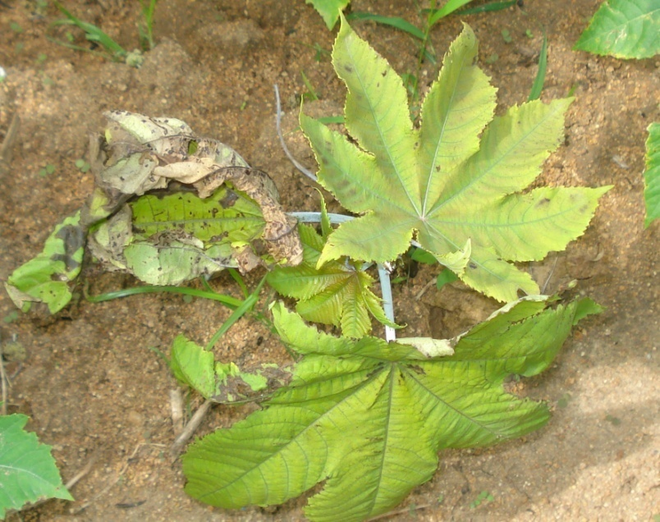
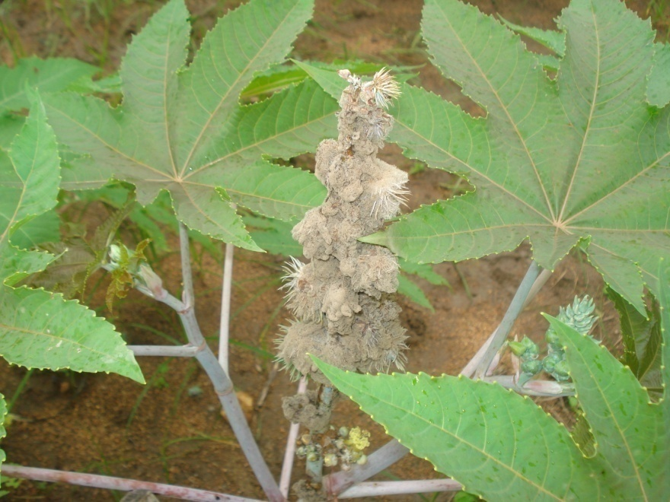
Castor crop is threatened by two devastating diseases
Wilt
Grey rot

Slide 8
Castor wilt caused by Fusarium oxysporum f.sp. ricini is one of the yield limiting factors in the major castor growing areas of the state.
The major strategy to manage the disease is to deploy wilt resistant varieties/hybrids.
Host plant resistance as a tactics of disease management can be highly effective looking into the soil-borne nature of the pathogen.
Most of the commercial hybrids are susceptible to wilt, and Long term rotations are not feasible.
Evolution of new races of pathogen that overcome widely used R genes is a continuous process necessitating identification of diverse sources of resistance.

Slide 9
Macroconidia on stem
Transverse section
Longitudinal section of stem

Slide 10
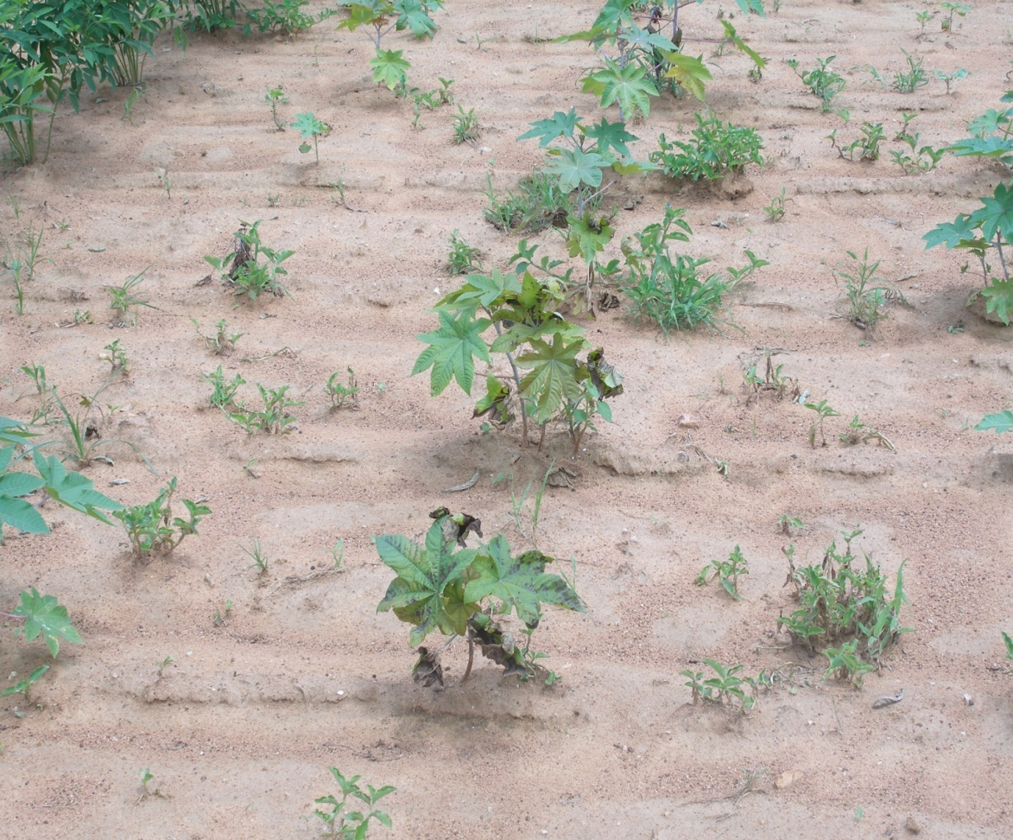
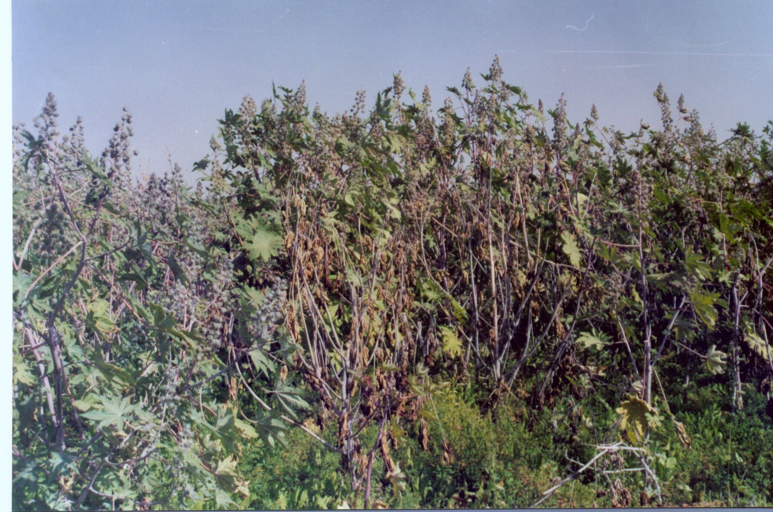
Fusarial wilt affected fields
Wilt at vegetative stage
Wilt at maturity stage

Slide 11
Disease cycle of castor wilt caused by Fusarium oxysporum f.sp. ricini
Stem infection
Infected castor plant
Survival in crop debris
Formation of tyloses
Deformation of vessels
Blackening of
stem
Fungal growth in pith region
Discoloration of
xylem tissue
Fungus in xylem vessels
Production of conidia
Root infection
Germinating conidia
Microconidia
Macroconidia
Entry through primary & secondary roots

Slide 12
Castor Varieties / Hybrids
S.No | Variety/ Hybrid | Duration (days) | Yield (q/acre) | Special features
1 | Kranthi (V) | 90 - 150 | 8 –10 | Bold seed Tolerant to drought
2 | Haritha (V) | 90-180 | 9 –11 | Resistant to Fusarium wilt
3 | Kiran (V) | 90 -150 | 7– 8 | Low incidence of Grey rot
4 | Jwala (V) | 90-150 | 9-10 | Resistant to Fusarium wilt
5 | DCH-177 (H) | 90-180 | 9-10 | Resistant to Fusarium wilt
6 | GCH-4 (H) | 90-180 | 9-10 | High yielding
7 | DCH 519 (H) | 90-180 | 9-10 | Resistant to Fusarium wilt
8 | PCH-111 (H) | 90-180 | 10-12 | Resistant to Fusarium wilt

Slide 13
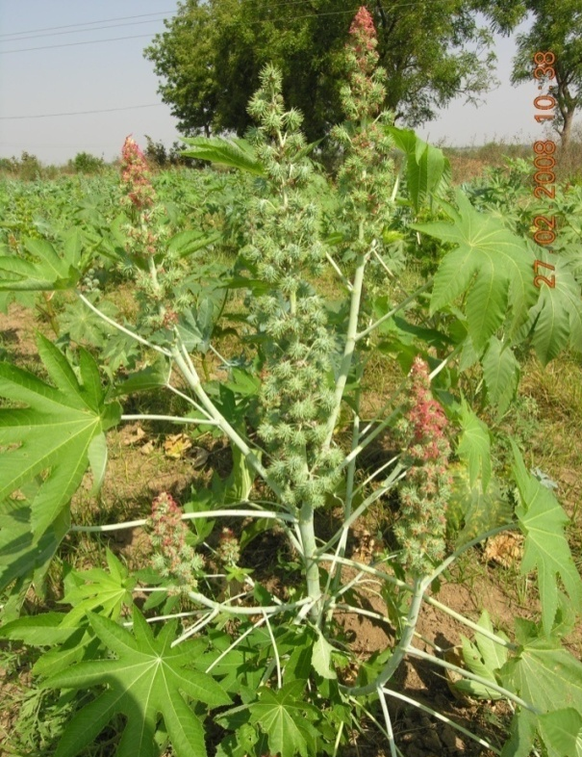
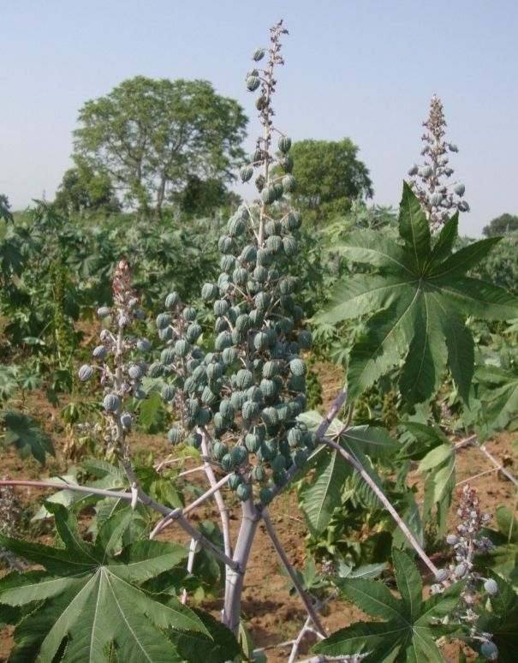
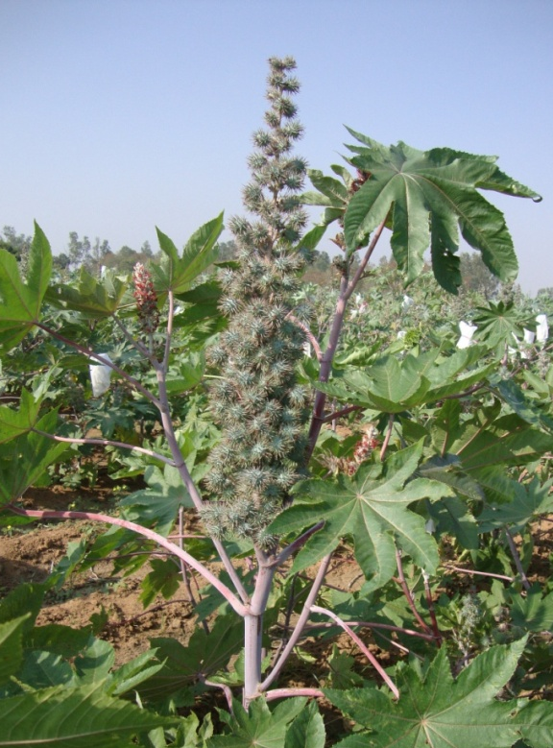
KRANTI
90-150 days
13-17 q/ha
Bold seeds
Drought tolerant
HARITHA
90-180 days
14-16 q/ha
Wilt resistant
KIRAN
90-180 days
12-15 q/ha
Drought tolerant

Slide 14
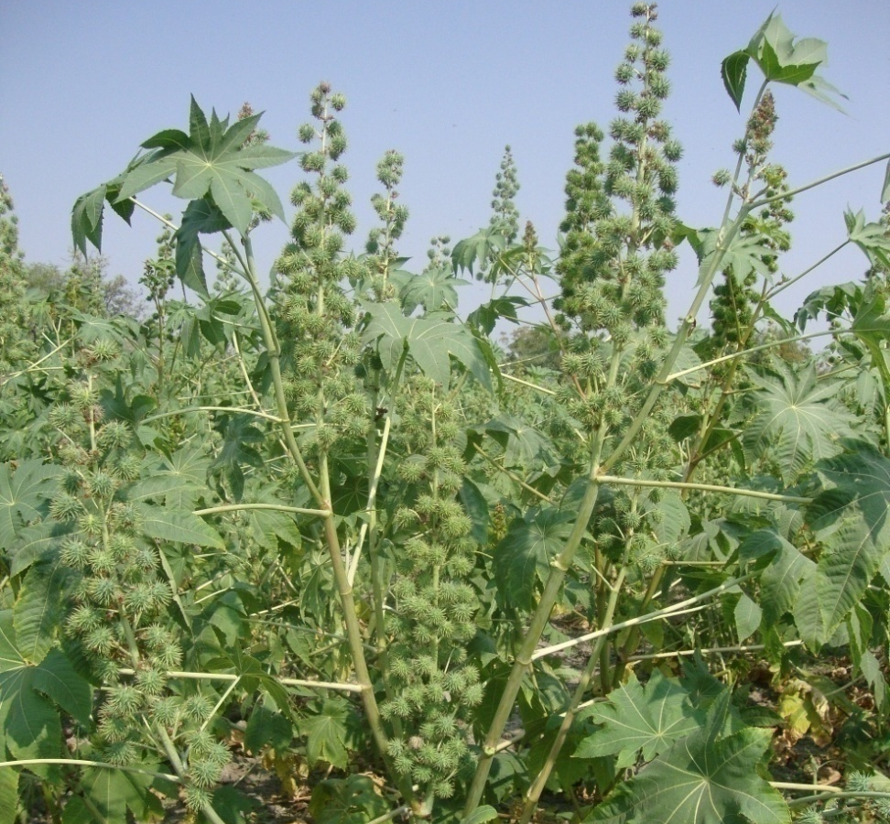
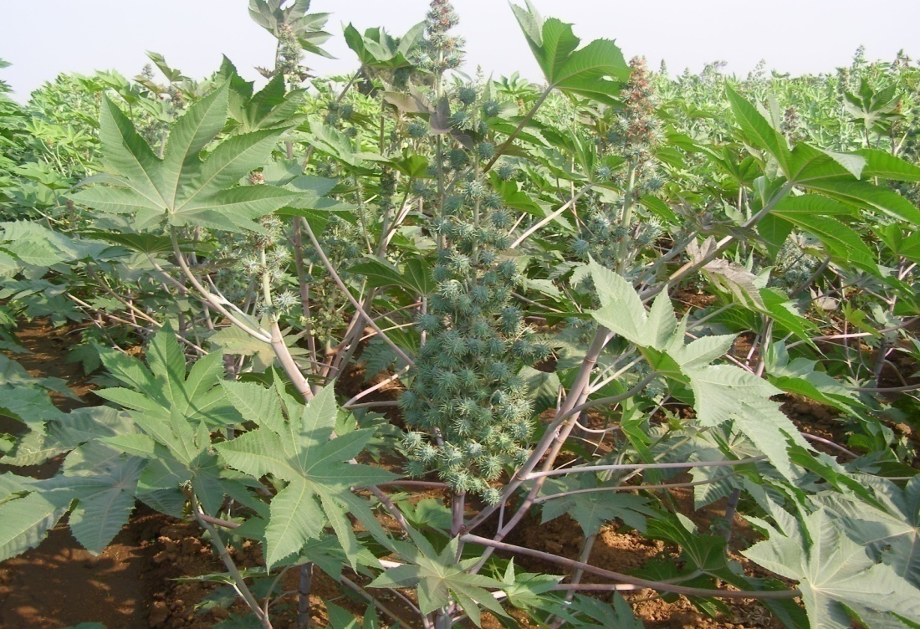
PCH 222
Wilt Resistant
Red Stem, Single bloom, Partially
spiny
PCH-111
Wilt Resistant
Green stem, single bloom, spiny
capsule

Slide 15
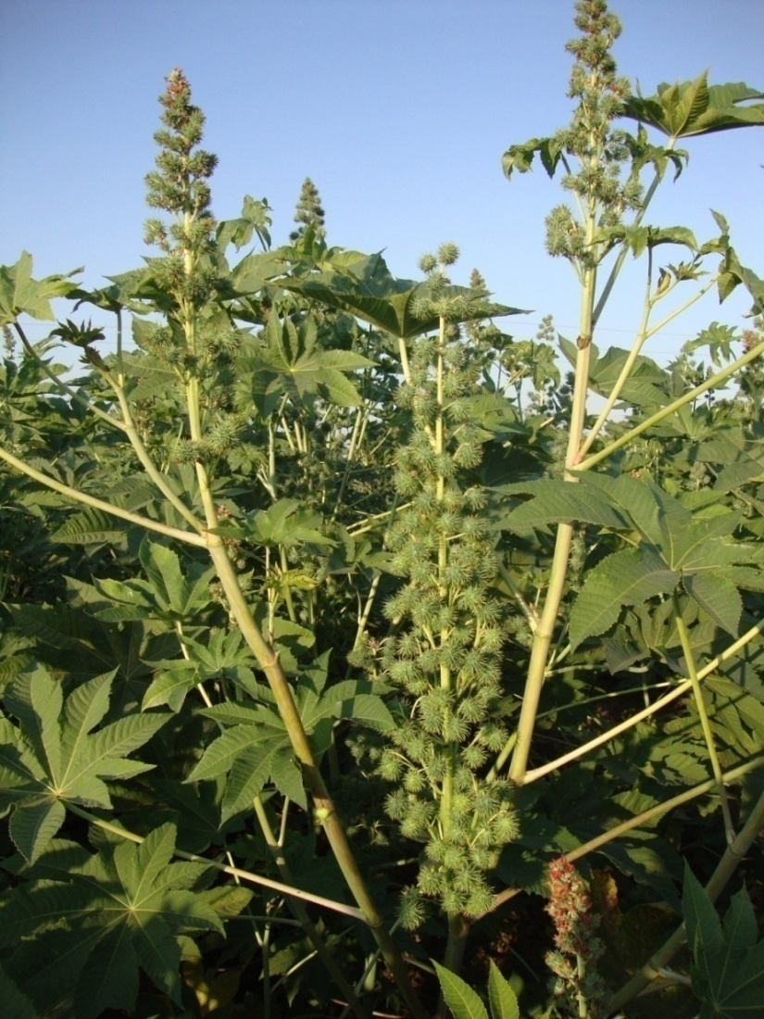
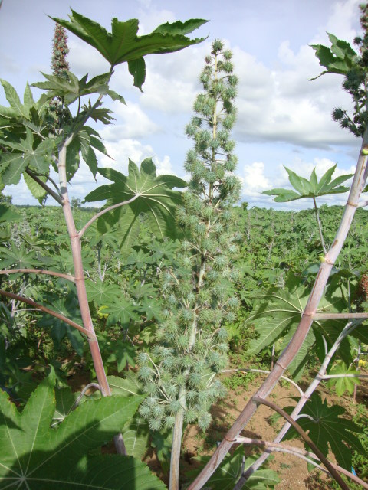
Hybrids in Pipeline
PCH 234
Wilt Resistant
Green Stem, Spiny, Single bloom
PCH 244
Wilt Resistant
Red Stem , Triple bloom, Spiny

Slide 16
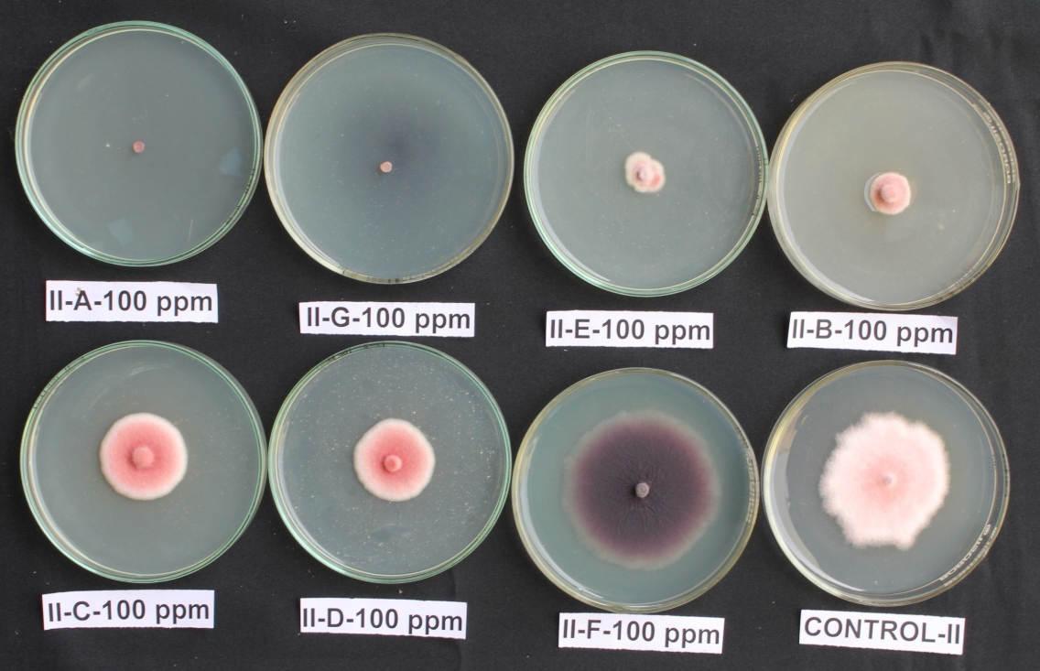
In vitro screening of Fusarium isolates with
different fungicides
Three isolates of Fusarium were screened in vitro with twenty fungicides at 100, 250, 500, 1000, 1500 and 2500 ppm.
Five fungicides viz., carbendazim, carbendazim + mancozeb, benomyl, propiconazole and hexaconazole are found effective at 100 ppm.

Slide 17
METHODOLOGY
During Kharif 2013, ninteen germplasm lines and 39 advanced breeding material were screened with high disease pressure in wilt sick plot at Regional Agricultural Research Station, Palem, along with susceptible check Kranthi and resistant check Haritha.

Slide 18
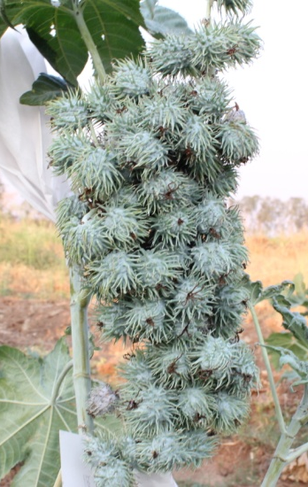
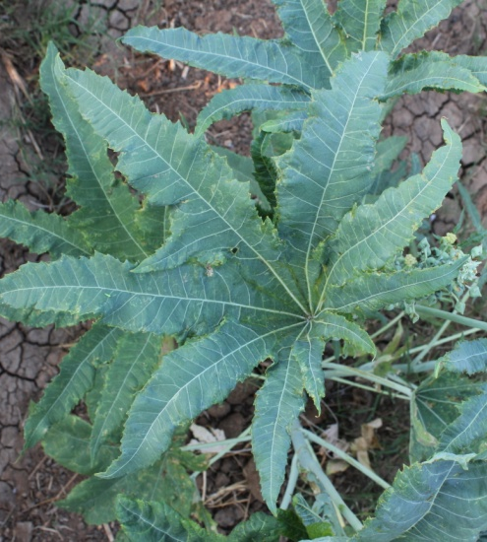
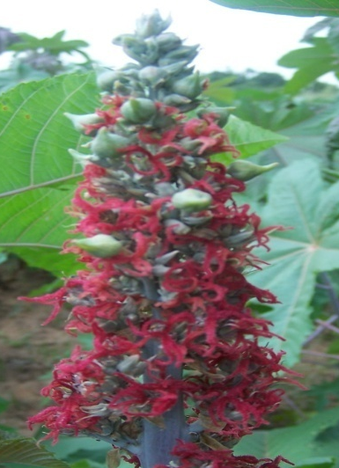
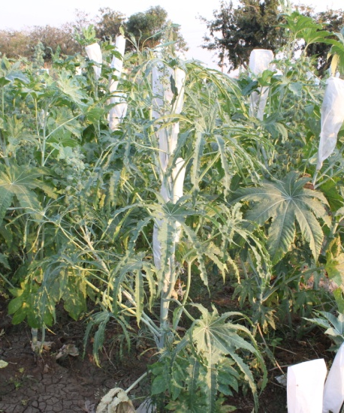
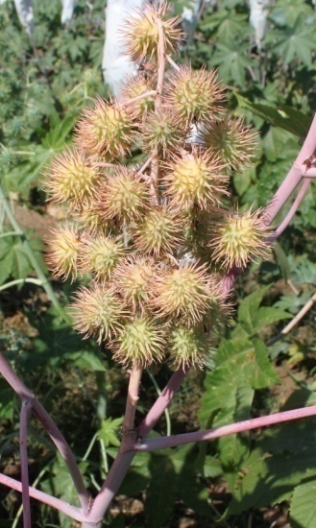
Range of Characters in Germplasm
Stem colour – Green, Red and pink
Bloom Nature - Zero, Single, Double and Triple
Capsule Nature – Spiny and non-spiny
Plant Height (cm) – 34.0 to 151.3 cm
No. of nodes to primary spike – 7.33 to 19.0
Primary spike length (cm) – 8.67 to 51.33 cm
No. of spikes per plant – 1.67 to 11.33
Single plant yield – 94.00 to 288.0 g

Slide 19
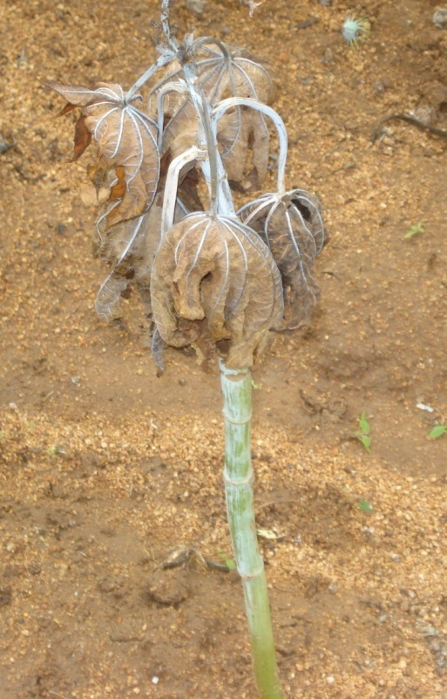
Screening of castor germplasm against wilt disease
Ninteen germplasm accessions supplied by DOR, Hyd. were evaluated for their reaction to wilt disease
Date of sowing – 04-7-2013, Row length – 6m (Sick plot)
Inoculum load of wilt sick plot was maintained by adding Fusarium culture mass multiplied on sorghum seeds at regular intervals and maintained through out the season.
Checks – Kranti (Susceptible)
Haritha (Resistant) after every five test entries
Wilt incidence recorded at monthly intervals up to 150 DAS
Inoculum load of wilt sick plot
Month | Inoculum load (c.f.u.)
July - August | 2.0X10³
November -December | 2.25X10³

Slide 20
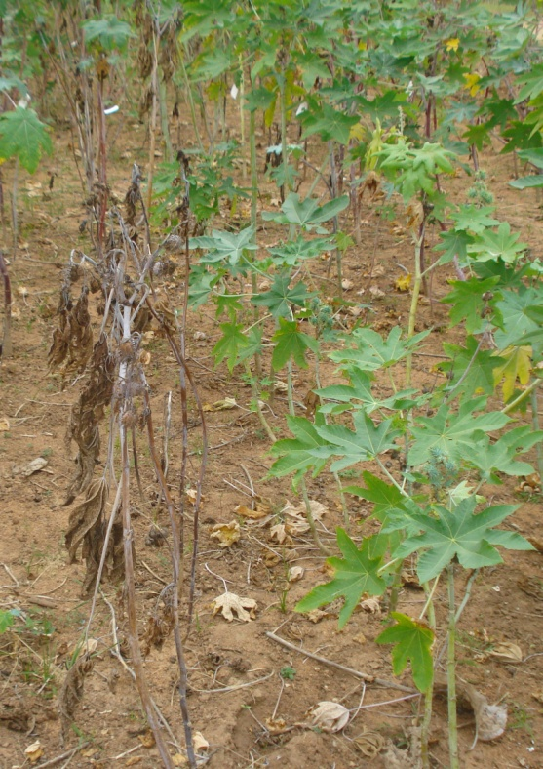
Eight entries were found to be resistant to wilt (< 20 % wilt) up to 150 days after sowing viz., RG- 1221,1624, 2746, 2781, 2787, 2800, 3105 and RG-3093
Disease incidence Susceptible Check
(Kranti) : 90.6%
Disease incidence Resistant Check
(Haritha) : 0.0%
Kranti
Haritha

Slide 21
Sl.No. | Germpalsm Entry | 30 DAS | 60 DAS | 90 DAS | 120 DAS | 150 DAS
1 | RG- 1221 | 0.0 | 12.5 | 12.5 | 18.8 | 18.8
2 | 1624 | 0.0 | 0.0 | 0.0 | 0.0 | 0.0
3 | 1631 | 6.3 | 6.3 | 18.8 | 25.0 | 31.3
4 | 1834 | 18.8 | 25.0 | 25.0 | 37.5 | 37.5
5 | 2090 | 31.3 | 43.8 | 56.3 | 75.0 | 87.5
6 | 2430 | 6.7 | 13.3 | 13.3 | 20.0 | 26.7
7 | 2432 | 15.4 | 61.5 | 76.9 | 84.6 | 92.3
8 | 2661 | 14.3 | 14.3 | 28.6 | 42.9 | 42.9
9 | 2746 | 6.3 | 6.3 | 12.5 | 12.5 | 12.5
10 | 2781 | 0.0 | 0.0 | 6.3 | 6.3 | 6.3
11 | 2787 | 14.3 | 14.3 | 14.3 | 14.3 | 14.3
12 | 2800 | 6.3 | 6.3 | 6.3 | 6.3 | 12.5
13 | 2809 | 9.1 | 27.3 | 36.4 | 45.5 | 45.5
14 | 2970 | 25.0 | 43.8 | 62.5 | 68.8 | 68.8
15 | 3016 | 7.14 | 35.7 | 50.0 | 57.1 | 57.1
16 | 3020 | 8.3 | 16.7 | 16.6 | 25.0 | 25.0
17 | 3105 | 0.0 | 0.0 | 0.0 | 0.0 | 0.0
18 | 3089 | 13.3 | 33.3 | 46.6 | 53.3 | 53.3
19 | 3093 | 6.3 | 6.3 | 12.5 | 12.5 | 12.5

Slide 22
Testing of advanced breeding material (varieties/hybrids) for their reaction to WILT
IHT (13), IVHT (15) and AVHT (11) entries supplied by DOR, Hyd. were evaluated for their reaction to wilt disease
Date of sowing – 04-7-2013
Design - RBD
Replications - 3
Checks – Kranti (Susceptible)
Haritha (resistant) after every five test entries
Wilt incidence was recorded up to 150 DAS (monthly intervals))

Slide 23
Wilt:
Trial | Entry | Reaction to Wilt
IHT | Nil | Less than 20% wilt infection up to 150 DAS
IVHT | 1305, 1308
AVHT-I | 1354

Slide 24
Wilt incidence in IHT at 30,60,90,120,150 days after sowing
Sl. No. | Entry | 30 DAS | 60DAS | 90DAS | 120DAS | 150DAS
1 | 1321 | 0.00 | 31.25 | 37.50 | 45.83 | 50.00
2 | 1322 | 12.34 | 27.40 | 31.57 | 36.22 | 41.35
3 | 1323 | 20.63 | 18.25 | 22.42 | 30.36 | 41.07
4 | 1324 | 0.00 | 9.89 | 20.90 | 23.93 | 26.31
5 | 1325 | 15.73 | 26.44 | 31.60 | 37.41 | 37.41
6 | 1326 | 15.14 | 40.56 | 51.11 | 63.89 | 76.67
7 | 1327 | 7.87 | 19.44 | 23.15 | 31.02 | 38.52
8 | 1328 | 4.46 | 21.13 | 23.51 | 25.89 | 27.98
9 | 1329 | 2.56 | 17.22 | 25.68 | 33.96 | 48.32
10 | 1330 | 21.58 | 33.40 | 49.86 | 61.47 | 76.57
11 | 1331 | 11.75 | 16.35 | 20.79 | 25.40 | 34.92
12 | 1332 | 14.60 | 24.13 | 26.51 | 33.65 | 48.10
13 | 1333 | 17.22 | 32.36 | 47.64 | 62.92 | 71.67

Slide 25
Wilt incidence in IVHT at 30,60,90,120,150 days after sowing
Sl. No. | Entry | 30 DAS | 60DAS | 90DAS | 120DAS | 150DAS
1 | 1301 | 4.76 | 20.24 | 25.00 | 31.85 | 34.23
2 | 1302 | 0.00 | 12.12 | 20.06 | 25.87 | 28.64
3 | 1303 | 9.29 | 34.07 | 42.88 | 52.47 | 57.88
4 | 1304 | 4.76 | 20.32 | 26.98 | 29.21 | 36.19
5 | 1305 | 2.08 | 6.25 | 17.93 | 20.0 | 20.0
6 | 1306 | 9.05 | 29.52 | 40.00 | 59.05 | 59.05
7 | 1307 | 7.91 | 17.48 | 20.04 | 24.83 | 27.61
8 | 1308 | 3.03 | 7.47 | 9.70 | 11.92 | 14.14
9 | 1309 | 10.42 | 29.58 | 42.22 | 50.56 | 54.86
10 | 1310 | 15.15 | 26.34 | 28.90 | 31.93 | 38.00
11 | 1311 | 10.71 | 16.27 | 16.27 | 21.83 | 28.31
12 | 1312 | 12.82 | 19.49 | 19.49 | 21.71 | 29.40
13 | 1313 | 13.68 | 32.82 | 40.17 | 44.96 | 56.41
14 | 1314 | 6.53 | 23.33 | 27.78 | 31.94 | 34.03
15 | 1315 | 8.12 | 14.39 | 26.00 | 28.77 | 37.82

Slide 26
Wilt incidence in AVHT at 30,60,90,120,150 days after sowing
Sl. No. | Entry | 30 DAS | 60DAS | 90DAS | 120DAS | 150DAS
1 | 1351 | 27.8 | 48.6 | 60.3 | 69.5 | 71.9
2 | 1352 | 4.2 | 23.5 | 23.5 | 27.6 | 36.1
3 | 1353 | 9.2 | 28.0 | 34.8 | 44.0 | 50.6
4 | 1354 | 2.1 | 7.2 | 9.3 | 11.9 | 13.9
5 | 1355 | 6.3 | 34.2 | 38.3 | 48.9 | 51.1
6 | 1356 | 2.2 | 21.7 | 29.1 | 31.3 | 33.5
7 | 1357 | 32.4 | 44.4 | 63.1 | 74.4 | 76.5
8 | 1358 | 2.6 | 17.6 | 19.8 | 24.0 | 24.0
9 | 1359 | 11.6 | 24.8 | 24.8 | 33.1 | 38.8
10 | 1360 | 23.4 | 30.5 | 32.7 | 39.7 | 44.5
11 | 1361 | 2.4 | 16.7 | 25.6 | 30.4 | 32.7

Slide 27
Confirmation of resistance to wilt
AVHT (11) and germplasm (19) entries were subjected to root dip inoculation and following entries were found to be resistant after 30 days
RG-1221, 1624, 1631, 2430, 2661,2746, 2781, 2787,2800,3200,3105,3093
AVHT- 1354,1356,1358,1361

Slide 28
Variability in wilt pathogen
F. oxysporum f.sp. ricini
Twenty five isolates of F. oxysporum f.sp. ricini supplied from DOR were sub cultured on PDA.
The flasks containing sorghum grains were inoculated with For cultures and incubated at 27º C and further used for root dip inoculation of following differential hosts
Selected variety/Hybrid
1 Kranthi
2 JI-35
3 VP-1
4 48-1
Haritha
DCS-9

Slide 29
Disease reaction (% wilt incidence) of Fusarium oxysporum f.sp. ricini isolates on 7 cultivars.
Isolate | Kranti | JI-35 | VP-1 | 48-1 | Haritha | DCS-9
FOR-1 | S | S | S | R | R | S
FOR-2 | S | S | S | S | R | S
FOR-3 | S | S | S | R | R | S
FOR-4 | S | S | S | R | R | R
FOR-5 | S | S | S | R | R | R
FOR-6 | S | S | S | R | R | R
FOR-7 | S | S | R | R | R | R
FOR-8 | S | S | S | R | R | R
FOR-9 | S | R | S | R | R | R
FOR-10 | S | S | S | R | R | R
FOR-11 | S | S | S | R | R | R
FOR-12 | S | S | S | R | R | R
FOR-13 | S | S | S | R | R | R
FOR-14 | R | S | R | R | R | R

Slide 30
Disease reaction (% wilt incidence) of Fusarium oxysporum f.sp. ricini isolates on 7 cultivars.
Isolate | Kranti | JI-35 | VP-1 | 48-1 | Haritha | DCS-9
FOR-15 | S | S | S | R | R | R
FOR-16 | S | S | S | R | R | R
FOR-17 | S | S | R | R | R | R
FOR-18 | S | S | S | R | R | R
FOR-19 | S | R | S | R | R | R
FOR-20 | S | S | S | R | R | R
FOR-21 | S | S | S | R | R | R
FOR- 22 | S | S | S | R | R | R
FOR-23 | S | S | S | R | R | S
FOR-24 | S | S | S | R | R | R
FOR- 25 | S | S | S | R | R | S
Cv.Kranti,JI-35,VP-1 showed susceptible reaction,whereas, 48-1, harita,DCs-9 showed resistant reaction. Isolates1,2,3 were more virulent

Slide 32
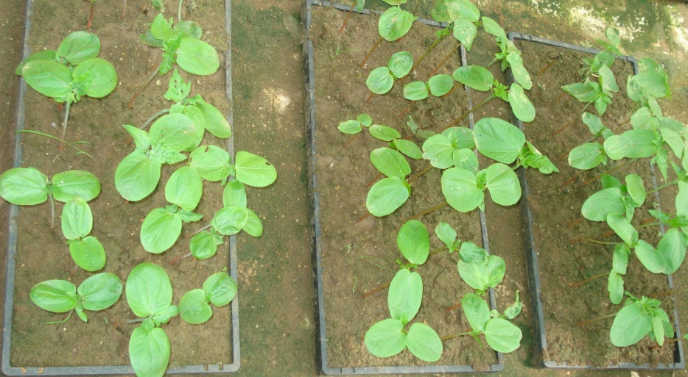
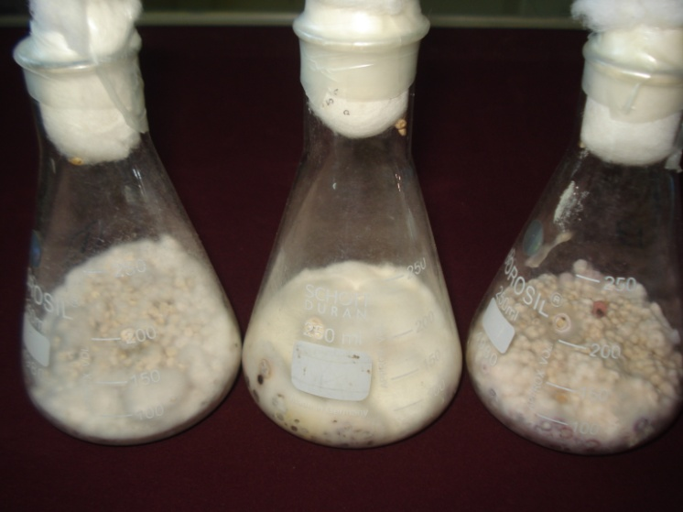
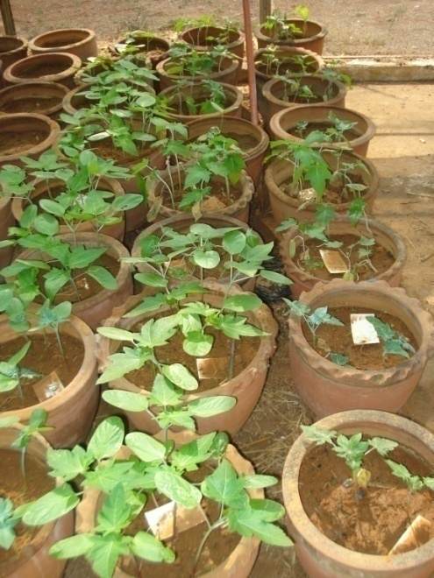
Root dip inoculation technique

Slide 33
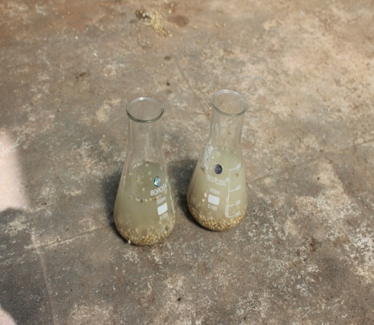
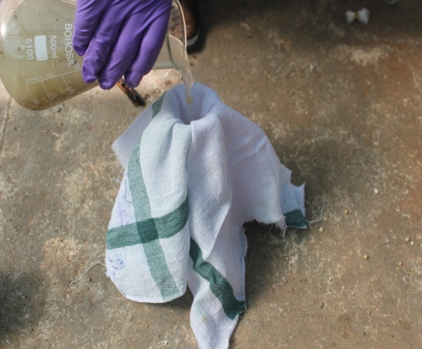
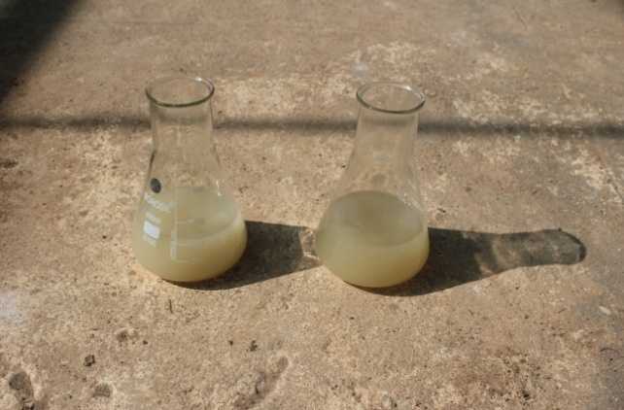
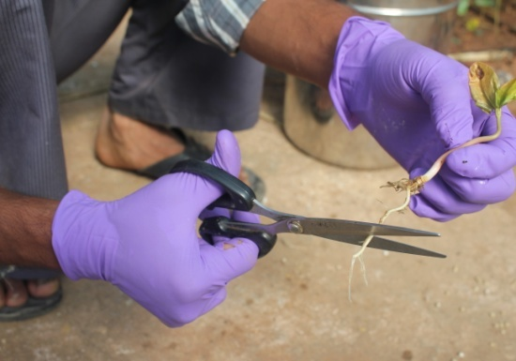
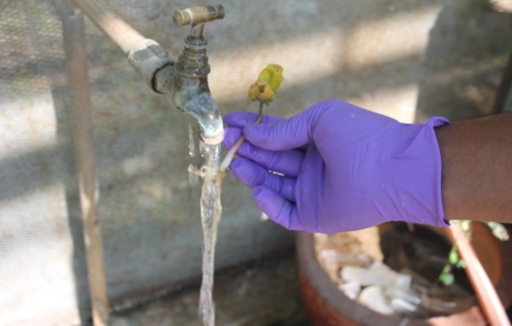
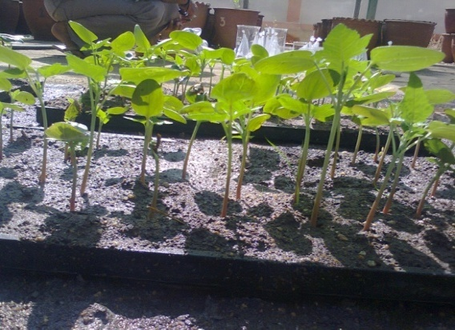
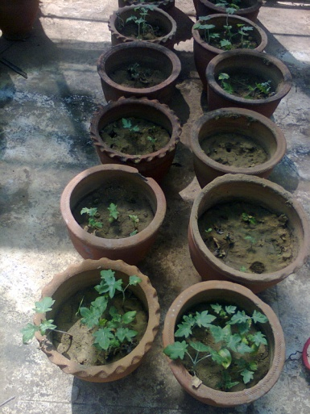
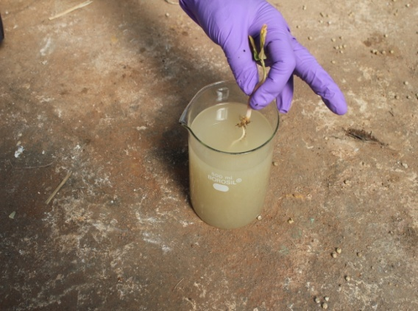
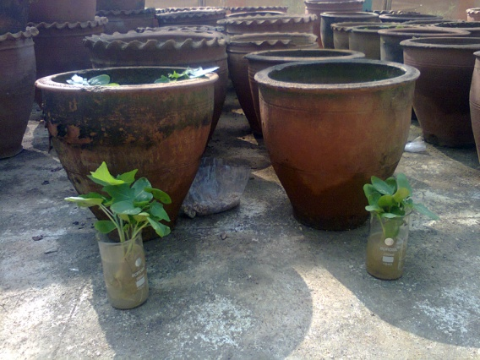
ROOT DIP INOCULATION TECHNIQUE

Slide 34
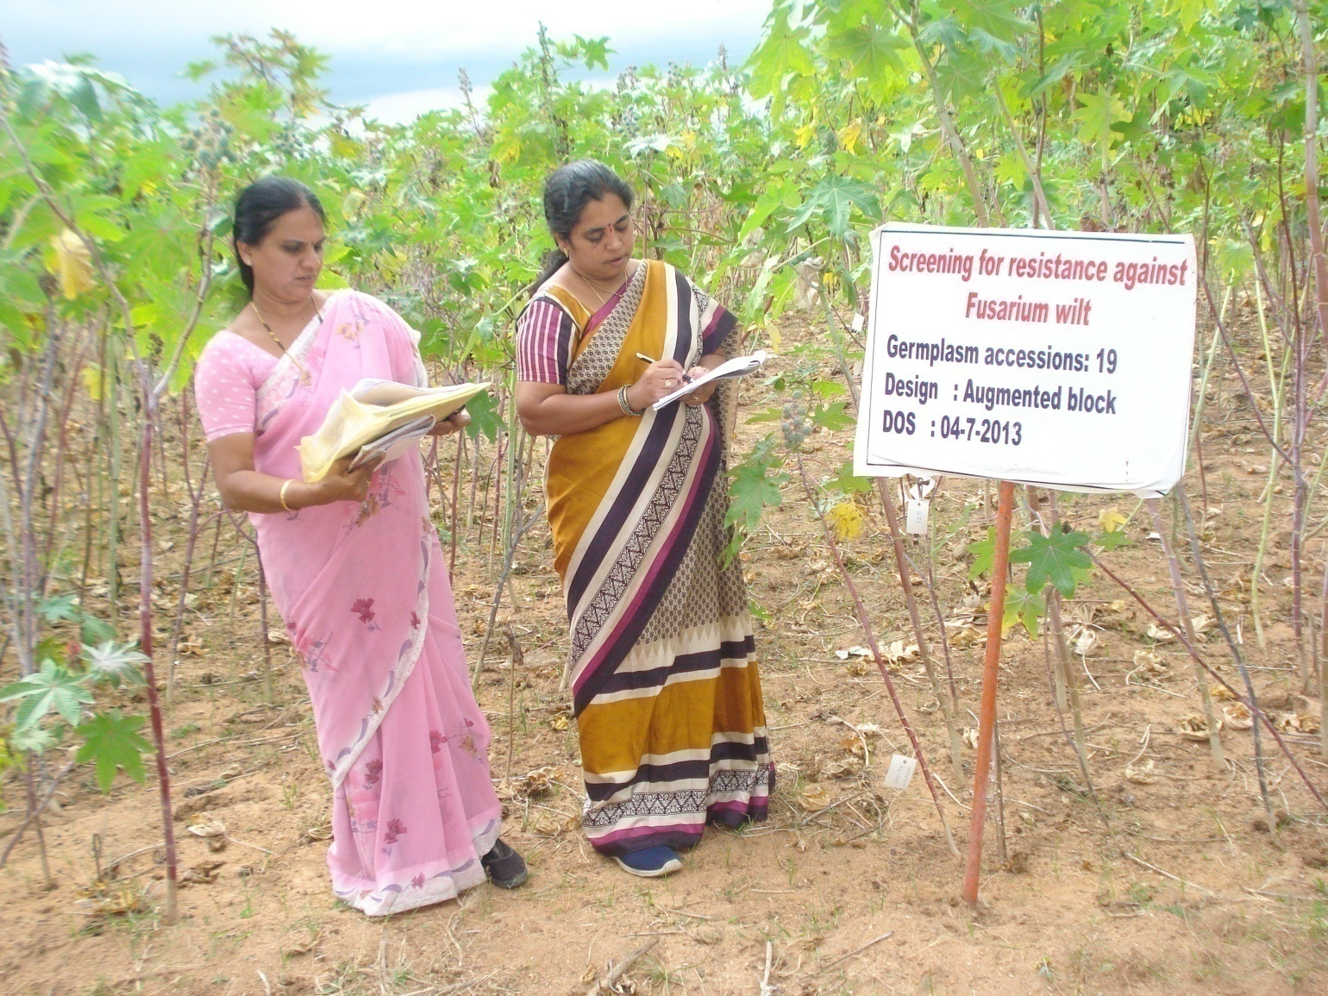
Monitoring team visit to wilt sick plot

Slide 35
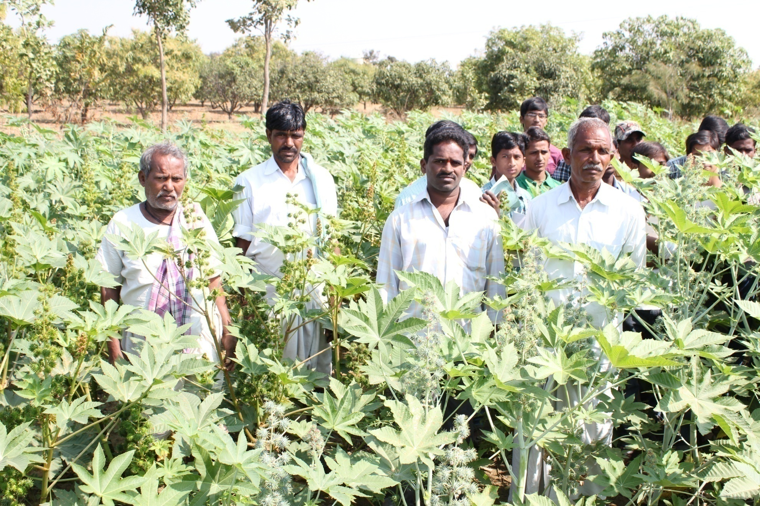
PCH-111: Hybrid seed production at Gangaram

Slide 36
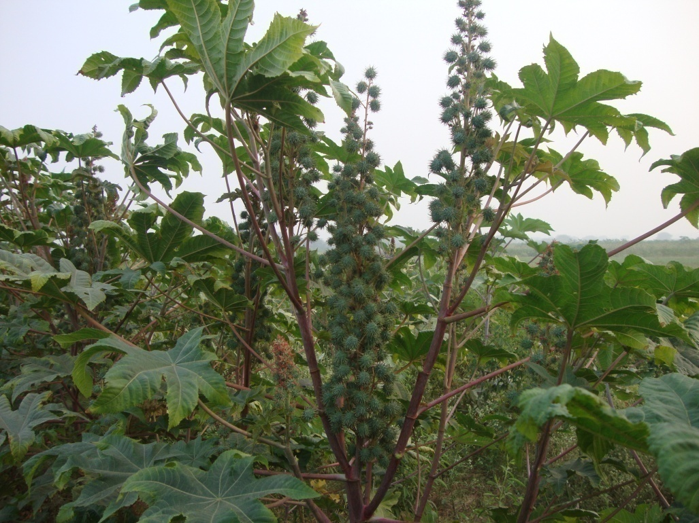
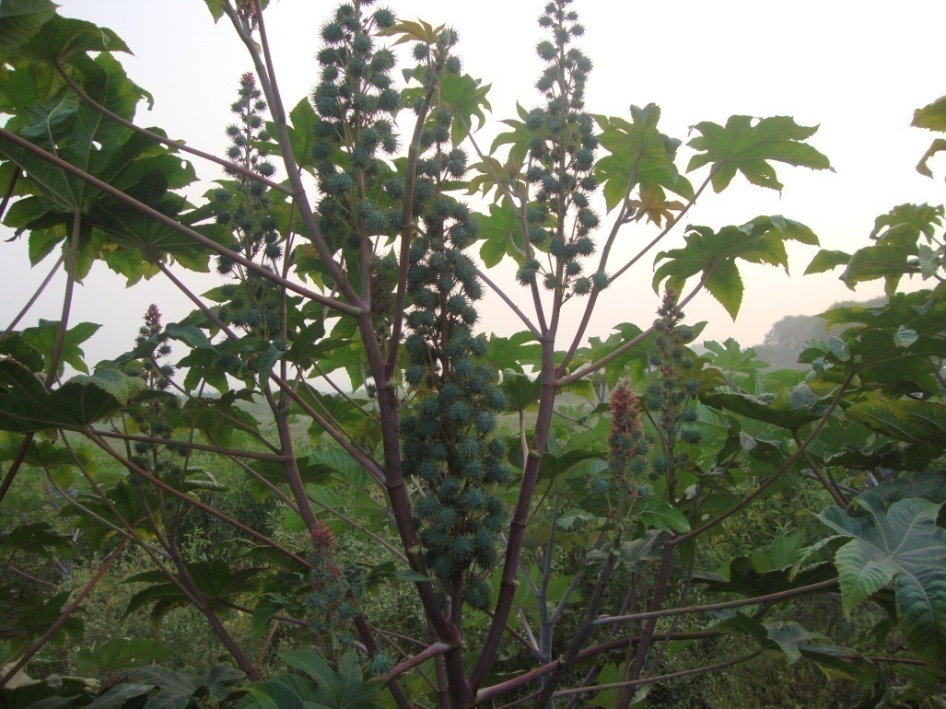
Hybrid Submitted for Release
PCH-222, a high yielding wilt resistant castor hybrid,
completed 3rd year of minikit testing.
Evalauted in Mahabubnahar, Ranga Reddy, Nalgonda,
Kadapa, Kurnool and Warangal districts during kharif & rabi

Slide 37
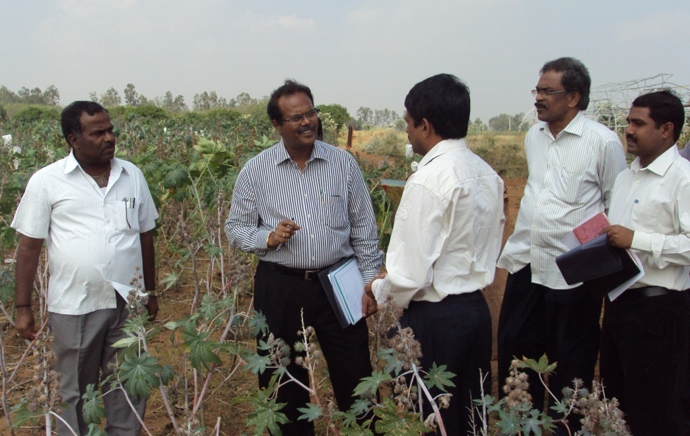
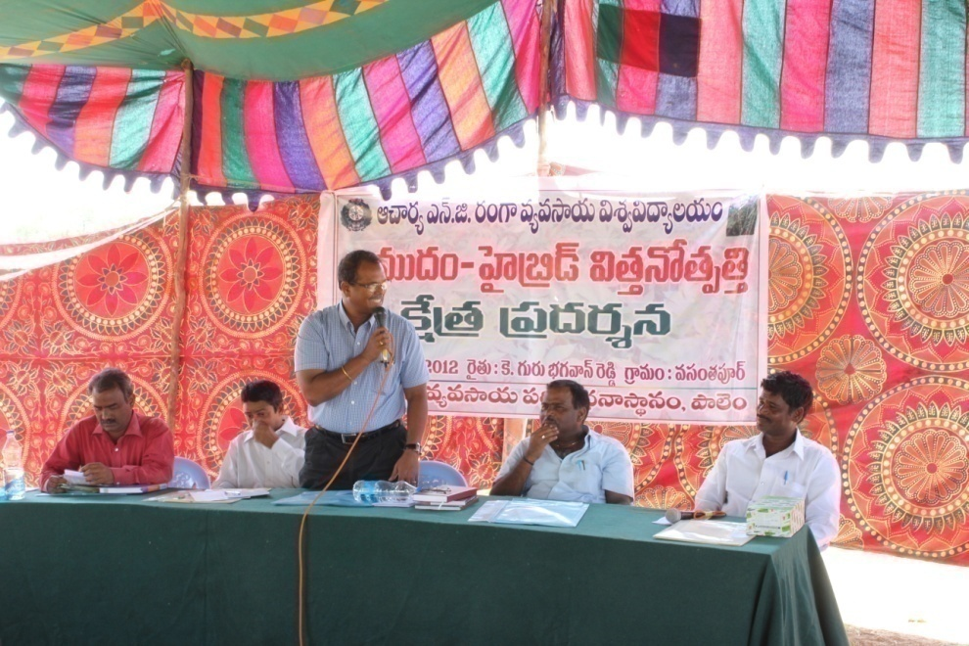
Project Director, DOR Dr. K.S. Vara Prasad visited on 30-10-11

Slide 38
Sl.No. | Entry | 30 DAS | 60 DAS | 90 DAS | 120 DAS | 150 DAS
1 | RG-558 | 0.0 | 0.0 | 0.0 | 0.0 | 0.0
2 | RG-3408 | 0.0 | 8.3 | 16.7 | 16.7 | 16.7
3 | RG-3017 | 0.0 | 14.3 | 28.6 | 42.9 | 42.9
4 | RG-3018 | 0.0 | 0.0 | 8.3 | 8.3 | 8.3
5 | RG-3020 | 0.0 | 8.3 | 16.7 | 16.7 | 16.7
6 | RG-3041 | 0.0 | 13.3 | 13.3 | 20.0 | 26.7
7 | RG-3105 | 0.0 | 0.0 | 7.7 | 7.7 | 7.7
8 | RG-1268 | 7.7 | 35.7 | 57.1 | 64.3 | 71.4
9 | RG-1631 | 0.0 | 8.3 | 25.0 | 33.3 | 41.7
10 | RG-1922 | 0.0 | 28.6 | 28.6 | 28.6 | 28.6
11 | RG-2301 | 10.0 | 36.4 | 54.5 | 54.5 | 54.5
12 | RG-2388 | 11.1 | 20.0 | 40.0 | 40.0 | 40.0
13 | RG-2602 | 7.1 | 26.7 | 46.7 | 46.7 | 46.7
14 | RG-2606 | 0.0 | 7.1 | 14.3 | 35.7 | 50.0
15 | RG-2661 | 0.0 | 0.0 | 0.0 | 7.7 | 15.4
16 | RG-2717 | 0.0 | 8.3 | 25.0 | 33.3 | 41.7
17 | RG-2746 | 0.0 | 7.7 | 15.4 | 30.8 | 30.8
18 | RG-2758 | 0.0 | 13.3 | 26.7 | 26.7 | 33.3
19 | RG-2781 | 0.0 | 7.1 | 7.1 | 7.1 | 7.1
20 | RG-2788 | 0.0 | 22.2 | 33.3 | 33.3 | 33.3
21 | RG-2820 | 0.0 | 13.3 | 20.0 | 20.0 | 26.7
22 | RG-2829 | 0.0 | 14.3 | 28.6 | 35.7 | 35.7

Slide 39
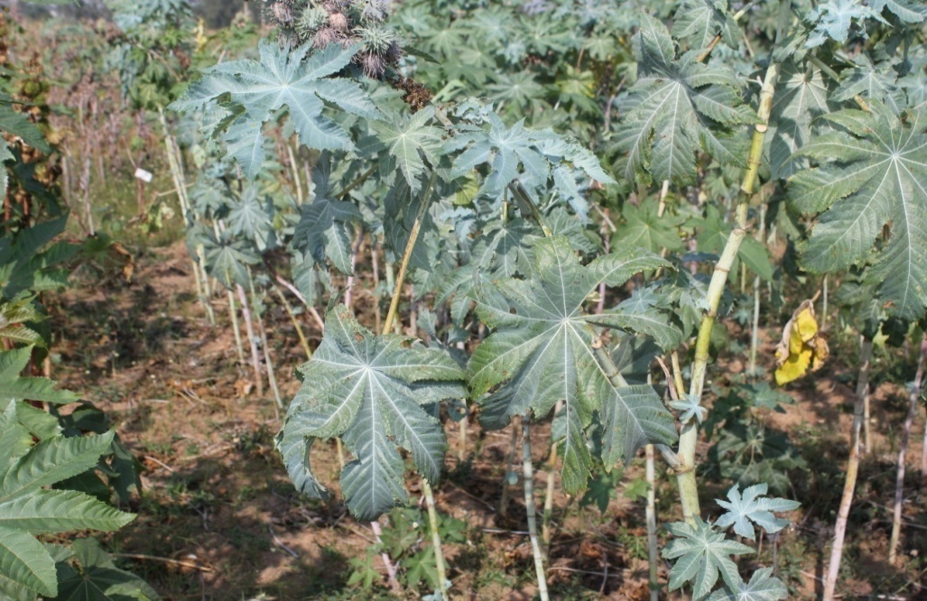
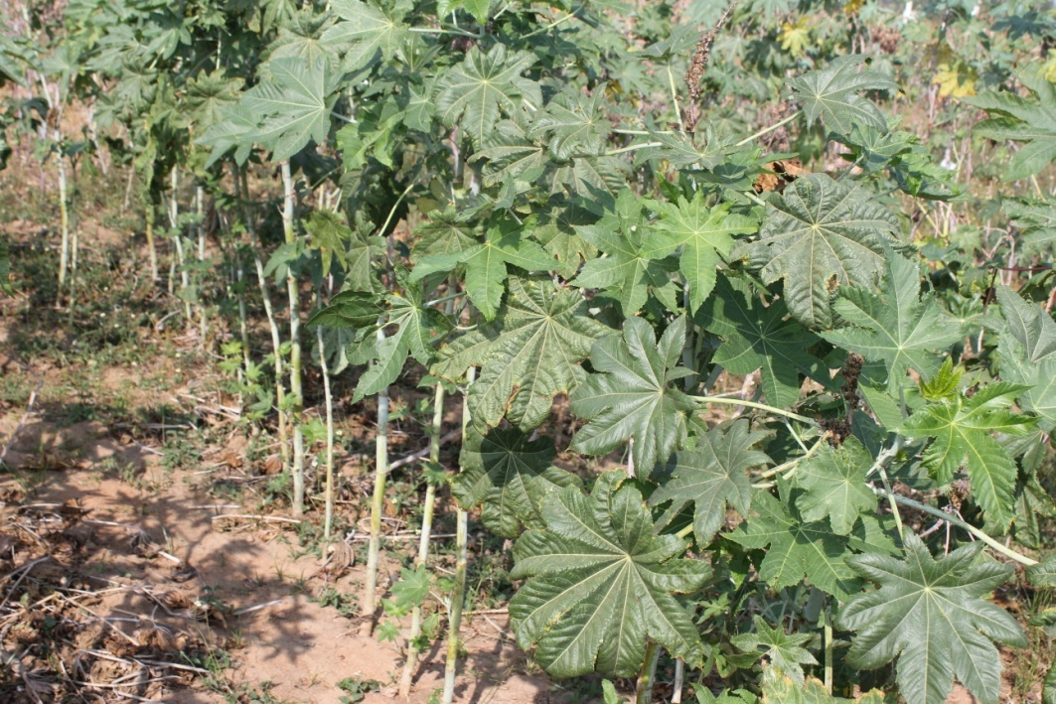
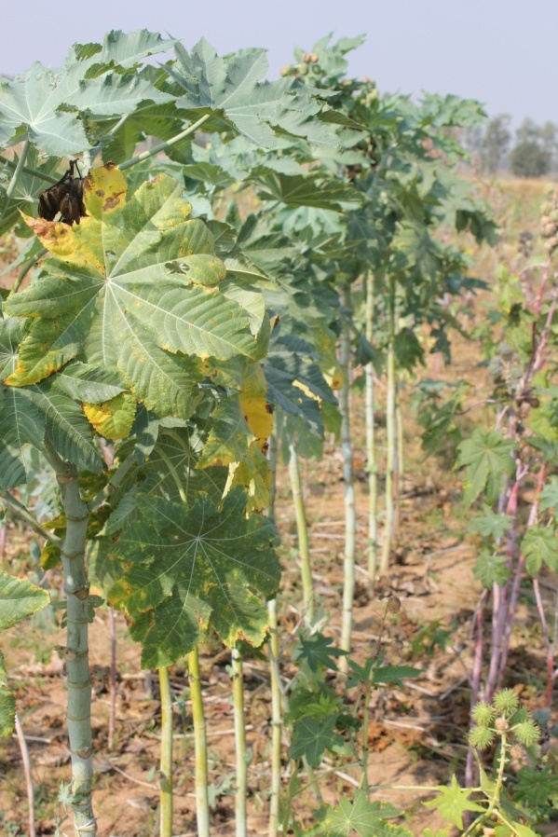
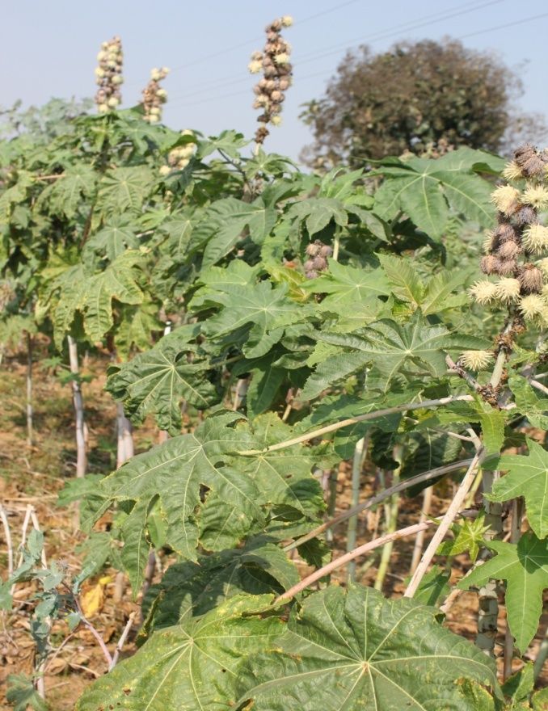
WILT RESISTANT GERMPLASM ACCESSIONS
RG-2661
RG-2976
RG-3406
RG-3105

Slide 40
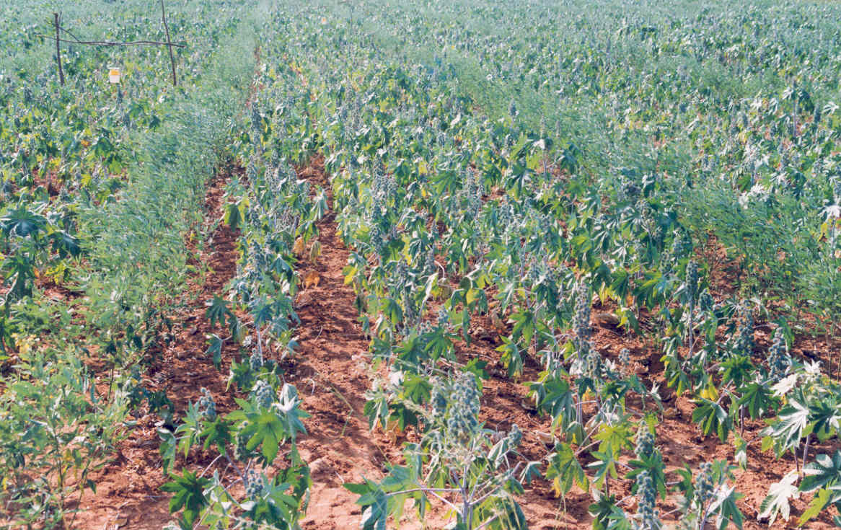
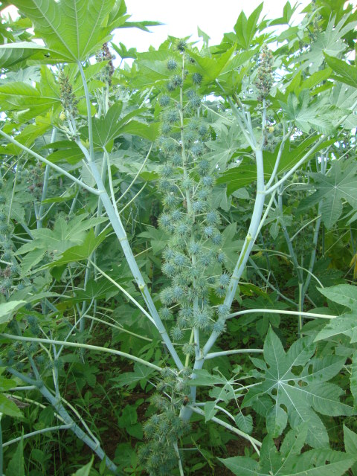

Slide 41
Seed (10 g/kg) and soil application (1kg/100 kg FYM) of Trichoderma viride will reduce the wilt incidence
Apply more quantity of FYM to the wilt affected plots
Nematodes – predisposes the plants to wilt – manage nematodes
Talc based Formulation

Slide 42
Seed Treatment
Mixed in Vermicompost
Mixed in Farmyard Manure (FYM)

Slide 43
Conclusion
The accessions exhibiting less than 20 percent wilt can be used in breeding programme to incorporate resistance against Fusarium wilt of Castor.
Development of resistant castor varieties against nematode-wilt complex will be a viable approach.
The diverse resistant accessions would serve as base material to develop wilt resistant gene pool with broad genetic base for desirable quantitative traits
and also as promising sources for molecular tagging and mapping of wilt resistantance genes to utilize in marker assisted breeding.

Slide 44
FUTURE STRATEGIES
Development of extra early maturing castor varieties / hybrids with durable resistance to wilt and Botrytis
Development of new biocontrol agents – molecular methods, mutations
Root enrichment strategy, mixers of bio-agents
Induction of cross protection
Exploitation of systemic acquired resistance

Slide 45
Exploitation of bacteriocins, Endophytes
Screening of new fungicide molecules
Development of molecular kits for early disease diagnosis
Development of location specific IDM strategies
Host differentials for identification of races of Fusarium sp.

Slide 46
Acknowledgements
Authors are thankful to Associate Director of Research, RARS, Palem for providing the facilities and DOR, Hyderabad for providing the castor germplasm lines.

Slide 47

THANK YOU

