Slide 1
Feeling Good In Your Neighborhood: A Nurse-Led Mobile Health Van Program (MHVP)
2nd International Conference on Nursing & Healthcare
Betty Boyle-Duke, MS, CPNP, Director of Clinical Services
Tawny Lowe, MS, MPH, CPNP
Notes:
We will speak about using mobile health as an innovative model for interdisciplinary collaboration

Slide 2
Disclosure
HRSA Grant
Nurse Education, Practice, Retention and Quality (NEPRQ) program
Notes:
The MHVP receives grant support through HRSA, specifically through the NEPRQ program

Slide 3
Objectives
Describe the Set-up, Catch-up, Hook-up model
Learn about MHVP initiatives
Identify healthcare delivery challenges in a mobile clinic setting

Slide 4
Mobile Health Van Program
Notes:
12.5’ high, 36’ long

Slide 5
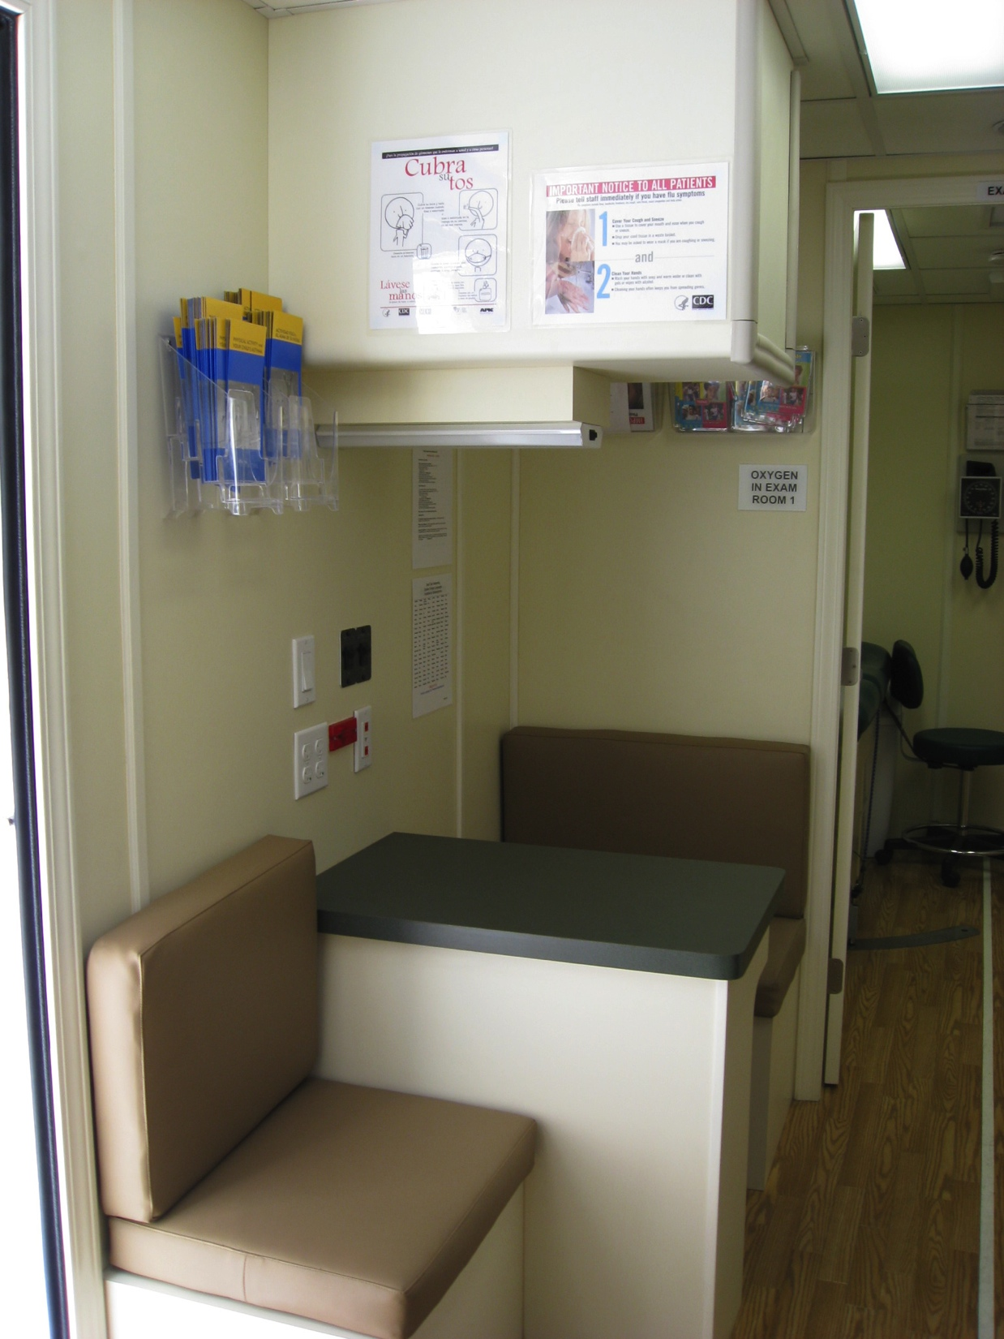
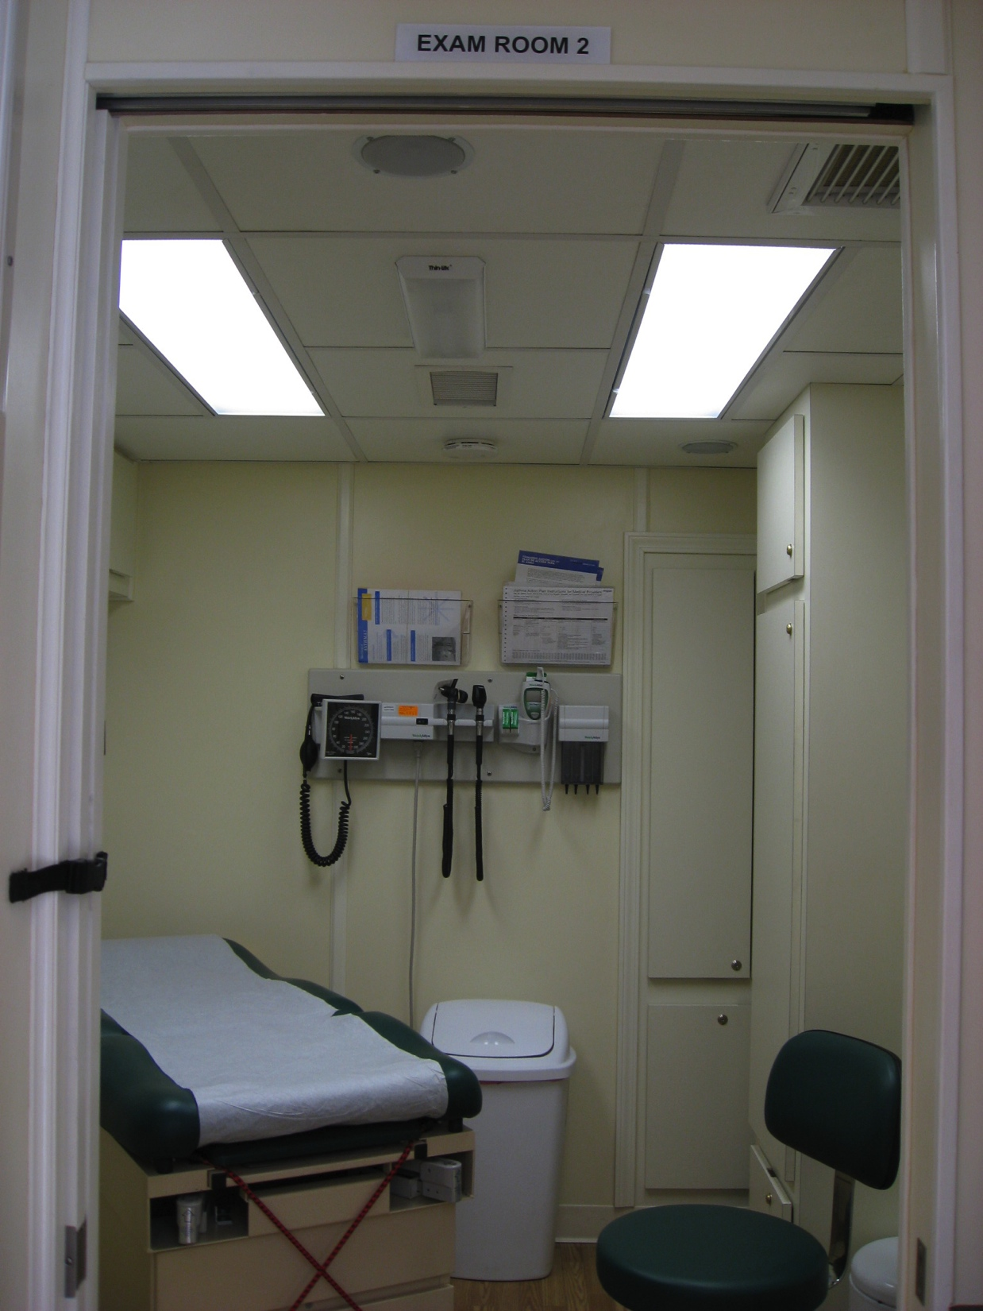
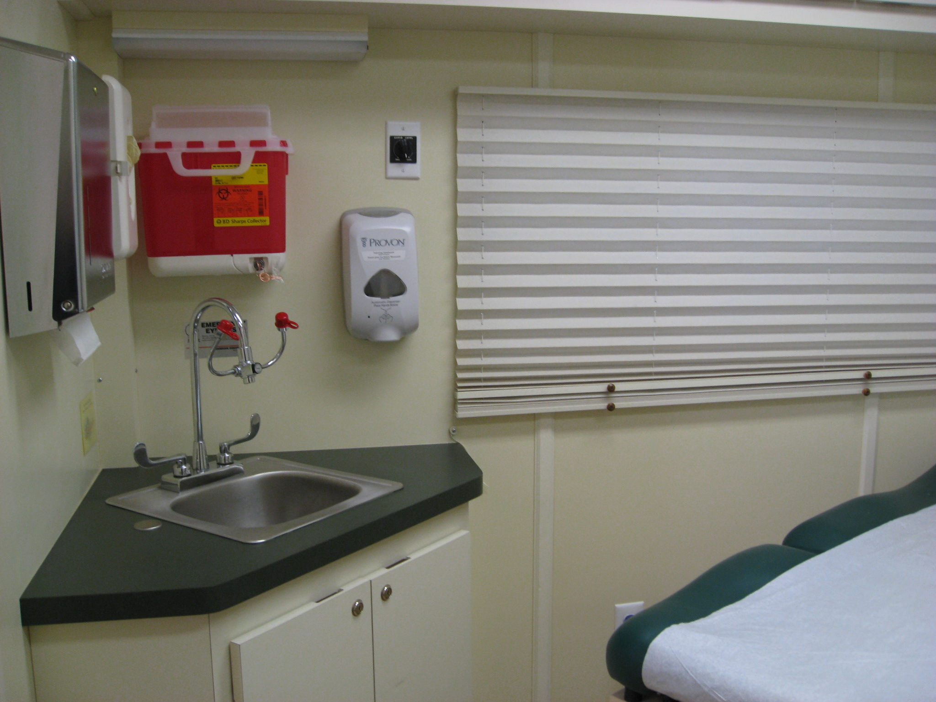
Interior

Slide 6
Staffing
2 Nurse Practitioners
Patient Care
1 Social Worker
Medicine (residents)
1 Medical
Assistant
Notes:
Nursing Van staffed with
2 Pediatric Nurse Practitioners
Medical Assistant
Social Worker
Additionally, we have a collaborating MD from a local hospital available for consultation as needed

Slide 7
Mobile Health Van Program
What
Who
How
Scope of Services
Notes:
WHO:
-underserved areas determined by high percentages of free-school meals
-high school students in Brooklyn, predominantly recent immigrants → targeted international high schools
WHAT:
The program started in 2010 with two main objectives:
Improved healthcare access – provision of primary care services like well health checkups, episodic care, chronic illness management, and immunizations; referrals for other services, such as blood work, dental, vision, and specialty care
HOW:
Our motto:
Set Up, Catch Up, Hook Up: will discuss in more detail in later slides
We decided an interdisciplinary approach would be best since access to care is a problem for many of these patients

Slide 8
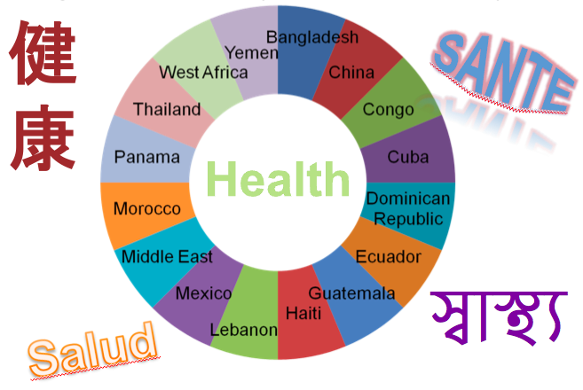
International Patient Population
Notes:
This slides shows a sample of where our international patients come from → information obtained through focus groups at international high schools

Slide 9
Model
Set-up
Catch-up
Hook-up

Slide 10
Set-Up
Notes:
Set Up: assesses initial health care needs

Slide 11
Catch-Up
Notes:
Addresses outstanding needs through care delivery → primary care services and health literacy education

Slide 12
Hook-Up
Notes:
linking patients with insurance, primary care providers, specialist services and referrals to community resources
**REMEMBER TO CLICK

Slide 13
Initiatives

Slide 14
Health Literacy Program
Notes:
-portion of HRSA grant allocated to creation of HLP
-designed to increase health knowledge, skills and attitudes in immigrant adolesents
-overall goals of: 1) expanded access, 2) competence in seeking preventative health care, 3) attitudes that value primary care, and 4) self-advocacy through effective navigation of the U.S. health care system
-Program: 9 short videos, shown in three parts, covering health topics such as teen pregnancy, STIs, diabetes, depression, and insurance issues. Test questions designed to measure students’ knowledge of effective health management and their ability to effectively access and navigate the health care system will be administered before and after viewing of the videos
-Roll-out started last year, continuing this year; data being colleted and analyzed

Slide 15
The Joe Health Power Show

Slide 16
Student Training
SW Interns
Family Medicine Residents
RN, NP Students
Notes:
And being that we are an university, we have schools of social work and nursing – so SW intern and nursing students who conduct their practicum on the van were easily included in this model
We also work with Family Medicine residents from local community hospital in the community we serve and collaborate and refer to on a regular basis
And bc we work with such a diverse population and have a diverse workforce, we strive to provide to culturally enriched clinical practicum for students and residents rotating on the van

Slide 17
Student Training
HEADSS Assessments
Physical Examinations
Health Literacy Program
Classroom Health Education
Notes:
HEADSS:
For our nursing students and residents, one of the ways we have them together is teaching them to conduct a proper HEADSS assessment. As anyone working with adolescents knows, this is the most important way to assess for any psychosocial concerns or needs that a teen may have.
PE:
Similarly, we have them learn how to conduct physical examinations, as they are all learning how to become primary care providers.
Health Lit:
We have the nursing students and SW interns work collaboratively on rolling out the Health Literacy Program,
Classroom:
Lastly, classroom presentations have been conducted by SW interns and nursing students on health topics such as STI prevention, cyberbullying and nutrition. The residents unfortunately have not taken part in these classroom presentations due to schedule conflicts.

Slide 18
Cultural Competence
Notes:
-framework used Purnell Modell for Cultural Competence
-Cultural awareness was integrated into the rotation on the van using case studies, clinical interactions and classroom health presentations involving both a multiethnic patient population and diverse, multilingual staff.

Slide 19
Benefits
Notes:
Breaks down barriers to care:
-transportation
-scheduling
-language / communication
**shown to improve health outcomes (American Academy of Pediatrics, 2012)
Improved health outcomes:
-increased vaccination
-provision of primary and episodic health care
-transition to US healthcare system, establishment of medical / dental home
-increased health literacy
Strengthening future health workforce, gets rid of silos between professions

Slide 20
Challenges

Slide 21
Coordination of Care
Notes:
-school liaison is key → pulling patients out of class, coordinating consents (general, vaccine)
-coordination with medical or dental home → continuity of care, access to medical records (sports PE clearance and prior cardiac workup, immunizations)
-fostering relationships with other community resources

Slide 22
Sustainability
Notes:
We cannot get reimbursed for our services --> we do not have designation as a school based clinic, therefore cannot bill. Also we are not a year-round program, so cannot serve as patients’ PCPs

Slide 23
The Elements
Notes:
Sandy October 2012 – flooding
Inclement weather → snow, icy; dangerous driving conditions

Slide 24
Mechanical
Notes:
Maintenance issues – electrical wiring, engine, back up generators
Vaccine refrigerator temperature maintenance

Slide 25
Connectivity

Slide 26
Program Growth
Year 1
Year 5

Slide 27
Program Growth
54%
50%
*Year-to-date: September – November 2014
Notes:
Grew by approx 50% from Year 1 in terms of # of patients and clinical visits
Key to growth: building relationships with schools, liaison, word of mouth, addition of urine STI screening in Yr 5
Yr 1: 592 pts, 1221 clinical visits
Yr 2: 745 pts, 1555 visits
Yr 3: 670 pts
Yr 4: 726 pts (full year, Sandy), 1297 visits
Yr 5: 888 pts (Sept-Nov), 1883 visits

Slide 28
Outcomes
Quality
Patient Care
Enhanced Training
Increased Cultural Competence
Notes:
For our outcomes- we saw an increase in cultural competence in our students. There is enhanced training of students- they really feel they are contributing. Our patients certainly benefit, this collaborative approach enhances their health care delivery,

Slide 29
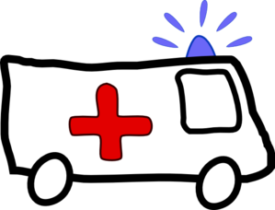
Questions?

