Slide 1
Addiction Therapy-2014 Chicago, USA August 4 - 6, 2014
Barry Tolchard

Slide 2
Attitudes towards Gambling in Ghanaian Adolescents
Dr Barry Tolchard
University of New England & University of Essex
Franklin Glozah & David Pevalin
University of Essex

Slide 3
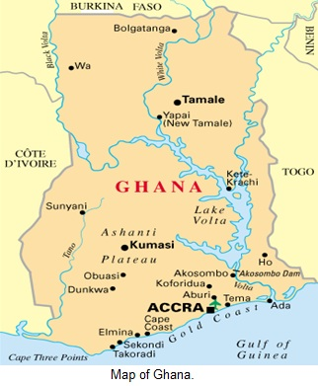
Gambling in Africa
Gambling varies across the continent
South Africa, Nigeria and Kenya biggest markets
Ghana
3 land based Casinos, 2 in Accra (La Palm Casino & The Millionaires Casino), 1 in Kumasi (Golden Tulip Kumasi City, Hotel & Casino); lotteries and horse racing; sports betting
Online gambling is legal

Slide 4
The Gaming Commission of Ghana (GCG)
Responsible: regulation, controlling, monitoring and supervision of games of chance; licencing; promotions
Gaming Act 721 (2006)

Slide 5
Behav Brain Sci. 2010 Jun;33(2-3):61-83; discussion 83-135. doi: 10.1017/S0140525X0999152X. Epub 2010 Jun 15.
The weirdest people in the world? Henrich J, Heine SJ, Norenzayan A.
Behavioral scientists routinely publish broad claims about human psychology and behavior in the world's top journals based on samples drawn entirely from Western, Educated, Industrialized, Rich, and Democratic (WEIRD) societies.
Researchers - often implicitly - assume that either there is little variation across human populations, or that these "standard subjects" are as representative of the species as any other population. Are these assumptions justified? Here, our review of the comparative database from across the behavioral sciences suggests both that there is substantial variability in experimental results across populations and that WEIRD subjects are particularly unusual compared with the rest of the species - frequent outliers. The domains reviewed include visual perception, fairness, cooperation, spatial reasoning, categorization and inferential induction, moral reasoning, reasoning styles, self-concepts and related motivations, and the heritability of IQ.
The findings suggest that members of WEIRD societies, including young children, are among the least representative populations one could find for generalizing about humans. Many of these findings involve domains that are associated with fundamental aspects of psychology, motivation, and behavior - hence, there are no obvious a priori grounds for claiming that a particular behavioral phenomenon is universal based on sampling from a single subpopulation.
Overall, these empirical patterns suggests that we need to be less cavalier in addressing questions of human nature on the basis of data drawn from this particularly thin, and rather unusual, slice of humanity

Slide 6
The study
A cross-sectional survey design of 770 second-year and third-year Senior High School (SHS) students between 14 and 21 years (504 boys, 266 girls) in Accra
Representative sample
Schools recruited via the permission of the head teacher and classes were randomly selected within each school
A study description and consent form was provided to individual students within the schools that agreed to participate and the classes randomly selected
Parents/guardians of students below 18 years of age were also required to provide consent before questionnaire completion which took place in the respective classrooms of the participants.
Research ethics approval was obtained from the University of Essex, UK

Slide 7
Measures
The Attitudes towards Gambling (Delfabbro & Thrupp, 2003)
Nine item measure of an adolescent’s economic perception of gambling
‘Gambling is a risky activity’, ‘You can lose all your money gambling’, ‘Gambling is a waste of money’, ‘Gamblers usually lose in the long-run’, ‘To gamble is to throw away money’, ‘You can make a living from gambling’, ‘Gambling is a good way to get rich quickly’, ‘Gambling is a better way to make money than working’, and ‘Gambling can give high returns’
Agreement on a 5-point from ‘strongly agree’ to ‘strongly disagree’.
The last four items are reversed so that higher scores represented a less positive attitude towards gambling
All items are added to give a total score
A lower score indicates a more positive attitude to gambling
The scale had good internal reliability, α = .78 with this sample

Slide 8
Measures
General Health Questionnaire - GHQ-12 (Goldberg, 1972)
General wellbeing
School Success Profile - SSP (Bowen and Richman, 1995, 2008)
Self-report somatic symptomatology
Perceived Social Support from Family (PSS-FA) and Friends (PSS-FR) scales (Procidano and Heller, 1983) and teachers scale - SSP (Bowen and Richman, 1995, 2008)
Perceived social support
Adolescent Stress Questionnaire - ASQ (Byrne et al., 1995)
Perceived stress
Personal Lifestyle Questionnaire - PLQ (Muhlenkamp and Brown, 1983; Mahon et al., 2003)
behavioural health or positive health practices

Slide 9
Results: Gambling participation
Male vs. female adolescent  participation on all forms of gambling
Younger students had  sports betting participation
Attending a mixed gender school led to  participation in card games

Slide 10
Relationship between participation and perceived social difficulties
home (arguments at home, disagreements between your parents, disagreements between you and your mother, disagreements between you and your father, lack of understanding by your parents, abiding by petty rules at home, living at home, not being taken seriously by your parents, little or no control over your life, lack of trust from adults, parents expecting too much from you, parents disturbing you about the way you look),
peer (pressure to fit in with peers, being hassled for not fitting in, peers disturbing you about the way you look, being judged by your friends, disagreements between you and your peers),
personal (satisfaction with how you look, changes in your physical appearance with growing up) and,
school (lack of respect from teachers, not being listened to by teachers, getting along with your teachers, disagreements between you and your teachers, teachers disturbing you about the way you look, abiding by petty rules at school) factors.

Slide 12
Relationship between participation and perceived social difficulties Card Games
Positive response*
‘disagreements between you and your father’
where, there were frequent arguments, more adolescents stated they sometimes gambled
Negative response*
‘lack of respect from teachers’
‘not being listened to by teachers’,
‘disagreements between you and your teachers’
‘teachers disturbing you about the way you look’
where the adolescent did not believe this statement had significantly higher card play
Overall, adolescent card gamblers who were having few problems at home or school were higher frequency players
Post-hoc analysis; Bonferroni correction p < .05

Slide 13
Relationship between participation and perceived social difficulties Sports betting
‘living at home’
adolescent who lived at home only some of the time were significantly more likely to gamble on sports
‘lack of trust from adults’
where the adolescent sometimes believed this statement they had significantly higher sports betting
‘teachers disturbing you about the way you look’
where the adolescent did not believe this statement they had significantly higher sports betting
‘abiding by petty rules at school’
where the adolescent sometimes believed this statement they had significantly higher sports betting
Adolescent sports bettors experienced higher frequency participation where they had some difficulties at home and school
Post-hoc analysis; Bonferroni correction p < .05

Slide 14
Relationship between participation and perceived social difficulties Lotteries
‘parents disturbing you about the way you look’
where the adolescent often believed this statement they had significantly higher lottery participation
‘teachers disturbing you about the way you look’
where the adolescent often believed this statement they had significantly higher lottery play
Adolescents who participated in lotteries had higher frequency play when experiencing difficulties regarding parent/teacher views of their appearance
Post-hoc analysis; Bonferroni correction p < .05

Slide 15
Relationship between participation and perceived social difficulties Slot machines
‘disagreements between you and your peers’
where the adolescent often believed this statement they had significantly higher slot machine play
‘teachers disturbing you about the way you look’
where the adolescent did not or sometimes believed this statement they had significantly higher slot machine play
Adolescents playing poker machines had higher participation when they experience peer problems

Slide 16
Gambling participation and perceived social protective factors Cards & Sports betting
Negative response*
‘ teachers give me lots of encouragement’
Adolescent experience higher participation in sports betting
No differences emerged with card play
*All significant at < .05; Bonferroni correction p < .05

Slide 17
Gambling participation and perceived social protective factors Lotteries
Negative response to item*
‘I’ve recently gotten a good idea about how to do something from a friend’,
‘family provide moral support’,
‘families are interested in what they think’,
‘my teachers care about me’
These items could be considered as being given positive regard and as such where the adolescent does not receive this, they are more prone to gamble
Positive response*
‘relying on their family for emotional support’
‘there is a member of my family I can go to when I feel down…’
‘my family is sensitive to my needs’
‘a deep sharing relationship with a number of members of my family’
‘relationship between me and my family is better than my friends’ relationship with their family’
Having strong family connections and believing their emotional needs are being met would indicate a lower need to participate in the lotteries
*All significant at < .05; Bonferroni correction p < .05

Slide 18
Gambling participation and perceived social protective factors Slot machines
Positive response*
‘friends enjoy hearing about what I think’
Adolescent experience higher participation
Negative response*
‘friends are good at helping me solve problems’
‘deep sharing relationship with a number of friends’
‘Family gives me the moral support I need’
‘teachers care about me’
‘Teachers listen to what I have to say’
‘My teachers show me respect’
Adolescent experience higher participation
Having unsupportive interpersonal relationships appears to be linked to an increase in gambling in slot machine players
*All significant at < .05; Bonferroni correction p < .05

Slide 19
Attitudes towards Gambling
Demographics
Gambling type
Significant differences found between non-gamblers and high frequency gamblers on all gambling types with all high frequency gamblers considering gambling to be a positive activity

Slide 20
Relationship between ATG scale and perceived social difficulties
‘satisfaction with how you [the adolescent] looked’
In this case there was significant difference between those very often concerned about the way they looked experienced lower scores on the ATG scale (Bonferroni correction p < .05).
Adolescent comfortable with the way they looked see gambling as less positive
‘abiding by petty rules at school’
where an adolescent believed very often that this was true experienced higher ATG scores
This may indicate more obedient adolescents were less likely to participate in gambling activities

Slide 21
Relationship between ATG scale and perceived social protective factors
No main effects found for positive relationships with friends
Significant differences emerged in family relationships
‘My family is sensitive to my personal needs
‘I have a deep sharing relationship with a number of members of my family’
With positive family relationships, adolescents saw gambling as more harmful
Finally, strongly disagreeing with ‘My teachers show me respect’
perceived lower level of respect was associated with higher gambling risk

Slide 22
Cigarettes/alcohol

Slide 23
Substance use/ATG
Cigarettes (F(4, 975) = 4.38, p <.01; Boneferroni correction < .05)
Alcohol (F(4, 992) = 6.23, p <.001; Boneferroni correction < .05)
‘never smoked’ (ATG: M = 31.87, SE = 1.22) and ‘sometimes smoked’ (ATG: M = 24.94, SE = 1.93).
Alcohol (F(4, 975) = 6.23, p <.001; Boneferroni correction < .05)
‘never drinks alcohol daily’ (ATG: M = 33.52, SE = 1.34) and ‘infrequent drinkers’ (ATG: not often (M = 31.41, SE = 1.40) sometimes (M = 29.40, SE = 1.37)).

Slide 24
Other behavioral issues Nutrition
lottery players
‘never’ bought tickets (M = 4.00, SE = .16)
‘not often’ bought tickets (M = 3.37, SE = .23).
Adolescents who did not buy lottery tickets had a better healthy intake (F(4, 1008) = 3.99, p <.01; Boneferroni correction < .05).
Card players
never’ played cards (M = 2.13, SE = .1923)
‘sometimes played’ (M = 2.65, SE = .20).
Adolescents using less salt did no play cards(F(4, 1002) = 4.22, p <.01; Boneferroni correction < .05).
‘very often’ (M = 3.05, SE = .29)
‘never’ (M = 1.97, SE = .17).
Adolescents who ‘eat junk food daily’ (F(4, 990) = 7.19, p <.001; Boneferroni correction < .05)
ATG
eats regularly (F(4, 992) = 2.77, p <.05; Boneferroni correction < .05). This related to those who had very disrupted eating patterns had a stronger positive attitude to gambling being a good thing
A significant difference was observed in response to eating ‘junk’ food daily (F(4, 968) = 4.39, p <.01; Boneferroni correction < .05)
‘never eat junk food daily’ (ATG: M = 36.36, SE = .44)
‘always eat junk food daily’ (ATG: M = 33.18, SE = .97)

Slide 25
Nutrition—‘eat at regular times during the day’
Sports bettors who ‘often gambled’ were significantly lesss likely to have regular meal times than those who ‘did not’ bet on sports at all
Lottery gamblers who ‘sometimes’ bought lottery tickets compared to those who ‘did not’ buy lottery tickets at all
 |  | M | (SD) | Inferential statistics
Sports Betting
 | Never | 3.11 | (.18)
 | Often | 2.17 | (.09) | F(4, 1005) = 4.02, p <.01
Lotteries
 | Never | 3.57 | (.15)
 | Sometimes | 2.92 | (.22) | F(4, 1005) = 2.36, p <.05

Slide 26
Exercise—play sports…at least three times weekly and ‘gets daily exercise’
Increased frequency of sports betting also indicated higher levels of sports playing (F(4, 1005) = 21.47, p <.001; Boneferroni correction < .05)
Took regular exercise (F(4, 1005) = 7.59, p <.001; Boneferroni correction < .05)
A multiple regression analysis where both exercise variables were computed with sports betting revealed a strong linear relationship (F(2, 1023) = 56.77, p <.001).

Slide 27
Psychological distress and attitudes to gambling in Ghanaian adolescents
As with overall attitudes to gambling; positive belief in gambling was related to gender and residential status and overall lower wellbeing

Slide 28
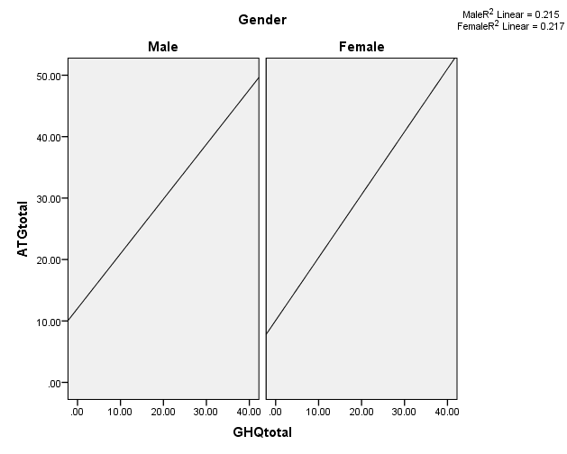
GHQ-12/ATG

Slide 29
Conclusion
Males were more likely to view gambling as a positive activity and were higher frequency players on all forms of gambling
None boarding students also had a more positive attitude to gambling and experienced lower wellbeing

Slide 30
Conclusion
Card players
Better adjusted than other gamblers
May be a family social event
Sports bettors
Adolescents who experience some disharmony at home and school have higher frequency play
generally high risk/impulsive group
Lotteries
Parent/teacher negative views of the adolescents appearance led to higher lottery participation
Large payout may be a way to change appearance
Slot machines
Negative peer issues reflected higher participation
Used as a means of escape

Slide 31
Conclusion
Social difficulties
Self confidence and obedient adolescents perceived gambling as a negative activity
Social protective factors
Emotionally stable family relationships and positive relationships with teachers indicated less positive attitudes to gambling

Slide 32
Risk behavior
General risky behavior associated with both higher frequency gambling and lower ATG scores

Slide 33
Brief comparison Australia/Ghana
Cards/sports/slots: Ghana adolescents  GHQ-12/ATG scores at higher frequency of play (p < .001)
Lottery: Australian adolescents  GHQ-12/ATG scores at higher frequency of play (p < .001)
Frequency: Ghana adolescents  Frequency  gambling risk/wellbeing

Slide 34
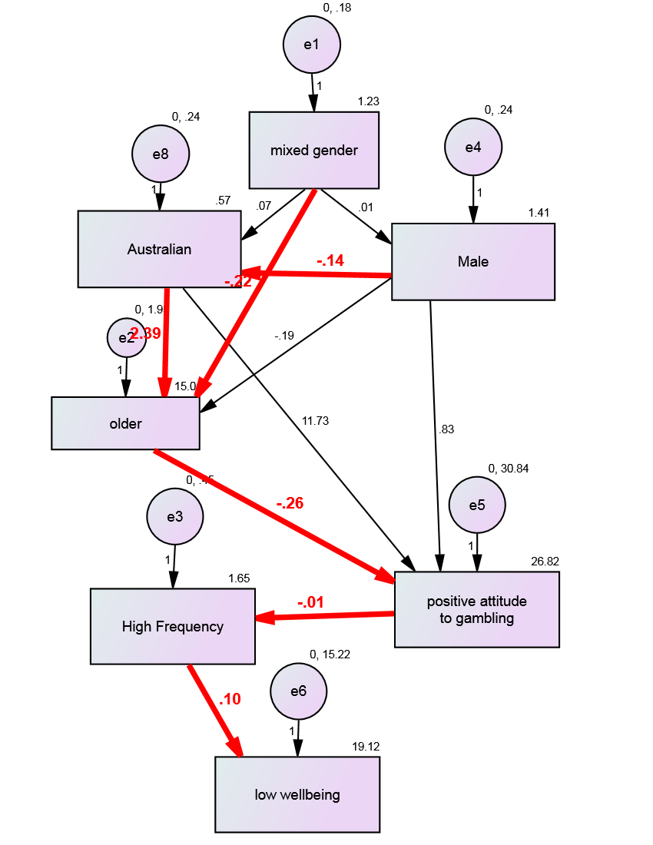
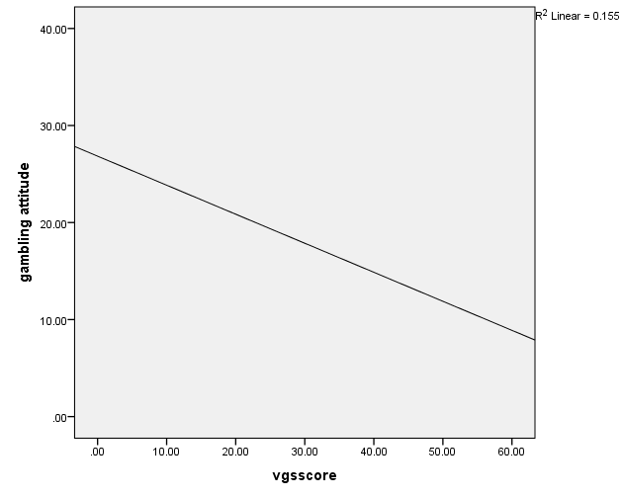
Gambling severity
VGS

Slide 35
Meet the eminent gathering once again at Addiction Therapy-2015 Florida, USA August 3 - 5, 2015
Addiction Therapy – 2015 Website:
addictiontherapy.conferenceseries.com

