Slide 1
EXOTIC VECTOR-BORNE VIRAL ZOONOSES - A THREAT FOR DISEASES-FREE COUNTRIES? Barbara Bażanów, Janusz Pawęska, Agnieszka Frącka Wrocław University of Environmental and Life Sciences, Department of Pathology, Poland National Institute for Communicable Diseases, Johannesburg, South Africa

Slide 2
Many viruses have co-evolved with animals and people on a specified geographic area over long period of time.
Latterly, many of them have entered new territory, due to movement of viremic hosts (both intentionally- e.g., trade and naturally – e.g., migration), movement of virus-carrying vectors, changes in the environment, climate, and agriculture.
Certain viruses pose threat to health and life of humans or animals.

Slide 3
West Nile Virus, Crimean- Congo Hemorrhagic Fever Virus and Rift Valley Fever Virus infections belong to the one of the most dangerous exotic vector-borne viral diseases.
The goal of the study was the assessment of the epidemiological situation of WNV, CCHFV and RVFV infections in Poland.

Slide 4
WEST NILE VIRUS (WNV)

Slide 5
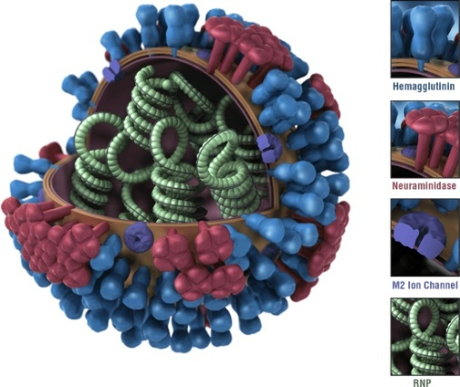
Virus classification and morphology
West Nile virus (WNV) - a mosquito-borne zoonotic arbovirus
Order: Unassigned
Family: Flaviviridae
Genus: Flavivirus
Species: West Nile virus
First isolation- West Nile district of Uganda (1937) –
blood a woman suffering from a mild febrile illness
enveloped, 45 nm in diameter,
linear single-stranded RNA+ ((+)ssRNA)
source:http://imgbucket.com/pages/w/west-nile-virus-structure-and-shape/

Slide 6
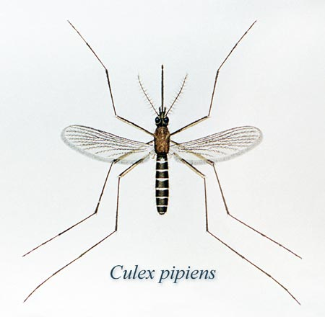
Vector and animal hosts
Mosquitoes of the genus Culex (Cx. Pipiens) - the principal vectors of WNV.
In mosquito populations - vertical transmission
(adults to eggs).
Source:http://www.medicinenet.com/west_nile_encephalitis/article.htm

Slide 7
Vector and animal hosts
Birds - the reservoir hosts of WNV.
In Europe, Africa, Middle East and Asia, mortality in birds associated with WNV infection - rare.
In the Americas - highly pathogenic for birds.
Members of the crow family (Corvidae) are particularly susceptible, but virus has been detected in dead and dying birds of more than 250 species.

Slide 8
Vector and animal hosts
Horses (and humans) are “dead-end” hosts - while they become infected, they do not spread the infection.
Symptomatic infections in horses are rare and generally mild, but can cause neurologic disease, including fatal encephalomyelitis.

Slide 9
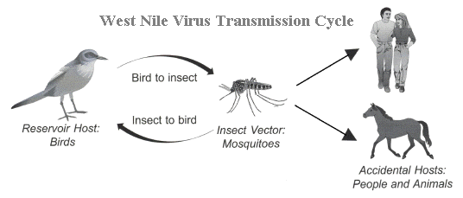
Transsmision cycle
Source: http://www.bcmvcd.com/viruses.html

Slide 10
Clinical symptoms in people
Most have no signs or symptoms
Mild infection signs and symptoms (about 20% of people) : fever, headache, body aches, fatigue, back pain (occasionally: skin rash, swollen lymph glands, eye pain)
Serious infection signs and symptoms (less than 1% of infected people) - a serious neurological infection (encephalitis, meningoencephalitis, meningitis, West Nile poliomyelitis); high fever, severe headache , stiff neck , disorientation or confusion, stupor or coma, tremors or muscle jerking , lack of coordination, convulsions , pain, partial paralysis or sudden muscle weakness
Signs and symptoms of West Nile fever usually last a few days, but signs and symptoms of encephalitis or meningitis can linger for weeks, and certain neurological effects, such as muscle weakness, may be permanent.

Slide 11
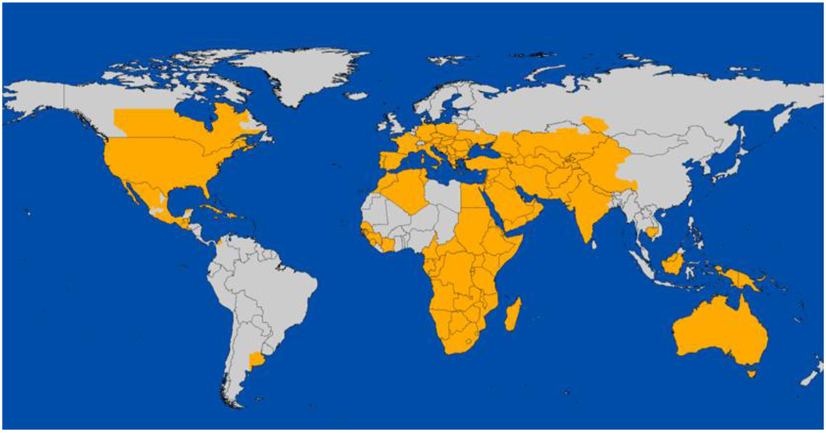
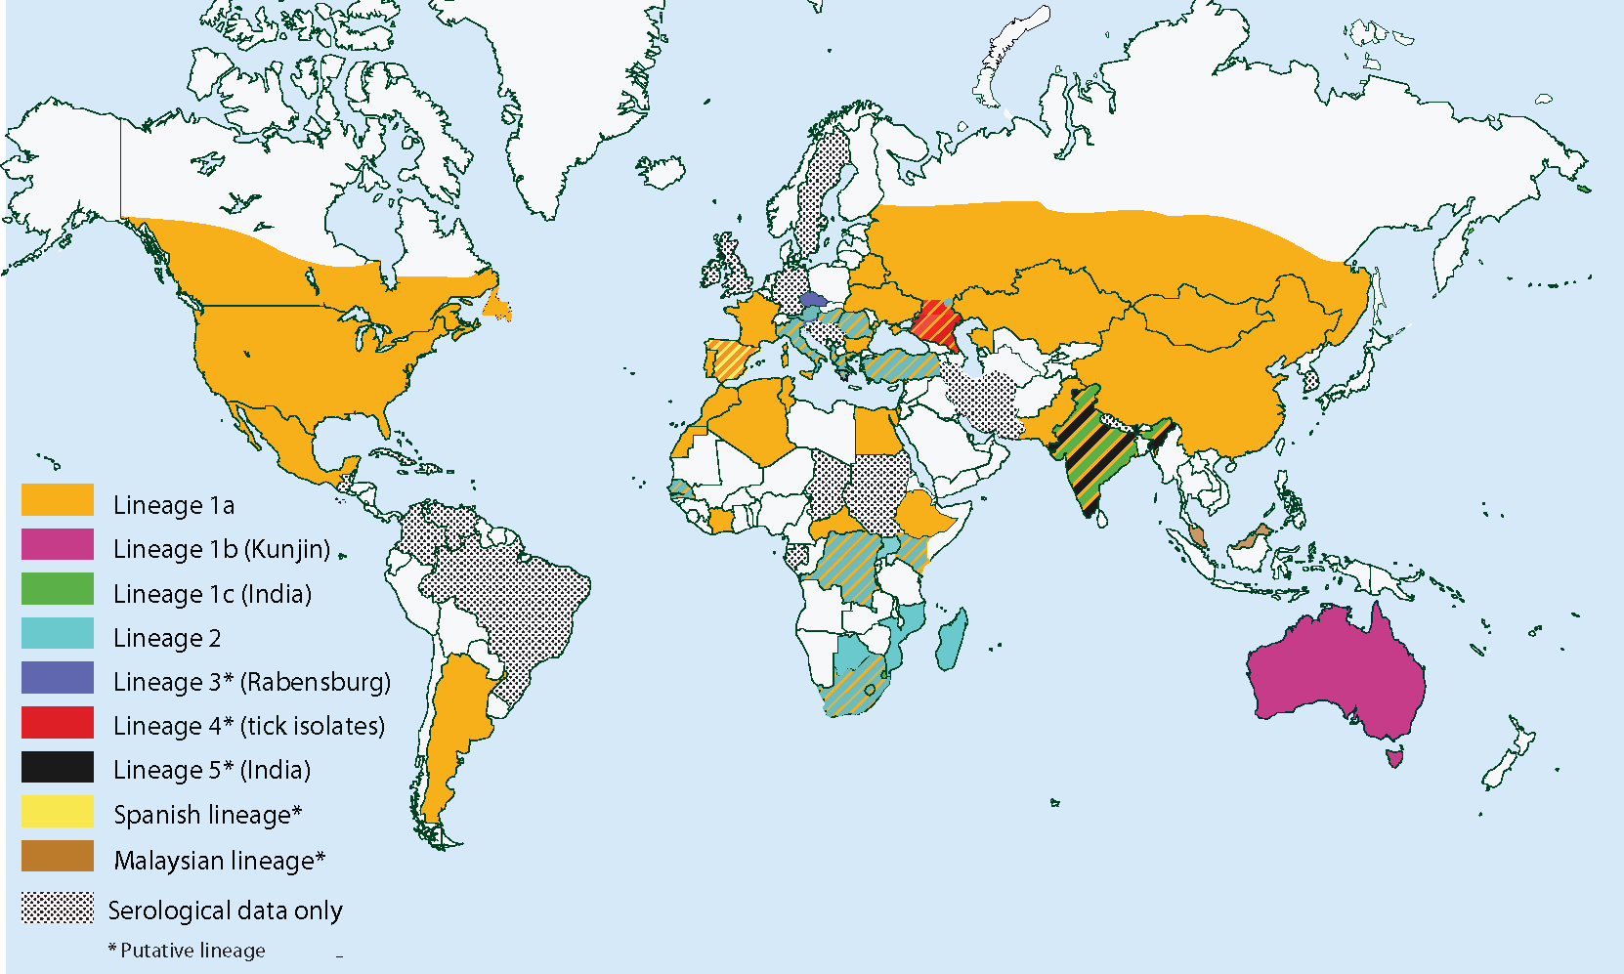
Global distribution of West Nile virus
Vector-Virus Interactions and Transmission Dynamics of West Nile Virus. Ciota and Kramer, 2013
the US Centers for Disease Control and Prevention, 2006

Slide 12
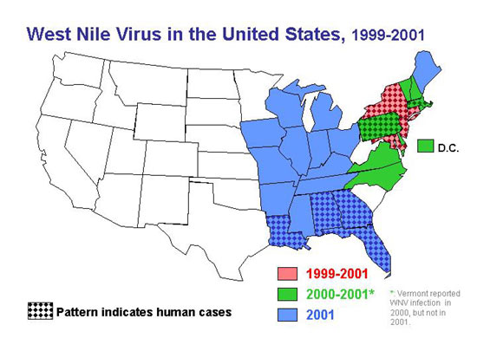
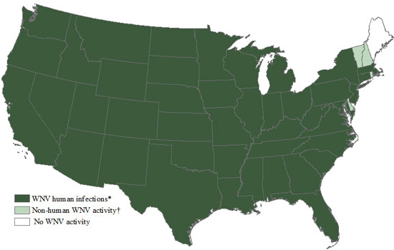
The first case in the Western Hemisphere: New York City in 1999; over the next five years, the virus spread across the continental United States, north into Canada, and southward into the Caribbean islands and Latin America
2014
http://www.microbiologybook.org/mhunt/arbo.htm

Slide 13
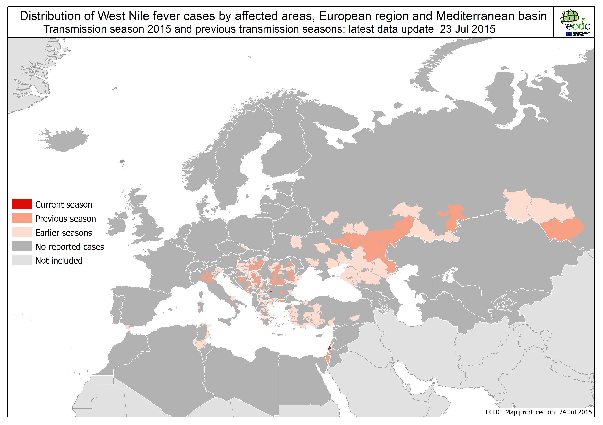
Source: the ECDC (European Centre for Disease Prevention and Control)

Slide 14
WNV IN POLAND
In the nineties of the last century, Juricova et al. confirmed WNV antibodies in 12.1% of
house sparrows (Passer domesticus) and in 2.8% of Eurasian tree sparrows (Passer montanus) in Campinas forest area in Poland.
In the next few years, WNV antibodies were found in three storks, one crow (Corvus corone cornix), and one mute swan (Cygnus olor) on the other part of Poland.
In 2008 antibodies were found in 2 horses (0.65 %) (Bażanów et al.).
In 2015 In Poland, WNV antibodies were detected in one (0.26%) out of 378 horses, in 63 (13.29%) out of 474 wild birds and in 14 (33.33%) out of 42 human patients displayed neurological symptoms (Niporczuk et al.).

Slide 15
Materials – birds (tissue samples)
Organs of 30 birds (brain, liver, lungs, heart spleen, trachea, kidneys) –
dead birds from Treatment And Rehabilitation Centre of Wild Animals of Wrocław University of Environmental and Life Sciences in Złotówek (OLiRDZ UP) and dead birds found in a field:
white-tailed Eagles (Haliaeetus albicilla) -9, common buzzard (Buteo buteo) – 4, goshawk (Accipiter gentilis) -1, peregrine falcon (Falco peregrinus)-1, capercaillie (Tetrao urogallus) -4, mute swans (Cygnus olor) -4, saker falcon (Falco cherrug) -1, crossbreed peregrine falcon/gyr falcon (Falco peregrinus/Falco rusticolus) -1, European herring gul (Larus argentatus) -1, mallard (Anas platyrhynchos) -1

Slide 16
Materials –birds (serum samples)
Serum samples from 14 birds:
1.healthy birds entrapped in live traps – 10 goshawks, 1 common buzzard
- capercaillie reintroduction programme
- health status of goshawk evaluation programme
2. sick birds, treated in OLiRDZ UP - 3 white-tailed Eagles, 1 common buzzard

Slide 17
Materials – horses (serum samples)
Serum samples from 411 horses from different farms (both small and stables) located throughout Poland.
Horses: different age, sex, breed (particularly Arabian, Thoroughbred, Hucul pony)

Slide 18
Methods Virus isolation and identification (birds)
Soon after preparation, the material was inoculated into:
1. Cell lines: RK-13 (rabbit kidney), Vero (green monkey kidney), chicken fibroblast cell culture (primary cell culture);
Cell cultures were examined daily for up to 4 days for the development of viral cytopathic effects (CPE), using an inverted microscope. In the absence of visible CPE, up to 4 subsequent passages were done.

Slide 19
Methods Virus isolation and identification (birds)
2. Embryonated chicken eggs (ECE) (inoculation on chorioallantoic membrane, into chorio-allantoic sac, intracerebellary);
ECE were opened after 4-5 days and examined for the changes in embryo and membranes. In the absence of visible changes, up to 4 subsequent passages were done.
Supernatant from cell cultures and allantoic liquid : hemagglutination test, RT-PCR

Slide 20
Serological methods (birds and horses)
All sera were tested by:
-a microneutralisation procedure on Vero cells.
Serum samples with a virus neutralisation titer of ≥1:4 were considered positive;
-reverse ELISA;
- IFA test (Euroimmun, Groß-Grönau,Germany).

Slide 21
Results
Virus isolation:
WNV - negative
Isolated: herpesvirus, paramyxovirus (Newcastle disease virus), orthomyxovirus (flu virus); negative – circovirus.

Slide 22
Results
Serological investigations:
Birds:
6 (42.85%) serum samples - positive (4 healthy goshawks, 2 sick white-tailed Eagles)
Titers: 1:10 -1; 1:20 – 1; 1:80 – 1; 1:160 – 2; 1:1280 - 1
Horses:
83 (20.2%) serum samples – positive (different age, sex, breed ; 56 percent of horses, according to their travel history, never left the country).
Titers: 1:10 – 10; 1:20 - 19, 1:40 – 46; 1:80 – 1, 1:320 – 1; 1:640 – 2; ≥1:1280 - 4

Slide 23
Discussion and conclusion
BIRDS
Antibiodies against WNV have been found in birds in Poland since over 15 years, but so far, the rate of seropositive birds was relatively low. The high percentage in our research can suggest that the virus is already present in Poland.
According Komar et al. blue jays, American crows, and house sparrows are some of the most susceptible birds to West Nile Virus infection. Our investigations involved goshawks and white-tailed Eagles - potentially less sensitive species, yet the rate of seropositive birds was high.
Admittedly positive wild birds could have contact with virus outside the country, but in the case of tested raptors species, adults do not migrate (the highest titers were found in 3-4 years old birds) .

Slide 24
Discussion and conclusion
HORSES
We obtained a surprisingly high percentage of seropositive horses in comparison to earlier research (2008) - 2 horses -0.65% and research from Puławy PIW (2015) - 1 horse - 0.26%.
In our research 20.2 percent of horses were serospositive (56% horses never left the country), it confirm the thesis that the virus is present in our ecosystem.

Slide 25
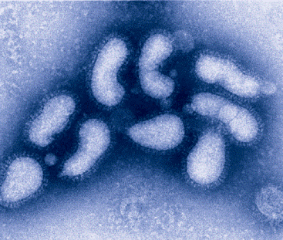
source: http://www.topnews.
CRIMEAN–CONGO HEMORRHAGIC FEVER VIRUS (CCHFV)

Slide 26
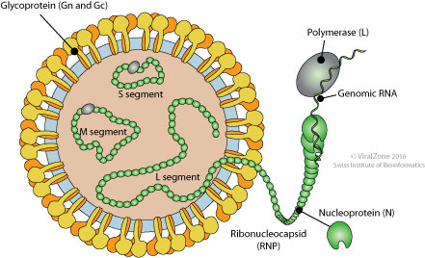
Virus classification and morphology
CCHF- a widespread tick-borne viral disease that is endemic in Africa, the Balkans, the Middle East and Asia.
Order: Unassigned
Family: Bunyaviridae
Genus: Nairovirus
Species: Crimean-Congo hemorrhagic fever virus
- first recognision - the Crimean peninsula in the mid-1940s; first isolation- from a patient in Kisangani, Democratic Republic of Congo, in 1956
-80–120 nm, pleomorphic, enveloped, the genome:
three copies of negative-strand RNA (ssRNA-) segments.
http://education.expasy.org/images/Bunyaviridae_virion.jpg

Slide 27
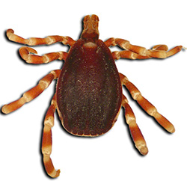
Vectors
-ticks : argasids and ixoids (especially the genus Hyalomma, Rhipicephalus and Dermacentor).
source: http://www.afrivip.org/sites/default/files/Ticks-importance/hyalomma.html

Slide 28
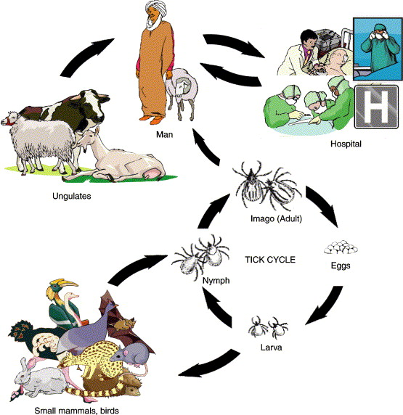
Transsmision cycle
source:http://www.infectionlandscapes.org/2012/10/crimeancongo-hemorrhagic-fever.html

Slide 29
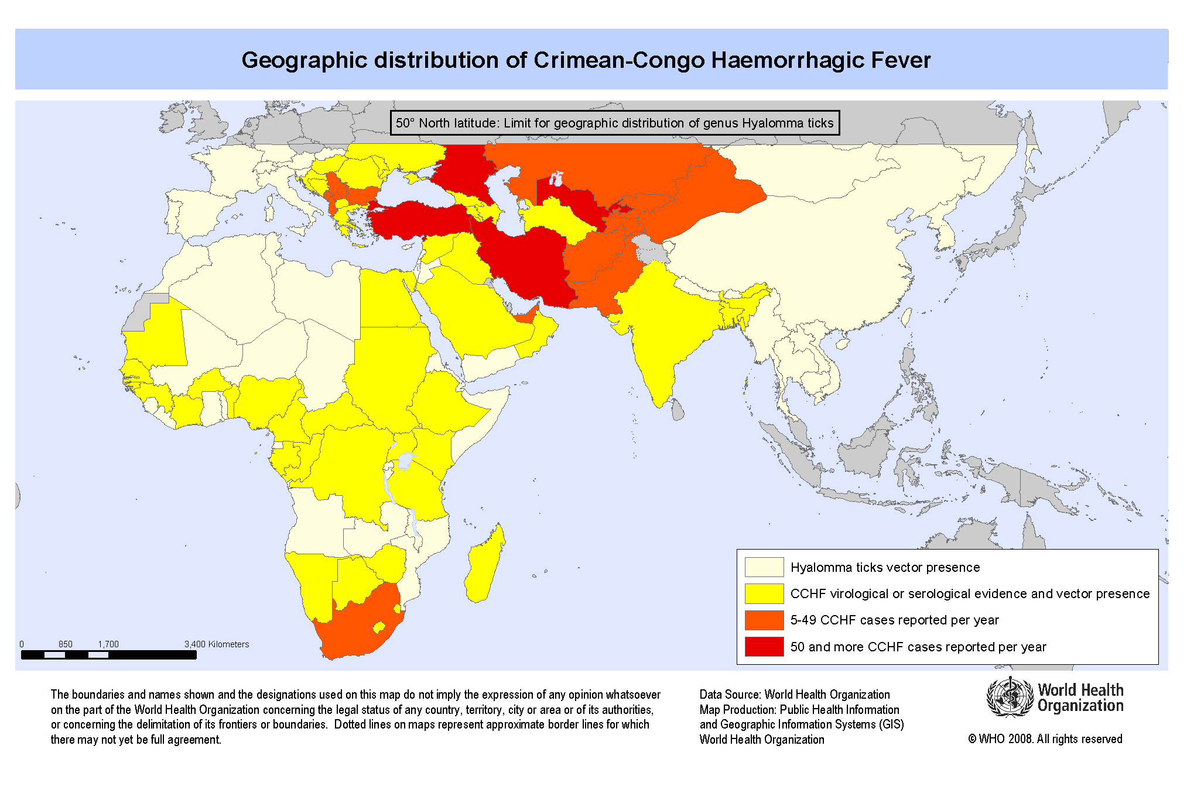
50° north latitude set limit for the geographic distribution of Hyalomma spp. ticks, thus CCHFV infections appear or can appear in areas underlying this latitude.
Poland - not considered as a country at risk, but southern parts of Poland reaches 49° north latitude, thereupon at least this territory should be under control

Slide 30
Clinical symptoms
Humans : a severe hemorrhagic disease.
The most common clinical signs: fever, nausea, headache, myalgia, diarrhea, petechial rash, and bleeding. Case fatality rate - 5-80%.
Animals, in particular small and large mammals (e.g. hedgehogs, hares, foxes, sheep and cattle) develop viremia (for up to 2 weeks), but do not show clinical signs .

Slide 31
Materials
- 592 bovine serum samples.
The tested animals derived from a small farms located mainly in south- east part of the country (Subcarpathian Voivodenship that borders Ukraine and Slovakia, Lesser Poland Voivodeship and Świętokrzyskie Voivodenship - Holy Cross Province).
The animals had a direct access to the pasture.
Blood samples were collected at routine screening of tuberculosis and bovine leukemia.

Slide 32
Methods
-Indirect immunofluorescence assay
-Enzyme-linked immunosorbent assay (ELISA)

Slide 33
Results
All sera - negative

Slide 34
Discussion and conclusion
The geographic range of the CCHFV is the most extensive among the tickborne viruses, which pose a health threat to the people, and the second (after dengue virus) most widespread of all medically important arboviruses.
Given the fact that there are many unknown factors about this disease and about dynamics of spread of CCHFV and, on the other hand, the geographic location of Poland as a country that borders countries at risk, it seems justifiable the control of CCHFV infection on this territory.

Slide 35
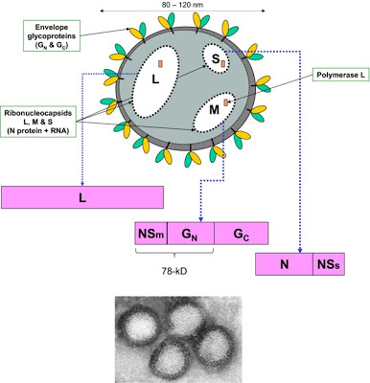
RIFT VALLEY FEVER VIRUS
RVFV structure (Published in: Vet. Res. 2010. 41(6): 61.)

Slide 36
Virus classification and morphology
Rift Valley fever (RVF) - an arthropod-borne zoonotic disease responsible for widespread outbreaks in both humans and ruminants.
Order: Unassigned
Family: Bunyaviridae
Genus: Phlebovirus
Species: Rift Valley fever virus
-spherical shaped, 80-120 nm, enveloped, a negative-sense single-stranded RNA (ssRNA -) 3 segments
- first identified in Kenya in 1930, the geographical range - the African continent.
-over the past 50 years - in over 30 countries (parts of western Africa, Egypt, Madagascar, the Comoros, the Arabian Peninsula (2000).

Slide 37
Vectors
- a range of mosquito vector species as well as other arthropods, many of which are currently present in North America and Europe

Slide 38
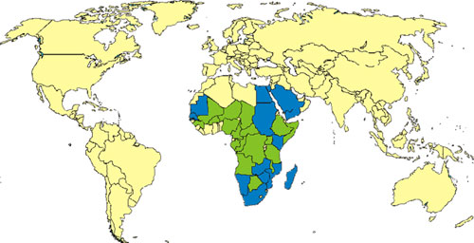
Countries with endemic disease and substantial outbreaks of RVF (blue)
Countries known to have some cases, periodic isolation of virus, or serologic evidence of RVF (green)
source: CDC - http://en.wikipedia.org/wiki/Image:Rift_valley_fever_distribution.jpg

Slide 39
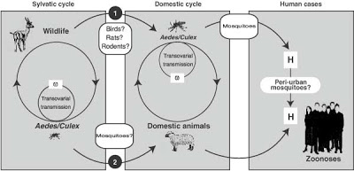
Transsmision cycle
source: http://www.infectionlandscapes.org/2012/10/rift-valley-fever.html

Slide 40
RVFV – THE RISK FACTOR
- is considered to have high colonization capacity;
- has been identified as a potential emergent risk in other nations, both as a natural exotic pathogen and an intentionally introduced biological weapon.
- classified as:
a category A priority pathogen- by the National Institute of Allergy and Infectious Diseases—indicating the potential to cause social disruption and requiring public health preparedness;
a high-consequence pathogen- by the World Organization for Animal Health;
the third most dangerous animal threat- by the United States Department of Agriculture Animal and Plant Health Inspection Service after avian influenza and foot-and-mouth disease.

Slide 41
Clinical symptoms
In ruminants: epizootics are characterized by mass abortions and high mortality resulting in high economic burden.
In humans: most human cases - relatively mild, severe complications - in a small proportion of people (hemorrhagic fever, blindness and residual neurological deficits). The total case fatality rate - less than 1%.

Slide 42
Material and methods
Material: 592 bovine serum samples used in CCHFV investigations.
Method: Enzyme-linked immunosorbent assay (ELISA).

Slide 43
Results
All sera - negative

Slide 44
Discussion and conclusion
The risk of importing RVFV into the US or EU is generally assumed to be low, but not excluded because of movement of viremic hosts, movement of virus-carrying vectors and intentional entry (bioterrorism).
Admittedly the negative result was expected, but it was worth to check it out.

Slide 45
EXOTIC VECTOR-BORNE VIRAL ZOONOSES - A THREAT FOR DISEASES-FREE COUNTRIES? – GENERAL CONCLUSION
The probability that exotic arboviruses may spread to other continents is high, hence a monitoring of exotic vector-borne viral zoonoses is necessary nowadays.
It is important to capture the moment when virus appears in new area, then there are possibility to prepare and implement the prophylaxis.

Slide 46
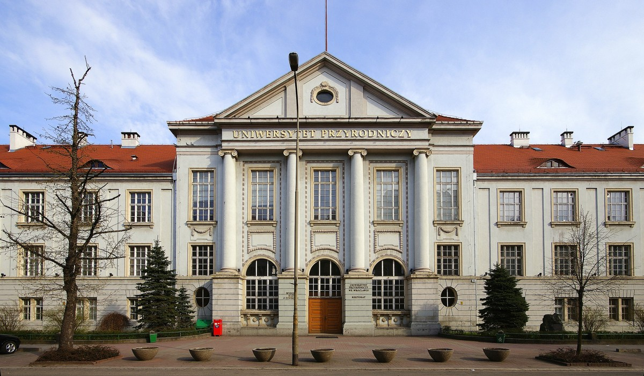
THANK YOU

