Slide 1
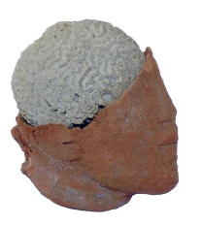

2nd International Conference on HIV/AIDS, STDs & STIs October 27-29, 2014 Las Vegas, USA
Significant differences between augmentation of kynurenine aminotransferase I and kynurenine aminotransferase II activities in various types of brain pathology after HIV-1 infection
Halina Baran, Berthold Kepplinger and Johannes A. Hainfellner
Karl Landsteiner Research Institute for Neurochemistry, Neuropharmacology, Neurorehabilitation and Pain Therapy, Landesklinikum Mauer, Amstetten,
Senecura Neurorehabilitation Center, Kittsee,
Institute of Neurology, Medical University Vienna, Austria

Slide 2
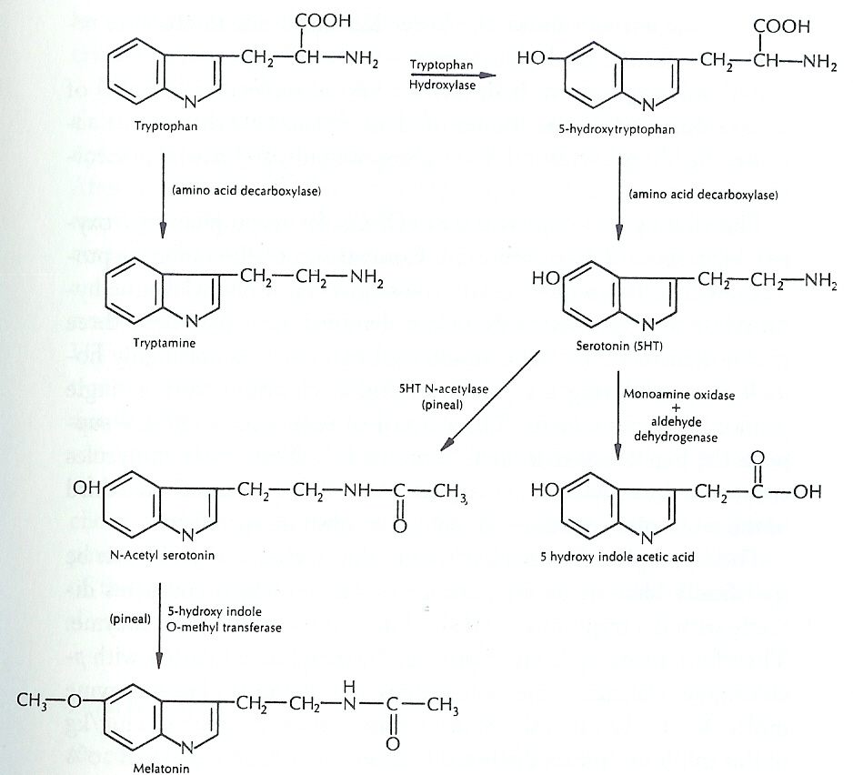
Tryptophan is a substrate for the synthesis of the neurotransmitter
Serotonin

Slide 3
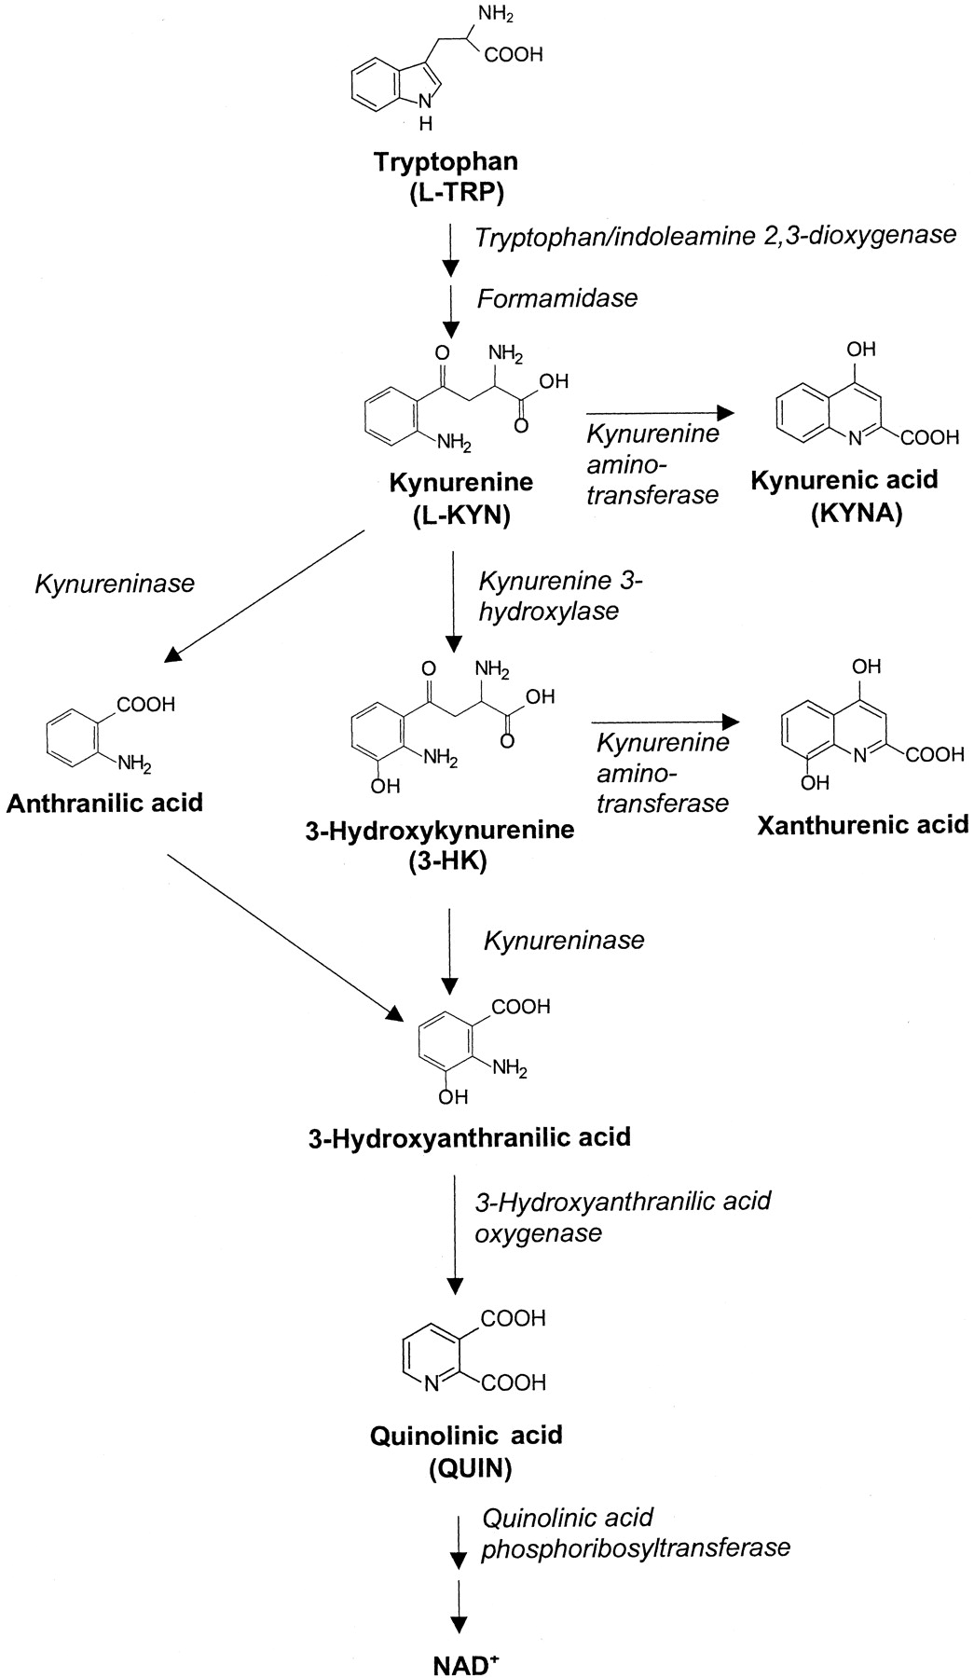
Kynurenine Pathway is the major road of
L-Tryptophan catabolism.

Slide 4
Kynurenic acid (KYNA) is an
endogenous metabolite in the
“kynurenine pathway” of
tryptophan degradation and is
an antagonist at the glycine site of the N-methyl-D-aspartate (NMDA)
an antagonist at the alpha-7 nicotinic cholinergic receptors (7αnACh), while
Quinolinic acid is an agonist at the NMDA receptors

Slide 5
Classification of Excitatory Amino Acid Receptors in the Mammalian CNS
GLUTAMATE
NMDA AMPA KAINATE METABOTROPIC
Glutamate Site Glycine Site
Agonists: NMDA Glycine Quisqualic acid Kainic acid L-AP4
D-Serin AMPA Domoic acid ACPD
R-HA966
Selective
Antagonists:AP-5 KYNA NBQX CNQX MCPG
AP-7 7-Cl-KYNA GYKI 52466 KYNA
CGS 5,7-Cl-KYNA KYNA
CGP MNQX
CPP L-689,560
KYNA
Channel
Blockers: Mg^{+2,}, Memantine
Effector
pathways: NA+/K+/Ca²⁺ NA+/K+/Ca²⁺ NA+/K+/Ca²⁺ IP3DAG
J. R. Cooper. Biochemical Basis of Neuropharmacology, Oxford University Press, 1996 (simplified).

Slide 6
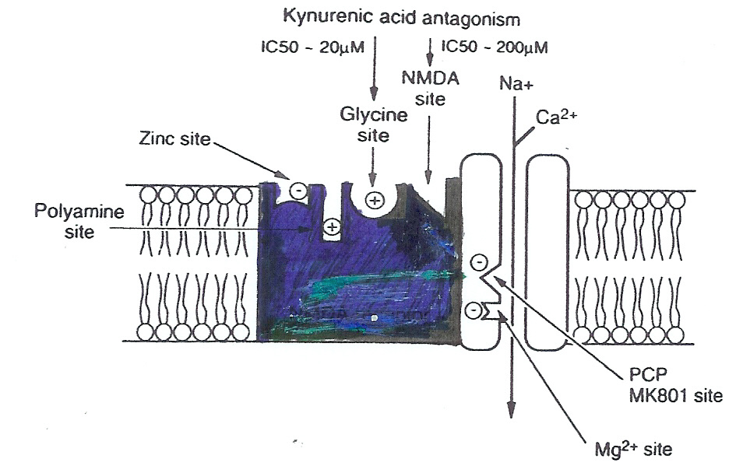
Kynurenic acid – an endogenous antagonist at the glycine site of the NMDA receptor
T. Stone 1983

Slide 7
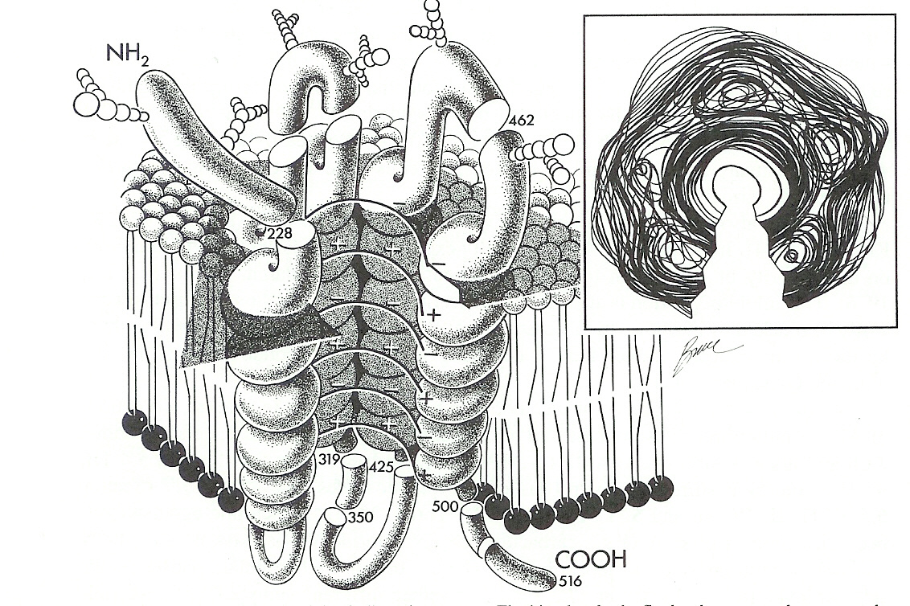
Kynurenic Acid and Cholinergic Receptor
Kynurenic acid blocks NON-competitively the α7nCh Receptor activity.
(Hilmas et al 2001 J. of Neuroscience)
Kynurenic acid may modulate the synaptic transmission through blockade of the alpha 7 nicotine cholinergic rezeptors (α7nChRs).
(Alkondon et al., J of Neuroscience 2004 /Albuquerque Group)

Slide 8
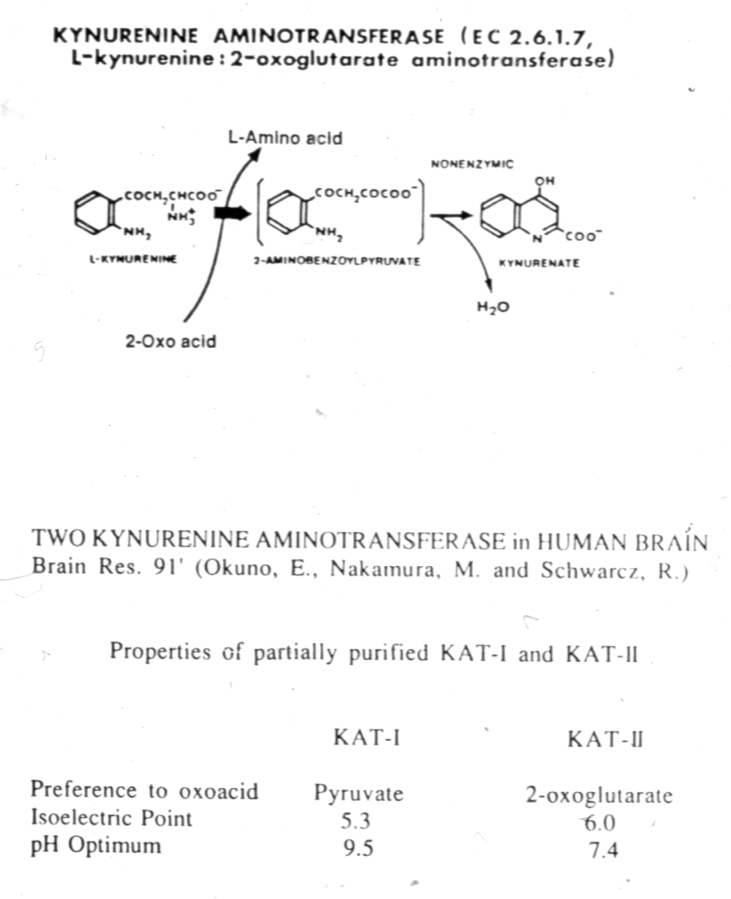
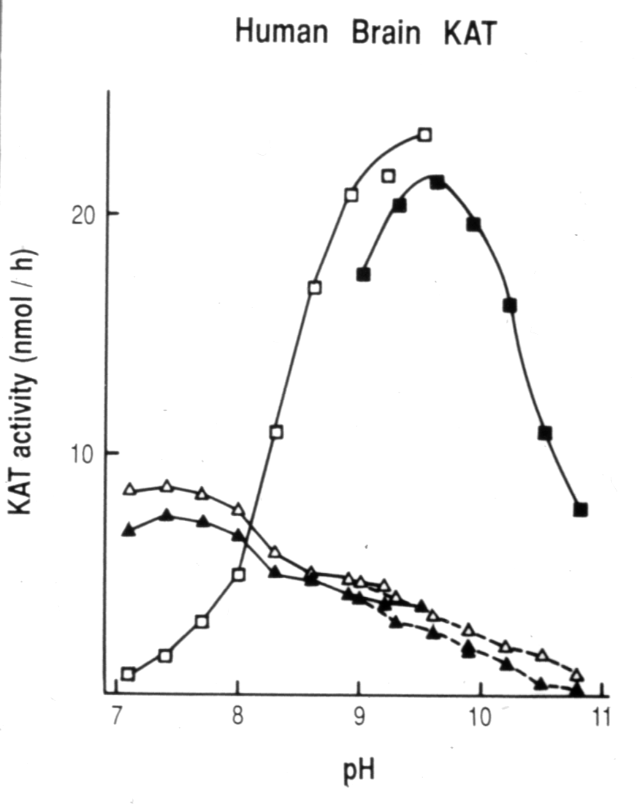
pH optimum of KAT I and KAT II
H. Baran, et al., J. Neurochem., 1994

Slide 9
Differences between KAT I and KAT II
In contrast to KAT II, which is not affected dramatically by
pH changes,
and shows no particular preference for aminoacceptors ,
and is not inhibited by millimolar concentrations of amino acids (substrate for KAT),
KAT I
is highly dependent on the composition of the incubation medium.

Slide 10
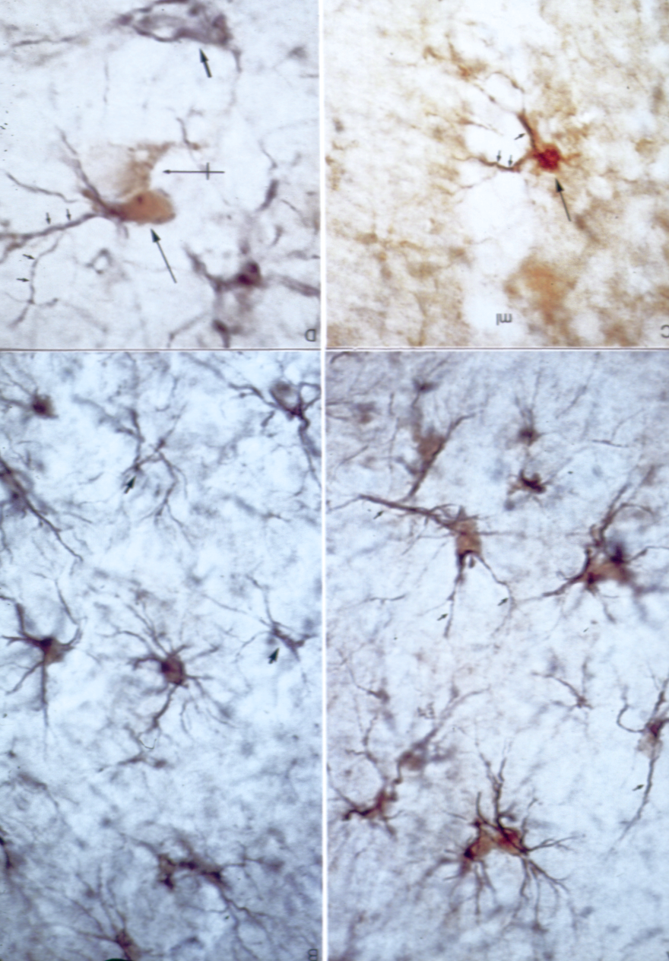
Rat‘s and human‘s Kynurenine Amino-transferase (KAT) is preferentially localized in microglia, astrocytes but is also present in discrete neuronal populations as has been demonstrated by immunhistochemical studies using KAT-antibodies.
(R. C. Roberts et al., J. Comp. Neurol., 1992)

Slide 11
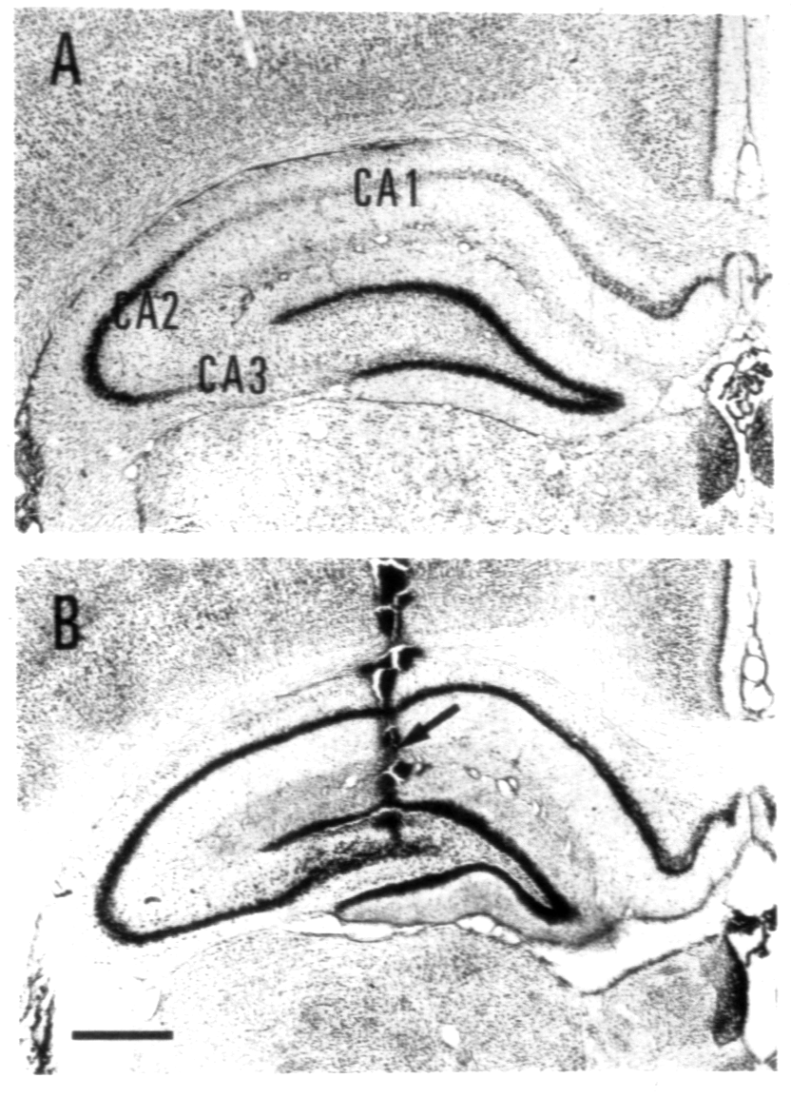

A) γ-Acetylenic GABA (GAG), a potent KAT inhibitor, produces axon-sparing neurodegeneration in CA1 and CA3 after focal injection into the rat hippocampus.
B) Induced lesions are blocked by the NMDA receptor antagonists MK801 or AP7, indicating that γ-acetylenic GABA caused excytotoxic damage is due to NMDA receptor activation.
O.G. McMaster H. Baran et al,. Exper. Neurology, 1993

Slide 12
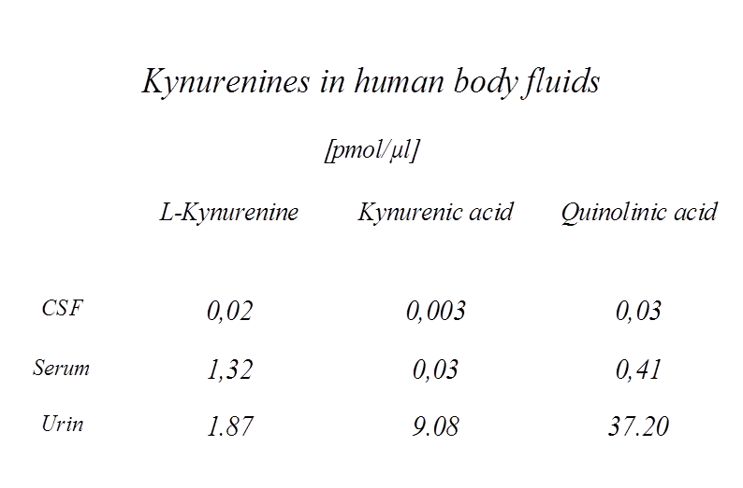

Slide 13
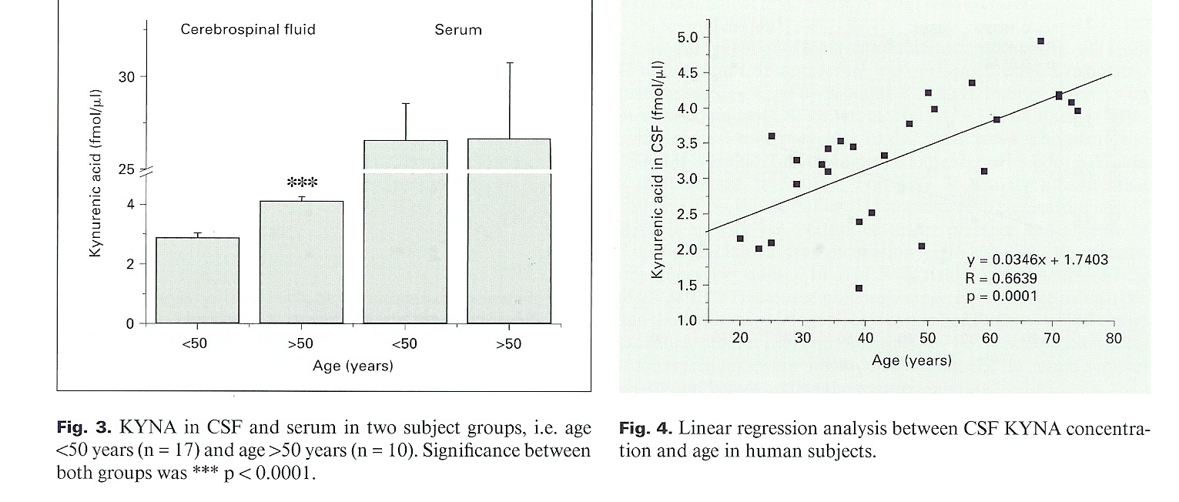
Kynurenic acid and ageing
B. Kepplinge H. Baran et al., 2005 Neurosignals

Slide 14
Alterations of L-Kynurenine Metabolism in Neurodegenerative and Neuropsychiatric Diseases
Chorea Huntington
Olivo-Ponto-Cerebellar Atrophy
Temporal Lobe Epilepsy
Hepatic Encephalopathy
Cerebral Ischemia including Stroke
Hypoglycemia
AIDS
Polyneuropathy
Down‘Syndrom
Alzheimer‘s
and in other conditions including aging

Slide 15
We evaluated the biosynthetic machinery of kynurenic acid e.g. the content of
L-kynurenine and kynurenic acid, as well as
the activity of enzymes synthesizing kynurenic acid, kynurenine aminotransferases I and kynurenine aminotransferase II (KAT I and KAT II) in the frontal cortex and cerebellum of HIV-1 infected patients in respect to different types of pathology and these were classified as follows:
HIV in brain (HIV); opportunistic infection (OPP); infarction of brain (INF); malignant lymphoma of brain (LY); and glial dystrophy (GD) and of control subjects.
Notes:
Our study: The study was performed according to the ethic regulation of lower Austria. 45 stroke patients, 33 men and 12 women, between 52 and 89 years old agreed to take part in this study. A set of ten treatments was planed for each patient, EEG investigations were done before and after the first, fifth and tenth magnetic stimulation unit. Before the first, after the fifth and after the tenth rTMS application, blood samples were collected and tryptophan metabolites were analysed in serum by HPLC.

Slide 16
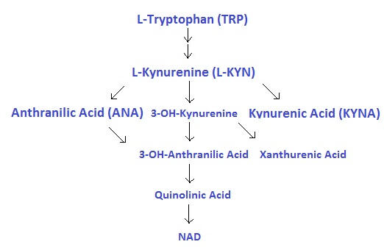
Tryptophan metabolites
Kynurenic acid (KYNA), an intermediate metabolite of L-kynurenine (L-KYN) , is a competitive antagonist of inotropic EAA receptors and a non competitive antagonist of 7 alpha nicotine cholinergic receptors and its involvement in memory deficit and cognition impairment has been suggested.
Alterations of kynurenic acid metabolism in the brain after HIV-1 infection have been demonstrated.
KAT I; KAT II
Notes:
From all metabolites of the kynurenine pathway, kynurenic acid and quinolinic acid are neuroactive compounds - Quinolinic acid as a very potent glutamate agonist and Kynurenic acid as a glutamante antagonist at the NMDA receptors and a non-competitive blocker of the alpha 7 nicotinic acetylcholine receptors.

Slide 17
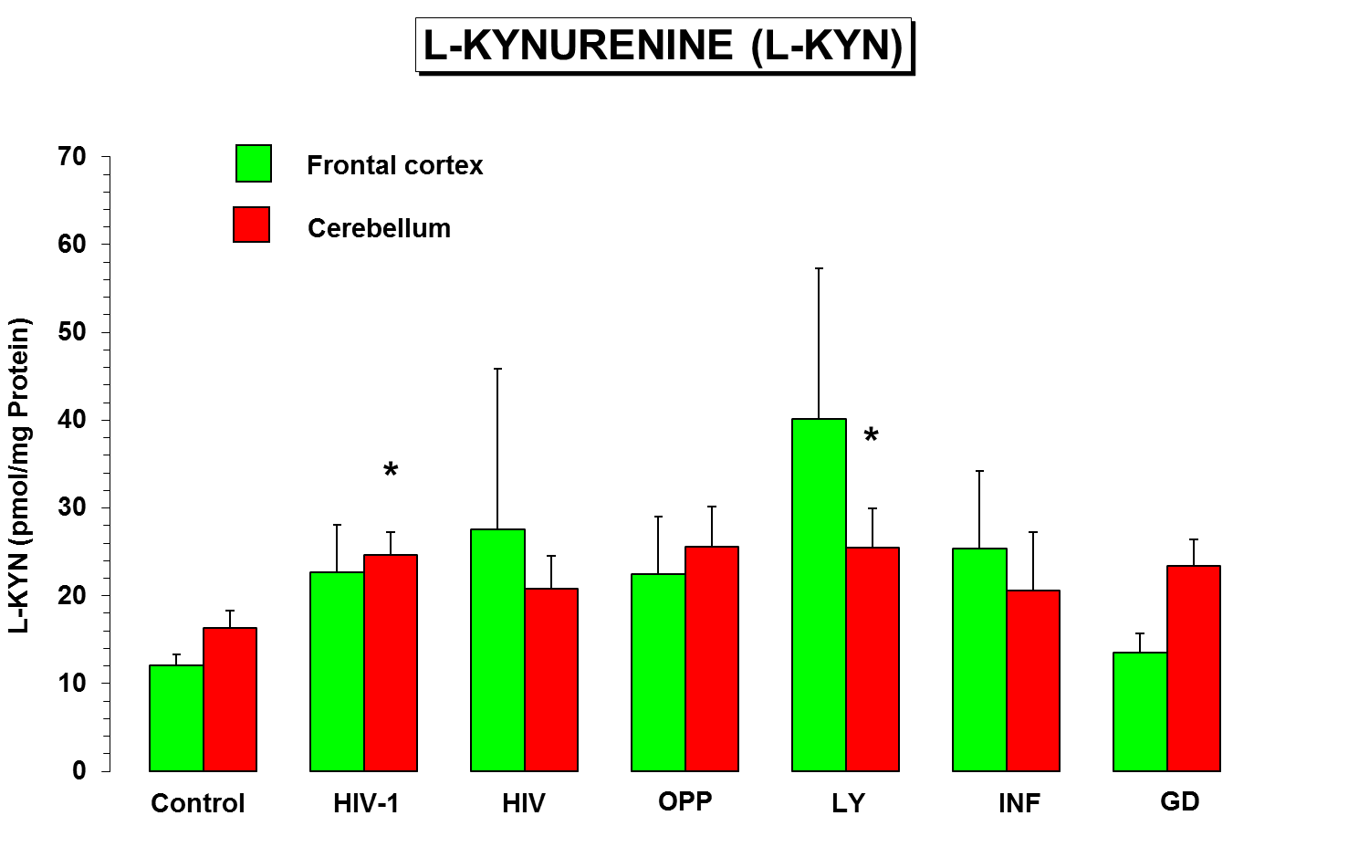
HIV (HIV in brain); OPP (opportunistic infection); LY (malignant lymphoma of brain); INF (infarction of brain); and GD (glial dystrophy) and of control (control subjects).

Slide 18
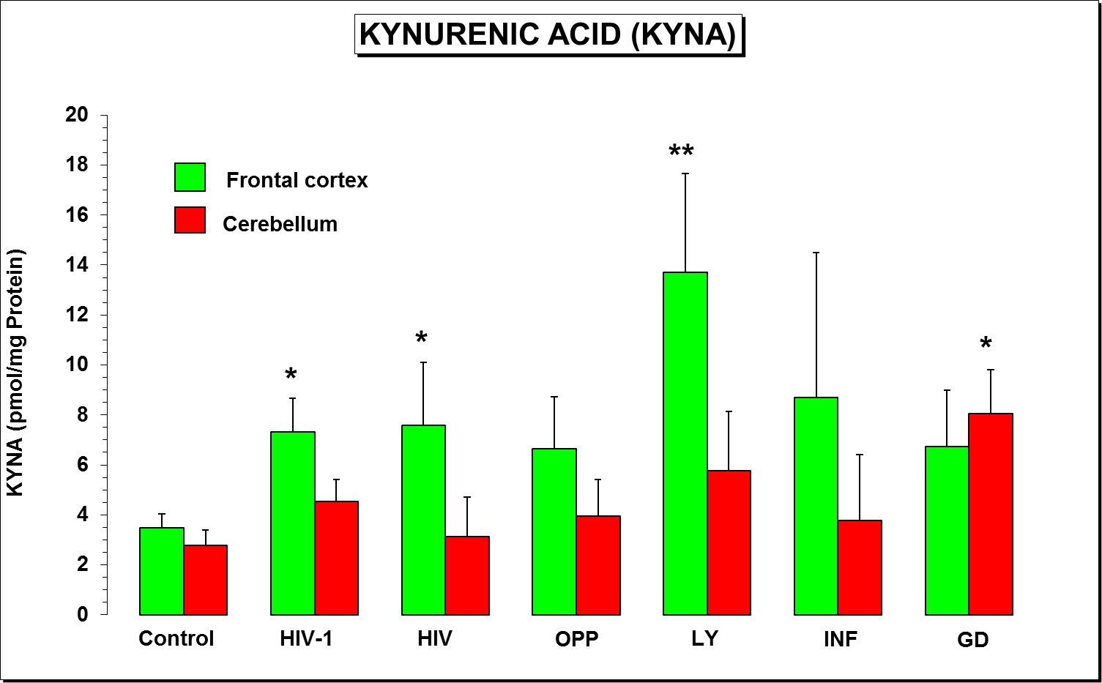
HIV (HIV in brain); OPP (opportunistic infection); LY (malignant lymphoma of brain); INF (infarction of brain); GD (glial dystrophy) and Control (control subjects).
Notes:
Our study: The study was performed according to the ethic regulation of lower Austria. 45 stroke patients, 33 men and 12 women, between 52 and 89 years old agreed to take part in this study. A set of ten treatments was planed for each patient, EEG investigations were done before and after the first, fifth and tenth magnetic stimulation unit. Before the first, after the fifth and after the tenth rTMS application, blood samples were collected and tryptophan metabolites were analysed in serum by HPLC.

Slide 19
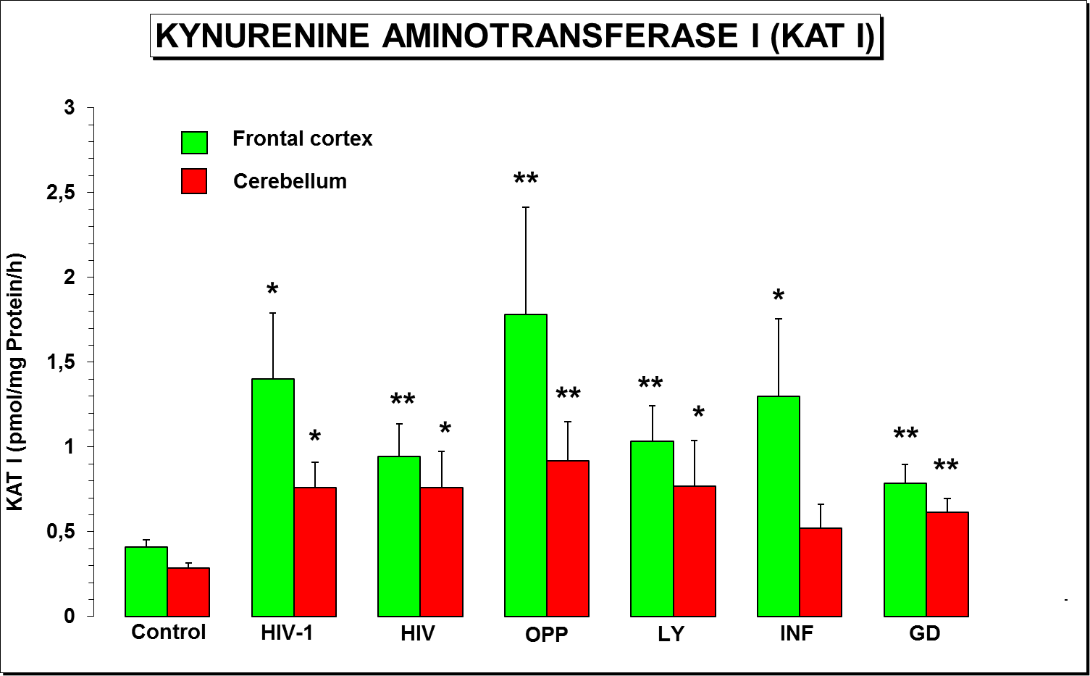
HIV (HIV in brain); OPP (opportunistic infection); LY (malignant lymphoma of brain); INF (infarction of brain); GD (glial dystrophy) and Control (control subjects).
Notes:
Our study: The study was performed according to the ethic regulation of lower Austria. 45 stroke patients, 33 men and 12 women, between 52 and 89 years old agreed to take part in this study. A set of ten treatments was planed for each patient, EEG investigations were done before and after the first, fifth and tenth magnetic stimulation unit. Before the first, after the fifth and after the tenth rTMS application, blood samples were collected and tryptophan metabolites were analysed in serum by HPLC.

Slide 20
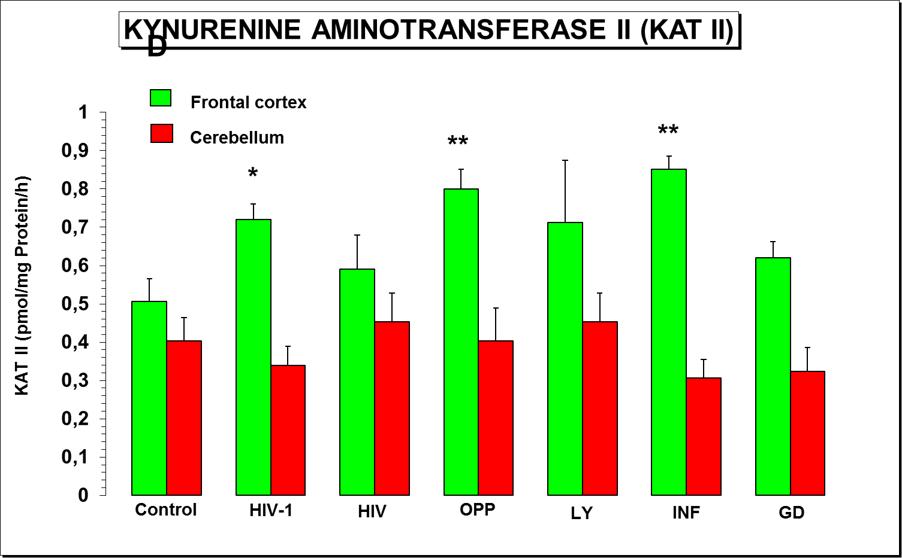
HIV (HIV in brain) ; opportunistic infection (OPP); malignant lymphoma of brain (LY); infarction of brain (INF); and glial dystrophy (GD) and of control subjects (control).
Notes:
Our study: The study was performed according to the ethic regulation of lower Austria. 45 stroke patients, 33 men and 12 women, between 52 and 89 years old agreed to take part in this study. A set of ten treatments was planed for each patient, EEG investigations were done before and after the first, fifth and tenth magnetic stimulation unit. Before the first, after the fifth and after the tenth rTMS application, blood samples were collected and tryptophan metabolites were analysed in serum by HPLC.

Slide 21
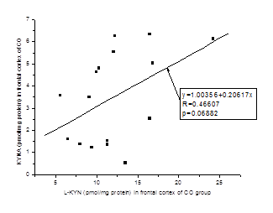
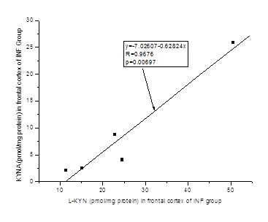
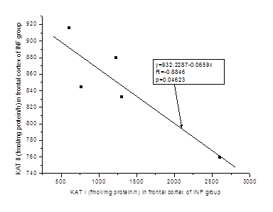
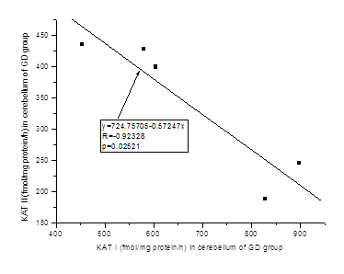
Statistical correlations
Notes:
Our study: The study was performed according to the ethic regulation of lower Austria. 45 stroke patients, 33 men and 12 women, between 52 and 89 years old agreed to take part in this study. A set of ten treatments was planed for each patient, EEG investigations were done before and after the first, fifth and tenth magnetic stimulation unit. Before the first, after the fifth and after the tenth rTMS application, blood samples were collected and tryptophan metabolites were analysed in serum by HPLC.

Slide 22
Patients infected with HIV-1 virus frequently present with neuro-psychiatric symptoms.
Is the marked increase of KAT I activity mainly due to macrophage invasion in HIV-1 encephalopathy ?
Do elevated KYNA levels mitigate the cytotoxic effects of Quinolinic and Glutamic Acids in the brain of HIV-1 patients?
Do elevated KYNA levels play a role in the high lethality by patients with bronchopneumonia or after HIV-1 infection?
Does the alteration of KYNA metabolism in the brain of HIV-1 infected subjects play a similar function as suggested in Alzheimer Dementia?

Slide 23
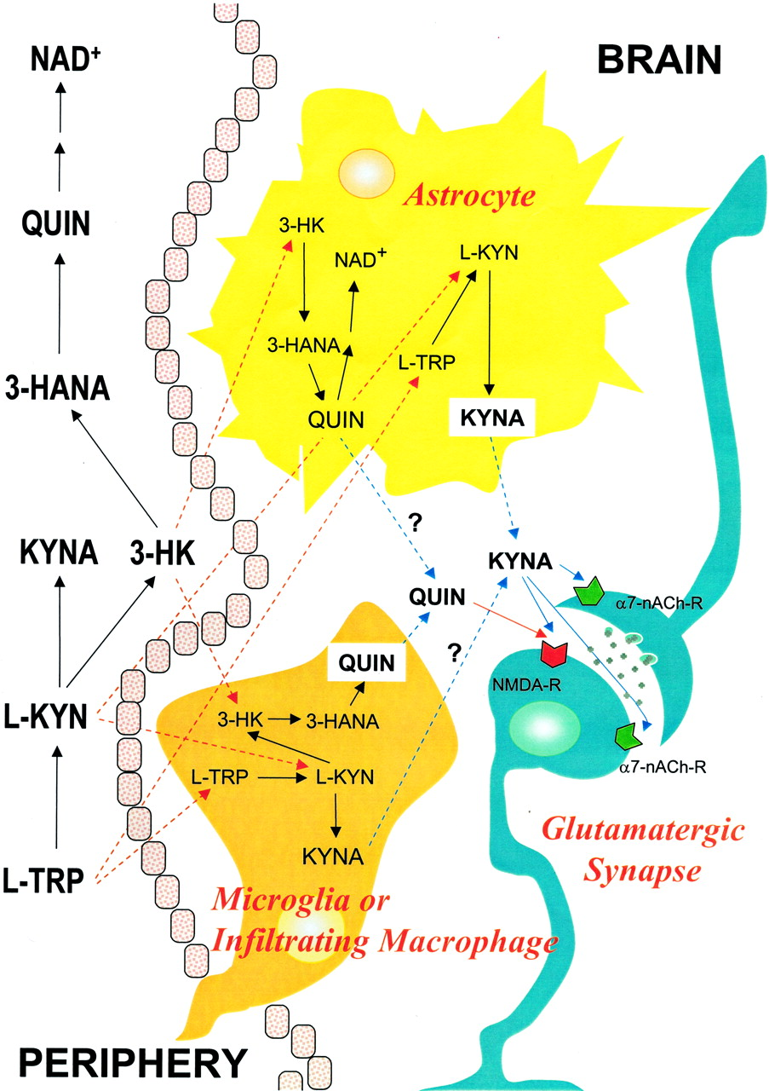
It is likely that the marked increase of KAT I activity is due to macrophage invasion in HIV-1 encephalopathy.
KATs
KATs

Slide 24
Patients infected with HIV-1 virus frequently present with neuro-psychiatric symptoms.
Is the marked increase of KAT I activity mainly due to macrophage invasion in HIV-1 encephalopathy ?
Do elevated KYNA levels mitigate the cytotoxic effects of Quinolinic and Glutamic Acids in the brain of HIV-1 patients?
Do elevated KYNA levels play a role in the high lethality by patients with bronchopneumonia or after HIV-1 infection?
Does the alteration of KYNA metabolism in the brain of HIV-1 infected subjects play a similar function as suggested in Alzheimer Dementia?

Slide 25
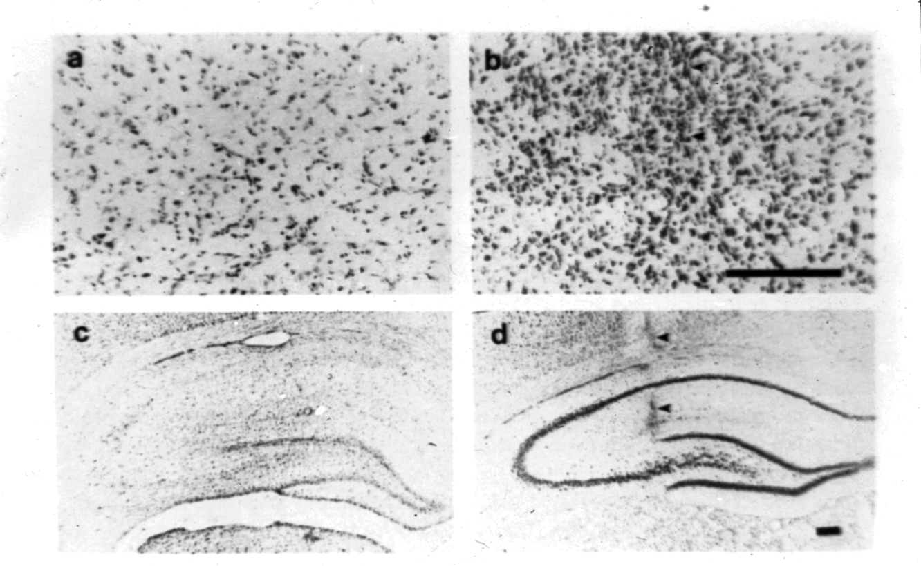
Protective effect of Kynurenic Acid against Quinolinic Acid induced neurotoxicity.
a and c: Intrahippocampal injection of saline and Quinolinic Acid (Nissl Staining).
b and d: Intrahippocampal injection of Kynurenic and Quinolinic Acid (Nissl Staining).
In HIV-1 infected patients
QUIN >> KYNA
Heyes et al., 1992
A.C. Foster, Neurosci. Lett., 1984

Slide 26
Patients infected with HIV-1 virus frequently present with neuro-psychiatric symptoms.
Is the marked increase of KAT I activity mainly due to macrophage invasion in HIV-1 encephalopathy ?
Do elevated KYNA levels mitigate the cytotoxic effects of Quinolinic and Glutamic Acids in the brain of HIV-1 patients?
Do elevated KYNA levels play a role in the high lethality by patients with bronchopneumonia or after HIV-1 infection?
Does the alteration of KYNA metabolism in the brain of HIV-1 infected subjects play a similar function as suggested in Alzheimer Dementia?

Slide 27
Time dipendent increase of Kynurenic acid in tha brain in rat experimental asphyxia.
(H. Baran et al., Life Sciences 2001)

Slide 28
H. Baran, et al., Life Sciences, 2001

Slide 29
Patients infected with HIV-1 virus frequently present with neuro-psychiatric symptoms.
Is the marked increase of KAT I activity mainly due to macrophage invasion in HIV-1 encephalopathy ?
Do elevated KYNA levels mitigate the cytotoxic effects of Quinolinic and Glutamic Acids in the brain of HIV-1 patients?
Do elevated KYNA levels play a role in the high lethality by patients with bronchopneumonia or after HIV-1 infection?
Does the alteration of KYNA metabolism in the brain of HIV-1 infected subjects play a similar function as suggested in Alzheimer Dementia?

Slide 32
After HIV-infection
The KAT I activity increased significantly in the frontal cortex of all pathological subgroups, i.e.
OPP = 433 % > INF > LY > HIV > GD = 182 % of CO
In the cerebellum, too, all pathological subgroups showed marked increase of KAT I activity
OPP = 326 % > LY, HIV > GD > INF = 181 % of CO.
On contrary, the activity of KAT II was moderately, but significantly, increased only in the frontal cortex of
INF and OPP (174 and 160 % of CO)
in the cerebellum of HIV, OPP and LY was comparable to control, while mildly reduced in INF and GD.
Notes:
Our study: The study was performed according to the ethic regulation of lower Austria. 45 stroke patients, 33 men and 12 women, between 52 and 89 years old agreed to take part in this study. A set of ten treatments was planed for each patient, EEG investigations were done before and after the first, fifth and tenth magnetic stimulation unit. Before the first, after the fifth and after the tenth rTMS application, blood samples were collected and tryptophan metabolites were analysed in serum by HPLC.

Slide 33
Occurrence of bronchopneumonia (BR) and tuberculosis (TB)
in different pathological group of patients after HIV-1 infection.
Ratio | OPP | HIV | LY | INF | GD
Number of pathology cases with BR/ total number of pathology cases; expressed in % | 9/15 (60%) | 1/6 (17%) | 3/5 (60%) | 2/5 (40%) | 2/5 (40%)
Number of pathology cases with TB/ total number of pathology cases; expressed in % | 2/15 (13%) | 2/6 (33%) | 1/5 (20%) | No case with TB | 1/5 (20%)
*
Notes:
In Kynurenic acid no alterations were found.

Slide 34
.
KYNA levels and activity of KAT I and KAT II in the
frontal cortex and cerebellum of patients wit bronchopneumonia
Brain region | KYNA | KAT I | KAT II
Frontal cortex; (in % of CO) | 13.383 ± 2.290 (383 % of CO)** | 3.603 ± 1.226 (877 % of CO)** | 0.511 ± 0.028 (101 % of CO)
Cerebellum (in % of CO) | 2.117 ± 0.005 (76 % of CO) | 1.371 ± 0.680 (479 % of CO)* | 0.513 ± 0.168 (127 % of CO)
*
Notes:
In anthranilic acid levels we could observe an moderate increase. Studies on the ratios between tryptophan metabolites revealed significant changes during the treatment with rTMS.

Slide 35
An increase of KYNA levels in the human central nervous system (CNS) is due to significant increase of KAT I activity and to lesser extend due to increase of KAT II activity.
Blockade of glutamate NMDA and nicotine acetylcholinergic receptors is in part responsible for impaired memory, learning and cognition in various disorders.

Slide 36
Dementia and Treatment
It is questionable if above mentioned anti-dementive
medication(s) influence(s) the Kynurenic acid synthesis
(blockade).
Acetylcholine Esterase Inhibitors
NMDA Receptor Blocker – Memantine
Nootropica: Piracetam, Ginko biloba
Cerebrolysin

Slide 37
Effect of Cerebrolysin on KAT I, KAT II and KAT III
H. Baran and B. Kepplinger (2008) Eur Neuropsychopharmacology

Slide 38
Clinical significances
Human studies indicated that Cerebrolysin improves dementia symptoms and cognitive performance
in patients with Alzheimer's disease (AD) and
in other types of senile dementia and
in elderly control subjects
(Álvarez et al., 2000; (Rüther et al., 1994; Ruether et al., 2001; Crook et al., 2005; Álvarez et al., 2006; Muresanu et al., 2008) .

Slide 39
D-Cycloserine, known as a partial agonist at the glycine modulatory site of the glutamatergic N-methyl-D-aspartate (NMDA) receptor, exerts anticonvulsive activities and improves cognitive function and….

Slide 40
Summary
Lowering of KYNA content due to D-cycloserine inhibition of KATs activities might be involved in the postulated mechanism for D-cycloserine to act as a partial agonist at the glycine site of the NMDA receptor.
We propose that this mechanism(s) is in part responsible for the improvement of symptoms like dementia, cognition and/or delusion in schizophrenia patients, Alzheimer’s, HIV-1 infected patients or Parkinson’s patients.

Slide 41
Conclusions
All these observations, together with the fact that KYNA dose dependently increases oxygen consumption and decreases ATP synthesis of rat heart mitochondria (Baran et al., 2003), suggest the improvement of cell function in pathological conditions due to D-cycloserine action of lowering KYNA formation.

Slide 42
Thank you for your attention

Slide 44
Effect of Cerebrolysin on KAT I, KAT II and KAT III
H. Baran and B. Kepplinger (2008) Eur Neuropsychopharmacology

Slide 45
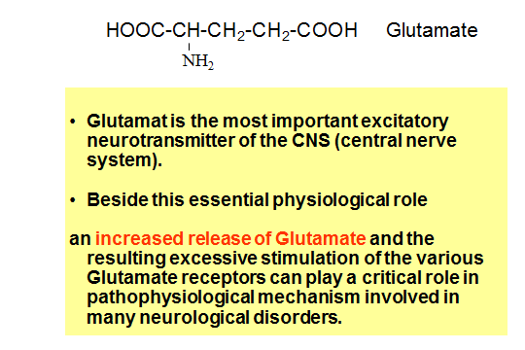

Slide 46
Kynurenic acid acts as an antagonist at the
excitatory amino acid (EAA) receptors trigger-ing neuroproterctive and anticonvulsive acti-vities, and acts as an antagonist at the nicotinic cholinergic Receptors 7α-Ach-R.
Quinolinic acid is a powerful agonist at the EAA receptors with excitotoxic, convulsive activities.
3-OH-kynurenine and 3-OH-anthranilic
acid are free radical generators.
3-OH-kynurenine is a cytotoxic agent.
3-OH-anthranilic acid is carcinogenic agent with respect to bladder and brest malignants and
the function of anthranilic acid is still unknown.

Slide 47
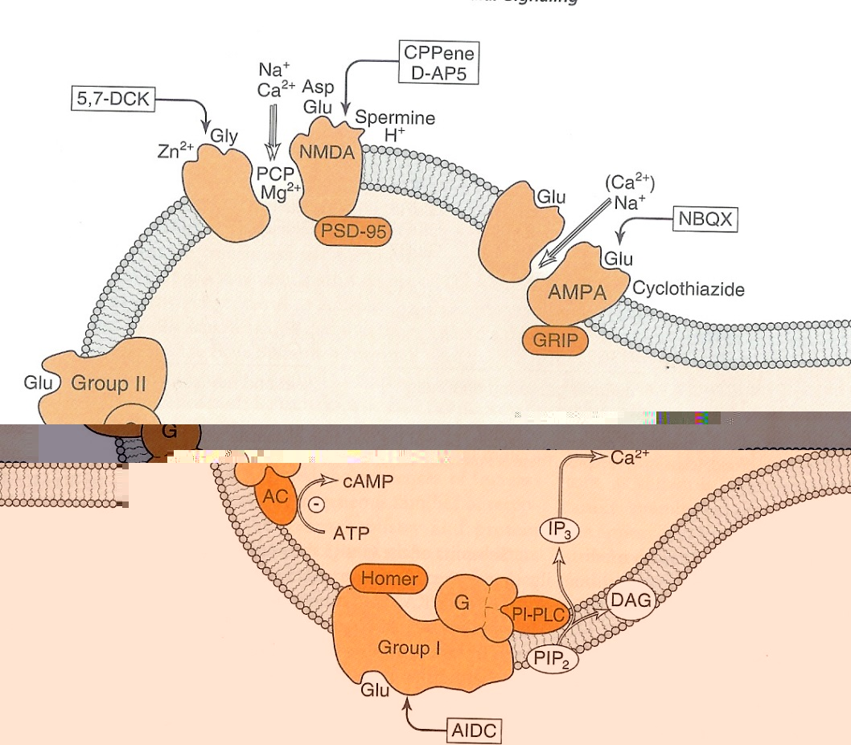
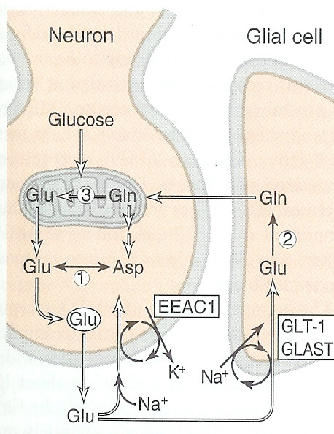
In Alzheimer‘s there was found also a significant change of glutamatergic transmission - (Glu ↑) beside the dysfunktion of the cholinergic neurotransmission.
-decrease of Glu carrier (EAA2) in astroglia
-elevated resp. reduced number of glutamatergic receptors Glu R (NMDA)
-synthesis of unknown NMDA agonists.
-NMDA antagonist MEMANTINE clinically effective in Alzheimer‘s and other forms of dementia.
-synthese von NO in microglia
NMDA
AMPA, KA

Slide 48
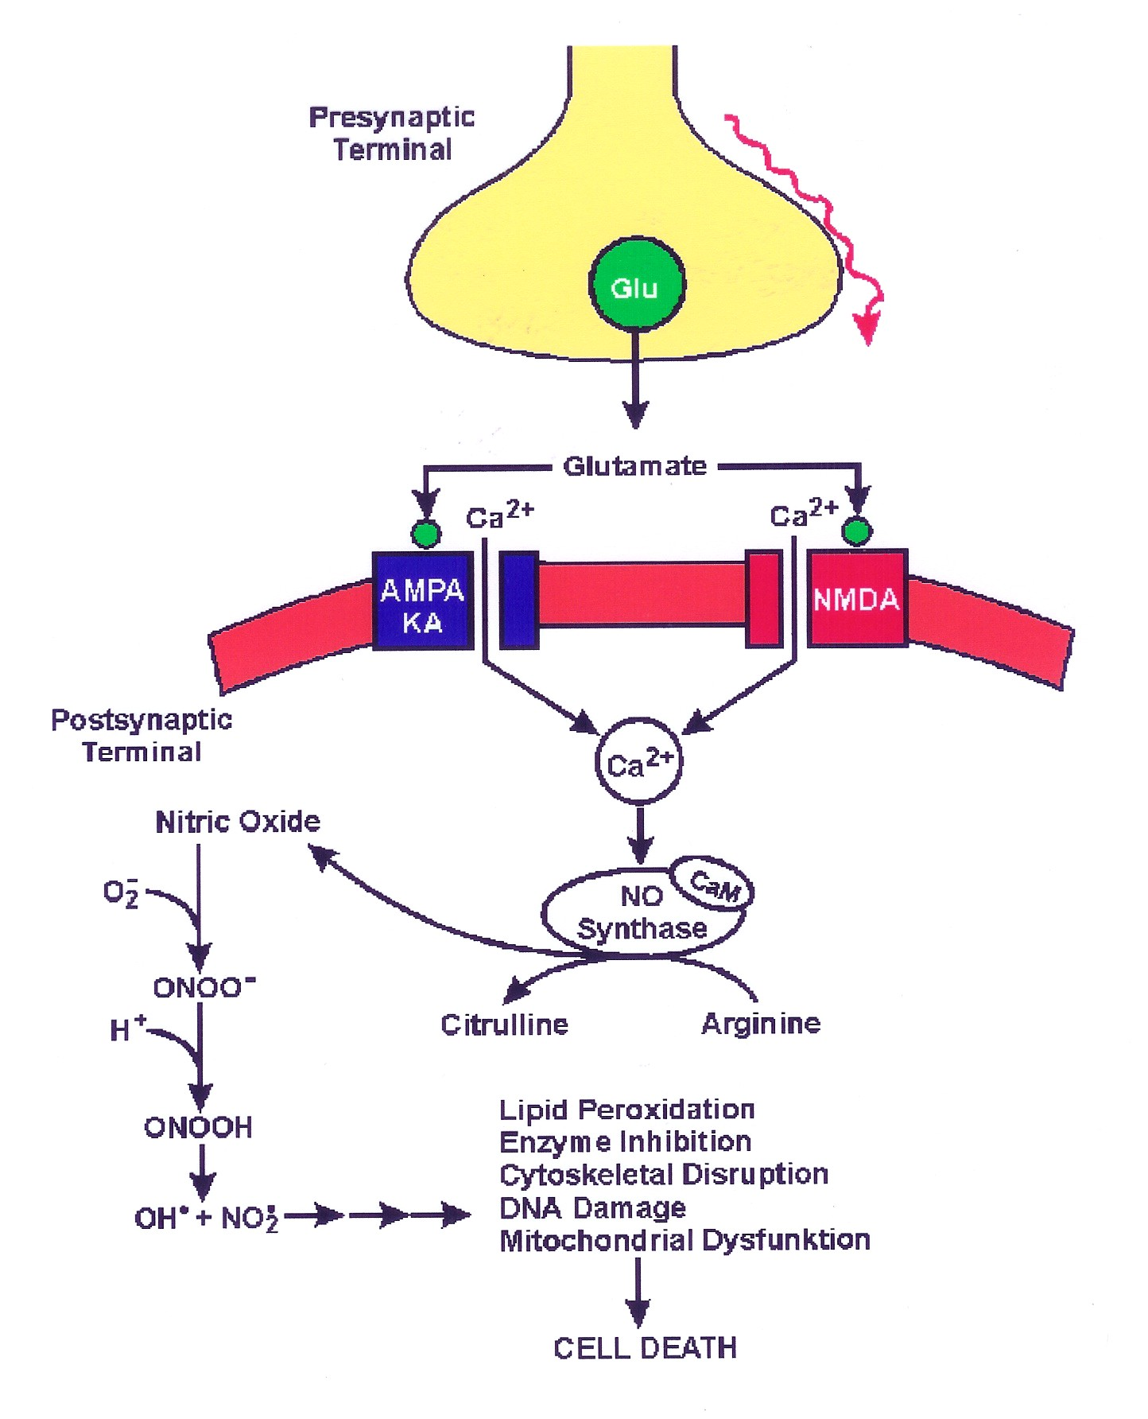
Glutamatergic neurotransmission
Overactivation of Glutamate
neurons
Released of Glutamate
Activation of the postsynaptic and
presynaptic EAA receptors:
- ionotropic NMDA, AMPA, KA and
- eight metabotropic receptors
Metabolic disturbance
Cell death

Slide 49
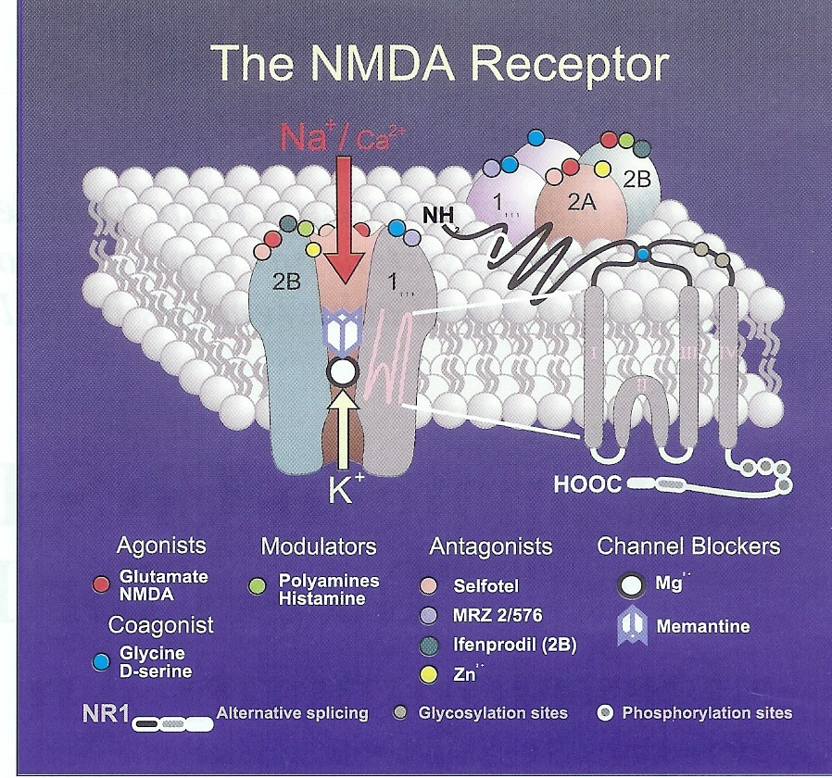

Slide 50
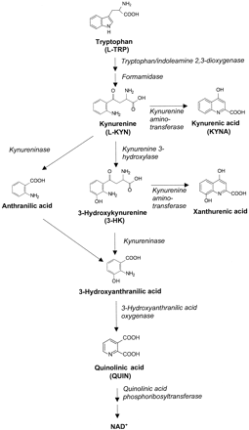
Lowering of Kynurenic acid synthesis
by blocking KATs activities using GAG and also AOAA (Y)
can produce lesions indirectly by
metabolic derangement and /or
inhibition of kynurenic acid formation.
Y
X
z

Slide 51
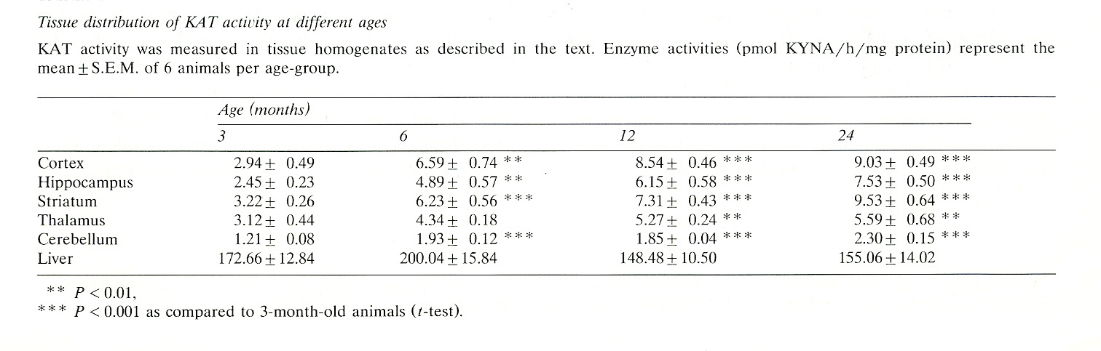
In old animals,
decline in the cerebral excitatory amino acid receptor densities with age corresponds with increased production of KYNA and with
age-related changes in astrocytes (hypertrophy).
Age related changes in astrocytes are likely responsible for the increase in KYNA formation with age and may be involved in cognitive and memory dysfunction.
(Gramsbergen et al., 1992 Brain Res)

Slide 52
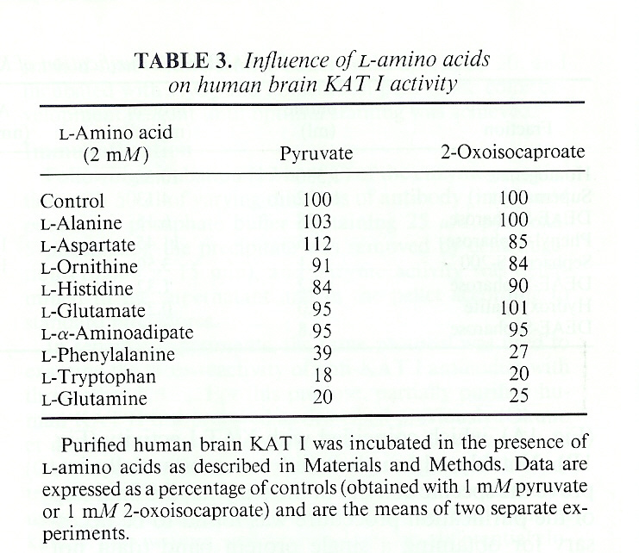
or fluctuation in the intracellular concentration of amino acids
H. Baran et al 1994,
J Neurochem

