Slide 1
Effect of supplementation of concentrate to sweet sorghum bagasse with leaf residue silage on nutrient utilization and nitrogen balance in native sheep
Dr.B.VIDYA
ASSISTANT PROFESSOR
DEPARTMRNT OF ANIMAL NUTRITION
CVSc, KORUTLA

Slide 2
Introduction
INDIA- Sheep and Goat play a vital role in rural economy
Sheep - 75 million ( FAOSTAT ,2012)
Goat - 160 million
In India during the year 2011, total meat production from sheep and goat was 2,93,000 and 8,46,600 tonnes, respectively (FAOSTAT, 2013).

Slide 3
Contd..
Major constraints:
Shortage of feed and fodder
Feed and Fodder Availability and Requirement in India
Feed | Requirement (mt) | Availability (mt) | Shortfall (%)
Concentrate | 123 | 45 | 63.41
Green Fodder | 1025 | 390 | 61.95
Dry Fodder | 570 | 443 | 22.28

Slide 4
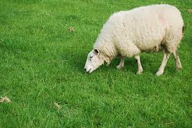
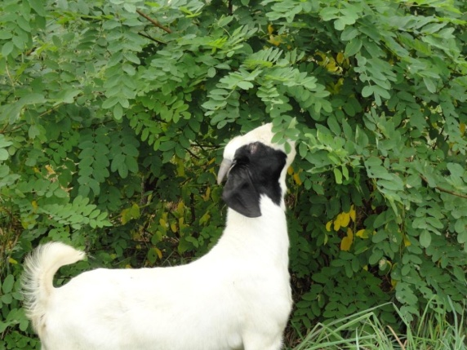
Small ruminants in India mainly depend on grazing and browsing resources to meet their nutrient requirements.
Now a days – Continuous depletion of grazing land
Grazing lands are converted to irrigated lands & SEZ of industries

Slide 5
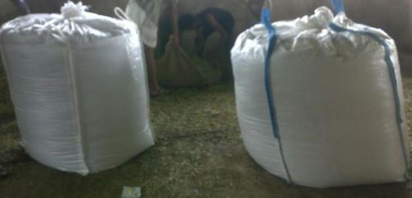
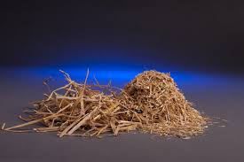
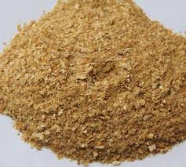
Possible alternatives
Conservation of fodders
Utilization of crop residues
Incorporation of unconventional feed stuffs (AIBP)

Slide 6
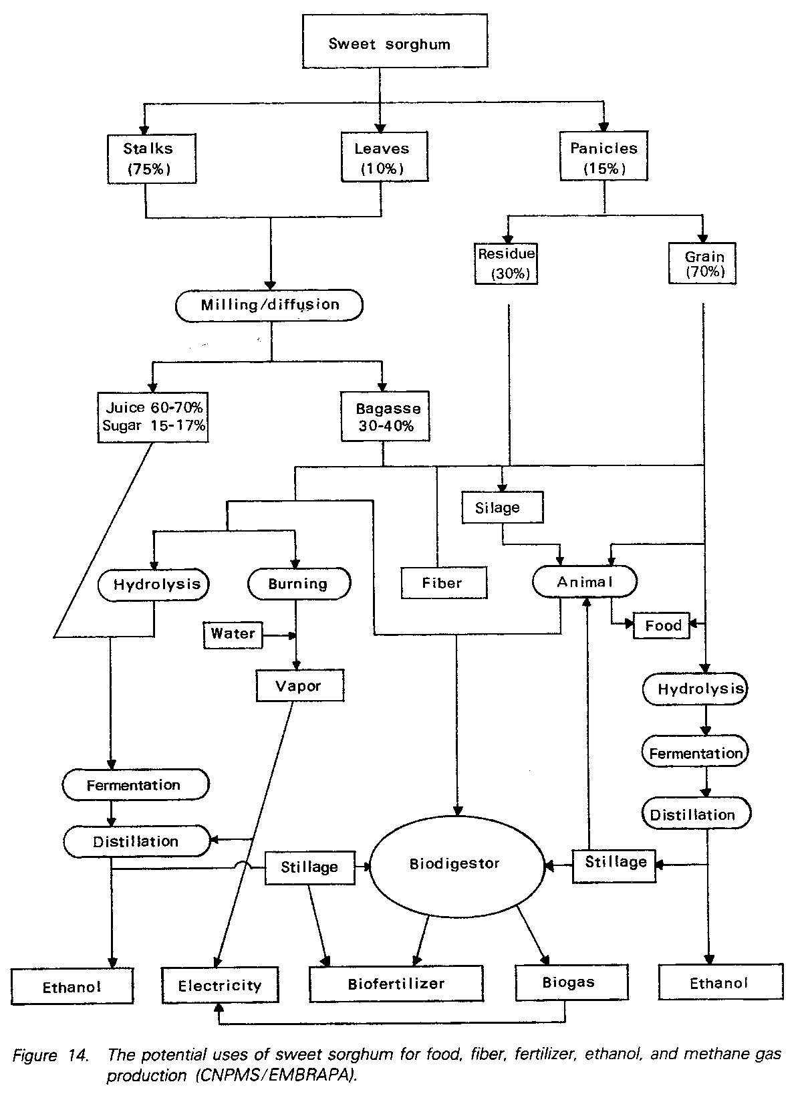
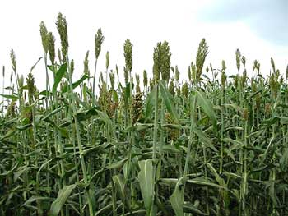
The potential uses of sweet sorghum for food, fiber, fertilizer, ethanol, and methane gas production
Silage
xxxx

Slide 7
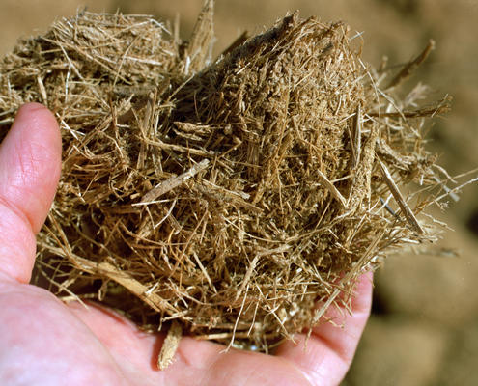
Sweet Sorghum Bagasse
Higher biological value
Rich in micronutrients
Used as feed and good for silage making (Rao et al. 2009).
Sweet sorghum bagasse and stripped leaves provide a valuable, tradable feed resource (Blümmel et al. 2009).

Slide 8
Objectives of Investigation
To study the effect of supplementation of concentrate at different levels to SSB silage on nutrient utilization and N balance in growing Nellore ram lambs.

Slide 9
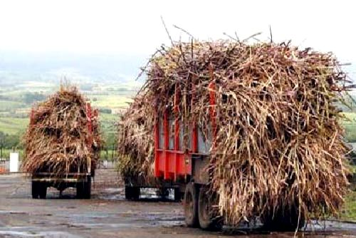
Materials and methods
Procurement of bagasse:
Decentralized crushing unit of ICRISAT, Patancheru, Daulathabad, Medak district.

Slide 10
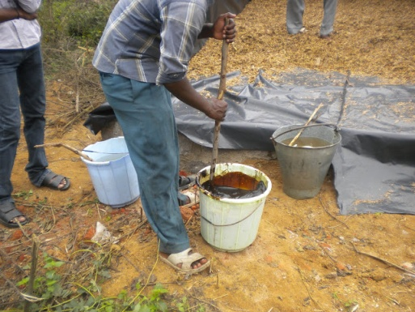
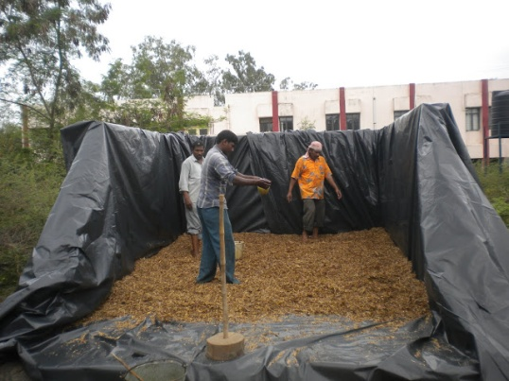
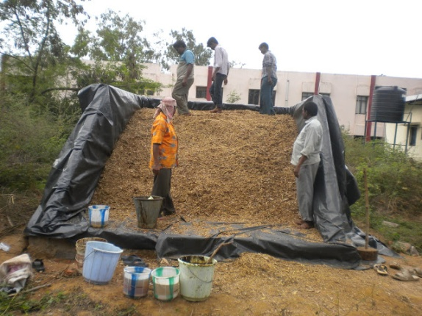
Silage making
Size of silo-12 LX9WX6H
Moisture -60%
Chopping length-1.5-2cm
Additives
Molasses- 1%
Urea- 0.5%
Salt – 0.5%
Incubation period: 30 days

Slide 11
Experimental design
Growth trial cum metabolism trial
Growth trial- 4 months
Twenty eight Nellore ram lambs of 3-4 months old with an average body weight of 12-14 kg were divided in to 4 groups comprising 7 animals in each group/treatment.
The following treatments were allotted at random to the 4 groups of Nellore ram lambs.
Sole SSB silage feeding
SSB Silage + concentrate @ 0.75 % of their live weight
SSB Silage + concentrate @ 1% of their live weight
SSB Silage + concentrate @ 1.25% of their live weight

Slide 12
Ingredient composition (g/kg) of concentrate mixture
Name of the ingredient | Concentrate mixture
Maize grain | 310.0
Ground nut cake | 165.0
Sunflower cake | 200.0
De oiled rice bran | 230.0
Molasses | 50.0
Urea | 15.0
Mineral mixture | 20.0
Salt | 10.0
CP 17% and ME 10.6 MJ/kg DM

Slide 13
METABOLISM TRIAL:
At the end of growth trial – 16 ram lambs -4X4
Adaptation period : 5 days
Collection period : 7 days
Samples of offered feed, left over feed, faeces and urine samples was collected.
Analysis of samples: proximate principles (AOAC, 1997) and fiber fraction (Van Soest et al. 1991).
Urine was analyzed for nitrogen content (AOAC, 1997).

Slide 14
Results and Discussion Chemical composition of experimental rations
Proximate principle | SSB silage | Concentrate mixture
Dry matter | 34.83 | 89.50
Organic matter | 92.46 | 88.31
Crude protein | 7.48 | 17.27
Ether extract | 1.99 | 3.45
Crude fibre | 37.14 | 9.34
Nitrogen free extract | 45.86 | 58.25
Total ash | 7.53 | 11.68

Slide 15
Cell wall constituent | SSB silage | Concentrate mixture
Neutral detergent fibre | 71.81 | 32.05
Acid detergent fibre | 46.75 | 13.32
Hemicellulose | 25.06 | 18.73
Cellulose | 31.16 | 7.09
Acid detergent lignin | 9.05 | 3.11

Slide 16
Effect of feeding SSBLR silage supplemented with different levels of concentrate on dry matter intake in growing Nellore ram lambs
Parameter | R-I | R-II | R-III | R-IV | SEM
Body weight (Kg) | 13.5 ^{b} | 19.1ª | 20.2ª | 20.7ª | 0.80
Metabolic body weight (Kg) | 7.02^{b} | 9.13ª | 9.51ª | 9.69ª | 0.29
Total DMI | 343^{b} | 608ª | 700ª | 613ª | 41.1

Slide 17
Nutrient digestibility
PARAMETER | R-I | R-II | R-III | R-IV | SEM
Dry matter | 53.42±1.10 | 55.53±2.21 | 56.31±1.68 | 58.44±1.26 | 0.86
Organic matter | 55.63±1.73^{b} | 56.86±0.95 ^{b} | 57.05±1.06 ^{b} | 60.20±0.77ª | 0.62
Crude protein | 62.81±1.02^{b} | 64.37±1.13^{ab} | 67.19±1.56^{ab} | 68.06±1.05ª | 0.75
Ether extract | 71.93±2.10 | 74.72±1.38 | 78.12±1.56 | 78.27±2.24 | 0.63
Crude fibre | 51.35±2.10 | 53.83±2.04 | 54.64±1.69 | 56.32±1.94 | 0.98
Nitrogen –free extract | 57.07±1.61^{b} | 62.66±1.40ª | 61.89±1.63ª | 64.68±1.48ª | 1.10

Slide 18
Nutrient digestibility
Cell wall constituents
Neutral detergent fibre | 59.43±2.44 | 60.08±2.68 | 62.48±2.44 | 62.52±2.09 | 1.14
Acid detergent fibre | 50.01±2.81 | 51.28±2.29 | 53.24±2.30 | 53.53±2.02 | 1.12
Hemicellulose | 60.62±1.66 | 62.03±1.62 | 65.40±2.07 | 66.07±2.52 | 1.07
Cellulose | 51.23±2.16 | 52.49±1.89 | 55.82±1.32 | 55.95±1.91 | 0.98

Slide 19
Nitrogen balance
PARAMETER | R-I | R-II | R-III | R-IV | SEM
N intake (g/d) | 4.11±0.35^{b} | 9.66±0.55ª | 11.53±0.21ª | 11.26±0.98ª | 0.81
Faceal N (g/d) | 1.38±0.23^{b} | 3.68±0.28ª | 3.46±0.45ª | 3.11±0.29ª | 0.27
Urinry N (g/d) | 2.93 ±0.55 | 3.82±0.23 | 4.75±0.11 | 4.26±0.45 | 0.24
Total N loss (g/d) | 4.31±0.42^{b} | 7.50±0.39ª | 8.21±0.49ª | 7.37±0.56ª | 0.44
N balance (g/d) | -0.20±0.07^{c} | 2.16±0.49^{b} | 3.33±0.43^{ab} | 3.90±0.79ª | 0.57

Slide 20
CONCLUSION
Sole SSBLR silage could not meet the protein and energy requirements.
However, supplementation with concentrate mixture improved the digestibility and nitrogen balance in growing lambs.
Recommended level of concentrate– 1.25 %

