Slide 1
Efficacy of Tulsi and Turmeric as antioxidants in combating heat stress in broilers
B. Swathi, P.S.P. Gupta and D. Nagalakshmi,

Slide 2
Need to produce safe food
Concern for food safety from the food born infections.
Consumer demand for food free from chemical and antibiotic residues
International standards are to be met to keep up the export of raw & processed foods
To face the competition from the new entrants having claims for safety food
Food bill 2002 by food processing industries ministry is emphasizing various standards for production and processing the safe food

Slide 3
phytobiotics
These are plant derived products added to the feed in order to improve performance of livestock or for medicinal purpose .
These may include
Herbs ( product from flowering, nonwoody and non persistent plants.
Botanicals (entire or processed parts of a plant i.e. leaves, roots, bark)
Essential oils (hydro distilled extracts of volatile plant compounds )
Oleoresins (extracts based on nonaqeous solvents )

Slide 4
Rigveda, the oldest document of human knowledge written between 4500 and 1600 B.C mention the use of medicinal plants in the treatment of man and animals
Ayurveda dates back to 5000to 10000 years includes natural medication

Slide 5
Ayurveda
(astha chikista)
Kaya chikista
(medicine)
Shalya chikista
(surgery)
Sutrashan
(Hygiene)
Prasooti tantra
(gynaecology)
Agadh tantra
(toxicology)
Kumar bhritya
(paediatrics)
Shalakya tantra
(diseases of head
and neck)
Nidan shastra
(diagnosis)

Slide 6
Advantages
Absence of side effects
Absence of residual effects
Non hazardous
Eco-friendly
Minimum problem of drug resistance
Limitations
not easily quantifiable and standardized due to their complex composition
.
The location, soil type, weather conditions, altitude, season during which the plant is grown, harvesting procedure & storage conditions may affect the composition of plants.
although majority of herbals are stable, there are various constituents which are photo labile, thermo labile thus less stable

Slide 7
Tulsi Pharmacological profile
Though whole plant has medicinal value, mostly leaves, sometimes seeds are used.
Leaves contain 0.7% volatile oil comprising of 71% eugenol,20% methyl eugenol and carvacol, caryophylline and ursolic acid.
Nair et al (1982) also isolated apigenin, luteolin, orientin, molludisin and phenolic groups such as crislineol crismartin, isothymonin, rosemarinic acid and traces of Zn, Mn & Na
Seeds of tulsi posses the fatty oil (17.82%) consisting of 6.9% palmitic acid,2.1% stark acid,15.7% linolenic acid,66% linoleic acid 7 9% oleic acid
Antimicrobial and antimycotic
Hepato protective activity
Immunomodulatory activity -
Hypoglycemic& hypolipedemic
Anti ulcerogenic & anti carcinogenic
Anti inflammatory, analgesic, antipyretic and anti diarrheal activity
Radio protective activity
Wound healing
Snakebite poisoning

Slide 8
Turmeric (Curcuma longa) Biological activities
Consists of essential oils (2.4- 4%),fatty oils (3%)
Active ingredients includes curcumin (diferulolyl methane), curcuminoids, fats, minerals, fiber, vitamins, proteins, CHO’s (Bakhru.,1997)
Anti inflammatory & anti arthritic (Chandra & gupta.,1972)
Antioxidant (Toda et al.,1985)
Antimicrobial (lutomski et al.,1974)
Anti leishmanial (Gomez et al.,2002)
Hepatoprotective ( Kiso et al.,1982)
Anticancer (Kuttan et al.,1985),
Vasodilator(Sasaki etal.,2003)
Hypolipedemic (Dixit et al.,1988)
Hypoglycemic (Arun and nalini.,2002)
Choleritic (Deters et al.,1999)
Immunomodulatory (Antony et al.,1999)
Neuroprotective ( Rajakrishnan et al.,1999)
Anti depressant (Yu etal.,2002)

Slide 9
Experimental design
G 1: HS+ Basal diet without inclusion of any antioxidant
G 2: HS+ vitamin E (200 mg/kg)
G 3: HS+ vitamin E (200mg/kg)+ selenium (0.15 ppm)
G 4: HS+ Tulsi (0.25% level)
G 5: HS+ Tulsi (0.5% level)
G 6: HS + Turmeric (0.2% level)
G 7; Hs+ Turmeric (0.4% level)
G 8: HS+ Tulsi (0.25%) +Turmeric (0.2%)
G 9: Hs+ Tulsi (0.5%) +Turmeric (0.4%)
Heat stress free group(Control)

Slide 10
Materials & Methods 1. Glutathione peroxidase activity was assessed as per the method of Rotruck et al(1973) 2. Catalase activity was determined by the method of Caliborne (1985) 3.Superoxide dismutase activity in the plasma was measured by the method of Marklund and Marklund (1974) 4. The glutathione level in plasma was measured by the method of Moron et al.(1979)

Slide 11
Table 1. Glutathione peroxidase activity in plasma of heat stressed broilers supplemented with various antioxidants
GSH-Px (µg /min/mg protein)
Treatment | 4th wk | 6th wk
Stress free control | 4.05±0.032^{c} | 4.85±0.021ª
Heat stress + BD | 2.47±0.021^{m} | 2.63±0.252^{l}
BD+ Vitamin E | 3.26±0.021^{g} | 3.95±0.033^{d}
BD+ Vitamin E + Se | 3.74±0.024e | 4.25±0.021^{b}
BD+ Turmeric(0.2%) | 2.93±0.041^{jk} | 3.21±0.021^{gh}
BD+ Turmeric(0.4%) | 3.13±0.031^{h} | 3.26±0.033^{g}
BD+Tulsi(0.25%) | 3.030±0.053^{i} | 3.24±0.022^{g}
BD+Tulsi(0.5%) | 3.17±0.023^{gh} | 3.41±0.021^{f}
BD+Tulsi(0.25%)+Turmeric (0.2%) | 2. 87±0.032^{k} | 2.96±0.042^{ij}
BD+Tulsi(0.5%)+Turmeric(0.4%) | 2.64±0.031^{l} | 2.71±0.023^{l}
Means with different superscripts for attributes differ significantly at P≤0.01

Slide 13
Table 2. catalase activity in plasma of heat stressed broilers supplemented with various antioxidants
Catalase (µm/min/mg protein)
Treatment | 4th wk | 6th wk
Stress free control | 20.02±0.081^{g} | 37.48±0.021ª
Heat stress + BD | 16.48±0.033^{l} | 26.11±0.052^{f}
BD+ Vitamin E | 19.02±0.042^{i} | 28.56±0.023^{d}
BD+ Vitamin E + Se | 20.72±0.034^{g} | 36.62±0.042ª
BD+ Turmeric(0.2%) | 18.67±0.024^{i} | 29.19±0.023^{d}
BD+ Turmeric(0.4%) | 18.68±0.012^{i} | 30.25±0.033^{c}
BD+Tulsi(0.25%) | 19.64±0.023^{h} | 31.42±0.022^{c}
BD+Tulsi(0.5%) | 19.81±0.021^{h} | 33.37±0.024^{b}
BD+Tulsi(0.25%)+Turmeric (0.2%) | 18.32±0.013^{j} | 28.01±0.051e
BD+Tulsi(0.5%)+Turmeric(0.4%) | 17.38±0.071^{k} | 27.86±0.023e
Means with different superscripts for attributes differ significantly at P≤0.01

Slide 15
Table 3 . superoxide dismutase (SOD) activity in plasma of heat stressed broilers supplemented with various antioxidants
SOD (units/mg protein)
Treatment | 4th wk | 6th wk
Stress free control | 3.26±0.022^{f} | 4.65±0.042ª
Heat stress + BD | 1.73±0.024º | 2.48±0.023^{j}
BD+ Vitamin E | 2.91±0.011^{h} | 4.06±0.054^{c}
BD+ Vitamin E + Se | 3.02±0.043^{g} | 4.35±0.021^{b}
BD+ Turmeric(0.2%) | 2.03±0.052^{m} | 3.63±0.032e
BD+ Turmeric(0.4%) | 2.34±0.025^{k} | 3.81±0.022^{d}
BD+Tulsi(0.25%) | 2.21±0.043^{l} | 3.72±0.023e
BD+Tulsi(0.5%) | 2.88±0.044^{h} | 3.92±0.021^{d}
BD+Tulsi(0.25%)+Turmeric (0.2%) | 1.95±0.031^{mn} | 2.94±0.044^{gh}
BD+Tulsi(0.5%)+Turmeric(0.4%) | 1.87±0.024^{h} | 2.78±0.025^{i}
Means with different superscripts for attributes differ significantly at P≤0.01

Slide 17
Table 4 Non enzymatic (reduced glutathione- GSH) activity (mg GSH / g of protein) in plasma of heat stressed broilers supplemented with various antioxidants
Reduced glutathione (mg GSH / g of protein)
Treatment | 4thwk | 6thwk
Stress free control | 2.67±0.032^{c} | 3.89±0.011ª
Heat stress + BD | 1.37±0.023^{i} | 1.77±0.123^{fgh}
BD + Vitamin E | 1.95±0.114^{def} | 3.02±0.041^{g}
BD+ Vitamin E+ Se | 2.06±0.032^{d} | 3.72±0.052ª
BD+ Turmeric (0.2%) | 1.67±0.042^{gh} | 2.69±0.132^{c}
BD+ Turmeric (0.4%) | 1.83±0.043^{ef} | 3.03±0.082^{b}
BD+Tulsi(0.25%) | 1.75±0.041^{fgh} | 2.71±0.051e
BD+Tulsi(0.5%) | 1.99±0.053^{def} | 3.16±0.072^{b}
BD+Tulsi(0.25%)+Turmeric (0.2%) | 1.65±0.017^{gh} | 2.12±0.041^{d}
BD+Tulsi(0.5%)+Turmeric(0.4%) | 1.57±0.055^{h} | 1.95±0.041^{def}
Means with different superscripts in a column differ significantly at P≤0.01

Slide 19
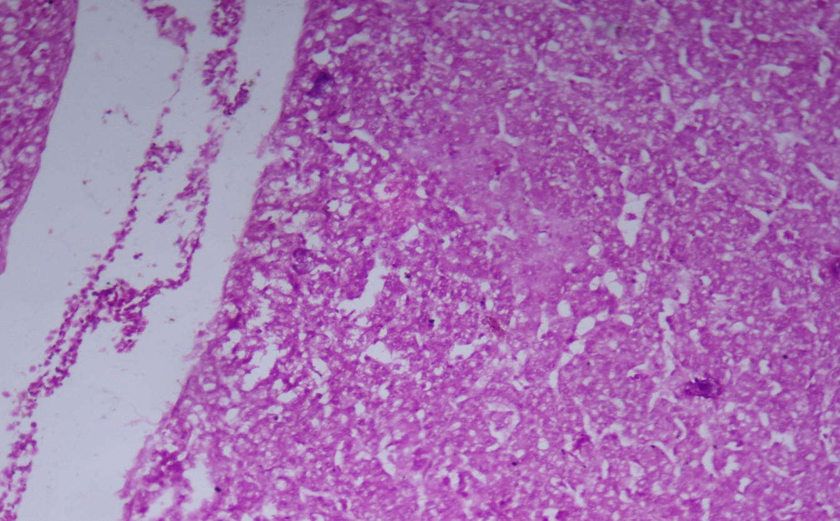
Photomicrograph of liver showing central venous congestion, franc necrosis and degenerative fatty changes HE X 20 (Heat stress group)

Slide 20
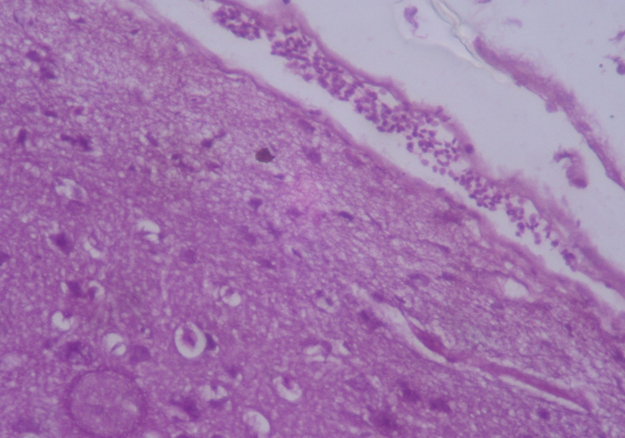
Photomicrograph of brain showing hemorrhages HE X 40 (Heat stressed group)

Slide 21
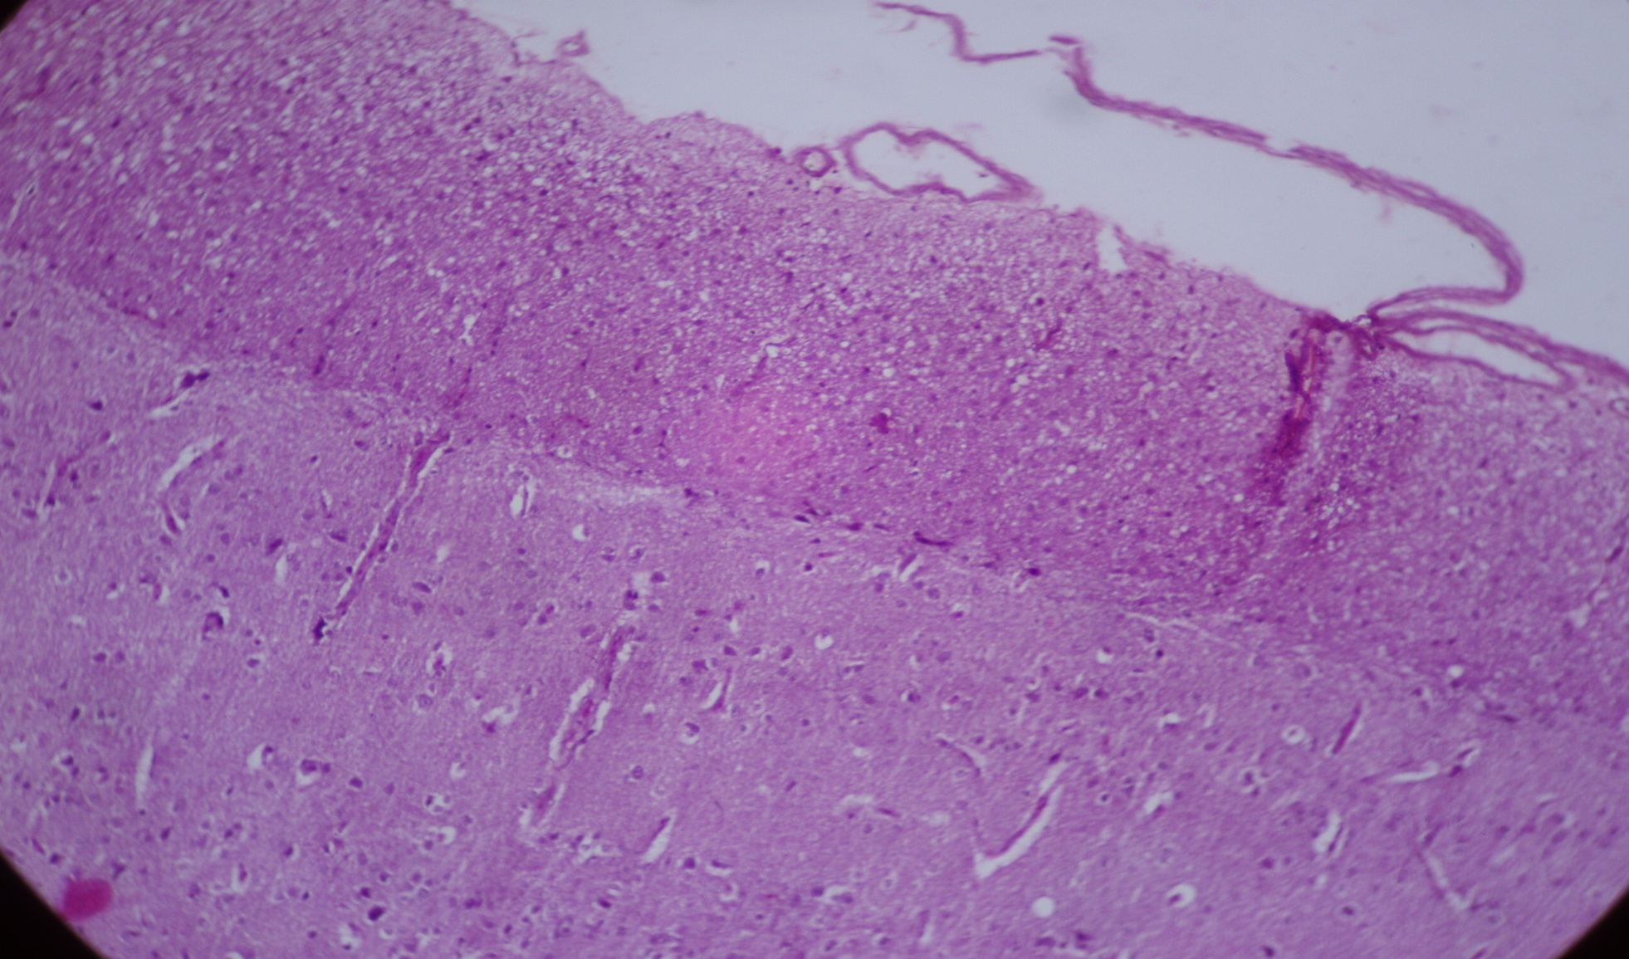
Photomicrograph of brain showing normal histology(Heat stress free group)

Slide 22
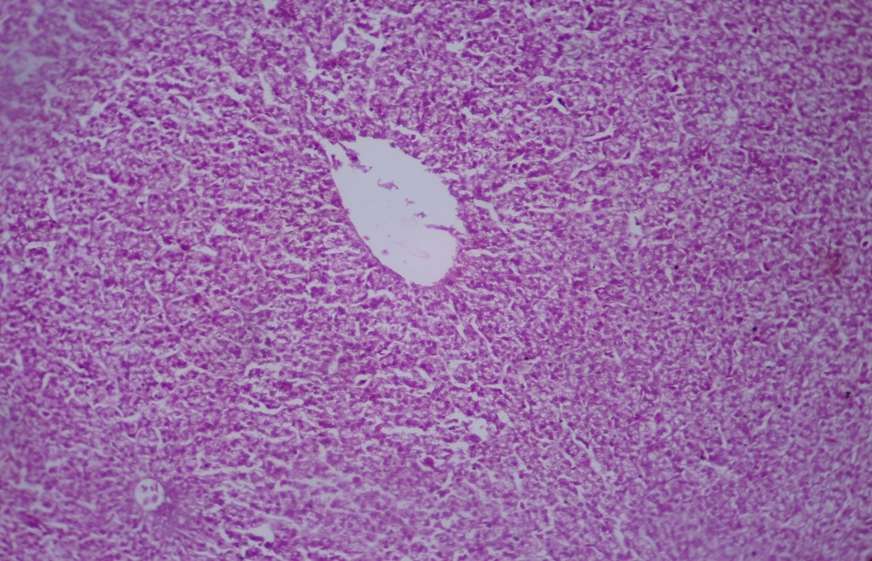
Photomicrograph of liver showing mild changes HE X 200 (group supplemented with turmeric 0.4%)

Slide 23
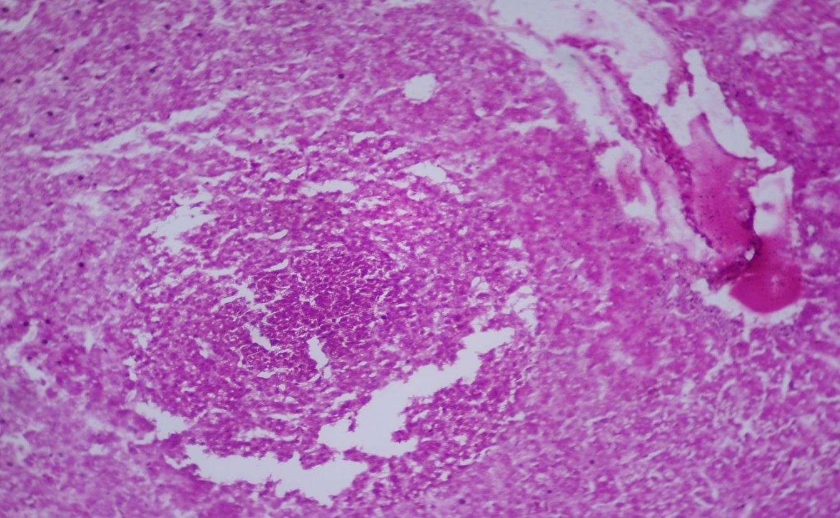
Photomicrograph of liver showing central venous congestion and granuloma HE X 20 (group supplemented with combination of Tulsi (0.5%) and Turmeric (0.4%))

Slide 24
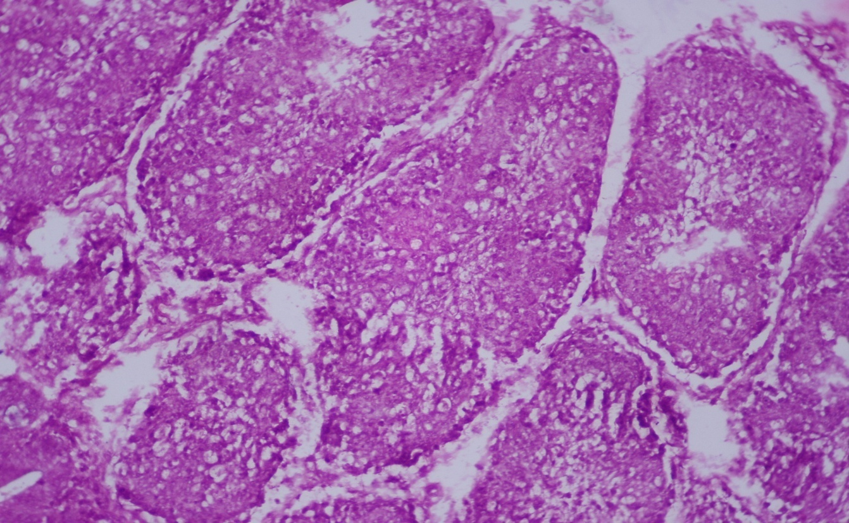
Photomicrograph of bursa showing depletion of lymphoid follicles HE X 20 (Heat stressed group)

Slide 25
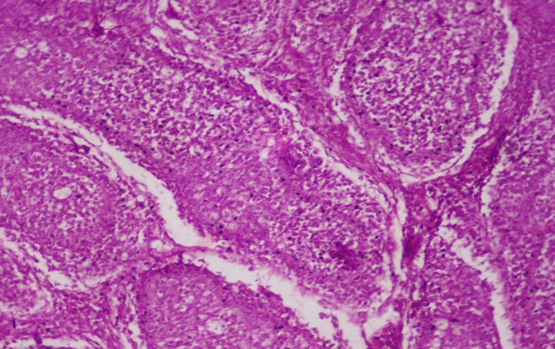
Photomicrograph of bursa revealing mild changes HE X 20 (group supplemented with Tulsi 0.5%)

Slide 26
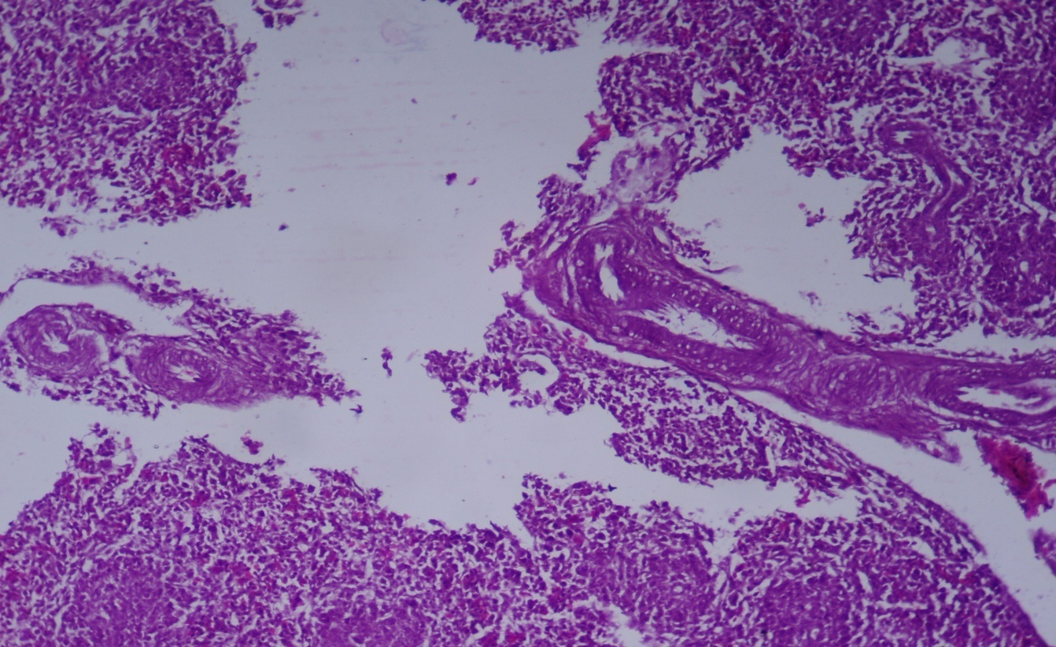
Photomicrograph of spleen showing depletion of lymphocytes and thickening of trabecular system HE X 20 (Heat stressed group)

Slide 27
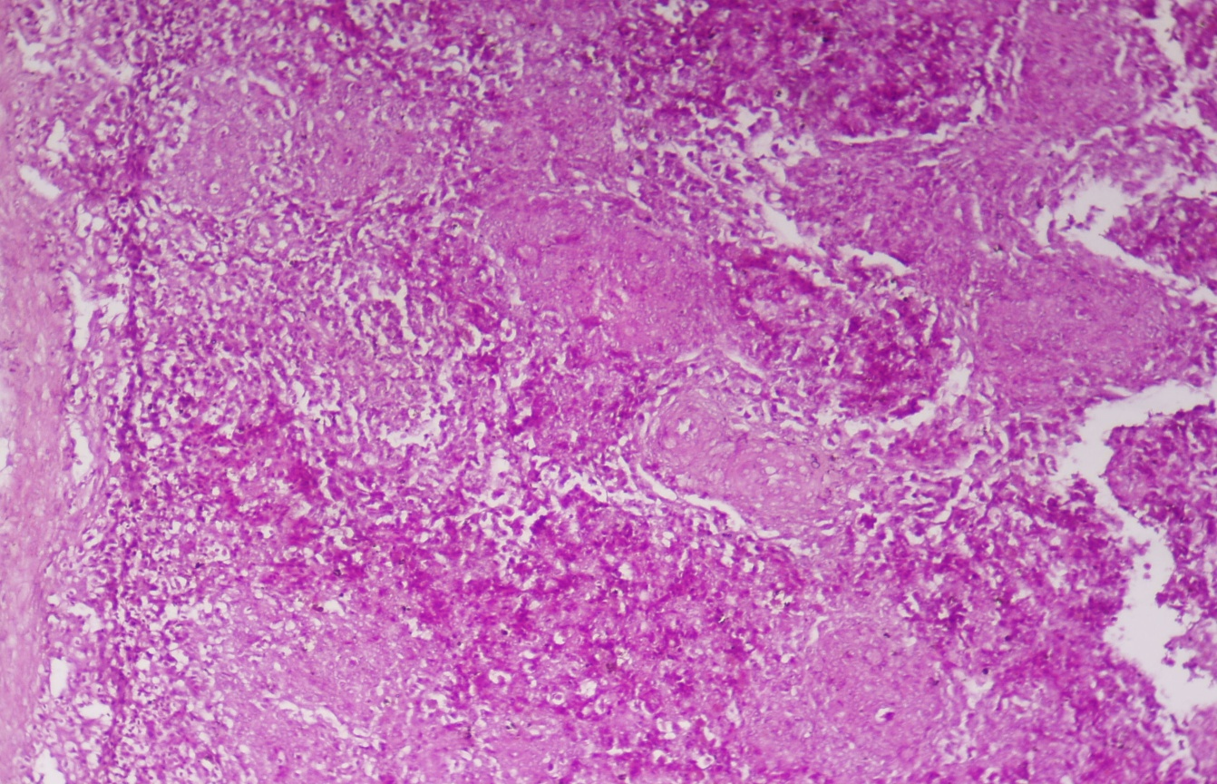
Photomicrograph of spleen showing mild changes HE X 20 (Group supplemented with Turmeric 0.4%)
Photomicrograph of spleen showing mild changes HE X 20 (Group supplemented with Turmeric 0.4%)

Slide 28
Conclusion Tulsi at 0.5% and turmeric at 0.4% inclusion to broiler dites improved the antioxidant status. The combinations of herbals at either of the doses didn’t have any added benefit than the independent inclusions.

Slide 29
SARVE JANA SUKHINOBHAVANTU

