Slide 1
LANTANA CAMERA ASSOCIATED HEPATIC AND RENAL TOXICITY IN BULLOCKS – A CASE REPORT
DR. B. ANIL KUMAR
ASSISTANT PROFESSOR
COLLEGE OF VETERINARY SCIENCE
KORUTLA-505 326
KARIMNAGAR DISTRICT, TELANGANA.

Slide 2
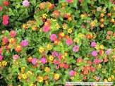
Overview
Lantana was introduced in India in 1807 as ornamental herb.
Species effected: cattle, sheep, goat, horses, pigs, wild animals, rabbit, guinea pigs
1st poisoning reported in Australia (Townville) in 1910
1st Incidences of Poisoning in buffalo (Kangra valley, H.P.), sheep, goats (Rampur bushier)
Toxic principle: Lantadine A,B,C,D (Triterpanoid) effect bile canaliculi
Known to cause Hepatotoxicity, nephrotoxicity and photosensitization.

Slide 3
Toxicodynamics
Ingestion of plant
Absorption from rumen and S I
Liver
Metabolism
Secretion of metabolates in to bile
Injury to bile canalicular membrane
Cholestasis, hepatitis
Retention of bilirubin, phylloerythrin and ruminal stasis
Jaundice Photosensitization pH alkaline (NH₄ &N₂)
Renal damage

Slide 4
Symptoms
Anorexia
Ruminal motility ceases up after 6hr and atony seen after 24 hrs
Complete constipation/impaction
Rumination ceased
Dehydration
Icterus after 2-4 days
Skin changes due photosensitization
Death due to hepatic and renal failure

Slide 5
Diagnosis
History
Clinical sign
Laboratory test:
Liver: ALT, AST, ALP, GGT & Bilirubin
kidney: BUN & Creatinine,
HPLC: Diagnosis of lantadine in the ruminal content, peaks on chromatogram 2.43 min and 7.01 min (Narendra Vyas, and Ameeta Argal, 2014 )
Thin layer chromatography

Slide 6
PARTICULARS OF OWNER & ANIMAL
Case No. 69 & 70 Date: 11-07-2014
Owner Particulars: S. Ravi,
Chaulamaddi Villaga, Korutla Mandal Karimnagar district, Telangana.
Animal Particulars:
Species : Bovine Breed : ND
Sex : Male (Bullock) Age : 10 years
Colour : White

Slide 7
History
Two Bullock were brought to the Teaching Veterinary Clinical Complex, College of Veterinary Science, Korutla with the history of anorexia and voiding scanty faeces since 3 days .
Owner has reported that 4 days back, unknowingly two bulls had entered the near by village and were there for one entire day .
Next day owner found them grazing on lantana plants.
From that day onwards they were not taking feed and voiding scanty faeces.
Owner has taken them to near by Veterinary hospital for 2 days but there was no improvement. There treated with rumentorics and B-complex injections.

Slide 8
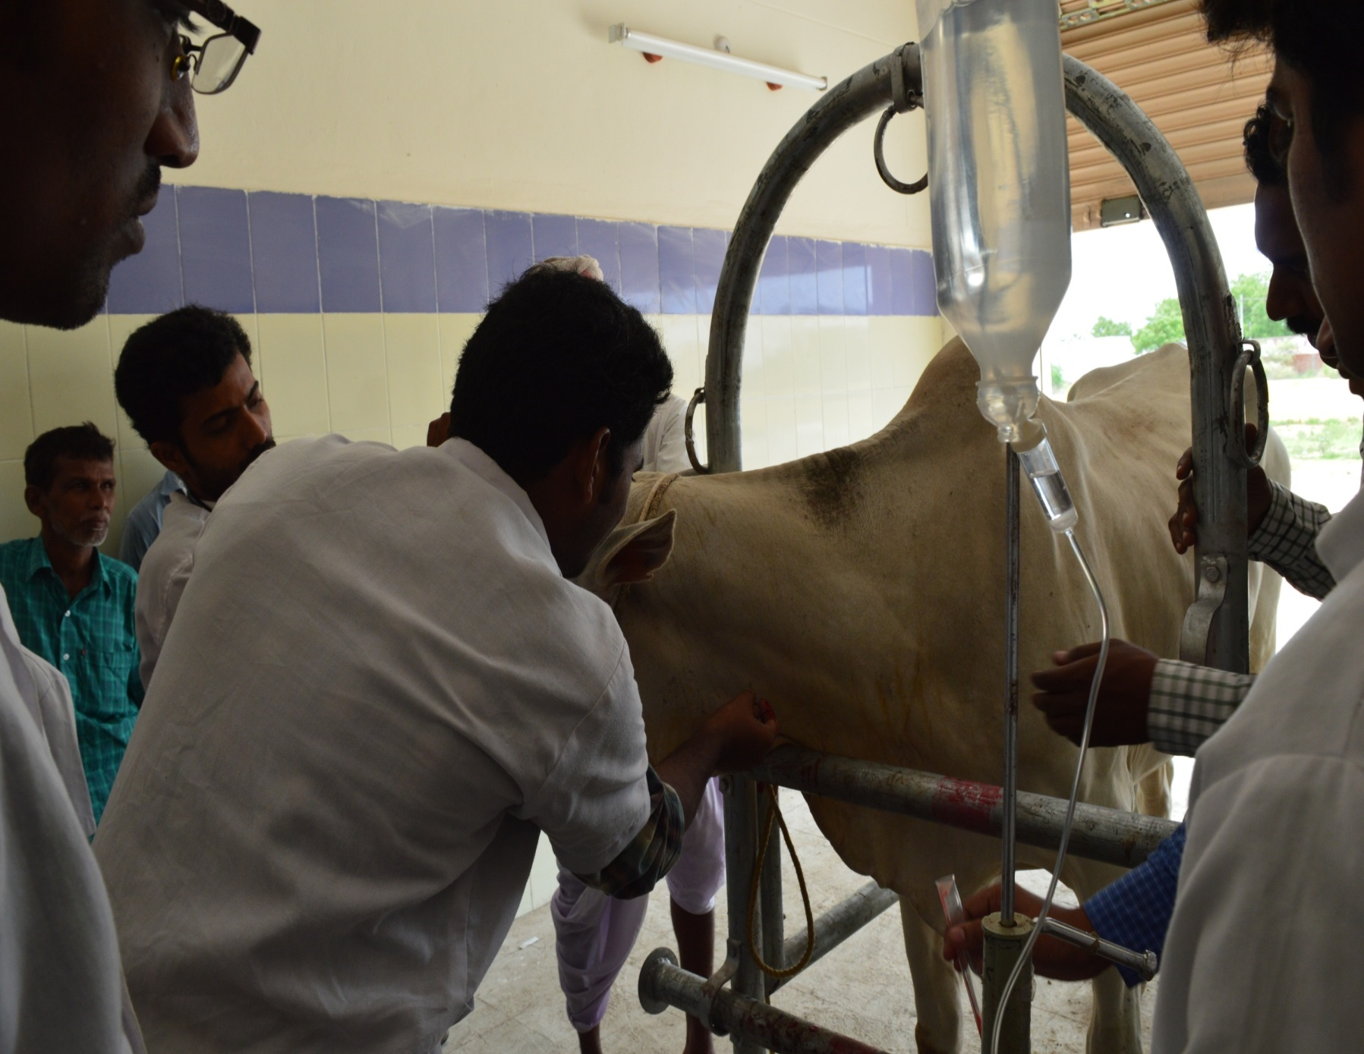

Slide 9
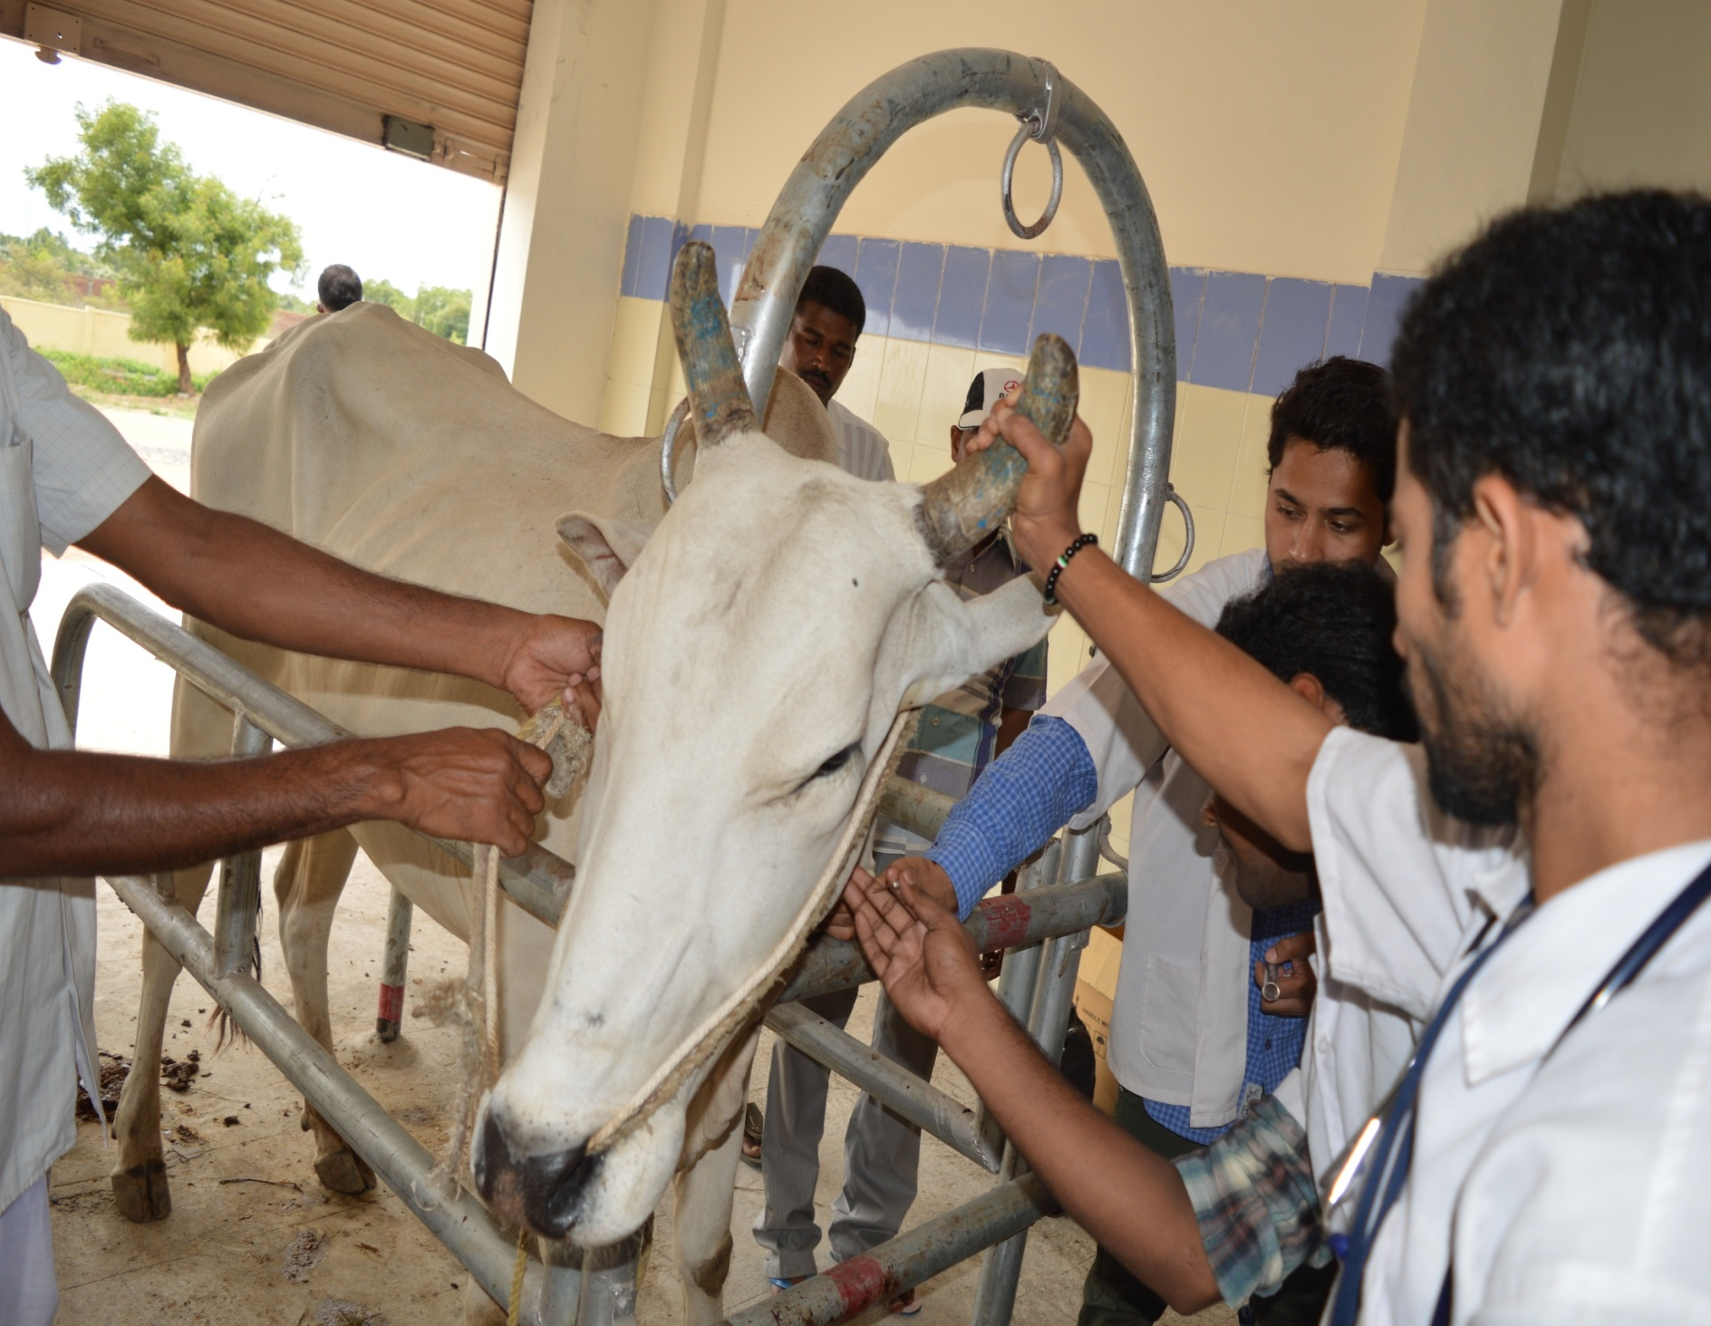

Slide 10
CLINCAL EXAMINATION
Detailed clinical examination has revealed,
Temp : 102 ⁰F
Pulse : 84/ minute
Heart rate : 47 beats/ minute
Resp. rate : 37/ minute
C.M.M. : Icteric (Moreicteric in one animal)
B.M.M. : Normal
Rumen motility : Atony
Rumen liquor pH: 8.0
Lymph nodes : Normal

Slide 11
General body condition : Lean and severely dehydrated
Demeanor : Dull and very weak
Profuse frothy salivation also noticed
We have collected dung, urine and blood.
Faecal sample is negative for parasitic ova
Peripheral blood smear is negative for haemoprotozoans
Urine examination:
Colour : Deep yellow
Odour : Slight pungent
Hay’s test : positive for bile salts

Slide 12
SERUM ANALYSIS
ALT values (IU): 74.3 IU/micro lit. (14-38)
ALP values (IU): 235.3 IU/micro lit. (90-170)
BUN values (mg%): 41.26 mg (20-30)
Serum Creatinine (mg %): 4.39 mg % (1-2)
Serum Bilirubin (mg %): 0.84mg % (0.1-0.5)
Indicating both hepatic and renal insufficiency.

Slide 13
TREATMENT
Animals are treated with the following medication
Inj. DNS 5D @ 1350 mL i.v
Admin. of activated charcoal @1.0kg in 10 liters of water
Magnesium sulphate @50gram p.o 1st Day
Inj. Histanil 20 mL i.m
Inj. Enrofloxacin 20 mL i.m
Inj. Melonex 15 mL i.m 5 Days
Inj. Belamyl 20 mL i.m
Rumentas bolus @ 4 boli daily for 3 days
Prescribed Liv-52 syrup @ 50 ml orally BID for 15 days.

Slide 14
Bullocks started defaecating by 2nd day and started taking green grass from 4th day onwards and recovered fully by 7th day.

Slide 15
THANKYOU

