Slide 1
Genetic Association Study Between ESR1 and Temporomandibular Joint Internal Derangement
Ayça Dilara YILMAZ¹, Gülden EREŞ²
¹Ankara University Faculty of Dentistry, Molecular Biology Laboratory, Ankara, Turkey
²Ankara University Faculty of Dentistry, Department of Periodontology, Ankara, Turkey

Slide 2
PRESENTATION PLAN
THE TEMPOROMANDIBULAR JOINT
Temporomandibular Joint Disorders
Temporomandibular Joint Internal Derangement (TMJ-ID)
Susceptibility to TMJ
TMJ-ID-Anterior disc displacement with/without reduction
Estrogen receptor α (ESR1)
AIM
MATERIALS AND METHODS / STATISTICS
RESULTS
PvuII polymorphism (rs2234693)
XbaI polymorphism (rs9340799)
Genetic Distribution of polymorphisms
DISCUSSION
CONCLUSION

Slide 3
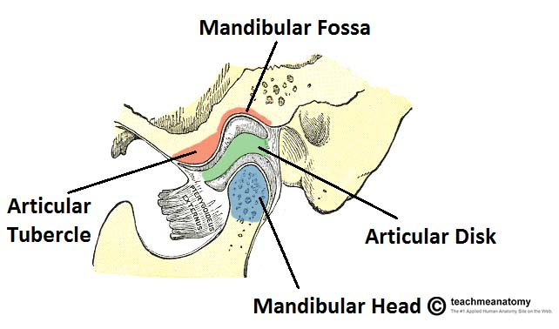
THE TEMPOROMANDIBULAR JOINT
Formed by the articulation of the mandible and the temporal bone of the cranium. It is located anteriorly to the tragus of the ear, on the lateral aspect of the face
Articulations
between three surfaces
the mandibular fossa,
articular tubercle,
the head of mandible
Oliver Jones, THE TEMPOROMANDIBULAR JOINT , January 27, 2017
http://teachmeanatomy.info/head/joints/temporomandibular/

Slide 4
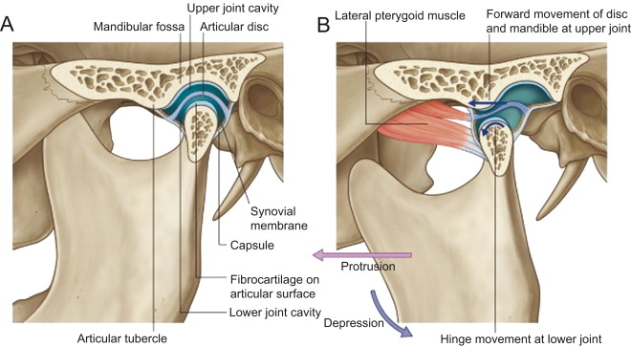
THE TEMPOROMANDIBULAR JOINT
Yin CS, Lee YJ, Lee YJ (2007) Journal of Bodywork and Movement Therapies 11(4); 285-294
This joint has a unique mechanism;
articular disc
two synovial joint cavities, each lined by a synovial membrane
fibrocartilage

Slide 5
Temporomandibular Joint Disorders
Complicated and poorly understood clinical conditions
A number of symptoms including pain and limited jaw movement
Caused by musculoskeletal and neuromuscular disorders,
masticatory musculature,
the temporomandibular joints,
and associated structures
The etiology of TMDs may be complex
The possible influence factors of TMDs;
mechanical and/or psychic stresses,
hormones,
genes,
ethnicity,
social status,
gender

Slide 6
Temporomandibular Internal Derangement (TMJ-ID)
Imbalance of metabolic processes in the extracellular matrix (ECM) of the
articular disc
Tissue breakdown
Articular disc positions of the joint to the mandibular condyle and the articular
eminence are distorted (Emshoff et al., 2002).
Observed in up to 80% of the temporomandibular joint disorder (TMD)
patients
Oliver Jones, THE TEMPOROMANDIBULAR JOINT , January 27, 2017
http://teachmeanatomy.info/head/joints/temporomandibular/

Slide 7
Susceptibility to TMJ
The intensity of the painful symptoms appears to be greater in women for many
anatomical locations, including the temporomandibular joints
The susceptibility to TMDs: Women and adolescents have a higher risk,
compared to men.
Genetic factors (SNPs) play a significant role in the pathology of TMDs.
The underlying mechanisms of TMDs remains largely unknown

Slide 8
TMJ-ID-Anterior disc displacement with/without reduction
TMJ-ID’s two most prevalent types;
Anterior disc displacement with reduction (ADDWR): The displacement of the TMJ articular disc while the mouth is closed, which reduces its normal position with mouth opening
Anterior disc displacement without reduction (ADDWOR): The permanent dislocation of the disc that cannot reduce to its normal position
Osteoarthritis (OA) (inflammatory) and osteoarthrosis (non-inflammatory) were proposed to be the underlying mechanisms of ID*
Coexistence of osteoarthrosis and ID:in one-third of the TMJ cases (Dimitroulis, 2005)
*Stegenga B, de Bont LG, Boering G (1992) Classification of temporomandibularjoint osteoarthrosis and internal derangement.
2.Specific diagnostic criteria. Cranio 10:107–116.
de Leeuw R, Boering G, Stegenga B, et al. (1995) Radiographic signs of temporomandibular joint osteoarthrosis and internal derangement 30 years after nonsurgical treatment. Oral Surg Oral Med Oral Pathol Radiol Endod 79:382–392.

Slide 9
Estrogen receptor α (ESR1)
Estrogen was proposed as a potential mediator of degradative TMJ remodeling in animal
ESR1receptors are known to be important regulators for skeletal growth and maturation
A significant association between single-nucleotide polymorphisms of ESR1 and symptoms of TMD or TMJ osteoarthritis in women was shown.
Previous genetic epidemiologic studies, which highlight the association between ERα polymorphism and osteoarthritis, also made it possible to speculate the role of the genetic component in dysregulation of the integrity of the TMJ and mandibular structures.
A genetic variation at the ERα could lead to significant modifications in the physiological role of estrogen and consequently in TMJ derangements.

Slide 10
Estrogen receptor α (ESR1)
The biological activity of estrogen is mediated by specific receptors.
The estrogen receptor;
a protein of the steroid receptors family
two forms: α and β
α receptor is in particular found in the intra-articular cartilage and osteocytes and plays a role of intracellular mediators regulator
In rats; α receptors found in synovial cells, articular disc stromal cells and chondrocytes of the TMJ
In humans; estrogen receptors found in temporomandibular joint disc
A greater proportion in women with TMD than in subjects without TMD
Few studies in the literature have studied the relationship of these polymorphisms to TMJ disorders, and none in TMJ-ID.

Slide 11
Estrogen receptor α (ESR1)
ERα : chromosome 6q25.1
8 exons and 7 introns
2 common restriction fragment length polymorphisms (RFLPs): XbaI and PvuII
The XbaI RFLP detects an A–G substitution at position 351 (−351int A/G; rs9340799)
PvuII detects a T–C substitution at position 397 (−397int T/C; rs2234693)
chromosome 6q25.1, intron 1 containing the Pvu II and Xba I RFLPs
Adapted from The Journal of Clinical Endocrinology and Metabolism, Interaction between Vitamin D receptor genotype and estrogen receptor alpha genotype influences vertebral fracture risk. 88(8): 3777–3784, 2003. Copyright 2003, The Endocrine Society.

Slide 12
AIM
The aim of this study was to investigate the association of ESR1
gene XbaI and PvuII polymorphisms with TMJ-ID disorder

Slide 13
Materials and Methods / Statistics
Blood samples in 5ml EDTA tubes
DNA extraction by standard proteinase K/phenol-chloroform method
polymerase chain reaction (PCR)
Restriction fragment length polymorphism (RFLP)
3% agarose gel electrophoresis
Pearson’s chi-square test or Fisher exact tests were used to compare genotype and allele distributions between the study and control groups, combined ERα genoypes in TMJ-ID patients versus control group. p<0.05 was considered statistically significant.

Slide 14
RESULTS
Table1. Demographic charecteristics of study participants
 | TMJ-ID patients n (%) | Healthy controls n (%)
Female | 38 (79.1) | 33 (47.1)
Male | 10 (20.9) | 37 (52.9)
Age (average) | 31.7 ±7.9 | 28.22 ±5.9

Slide 15
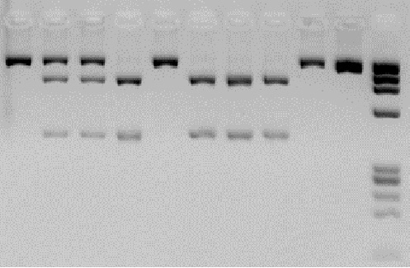
PvuII polymorphism (rs2234693)
1 2 3 4 5 6 7 8 9 10 11
1300 bp
850 bp
450 bp
3, 7, 11: PP (1300 bp)
9,10: Pp (1300 + 850 + 450 bp)
4, 5, 6, 8: pp (850 + 450 bp)
2 : uncut PCR product
1: φX 174 Marker

Slide 16
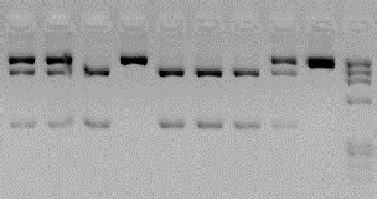
XbaI polymorphism (rs9340799)
1 2 3 4 5 6 7 8 9 10
1300 bp
900 bp
400 bp
7: XX (1300 bp)
3,9,10: Xx(1300 + 900 + 400 bp)
4, 5, 6, 8: xx (900 + 400 bp)
2: uncut PCR product
1: φX 174 Marker

Slide 17
RESULTS

Slide 18
Table 2. Distrubution of PvuII genotype and allel frequencies in TMJ-ID patients versus healthy controls
ESR1 PvuII | Control Group | TMJ-ID Group | OR [CI] | Ρ value | χ²
Genotype | n (%) | n (%)
PP | 21 (30) | 12 (25) | 1 |  | 0.35
Pp | 38 (54.3) | 28 (58.3) | 1.28 [0.5-3.05] | 0.55
pp | 11 (15.7) | 8 (16.7) | 1.27 [0.4-4.03] | 0.68
 |  |  |  | 0.82
Allele
P | 80 (57.1) | 52 (54.2) | 1
p | 60 (42.9) | 44 (45.8) | 1.12 [0.66-1.90]
 |  |  |  | 0.65 | 0.2

Slide 19
Table 3. Distrubution of PvuII genotype and allele frequencies in ADDWR patients versus healthy controls, in ADDWOR patients versus healthy controls
ESR1 PvuII | Control Group | ADDWR Group | OR [CI] | Ρ value | χ²
Genotype | n (%) | n (%)
PP | 21 (30) | 5 (21.7)) | 1 |  | 0.8
Pp | 38 (54.3) | 13 (56.6) | 1.43 [0.45-4.58] | 0.53
pp | 11 (15.7) | 5 (21.7) | 1.90 [0.45-8.04] | 0.37
 |  |  |  | 0.65
Allele
P | 80 (57.1) | 23 (50) | 1
p | 60 (42.9) | 23 (50) | 1.33 [0.68-2.60]
 |  |  |  | 0.39 | 0.7
 | Control Group | ADDWOR Group | OR [CI] | Ρ value | χ²
Genotype | n (%) | n (%)
PP | 21 (30) | 7 (28) | 1 |  | 0.3
Pp | 38 (54.3) | 15 (60) | 1.18 [0.41-3.36] | 0.75
pp | 11 (15.7) | 3 (12) | 0.81 [0.17-3.80] | 0.79
 |  |  |  | 0.85
Allele
P | 80 (57.1) | 29 (58) | 1
p | 60 (42.9) | 21 (42) | 0.96 [0.5-1.85]
 |  |  |  | 0.91 | 0.01

Slide 20
Table 4. Distrubution of PvuII genotype and allele frequencies in TMJ-ID
women versus healthy women
ESR1 PvuII | Control Women | TMJ-ID Women | OR [CI] | Ρ value | χ²
Genotype | n (%) | n (%)
PP | 9 (27.3) | 11 (28.9) | 1 |  | 0.83
Pp | 17 (51.5) | 22 (57.9 | 1.05 [0.35-3.13 ] | 0.91
pp | 7 (21.2) | 5 (13.2) | 0.58 [ 0.13-2.48 ] | 0.46
 |  |  |  | 0.66
Allele
P | 35 (49.3) | 44 (57.9) | 1
p | 36 (50.7) | 32 (42.1) | 0.70 [0.36-1.35]
 |  |  |  | 0.29 | 1.09

Slide 21
Table 5. Distrubution of XbaII genotype and allele frequencies in TMJ-ID patients versus healthy controls
ESR1 XbaI | Control Group | TMJ-ID Group | OR [CI] | Ρ value | χ²
Genotype | n (%) | n (%) |  |  | 0.19
XX | 25 (35.7) | 19 (39.6) | 1
Xx | 36 (51.4) | 23 (47.9) | 0.84 [0.38-1.85] | 0.66
xx | 9 (12.9) | 6 (12.5) | 0.87 [0.26-2.89 ] | 0.82
 |  |  |  | 0.9
Allele
X | 86 (61.4) | 61 (63.5) | 1
x | 54 (38.6) | 35 (36.5) | 0.91[0.53-1.56]
 |  |  |  | 0.7 | 0.1

Slide 22
Table 6. Distrubution of XbaII genotype and allele frequencies in ADDWR patients versus healthy controls, in ADDWOR patients versus healthy controls
ESR1 XbaI | Control Group | ADDWR | OR [CI] | Ρ value | χ²
Genotype | n(%) | n(%)
XX | 25 (35.7) | 6 (26.08) | 1 |  | 0.82
Xx | 36 (51.4) | 13 (56.52) | 1.5 [0.5-4.49] | 0.46
xx | 9 (12.9) | 4 (17.4) | 1.85 [0.42-8.1] | 0.4
 |  |  |  | 0.6
Allele
X | 86 (61.4) | 25 (54.3) | 1
x | 54 (38.6) | 21 (45.7) | 1.33 [0.68-2.62]
 |  |  |  | 0.39 | 0.72
Genotype | Control Group | ADDWOR | OR [CI] | Ρ value | χ²
XX | 25 (35.7) | 13 (52) | 1 |  | 2.09
Xx | 36 (51.4) | 10 (40) | 0.53 [0.2-1.40 ] | 0.2
xx | 9 (12.9) | 2 (8) | 0.42 [ 0.08-2.27] | 0.3
 |  |  |  | 0.35
Allele
X | 86 (61.4) | 36 (72) | 1
x | 54 (38.6) | 14 (28) | 0.61 [0.30-1.25 ]
 |  |  |  | 0.18 | 1.79

Slide 23
Table 7. Distrubution of XbaI genotype and allele frequencies in TMJ-ID
women versus healthy women
ESR1 XbaI | Control Women | TMJ-ID Women | OR [CI] | Ρ value | χ²
Genotype | n(%) | n(%)
XX | 12 (36.4) | 18 (47.4) | 1 |  | 1.29
Xx | 15 (45.4) | 16 (42.1) | 0.71[0.25-1.96] | 0.5
xx | 6 (18.2) | 4 (10.5) | 0.44 [0.10-1.91] | 0.44
 |  |  |  | 0.52

Slide 24
Table 8. Combined genotype distribution of ESR1 polymorphisms
ESR1 |  | TMJ-ID group | Control group | TMJ-ID group | Control group | TMJ-ID group | Control group
 |  | XbaI
 |  | XX |  | Xx |  | xx
PvuII | PP | 10 | 19 | 2 | 2 | 0 | 0
 | Pp | 7 | 6 | 21 | 32 | 0 | 0
 | pp | 2 | 0 | 0 | 2 | 6 | 9
The values represent the observed number of subjects with the combined genotypes of PvuII and XbaI RFLPs for the TMJ-ID patients and controls.

Slide 25
Table 9. Frequencies of haplotypes and combined ERα genoypes in TMJ-ID patients versus
control group
ESR1 | TMJ-ID Group | Control Group | OR | Ρ value | χ²
Haplotype
PX | 50 (54.3) | 78 (56.53) | 1
px | 33 (35.9) | 52 (37.69) | 1.01 [0.57-1.77] | 0.97
pX | 7 (7.6) | 6 (4.34) | 0.54 [0.17-1.72] | 0.3
Px | 2 (2.2) | 2 (1.44) | 0.64 [0.08-4.69] | 0.65
 |  |  |  | 0.72 | 1.3
Genotype
PXpx | 21 (45.66) | 32 (47.05) | 1
PXPX | 10 (21.74) | 19 (27.94) | 1.26 [0.48-3.2] | 0.64 | 0.21
pxpx | 6 (13.04) | 9 (13.24) | 0.98 [0.3-3.17] | 0.97 | 0.0007
PXpX | 7 (15.22) | 6 (8.83) | 0.56 [0.16-1.9] | 0.35 | 0.86
PXPx | 2 (4.34) | 2 (2.94) | 0.65 [0.08-5.02] | 0.68 | 0.16
 |  |  |  | 0.81 | 1.56
The values represent the observed number of combined genotypes of ESR1

Slide 26
DISCUSSION
XbaI and PvuII of ERα prevalence in patients with (n=42) and without (n=36) TMJ was studied by RFLP technique. 5 different ERα genotypes were found in both groups and TMJ samples had higher prevalence of the polymorphisms (statistically non-significant prevalence of ERα). The authors suggested ERα polymorphism as a predisposing factor for degenerative joint disease in temporomandibular joint cartilage deterioration (Stemig et al.,2015)
In a study investigating ERα polymorphism influence in 76 female symptomatic TMJ-OA patients by direct haplotyping procedure. Px haplotype was associated with smaller facial axis angle and mandibular body lenght in the carriers (Lee,2006).
Investigating the association of ERα polymorphisms in women with TMJ disorders (100 with chronic pain, 100 with signs of TMJ disorder but no pain), GC haplotype of the XbaI locus displayed high risk factors of 3.2 and 2.5 in the painful TMJD group vs. the control group and in the TMJD no pain versus the control group, leading to the conclusion that the presence of [GC] haplotype in the XbaI locus might be increasing the susceptibility of women to develop TMJD (Dasilva 2009).
In a study investigating the association between PvuII and XbaI polymorphisms and pain susceptibility in female symptomatic temporomandibular joint (TMJ) osteoarthritis (OA) patients, higher risk of moderate or severe pain was found in TMJ OA patients carrying the PX haplotype compared to those without the PX haplotype. The authors suggested ERα possible association with pain susceptibility in female TMJ OA patients, (no significant differences in genotype and haplotype frequencies were found between the patient and control groups).

Slide 27
DISCUSSION
Although statistically not significant having the Pp and pp genotype of PvuII polymorphism among TMJ-ID patients and ADDWR cases compared to the healthy individuals is a risk factor of 1.27-1.90 for developing the disorder.
p (PvuII) allele is a risk factor of 1.33 in ADDWR cases
Although statistically not significant having the Xx and xx genotype of XbaI polymorphism among TMJ-ID patients and ADDWR cases compared to the healthy individuals is a risk factor of 1.5-1.85 for developing the disorder.
x (XbaI) allele is a risk factor of 1.33 in ADDWR cases
Genotype and allele distributions and odds ratios were not significant in TMJ-ID
women compared to healthy women in both polymorphisms
6. We found 5 different ERα haplotypes in TMJ-ID patients and the control groups
7. Frequencies of haplotypes in TMJ-ID patients versus the control group did not have significant risk factors except the PXPX genotype with a 1.26 odds ratio.

Slide 28
CONCLUSION
The PvuII and XbaI polymorphic sites are located on intron 1, and the functional consequences of these sites is unknown.
However, polymorphisms on introns could affect mRNA production, as these sites may contain transcriptional regulatory sequences.
Similarly, the PvuII–XbaI polymorphic sites on the first intron of the ERα gene could influence gene expression.
Other polymorphic sites in the estrogen receptor gene might similarly influence TMJ disorder predisposition
The finding that PvuII and XbaI polymorphisms is a risk for developing TMJ-ID disorder needs to be further evaluated by increasing the case and controls numbers. A polymorphism in the ESR1 gene may be associated to TMJ-ID.
In the event that an association can be established, these marker alleles are supposed to be in linkage with a truly functional allele elsewhere in the gene.
For improving the treatment of TMJ disorders and potentially other painful conditions, a genetic marker that would predict treatment efficacy with a high degree of success would add a very powerful approach toward.

Slide 29
THANK YOU

