Slide 1
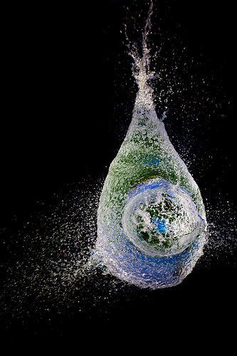



Advance in perioperative fluid therapy: from fixed volume to individual approach, from individual practices to decision-support and closed loop systems
3rd International Conference on Surgery and Anesthesia 2014, Chicago-North Shore, USA
Audrius Andrijauskas MD, PhD
Associate Professor of Anaesthesiology and Intensive Care
Vilnius University Faculty of Medicine
Clinic of Anaesthesiology and Intensive Care
Vilnius, LITHUANIA

Slide 2

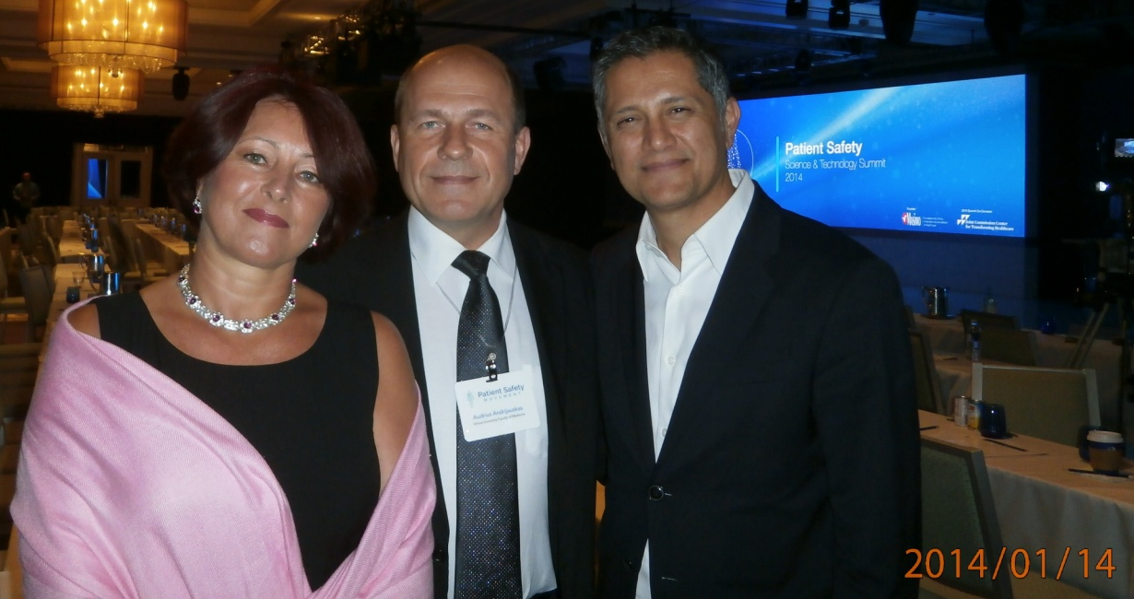
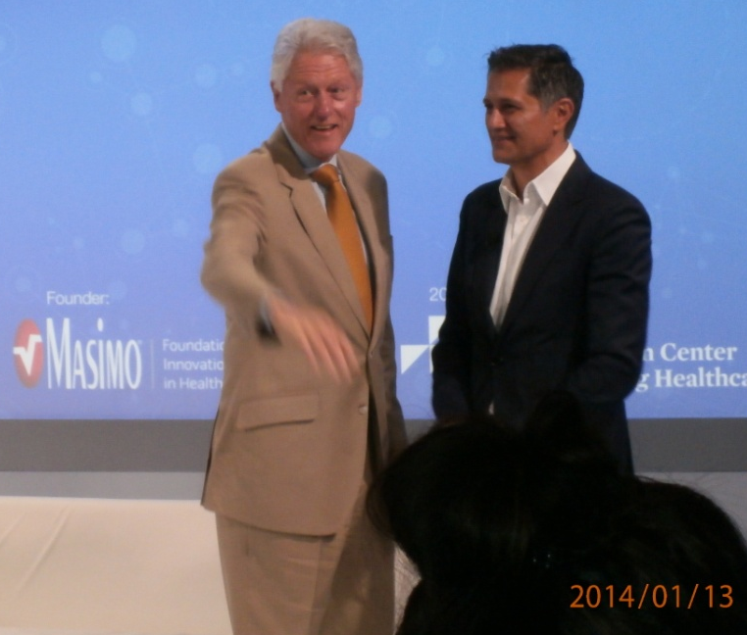
Conflict of interest
I received consultant’s fees from Masimo Corp., Irvine, CA, USA.
I am an inventor on US Patent No. 7,788,045 B2, non-provisional US patent application PCT/US2011/057,362, and US and EU non-provisional patent application No. 61/692,904.
I have commitments to the
Patient Safety, Science & Technology Summit 2014, Laguna Niguel, CA, USA (Pictures from my personal album)

Slide 3

I am from Lithuania

Slide 4

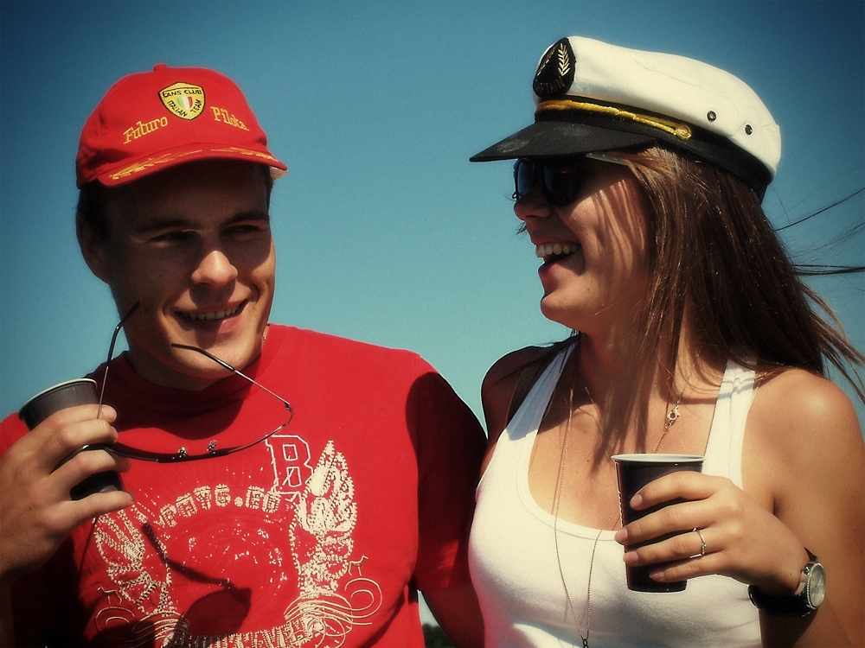

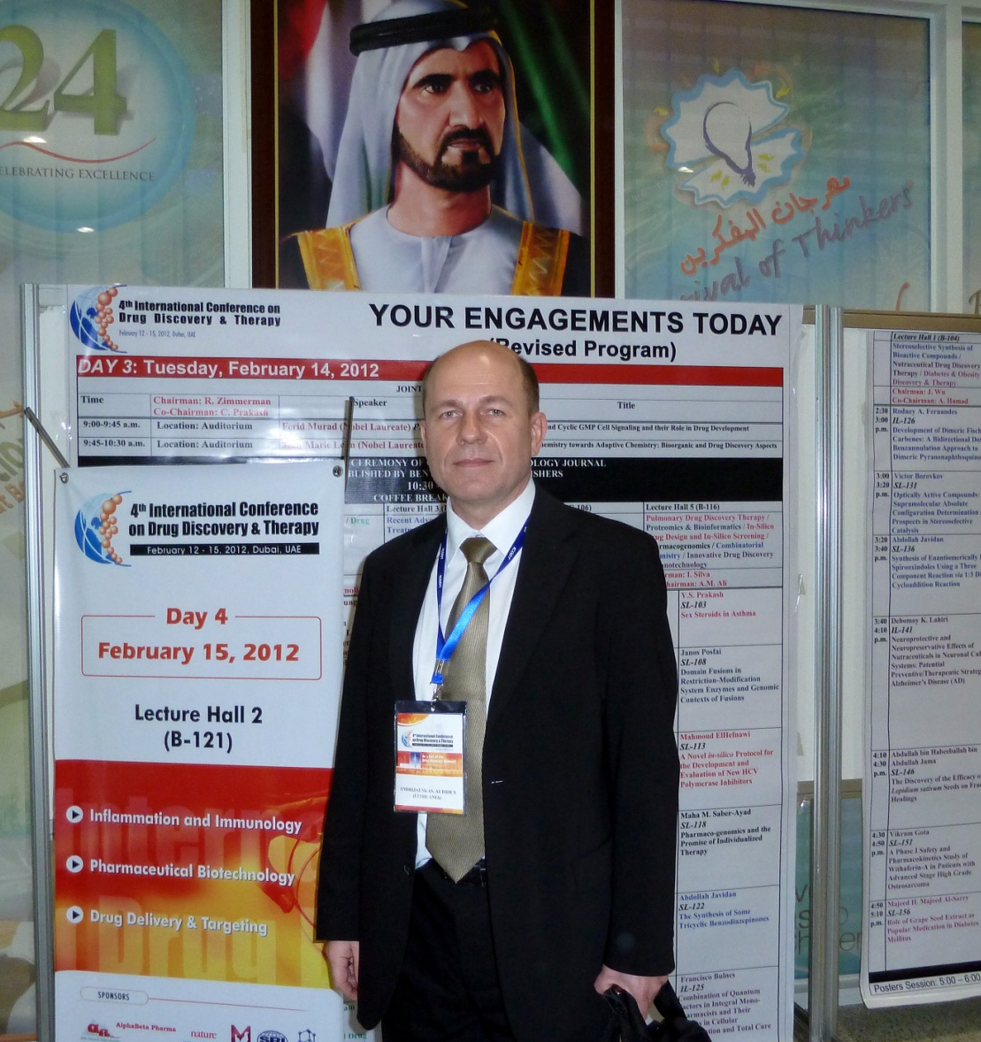



I am from Lithuania
Sometimes I travel
But usually I travel on a boat in my own country
(although not on my own boat ☺ )
and I like when the captain is good!
…sometimes I take my son with me
…sometimes I look at the captain too long!
…and my wife, for sure!

Slide 5
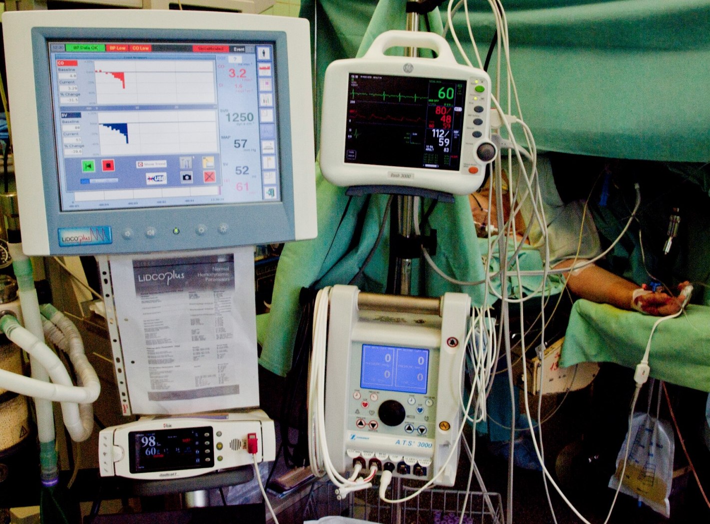

Most of the time I spend at work

Slide 6
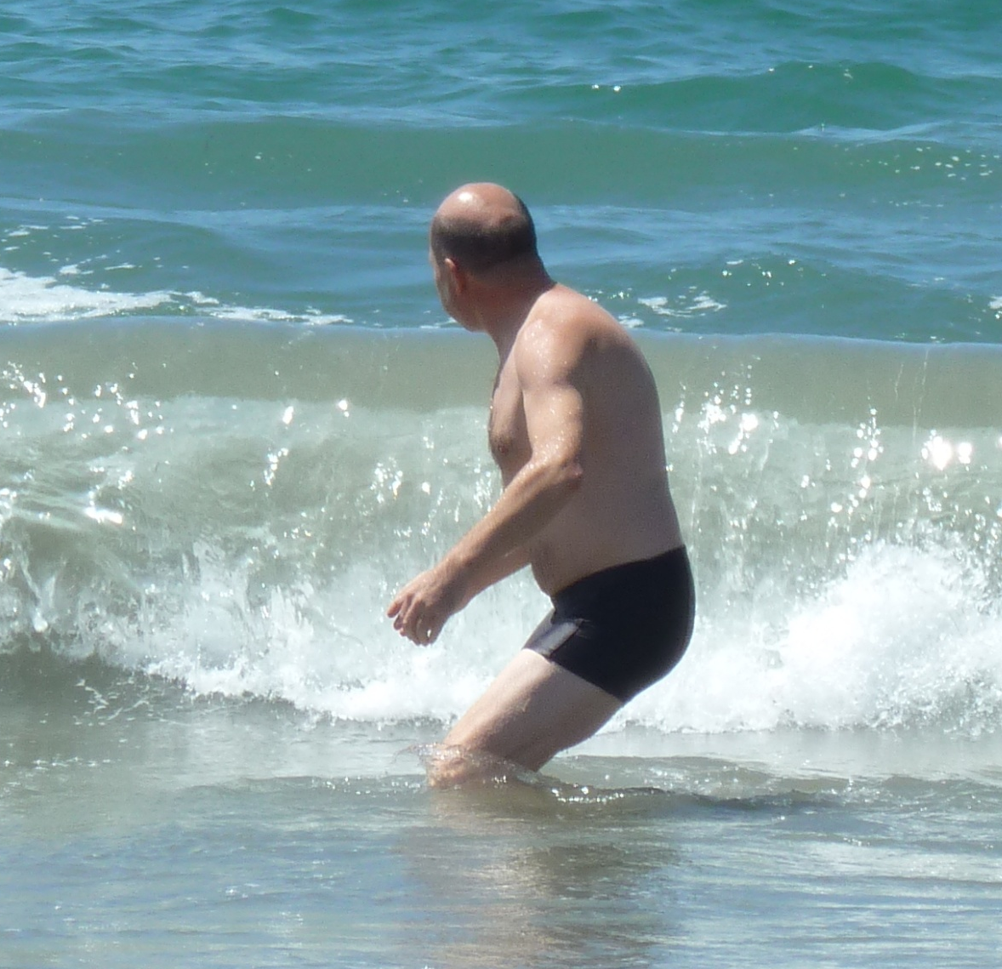
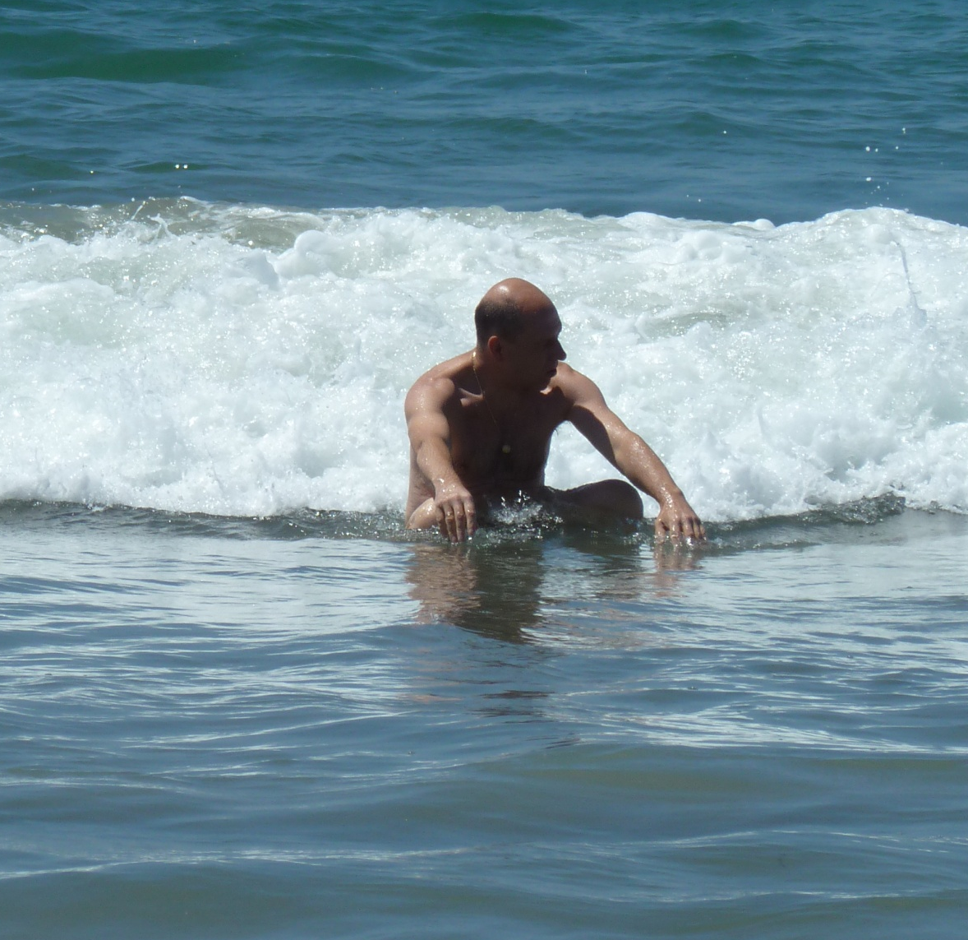
I like to take challenges
Maybe next time I will be stronger...

Slide 7

Let’s get serious!

Slide 8
Rational fluid therapy
Implementation of rational perioperative fluid management is estimated to contribute to the yearly prevention of 3 million post-operative complications and 800 000 perioperative deaths worldwide [1].
Anaesthetist is usually responsible for the pre- and intra- operative, also close post-operative fluid administration. Optimisation of perioperative fluid therapy is therefore among the research priorities in anaesthesia [2].
[1] Michard F. the burden of high-risk surgery and the potential benefit of goal-directed strategies. Crit care 2011; 15:447.
[2] Mahajan, Reilly CS. Setting research priorities in anaesthesia. BJA 2012; 108(1):1-3.

Slide 9
Rational fluid therapy
A need for perioperative hemodynamic optimization makes physiologic sense, and has a growing evidence base*.
The related reduction in complication rates and shorter hospital stays have been widely demonstrated across surgical patient populations.
There is emerging evidence that it may be associated with a long-term survival benefit in high-risk patients.
* Miller TE, et al. Anesth Analg 2011, 112 (6):1274-6.

Slide 10
Rational fluid therapy
Hemodynamic endpoints are among the priorities in perioperative patient optimization.
Fluid infusion is conventionally used for the treatment of perioperative arterial hypotension and optimization of cardiac output.
Recent concerns regarding safety of colloid solutions, at least in Europe, has shifted the priority to crystalloids.
However, brisk administration of crystalloids may lead to swelling of tissues (edema) because significant part of infused crystalloid shifts into tissues.
The body has very efficient regulation of fluid balance but it is context-sensitive.

Slide 11
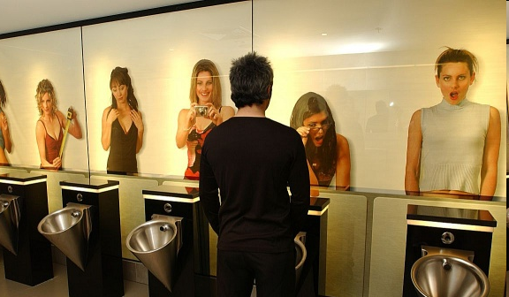
Even critically ill may have a preserved renal elimination of excessive fluids, but they can hardly compete with this man.

Slide 12
Rational fluid therapy
Thus, research is currently focused on the development of individual-targeted and surgery-specific methods for perioperative fluid administration.
The leading trend is Goal Directed Therapy (GDT) protocols.
However, since benefits of GDT are recently challenged by controversial reports in literature, the historic debate over liberal vs. restrictive strategy continues.
Amazingly, even a consensus understanding of fluid volume attributable to liberal and restrictive strategies is missing. And that ends up in a funny speculations of what is what like the following.

Slide 13
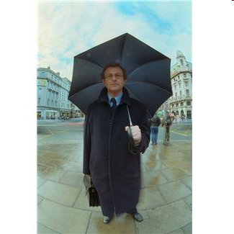



Debate ‘restrictive’ vs. ‘liberal’ goes on!
(Della Rocca et al. BMC Anesthesiology 2014, 14:62)
Restrictive strategy
Liberal strategy
‘Practical strategy’
GDT?

Slide 14
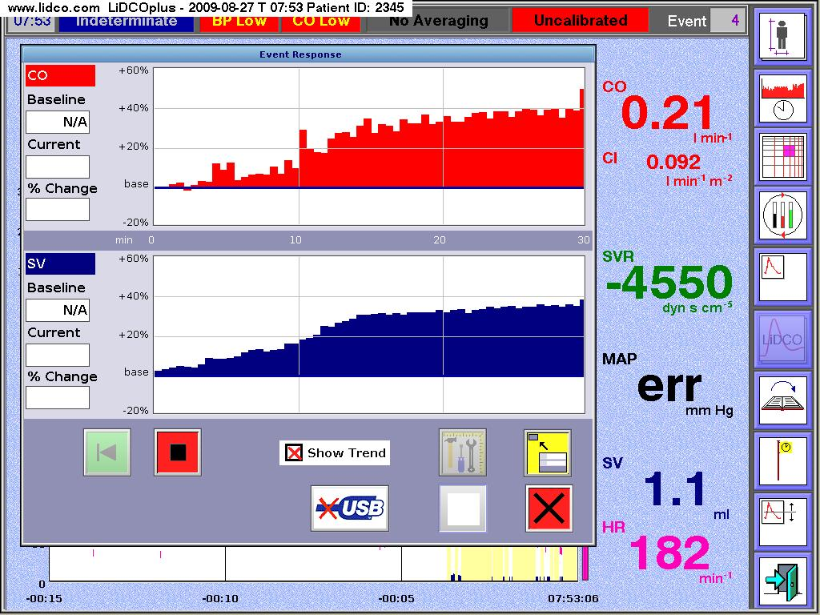
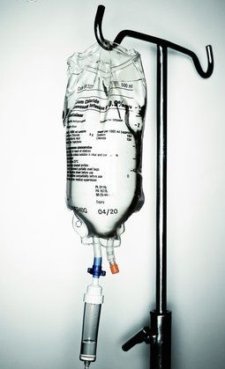
Conventional GDT fluid administration protocol
ΔSV >10%
ΔSV >10%
ΔSV <10%
Probably the most reliable static target parameter is cardiac stroke volume (SV)

Slide 15
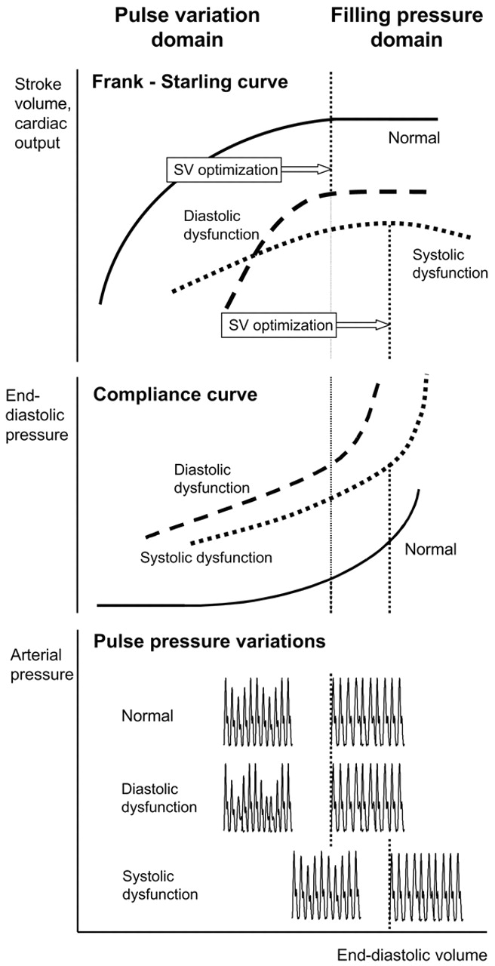

Criteria in GDT fluid protocols indicate when to stop using fluids as a means for optimization of cardiovascular performance.

Slide 16

Pitfalls of GDT
Hemodynamic targets guided infusion may reach improvement of cardiovascular parameters in expense of interstitial fluid overload.

Slide 17
Socio-clinical case

Slide 18
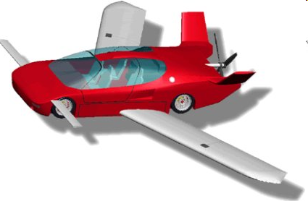
A gentleman hurries home

Slide 19
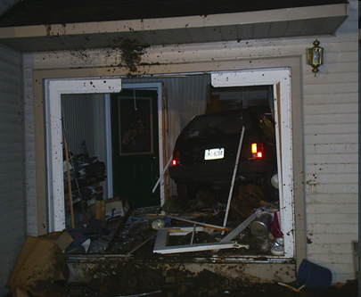
A gentleman ’comes’ home

Slide 20
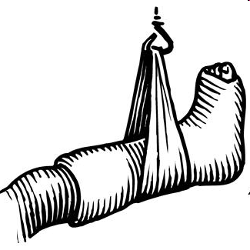
A gentleman is ’taken’ to hospital

Slide 21


A gentleman is given ‘some’ fluids

Slide 22
Will umbrella protect him from getting wet?

Slide 23
Probably he needs more than umbrella ☺
A brand new method follows an objective to non-invasively detect imminent edema in real time during GDT fluid protocols.
This is a mini Volume Loading Test (mVLT) which implies evaluation of plasma dilution response during stepwise fluid infusion in GDT. (Svensen CH et al. Medicina (2014); e-pub ahead of print. http://dx.doi. org/10.1016/j.medici.2014.09.007)

Slide 24
mini Volume Loading Test (mVLT) for the detection of imminent edema
The background concept was developed by our International inter-disciplinary team by linking clinical thinking and insights from previous observations with an advanced understanding of macro- and micro-circulation, tissue fluid exchange and lymphatic system.
The starting point for our model were observations of changes in arterio-venous dilution difference during fluid loading made in 2009 by Dr. Svensen’s team.

Slide 25
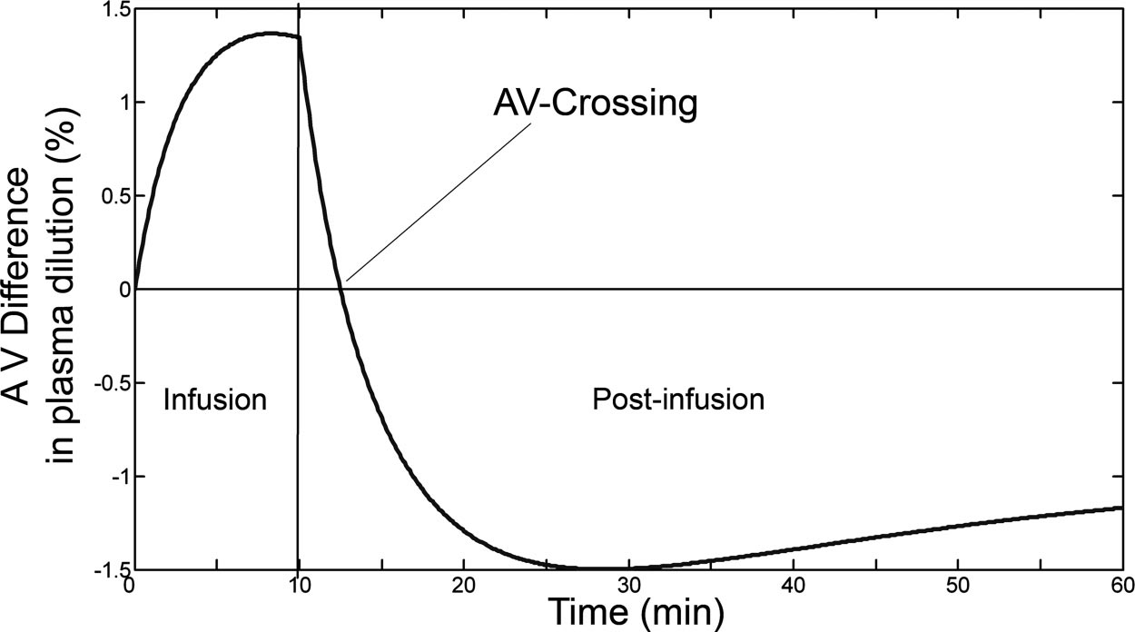
mini Volume Loading Test (mVLT) : the background
Svensen CH Anesth Analg 2009 108.
The positive arterio-venous dilution difference turning into negative soon after the end of crystalloid bolus was explained by transcapillary reflux of excessive interstitial fluid.
Andrijauskas The Open Conference Proceedings Journal 2012; 3.

Slide 26
The ‘transcapillary reflux’ model
Andrijauskas Eur J Anaesthesiol 2012; 29: Supplement 47. Andrijauskas The Open Conference Proceedings Journal 2012; 3.
Transcapillary fluid influx overcomes lymph efflux
Lymph efflux matches transcapilary fluid influx

Slide 27

Soon after the overloading infusion, a transcapillary reabsorption of excessive interstitial fluid begins resulting in negative arterio-venous dilution difference

Slide 28
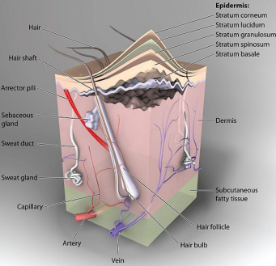
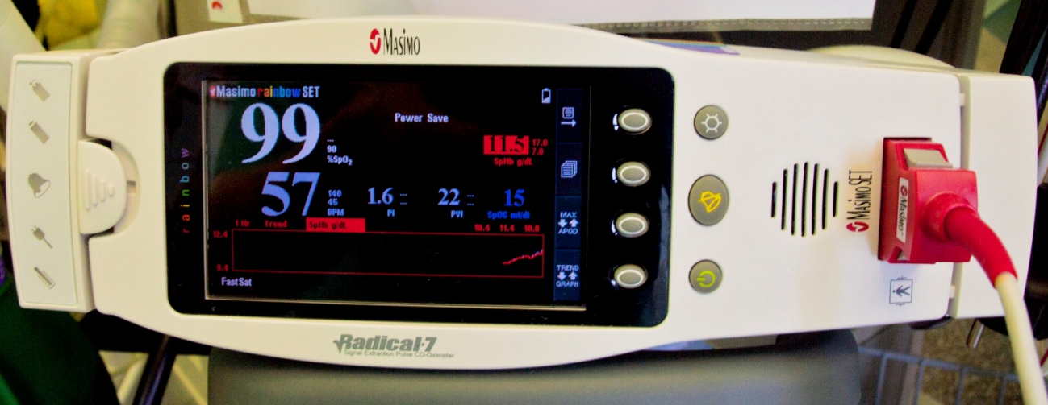
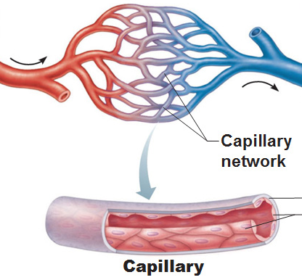
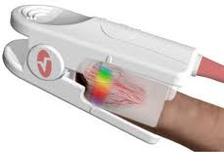
Clinical interpretation of noninvasive Hb: capillary rather than large vessel
Non-invasively measured hemoglobin such as SpHbTM measured by Radical 7 from Masimo Corp., Irvine, CA, USA should be addressed as capillary, because the spectrophotometric technique scans capillaries of derma under the finger nail.
Andrijauskas et al. The Open Conference Proceedings Journal, 2012; 3:42-51.
Andrijauskas et al. Eur J Anaesthesiol, May 2012; Supplement 47.

Slide 29
The mVLT method: how it works
The unique mathematical algorithm is used for processing of plasma dilution related parameters – the invasively and/or noninvasive obtained hemoglobin concentration (Hb).
It has three mathematical steps:
Step 1. Calculating plasma dilution as fractional change of Hb from baseline.
plasma dilution-1
plasma dilution-2
plasma dilution-3
5 min.
Hb
Hb
Hb
Hb
5 min.
5 min.

Slide 30
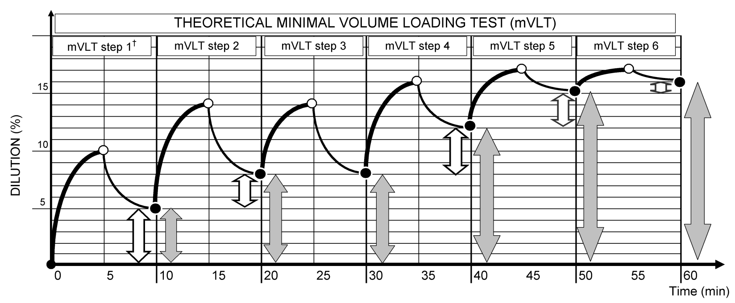
Hemodilution non-responsiveness: the dilution plateau
Dilution plateau during mVLT is recognized by EQUAL plasma dilution in AT LEAST TWO consecutive mini fluid challenges (mVLT steps).
DILUTION
PLATEAU

Slide 31
Dilution non-responsiveness: dilution plateau
Two states of fluid non-responsiveness can be observed during GDT protocol:
hemodynamic plateau and dilution plateau
Hemodynamic non-responsiveness: hemodynamic plateau
These two states of fluid non-responsiveness may not appear simultaneously
because correlation between dilution and hemodynamics is not allways warranted.
Haemodynamic
PLATEAU
DILUTION
PLATEAU

Slide 32
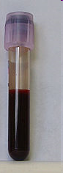
Preliminary clinical evidence
Andrijauskas Eur J Anaesthesiol 2012; 29: Supplement 47.
Data from 36 cases of pre-operative mVLT (a prospective RCT in elective primary TKA patients): four Hb measurements were used to calculate plasma dilution of the three mini fluid challenges.
Three boluses of 5 ml/kg of acetated Ringer’s solution infused over 3-5 min. were followed by the 5 minute periods without fluid.
Arterial blood samples from radial artery were analysed in a laboratory (COULTER® LH750; Beckman Coulter, Inc. USA).
Capillary hemoglobin (SpHb) was measured noninvasively and continuously by Radical 7 (Masimo Corp, Irvine, CA).

Slide 33
Preliminary clinical evidence
Andrijauskas Eur J Anaesthesiol 2012; 29: Supplement 47.
plasma dilution-1
plasma dilution-2
plasma dilution-3
Hb
Hb
Hb
Hb
5 min.
5 min.
5 min.

Slide 34
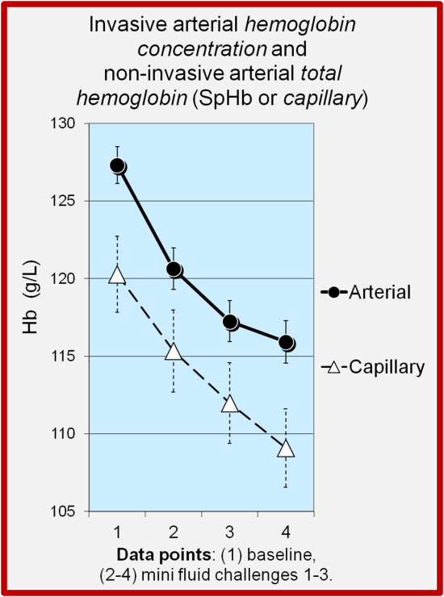
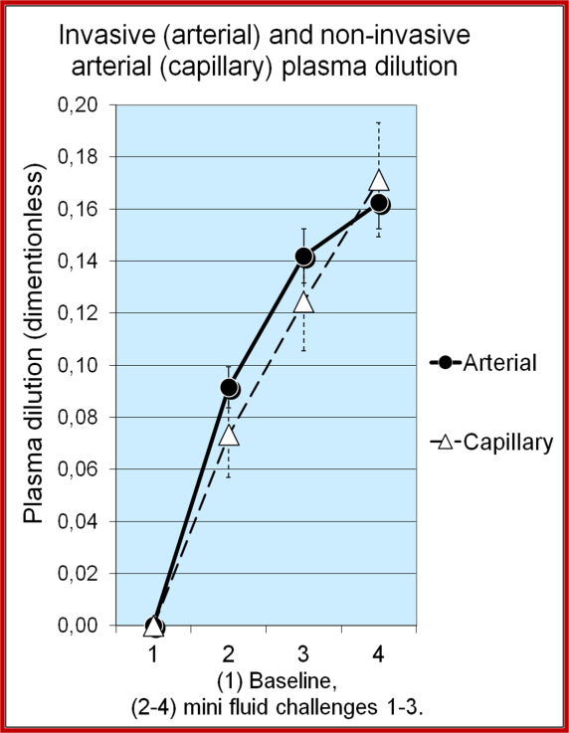
From hemoglobin to plasma dilution
Preliminary clinical evidence
Andrijauskas Eur J Anaesthesiol 2012; 29: Supplement 47.
Means from 36 clinical cases of 3 pre-operative mini fluid challenges: four Hb are used to calculate plasma dilution at 3 data points.
(Data presented as means +/- SEM)

Slide 35
From plasma dilution to plasma dilution efficacy
Andrijauskas Eur J Anaesthesiol 2012; 29: Supplement 47.
Since mini fluid challenges are separated by only 5 min periods without fluid, the plasma dilution is overlapping.
Since detection of the dilution plateau requires exceptionally accurate Hb measures it can easily be missed.
Thus, a new variable was proposed - plasma dilution efficacy which is a fractional change of plasma dilution in a single fluid challenge.

Slide 36
From plasma dilution to plasma dilution efficacy
Andrijauskas Eur J Anaesthesiol 2012; 29: Supplement 47.
plasma dilution-1
plasma dilution-2
plasma dilution-3
Hb
Hb
Hb
5 min.
5 min.
5 min.
Hb
plasma dilution efficacy-1
plasma dilution efficacy-2
plasma dilution efficacy-3

Slide 37
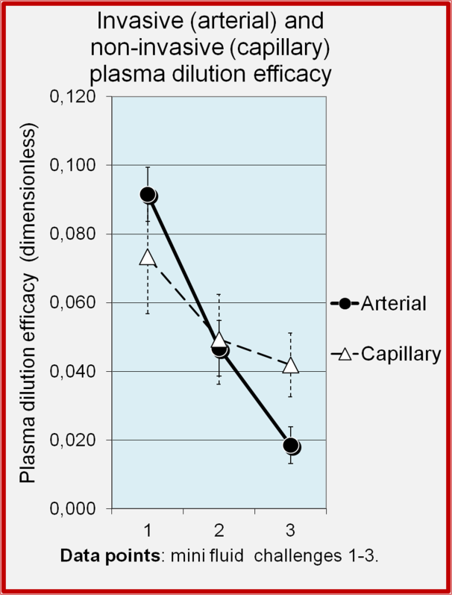
Preliminary clinical evidence
Andrijauskas Eur J Anaesthesiol 2012; 29: Supplement 47.
Means from 36 clinical cases of 3 pre-operative mini fluid challenges: four Hb are used to calculate plasma dilution at 3 data points.
(Data presented as means +/- SEM)

Slide 38
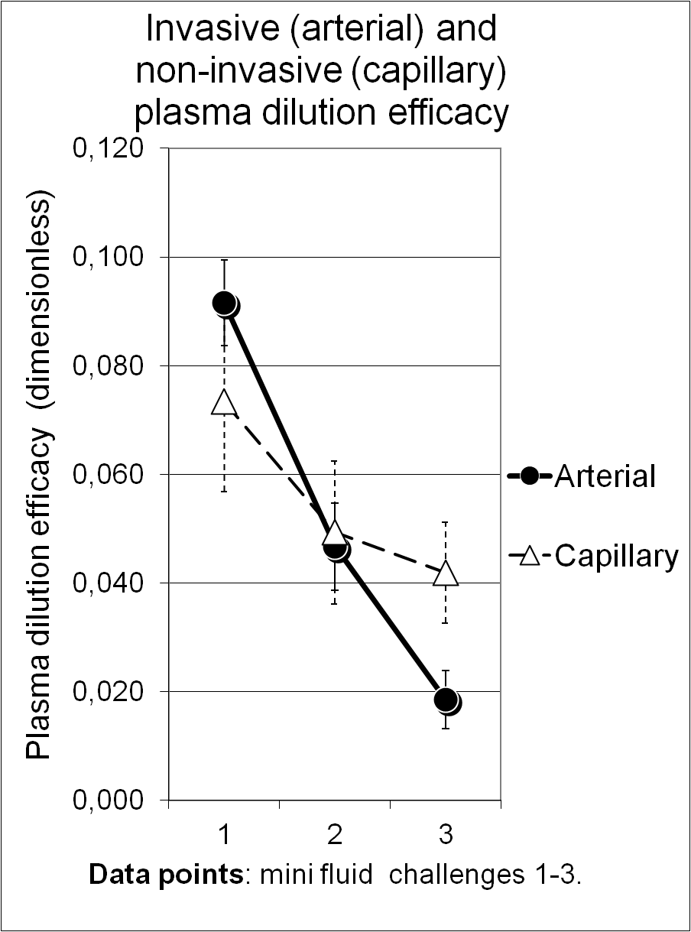
Re-hydrating interstitial fluid accumulation
The theory behind the reported differences in large vessel (arterial) and small vessel (capillary) plasma dilution during mVLT
Andrijauskas The Open Conference Proceedings Journal 2012; 3.
An increase of transcapillary filtration absorption ratio resulted in
positive arterio-capillary plasma dilution efficacy difference
after the 1st mini fluid challenge.

Slide 39
The theory behind the reported differences in large vessel (arterial) and small vessel (capillary) plasma dilution during mVLT
Andrijauskas The Open Conference Proceedings Journal 2012; 3.
Over-hydrating interstitial fluid accumulation
A decrease of transcapillary filtration absorption ratio and ‘reflux’ of excessive interstitial fluid resulted in negative arterio-capillary plasma dilution efficacy difference
after the 3rd mini fluid challenge.

Slide 40
The theory behind the reported differences in large vessel (arterial) and small vessel (capillary) plasma dilution during mVLT
Andrijauskas The Open Conference Proceedings Journal 2012; 3.
Imminent edema is when the arterio-capillary plasma dilution efficacy difference reaches zero in consecutive mini fluid challenges.

Slide 41
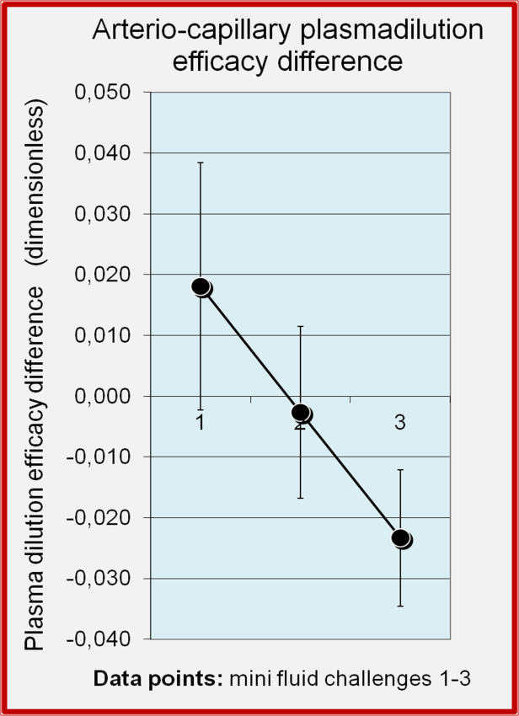
Preliminary clinical evidence
Andrijauskas Eur J Anaesthesiol 2012; 29: Supplement 47.
Means from 36 clinical cases of 3 pre-operative mini fluid challenges: four Hb are used to calculate plasma dilution at 3 data points.
(Data presented as means +/- SEM)

Slide 42
The conclusive hypothesis
Capillary plasma dilution efficacy of a fluid challenge decreases during rehydration and starts to increase during overhydration due to transcapillary fluid ‘reflux’. In contrast, the arterial variable will decrease further due increased net body fluid elimination.
Clinical relevance: the threshold when edema is imminent during stepwise infusion may be detected solely non-invasively --- it is the timepoint when capillary plasma dilution efficacy of a mini fluid challenge is minimized and starts to increase.
Aiming to avoid edema other measures should be applied for hemodynamic endpoints thereafter.

Slide 43
Transcapillary reflux – is it regional or the whole body state?
Our transcapillary reflux model is based on physiological reasoning without any validation of what actually happens in the pertinent tissues.
Capillary Hb measurements are obtained from a single segment of derma under a fingernail.
However, we postulate that because the derma and the skeletal muscles constitute a major proportion of body tissue volume and poses similar fluid accumulation features*, the transcapillary fluid equilibration processes observed in a segment of capillaries under a fingernail are similar to those in the majority of body capillaries.
* Wiig H. Pathophysiology of tissue fluid accumulation in inflammation. The Journal of physiology. 2011

Slide 44
Patient optimization strategies in practice
Poor adoption of hemodynamic optimization during major surgery is both surprising and concerning (Miller et al. Anesth Analg, vol. 112, no. 6, pp. 1274–6, 2011. M.) .
Aside from GDT and mVLT applications, perioperative patient optimization and critical care require simultaneous evaluation of numerous parameters and administration of intravenous fluid and vasopressor infusions, as well as blood transfusions.
A survey among North American and European anesthesiologists has revealed that complexity of the procedures is one of the reasons why only 16 % of anesthesiologists use GDT for the high risk patients. Cannesson et al. Crit Care, vol. 15, no. 4, p. 197, 2011)
Automated Decision Support (ADS) systems may ease the task.

Slide 45
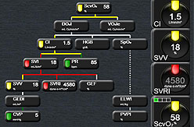
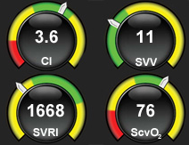
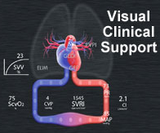
Automated Decision Support (ADS) systems
Currently available industrial ADS systems generate clinical advices based on clinical algorithms and the feedback from monitors.
Vital signs’ monitors provide a real-time parameter readings for ADS systems.
ADS application within the PC in a standard Windows® operating environment.
ADS application within clinical platforms.

Slide 46
Automated Decision Support (ADS) systems
Ultimate clinical application of ADS systems is in semi-closed or closed loop systems.
Can we and shall we trust robotics?
Do we trust an auto-pilot on an airplane?

Slide 47
There are dreamers and believers !
With increasing reliability of non-invasive measurements of hemodynamics and hemodilution there is a potential for the development of semi-closed or even closed-loop fluid management and hemodynamic optimization systems. (Saugel et al. Br J Anaesth 113 (3) 2014)

Slide 48
There are pioneers !
The closed-loop infusion system based on hemodynamic parameters has already been successfully tested by Dr. Cannesson’s team in hospitals of France and USA. (Rinehart et al. Annales Franc¸aises d’Anesthe´ sie et de Re´animation 33 (2014) e35–e41.)

Slide 49
They are not alone!
We created a novel clinical algorithm for an automated decision system. It is based on the joint consensus of orthopaedic surgeons and anesthesiologists within our research group. (Markevicius et al. Electronics and Electrical Engineering, 2013 and 2014)
In contrast to existing algorithms, our decision-making takes into account not only the hemodynamic responsiveness, but also the hemodilution efficacy of mini fluid challenges during goal directed optimization of hemodynamics.
According to a mini volume loading test (mVLT), further fluid loading is not any longer justifiable when hemodilution is not any longer enhanced. Vasopressors are then considered. (Svensen CH et al. Medicina (2014); e-pub ahead of print. http://dx.doi. org/10.1016/j.medici.2014.09.007)
Red cell transfusion is considered if signs of anemia persist after the optimization.

Slide 50
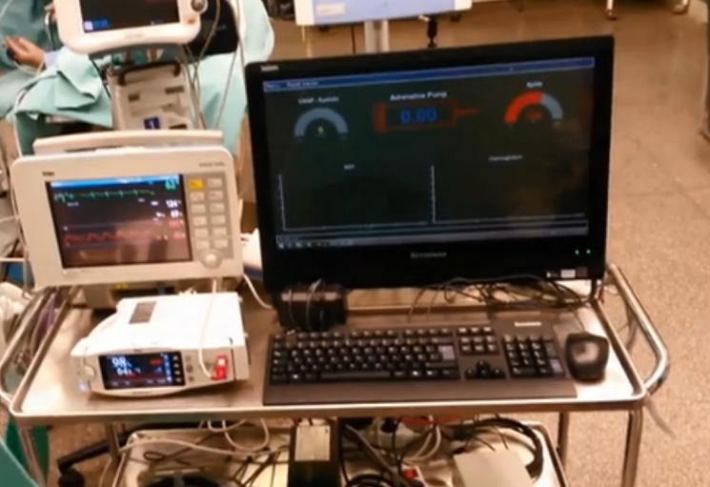
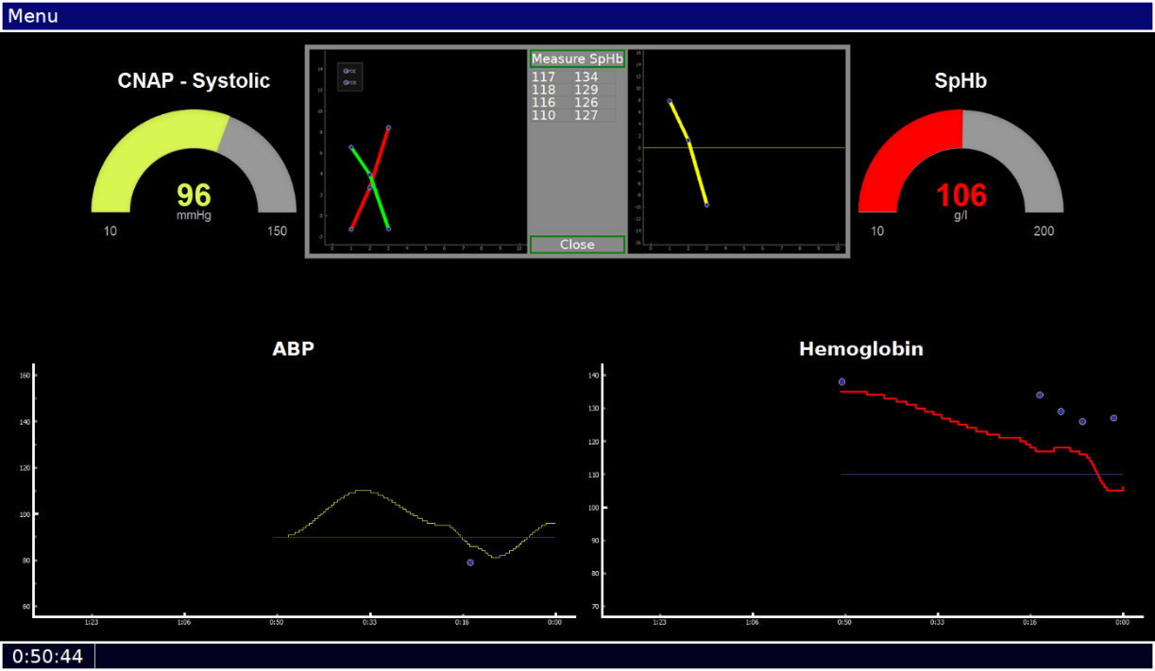
They are not alone!
Our prototype automated decision-support system within a semi-closed loop system
ADS application within the PC in a standard Windows® operating environment. Target parameters are CNAP and SpHb.
The snap-shot of a screen with a pop-up window for plasma dilution efficacy evaluation during the pre-operative mVLT .

Slide 51
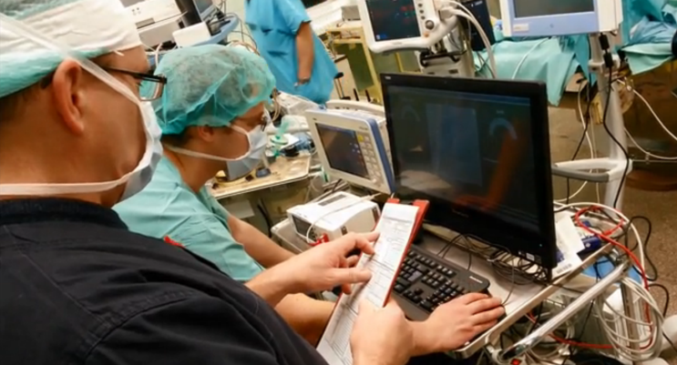
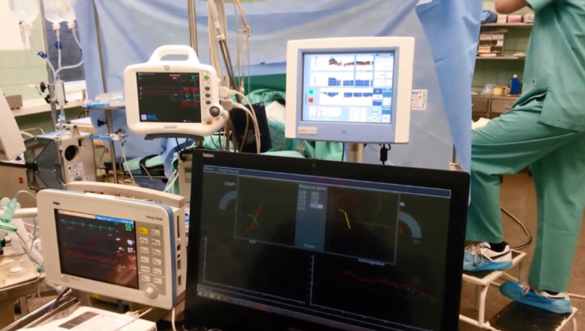
In a RCT we are testing our prototype semi-closed loop infusion system

Slide 52
Acknowledgement
Presentation was supported by the European Social Fund under the Global Grant measure (EU Structural Funds)

Slide 53
Thank you for attention!

Slide 54


