Slide 1
A Theoretical Framework for Environmental Design Interventions to Support Neurodegenerative Disease Management
KNOWLEDGE
TRANSFER
KNOWLEDGE
TRANSLATION
DESIGN
PREMISE
DESIGN
STRATEGY
Attila Lawrence, Professor of Interior Architecture and Design
School of Architecture, University of Nevada, USA

Slide 2
Facts and Futures
U.S. Population: 311,000,000
U.S. Population age 45-64: 82,800,000
U.S. Population age 65 and over: 41,400,000
Age 45 and over represents 40% of the U.S. population
census.gov 2010
Every day more than 10,000 will reach the age of 65
Projected to occur every single day for the next 20 years
endoftheamericandream.com

Slide 3
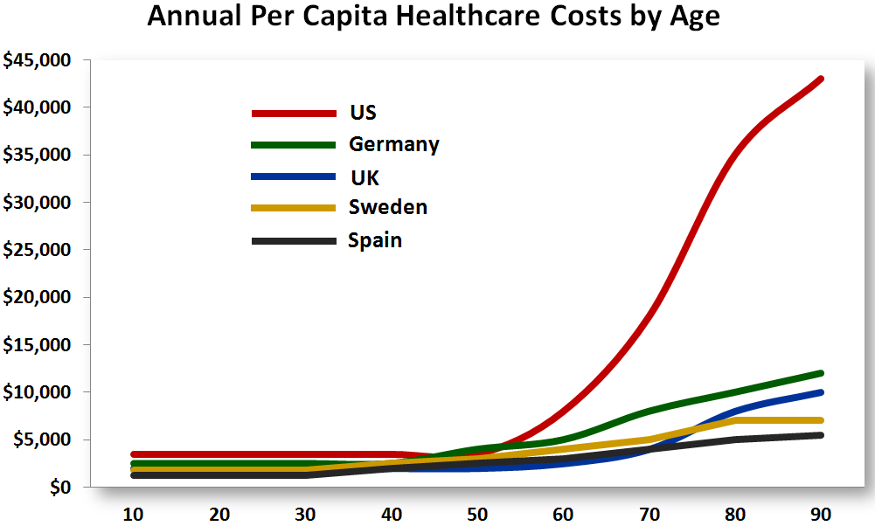
U.S. Health Care Expenditures 18 % Gross of Domestic Product (GDP)
whitehouse.gov
2012 - The Year In Healthcare, forbes.com

Slide 4
Falls:
Leading Cause of Injuries Among Older Adults
direct costs to the U.S. health care system $30 billion per year
indirect costs include long-term disability, dependence on others, lost time from work, reduced quality of life, risk management,
legal fees, and settlement awards
average cost per fall
$13,797 - $20,450
Centers for Disease Control and Prevention
National Center for Injury Prevention and Control

Slide 5
Core competencies in professional education and practice grounded in an artistic tradition
SCIENCE
AND
TECHNOLOGY
DESIGN
FOUNDATION
ART
HISTORY
THEORY
TRADITIONAL BODY OF KNOWLEDGE

Slide 6
Core competencies in professional education and practice grounded in an artistic tradition
SCIENCE
AND
TECHNOLOGY
DESIGN
FOUNDATION
ART
HISTORY
THEORY
TRADITIONAL BODY OF KNOWLEDGE

Slide 7
Core competencies in professional education and practice grounded in an artistic tradition
HUMAN BEHAVIOR
HUMAN NEEDS
SCIENCE
AND
TECHNOLOGY
DESIGN
FOUNDATION
ART
HISTORY
THEORY
ECOLOGY
SOCIAL
SCIENCES
TRADITIONAL BODY OF KNOWLEDGE
TOWARD 21st CENTURY BODY OF KNOWLEDGE
Adapted from S. Caan, 2014

Slide 8
Essential elements of design programming
RESEARCH
PROJECT TYPE
review of literature on the building type and analysis of plans of existing projects
ESTABLISH GOALS AND OBJECTIVES
organizational, aesthetic, function, economic, schedule, and management goals
GATHER RELEVANT INFORMATION
based upon the goals, relevant information is determined and researched, i.e., users, activities, and schedules
IDENTIFY STRATEGIES
ways to accomplish goals within constraints
DETERMINE
QUANTITATIVE
REQUIREMENTS
reconciliation of budget with design intentions desired within the project time frame
SUMMARIZE DESIGN
PROGRAM
information to be integrated into the design process

Slide 9
Environmental design intervention strategy to support neurodegenerative disease management
BEHAVIORAL
and/or
PHARMACOLOGIC
INTERVENTION
ANTECEDENT
HUMAN FACTORS
ANTECEDENT
PHYSICAL ENVIRONMENTAL
FACTORS
PROBLEM
BEHAVIOR
REQUISITE
BEHAVIOR
ANTECEDENT
SOCIAL ENVIRONMENTAL FACTORS
KNOWLEDGE
TRANSFER AND
TRANSLATION
NEW KNOWLEDGE,
DESIGN PREMISE
AND STRATEGY
INFORMED
DESIGN
INTERVENTION

Slide 10
DEMENTIA
1 Delusions
2 Hallucinations
3 Agitation/Aggression
4 Depression/ Dysphoria
5 Anxiety
6 Elation/Euphoria
7 Apathy/Indifference
8 Disinhibition
9 Irritability/Lability
10 Aberrant Motor Activity
11 Sleeping And Nighttime Behavior Disorders
12 Eating Disorders
Adapted from The Neuropsychiatric Inventory
Jeffrey L. Cummings, MD

Slide 11
Aberrant Motor Behavior
1.1 PROBLEM BEHAVIOR
• agitation and irritability
• lack of concentration
difficulty with balance management and falls, postural instability
restlessness
wandering
night wandering and confusion
slips and falls (common cause of injury and death among the elderly)
1.2 ANTECEDENT HUMAN FACTORS
aging process
diminished physical functions
muscle tension, stiffness or rigidity of the arms, legs, or trunk
diminished psychological functions
retinal dysfunction (the increase of both contrast and brightness occurs
in the image projected onto their retina)
psychoactive drugs
1.3 ANTECEDENT PHYSICAL ENVIRONMENTAL FACTORS
lighting inappropriate to spatial function
confusing surroundings
excessive sensory stimulation
1.4 ANTECEDENT SOCIAL ENVIRONMENTAL FACTORS
excessive demands from family, friends, etc.
distressing behavior of others
loneliness/boredom and social isolation

Slide 12
Aberrant Motor Behavior
1.5 DESIGN PREMISE
under daylight condition older adults take more confident steps
under nightlight condition adults take more cautious steps
daylight equivalent lighting may help decrease risk of falling
1.6 DESIGN STRATEGY
design fall preventive milieu that supports balance recovery
specify high intensity lighting with a highly correlated color temperature emitted by ceiling-mounted luminaires to positively influence restless behavior
specify floor surfaces to support traction
specify transitional floor surfaces to avoid abrupt changes in surface friction or surface heights
integrate clear sight lines to spatial destinations
specify contrasting colors to enhance depth perception
integrate combinations of daylight equivalent lighting (fluorescents) to generate diffused light and incandescent single point spot and flood lighting to enhance color, texture and form

Slide 13
Conclusion
we spend approximately 90 % of our time inside buildings *
building interiors constitute a multisensory experience from which the brain acquires and uses new and retained information to direct behaviors **
neuroscience identifies and explains brain functions relevant to multisensory experience
* Environmental Protection Agency
** Thomas Albright, Salk Institute

Slide 14
interior design interfaces building performance with human performance
design intervention (vs. design interference)
to support neurodegenerative disease management requires the transfer and translation of current knowledge to advance toward a health care responsive methodological paradigm

