Slide 1


Slide 2
Ashraf M. Ahmed
King Saud University, 2015

Slide 3


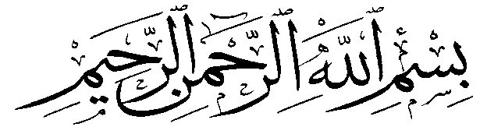
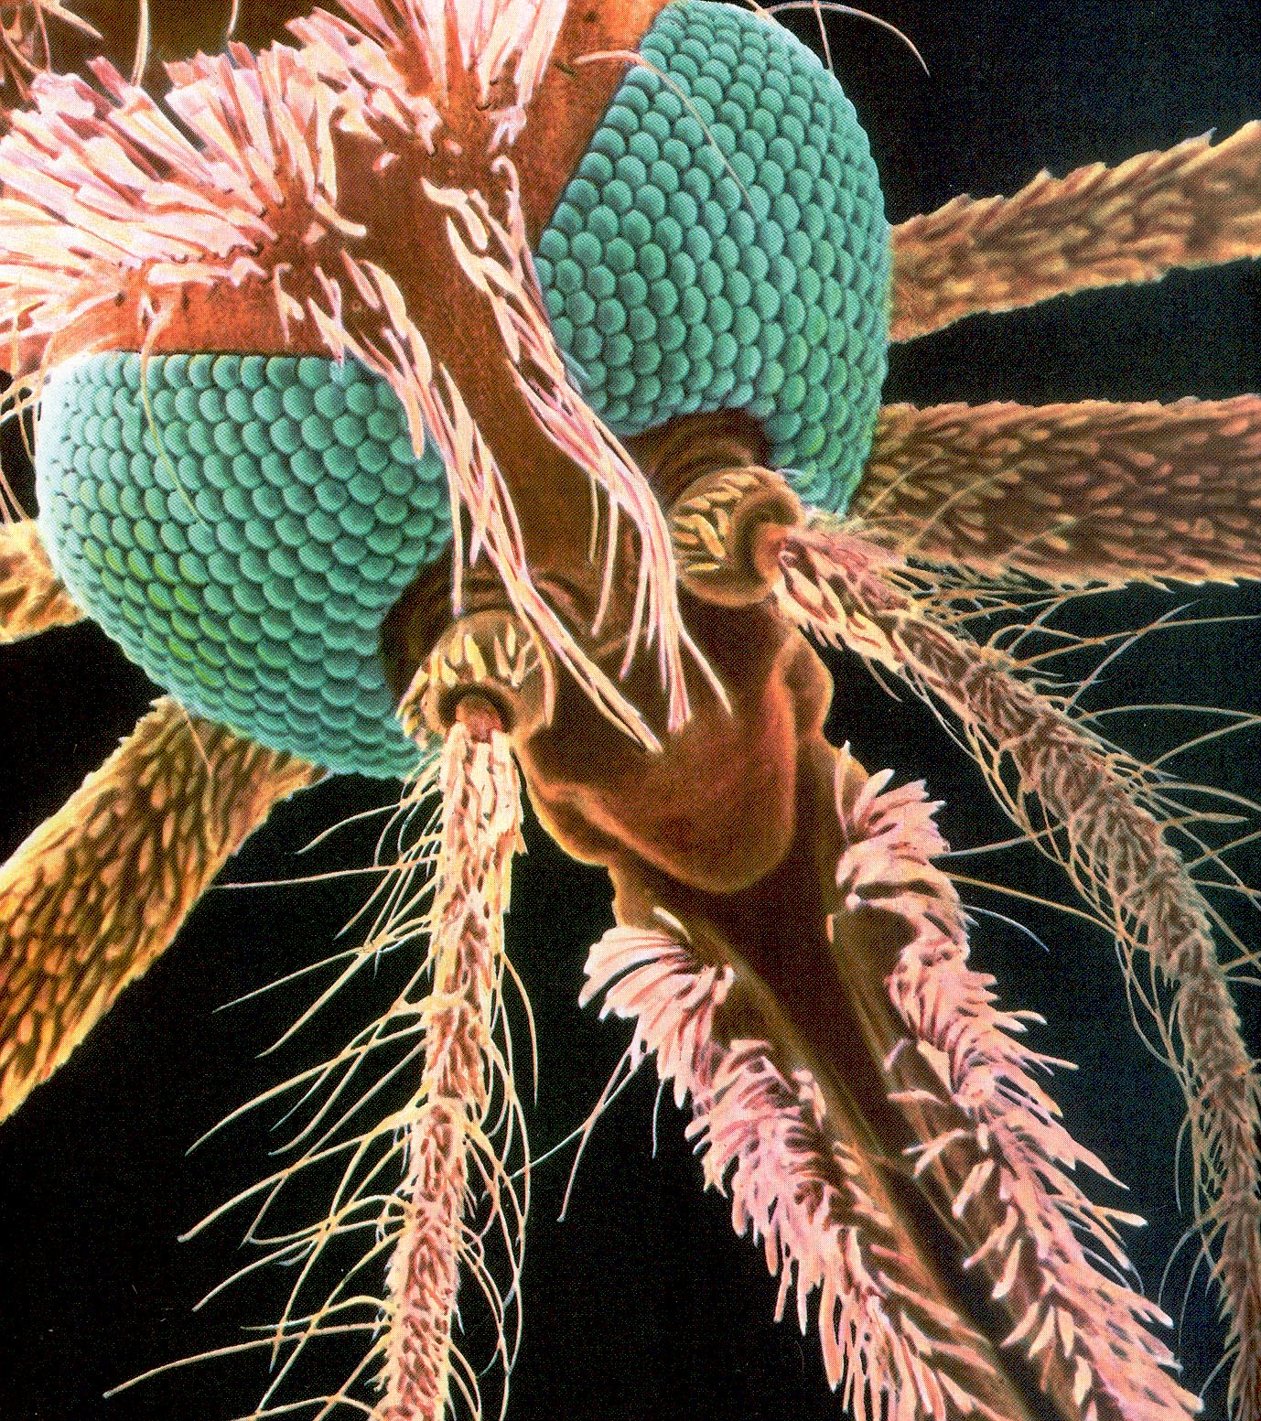
King Saud University ,
Faculty of Science,
Zoology Department.
Bacillus thuringiensis strains native to Saudi Arabia with enhanced larvicidal toxicity against the Rift Valley Fever mosquito vector, Aedes caspius.
Ashraf M. Ahmed, Hamdy I. Hussein, Talat A. El-Kersh, Yazeed A. Al-Sheikh, Fahd A. Al-Mekhlafi

Slide 4
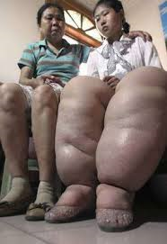
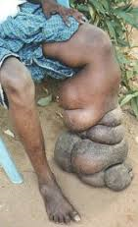
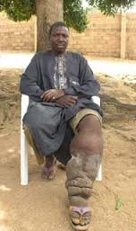
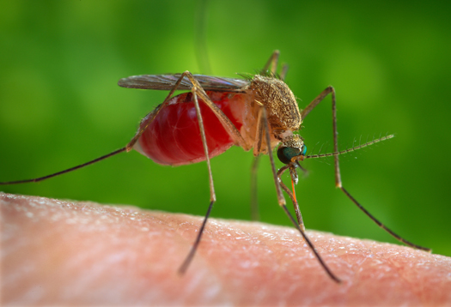
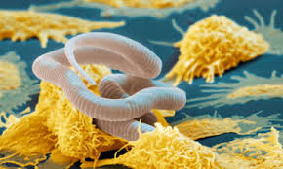
Filaria
Transmitted by Culex mosquitoes
Wuchereria bancrofti, Brugia malayi or B. timori
Nearly 1.4 billion people in 73 countries worldwide are threatened by filariasis.
Over 120 million people are currently infected.
Culex mosquitoes
Filaria worm

Slide 5

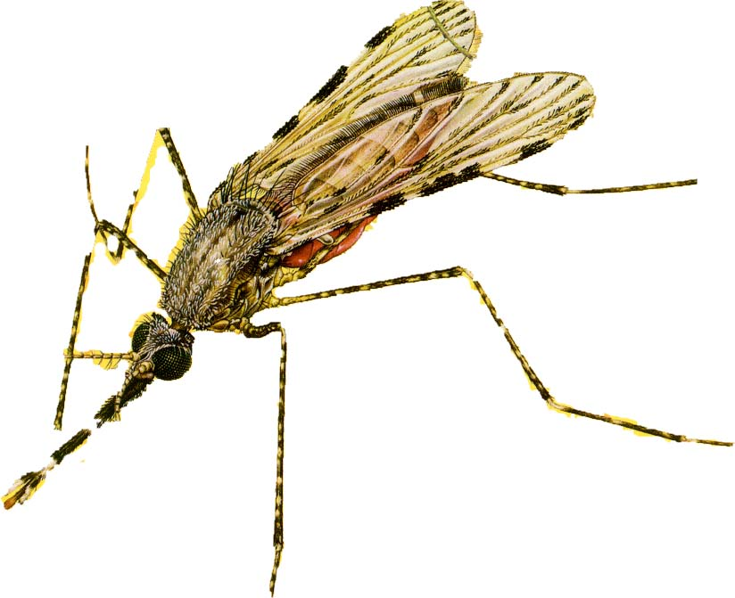
Malaria is a major and increasing threat to global health
135-287 millions
WHO
473-789 thousands

Slide 6
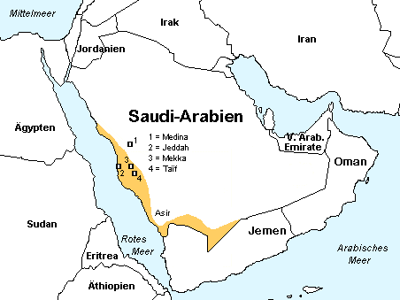
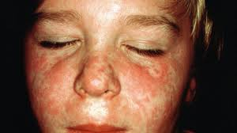
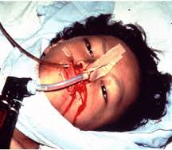
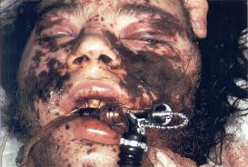
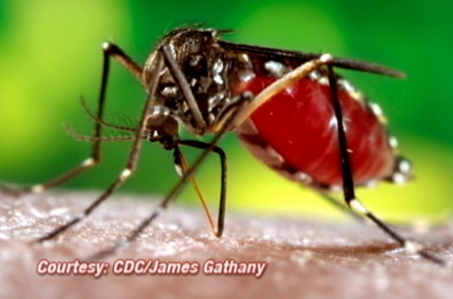
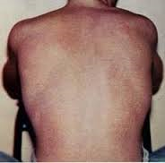
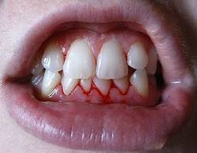
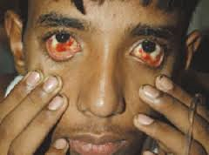
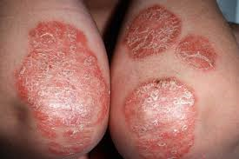
Dengue Fever
Viral disease transmitted by Aedes aegypti
Aedes aegypti

Slide 7
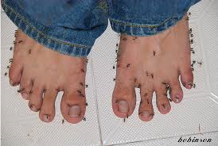
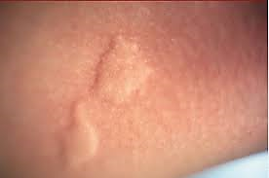
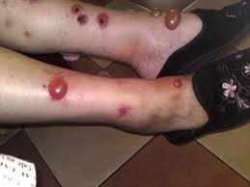
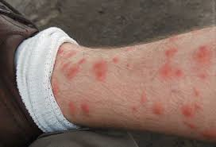

Slide 8
Immuno-Control Strategy of Mosquito-borne Diseases

Slide 9
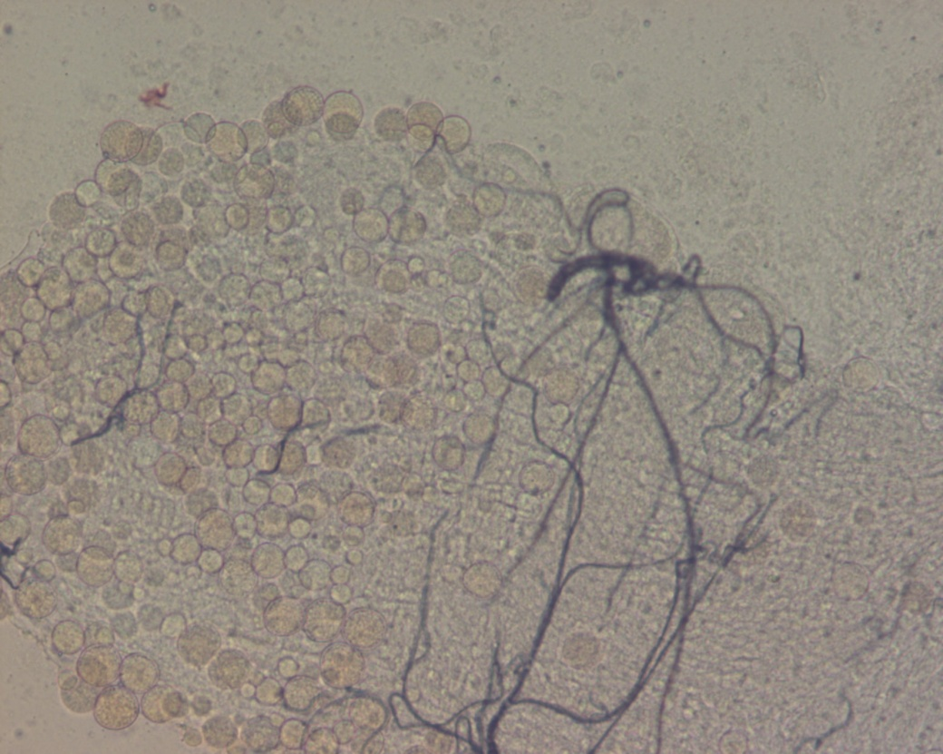
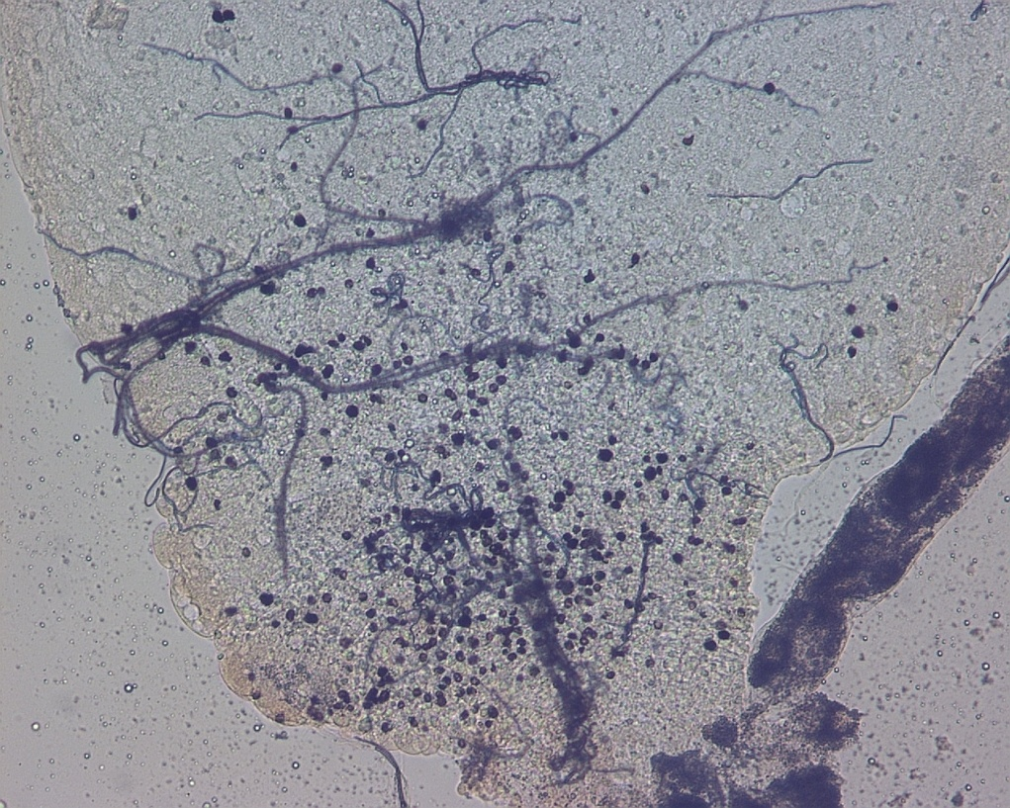
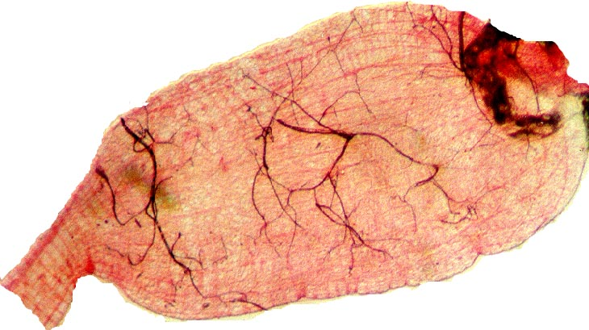
Malaria Control
A) Immuno-control
Susceptible
Refractory
B) Mosquito Transgenesis
C) Bio-control

Slide 10


Paskewitz, S. M., Brown, M. R., Lea, A. O. and Collins, F. A. (1988). Parasitology. 74: 432-439.
The melanotic encapsulation (Refractory)
A) Immuno-control (Vector Refractoriness)
Dimopoulos, G.; Richman, A.; Muller, H-M. and Kafatos, F. C. (1997). PNAS, USA, 94: 11508-11513
Vector immunity (susceptible)

Slide 11


Immuno-control
Shahabuddin, M.; Fields, I.; Bulet, P.; Hoffman, J. A. and Miller, L. H. (1998). Experimental Parasitology. 89: 103-112
Antimicrobial/Antiparasitic
Ramirez & Dimopoulos, G. (2010). Developmental and Comparative Immunology 34: 625–629.
Anti-dengue defense in Ae. aegypti

Slide 12
B)- Mosquito Transgenesis

Slide 13

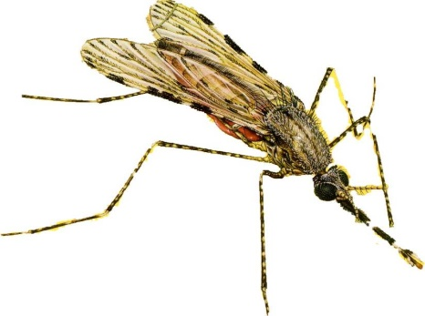
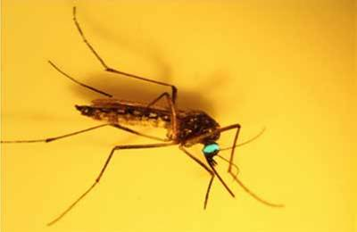
Mosquito Transgenesis
Kim et al. (2004). J. Med. Entomol. 41, 447–455
Defensin, cecropin and gambicin from An. gambiae are antibacterial and anti-Plasmodium activity.
Kokoza, V.; Ahmed, A.; Cho, W-L; Jasinskiene, N.; James, A. A. and Raikhel, A. (2000). PNAS, USA. 97: 9144-9149.
Genetically modified mosquito (refractory)
This is in the favor of the strategy of releasing transgenic mosquitoes into the field.

Slide 14
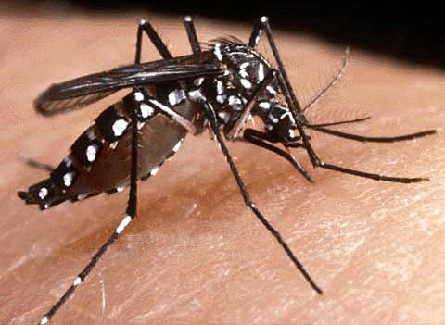
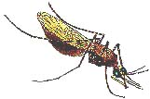
Refractoriness: disadvantage
Yan G, et al. (1997). Evolution, 51:441-450.
Ae. aegypti selected for refractoriness to P. gallinaceum had shorter longevity, smaller body sizes and laid fewer eggs than the susceptible ones.
Hurd H, et al (2005). Evolution, 59:2560-2572.
An. gambiae selected for refractoriness to P. y. nigeriensis produced fewer offspring than susceptible ones after nine generations.
Somboon, et al. (1999). Medical and Veterinary Entomology. 13: 355-361.
An. dirus selection for refractoriness and susceptibility to P. y. nigeriensis.

Slide 15
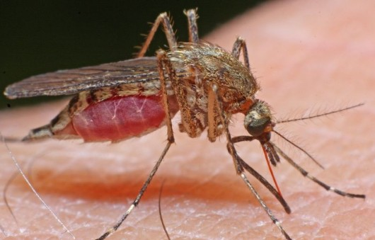
How these would be introduced into the wild (Field Release)?
More Risks
How GMM would be competent with the naturally existed wild-mosquitoes
Transgenic mosquito will require careful assessment before the approach could become reality.

Slide 16
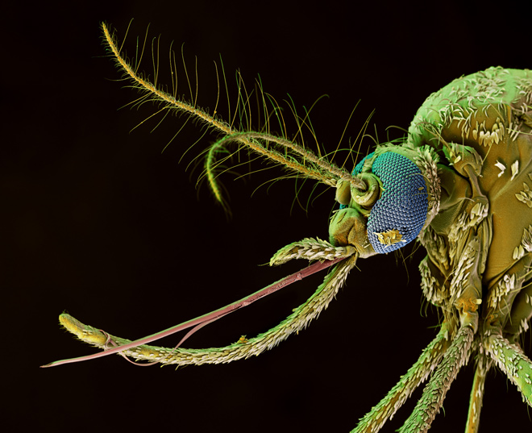
C) Approaching the nature: Entomopathogenic bacteria

Slide 17
Targeted mosauitocidal bacteria
Bacillus thuringiensis (Bt):
Gram-positive spore forming bacterium belongs to Genus Bacillum.
Known with its mosquito larvicidal activity (Goldberg and Margalit, 1977).
Isolated from the Saudi environment (El-Kersh et al., 2012).

Slide 18
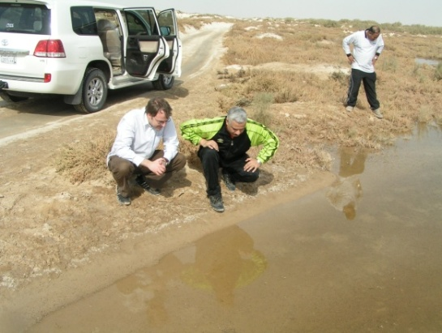
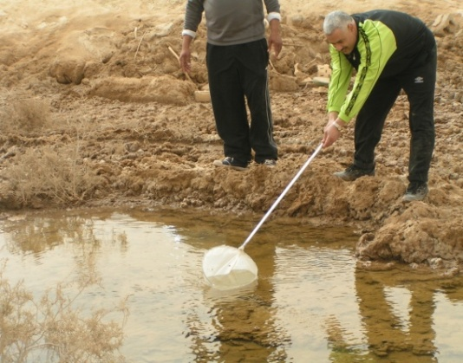
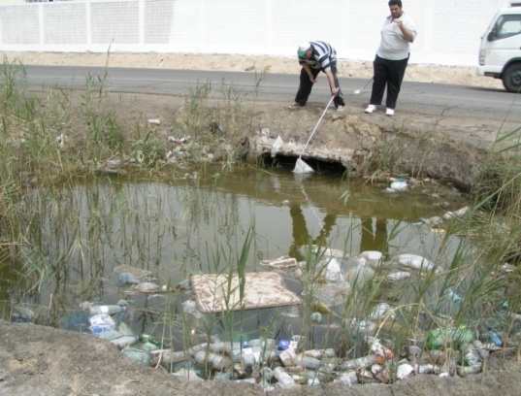
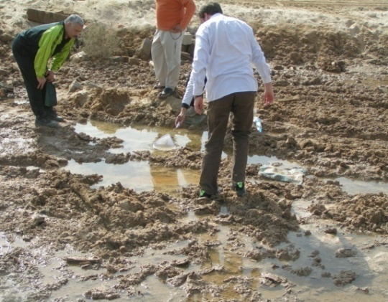
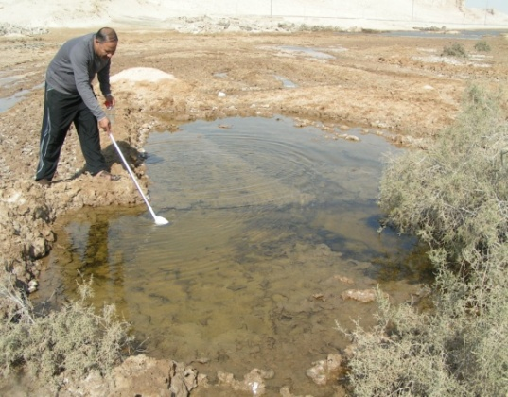
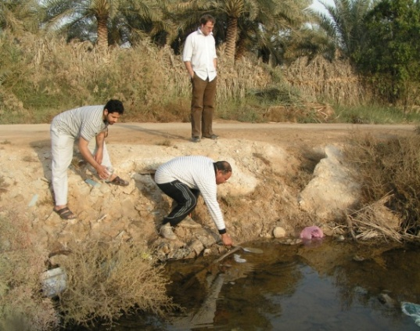

Slide 19
Geographical distribution of processed samples

Slide 20
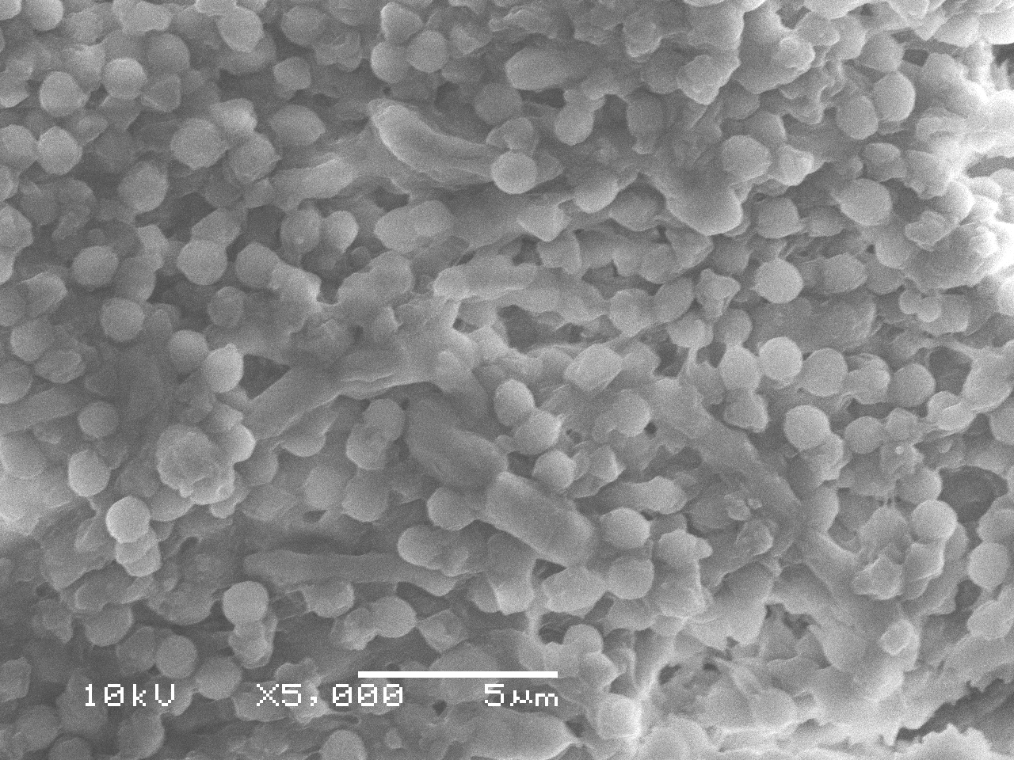
Different types of Bt colonial morphology
Still going on

Slide 21
Bioassay test
Bt- code | City of collection | Hrs P-T | LC₅₀ (µg/ml) (lower - upper)* | LC₉₅ (µg/ml) (lower to upper) | X 10⁵ CFU/µg | Slope ± SE
Bt-63 | Makkah | 24 | 0.91 (0.7 – 1.07)ª | 5.51 (4.1 – 8.2) | 0.7 ± 0.2 | 2.1 ± 0.053
 |  | 48 | 0.5 (0.41 – 0.58) | 1.12 (0.95 – 1.4) |  | 4.72 ± 0.006
Bt-55 | Madinah | 24 | 1.7 (1.5 – 1.98)^{b} | 7.9 (6.11 – 10.68) | 1.95 ± 0.3 | 2.5 ± 0.059
 |  | 48 | 1.06 (0.91 – 1.2) | 2.29 (2.5 – 3.8) |  | 3.65 ± 0.21
Bt-53 | Madinah | 24 | 1.9 (1.7 – 2.2)^{b} | 8.08 (5.8 – 11.7) | 1.3 ± 0.4 | 2.6 ± 0.0011
 |  | 48 | 0.72 (0.6 – 0.8) | 2.5 (2.08 – 3.6) |  | 2.9 ± 0.0014
Bt-60 | Madinah | 24 | 1.9 (1.7 – 2.2)^{b} | 5.01 (4.2 – 6.15) | 0.13 ± 0.1 | 4.05 ± 0.002
 |  | 48 | 0.94 (0.8 – 1.05) | 2.9 (2.5 – 3.8) |  | 3.3 ± 0.09
Bt-68 | Madinah | 24 | 2.3 (2.06 – 2.7)^{c} | 10.7 (7.8 – 15.7) | 1.05 ± 0.3 | 2.5 ± 0.055
 |  | 48 | 1.1 (0.97 – 1.3) | 5.4 (4.2 – 7.5) |  | 2.4 ± 0.056
Bt-42 | Jezan | 24 | 2.5 (2.2 – 2.9)^{c} | 15.4 (10.9 – 22.8) | 0.93 ± 0.3 | 2.1 ±0.048
 |  | 48 | 1.2 (1.04 – 1.35) | 3.07 (2.5 – 3.8) |  | 4.02 ± 0.26
Bt-44 | Jezan | 24 | 3.03 (2.7 – 3.4)^{d} | 9.4 (7.7 – 11.6) | 0.63 ± 0.4 | 3.35 ± 0.075
 |  | 48 | 2.08 (1.8 – 2.3) | 6.12 (5.1 – 7.5) |  | 3.5 ± 0.094
Bt-29 | Madinah | 24 | 4.2 (3.5 – 5.0)^{e} | 32.6 (22.8 – 47.8) | 0.52 ± 0.1 | 1.8 ± 0.03
 |  | 48 | 2.2 (1.8 – 2.7) | 14.05 (10.6 – 19.2) |  | 2.05 ± 0.037
Bt-12 | Yanboa | 24 | 4.6 (4.2 – 5.1)^{e} | 9.4 (7.9 – 11.08) | 0.53 ± 0.4 | 5.4 ± 0.005
 |  | 48 | 2.4 (2.04 – 2.8) | 10.4 (8.01 – 13.9) |  | 2.6 ± 0.06
Bt-26 | Madinah | 24 | 4.8 (4.1 – 5.6)^{e} | 33.9 (21.8 – 54.5) | 4.1 ± 0.7 | 1.94 ± 0.044
 |  | 48 | 1.9 (1.5 – 2.4) | 14.6 (10.2 – 22.01) |  | 1.9 ± 0.051
Bt-15 | Bti-H14 | 24 | 4.88 (4.2 – 5.4)^{e} | 21.93 (17.3 – 28.03) | 4.5 ± 0.3 | 2.52 ± 0.044
 |  | 48 | 2.62 (2.2 – 3.1) | 10.01 (7.8 – 13.2) |  | 2.82 ± 0.092
Toxicity of Bt isolates against 3rd larval stage of Cx. pepiens at 24h post-infection. Bt subsp. israelensis strain (H14) is the positive control.
KEY; LC₅₀= Lethal concentration (concentration to kills 50% of test organisms); LC₉₅ = Lethal concentration (concentration to kills 95% of test organisms); CFU= colony forming unit; * significant different compared to the reference positive control Bti-H14 (based on the non-overlapping confidence limits).

Slide 22
Bioassay test
Bt- code | City of collection | LC₅₀ (µg/ml) (lower to upper) | LC95 (µg/ml) (lower to upper) | Slope ± SE | × 10⁵ CFU/µg
Bt-H14 | H14(Reference) | 13.33 (11.2-15.9) | 63.7 (40.4-102.3) | 2.4 ± 0.071 | 4.5±0.3
Bt-05 | Kharj | 13.4 (11.07-16.5) | 78.5 (46.0-137.0) | 2.15 ± 0.0612 | 1.0±0.1
Bt-07 | Asseer | 15.0 (12.2-18.8) | 90.4 (50.5-166.0) | 2.12 ± 0.065 | 1.0±0.2
Bt-10 | Qassim | 4.96 (4.41-5.58)* | 18.59 (14.6-23.8) | 2.9 ± 0.062 | 1.2±0.3
Bt-11 | Younboa | 12.3 (10.2-14.8)* | 72.6 (43.5-124.25) | 2.1 ± 0.057 | 0.65±0.3
Bt-12 | Younboa | 9.5 (8.3-10.9)* | 41.6 (29.4-59.6) | 2.6 ± 0.0613 | 0.53±0.4
Bt-16 | Asser | 13.0 (10.6-16.0) | 84.2 (47.8-152.6) | 2.02 ± 0.0563 | 0.92±0.3
Bt-17 | Hafr-elbaten | 22.0 (18.2-26.7) | 128.5 (76.4-219.7) | 2.14 ± 0.059 | 8.1±0.4
Bt-26 | Madinah | 12.9 (9.9-16.9) | 149.7 (64.7-367.2) | 1.54 ± 0.0456 | 4.1±0.7
Bt-27 | Madinah | 7.1 (6.1-8.2)* | 40.1 (27.3-60.2) | 2.2 ± 0.048 | 5.9±0.4
Bt-28 | Makkah | 8.6 (7.7-9.6)* | 27.5 (22.4-33.9) | 3.3 ± 0.073 | 6.2±0.3
Bt-29 | Madinah | 14.4 (12.4-16.73) | 49.4 (34.1-72.3) | 3.1 ± 0.12 | 0.52±0.1
Bt-42 | Jezan | 5.9 (5.2-6.8)* | 24.3 (18.9-31.3) | 2.7 ± 0.067 | 0.93±0.3
Bt-44 | Jezan | 16.1 (13.7-18.9) | 91.9 (59.3-144.2) | 2.2 ± 0.052 | 0.63±0.4
Bt-53 | Madinah | 13.8 (11.7-16.4) | 101.7 (61.3-171-9) | 1.9 ± 0.0452 | 1.3±0.4
Bt-55 | Madinah | 4.11 (3.6-4.6)* | 14.4 (11.6-18.1) | 3.02 ± 0.071 | 1.95±0.3
Bt-56 | Madinah | 11.7 (10.2-13.5)* | 43.8 (31.2-62.2) | 2.9 ± 0.083 | 0.15±0.3
Bt-57 | Madinah | 7.4 (6.5-8.25)* | 26.12 (20.9-32.9) | 2.98 ± 0.068 | 1.27±0.3
Bt-58 | Madinah | 5.73 (5.06-6.5)* | 24.62 (18.6-32.9) | 2.6 ± 0.05 | 1.24±0.2
Bt-59 | Madinah | 10.3 (8.5-12.6)* | 84.9 (46.3-161.6) | 1.8 ± 0.047 | 1.28±0.2
Bt-60 | Madinah | 14.7 (12.5-17.5) | 58.2 (38.1-89.9) | 2.75 ± 0.096 | 0.13±0.1
Bt-63 | Makkah | 3.9 (3.4-4.4)* | 15.7 (12.3-20.3) | 2.7 ± 0.063 | 0.7±0.2
Bt-67 | Madinah | 6.9 (5.9-8.2)* | 50.6 (31.5-83.4) | 1.9 ± 0.045 | 0.6±0.1
Bt-68 | Madinah | 5.16 (4.5-5.8)* | 21.6 (16.6-28.5) | 2.64 ± 0.0564 | 1.05±0.3
Toxicity of Bt isolates against 3rd larval stage of An. gambiaeat 24h post-infection. Bt subsp. israelensis strain (H14) is the positive control.
KEY; LC₅₀= Lethal concentration (concentration to kills 50% of test organisms); LC₉₅ = Lethal concentration (concentration to kills 95% of test organisms); CFU= colony forming unit; * significant different compared to the reference positive control Bti-H14 (based on the non-overlapping confidence limits).

Slide 23
Bioassay test
Bt- code | City of collection | Hrs P-T | LC₅₀ (µg/ml) (lower to upper) | LC₉₅ (µg/ml) (lower to upper) | X 10⁵ CFU/µg | Slope ± SE
Bt-15 | B.t.i. (H14) (Reference) | 24 | 13.02( 11.9-14.2) | 28.74(24.4-33.8 ) | 4.5 ± 0.3 | 4.78± 0.2
 |  | 48 | 4.1(3.5-4.7 ) | 15.1( 11.9-19.2) |  | 2.9±0.064
Bt-05 | Kharj | 24 | 1.3(1.2-1.5 ) | 4.7(3.8-6.05 ) | 1.0 ± 0.1 | 3.02±0.0673
 |  | 48 | 0.54(0.43-0.64 ) | 1.9(1.5-2.5 ) |  | 3.06±0.16
Bt-07 | Asseer | 24 | 9.9(9.2-10.7 ) | 19.37(16.77-22.41 ) | 1.0 ± 0.2 | 5.64±0.26
 |  | 48 | 5.71(5.09-6.4 ) | 15.25(12.5-18.7 ) |  | 3.85±0.2
Bt-10 | Qassim | 24 | 3.67(3.03-4.42 ) | 30.05(20.88-44.65 ) | 1.2 ± 0.3 | 1.8±0.034
 |  | 48 | 1.4(1.07-1.75 ) | 8.8(6.37-12.91 ) |  | 2.05±0.059
Bt-11 | Yanboa | 24 | 3.98(3.4-4.6 ) | 20.3(15.6-26.8 ) | 0.65 ± 0.3 | 2.32±0.038
 |  | 48 | 2.01(1.6-2.4 ) | 11.9(8.6-17.4 ) |  | 2.12±0.052
Bt-12 | Yanboa | 24 | 4.79(4.13-5.54 ) | 14.05(11.32-17.53 ) | 0.53 ± 0.4 | 3.52±0.20
 |  | 48 | 1.43(1.15-1.73 ) | 6.58(5.04-9.03 ) |  | 2.52±0.47
Bt-16 | Asser | 24 | 3.88(3.46-4.35 ) | 14.5(11.3-18.7 ) | 0.92 ± 0.3 | 2.9±0.06
 |  | 48 | 1.44(1.3-1.6 ) | 3.41(2.86-4.16 ) |  | 4.4±0.32
Bt-17 | Hafr-Elbaten | 24 | 1.32(1.2-1.5 ) | 5.8(4.5-8.01 ) | 8.1 ± 0.4 | 2.5±0.058
 |  | 48 | 0.58(0.45-0.71 ) | 2.98(2.35-4.23 ) |  | 2.3±0.082
Bt-27 | Madinah | 24 | 4.58(3.96-5.29 ) | 21.19(16.45-27.7 | 5.9 ± 0.4 | 2.47±0.043
 |  | 48 | 1.25(0.95-1.58 ) | 7.5(5.5-10.8 ) |  | 2.11±0.065
Bt-28 | Makkah | 24 | 5.5(4.7-6.4 ) | 23.3(17.5 31.4) | 6.2 ± 0.3 | 2.62±0.064
 |  | 48 | 2.2(1.6-2.8 ) | 15.9(11.1-23.9 ) |  | 1.9±0.054
Bt-44 | Jezan | 24 | 2.24(1.96-2.56 ) | 10.58(7.77-15.26 ) | 0.63 ± 0.4 | 2.44±0.052
 |  | 48 | 1.44(0.98-1.31 ) | 5.04(3.97-6.84 )
 |  |  |  |  |  | 2.55±0.0613
Bt-53 | Madinah | 24 | 2.23(1.9-2.6 ) | 11.78(8.0-19.5 ) | 1.3 ± 0.4 | 2.3±0.056
 |  | 48 | 1.06(0.94-1.2 ) | 3.93(3.2-5.2 ) |  | 2.9±0.062
Bt-60 | Madinah | 24 | 1.17(1.03-1.32 ) | 4.81(3.81-6.56 ) | 0.13 ± 0.1 | 2.7±0.057
 |  | 48 | 0.41(0.28-0.52 ) | 2.76(2.09-4.27 ) |  | 2.0±0.071
Bt-63 | Makkah | 24 | 1.28(1.12-1.46 ) | 5.93(4.5-8.4 ) | 0.7 ± 0.2 | 2.4±0.053
 |  | 48 | 0.7(0.6-0.8 ) | 2.63(2.14-3.5 ) |  | 2.8±0.08
Bt-68 | Madinah | 24 | 1.7(1.5-1.9 ) | 6.7(5.2-9.2 ) | 1.05 ± 0.3 | 2.7±0.0603
 |  | 48 | 1.07(0.95-1.2 ) | 3.7(3.0-4.7 ) |  | 3.06±0.069
Toxicity of Bt isolates against 3rd larval stage of Ae. aegypti at 24h post-infection. Bt subsp. israelensis strain (H14) is the positive control.
KEY; LC₅₀= Lethal concentration (concentration to kills 50% of test organisms); LC₉₅ = Lethal concentration (concentration to kills 95% of test organisms); CFU= colony forming unit; * significant different compared to the reference positive control Bti-H14 (based on the non-overlapping confidence limits).

Slide 24
Conclusion and recommendation
We isolated 68 native Bt isolates, 23 of them are mosquitocidal, and only 8 of them showed higher mosquitocidal activity compared to Bti.
These native mosquitocidal Bt could be utilized in the battle against mosquito vector in Saudi Arabia and worldwide.
Molecular characterization of these potentially active isolates and their toxic parasporal protein crystals are currently being investigated.
We strongly recommend to continuou use this eco-friend biocontrol agent in the battle against mosquito vectors.

Slide 25
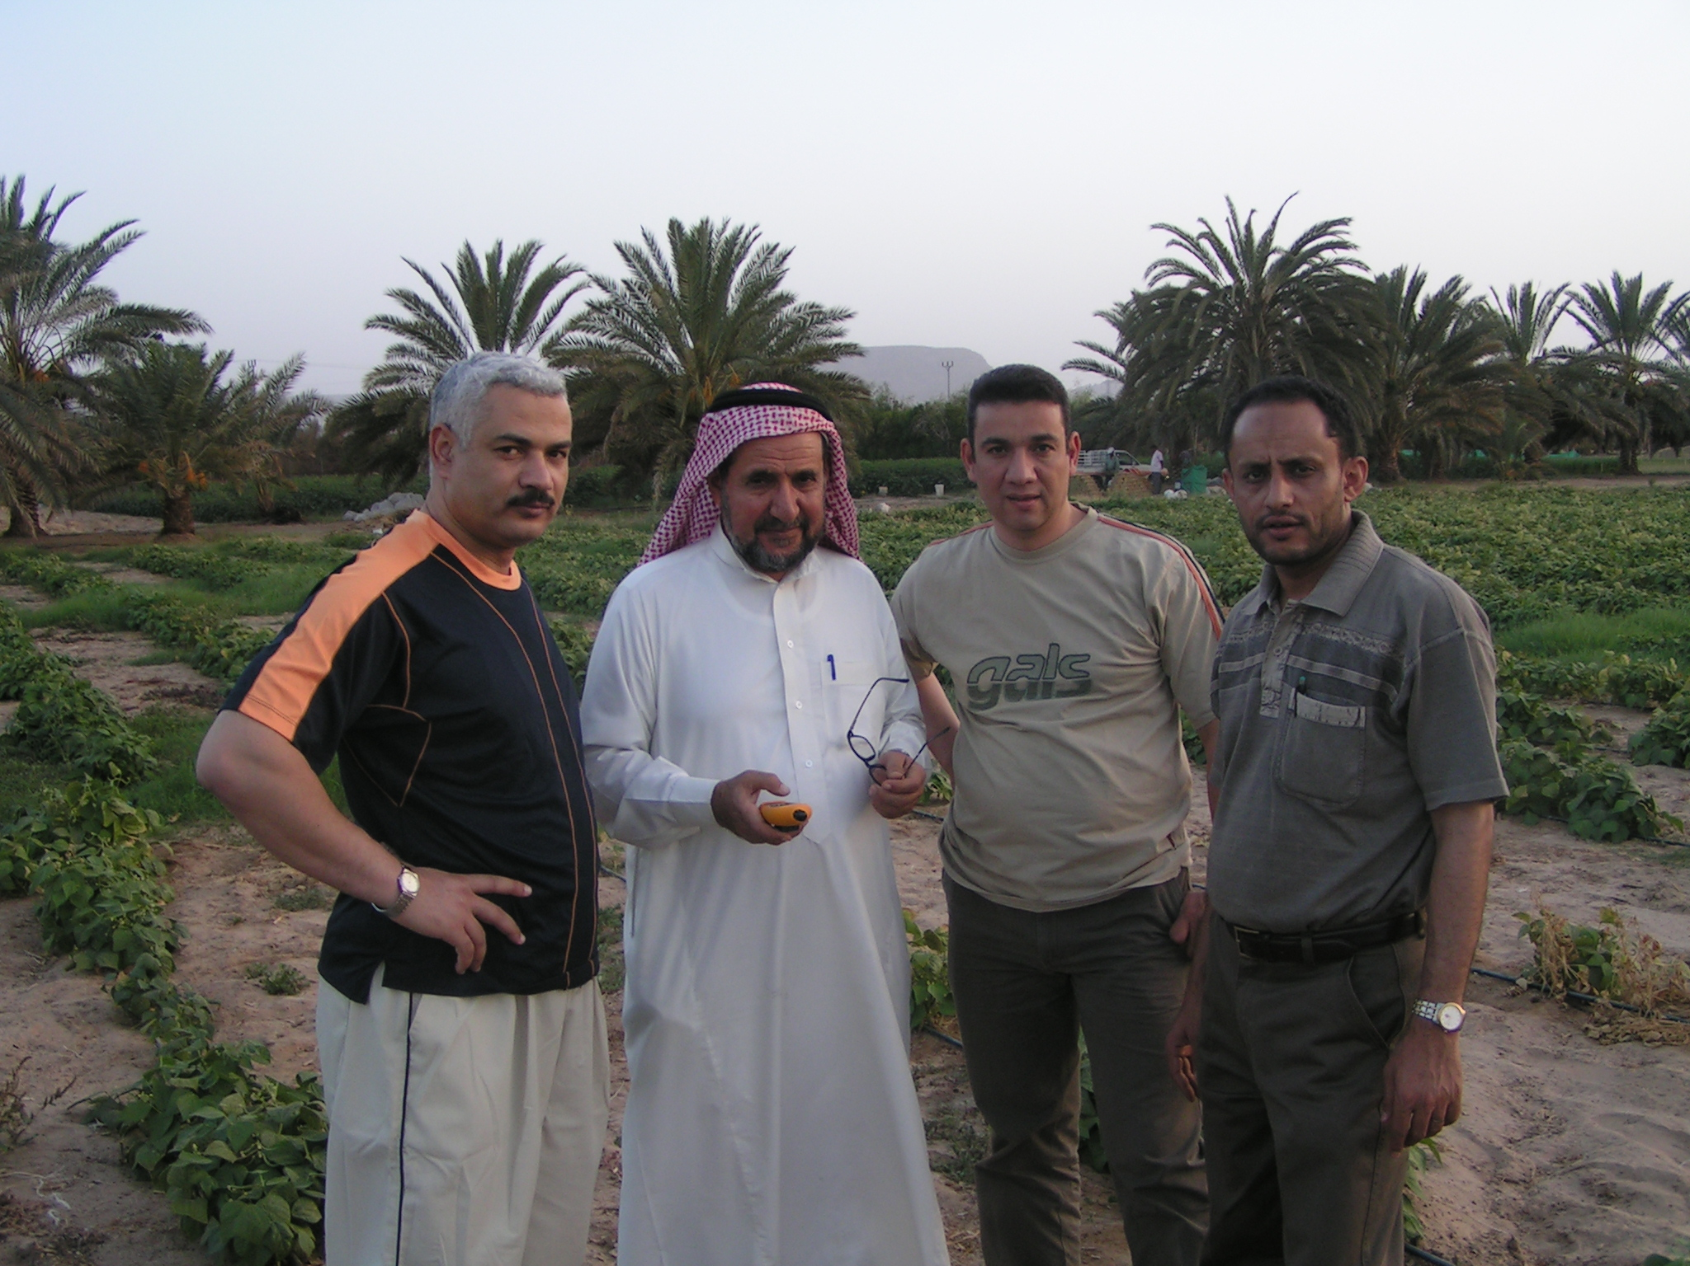
Collaborators
Prof. A. Alkhalifa
Dr. A. Mashaly
Dr. F. Almekhlafy

Slide 26
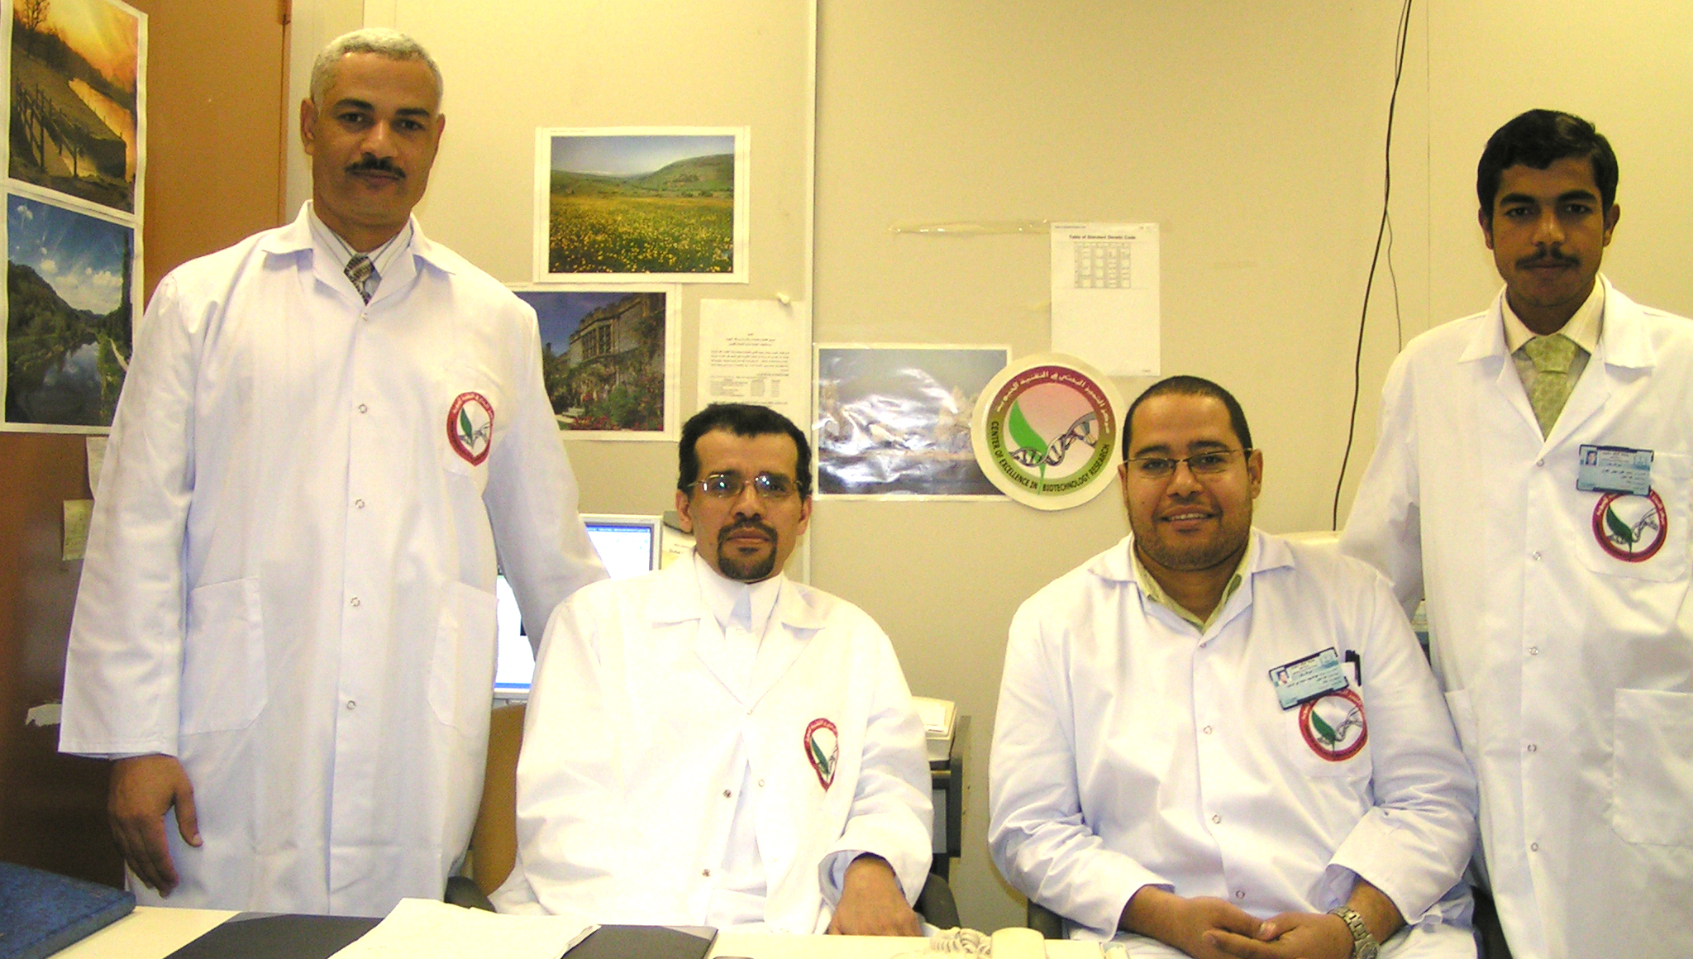
Collaborators
Prof. A. Alkedhairy
Dr. M. Abul-Sood
Mr. M. Mehany

Slide 27


Foreign collaborators
Dr. F. Trepet
Prof. E. D. Morgan

Slide 28
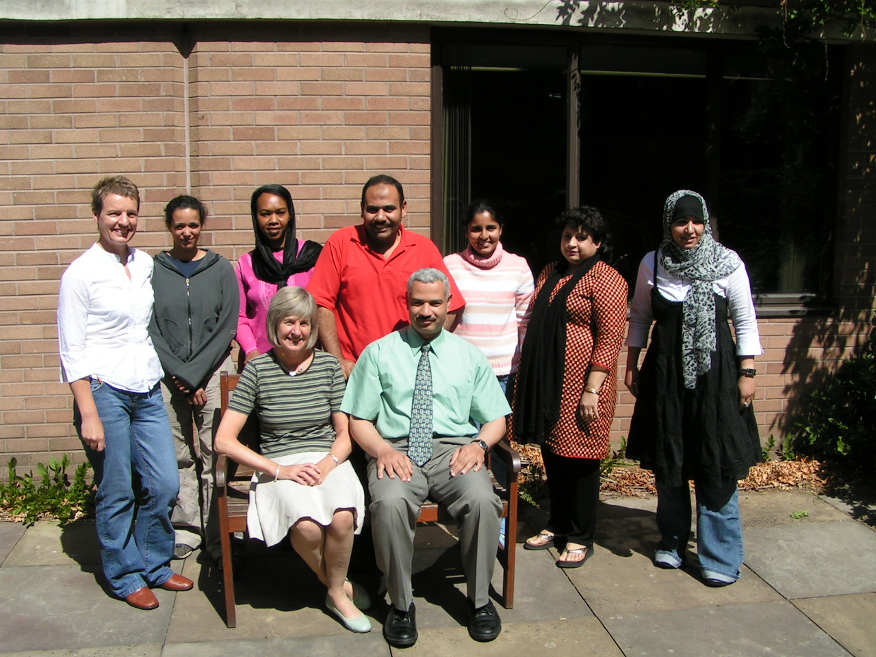
Collaborators

Slide 29
Acknowledgements
National Program at King Saud University, project number (11-MED-1848-02).
Thank you very much

