Slide 1
Population and family based association study on TPH1, TPH2 and ITGB3 genes indicate serotonergic system involvement in autism spectrum disorder
Asem Surindro Singh, Ph. D.
Email: asemsuren@gmail.com

Slide 2
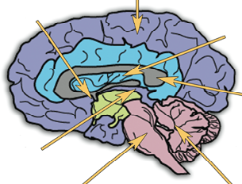
Introduction
ASD: childhood onset, genetic, neurodevelopmental disorder. (autism, asperger’s syndrom, PDD-NOS)
Behaviorally defined
Lack of social interaction
Lack of communication
Restricted, repetitive behaviors and interests.
Cerebral Cortex
Amygdala
Figure 1. Parts of brain affected by autism
Basal Ganglia
Corpus Callosum
Pic: Jacob Bartnett
Hippocampus
Brain stem
Cerebellum

Slide 3
High Prevalence: 1 in 68 children, (CDC, 2014).
Prevalence and cure: Urgently needed, pathophysiology unclear.
Concordance: 3 - 8% (dizygotic twins) and 69 – 95% (monozygotic twins) (Dawson G, 2008).
Serotonin system abnormality in ASD: Brain and peripheral
Serotonergic system: TPH1, TPH2, SLC6A4, SLC18A2, ITGB3.
Serotonin abnormality: Synthesis, degradation, transport.
Candidate gene association studies.
Present study: TPH1, TPH2 and ITGB3 genes
Two approaches: genetic association & gene-gene interaction
analysis.

Slide 4
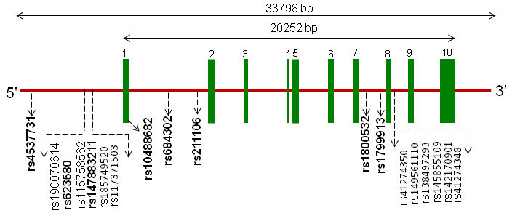
Figure 2. Diagrammatic representation of TPH1 showing the
location of the investigated SNPs.

Slide 5
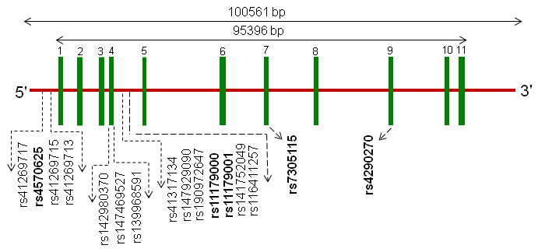
Singh AS et al., PROG NEURO-PSYCHOPH, 2014
Figure 3. Diagrammatic representation of TPH2 showing the
location of the investigated SNPs.

Slide 6
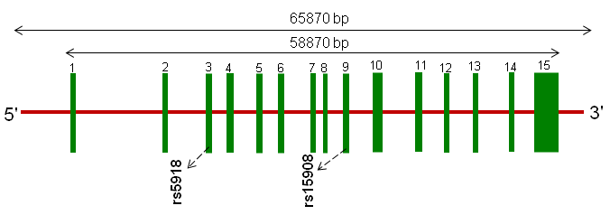
Singh AS et al., PROG NEURO-PSYCHOPH, 2014
Figure 4. Diagrammatic representation of ITGB3 showing the
location of the investigated SNPs.

Slide 7
Study Designs
Recruitment of subjects
Approval of human ethics committee
Blood collection
WBC separation
DNA extraction
Genotyping analysis
Genetic association studies
Gene-gene interaction analysis
Bioinformatics analysis

Slide 8
Results in brief
Table 1. Genotypic and allelic frequencies of ITGB3 and TPH2 Markers
SNP ID | Study group |  | Genotypic frequency |  |  | Allelic frequency |  | HWE χ² | p_ value
ITGB3
rs15908 |  |  | CC | CA | AA | C | A
 |  | Case (n = 139) | 0.20 | 0.58 | 0.23 | 0.48 | 0.52 | 3.740 | 0.053
 |  | Parent (n = 260) | 0.22 | 0.48 | 0.31 | 0.45 | 0.55 | 0.413 | 0.520
 |  | Control (n = 165) | 0.24 | 0.56 | 0.21 | 0.52 | 0.48 | 2.112 | 0.146
rs5918 |  |  | TT | TC | CC | T | C
 |  | Case (n = 139) | 0.76 | 0.23 | 0.01 | 0.87 | 0.13 | 0.043 | 0.834
 |  | Parent (n = 260) | 0.81 | 0.18 | 0.01 | 0.90 | 0.10 | 0.148 | 0.700
 |  | Control (n = 163) | 0.76 | 0.23 | 0.01 | 0.87 | 0.13 | 0.141 | 0.707
TPH2
rs4570625 |  |  | GG | GT | TT | G | T
 |  | Case (n = 136) | 0.56 | 0.32 | 0.13 | 0.72 | 0.28 | 6.892 | 0.008
 |  | Parent (n = 254) | 0.48 | 0.45 | 0.07 | 0.71 | 0.29 | 2.068 | 0.150
 |  | Control (n = 129) | 0.57 | 0.36 | 0.07 | 0.75 | 0.25 | 0.299 | 0.584
rs11179000 |  |  | AA | AT | TT | A | T
 |  | Case (n = 136) | 0.46 | 0.38 | 0.15 | 0.65 | 0.35 | 3.416 | 0.064
 |  | Parent (n = 252) | 0.45 | 0.44 | 0.11 | 0.67 | 0.33 | 0.099 | 0.752
 |  | Control (n = 131) | 0.44 | 0.45 | 0.11 | 0.66 | 0.34 | 0.000 | 0.998
rs11179001 |  |  | GG | GA | AA | G | A
 |  | Case (n = 136) | 0.68 | 0.30 | 0.03 | 0.82 | 0.18 | 0.009 | 0.923
 |  | Parent (n = 252) | 0.71 | 0.25 | 0.04 | 0.84 | 0.16 | 2.208 | 0.137
 |  | Control (n = 130) | 0.68 | 0.30 | 0.02 | 0.83 | 0.17 | 0.256 | 0.612
rs4290270 |  |  | TT | TA | AA | T | A
 |  | Case (n = 132) | 0.33 | 0.46 | 0.20 | 0.56 | 0.44 | 0.540 | 0.462
 |  | Parent (n = 245) | 0.31 | 0.48 | 0.21 | 0.55 | 0.45 | 0.201 | 0.653
 |  | Control (n = 125) | 0.31 | 0.48 | 0.21 | 0.55 | 0.45 | 0.140 | 0.707
rs7305115 |  |  | GG | GA | AA | G | A
 |  | Case (n = 131) | 0.33 | 0.44 | 0.24 | 0.55 | 0.45 | 2.087 | 0.148
 |  | Parent (n = 243) | 0.29 | 0.51 | 0.21 | 0.54 | 0.46 | 0.071 | 0.788
 |  | Control (n = 159) | 0.25 | 0.51 | 0.24 | 0.51 | 0.49 | 0.040 | 0.841

Slide 9
Table 2. Population wise data on the allele frequencies obtained from the HapMap dbSNP database and present study population from India
Population | TPH2 |  |  |  |  |  |  |  |  |  | ITGB3
 | rs4570625 |  | rs11179000 |  | rs11179001 |  | rs7305115 |  | rs4290270 |  | rs15908 |  | rs5918
 | G | T | A | T | G | A | A | G | A | T | C | A | C | T
ASW | 0.675 | 0.325 | NA | NA | 0.868 | 0.132 | 0.360 | 0.640 | NA | NA | 0.342 | 0.658 | 0.123 | 0.877
CEU | 0.792 | 0.208 | 0.784 | 0.216 | 0.912 | 0.088 | 0.357 | 0.643 | 0.285 | 0.715 | 0.336 | 0.664 | 0.137 | 0.863
CHB | 0.482 | 0.518 | 0.488 | 0.512 | 0.836 | 0.164 | 0.478 | 0.522 | 0.511 | 0.489 | 0.554 | 0.456 | 0.007 | 0.993
CHD | 0.445 | 0.555 | NA | NA | 0.839 | 0.161 | 0.583 | 0.417 | NA | NA | 0.628 | 0.372 | 0.005 | 0.995
GIH | 0.782 | 0.218 | NA | NA | 0.851 | 0.149 | 0.460 | 0.540 | NA | NA | 0.431 | 0.569 | 0.089 | 0.911
JPT | 0.504 | 0.496 | 0.456 | 0.544 | 0.894 | 0.106 | 0.434 | 0.566 | 0.411 | 0.589 | 0.504 | 0.496 | 0.011 | 0.989
LWK | 0.560 | 0.440 | NA | NA | 0.873 | 0.127 | 0.514 | 0.486 | NA | NA | 0.545 | 0.455 | 0.145 | 0.855
MEX | 0.675 | 0.325 | NA | NA | 0.836 | 0.164 | 0.509 | 0.491 | NA | NA | 0.379 | 0.621 | 0.112 | 0.888
MKK | 0.580 | 0.420 | NA | NA | 0.939 | 0.061 | 0.478 | 0.522 | NA | NA | 0.641 | 0.359 | 0.173 | 0.827
TSI | 0.750 | 0.250 | NA | NA | 0.911 | 0.089 | 0.475 | 0.525 | NA | NA | 0.426 | 0.574 | 0.162 | 0.838
YRI | 0.619 | 0.381 | 0.548 | 0.452 | 0.894 | 0.106 | 0.337 | 0.663 | 0.587 | 0.413 | 0.493 | 0.507 | 0.128 | 0.872
Study from INDIA | 0.750 | 0.250 | 0.660 | 0.340 | 0.830 | 0.170 | 0.550 | 0.450 | 0.510 | 0.490 | 0.520 | 0.480 | 0.130 | 0.870

Slide 10
Figure 5. Linkage analysis.

Slide 11
Figure 6. Multifactor dimensionality reduction test for case control

Slide 12
Table 3. MDR-phenomics analysis for TPH1 and TPH2 interaction
using all trio families
Marker combination | HR |  | LR |  | M (Fix P)
 | T | NT | T | NT
rs4537731-rs211106 | 58 | 31 | 67 | 88 | 37.1 (0.026)
rs623580-rs10488682 | 80 | 51 | 48 | 75 | 25.5 (0.043)
rs623580- rs4570625 | 54 | 30 | 71 | 93 | 31.0 (0.024)
rs623580- rs4290270 | 78 | 47 | 50 | 78 | 22.4 (0.050)
rs623580-rs1799913- rs4570625 | 69 | 35 | 56 | 88 | 52.7 (0.026)
rs623580- rs1799913- rs4290270 | 69 | 32 | 57 | 90 | 45.7 (0.041)

Slide 13
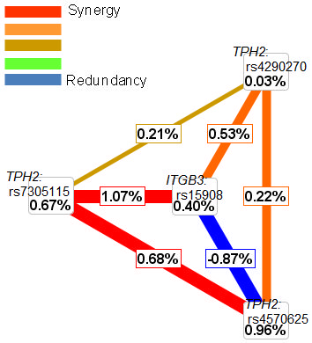
Figure 7. Radial diagram showing genetic interaction pattern
between the SNPs of the genes.

Slide 14
Figure 8. Bioinformatic analysis for protein-protein interaction

Slide 15
Table 4. Interacting proteins with the text mining scores resulted by online database
resource Search Tool “STRING”
Interacting Proteins | Text mining score
SLC6A4 and TPH1 | 0.956
TPH2 and SLC6A4 | 0.889
HTR2A and TPH2 | 0.908
HTR2A and TPH1 | 0.963
HTR2A and SLC6A4 | 0.926
ITGB3 and SLC6A4 | 0.960

Slide 16
Table 5. Transcription factor and transcription factor binding site changes due to single
nucleotide polymorphism
SNP ID | Alleles | TFB sites | TF | Score
rs4570625 | G | TAGAATA ← | CdxA | 85.7
 | T | AATTATA → | CdxA | 98.6
 |  | TATAATA ← | CdxA | 91.4
 |  | TATAATA → | CdxA | 91.4
rs11179000 | A | ACACGTGT → | USF | 94.1
 |  | ACACGTGT ← | USF | 94.1
 |  | GTACACGTGTTG → | N-Myc | 90.8
 |  | TGTACACGTGTTGA ← | USF | 88.2
 |  | TGTACACGTGTTGA → | USF | 88.2
 |  | GTACACGTGTTG ← | N-Myc | 87.6
 |  | GTACACGTGTTG → | c-Myc | 86.8
 |  | GTACACGTGTTG ← | MyoD | 86.0
 | T | NA | NA | NA
rs11179001 | A | ACTGGAAGCA → | c-Ets- | 90.2
 | G | ACTGGAAGCG → | c-Ets- | 89.2
 |  | ACTGGAAGCG → | NRF-2 | 86.0

Slide 17
Summary of the result
LD variation pattern was observed between the SNPs of case,
control and parents.
Pair-wise haplotype analysis showed under-expression of TPH2.
Pair-wise haplotype analysis reveal over-transmission ofTPH1.
MDR and MDRP showed significant interaction of TPH1 & TPH2
Indirect interaction of TPH1,TPH2 and ITGB3 was shown by
bioinformatic analysis; and the SNP markers were shown to have
functional (from low to moderate) role in gene regulation.

Slide 18
Conclusion
The present study using genetic association and gene-gene
interaction analyses of TPH1, TPH2 and ITGB3 variants
support the serotonergic abnormality in ASD.
The three genes are likely involve in the etiology of the
disorder.
However further studies using cellular and animal models
are required to validate the finding which may provide
some important information in the disease pathophysiology
and in the future therapeutic development of ASD.

