Slide 1
EVALUATION OF EOL/USED CELL PHONES MANAGEMENT & DISPOSAL ALTERNATIVES: AN ANP AND BALANCED SCORECARD APPROACH
By
ARVIND JAYANT
Associate Professor & Head
Department of Mechanical Engineering
Sant Longowal Institute of Engineering and Technology
(University under MHRD, Govt. of India) Longowal, Sangrur, Punjab, INDIA

Slide 2
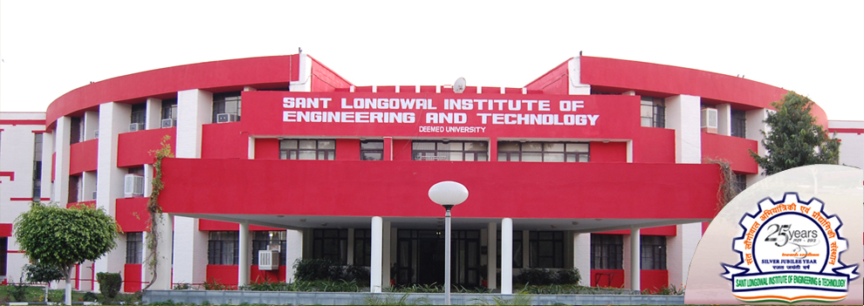

Slide 3
OUTLINES OF PRESENTATION
Introduction
Issues in mobile phone remanufacturing
Mobile phone remanufacturing process chain
Reverse logistics
The decision environment
Application of ANP Methodology
Balance Score Card
Discussion and managerial implications
Conclusions

Slide 4
REVERSE SUPPLY CHAIN MANAGEMENT
Reverse supply chain management (RSCM) is defined as the effective and efficient management of the series of activities required to retrieve a product from a customer and either dispose of it or recover value.

Slide 5
REVERSE LOGISTICS
Management of reduction and disposal
Reverse distribution
Collection of damaged or unsold products.
Recycling of used products.
The manufacturer takes responsibility for delivery as well as take-back.
Two reverse channels
Recycling / reuse (back to the suppliers).
Disposal (shipment of non-recyclable waste).
Suppliers
Supply Chain
Recycling / Reuse
Disposal
Customers

Slide 6
REVERSE LOGISTICS…………………
A reverse logistics system comprises a series of activities, which form a continuous process to treat return products until they are properly recovered or disposed of.
These activities include collection, cleaning, disassembly, test and sorting, storages, transport, and recovery operations.
The latter can also be represented as one or a combination of several main recovery options, like reuse, repair, refurbishing, remanufacturing, cannibalization and recycling[3-5]

Slide 7
REASONS FOR RETURNING USED PRODUCTS
End-of-Life Returns. These are returns that are taken back from the market to avoid environmental or commercial damage. These used products are often returned as a result of take back laws.
End-of-Use Returns. These are used products or components that have been returned after customer use. These used products are normally traded on an aftermarket or being remanufactured.
Commercial Returns. These returns are linked to the sales process. Other reasons for the returns include problems with products under warranty, damage during transport or
Product recalls.
Re-Usable Components. These returns are related to consumption, use or distribution of the main product. The common characteristic is that they are not part of the product itself, but contain and/or carry the actual product; an example for this kind of return is remanufactured toner cartridges [14].

Slide 8
REVERSE LOGISTICS DRIVERS
In the last decades, economic, legislative and social engaging incentives have driven industrial sectors and governments to become active in reverse logistics.
Economic incentives, because the implementation of reverse logistics represents direct incomes from reduced consumption of raw-materials, from adding value to recovered material and from cost reduction on waste treatment and/or disposal.
Legislative incentives, because the recent legislation addressing take-back responsibilities, recycling quotas and packaging regulations, that must be accomplished by companies. The engagement of companies with society and environmental issues also can generate incentives to manage return flows in a supply chain.
Marketing, competitiveness and strategic issues are other incentives for companies to become active in reverse logistics. All incentives are not mutually exclusive and might be present as a mixture in one industrial sector[10].

Slide 9
REVERSE LOGISTICS PRACTICES IN INDIA
Today, India is the fourth largest country in terms of purchasing power parity (PPP) and constitutes one of the fastest growing markets in the world [5]. However, RL is yet to receive the desired attention and is generally carried out by the unorganized sector for some recyclable materials such as paper and aluminum.
Some companies in consumer durables and automobile sectors have introduced exchange offers to tap customers who already own such products. The returned products are sold either as it is or after refurbishment by third parties. Ravi et al (2005) opine that reverse logistics, which is the ability to handle customer returns in one of the major challenges faced by the Indian industries.
The concerns to the environment have increased in the recent times with many Indian companies adopting ISO 14000 practices in their organization.
Also, legislations (E-Waste, Handling & Disposal Rules, 2012) has been implemented gradually for proper disposal of products for the cause of environmental concern. Thus reverse logistics is an issue which holds a great relevance for India companies.

Slide 10
PROBLEM EXPLANATION
Present work focused on the end-of-life options market for cell phones, and considered Indian legislations as well as global design trends that affect the economic and environmental outcomes of various management schemes.
The management of electronic waste is emerging as a global environmental problem due to the hazardous materials contained in electronic products and increasing consumption of these products. Cell phones are a unique niche in the e-waste stream not only because of their high rate of displacement by consumers, but also because they have viable reuse and recycling markets.
The main objective of this work is to recommend an optimal end-of-life (EOL) management strategy/option for cell phones within the Indian business environment.
In the present work five end-of-life management options for mobile phones has been considered:
Repair, Refurbishing & Reuse (RRR),
Cannibalization, Remanufacturing & Reuse (CRR),
Incineration with energy recovery for most of the elements & disposal to landfill for a few elements (INC),
Recycling of complete mobile phone for material recovery (REC) and :
Disposal of Whole Product to Landfill (LND).
Data was collected and analyzed in order to quantify the environmental and economic outcomes of the current market situation. Based on a literature survey, interview process and mobile phones industries field study, the key variables were determined and used to construct five scenarios which examine the market outcomes under different conditions using analytic network process analysis (ANP).

Slide 11
REVERSE LOGISTICS PRACTICES FOR EOL MOBILE PHONES: A CASE STUDY
The ANP model that is presented in this research has been evaluated for mobile phones manufacturing/remanufacturing industries, these industries were interested in the implementation of the reverse logistics operations for used mobile phones.
Due to the limited budget constraints, the industries wanted a systematic way to determine the best possible option for conducting the reverse logistics operations to used mobile phones.
The case experience helps us to understand in a better way the advantages and disadvantages of the methodology from a practical point of view. The analysis and the implementation of the ANP model are presented in the following nine steps.

Slide 12
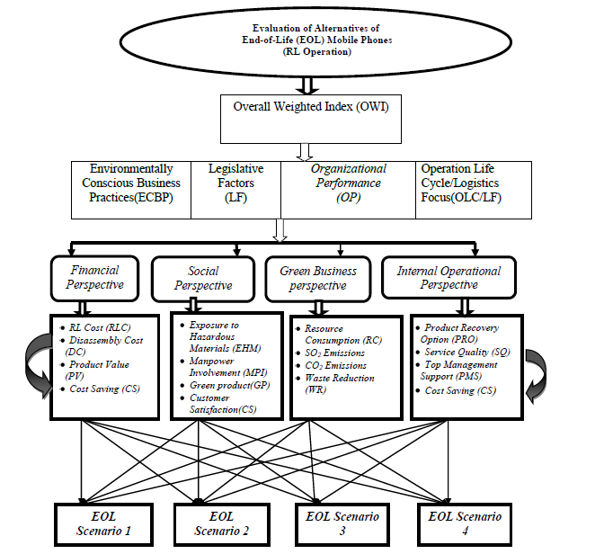
ANP Model for Reverse Logistics Operations for EOL Mobile phones

Slide 13
REMANUFACTURING STRATEGIES
SCENARIO 1: Repair, Refurbishing & Reuse (RRR) of Mobile Phone
SCENARIO 2: Cannibalization, Remanufacturing & Reuse (CRR) of Mobile Phone
SCENARIO3: Incineration with energy recovery (INC) for most of the elements & disposal to landfill for a few elements of the mobile phone
SCENARIO4: Recycling of complete mobile phone for material recovery (REC)
SCENARIO 5: Disposal of Whole Product to Landfill (LND)

Slide 14
ANALYTIC NETWORK PROCESS (ANP)MODEL
Analytic network process (ANP) based decision model presented in this work structures the problem related to options in reverse logistics for EOL mobile phones in a hierarchical form and links the determinants, dimensions, and enablers of the reverse logistics with alternatives available to the decision maker.
In the proposed model, uncertainties regarding quantity and conditions of mobile phones, reliability of capacities, processing times, and demand are considered. The few dimensions of reverse logistics for the EOL mobile phones have been taken from four perspectives derived from balanced scorecard approach, viz. finance, social, green business and internal operational perspective.
The present approach links the financial and non-financial, tangible and intangible, internal and external factors, thus providing a holistic framework for the selection of an alternative for the reverse logistics operations for EOL cell phones. Many criteria, sub-criteria, determinants, etc. for the selection of reverse manufacturing options are interrelated.
The ability of ANP to consider interdependencies among and between levels of decision attributes makes it an attractive multi-criteria decision-making tool. Thus, a combination of balanced scorecard and ANP-based approach proposed in this work provides a more realistic and accurate representation of the problem for conducting remanufacturing logistics operations for EOL cell phones.

Slide 15
BALANCE SCORECARD APPROACH
In the present work author inherit the few dimensions of the balanced score card, which allow the managers to look at the business from four important perspectives, namely, financial perspective, social perspectives, green business perspective and internal operation business perspectives (Kaplan & Norton, 1992). Although Kaplan & Norton has been used the concept of balanced scorecard primarily designed for the measurement of the system performance, in present model, we have used these dimensions to evolve a holistic framework towards the conduct of reverse logistics operations for EOL mobile phones

Slide 16
Table Data Collection for the EOL Scenario Evaluation for Mobile Phones
Attributes (For Non-tangible attributes) : on 1-5 scale:1for very high, 5 for very low) | S1 | S2 | S3 | S4 | S5 Due to legislation restrictions, this scenario is not possible, hence eliminated.
Reverse Logistics Cost (Rs.) | 75 | 85 | 65 | 70
Disassembly Cost (Rs.) | 200 | 300 | 300 | 350 | ---------
Product Value | 1 | 2 | 3 | 1 | --------
Product Cost | 4 | 3 | 4 | 2 | ---------
Manpower Involvement | 3 | 2 | 4 | 1 | ----------
Exposure to Hazardous materials | 5 | 4 | 2 | 3 | -----------
CO₂ Emissions | 5 | 4 | 1 | 2 | -----------
SO₂ Emissions | 5 | 4 | 1 | 1 | ----------
Waste Reduction (WR) | 1 | 2 | 3 | 4 | -------------
Cost Saving (CS) | 1 | 3 | 4 | 2 | ------------
Product Recovery Option (PRO) | 2 | 3 | 5 | 3 | ---------
Resource Consumption (RC) | 4 | 3 | 2 | 1 | ------------
Customer Satisfaction(CS) | 1 | 2 | 5 | 4 | -----------
Service Quality (SQ) | 2 | 1 | 4 | 3 | --------
 |  |  |  |  | ------------

Slide 17
ANP ANALYSIS AND SOLUTION METHODOLOGY
Step 1: Model construction and problem structuring
Steps 2: Pair wise comparisons matrices between component/ levels
Steps-3 Pair wise comparison matrices of interdependencies
Step-4 Super matrix formulation and analysis
Step-5 Pair wise comparison for different alternatives
Step-6: Selection of best alternative
Step –7 Relative importance weight for the relationship
Step-8 Calculation of RL performance weighted index

Slide 18
The matrix showing pair-wise comparison of determinants along with the e-vectors of these determinants
DETERMINENTS | ECBP | LF | OP | OLC/LF | E-VECTER
ECBP | 1 | 1/5 | 1/5 | 1/4 | 0.0656
LF | 5 | 1 | 1 | 2 | 0.3638
OP | 5 | 1 | 1 | 2 | 0.3638
OLC/LF | 4 | 1/2 | 1/2 | 1 | 0.2069
CR= 0.011

Slide 19
PAIRWISE COMPARISION FOR DIMENSIONS
Pair wise Comparison for dimensions under Environmentally Conscious Business Practices (ECBP)
ECBP | FP | SP | GBP | IOP | E-VECTER
FP | 1 | 2 | 3 | 1 | 0.3507
SP | ½ | 1 | 2 | 1/2 | 0.1892
GBP | 1/3 | 1/2 | 1 | 1/3 | 0.1093
IOP | 1 | 2 | 3 | 1 | 0.3507
CR= 0.0039

Slide 20
Pair-wise Comparison for Green Business Perspective under Environmentally Conscious Business Practices(ECBP) determinant
ECBP/GBP | RC | SO2 | CO2 | WR | E-VECTER
RC | 1 | 3 | 5 | 1 | 0.3935
SO2 | 1/3 | 1 | 2 | 1/3 | 0.1376
CO2 | 1/5 | 1/2 | 1 | 1/5 | 0.0754
WS | 1 | 3 | 5 | 1 | 0.3935
CR=0.0016

Slide 21
Table Reverse Logistics overall weighted Index
It is observed from Table that EOL-S1 (Repair, Refurbishing & Reuse (RRR) of Mobile Phone ) is the most-suited alternative for the reverse logistics operations for used mobile phones for the mobile manufacturing/remanufacturing industries. Alternatives EOL-S4, EOL-S2 and EOL-S3 in sequence follow alternative EOL-S1 respectively.
It is observed from Table that legislative factors and operating performance factors plays a major role in the conduct of reverse logistics operations for used mobile phones.
It is further observed from the second column of this table that EOL-S1 (0.1078929) performs business in the more environmentally conscious RL operation as compared to EOL-S2 (0.0871902), EOL-S3 (0.038042) and EOL-S4 (0.071449).
Logistics overall weighted Index
Alternatives | ECBP | LF | OP | OLC/LF | LOW I | Normalized values for LOW I
Weights | 0.0656 | 0.3638 | 0.3638 | 0.2069
EOL-S1 | 0.1078929 | 0.1981808 | 0.1030396 | 0.1078929 | 0.138985 | 0.3403
EOL-S2 | 0.0871902 | 0.1242377 | 0.0788480 | 0.0871902 | 0.097642 | 0.2391
EOL-S3 | 0.038042 | 0.067707 | 0.040589 | 0.038042 | 0.049765 | 0.1218
EOL-S4 | 0.071449 | 0.187266 | 0.09468 | 0.071449 | 0.122042 | 0.2988

Slide 23
RESULTS AND CONCLUSIONS
The proposed methodology provides for simplification of a complex multi-criteria decision-making problem.
It may also be used to quantify many subjective judgments, which are necessary to evaluate different EOL mobile remanufacturing alternatives/strategies.
Another advantage of this methodology is that it not only supports group decision-making but also enables us to document the various considerations in the process of decision making.
In this study, the results indicate that EOL Scenario 1 (Repair, Refurbishing & Reuse (RRR) of Mobile Phone) is the best End-of-life remanufacturing strategy for mobile phones collected by the case company.
This option may be attributed to its more environmentally conscious business practices (ECBP), legislative factors, and organizational performance and operation life cycle/logistics focus capabilities.
The option of EOL-S4 (Recycling of complete mobile phone for material recovery) in the framing of environmentally conscious business practices (ECBP), legislative Factors and operation life cycle/logistics focus capabilities policy also supports this result.
It is pertinent here to discuss the priority values of the dimensions, which influence this decision. From Table 50 , it is observed that financial perspective (0.3507) and internal operation performance (0.3507) is found to be equal and most important dimensions in the selection of an EOL Scenario for used mobile phones. It is followed by social perspective SP (0.1892) and Green business perspective (0.1093).

Slide 24
FUTURE SCOPE OF WORK
For future research, it would be worthwhile to implement the ANP model with a decision maker or a set of decision makers. Such research endeavour could be used to validate the effectiveness of the ANP model.
More importantly, managerial implications can be empirically derived regarding the selection of best remanufacturing strategy/option for used mobile phones collected by the concerned companies. Such research should include a comprehensive sensitivity analysis to examine the significance of individual attributes to the selection decision.
It is also worthwhile to compare the proposed ANP approach with other evaluation approaches. Here ANP approach illustrated in this paper has a few limitations as well.
For example, the model result efficiency is dependent on the inputs provided by the reverse logistics manager of the particular industry segments. The possibility of bias of the decision-maker towards any particular strategy/option cannot be ruled out while applying this model.
Therefore, group decisions should be preferred in the pair-wise comparison. Moreover, the formation of pair-wise comparison matrices is a time-consuming and tedious task. Inconsistency and human error may also occur in calculating the pair-wise comparison of matrices, which may give wrong results.

Slide 25
REFERENCES
Franke, C., B. Basdere, M. Ciupek, and S. Seliger; "Remanufacturing of Mobile Phones—Capacity, Program and Facility Adaptation Planning" Omega, 2004
Kaplan, R. S., & Norton, D. P. (1992). The balanced scorecard—Measures that drive performance. Harvard Business Review, 70(1), 71–79.
Directive 2002/96/EC of the European Parliament and of the council on waste electrical and electronic equipment (WEEE) of 27 January, 2003.
Westkämper E, Alting L, Arndt G. Life cycle management and assessment, approaches and visions towards sustainable manufacturing. Annals of the CIRP 2000; 49/2:501–26.
Fleischmann M. Quantitative models for reverse logistics. Berlin: Springer Verlag; 2001. p. 11–5.
Kharif O. Where recycled cell phones ring true. Business Week Online, 07-25-2002.
Marcussen CH. Mobile Phones, WAP and the Internet—The European Market and Usage Rates in a Global Perspective 2000–2003. http://www.crt.dk/uk/staff/chm/wap.htm, 11-25-2003.
Ba dere B, Chan K, Morrow R, Prasitnarit A, Seliger G, Skerlos S. Economic and environmental characteristics of global cellular telephone remanufacturing. In: Proceedings of the IEEE international symposium on electronics & environment, Boston, 2003.
Seliger G, Ba dere B, Ciupek M, Franke C. Remanufacturing of cellular phones. In: CIRP Seminar on Life Cycle Engineering, Copenhagen, 2003.
Seliger G, Ba dere B, Keil T, Rebafka U. Innovative processes and tools for disassembly. Annals of the CIRP 2002; 51/1: 37–40.
Kim HJ, Lee DH, Xirouchakis P, Züst R. Disassembly scheduling with multiple product types. Annals of CIRP 2003; 52/1:403–6.
Hentschel C, Seliger G, Zussman E. Grouping of used products for cellular recycling systems. Annals of the CIRP 1995; 41/1:11–4.
Meade L M, Sarkis J. Strategic analysis of logistics and supply chain management systems using the analytic network process. Logistics and Transportation Review 1998; 34(2): 201–15.

Slide 26
CONTINUE..
14. Saaty TL. The analytic hierarchy process. New York, NY: McGraw-Hill; 1980.
15. Saaty TL. Decision making with dependence and feedback: the analytic network process. Pittsburgh, PA: RWS Publications; 1996.
16. Sarkis J. Evaluating environmentally conscious business practices. European Journal of Operational Research 1998; 107:159–74.
17. Sarkis J. Manufacturing strategy and environmental consciousness. Technovation 1995; 15(2):79–97.
18. Thompson TJ. An analysis of third party logistics and implications for USAF logistics. Unpublished Masters Thesis, Air Force Institute of Technology/GTM/LAL/96S-15, September, Wright-Patterson Air Force Base, Ohio, 1996, submitted.
19. Thomas L. Saaty, the Analytic Hierarchy Process, RWS Publications, Pittsburg, 1990, pp. 184–192.
20. Thomas L. Saaty. Fundamentals of the Analytic Network Process. ISAHP Japan, 1999, pp. 12–14.
21. Saaty L. Thomas, Niemira P. Michael, An analytical network process model for financial-crisis forecasting, Int. J. Forecasting 20(2004) 573–587.
22. Saaty TL. Theory and applications of the analytic network process: decision making with benefits, opportunities, costs, and risks. USA: RWS Publications; 2005.
23. V. Ravi, Ravi Shankar, M.K. Tiwari (2005). Analyzing alternatives in reverse logistics for end-of-life computers: ANP and balanced scorecard approach” Computers & Industrial Engineering 48 (2005) 327–356
24. Gopal Agarwal and Lokesh Vijayvargy (2012) Green Supplier Assessment in Environmentally Responsive Supply Chains through Analytical Network Process, proceedings of International multi-conference for engineers & computer scientists, Volume II, March 12-14, 2012, Hongkong.
25. Amini M, Retzalff-Roberts D, Bienstock C., 2005. Designing a reverse logistics operation for short cycle time repair services. International Journal of Production Economics. 96:367–80.

Slide 27
Thanks!

