Slide 1
Management of Female Stress Incontinence
Dr. Arvind Goyal
Associate Professor
(Urology& Renal Transplant)
Dayanand Medical College & Hospital, Ludhiana, Punjab, India

Slide 2
Stress Incontinence
“Involuntary loss of urine, objectively demonstrable & social or hygienic problem”

Slide 3
Female Stress Urinary Incontinence
Significant impact on women's lives
Result in negative body image & reduced self esteem.
70% patients do not seek professional.
Combination of embarrassment & belief that SUI is natural consequence of ageing and childbirth .

Slide 4
Increased Intra-abdominal Pressure:
Pregnancy
Pulmonary disease – smokers cough
Constipation/straining
Lifting – work and home
Exercise
Obesity

Slide 5
Basic Evaluation of UI
History: Bladder diary
Physical examination, especially genitourinary & neurological.
Bladder stress test
Postvoid residual
Urinalysis, urine culture if indicated
BUN, Creatinine, Fasting glucose

Slide 6
CAUSES OF PERSISTANT
UI
Stress
Urge/OAB
Functional
Overflow

Slide 7
Stress UI
Abrams P et al. Urology. 2003;61:37-49.
The complaint of involuntary leakage with effort or exertion or on sneezing or coughing
Sudden increase in
abdominal pressure
Urethral pressure

Slide 8
Urge UI
Abrams P et al. Urology. 2003;61:37-49. Ouslander J. N Engl J Med. 2004;350(8):786-799.
The complaint of involuntary leakage accompanied by or immediately preceded by urgency
Involuntary detrusor
contractions
Urethral pressure

Slide 9
Overactive bladder
Includes urinary urgency with or without urge incontinence, urinary frequency, and nocturia
Associated with involuntary contractions of the detrusor muscle

Slide 10
Mixed UI
Abrams P et al. Urology. 2003;61:37-49. Chaliha C et al. Urology. 2004;63:51-57.
The complaint of involuntary leakage associated with urgency and also with exertion, effort, sneezing, or coughing
Sudden increase in
abdominal pressure
Involuntary detrusor
contractions
Urethral pressure

Slide 11
Investigations
Midstream urine sample
To check for disease, infection
Renal Ultrasound
To check the ureters and residual urine.
Problems such as bladder tumours or fibroids, which can obstruct the urinary tract.
X-ray
Detecting kidney or bladder stones.

Slide 12
Investigations
Cystoscopy –To detect any inflammation, stones or growths in the bladder or any obstructions in the urethra.

Slide 13
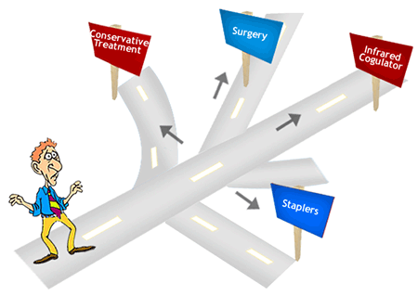
Treatment Options
Behavioral
Pharmacological
Exercises
Surgery

Slide 14
Self Management
Fluid Intake
Don’t reduce amount
Do not drink fluids 2 hr before bedtime
Avoid: caffeine, alcohol, nicotine

Slide 15
Bladder Training
Scheduled voiding with systematic delay of voiding
Schedule based on time interval
Void at scheduled time even if urge not present
Suppress urge if not time with“Quick Kegels”
Increase voiding interval by 30 min each week until continent for up to 4 hr

Slide 16
Drug treatment for urgency/OAB
Darifenacin
Solifenacin
Tolterodine
Trospium

Slide 17
(Kegel Exercises) Pelvic floor exercises
Designed to strengthen the pelvic floor muscles through actively tightening and lifting them at intervals.
Strong, well-activated pelvic floor muscles help support the bladder, uterus and bowel
Allows urethral sphincter to function properly.

Slide 18
Pelvic floor muscles strengthening

Slide 19
Pelvic Floor Muscle Exercises
Randomized trials for behavioral treatment
Pelvic Floor exercises were very effective, upto 75% in reducing symptoms

Slide 20
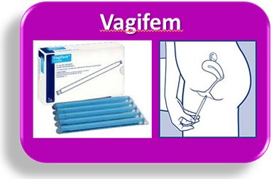
Local Estrogen Therapy

Slide 21
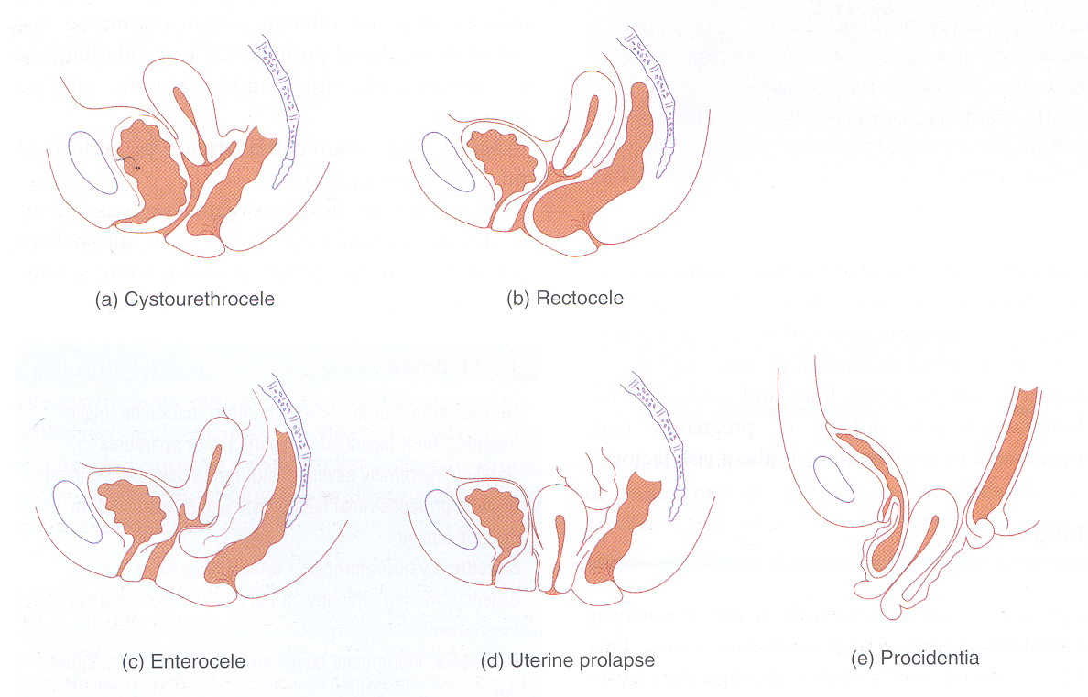
Vaginal Pessaries

Slide 22
Vaginal Pessaries
Women who have incontinence as a result of genital prolapse ,but surgery or other treatments are unsuitable.
Help re-position the bladder and urethra, limiting the leakage of urine.
Do not deal with the underlying cause of the incontinence.
Can cause irritation and increase the risk of urinary infections.

Slide 23
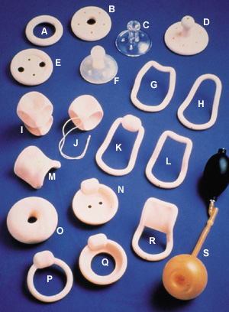

Slide 24
Minimally invasive treatments
Bladder distension, urethral dilatation
Botox injections to bladder wall
Urethral bulking injections

Slide 25
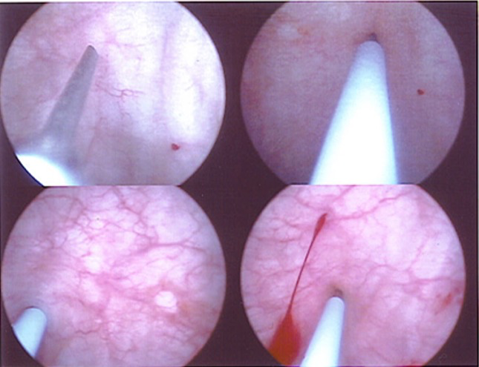

Slide 26
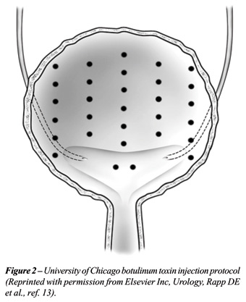
Bladder Botox Injections

Slide 27
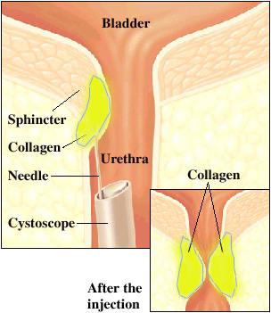
Urethral injections

Slide 28
Urethral injections
Collagen, fat or synthetic materials injected into the tissues around the urethra to ‘bulk up’ the area & tighten the seal of the urethra.
Urethral injections may need to be topped up and can be costly.
Alternative to surgical treatment.

Slide 29
Urodynamic Assessment
Appropriate for women who have a combination of urge & stress incontinence.
Should always be performed before any surgical intervention is planned.

Slide 30
TVTO
A piece of fascia or mesh tape is placed under the urethra like a hammock to support it.
Out patient procedure
Mostly under regional anaesthetic.

Slide 31
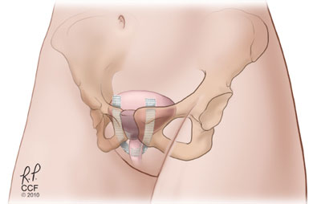

Slide 32
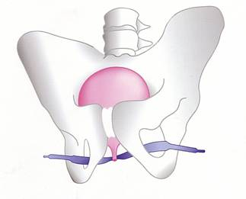
Trans Obturator Tape

Slide 33
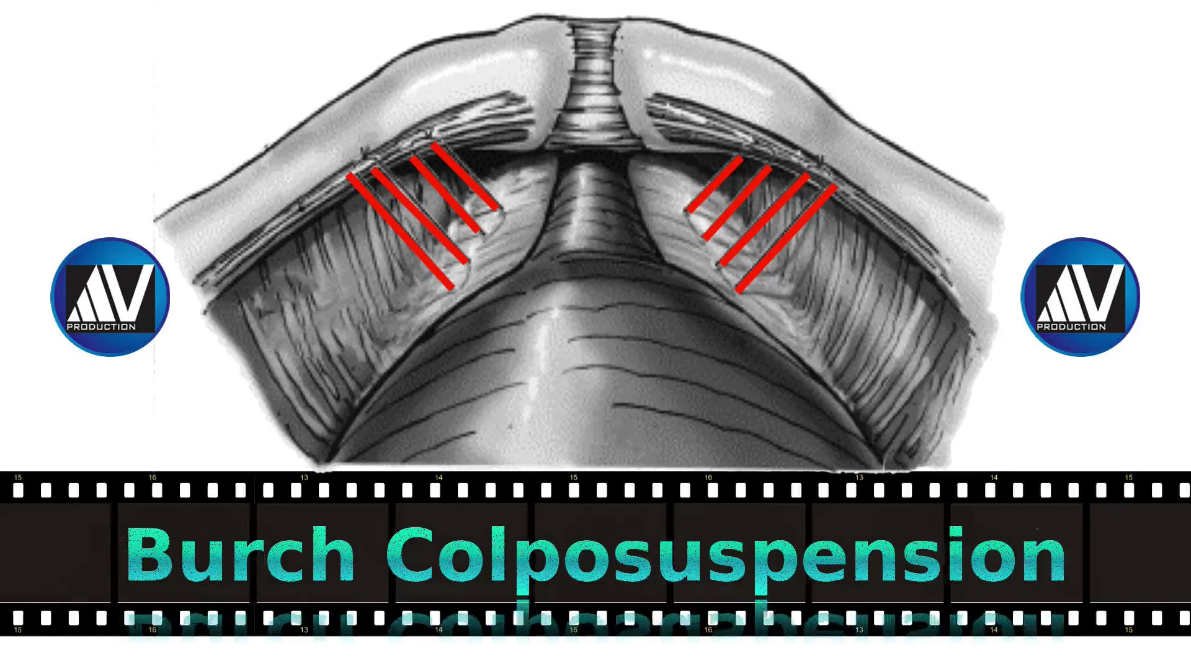

Slide 34
Burch Colposuspension
Bladder neck lifted back to its proper position.
The front wall of the vagina is lifted & stitched to strong ligaments near pubic bone.
Abdominally or laparoscopically

Slide 35
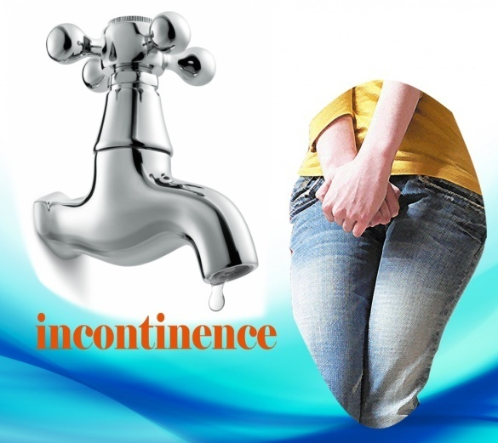

Slide 36
Summary
Behavioral treatment is effective for treating stress and urge UI and OAB.
Drugs are effective
Minimally invasive procedures available.
Surgery after careful evaluation.

