Slide 1
Clinical and experimental studies on theophylline toxicity: in search for and antidote
Arunabha Ray
Department of Pharmacology
Vallabhbhai Patel Chest Institute
University of Delhi, Delhi-110 007, India
Toxicol-2014, Chicago

Slide 2
Methylxanthines
Methylxanthines have been effectively used therapeutically in respiratory disorders, e.g. COPD, asthma, cor pulmonale, apnea in newborns, etc.
Caffeine (Tea/Coffee) and theophylline (as a drug) commonly used
Theophylline, a methylxanthine bronchodilator, given for asthma and COPD, and newer uses emerging
Steroids are the first line of drugs for asthma but are given along with bronchodilators like theophylline to reduce their dosage and reverse steroid resistance
Theophylline is an effective, pharmacoeconomically viable drug, but has a narrow therapeutic index, i.e. low margin of safety

Slide 3
Theophylline…
Toxicity profile includes cardiotoxicity, GI toxicity and CNS toxicity
Susceptibility to cardiac arrhythmias and seizures is particularly increased in asthmatics in extremes of age
Cardiac arrhythmias and seizures not preceded by milder warning symptoms and conventional anti consultants are only partially effective against these seizures
However, in view of its recently demonstrated anti-inflammatory and immunomodulatory effects, it is re-emerging as an important adjunct to therapy in asthma and COPD
Strategies are being devised to improve the safety profile

Slide 4
Theophylline……
Adenosine antagonism and PDE inhibition are commonly proposed mechanisms of action of theophylline
CV effects due to increased vascular tone, myocardial contractility, conduction and sympathetic nervous system
A combination of hemodynamic and neurohumoral effects
Chronic methylxanthine intake increases CNS and cardiac risk factors
Mechanisms of such toxicity poorly understood

Slide 5
PHARMACOVIGILANCE
The science and activities relating to the detection, assessment, understanding and prevention of adverse effects or any other drug-related problems
A tool for drug safety
Primarily a regulatory issue, but data/concept may to extended to device pharmacological strategies for rational therapy

Slide 6
ADR monitoring in Asthma and COPD
120 patients of bronchial asthma and COPD were selected from the VPCI OPD
Ethical clearance and GCP guidelines
Standard inclusion/exclusion criteria
Diagnosed by clinical features and PFT findings
ADR profile was recorded as per Pharmacovigilance Programme of India proforma
Dechallenge and rechallenge were done wherever appropriate
Causality Assessment was done by using the Naranjo`s scale

Slide 7
ADR profile with drugs in asthma and COPD
Drugs | Br. Asthma | COPD | Profile
Inhaled steroids | 54/60 (90%) | 30/60 (50%) | Sore throat,dysguesia,hoarseness,gloss-itis, others
Inhaled anticholinergics | 25/40 (62%) | 10/44 (23%) | Dry mouth,thirst, urinary difficulty
Inhaled beta-2 agonists | 25/60 (43%) | 3/60 (5%) | Hand tremors, palpitations
Oral steroids | 28/32 (87%) | 3/14 (21%) | Wt. gain, acne, cramps, mood changes
Oral theophylline | 14/20 (70%) | 20/43 (46%) | Anxiety, dyspepsia, ms spasm, paresthesia, etc

Slide 8
ADR monitoring in OAD…
Sex distribution of patients were equal in asthma whereas COPD patients were predominantly males
All patients received multi-drug treatment schedules (inhalation and oral)
Most patients received inhaled steroids and bronchodilators
Few received mucolytics, antibiotics, analgesics, etc.

Slide 9
Prescription monitoring in obstructive airway disease (theophylline)
Prescriptions | Total No. | With theophylline | %
All patients | 120 | 63 | 52.6
Br. Asthma | 60 | 20 | 33.3
COPD | 60 | 43 | 71.6

Slide 10
ADR incidence with theophylline
Patients | Received Theophylline | Showed ADRs | %
Br. Asthma | 20 | 14 | 70
COPD | 43 | 20 | 46.5
Total | 63 | 34 | 53.9

Slide 11
Incidence of ADRs with theophylline in asthma and COPD
ADR | Asthma | COPD
Dyspepsia | 45% | 65%
Anxiety/Palpitation | 50% | 60%
Spasm of Muscles | 35% | 30%
Insomnia | 40% | 10%
Dizziness | 15% | 10%
Theophylline Withdrawal Induced Constipation | - | 5%
Paraesthesia | 20% | 10%
Others | 10% | 5%

Slide 12
CASUALITY ASSESSMENT OF ADRs DUE TO ORAL
THEOPHYLLINE USING THE NARANJO’S SCALE
Drug | Highly Probable (9) | Probable (5-8) | Possible (1-4) | Doubtful (0)
Oral Theophylline | Muscle spasm of calves (most commonly) sternocleido-mastoid, intercostal muscles | Dyspepsia Insomnia (3) Anxiety & Palpitation (4)Dizziness (5)Withdrawal induced Constipation (6)Paraesthesia (7)Colicky Pain (8)Diuresis

Slide 13
Summary
Most ADRs were mild to moderate in nature and tolerable
Few, particularly those related to oral steroids and theophylline, were intolerable and required dose reduction
Causality assessment showed that most were in the probable category (score from 5 - 8)
Some effects of oral theophylline and steroids
were having scores > 9 (highly probable)
Such focused studies are helpful in reducing ADRs in OAD and rationalizing drug therapy

Slide 14
Reverse Pharmacology
Experimental evaluation/documentation of clinically observed findings
Reverse pharmacology is an alternative strategy for new drug development
Reverse pharmacology can play an important role in safety pharmacology studies
A practice which was successfully employed in the past (eg. Reserpine) and is being more scientifically implemented now

Slide 15
Reverse pharmacology studies: Basis
The role of oxidant/anti-oxidant balance in obstructive airway disease has been proposed
Oxidative stress and drug toxicity connection: adriamycin, paracetamol, etc.
A connection between theophylline and oxidative stress: OFRs formed during xanthine-XO interactions
Earlier studies showed that theophylline induced seizures were attenuated by antioxidants
Preclinical study planned to evaluate the MOA of Theophylline induced ADRs viz. anxiety and tachycardia

Slide 16
Effects of anti-oxidants on Aminophylline induced Anxiety
-----------------------------------------------------------------------------------
Treatment Elevated Plus Maze (%)
(mg/kg) OA entry OA time
--------------------------------------------------------------------------
Vehicle 30.0 ± 5.6 23.2 ± 3.6
Amino (50) 16.6 ± 4.2* 13.3 ± 2.8*
Amino (100) 9.0 ± 1.3* 5.3 ± 1.1*
TP(40)+Amino(100) 22.2 ± 7.0 15.2 ± 5.0
Mel(50)+ Amino(100) 18.7 ± 6.5ª 12.1 ± 4.6 ª
--------------------------------------------------------------------------
n=8/ group ; TP: tocopherol; Mel: melatonin
* p< 0.05 (compared to vehicle)
ª. p<0.05(compared to Amino-50)

Slide 17
Aminophylline (A) induced anxiety and oxidative stress markers
Treatment (mg/kg) | EPM (%OAE) | Brain MDA nmol/mg pr. | Brain GSH μmol/g tissue
Controls | 23.6 ± 3.1 | 5.2 ± 0.5 | 9.8 ± 0.3
A (100) | 9.0 ± 1.3 * | 8.2 ± 1.2 * | 6.7 ± 0.8 *
A (50)+ RS | 4.0 ± 1.2 * | 7.6 ± 0.4 * | 4.9 ± 0.4 *
TP + A (100) | 17.1 ± 4.4 | 5.0 ± 0.2 | 8.0 ± 0.3
Mel + A (100) | 22.6 ± 3.8 | 4.2 ± 0.5 | 7.6 ± 0.5

Slide 18
Effects of aminophylline on Mean B.P and Heart rate
Treatment (mg/kg) | Mean B.P(mm Hg) | Heart rate(BPM)
Controls | 70.96 ± 2.30 | 413.79 ± 5.60
Aminophylline (50) | 81.00 ± 6.45 | 402.90 ± 8.52
Aminophylline (100) | 80.18 ± 3.33 | 480.00 ± 6.15 *
Aminophylline (150) | 91.66 ± 7.20 * | 531.00 ± 16.66 *

Slide 19
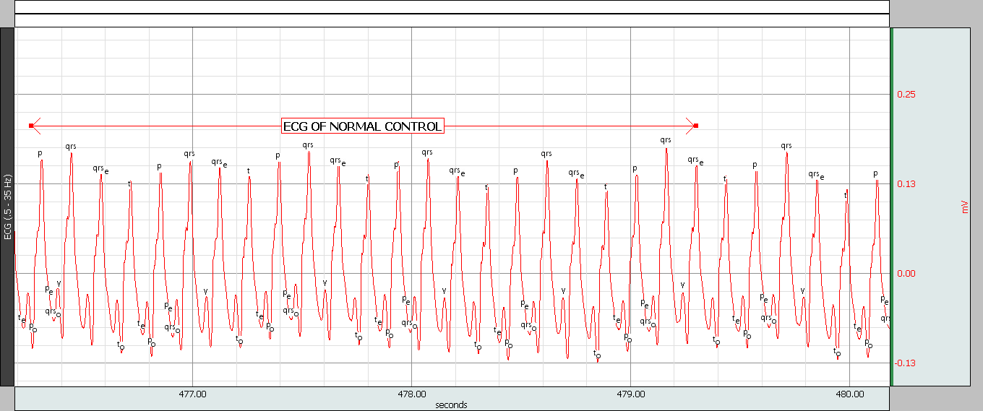
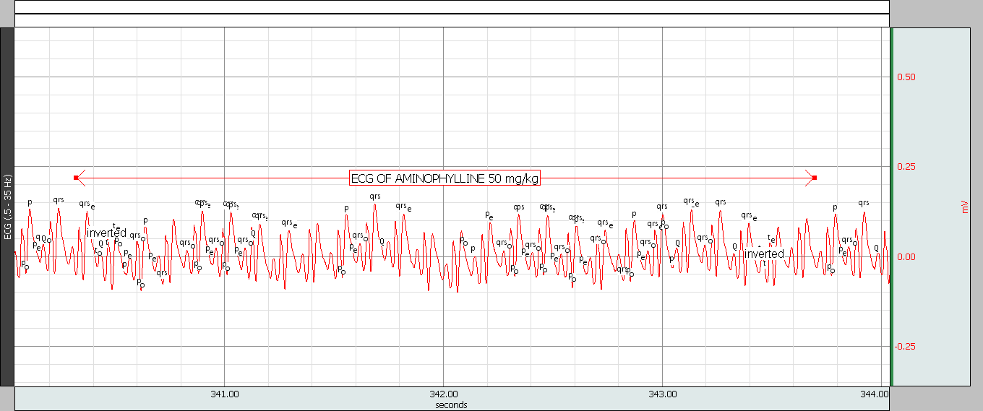
ECG TRACING BY BIOPAC SYSTEM
CONTROL
AMINO-50

Slide 20
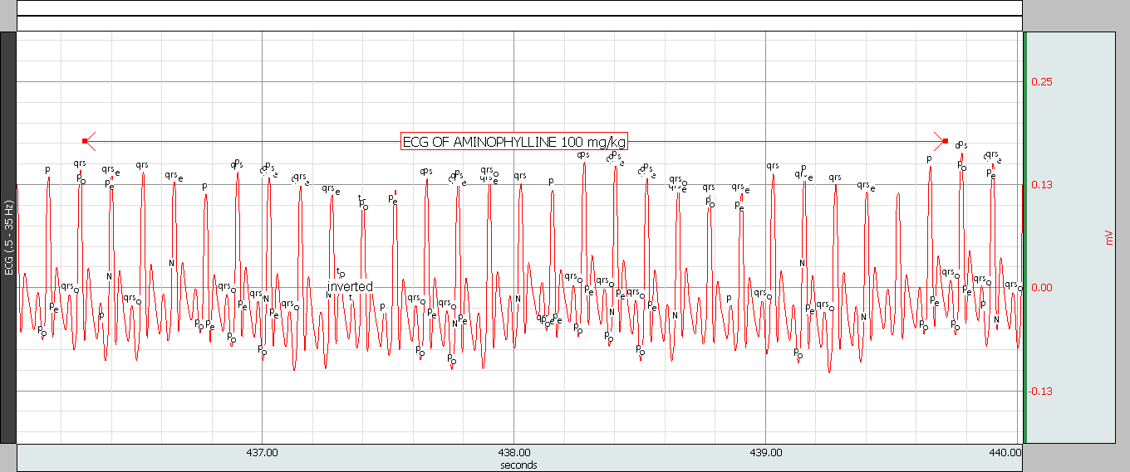
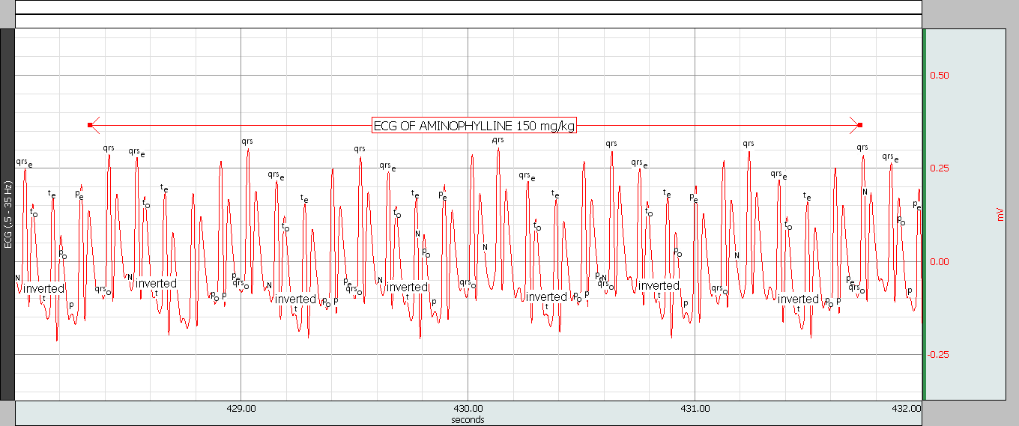
ECG TRACING BY BIOPAC SYSTEM
AMINO(150mg/kg)
AMINO (100 mg/kg)

Slide 21
Effects of tocopherol on aminophylline induced cardiotoxicity
Treatment(mg/kg) | Mean B.P | Heart rate
Control | 70.96 ± 2.30 | 413.79 ± 5.60
Amino (150) | 91.66 ± 7.20 | 531.00 ± 16.66 *
α-tocopherol (20) + Amino(150) | 91.80 ± 6.96 | 529.40 ± 19.18
α-tocopherol (40) + Amino(150) | 72.62 ± 11.49 | 405.88 ± 29.37 ª

Slide 22
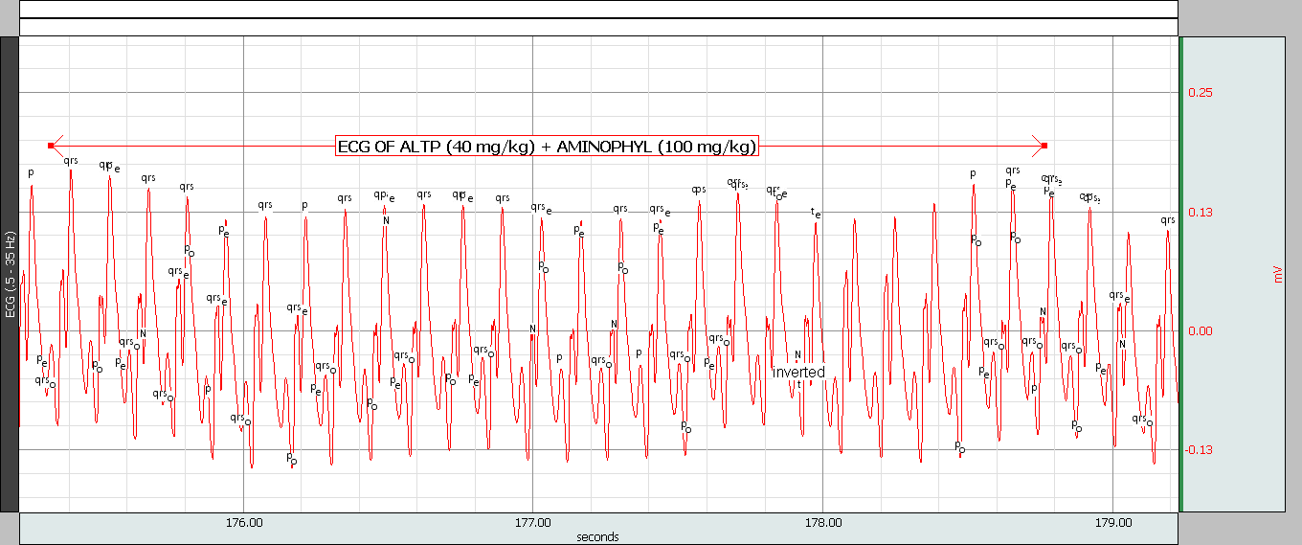
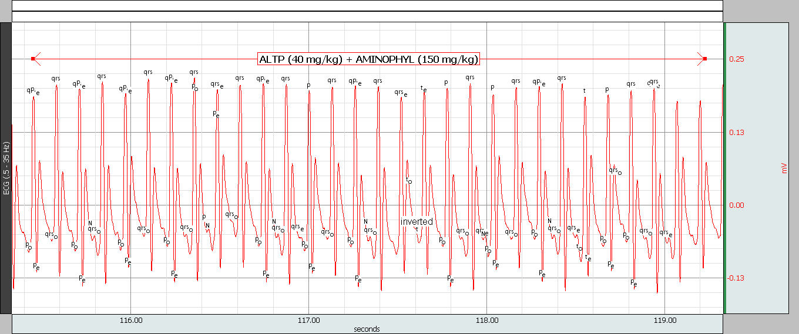
Antioxidants and aminophylline toxicity
α-TP (40 mg/kg) + AMINO (100 mg/kg)
α-TP (40 mg/kg) + AMINO (150 mg/kg)

Slide 23
Effects of Aminophylline on oxidative stress markers
Group | MDA (nmol /mg protein) | GSH (µmol/mg protein) | SOD (U/mg protein)
Controls | 0.35 ± 0.06 | 0.57 ± 0.03 | 0.51 ± 0.15
Aminophylline (50 mg/kg) | 0.42 ± 0.10 | 0.54 ± 0.09 | 0.60 ± 0.21
Aminophylline (100mg/kg) | 0.66 ± 0.08 * | 0.44 ± 0.06 | 0. 44 ± 0.40
Aminophylline (150mg/kg) | 1.02 ± 0.18 * | 0.40 ± 0.07 * | 0.30 ± 0.02 *

Slide 24
Effects of α-tocopherol (TP) on aminophylline (A) induced cardiotoxicity

Slide 25
Summary and Conclusion
These experimental studies show that theophylline-induced anxiety and tachycardia may be due to oxidative stress, and antioxidants may have protective role
Thus it could be speculated that treatment with antioxidants may be helpful in preventing such ADRs due to theophylline
The data of clinical and preclinical studies show that such translational approach could help to highlight some yet unexplored areas of safety pharmacology and toxicology
The deliverable could be rationalization of drug therapy

Slide 26
Acknowledgements
Vallabhbhai Patel Chest Institute
Department of Science and Technology, Govt of India
Dr. Kavita Gulati
Mr. Md. Shamsuzzaman
Mr. Jagdish Joshi

Slide 27

Thank You

