Slide 1
Marine Ecology of the Arctic Connectivity, change, and resilience
Arny Blanchard
Institute of Marine Science
University of Alaska Fairbanks
Oceanography 2015
Philadelphia, PE, June 22, 2015

Slide 2
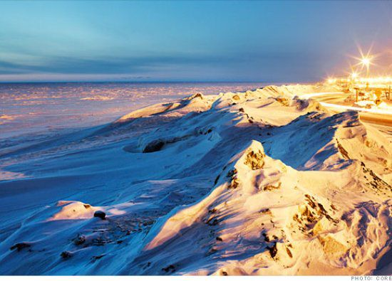
Alaska’s Arctic is striking
http://fortunedotcom.files.wordpress.com/2012/05/barrow_alaska_tundra.jpg

Slide 3
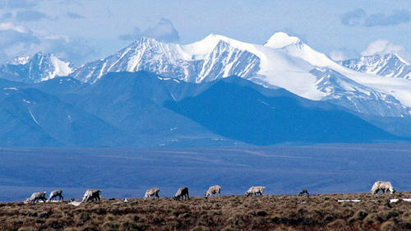
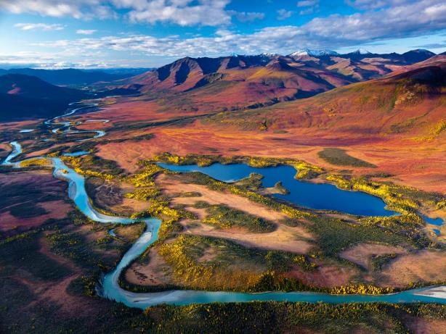
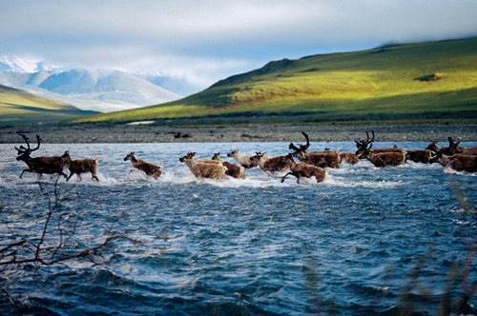
Alaska’s Arctic is resource rich
www.trbimg.com
http://hqworld.net/gallery/data/media/154/gates_of_the_arctic_national_park_and_preserve__alaska.jpg
www.northwestern.edu/magazine

Slide 4
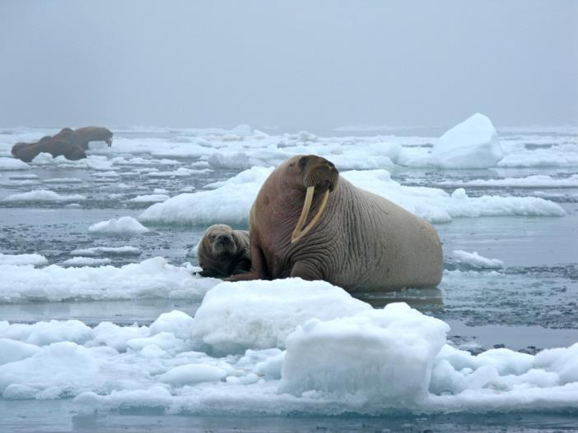
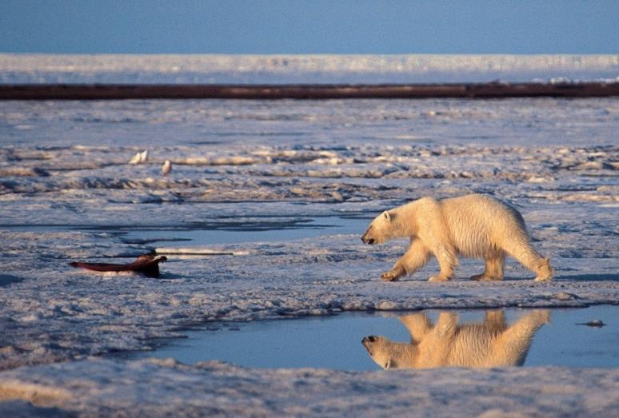
Alaska’s marine Arctic systems are resource rich
https://img.washingtonpost.com/wp-apps/imrs.php?src=https://img.washingtonpost.com/rf/image_908w/2010-2019/WashingtonPost/2010/12/17/Health-Environment-Science/Images/polarbear.JPG&w=1484
http://img841.imageshack.us/img841/7918/walruspup2010norsemansa.jpg

Slide 5
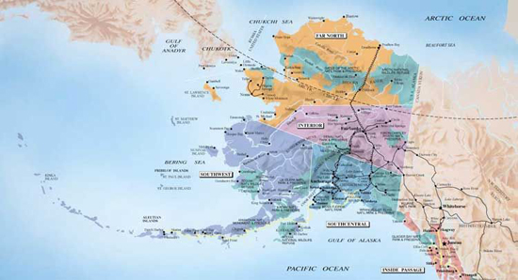
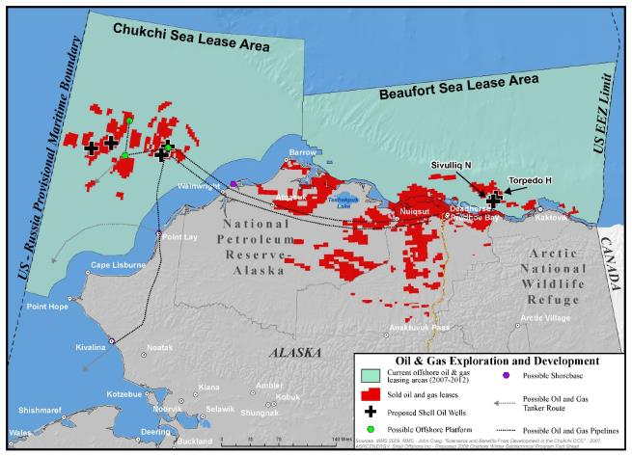
Alaska’s Arctic
Alaska’s Arctic encompasses 3 seas
http://itmakessenseblog.com/files/2012/04/ALASKA-ISLANDS.jpg

Slide 6
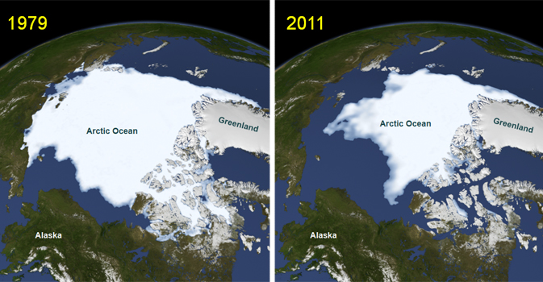
Arctic systems are in flux
Arctic marine ecosystems are experiencing rapid change.
Reductions in sea ice overall.
Reductions in seasonal ice cover.
Earlier meltback dates
http://www.nasa.gov/images/content/655895main_icescape-Picture11.jpg

Slide 7
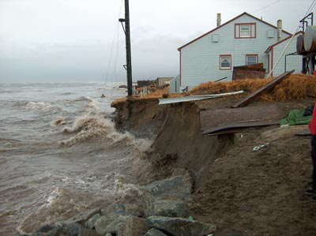
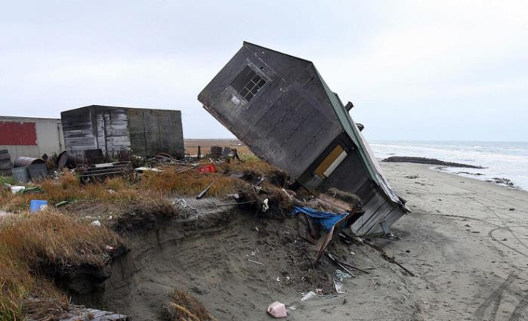
Arctic systems are in flux with high costs
http://neven1.typepad.com/.a/6a0133f03a1e37970b017c317598c6970b-pi
http://i.huffpost.com/gen/2370076/images/o-SHISHMAREF-facebook.jpg

Slide 8
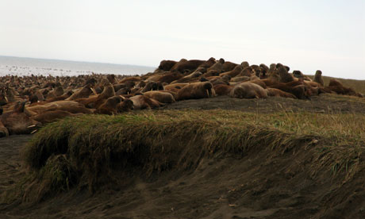
Arctic systems are in flux with high costs
http://img543.imageshack.us/img543/3659/walrushighonthebarrie00.jpg

Slide 9
Characteristics of arctic marine ecosystems
Sea ice systems.
High seasonality.
Connections to lower latitudes.
[MODIS satellite image]

Slide 10
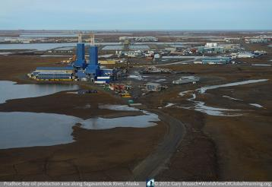
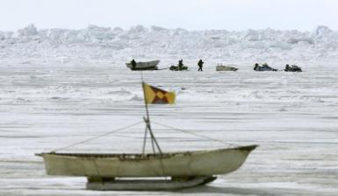
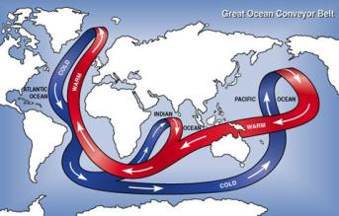
Arctic ecosystems are important:
High productivity supporting commercial and subsistence harvests.
Sites of human activities.
Transportation pathways.
Exports of water to ocean basins promoting global heat and nutrient exchanges.
Bellweather of coming change.
http://images.latinpost.com/data/images/full/18014/alaska-arctic-ocean-climate-change.jpg?w=600
http://science.nasa.gov/media/medialibrary/2004/03/01/05mar_arctic_resources/currents1.jpg

Slide 11
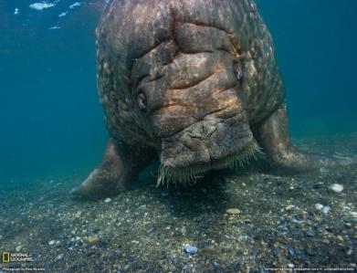
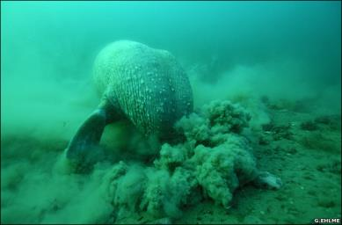
Concerns for arctic ecosystems:
Resiliencies to rapid change.
Novel ecosystem interactions.
Variations in connectivity.
Feedback cycles with lower latitudes.
Population-level effects on migratory avian and mammal predators.
http://images.nationalgeographic.com/wpf/media-live/photos/000/037/custom/3711_1600x1200-wallpaper-cb1267712147.jpg
http://news.bbc.co.uk/nol/shared/spl/hi/pop_ups/07/sci_nat_beasts_of_the_deep/img/5.jpg

Slide 12
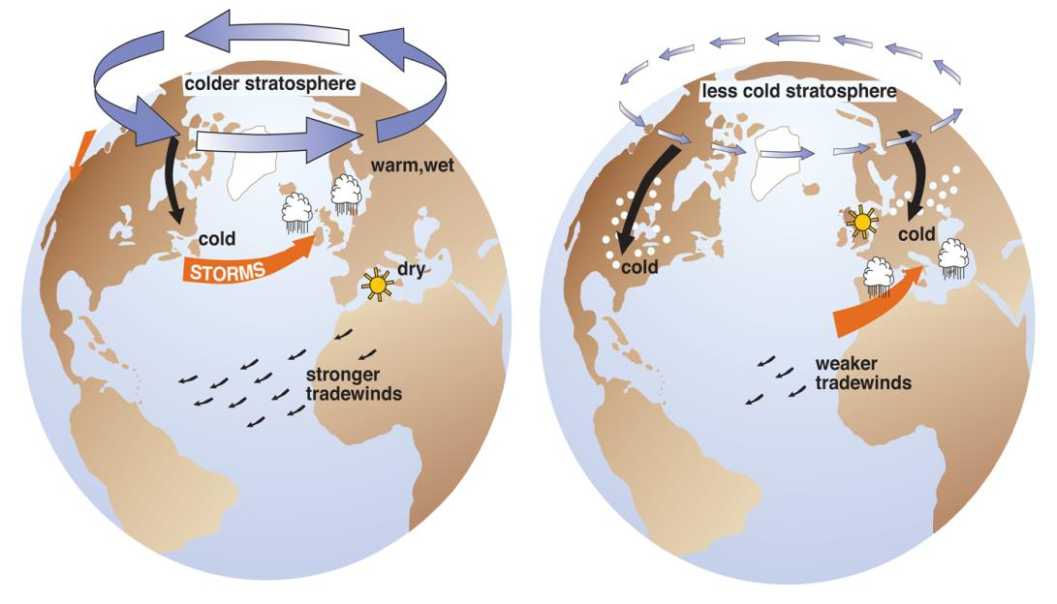
Climatic connectivity and the Arctic
https://nsidc.org

Slide 13
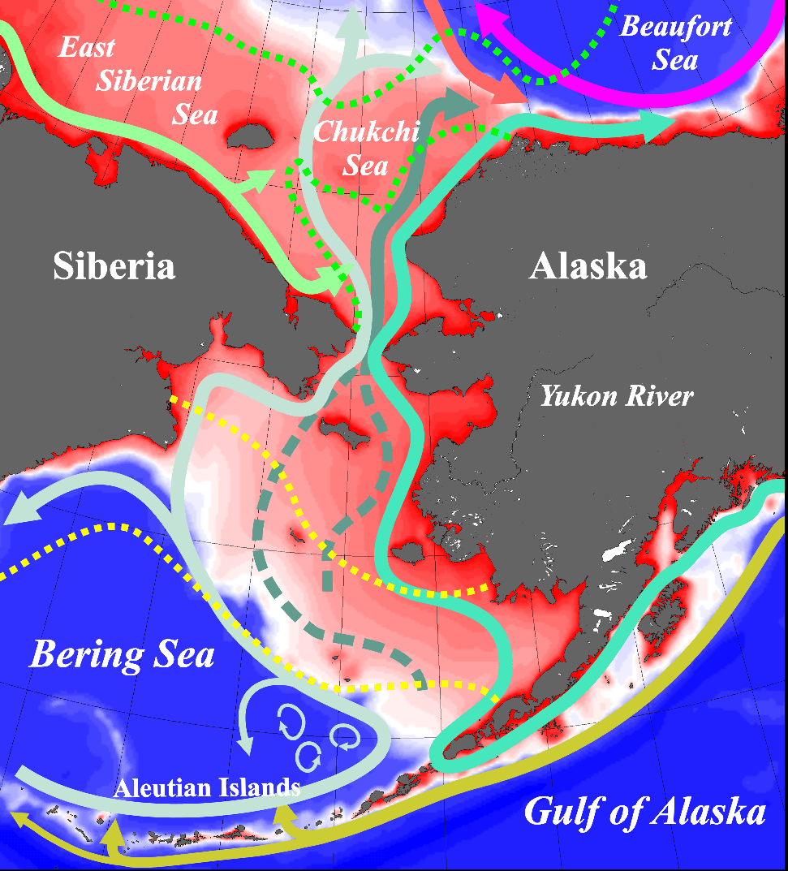
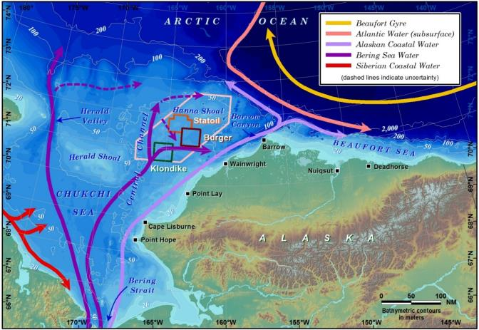
Oceanographic connectivity in the Arctic
Courtesy of T. Weingartner, S. Danielson, and R. H. Day

Slide 14
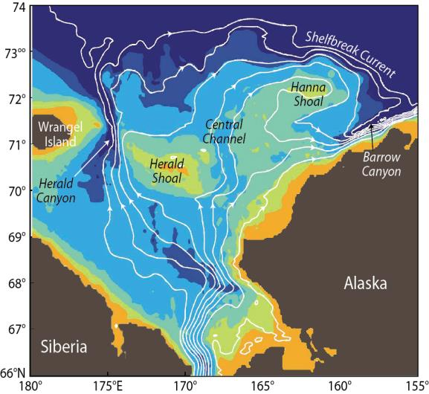
Spatial drivers of change
(Spall, 2007)
(Blanchard et al, in prep.)

Slide 15
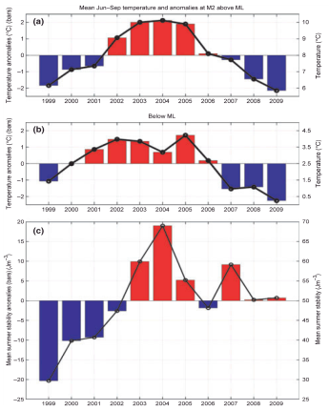
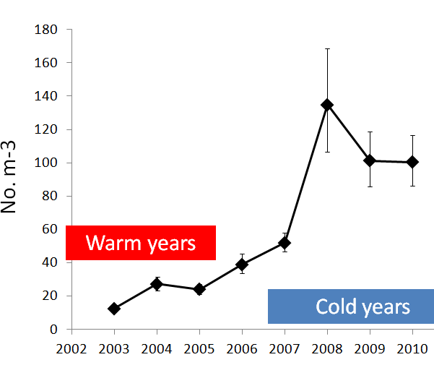
Temporal drivers of change: climatic influences
Pelagic community characteristics linked to climate variations.
Copepods in the Southeastern Bering Sea (<60°N)
Calanus marshallae/glacialis.
Eisner et al.
Courtesy of R. Hopcroft

Slide 16
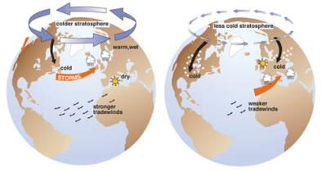
Temporal drivers of change: climatic influences
Benthic community characteristics linked to climate variations, likely through water circulation.

Slide 17
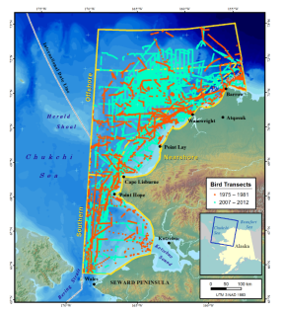
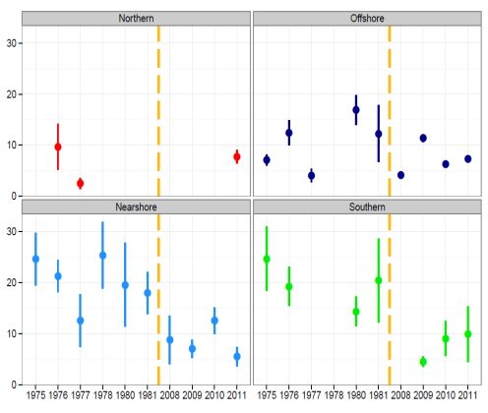
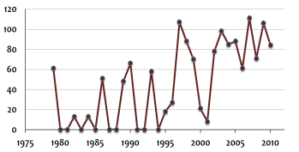
Climate and temporal change at higher levels
Total abundance
Northern
Offshore
Shearwaters
Planktivores
Piscivores
Birds km¯²
Omnivores
Nearshore
Southern
Benthic feeders
Ice-free days 72–73°N
Days of ≤10% ice cover
Year
Courtesy of A. Gall

Slide 18
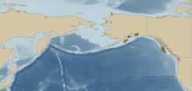
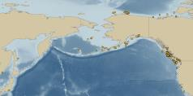
Linkages
30% similarity between faunal composition of benthic fauna between Port Valdez, a glacial fjord in Prince William Sound, Alaska, and the Chukchi Sea.
Many invertebrate fauna are widely distributed from California and Oregon to the Chukchi Sea.
Many seabirds and marine mammals travel great distances to feed in the Arctic.
Mytilus trossulus
(mussel)
Semibalanus balanoides
(barnacle)
Ctenodiscus crispatus
(seastar)

Slide 19
Resiliences
Connectivities are both challenges to and sources for resiliency.
Connectivities are major sources of change via heat transport.
Connectivities also provide long-term sources for key fauna, nutrients, carbon, etc.
Connectivities poorly known.
Resiliencies of the Arctic poorly studied.
AK infauna studied with respect to dredging, sediment dumping, fish wastes, and long-term discharges.
Some components highly resilient.

Slide 20
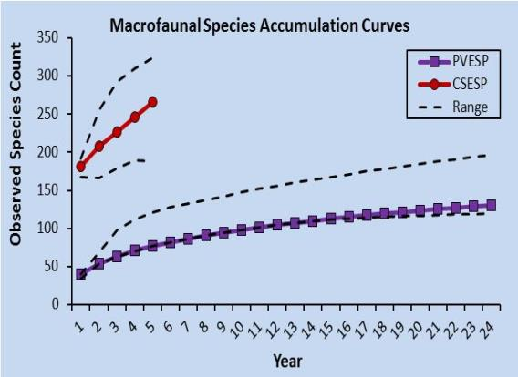
What we don’t know
In spite of great effort, we still have inadequate knowledge arctic ecosystems.
We have inadequate information on:
Biodiversity and drivers.
Ecosystem resiliencies.
Area ~38,000 km²
Short-term study represents ~≤50% of species available
Area ~100 km²
~75% of species captured
Length of a short-term study

Slide 21
What we don’t know
In spite of great effort, we still have inadequate knowledge arctic ecosystems.
We have inadequate information on:
Biodiversity and drivers.
Ecosystem resiliencies.
Long-term variations.
Port Valdez Benthos Number of Taxa

Slide 22
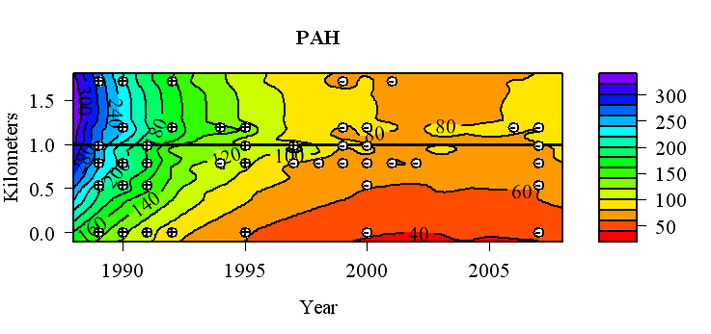
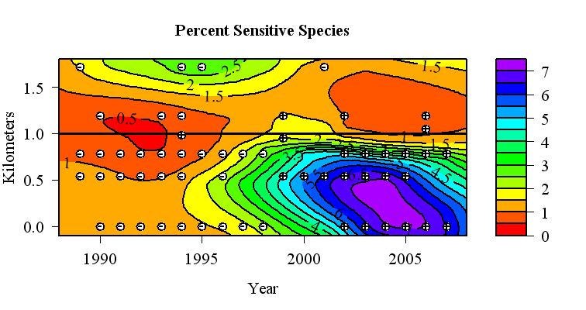
What we don’t know
In spite of great effort, we still have inadequate knowledge arctic ecosystems.
Port Valdez Benthos & Hydrocarbons
We have inadequate information on:
Biodiversity and drivers.
Ecosystem resiliencies.
Long-term variations.
Potential anthropogenic effects.
And many other topics.
PAH (ng g⁻¹)
Percent Sensitive Species
(Galathowenia oculata and Melinna cristata)

Slide 23
Thoughts
Statistically designed long-term monitoring efforts are needed.
Pre-existing programs can provide guidance.
New directions, new thoughts needed.
Spatial and temporal interactions between geomorphology, oceanography, climate, and biota may provide unexpected but highly significant sources for change.
Resiliencies and conservation of their sources may be important.
Connectivity among seas, climate, and biota plays a major role in ecological characteristics of arctic marine ecosystems.
Effects extend backwards as well.

Slide 24
The Arctic is at the nexus of change
The loss of summer sea ice:
Influences timing and seasonality of ecosystem processes.
Removes habitat for ice-associated fauna.
Alters productivity.
http://img543.imageshack.us/img543/3659/walrushighonthebarrie00.jpg

Slide 25
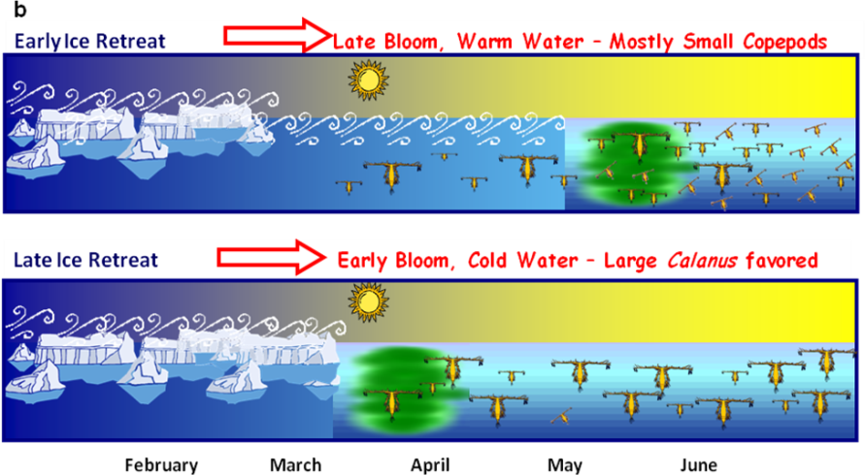
Alternating control for interannual change
Courtesy of R. Hopcroft

