Slide 1
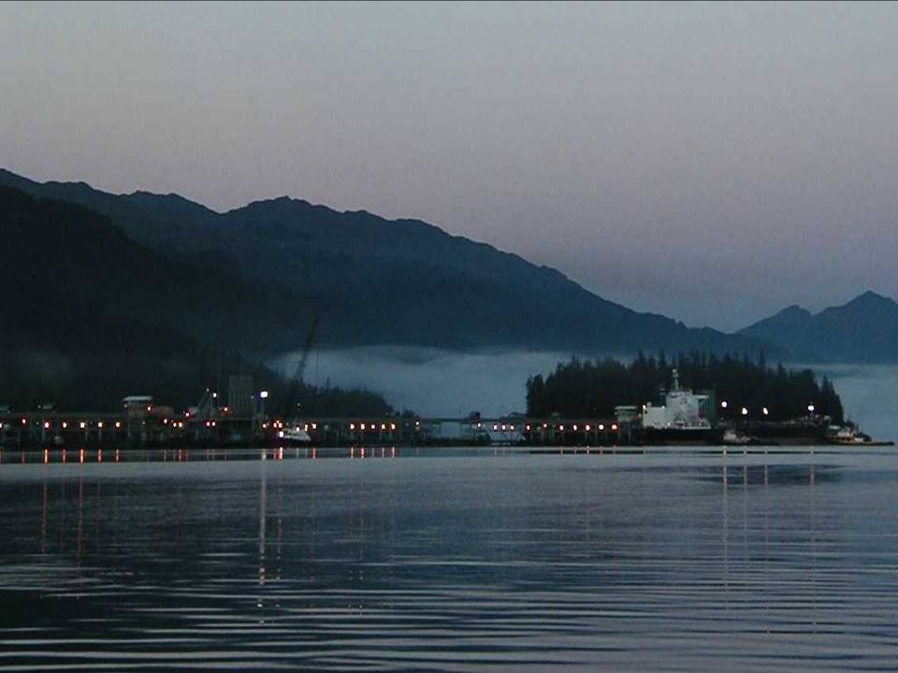
Long-Term Studies
in Port Valdez, Alaska
Highlights of 40+ Years of Research
Environmental/Biological interactions
Arny Blanchard
Institute of Marine Science
University of Alaska Fairbanks
Oceanography 2015
Philadelphia, PE, June 22, 2015
Studies 1971-2011
Port Valdez
40 Years
Notes:
1
Today, I will be presenting results from a long-term environmental monitoring study in Port Valdez, Alaska. The oil terminal in Port Valdez is the point of transfer of crude oil from the trans-Alaska pipeline from Prudhoe Bay to oil tankers.

Slide 2
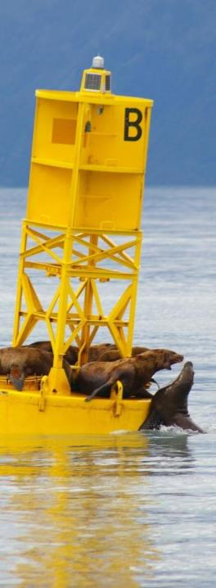
Acknowledgments
The environmental studies in Port Valdez were funded by the Alyeska Pipeline Service Co.
We thank the many technicians and students who have assisted on the project, David Connor of Alyeska Pipeline Service Co. for his support, and the captains and crews of the M/V Valdez Star for their assistance in sampling.

Slide 3
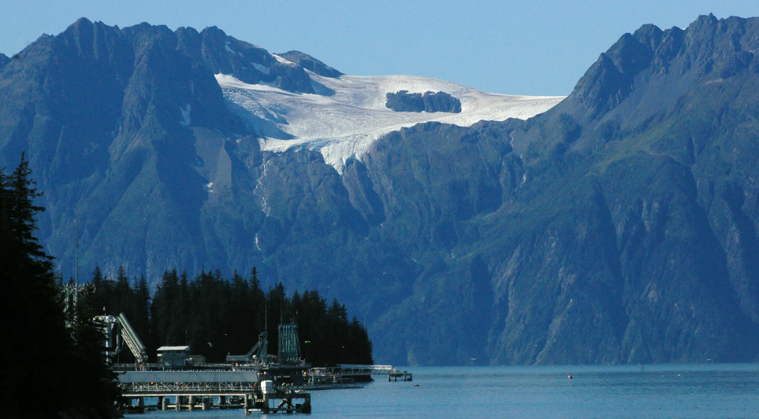
Alaska’s Coastal Aesthetics
Alaska’s coastal waters are of interest to wide ranging stakeholders due their beauty

Slide 4
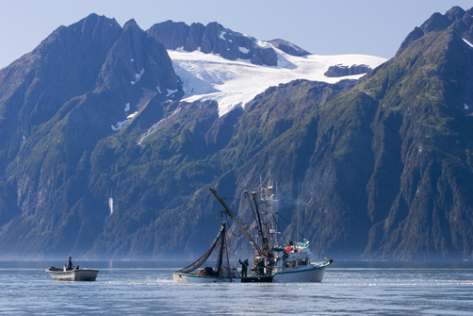
Alaska’s Coastal Resources
Alaskan’s care deeply about their resources they depend on.
http://www.natgeocreative.com/comp/AS/001/1183095.jpg

Slide 5
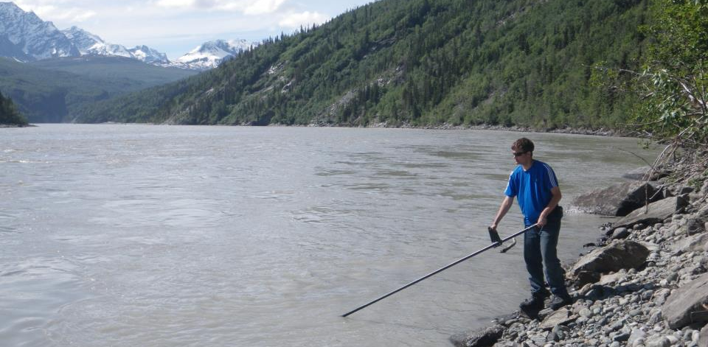
Alaska’s Coastal Resources
Even for personal use and subsistence.

Slide 6
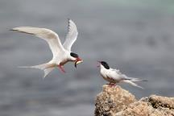
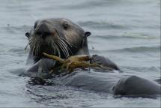
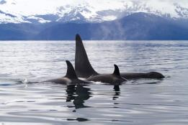
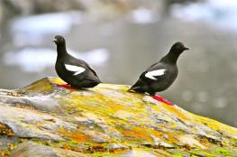
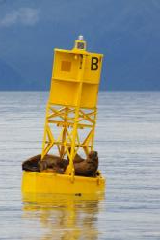
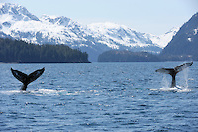
Alaska’s Coastal Resources
Resource include numerous marine mammals and birds.

Slide 7
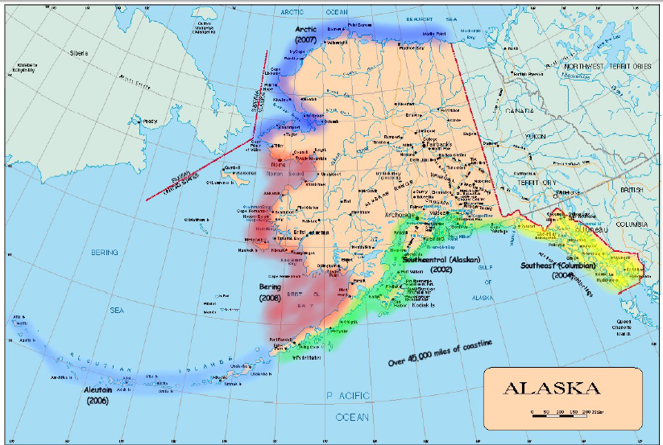
Alaska’s Coastal AK MAP Regions

Slide 8
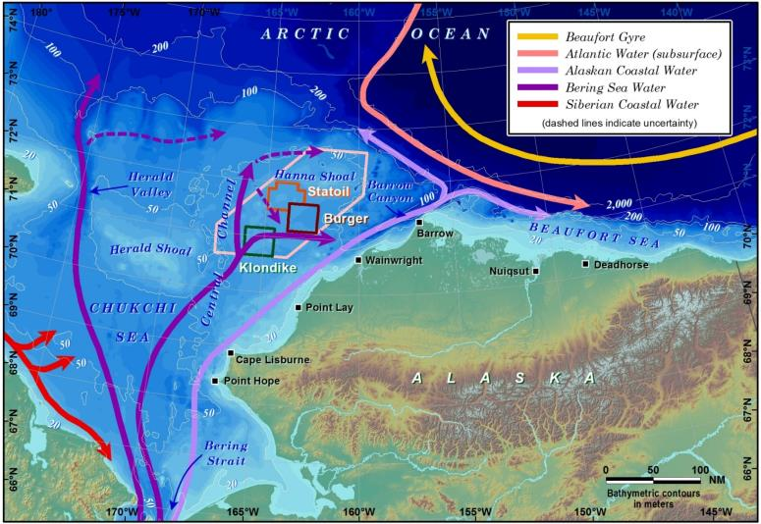
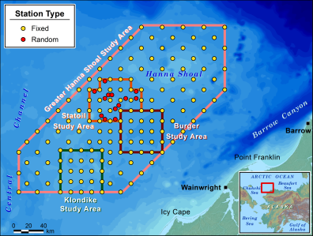
Chukchi Sea Environmental Studies Program (CSESP)

Slide 9
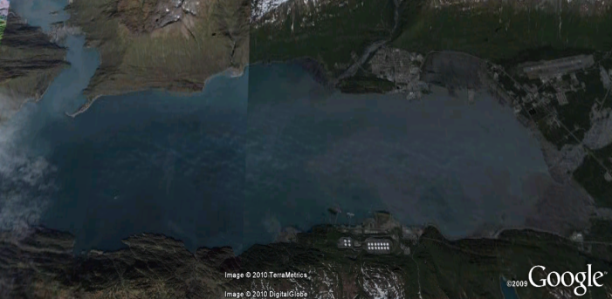
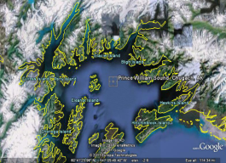

Port Valdez Environmental Studies Program (PVESP)
A long-term environmental project monitoring sediments adjacent to a treated ballast water outfall.
City of Valdez
Mineral Creek
Port Valdez
Valdez Glacier Stream
Solomon Gulch
Fish Hatchery
Valdez Marine
Terminal
Lowe and Robe Rivers

Slide 10
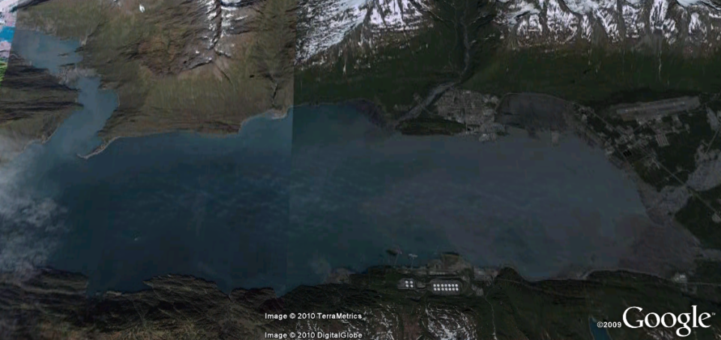
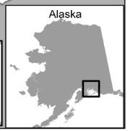
Port Valdez: a glacial fjord
Shoup Glacier
Valdez
Glacial Rivers
VMT
SGFA

Slide 11
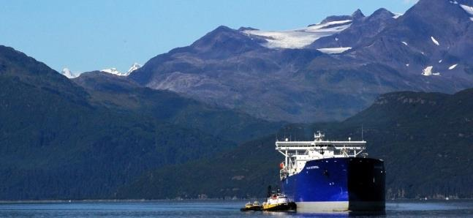
Unique Features of Glacial Fords
Glaciers and glacial sediments.
Steep sides.
Sharp environmental gradients.
Sites of human activities & change.

Slide 12










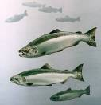











Fjord Ecology
Natural Variations
Anthropogenic Stressors
Intertidal
Macoma sp.
Sediments
Phyto- and Zooplankton
Pelagic fishes
Subtidal
Sill
Bacteria
Benthic fishes
Eudorellopsis biplicata
Nephtys sp.
Adontorhina cyclia
Galathowenia oculata
Studies 1971-2011
Benthos
Sternaspis fossor
Port Valdez
Polydora sp.
40 Years

Slide 13
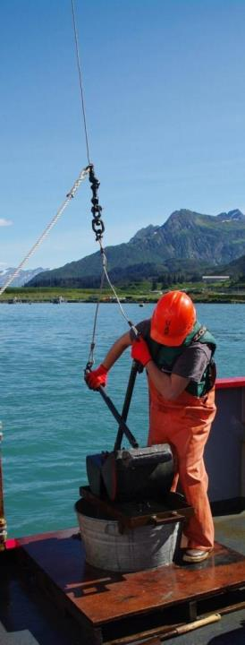
Facts about Port Valdez
Was heavily impacted by sediment slumping and tsunami scouring after a 9.2 magnitude earthquake in 1964,
Is the site of a major marine oil terminal, and
Is the site of a shoreline fish hatchery.

Slide 14
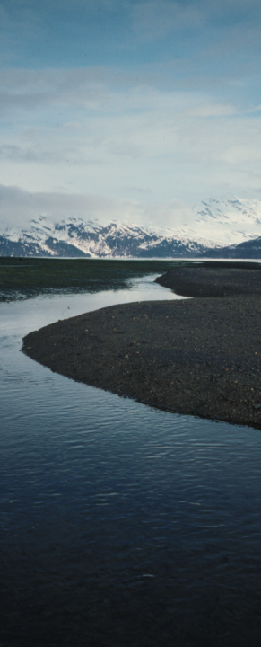
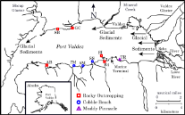






Intertidal Studies 1976-1992
Influence of Physical Factors (1988-1992)
High Salinity,
Lower glacial sediments
Low Salinity,
High glacial sediments
Studies 1971-2011
Port Valdez
40 Years
Freshwater Influences

Slide 15
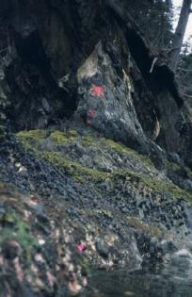
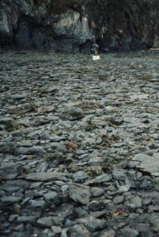
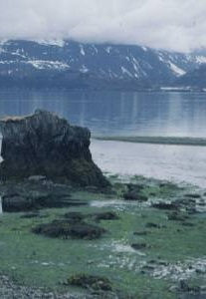
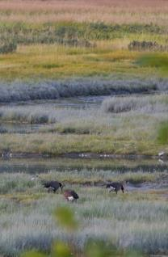

Intertidal/shoreline gradients
Brackish-water
Grasses
Rocky Shore
Cobble Beach
Mudflat and Pinnacle
High Salinity,
Lower glacial sediments
Low Salinity,
High glacial sediments
Freshwater Influences

Slide 16
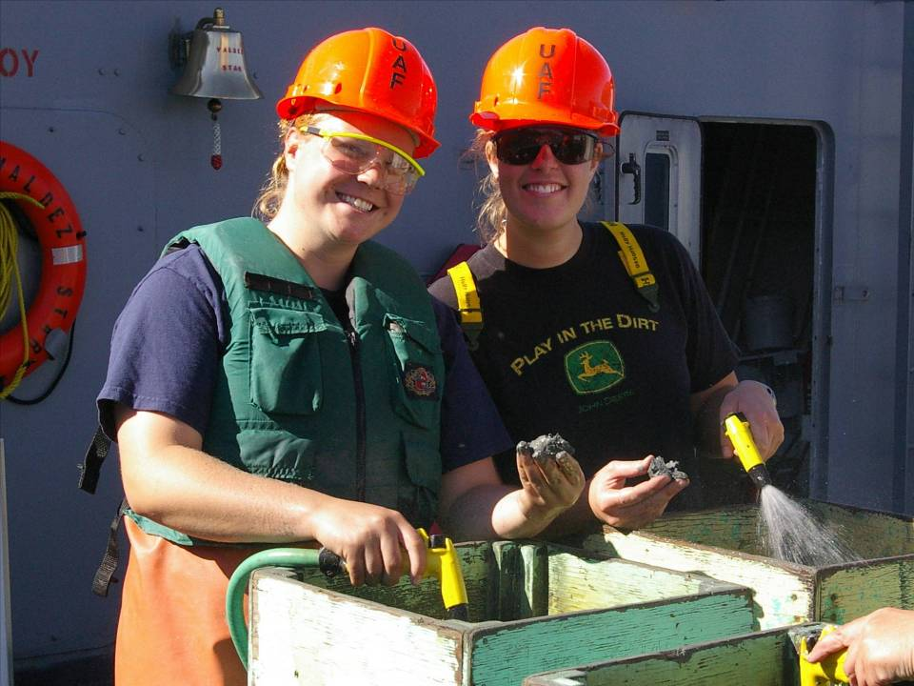
Subtidal Studies
1971-2012

Slide 17
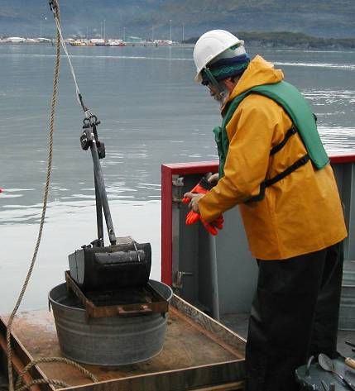
Sampling for Benthic Inverts
The target animals are sediment-dwelling invertebrates.
Samples are collected with a vanVeen grab (0.1 m²).
Notes:
Point out:
1.0 mm screen = macrofauna.
Methods consistent since 1971.
Hydrocarbons:
TARO = EPA’s priority pollutants.
Polycyclic aromatics have been shown to be mmost toxic to animals.
Thus, TARO includes those compounds that should result in acute toxicity to animals.
Note that amphipods and echinoderms, animals known to be sensitive to hydrocarbons, are not abundant in the sites sampled throughout Port Valdez. it is suspected that this is related to direct response to fine fractions or swamping of OC.

Slide 18
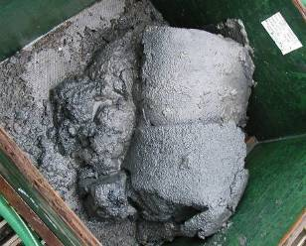
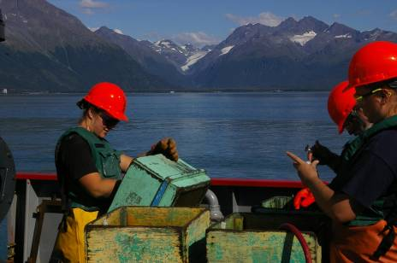
Sampling for Benthic Inverts
Samples are washed through 1.0 mm screen and the animals sorted, identified, counted and weighed.
Notes:
Point out:
1.0 mm screen = macrofauna.
Methods consistent since 1971.
Hydrocarbons:
TARO = EPA’s priority pollutants.
Polycyclic aromatics have been shown to be mmost toxic to animals.
Thus, TARO includes those compounds that should result in acute toxicity to animals.
Note that amphipods and echinoderms, animals known to be sensitive to hydrocarbons, are not abundant in the sites sampled throughout Port Valdez. it is suspected that this is related to direct response to fine fractions or swamping of OC.

Slide 19

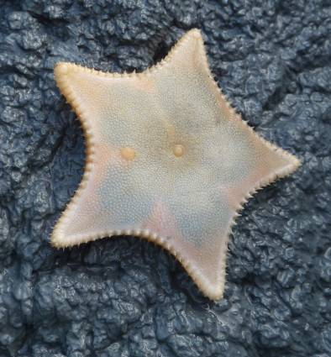
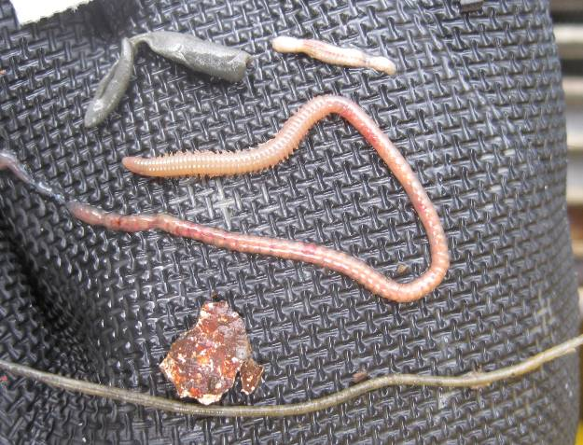
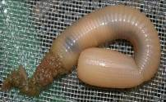
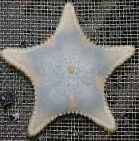
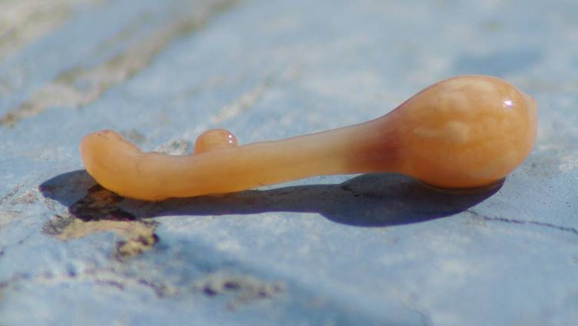
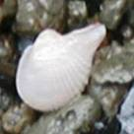
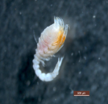
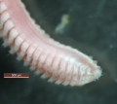
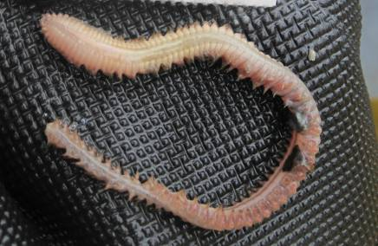

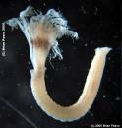
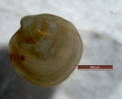

Benthic Invertebrates of
Port Valdez
Priapulus
Mudstar
Cardiomya
Eudorellopsis biplicata
Nephtys sp.
Sabellid Worm
Adontorhina cyclia
Galathowenia oculata
Sternaspis fossor
Notes:
Point out:
1.0 mm screen = macrofauna.
Methods consistent since 1971.
Hydrocarbons:
TARO = EPA’s priority pollutants.
Polycyclic aromatics have been shown to be mmost toxic to animals.
Thus, TARO includes those compounds that should result in acute toxicity to animals.
Note that amphipods and echinoderms, animals known to be sensitive to hydrocarbons, are not abundant in the sites sampled throughout Port Valdez. it is suspected that this is related to direct response to fine fractions or swamping of OC.

Slide 20
Why monitor Invertebrates?
Sediment-dwelling invertebrates are preferred organisms for biological monitoring because:
They can’t escape changing environmental conditions.
They must either adapt, move, or die.

Slide 21








Marine Succession
Diversity
Disturbance
No Disturbance

Slide 22
Sources of Variability in Port Valdez
Climatic Variability
Fish Processing
& SERVS
Sediment
Gradient
1964 Earthquake
VMT
SGFA
Lower Sediment Loads
Higher Sediment Loads

Slide 23
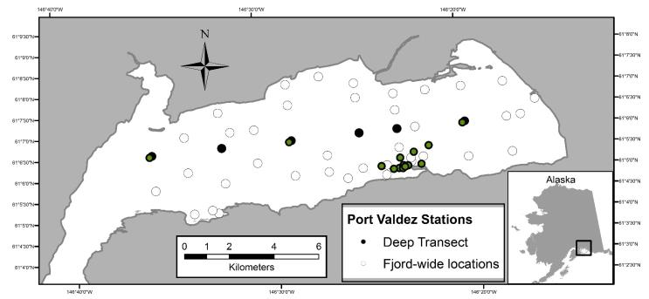
Fjord-wide sampling
In 1971, 1976, 1982, 2002, sediments were sampled throughout the fjord.

Slide 24
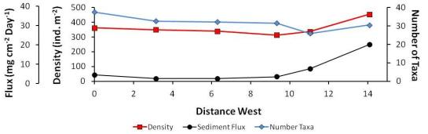

Spatial Trends in the Deep Basin:
Effects of glacial sediments

Slide 25
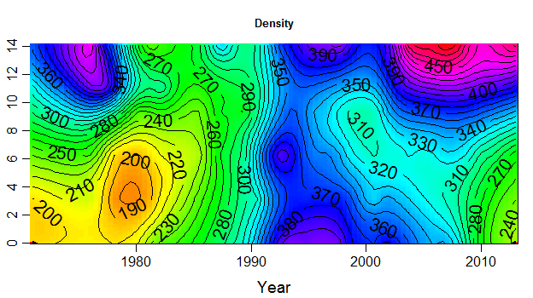
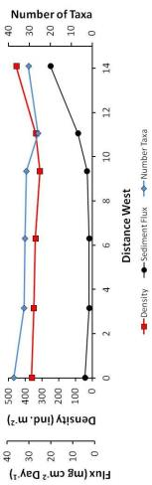
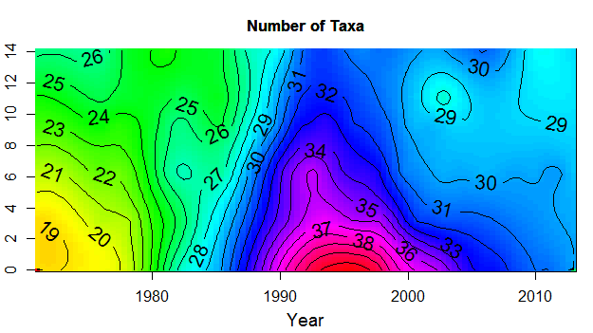
Spatial Trends in the Deep Basin:
Effects of glacial sediments
Density
Density and richness are higher in these areas associated with greater sedimentation.
Richness
A peak due to other sources.

Slide 26
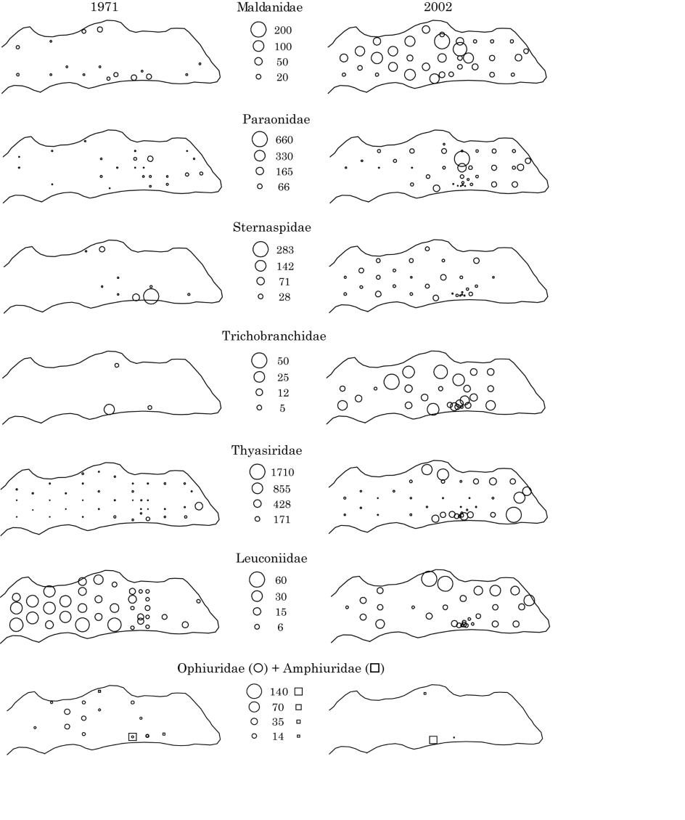




Response to Sediment Gradient
These animals have higher abundance towards the west.
Sternaspis fossor
These animals have higher abundance towards the east.
Adontorhina cyclia

Slide 27
Sources of Variability in Port Valdez
Climatic Variability
Fish Processing
& SERVS
1964 Earthquake
Sediment
Gradient
VMT
SGFA

Slide 28
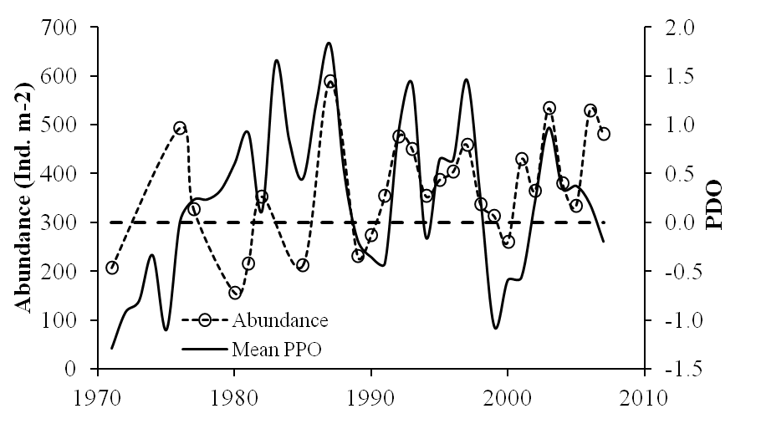
Climatic Variability
Benthic Abundance vs. PDO
ρ = 0.12
ρ = 0.55
Abundance
Mean PDO

Slide 29
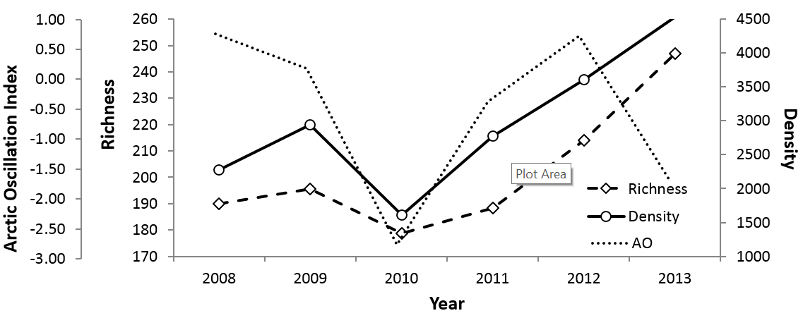
Climatic variability:
Benthic communities vs. AO
A similar trend was observed in the Chukchi Sea.

Slide 30
Sources of Variability in Port Valdez
Climatic Variability
Fish Processing
& SERVS
1964 Earthquake
Sediment
Gradient
VMT
SGFA

Slide 31
The 1964 Earthquake
March, 1964, the magnitude 9.1 earthquake struck in Prince William Sound.
Port Valdez was on the axis of uplift so there was little change in geomorphology.
The earthquake largely influenced marine flora and fauna by:
  the destruction caused by massive sediment slumping
  and tsunamis.

Slide 32
Fjord-wide sampling
In 1971, 1976, 1982, 2002, sediments were sampled throughout the fjord.

Slide 33

Trends in the Deep Basin:
Galathowenia oculata
564 ind. m⁻²
1971
1982
Galathowenia oculata
3 ind. m⁻²
Extensive sampling - G. oculata at only one location.
Limited sampling - G. oculata at almost all stations sampled.
1976
6,430 ind. m⁻²
2002
60 ind. m⁻²
540 ind. m⁻²
Extensive sampling - G. oculata at eight locations.
Extensive sampling .

Slide 34





Trends in the Deep Basin
A number of taxa recolonized and redistributed themselves within the sediments of Port Valdez.

Slide 35
Temporal Trends in the Deep Basin:
The community appears to stabilize around 1989.
Density
Richness

Slide 36
Sources of Variability in Port Valdez
Climatic Variability
Fish Processing
& SERVS
1964 Earthquake
Sediment
Gradient
VMT
SGFA

Slide 37
Climatic Variability
Benthic Abundance vs. PDO
ρ = 0.12
ρ = 0.55
Abundance
Mean PDO

Slide 38
Climatic variability:
Benthic communities vs. AO
A similar trend was observed in the Chukchi Sea.

Slide 39
Sources of Variability in Port Valdez
Climatic Variability
Fish Processing
& SERVS
1964 Earthquake
Sediment
Gradient
VMT
Solomon Gulch
Fish Hatchery

Slide 40

Hatchery Salmon and the Benthos
Carcasses of returning adult salmon may provide greater food for fauna down to the deep basin.
Studies 1971-2011
Port Valdez
40 Years

Slide 41
Sources of Variability in Port Valdez
Climatic Variability
Fish Processing
& SERVS
1964 Earthquake
Sediment
Gradient
VMT
SGFA

Slide 42

The Valdez Marine Terminal
The marine oil terminal became operational in 1977.
Ballast water from incoming tankers is treated onshore and discharged at about 60-80 m.

Slide 43

Port Valdez Environmental Monitoring Sites

Slide 44


Treated Ballast-Water Discharges
Biological treatment phase added
PAH (ng g⁻¹)
Decreasing PAH concentrations over time.
The percent abundance of two tube-dwelling polychaetes increases with lower PAH.
Percent Sensitive Species
(Galathowenia oculata and Melinna cristata)

Slide 45

Hydrocarbons in Southcentral Alaska

Slide 46
Other Studies in Port Valdez
Intertidal studies: Barnacle, limpet and mussel ecology.
Interactions of multiple stressors and indirect effects.
Food webs (isotope) studies.
Effects from the salmon hatchery.
Chemical and hydrocarbon studies.
Geological, physical, biological, and fisheries oceanography.
Marine mammals (sea otters) and sea birds.
Microbial studies and more!

Slide 47
What We’ve Learned
Faunal responses to and recovery from stress mediated by fjord characteristics:
  Seasonal stratification, deep basin, and strong sediment gradient important factors for infauna.
Earthquake had long-lasting effects:
  Benthic fauna appeared to have re-adjusted ~1989/1990, 26 years later.
Interactions between sources of stress can have unanticipated effects.

Slide 48



















Not the end, but the beginning!
Studies 1971-2011
Port Valdez
40 Years

