Slide 1
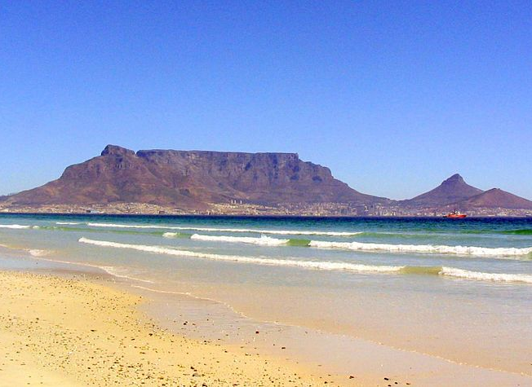

Microbial pollutants in stagnant water in an informal settlement in the Western Cape, South Africa
Qenehelo A. Leuta, James P. Odendaal and
Arnelia N. Paulse
Department of Environmental and Occupational Studies, Faculty of Applied Sciences, Cape Peninsula University of Technology, Bellville 7535, South Africa

Slide 2
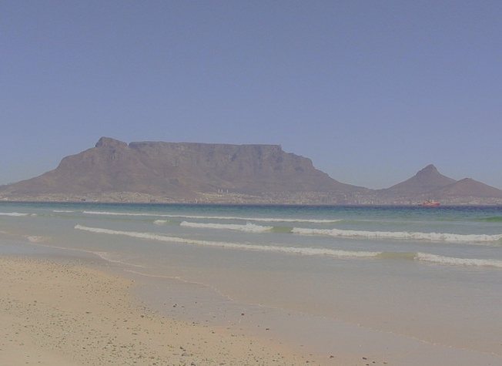
Introduction
In developing country – South Africa, migration of people from rural to urbanised areas occurs on daily basis;
Due to urbanisation informal housing schemes or informal settlements are constantly increasing and expanding as in most cases these houses are built with any material possibly found;
This lead to overcrowding; no or low access to an adequate freshwater supply for daily use, as well as lack of sanitary facilities;
Unfortunately, these problems are not monitored intensively by municipalities, or even sometimes ignored;
Ms. Leuta collaborated with Social Justice Coalition who evaluates the moral, social, psychological issues of communities in such areas;

Slide 3
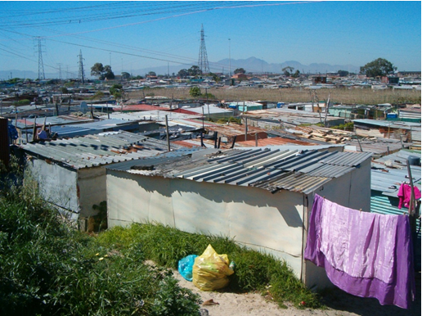

Slide 4
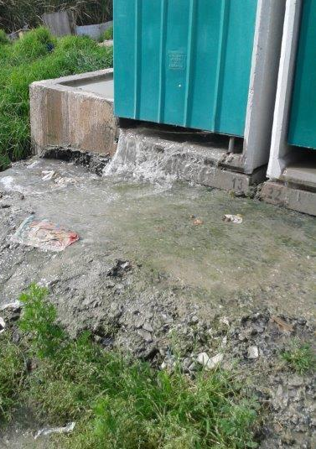
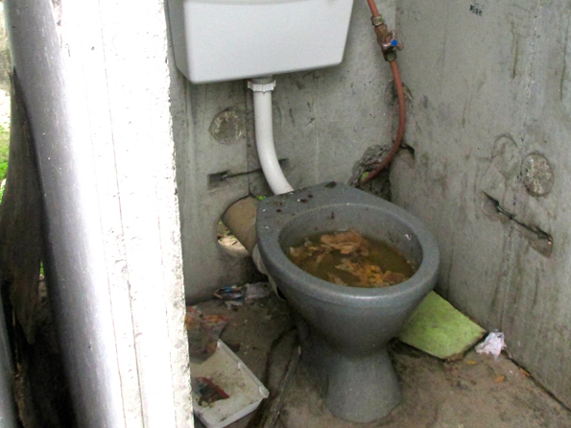
High population density and fact that municipalities cannot accommodate high numbers → leads to the allocation of one tap for every 25 households within a distance of 200m and one toilet for every five households; Inadequate sanitation and poor drainage thereby puts water systems under major stress;
Raw sewage from night pots and damaged sanitary facilities due to poor infrastructure and poor maintenance, mix with surface runoff → causes possible pathogens spreading throughout the community;

Slide 5
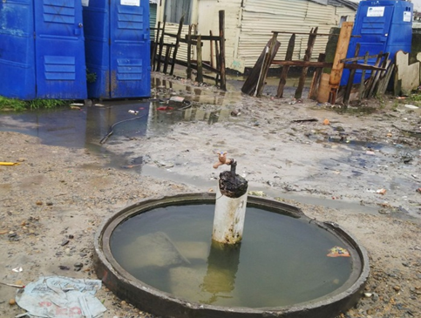
Stagnant water accumulating at bottom of a communal standpipe

Slide 6
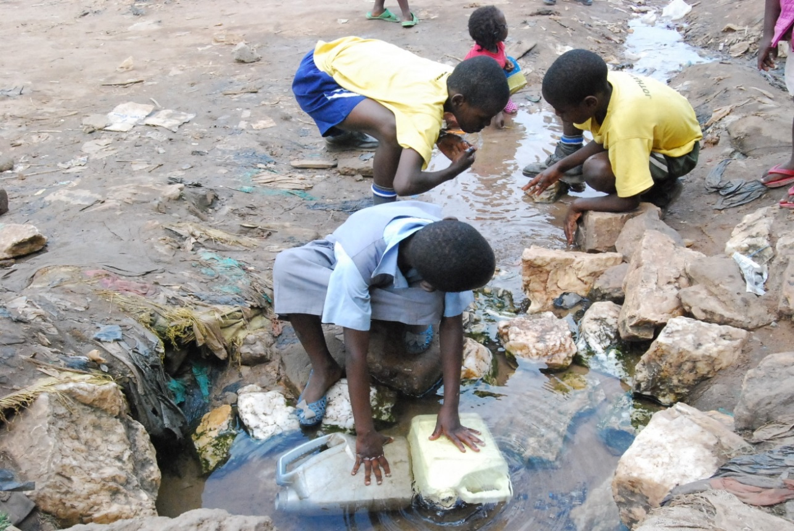
No drainage away from communal standpipes - result in greywater being stagnant at the base of communal taps;
Becomes a possible breeding ground for various microorganisms - Escherichia coli, Vibrio cholerae and Pseudomonas aeruginosa;
Becomes a health risk as children seen playing at or close to these standpipes;

Slide 7
Objectives
To identify, select and sample six water points (stagnant water underneath standpipes) twice monthly for a period of five months;
To determine the level of bacterial contamination in the stagnant pools by means of the Most Probable Number (MPN) techniques;
To determine the total bacterial counts - HPC and FCM techniques using liquid counting beads and the LIVE/DEAD® BacLightTM Probe;
To isolate and identify Gram-negative bacteria - API 20E and the RapID™ ONE systems;
To isolate and identify Gram-positive bacteria - BBL Crystal™ Gram Positive (GP) Identification system.

Slide 8
Materials and methods
Sample Collection: Water samples collected RR section in Khayelitsha on monthly basis from February 2012 to June 2012
↓
Enumeration of facecal coliforms and E. coli via MPN
↓
Total microbial counts via HPC and FCM
↓
Isolation and identification of Gram negative microorganisms via API 20E and RapIDTM ONE systems
↓
Isolation and identification of Gram positive microorganisms via BBL Crystal™ Gram Pos. (GP) Identification (ID) system

Slide 9
Results and Discussion
Enumeration (Statistical analysis):
MPN – highest MPN count obtained → 1.6 x 10⁸ microorganisms/100mℓ; highest faecal coliform count → 4.7x10⁶ microorganisms/100mℓ; highest E. coli count 1.8x10⁶ microorganisms/100mℓ;
HPC – highest count obtained → 2.9 x 10⁵ microorganisms/mℓ (Site C, week 4);
FCM – highest obtained → 3.4 x 10⁷ microorganisms/mℓ (Site A, week 5);
Most counts were significantly (p < 0.05) higher than the allowable limit as set out by DWAF (1996a) and the SABS (2011);
FCM – most effective technique for enumeration purposes – yielded the best results;
Counts alarming for communities in the area.

Slide 11
Results and Discussion, cont.
Isolation and Identification:
a) Gram-negatives:
The RapID ONE and the API 20E identification systems mostly identified Escherichia coli, Salmonella spp., Klebsiella spp., Acinetobacter spp. and Enterobacter spp.;
b) Gram-positives:
BBL Crystal™ Gram Positive (GP) Identification (ID) system mostly identified Corynebacterium species and Bacillus cereus.

Slide 13
Conclusion
Many studies that assess greywater quality in informal settlements in South Africa concentrate on the chemical analysis;
Microbial analysis usually focuses on indicator organisms such as total coliforms, faecal coliforms and E. coli;
This study - given a basis for understanding pathogenic microorganisms present in greywater in informal settlements;

Slide 14
Conclusion, cont.
Presence of pathogenic microorganisms, e.g. Klebsiella pneumonia, Salmonella spp., Bacillus cereus and Micrococcus luteus in the greywater at the base of the communal standpipes - health risk to the children playing in close proximity to the greywater, as well as adults using this water for daily use such as hand washing;
Alarming as this would probably always be a money issue instead of a health issue

Slide 15
Acknowledgements
Qenehelo Leuta – conducting the study
CPUT/URF – funding
Social Justice Coalition

