Slide 1
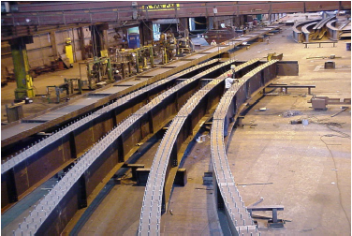

Cold Bending Steel Beams: a State-of The-Art Engineering Solution that Meets Industry Challenges
By: Antoine N. Gergess, PhD, PE, F.ASCE
Professor, University of Balamand, Lebanon
www.balamand.edu.lb
World Congress and Exhibition on Steel Structure, Dubai
November 15 - 17, 2015

Slide 2
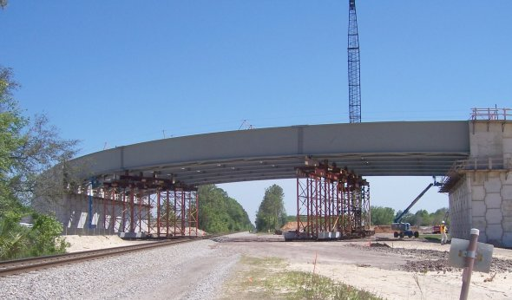
Horizontal Curves

Slide 3
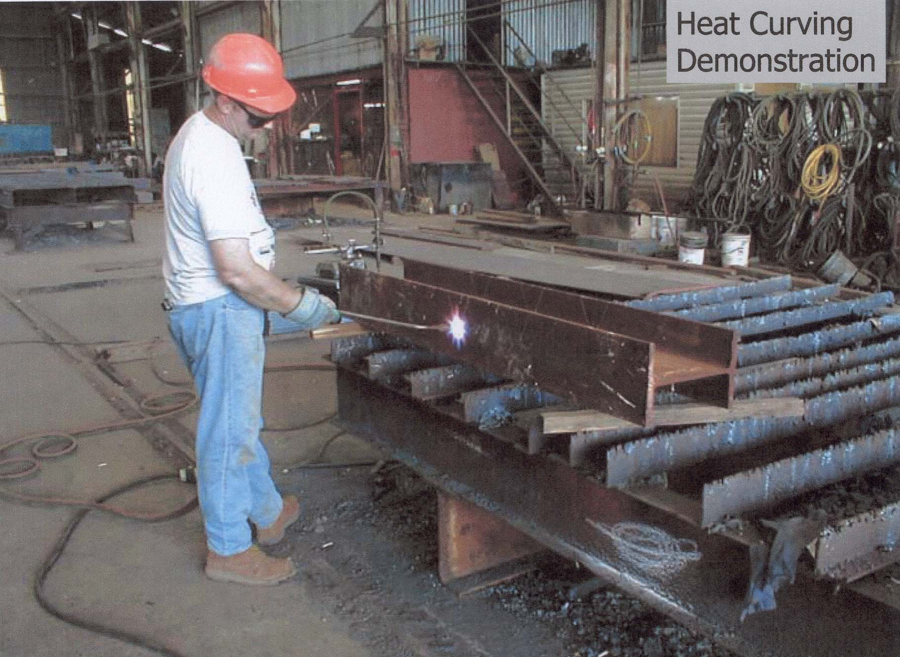
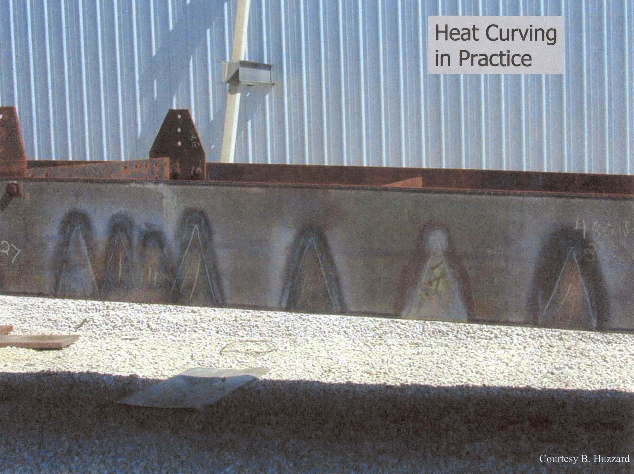
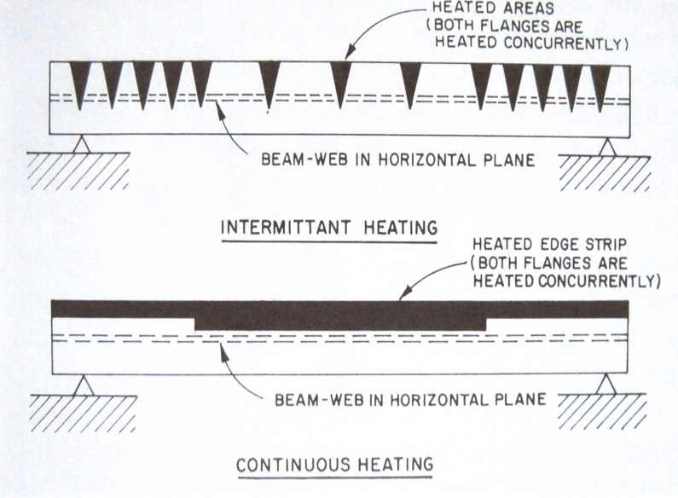
Heat Curving
Continuous heat
V heat (R > 300m)

Slide 4
Drawbacks
Procedure is complex
Numerical computations have to account for material and geometric non-linearity
Temperature distribution along the flange width are not exactly uniform
Analysis has to account for the girder behavior during heating and during cooling (natural cooling).
During heating, heated zone elongates to form a larger outer radius
During cooling, the heated portion shortens to form a reverse curvature

Slide 5
Material Properties
E/E′
F_{y}/F′_{y}

Slide 6
Cut-Curving
Flange
Flange
Flange
Scrap
Pressure Applied
During Fit-up
Web
Flange
Flange
Fitting Jig

Slide 7
Draw-Backs
  Too costly because of excessive waste
  Too much scrap for sharp curvatures
  Used for mild curvatures (R > 300m)
  Fit-up operation too complicated

Slide 8
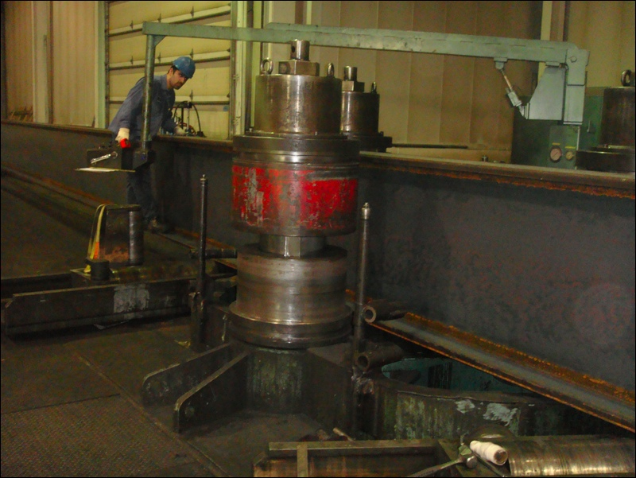
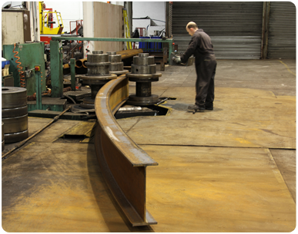
3-ROLLERS BENDING
  Mainly used in buildings
  Fit-up difficult for larger size bridge girders
  Perfect curve

Slide 9
OTHER IDEAS?

Slide 10
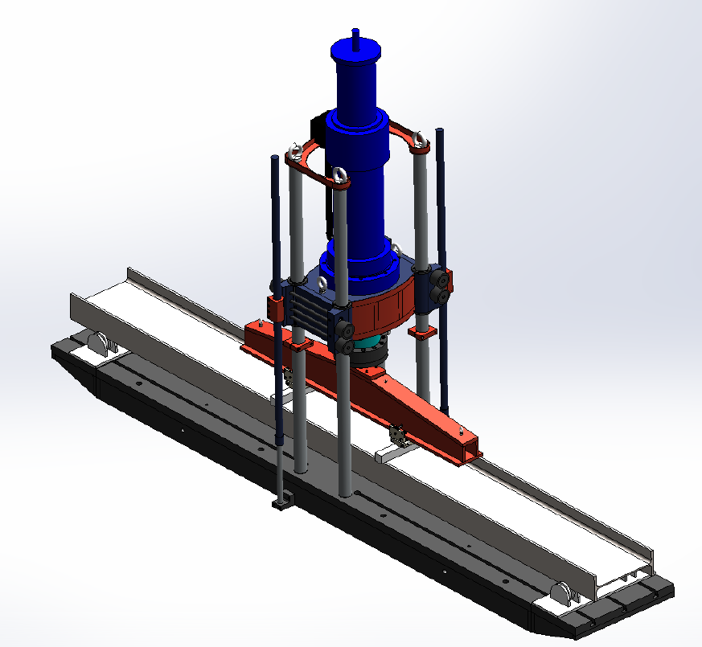
COLD BENDING

Slide 11
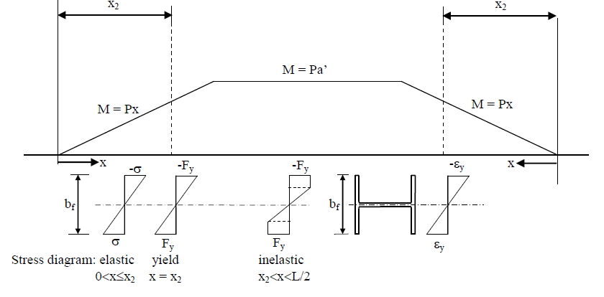
Analysis
τ = a’/L; χ = x₂/a’
(limit state of flange local buckling)
(lateral bracing limit)
Notes:
X2 = 2L/3 fully plastic

Slide 12
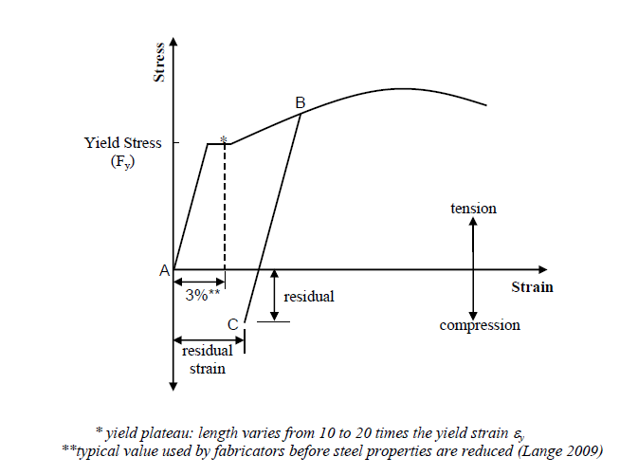
Stress-strain curve

Slide 13
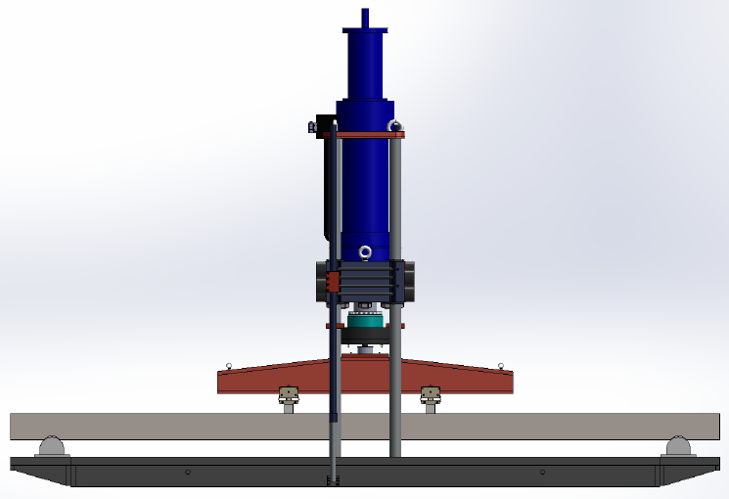
Idealization
a′

Slide 14
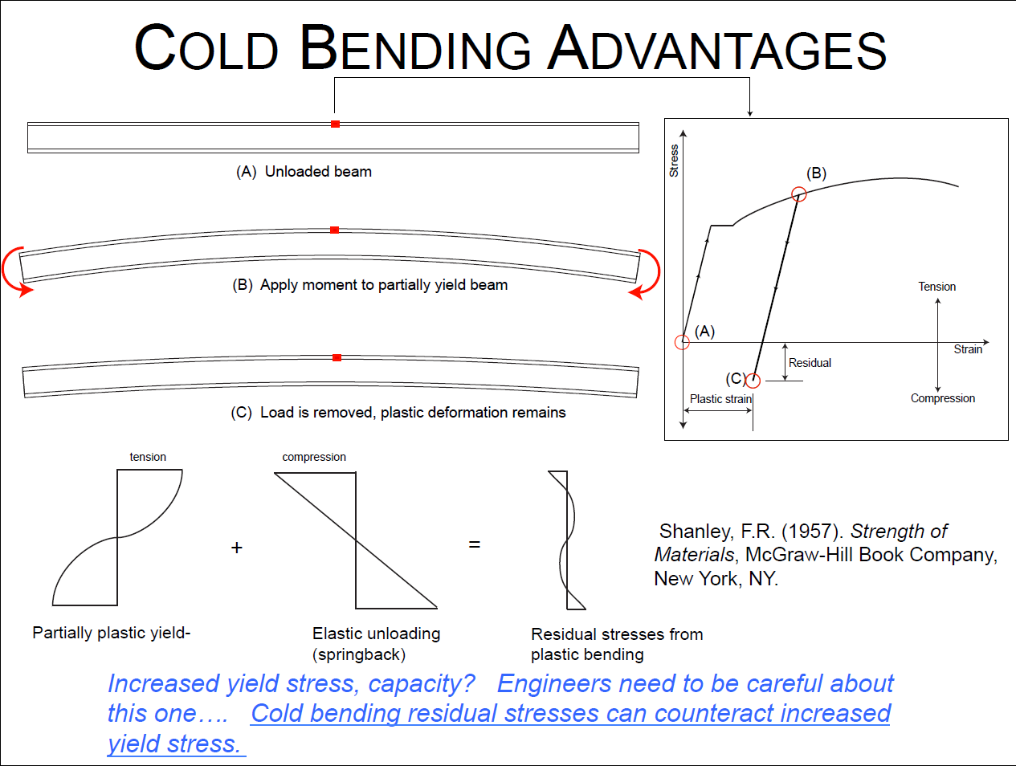

Slide 15
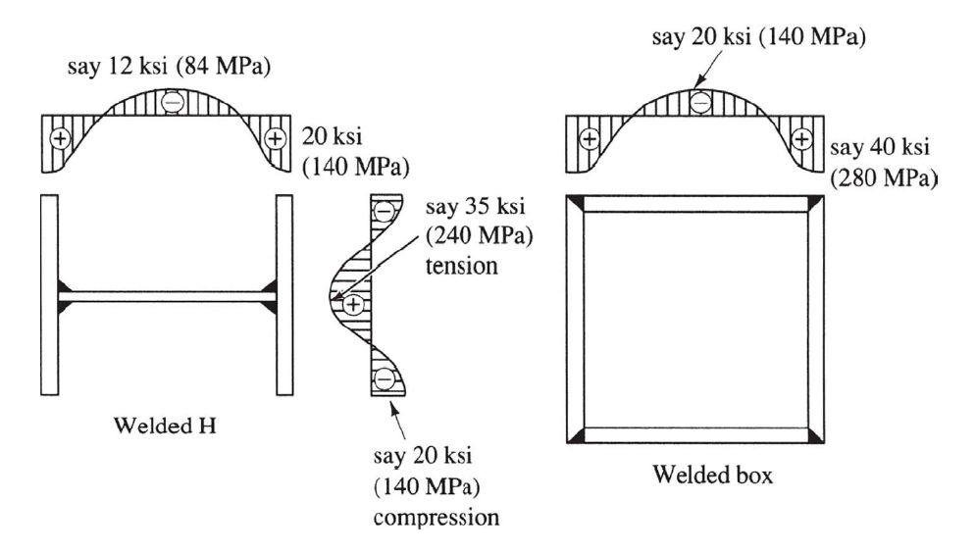
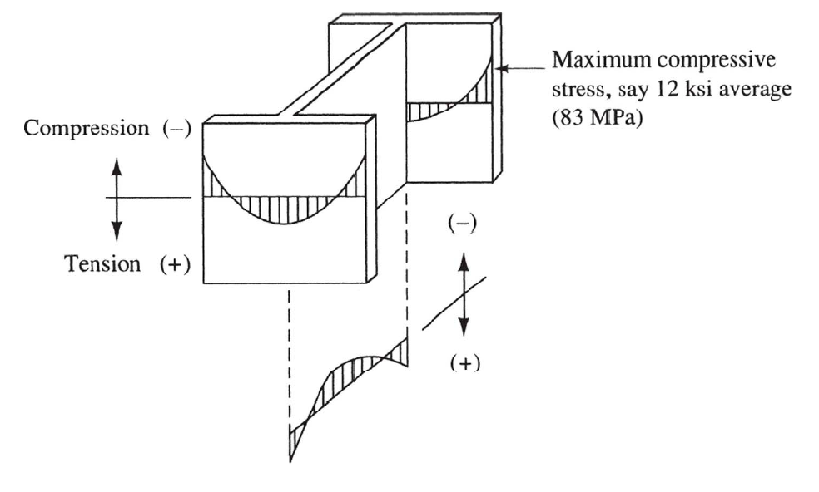
Residual Stresses
Flexural stiffness is reduced by the presence of cold bending residual stresses.
ROLLED BEAMS
WELDED SHAPES

Slide 16
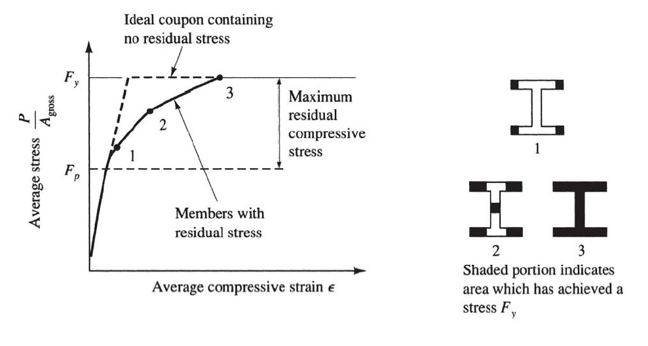
Influence of Residual Stress on Average Stress-Strain Curve

Slide 17

Tampa Steel Concept
Apply smaller loads at uniform intervals to achieve desired curvature

Slide 18
Idealization of Curve
L
1
2
3
4
5
6
7
δ₃
δ_{max} = δ₄
δ₅
δ₂
δ₆
x

Slide 19
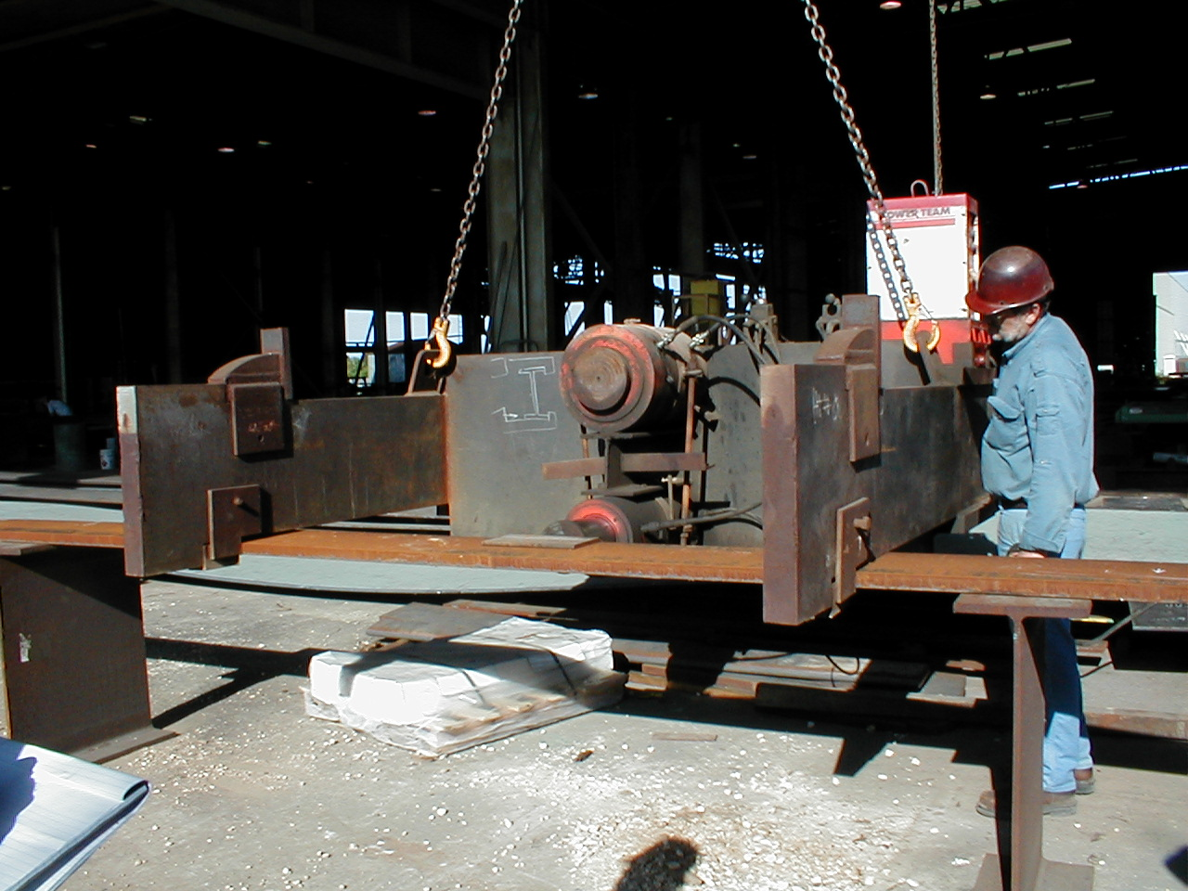
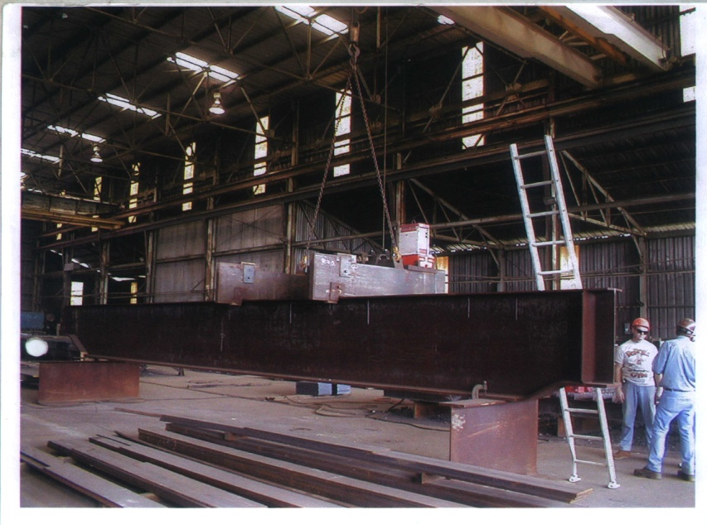
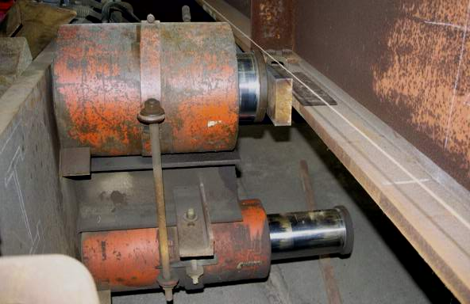
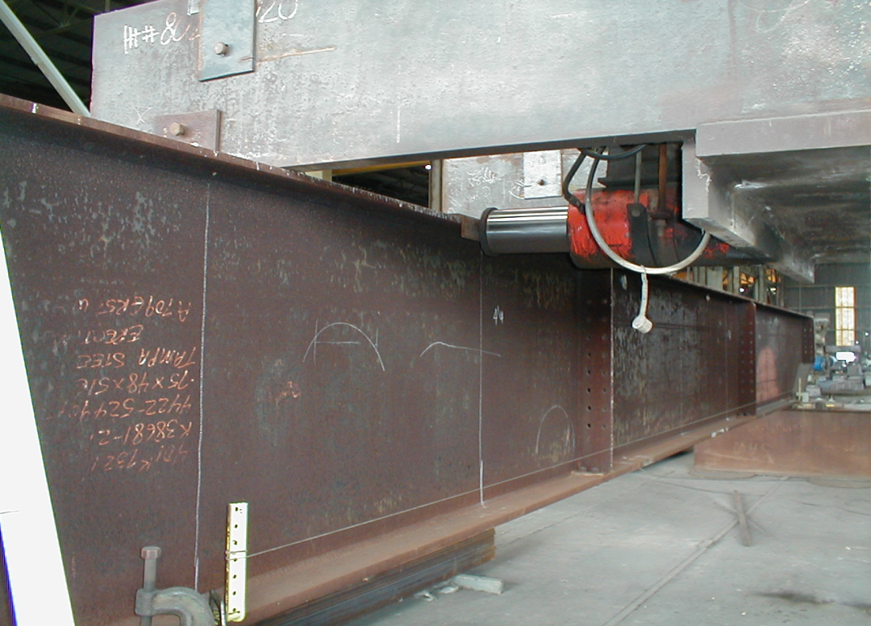
S
S
Load P
L_{i}

Slide 20
OFFSETS δ_{ii}, δ_{ij}
1
2
3
4
5
6
7
Load: 2
δ₂₂
Load: 3
δ₂₃
δ₃₃
Load: 4
δ₂₄
δ₃₄
δ₄₄
Load: 5
δ₂₅
δ₃₅
δ₄₅
δ₅₅
Load: 6
δ_{max}
δ₂₆
δ₄₆
δ₃₆
δ₅₆
δ₆₆

Slide 21

Test Girder

Slide 22
Loading Details

Slide 23
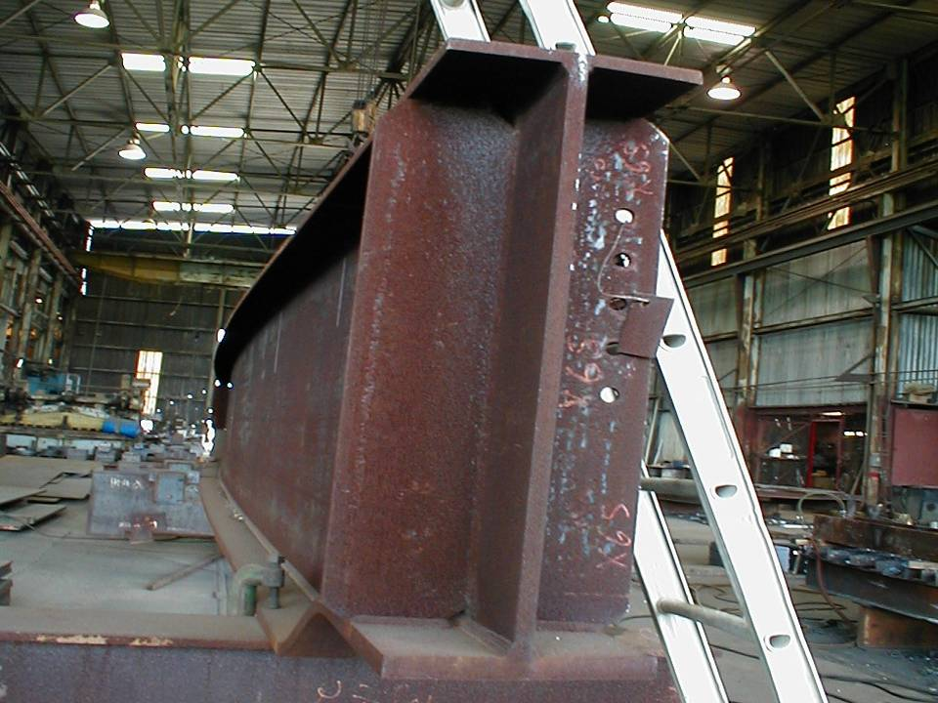
Test Girder after Curving

Slide 24
Idealized Stress-Strain Curve
ε ≈ 2.27ε_{y}
ε ≈ 1.89ε_{y}
ε_{max} ≈ 10 ε_{y}
F_{y}
R = 255 m
R = 115 m
STRESS
ε_{r} ≈ 0.39ε_{y}
ε_{r} ≈ 0.77ε_{y}
ε_{y}
STRAIN
ε_{residual} ≈ 8.5 ε_{y}
1.5 ε_{y}

Slide 25

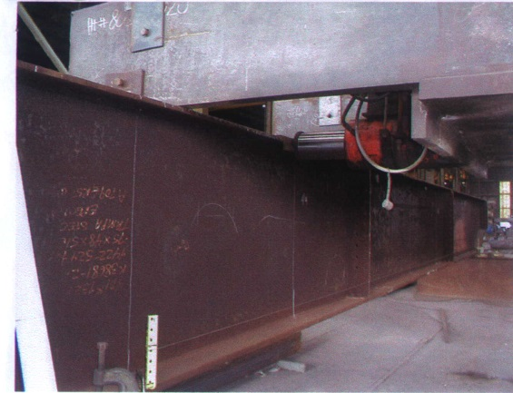
FORMULATION
  PARAMETERS:
  Load Frame Spacing S
  Bending Loads P_{tf}, P_{bf}
  Deflection Δ within span S
  Segment Length L_{i}
  Number of Segments n
  Offsets
S
P_{tf}
L_{i}

Slide 26
LOAD FRAME SPACING (S)
  Based on lateral bracing limit:
  S = 14.4c for Grade 250 steel
  S = 12.2c for Grade 345 steel
  For unsymmetrical sections use c_{tf}
Load P
Flange
Width 2c
Comp. side
Flange
S = L_{p}

Slide 27
BENDING LOADS (P_{tf}, P_{bf})
  From simple beam plastic load analysis:
Top Flange: P_{tf} based on t_{tf}, c_{tf}
Bot. Flange: P_{bf} based on t_{bf}, c_{bf}
Constant
P
F_{y}t_{f}c
c
F_{y}t_{f}c
c
S
M_{p} = F_{y}t_{f}c²

Slide 28
DEFLECTION Δ
c_{tf} ≤ c_{bf}
P_{tf} ≤ P_{bf}
Load P
Δ_{tf} ≥ Δ_{bf}
set Δ = cte = Δ_{tf}
⇒ Δ ≥ Δ_{bf} ???
Δ_{bf}
Δ_{tf}
Plastic
Hinge
Set P = P_{bf},
Load in cycles
m=Δ_{tf}/Δ_{bf}
P ≥ P_{bf}
(on-going research)
S

Slide 29
SEGMENT LENGTH L_{i}
2L_{i}
Δ_{tf}
S
[m]
×
Δ
Constant
[m-1]
×
×
[m+1]
2ΔL_{i}/S
2L_{i}
Radius R

Slide 30
NUMBER OF SEGMENTS
Length L
nL_{i}
a
a
1
2
3
4
5
n
n+1
Line of symmetry
Round-down to the nearest even integer
adjust

Slide 31
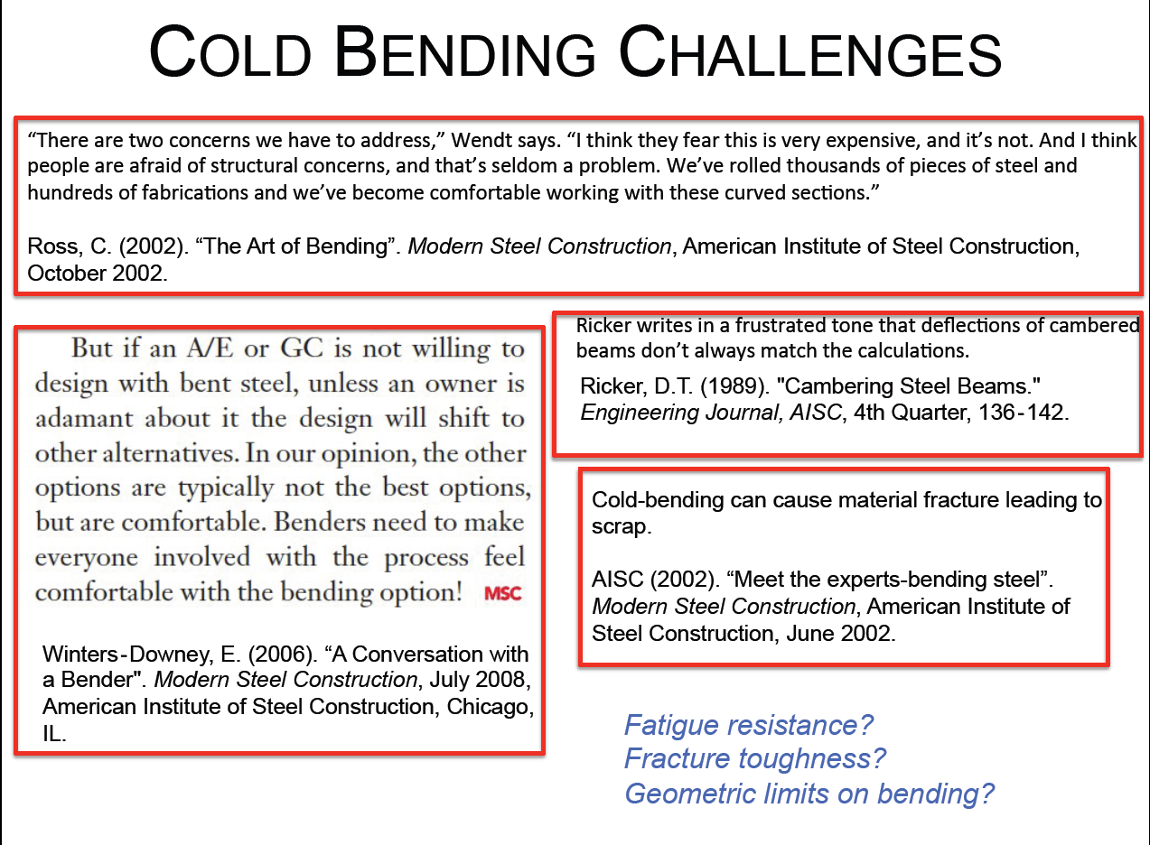

Slide 32
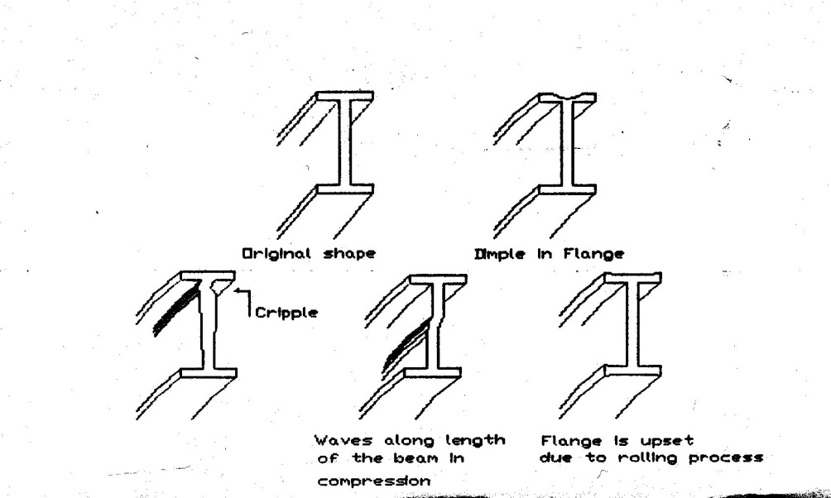
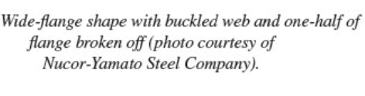
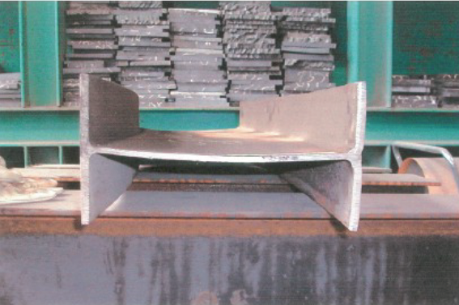
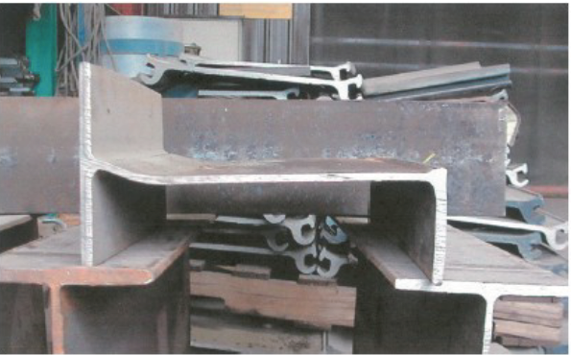
Challenges ?
  Cracking, Fracture
  Flange Upsets
  Dimples
  Web Crippling

Slide 33
Challenges ?
  - Effects on Steel mainly fracture characteristics
  - Does it lead to a permanent reduction
  in the ductility and fracture resistance of steel?
  - Effects if steel is loaded beyond plastic limits
  - ANSWERS ? Specific need for full-scale
  testing.

Slide 34
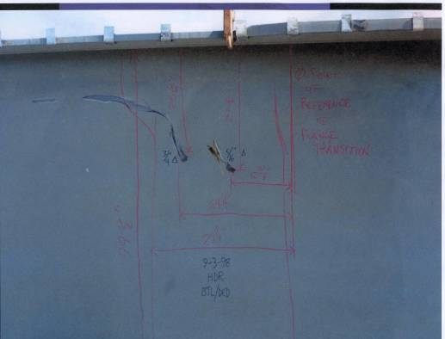
How could it be assessed - 1?
Perform visual inspection using NDT techniques
Instrument to measure loads, offsets, strains and web movement

Slide 35
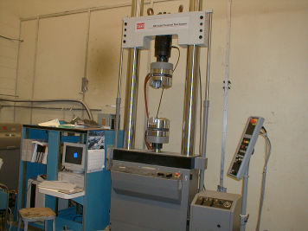
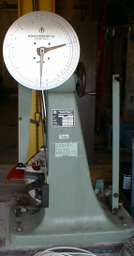
How could it be assessed - 2?
Perform in-depth material testing of the bent zone, e.g.
Charpy V-notch test
Fracture sensitivity
Tensile strength
Brinell hardness

Slide 36
How could it be assessed – 3?
  Check for compliance with AASHTO Requirements

Slide 37
HPS 485W
Results of FHWA Tensile Tests on HPS 485W Specimens.
Wright W, Candra H, Albrecht P. “Fracture Toughness of A709 Grade HPD -485W Steel”. Draft FHWA Report, Washington, D.C, 2005.

Slide 38
How could it be assessed – 4?
3D Finite Element Modeling

Slide 39
Specifications
Develop criteria and specifications for consideration by AASHTO
    Limits on strain
    Limits on applied load
    Limits on minimum radius
Guidelines for localized damage repair
Guidelines for inspection
Fabrication aids

Slide 40
Acknowledgment
    Dr. Rajan Sen, PhD, PE, F.ASCE, Samuel and Julia Flom Professor, University of South Florida, Tampa
    Tampa Steel Erecting Company, Tampa, Florida

Slide 41

Thank You!
www.balamand.edu.lb

