Slide 1


5TH WORLD CONVENTION ON RECYCLING AND WASTE MANAGEMENT
September 11-12, 2017 Singapore
Recycling based comprehensive characterization of waste printed circuit boards of various brown and white goods
Anshupriya
    Dept. of Civil & Environmental Engineering
    Indian Institute of Technology Patna
    Bihar, India

Slide 2

Introduction
Electronic waste (e-waste) constituting of various groups such as brown and white goods is one is the fastest growing waste stream in the world making up about 8% of municipal solid waste (MSW) (Widmer et al., 2005).
Printed circuit board (PCB) is core component of EEEs and constitute 3-6% of the total weight of EEEs (Das et al., 2009; Li et al., 2004).
The rich content of metals, precious metals and toxic metals make PCB potential secondary metal reservoirs as well as source of metal toxicity.
Comprehensive characterization of PCB of e-waste is critical attribute in determination of resource content for recycling.
Till date, very scarce and scattered information on comprehensive characterization of PCBs of different end-of-life EEEs in terms of their metals content, moisture, volatile matter content, and pH exist.
The research aims at comprehensive characterization of two brands of PCBs from each of 16 end-of-life EEEs classified as brown and white goods for content of general and precious metals along with moisture, volatile matter and pH for recycling purpose.

Slide 3
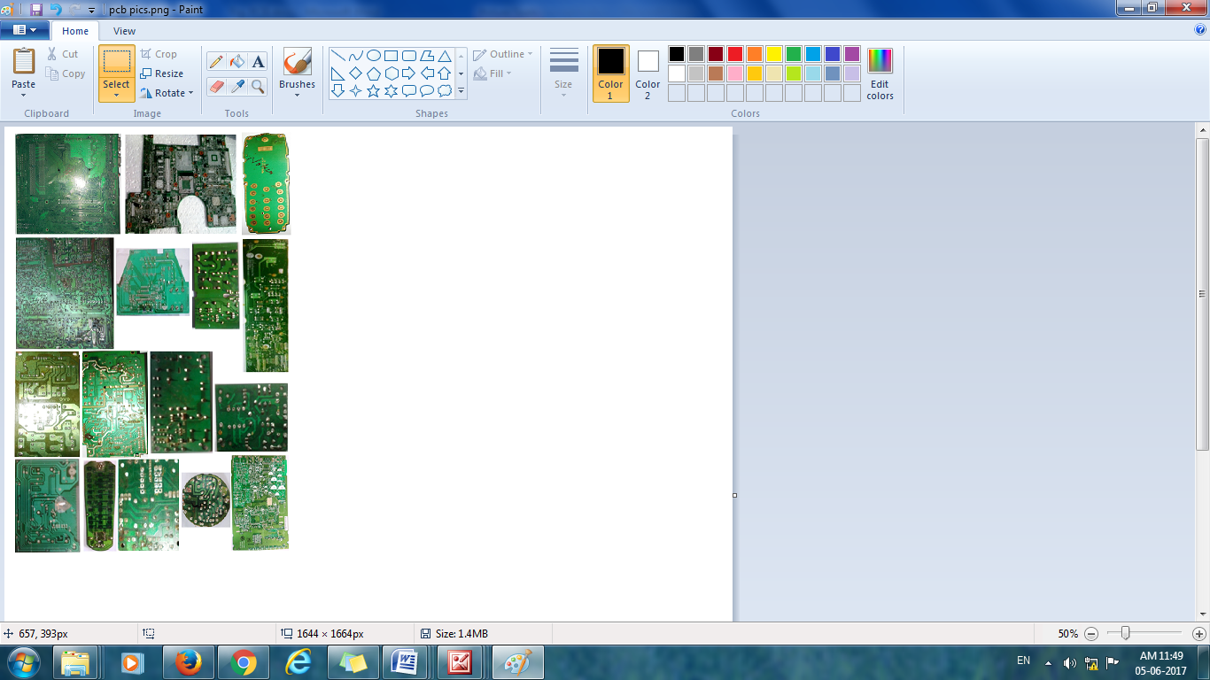
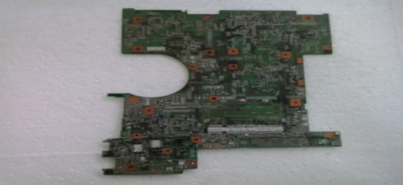
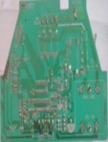
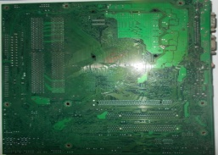

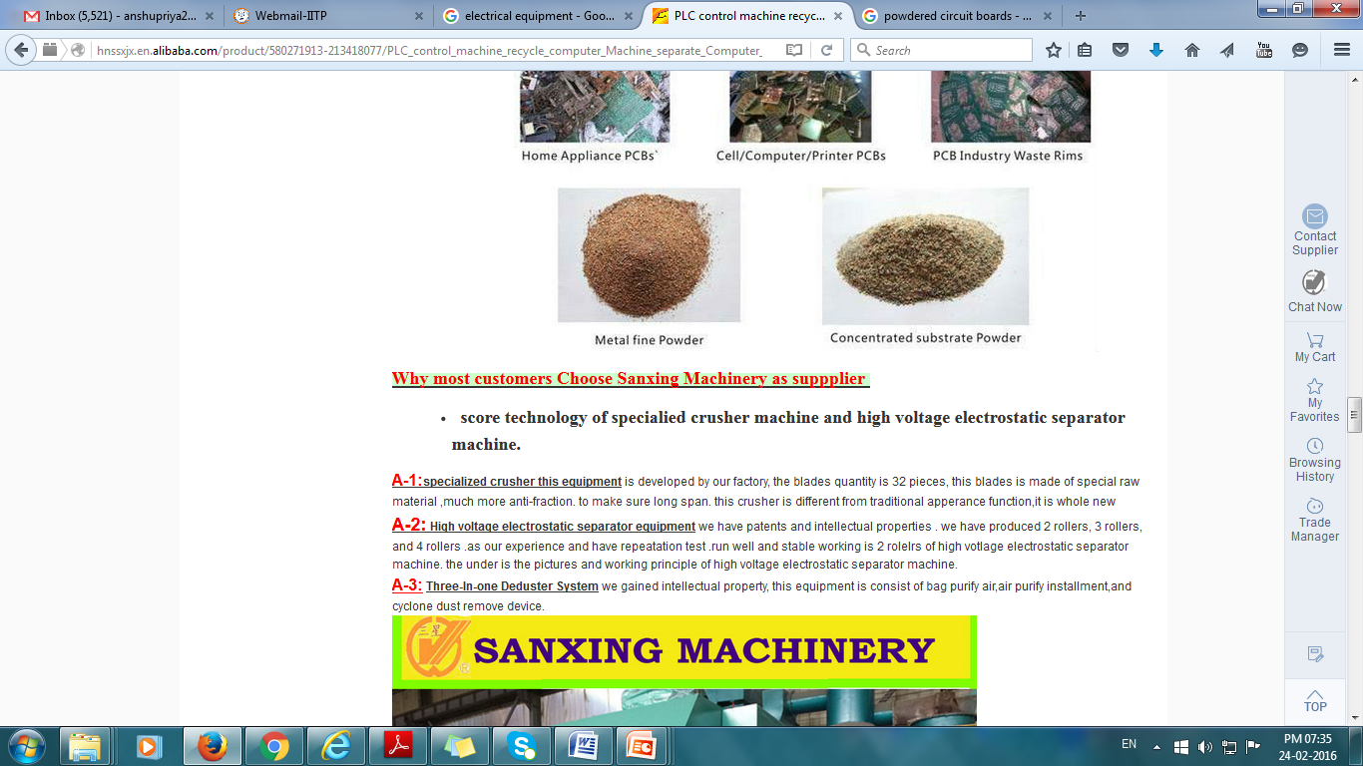
Materials and Methods
Collection of PCBs
Brown Goods
White Goods
a
b
c
d
e
f
g
h
i
j
K
l
m
n
o
p
(a) Computer, (b) Laptop, (c) Mobile phones (MP), (d) Calculators, (e) Modem, (f) TV, (g) Radio, (h) DVD player, (i) TV remote control (TRC), (j) Stereo amplifiers (SA) , (k) CFL, (l) Rechargeable lamp (RL), (m) Refrigerator, (n) WM, (o) Air conditioner (AC), (p) Inverter
Comminution
Moisture Content
General Metals
Volatile Matter Content
Metal Quantification
Precious Metals
pH
Powdered PCB

Slide 4
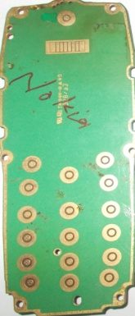
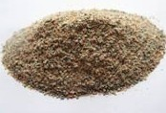
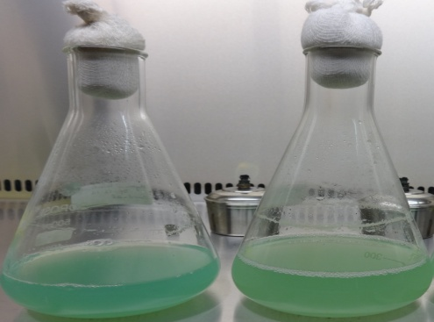
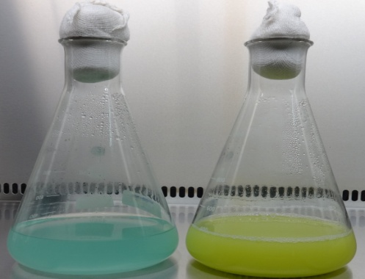
Materials and Methods cont…
Bioleaching studies
Mobile Phone PCB
Comminution
Pulverized PCBs
Bioleaching
Computer PCB
A. acidophilum
based
A. ferrooxidans based
Fig. 1 Experimental set up for feasibility of bioleaching of selected metals from high grade PCBs.
C
C

Slide 5
Results and Discussion
Table 1 Metal concentrations in waste brown electrical and electronic goods.
WEEE | General Metals (wt.%) |  |  |  |  |  |  | Precious Metals (g/ton)
 | Cu | Zn | Al | Pb | Ni | Cd | Ba | Au | Ag
(i) Computer
Brand I | 20.91±0.31 | 1.59±0.70 | 3.03±0.50 | 4.64±0.60 | 0.014±0.003 | 0.033±0.015 | 0.510±0.006 | 184.57±0.02 | 630.78±0.4
Brand II | 20.73±0.21 | 2.19±0.40 | 5.94±0.10 | 3.31±0.60 | 0.028±0.002 | 0.047±0.002 | 0.214±0.004 | 224.69±0.13 | 524.04±0.49
Literature data | 6.9-24.69 | 0.07-4.48 | 1.3-5.7 | 1.5-5.5 | 0.13-1 | - | 0.19 | 86-1300 | 570-1600
(ii) Laptop
Brand I | 20.59±0.73 | 1.81±0.01 | 0.50±0.04 | 8.08±0.14 | 0.03±0.01 | 0.029±0.004 | 0.58±0.03 | 194.46±1.17 | 635.77±7.84
Brand II | 22.57±1.69 | 0.72±0.60 | 0.60±0.04 | 6.71±3.56 | 0.11±0.14 | 0.025±0.004 | 0.34±0.02 | 222.74±0.36 | 632.88±0.34
Literature data | - | - | - | - | - | - | - | - | -
(iii) Mobile phone
Brand I | 11.53±0.85 | 1.04±0.11 | 0.68±0.08 | 6.29±1.55 | 0.32±0.01 | 0.077±0.004 | 0.11±0.01 | 315.93±2.51 | 524.53±0.33
Brand II | 19.27±1.41 | 1.27±0.24 | 1.00±0.15 | 5.50±2.88 | 0.30±0.03 | 0.018±0.002 | 0.13±0.01 | 280.58±3.36 | 510.90±0.24
Literature data | 0.187-34.5 | 0.5-3.39 | 0.26-1.5 | 0.3-1.9 | 0.1-33.41 | 2.16-5.23 | 1.9 | 350-1500 | 1380-3800
(iv) Calculator
Brand I | 0.717±0.018 | 0.020±0.003 | 0.20±0.04 | 0.74±3.95 | 0.07±0.01 | 0.016±0.004 | 0.02±0.01 | 0.15±0.09 | 0.14±0.01
Brand II | 0.590±0.001 | 0.136±.041 | 0.25±0.02 | 1.59±2.60 | 0.59±0.15 | 0.084±0.035 | 0.15±0.02 | 0.08±0.02 | 0.94±0.07
Literature data | 3 | - | 5 | 0.1 | 0.5 | - | - | 50 | 260
(v) Modem
Brand I | 0.70±0.04 | 0.012±0.005 | 0.68±0.03 | 0.14±0.04 | 0.026±0.001 | 0.07±0.02 | 0.20±0.02 | 3.68±0.55 | 8.20±0.01
Brand II | 1.16±0.11 | 0.016±0.003 | 0.32±0.02 | 0.71±0.15 | 0.018±0.008 | 0.14±0.02 | 0.16±0.01 | 9.99±0.63 | 13.15±0.05
Literature data | 21.63 | 0.861 | 5.90 | 0.34 | 0.464 | 0.00006 | 0.17 | 199 | 1213

Slide 6
Results and Discussion
Table 1 …cont.
WEEE | General Metals (wt.%) |  |  |  |  |  |  | Precious Metals (g/ton)
 | Cu | Zn | Al | Pb | Ni | Cd | Ba | Au | Ag
(vi) TV
Brand I | 13.05 ±0.01 | 1.15±0.83 | 0.27±0.08 | 3.48±0.23 | 0.050±0.001 | 0.08±0.01 | 4.33±1.72 | 23.44±0.07 | 286.58±0.68
Brand II | 16.17±0.09 | 0.93±0.01 | 0.36±0.02 | 3.17±0.12 | 0.008±0.003 | 0.05±0.01 | 7.08±0.65 | 32.91±0.32 | 294.51±0.01
Literature data | 7.2-10 | 0.02-0.53 | 0.75-10 | 0.0003-4.6 | 0.01-0.3 | - | 0.24 | 3-20 | 86-280
(vii) Radio
Brand I | 5.74±0.23 | 0.04±0.01 | 0.26±0.04 | 3.59±0.08 | 0.031±0.005 | 0.195±0.003 | 0.006±0.003 | 2.38±0.41 | 20.43±0.11
Brand II | 8.71±0.38 | 0.04±0.02 | 0.25±0.10 | 5.08±0.32 | 0.019±0.002 | 0.188±0.003 | 0.010±0.003 | 1.63±0.24 | 26.66±0.33
Literature data | 14 | 1.1 | 6.1 | 1.7 | - | - | 1.4 | 26 | 170
(viii) DVD player
Brand I | 11.21±0.08 | 0.09±.01 | 2.68±0.04 | 14.88±3.09 | 0.013±0.002 | 0.079±0.004 | 0.007±0.004 | 18.86±2.35 | 136.14±0.11
Brand II | 8.24±0.19 | 0.07±0.01 | 2.56±0.04 | 14.65±3.26 | 0.009±0.001 | 0.045±0.003 | 0.015±0.009 | 4.39±0.69 | 87.88±0.06
Literature data | 5-22 | 2.6 | 2-5.4 | 0.3-1.2 | 0.05 | - | 4.3 | 15-150 | 115-710
(ix) Stereo amplifier
Brand I | 1.25±0.15 | 0.02±0.01 | 0.14±0.01 | 0.15±0.06 | 0.09±1.79 | 0.164±0.004 | 0.008±0.002 | 0.720±0.013 | 0.15±0.03
Brand II | 2.85±0.25 | 0.06±0.01 | 0.34±0.02 | 0.47±0.29 | 0.04±1.41 | 0.075±0.007 | 0.006±0.002 | 1.002±0.602 | 0.08±0.04
Literature data | 15 | 1.4 | 2.9 | 1.9 | - | - | 1.4 | 6 | 57
(x) TV remote control
Brand I | 1.32±0.13 | 0.006±0.001 | 0.50±0.06 | 0.58±0.08 | 0.018±0.003 | 0.05±0.01 | 0.044±0.007 | N.D. | N.D.
Brand II | 1.79±0.08 | 0.032±0.008 | 0.28±0.04 | 0.49±0.01 | 0.008±0.001 | 0.03±0.01 | 0.006±0.003 | N.D. | N.D.
Literature data | - | - | - | - | - | - | - | - | -

Slide 7
Results and Discussion
Table 1 …cont.
WEEE | General Metals (wt.%) |  |  |  |  |  |  | Precious Metals (g/ton)
 | Cu | Zn | Al | Pb | Ni | Cd | Ba | Au | Ag
(xi) CFL
Brand I | 0.36±0.02 | 0.061±0.005 | 0.97±0.05 | 0.09±0.02 | 0.018±0.002 | 0.022±0.003 | 0.028±0.008 | 0.039±0.006 | 0.16±0.08
Brand II | 0.23±0.04 | 0.059±0.001 | 0.50±0.15 | 0.30±0.01 | 0.008±0.001 | 0.036±0.002 | 0.012±0.003 | 0.008±0.004 | 0.08±0.02
Literature data | - | - | - | - | - | - | - | - | -
(xii) Rechargeable lamp
Brand I | 1.35±0.28 | 0.014±0.004 | 0.189±0.005 | 1.94±0.11 | 0.012±0.002 | 0.148±0.003 | 0.004±0.001 | 0.008±0.003 | 0.13±0.02
Brand II | 2.23±0.05 | 0.634±0.166 | 0.123±0.002 | 7.13±2.91 | 0.006±0.002 | 0.175±0.059 | 0.006±0.003 | 0.090±2.137 | 0.15±0.06
Literature data | - | - | - | - | - | - | - | - | -
N.D.: Not detected

Slide 8
Results and Discussion
Table 2 Metal concentrations in waste white electrical and electronic goods.
WEEE | General Metals (wt.%) |  |  |  |  |  |  | Precious Metals (g/ton)
 | Cu | Zn | Al | Pb | Ni | Cd | Ba | Au | Ag
(i) Refrigerator
Brand I | 16.61±0.25 | 2.04±0.33 | 0.76±0.04 | 1.92±0.28 | 0.023±0.003 | 0.07±0.01 | 0.008±0.001 | 8.02±0.72 | 357.67±4.95
Brand II | 14.13±0.09 | 1.15±0.43 | 1.60±0.06 | 1.8±0.06 | 0.016±0.002 | 0.08±0.01 | 0.013±0.008 | 9.12±1.01 | 334.71±3.58
Literature data | 17 | 1.7 | 1.6 | 2.1 | - | - | 0.0082 | 42 | 44
(ii) WM
Brand I | 2.94±0.67 | 0.35±0.07 | 0.49±0.03 | 2.53±1.19 | 0.011±0.001 | 0.043±0.003 | 0.014±0.001 | 4.41±0.05 | 9.42±0.10
Brand II | 4.02±0.47 | 0.54±2.12 | 0.55±0.07 | 3.86±0.98 | 0.037±0.002 | 0.030±0.006 | 0.021±0.004 | 9.04±3.73 | 15.55±0.03
Literature data | 7 | 0.24 | 0.1 | 0.22 | - | - | 0.0065 | 17 | 51
(iii) AC
Brand I | 4.78±0.15 | 0.38±0.01 | 0.628±0.029 | 3.94±0.19 | 0.032±0.003 | 0.035±0.001 | 0.009±0.001 | 2.03±0.31 | 18.82±0.01
Brand II | 6.64±0.16 | 0.46±0.01 | 0.314±0.002 | 3.45±0.31 | 0.005±0.003 | 0.020±0.002 | 0.019±0.002 | 1.53±0.18 | 16.34±0.30
Literature data | 7.5 | 0.49 | 0.69 | 0.58 | - | - | 0.032 | 15 | 581
(iv) Inverter
Brand I | 1.74±0.13 | 0.50±0.34 | 0.31±0.01 | 2.75±0.05 | 0.011±0.002 | 0.09±0.01 | 0.03±0.01 | 9.77±3.96 | 14.44±0.01
Brand II | 2.40±0.10 | 0.03±0.01 | 1.26±0.02 | 4.87±0.17 | 0.009±0.001 | 0.17±0.01 | 0.04±0.01 | 4.17±0.37 | 10.32±0.04
Literature data | - | - | - | - | - | - | - | - | -

Slide 9
Results and Discussion
Table 3 General physico-chemical characterization of PCBs of various end-of-life EEEs.
Sl. No. | WEEE category | EEEs | Moisture content (%) | Volatile matter content (%) | pH
1 | Brown goods | Computer | 0.007±0.002 | 0.061±0.003 | 7.82±0.05
 |  | Laptop | 0.006±0.001 | 0.032±0.001 | 7.85±0.03
 |  | Mobile Phone | 0.005±0.002 | 0.022±0.001 | 7.83±0.02
 |  | Calculator | 0.013±0.003 | 0.201±0.003 | 7.82±0.01
 |  | Modem | 0.013±0.004 | 0.011±0.006 | 7.70±0.10
2 | White goods | Refrigerator | 0.008±0.002 | 0.162±0.004 | 7.80±0.02
 |  | WM | 0.015±0.004 | 0.202±0.006 | 7.83±0.06
 |  | AC | 0.012±0.006 | 0.187±0.004 | 7.78±0.09
 |  | Inverter | 0.010±0.003 | 0.121±0.003 | 7.81±0.07
3 | Brown goods | TV | 0.012±0.002 | 0.193±0.002 | 7.81±0.05
 |  | Radio | 0.010±0.002 | 0.147±0.004 | 7.86±0.03
 |  | DVD player | 0.018±0.001 | 0.200±0.003 | 7.79±0.01
 |  | TV remote control | 0.014±0.002 | 0.271±0.002 | 7.80±0.12
 |  | Stereo amplifier | 0.010±0.002 | 0.167±0.002 | 7.78±0.02
4 | Brown goods | CFL | 0.011±0.006 | 0.163±0.005 | 7.79±0.01
 |  | Rechargeable lamp | 0.016±0.001 | 0.156±0.004 | 7.79±0.13

Slide 10
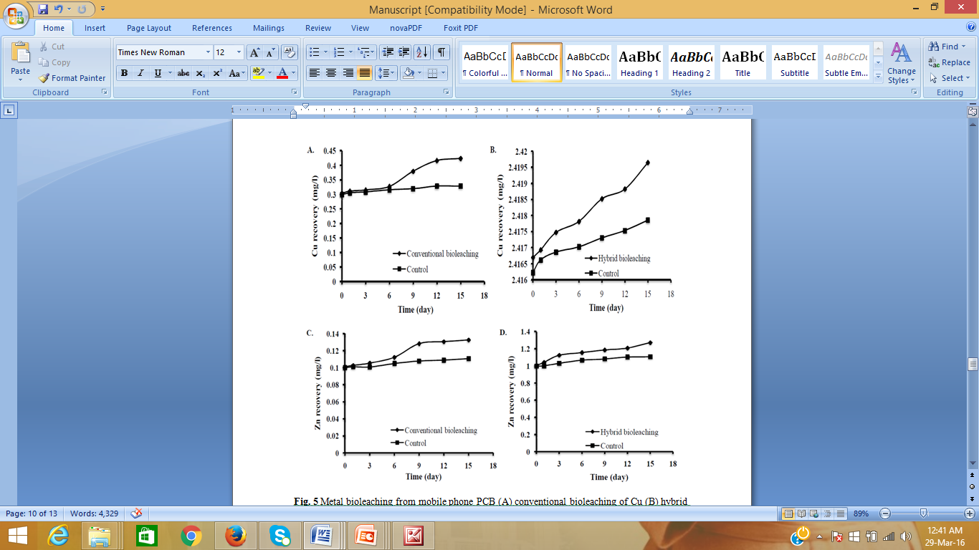
Metal Bioleaching for Mobile Phone PCBs using A. acidophilum
Result and Discussion cont…
B.
Fig. 2 Metal bioleaching from mobile phone PCB (A) bioleaching of Cu (B) bioleaching of Zn.

Slide 11
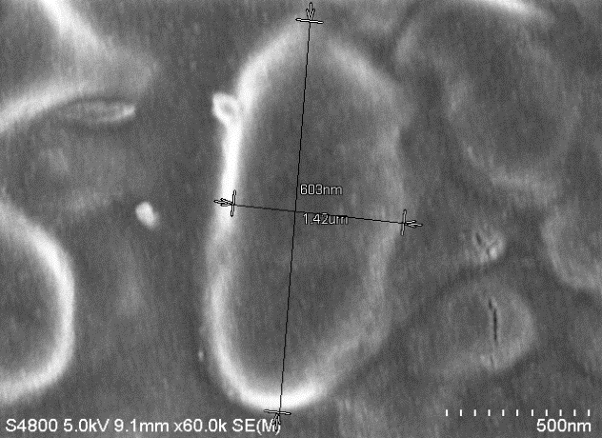
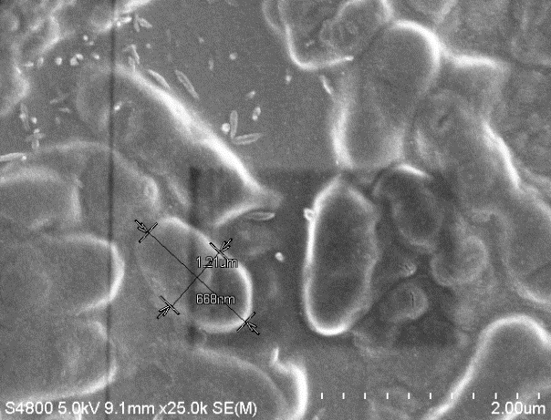
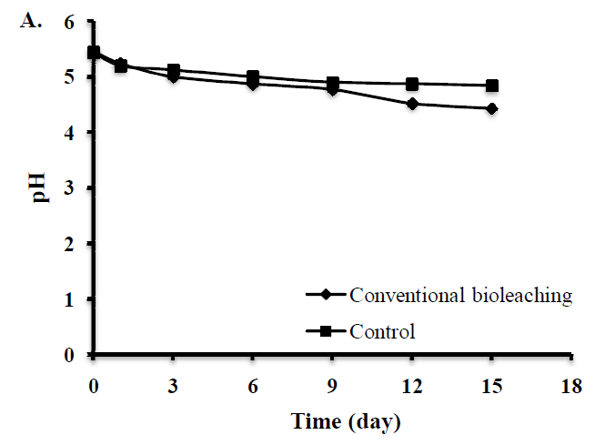
Result and Discussion cont…
Characterization of A. acidophilum
Rod shaped cells of size 0.5-0.8 µm x 1.0- 1.5µm
Occur singly, usually in pairs and very rarely in chains
Colonies are small, round, smooth, convex translucent and cream in colour
Fig. 3 SEM micrograph of Acidiphilium acidophilum cells.
Metal Bioleaching Studies
Fig. 4 Variation in pH of the A acidophilum medium with leaching time.

Slide 12
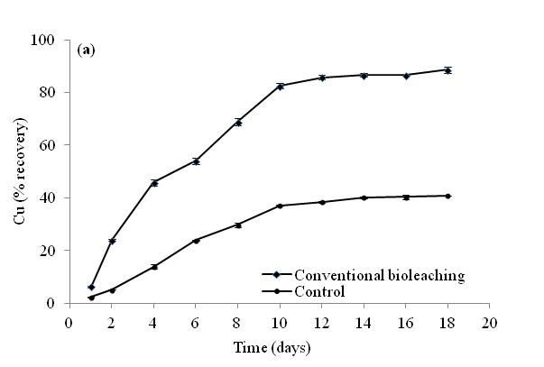
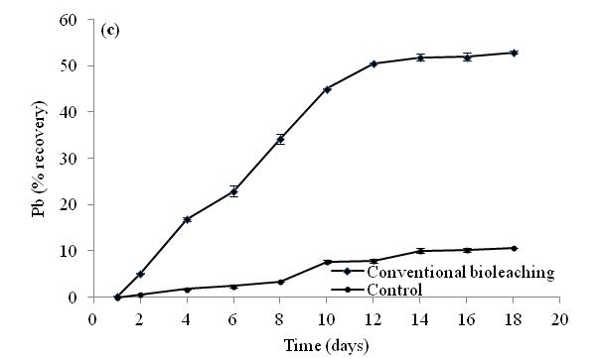
Metal Bioleaching for Computer PCBs using A. ferrooxidans
Result and Discussion cont…
(b)
Fig. 5 Metal solubilisation from waste PCB of computer (a) bioleaching of Cu, (b) bioleaching of Pb.

Slide 13
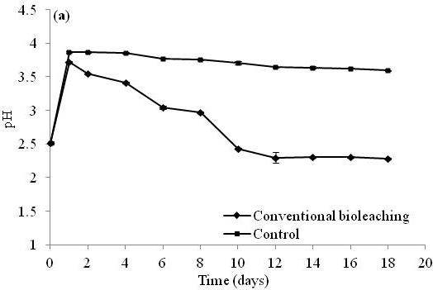
Results and Discussion
Bioleaching studies
Fig. 6 Variation in pH of the A. ferrooxidans medium with leaching time.

Slide 14
Conclusion
Based on the content of metals quantified in waste PCBs, computer, laptop and mobile phone can be categorized under high grade PCBs.
Metal bioleaching results indicated dissolution of both the base and toxic metals from the comminuted PCB fines.
A. acidophilum recovered 0.424 mg/L and 0.132 mg/L of Cu and Zn respectively from mobile phone PCB at 15 day of bioleaching.
A. ferrooxidans achieved Cu solubilisation of 86% at 12 day which asymptotically increased to 89% at 18 day and Pb recovery of 51% at 12 day which asymptotically increased to 52% at 18 days of bioleaching from computer PCB.
Bioleaching of metals was significantly more effective by A. ferrooxidans than bioleaching by A. acidophilum.
Enhanced recovery of the selected metals from the waste comminuted PCB from computer PCB can be attributed to the efficiency of bioleaching bacteria, A. ferrooxidans.
These findings highlight practical applicability of bioleaching technique and successful development of fast recovery of metals by A. ferrooxidans.
However, the rate of metal recovery needs to be improved for commercial applications by optimizing various environmental, biological and physicochemical factors regulating the bioleaching process.

Slide 15


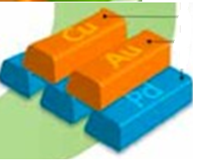
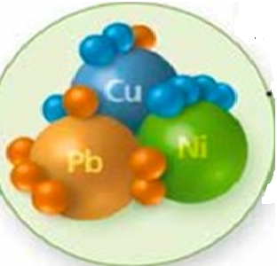

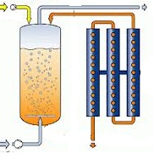

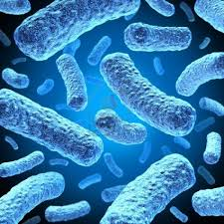
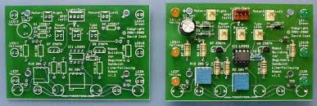
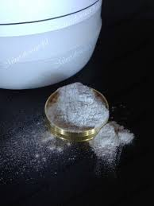
Electronic Waste (E-waste) - Bioleaching & Adsorptive Removal of Heavy Metals
Industry
Reuse
Domestic Source
Recycled Metals
Repair Shops
Metals Recovered
Sources of E-waste
E-waste
Bioreactor
Inoculation
Dismantling & Crushing
Bacteria
Adsorbent Column
Metals content analysis
Bioleaching Metals in Bioreactor Coupled with extraction
Printed Circuit Board
Powdered PCB

Slide 16
References
Baldé, C.P., Wang, F., Kuehr, R., Huisman, J., 2015. The global e-waste monitor – 2014, United Nations University, IAS – SCYCLE, Bonn, Germany.
Chang, E.E., Chiang, P.C., Lu, P.H., Ko, Y.W., 2001. Comparisons of metal leachability for various wastes by extraction and leaching methods. Chemosphere, 45: 91-99.
Cui J, Zhang L (2008) Metallurgical recovery of metals from electronic waste: A review. J Hazard Mater 158:228 -256
Das, A., Vidyadhar, A., Mehrotra, S.P., 2009. A novel flowsheet for the recovery of metal values from waste circuit boards. Resour. Conserv. Recy. 53 (8): 464–469.
Department of Toxic Substances Control (DTSC), 2004. Determination of regulated elements in even types of discarded consumer electronic products. Hazardous Material Laboratory, California.
Dutta, S. K., Upadhyay, V. P., Sridharan, U., 2006. Environmental management of industrial hazardous wastes in India. J. Environ. Sci. Eng. 48(2): 143-150.
Hicks C, Dietmar R, Eugster M (2005) The recycling and disposal of electrical and electronic waste in China – legislative and market responses. Environ Impact Assess Rev 25:459–471
Liang, G.; Tang, J.; Liu, W.; Zhou, Q. ,2013. Optimizing mixed culture of two acidophiles to improve copper recovery from printed circuit boards (PCBs). J Hazard Mater. 250– 251: 238– 245.
Li, J.; Shrivastava, P.; Gao, Z.; Zhang, H.C., 2004. Printed circuit board recycling: A state-of-the-art survey. IEEE Trans. Electron. Packag. Manuf. 27: 33–42.
United States (US) Federal Register, 1980. Hazardous/radioactive materials management and operations, 45 (98): 33063–33285.
Widmer, R., Karpi, H. O., Khetriwal, D. S., Schenellmann, M., Bonii, H., 2005. Global perspectives on e-waste. Environ. Impact. Assess. Rev. 25(5):436-458.

Slide 17


ThanK
You

