Slide 1
Incidence and Associated Factors of Type2 Diabetes Mellitus in Thai Rural Community
5th Year Medical Cadet Student, Phramongkutklao College Of Medicine
Notes:
Good afternoon chair, cochair, ladies and gentlemen,I am Annop Kittithaworn, fifth year medical cadet from Phramongkutklao College of Medicine.
, I’d like to present our study entitled, A study of incident and associates of type2 Diabetes in a Thai rural community.

Slide 2
Global Prevalence of Type2 DM in 2015
140 million
415 million
Source: International Diabetes Federation
Notes:
Slide 2
-Let’s start with the current situation of diabetes around the world…
-According to the International Diabetes Federation studied , there are 415 million people worldwide who are living with diabetes. Unfortunately there is only a half of the people with diabetes know that they have the disease. And 4 out of 5 diabetes sufferers live in low- and middle-income countries.
--As seen in this illustration, Western Pacific is the most highest Diabetes prevalence in the world and Thailand is a country on this area, Base on the International Diabetes Federation classifies

Slide 3
Global Prevalence of Type2 DM
Notes:
Moreover, at the current growth rates in this region, the number of diabetes patient is estimated to reach 592 million by 2035. And among countries with the largest incidence of diabetes, China is the leader.

Slide 4
Prevalence of Type2 DM in Thailand
Source: Aekplakorn W, InterASIA Collaborative Group: The prevalence and management of Diabetes in Thai Adults. Diabetes Care 2003, 25(10):2758–63
Notes:
In Thailand, as presented on the bar chart, the percentage of the prevalence of type 2 Diabetes in the country from 1991 to 2009 had gradually increased.

Slide 5
Incidence of Type2 DM in Thailand
Number per 1000 people-year
Source: Jiamjarasrangsi W, Lohsoonthorn V, Lertmaharit S, Sangwatanaroj S. Incidence and associates of abnormal fasting plasma glucose among the university hospital employees in Thailand. Diabetes research and clinical practice 2008;79(2):343-9
Notes:
• Data from many countries also reports similar trend and shows smiliar risk factors, for type 2 diabetes such as age, gender, BMI, underlying diseases and medications.
•Also, previous studies illustrated the incidence of type 2 Dm in Thailand which was different with gender and its incident was approximately 15 per 1,000 year

Slide 6
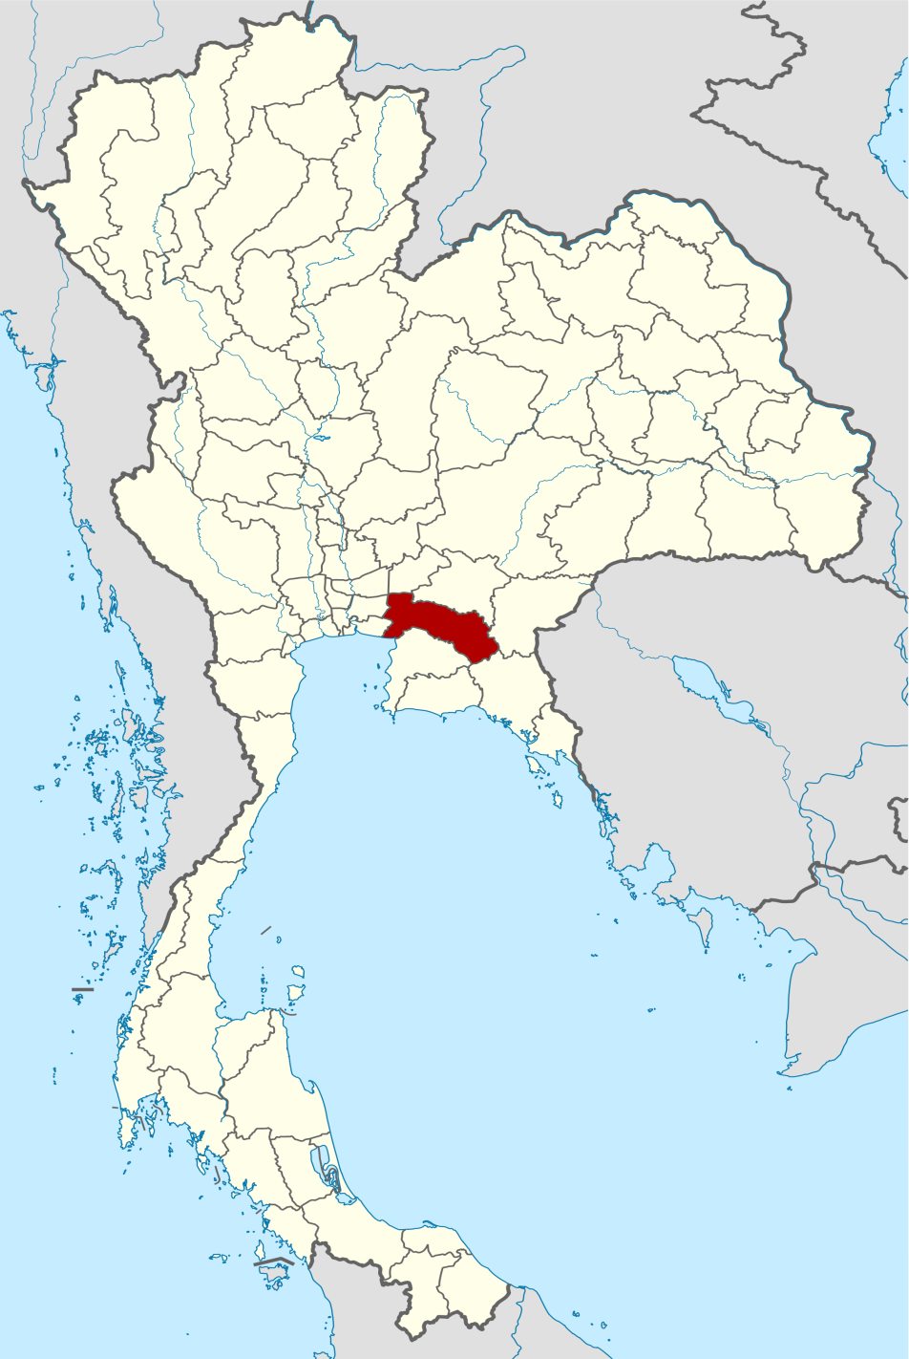
Na Yao Community, Thailand
Notes:
And our study concerns over a community in Thailand called Na Yao, which is located in Sanam chai Khet district in Chacheongsao Province in the central region of Thailand. The number of population is approximately 6,500 people .This community can be divide into main 5 villages.

Slide 7
Prevalence of Type2 DM in Na Yao Community
Source: Hatthachote P, Suwan K, Pongmanee K, Areekul W. Albuminuria in rural Thai people: a community-based screening with Combur test and Micral test strips. J Med Assoc Thai 2005;88(3):164-74
Notes:
Along with the trend in the region, the prevalence of type 2 Diabetes from the year 2003 to the year 2008 rose gradually in Nayao community.

Slide 8
RATIONALE
Worldwide increasing in numbers of T2DM patient
Useful for effective control and prevention of the disease
Very first community based research on incidence and associated factors of diabetes type 2 in rural community of Thailand
Notes:
These previous studies do yield the broad the preliminary information that…
-type 2 diabetes mellitus (DM) in thai population tends to increase every year.
and -this study is useful for effective early screening and preventing of the disease.
However, the limitation of most studies was that they were based on urban communities while only a few were conducted in rural communities. So, the result cannot represent the incidence in Thailand as a whole accurately yet.

Slide 9
objective
To determine the incidence and associated factors of type 2 Diabetes Mellitus among people in Nayao community, Chacheongsao province, Thailand between 2008-2015
Notes:
•In order to expand the knowledge of the prevalence of this disease in other parts of Thailand apart from the urban ones, this study then was conducted to determine the incidence and associated factors of type 2 diabetes among people in a chosen rural community called Nayao community.

Slide 10
Study design
Retrospective Cohort Study
Notes:
Our study design/ was conducted as a Retrosoective Cohort study based on data collection from Medical staff department of military and community medicine in 2008

Slide 11
Study population
Inclusion criteria
Exclusion criteria
Tested blood glucose level in 2008-2009 without diabetes mellitus diagnosis
Age 35 years old or older in 2015
Accept and sign on the informed consent form
Pregnant woman or less than 6-month post partum
Move out from Nayao community
Notes:
As for the criteria for study population, the study divided as followed…
Firstly, the inclusion criteria was composed of 3 factors . The first of all, the study population must be the people who have tested blood glucose level in 2008-2009 without diabetes mellitus diagnosis. The second, they must be people who was 35 years old or older, and the last one, the study population must sign on the informed consent form
Secondly, the exclusion criteria were pregnant women or women with less than 6-month post partum to exclude gestational diabetes and people who did not stay in Nayao community during the research process

Slide 12
Study procedure
Participants = 1,735
T2DM = 187
IFG = 155
Normal = 1,393
Non T2DM = 1,548
n=1,548
Baseline
2008-2009
2015
Notes:
-A previous study in 2008-2009 showed that
-The total of 1,735 people were studied in plasma glucose and associated factor. The result were divided into three groups. In the first group, the normal plasma glucose group had 1,393 people. The second group were 155 people in the impaired plasma glucose group, and 187 people were in the third group, the Diabetes group.
- After that, 1,548 people in the non diabetes group were followed up to serum study in 2015.

Slide 13
Data collection
Exposures (Risk factors)
Standardized Questionnaires
Physical examination
Outcome (Incidence of T2DM)
Plasma glucose ≥ 126 mg/dl
HbA1c ≥ 6.5
Notes:
Data collection was divided into two main parts to determine associated factors. The first part of the data collection was to collect the modified factors and the latter the non modified factors with standardized questionnaires and physical examination.
In this study, the outcome showed a number of new case as plasma glucose which was greater than or equal to 126 mg/dL to diagnosis and confirmed diagnosis with HbA1C greater than or equal to 6.5.

Slide 14
Ethical consideration
This study was reviewed and approved by the Institutional Review Board (IRB) of the Royal Thai Army Medical Department
Notes:
Ethical consideration,This study was reviewed and Approved by the Institutional Review Board(IRB) of the medical department of royal Thai army.

Slide 15
Results: Enrollment
Excluded = 778
Move out = 341
Death = 82
Loss of follow up = 355
Included =770
T2DM = 136
Non T2DM = 634
2015
Notes:
-The study follow up 1,548 participants from 2008 to 2015, but then lost track of 778 participants during the 7 years.
Finally, the final coverage was 770 participants.
-And the end result after the serum study showed that there were 136 participants who had Diabetes.

Slide 16
Results: Incidence of t2dm
T2DM = 136
Cumulative incidence = 136/770 = 17.66%
Non T2DM =634
Total time of follow up = 5323.53 years
Incidence density = 136/5323.54 = 25.55 per 1,000 PY
2015
Notes:
therefore, we found that cumulative incidence of this study is 17.66% and total time of follow up is 5,323.53 years ,so incidence density of the study is 25.55 per 1,000 person year

Slide 17
Table1-Baseline Characteristics of the Study Population
 | Non T2DM, n(%) | T2DM, n(%) | p-value
Gender
Male | 217 (34.2) | 61 (45.5) | 0.013
Female | 417 (65.8) | 73 (54.5)
Age group (years)
30-39 | 163 (26.6) | 12 (9.2) | 0.001
40-49 | 185 (30.2) | 40 (30.8)
50-59 | 157 (25.7) | 50 (38.5)
>60 | 107 (17.5) | 28 (21.5)
Notes:
• In this table1 present the demographic data of -Baseline Characteristics of the Study Population • We found that most participants were 40-59 years and the number of new diabetes patient in female more than male

Slide 18
Table1-Baseline Characteristics of the Study Population
 | Non T2DM, n(%) |  | T2DM, n(%) | p-value
Smoking
Never | 521 (82.2) |  | 103 (75.7) | 0.082
Ever | 113 (17.8) |  | 33 (24.3)
Alcohol drinking
Never | 439 (69.2) | 91 (66.9) |  | 0.594
Ever | 195 (30.8) | 45 (33.1)
Notes:
The study determined the habits of participants show that almost all participants are not smoking, not consuming alcohol nor having a Family history of DM.

Slide 19
Table-2 Univariate and Multivariate Analysis Using Cox Proportional Hazard Regression for Factors Associated with Type2 DM
 | Univariate |  |  | Multivariate
 | Crude HR | 95% CI | p-value | Adjusted HR | 95% CI | p-value
Gender
Female | 1.00 |  |  | 1.00
Male | 1.47 | 1.04-2.07 | 0.03 | 1.77 | 1.18-2.67 | <0.01
Age | 1.02 | 1.01-1.04 | <0.01 | 1.02 | 1.00-1.04 | 0.04
BMI
18.5-22.9 | 1.00 |  |  | 1.00
23.0-24.9 | 0.72 | 0.42-1.25 | 0.24 | 0.84 | 0.46-1.52 | 0.55
25.0-29.9 | 1.47 | 0.97-2.23 | 0.07 | 1.43 | 0.80-2.56 | 0.23
>30.0 | 2.55 | 1.55-4.19 | <0.01 | 1.62 | 0.78-3.35 | 0.20
Notes:
•The study uses Univariate & Multivariate analysis using cox proportional hazard regression to evaluate the risk factors associated to incidence of DM include gender, age,

Slide 20
Univariate and Multivariate Analysis Using Cox Proportional Hazard Regression for Factors Associated with Type2 DM
 | Univariate |  |  | Multivariate
 | Crude HR | 95% CI | p-value | Adjusted HR | 95% CI | p-value
Family history of T2DM
No | 1.00 |  |  | 1.00
Yes | 1.77 | 1.26-2.50 | <0.01 | 1.85 | 1.27-2.69 | <0.01
Blood Pressure
Normal | 1.00 |  |  | 1.00
Pre-hypertension | 2.07 | 1.23-3.25 | <0.01 | 2.03 | 1.28-3.21 | <0.01
Hypertension | 2.27 | 1.25-2.43 | <0.01 | 1.69 | 1.04-2.75 | 0.03
Notes:
Family history of dm, Pre hypertension, hypertension,

Slide 21
Univariate and Multivariate Analysis Using Cox Proportional Hazard Regression for Factors Associated with Type2 DM
 | Univariate |  |  | Multivariate
 | Crude HR | 95% CI | p-value | Adjusted HR | 95% CI | p-value
Waist circumference (inches)
M≤36, F≤32 | 1.00 |  |  | 1.00
M>36, F>32 | 1.83 | 1.27-2.64 | <0.01 | 1.75 | 1.02-3.02 | 0.04
Fasting Blood Sugar
Normal | 1.00 |  |  | 1.00
Impaired | 5.55 | 3.48-8.86 | <0.01 | 4.08 | 2.73-6.08 | <0.01
Cholesterol level (mg/dl)
< 200 | 1.00 |  |  | 1.00
≥ 200 | 1.48 | 1.05-2.08 | 0.03 | 0.94 | 0.63-1.39 | 0.76
Notes:
waist circumference and impaired FBS.
- The impaired Fasting blood sugar was especially the most significant key factor of risking having Diabetes in this community

Slide 22
Discussion
T2DM was common health problem in rural community in Thailand that need the effective intervention to prevent and control as same as in the urban area.
Incidence density in 1999-2003 = 11.4 per 1000 person-year in a Thai urban area
Other countries
India (rural area in 2007-2011) = 21.5/1000 Person-Year
Islamic Republic of Iran (2001-2008) = 18.9/1,000 Person-Year
Notes:
-The findings show that T2DM was common health problem in rural community in Thailand that need the effective intervention to prevent and control as same as in the urban area.
Moreover, this study shows that there was a significant increase in the incidence density compared with 11.4 per 1,000 person year during 1999-2003.
- Also, comparing with other countries, the findings indicates the diabetes is the crucial health problem in Thailand.

Slide 23
Discussion: associated factors
Previous studies
Current study
Gender, Age, Family history, Waist circumference, Hypertension, Impaired fasting plasma glucose
Physical status, BMI, Alcohol drinking, Smoking, Dyslipidemia
Gender, Age, Family history, Waist circumference, Hypertension, Impaired fasting plasma glucose
Notes:
-So,we found that Associated factors in this study are subset of previous study

Slide 24
conclusion
The incidence of type2 DM in rural community is major health problem compared with other countries
Should focus on modified risk factors to reduce the rise in T2DM cases
Early detection is necessary for high risk people
Notes:
So , health promotion interventions focusing on maintaining an optimal
Waist circumferential ,control blood sugar and decreasing blood pressure may be effective in reducing the rise
in T2DM cases.
However, Early detection is necessary for high risk people

Slide 25
Acknowledgement
Phramongkutklao College of Medicine
Department of military and community medicine
Department of parasitology
Department of physiology
Department of endrocrinology
Sheriff of Sanamchaiyaked district
Abbot of Nayao temple
Public health volunteer of Nayao community
Neighbor of Nayao community
Notes:
I would like to thanks to department of military and community medicine, department of parasitology, department of physiology , staff department of endrocrinology

Slide 26
Research Team
Notes:
here are our medical student team behind this research and thanks for you’re attention

