Slide 1


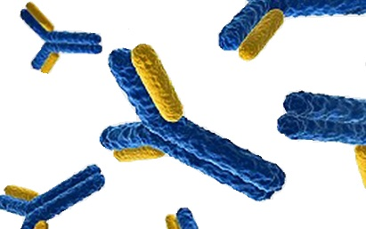
Deciphering the crystal structure of NF-CU
- a novel bispecific antibody for the treatment of acute myeloid leukemia -
Anne Stinn
5th European Immunology & Innate Immunity Conference
July 22, 2016

Slide 2
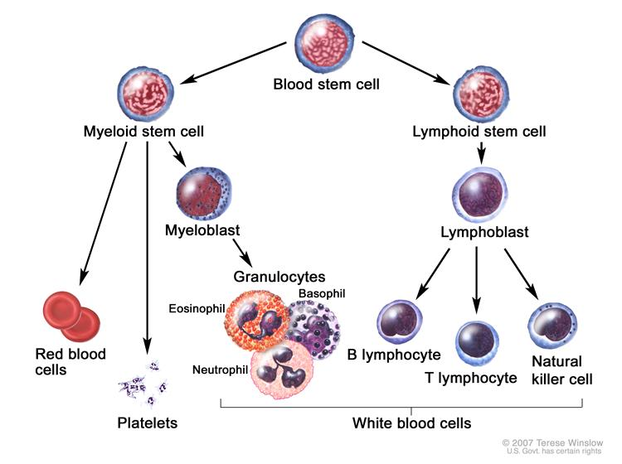
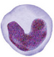

Acute myeloid leukemia (AML)
cancer of the myeloid blood cells
  rapid growth of abnormal white blood cells: accumulate in the bone marrow and interfere with the production of normal blood cells
Monocyte
Eosinophil
modified by: Winslow (2007)

Slide 3
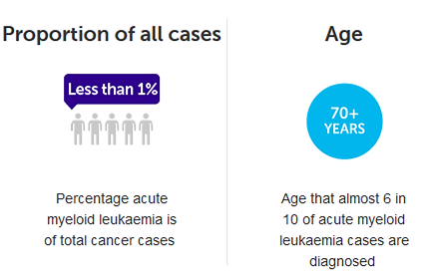

Acute myeloid leukemia (AML)
cancer of the myeloid blood cells
  rapid growth of abnormal white blood cells: accumulate in the bone marrow and interfere with the production of normal blood cells
majority of all cases mutations in the genes NPMI1, CEBPA and FLT3 are reported
Propotion of all cases
Age
5-year survival rate
Percentage acute myeloid leukaemia is of total cancer cases
Age that almost 6 in 10 of AML cases are diagnosed
25% of AML patients live > 5 years after diagnosis

Slide 4
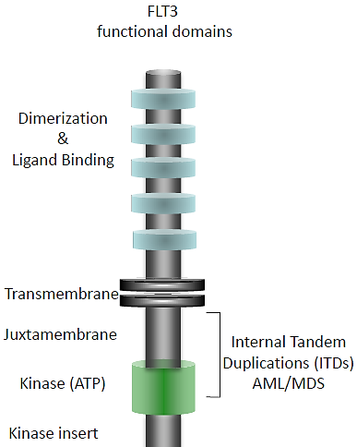
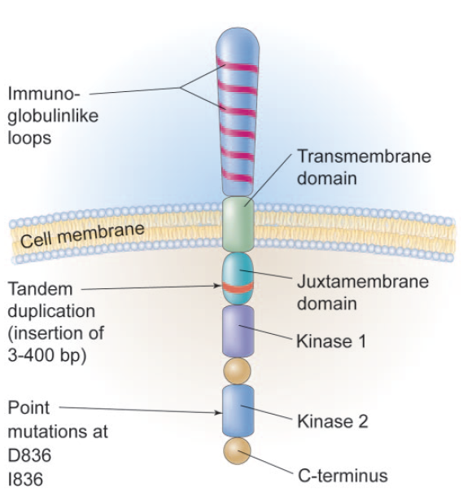
FLT3 (CD135) fms-like tyrosine kinase 3
primarily expressed on early hematopoietic progenitors and DCs
  proliferation and differentiation
type III receptor tyrosine kinase family
five extracellular Ig-like domains (D1-5)
expressed on 70 - 100% of AML and >90% ALL blasts
Internal Tandem Duplications (ITD) or point mutations in the kinase domain are commonly occurring with AML
  poor disease prognosis
PI3K
Ras/ MAPK
STAT5
  → target molecule for treatment of AML
modified by: Litzow (2005), Blood

Slide 5
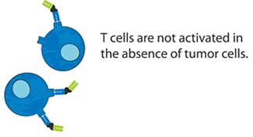
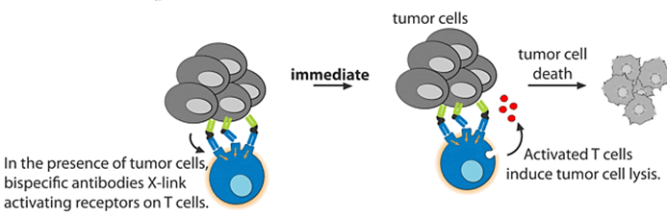
Immunotherapy with bispecific antibodies
artificially designed antibodies that are able to bind two different antigens
tumor-associated antigen (TAAs)
agonistic T-cell receptor
  → selective activation of immune cells
Source: SYNIMMUNE GmbH

Slide 6
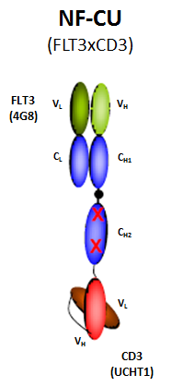
Immunotherapy with bispecific antibodies
artificially designed antibodies that are able to bind two different antigens
tumor-associated antigen (TAAs)
agonistic T-cell receptor
  → selective activation of immune cells
NF-CU
(Fabsc-format)
Source: SYNIMMUNE GmbH

Slide 7
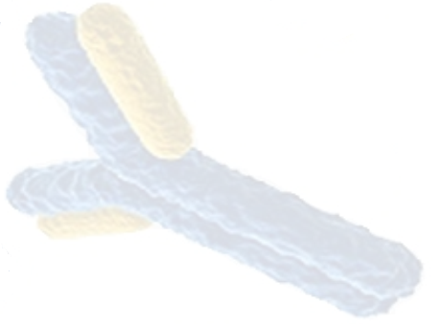
Aims
  insights into epitope recognition as well as molecular mechanism of T-cell activation and tumor cell death
solving the crystal structure of the bispecific antibody NF-CU
co-crystallization of NF-CU with its antigens FLT3 and CD3 δ/ε

Slide 8
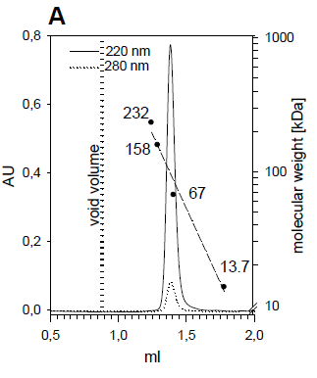
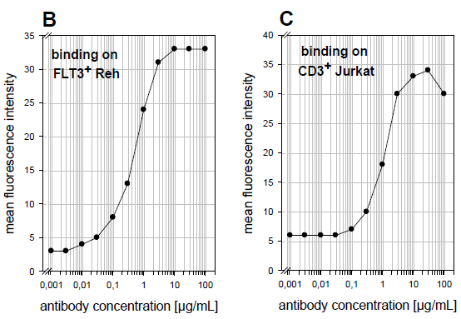
Functional characterization of the bispecific antibody NF-CU
Production in eukaryotic cells
Preserved binding to both antigens, FLT3 and CD3
- Flow cytometry-
- Analytic gel filtration with recombinant expressed antigens-
Source: SYNIMMUNE GmbH

Slide 9
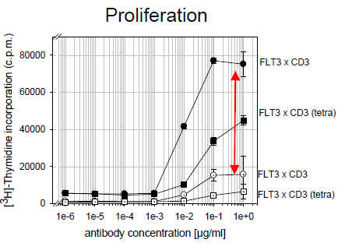
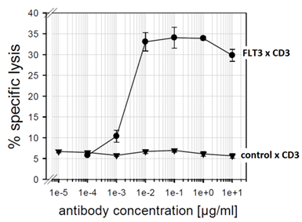
Target-cell restricted T-cell activation with NF-CU
PBMC : Reh cells
Specific lysis
●▪ with tumor cells
o□ w/o tumor cells
activation of PBMCs (proliferation and cytokine release)
  high toxicity and reduction of leukemic blasts
no cross reactivity towards FLT3 molecules from other species
promising results in in vitro assays using laboratory cell lines as well as material from AML patients
Source: SYNIMMUNE GmbH

Slide 10
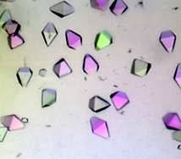
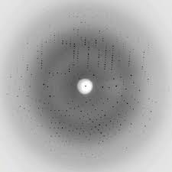
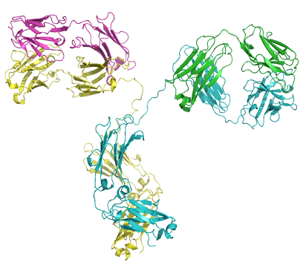
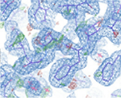
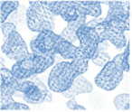
Structural investigation of NF-CU
- workflow -
(recombinant) protein production and purification
crystals
diffraction pattern
crystallization
X-ray diffraction at synchrotron
phases
refinement
evaluation and PDB submission
molecular modelling/
fitting
atomic model
electron density map

Slide 11
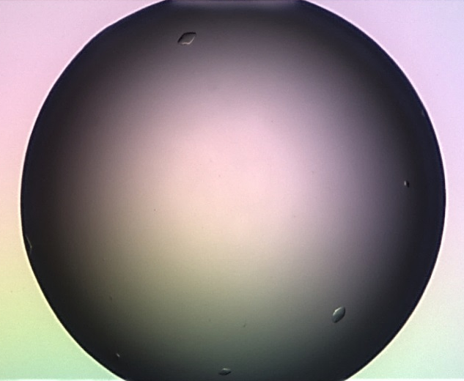

Crystallization of the bispecific antibody NF-CU
highly pure NF-CU antibody expressed in CHO cells
initial crystal screens (sitting drop at 20°C)
  screened ~600 conditions
    → 1.6 M ammonium sulfate, 0.1 M MES pH 6.0 (pH Clear Screen)
  dataset collection at the synchrotrons in Berlin (BESSY) and Hamburg (DESY)
      → diffraction with a resolution of ~ 2.8 Å
1st observation (day 0)
3rd observation (day 6)

Slide 12
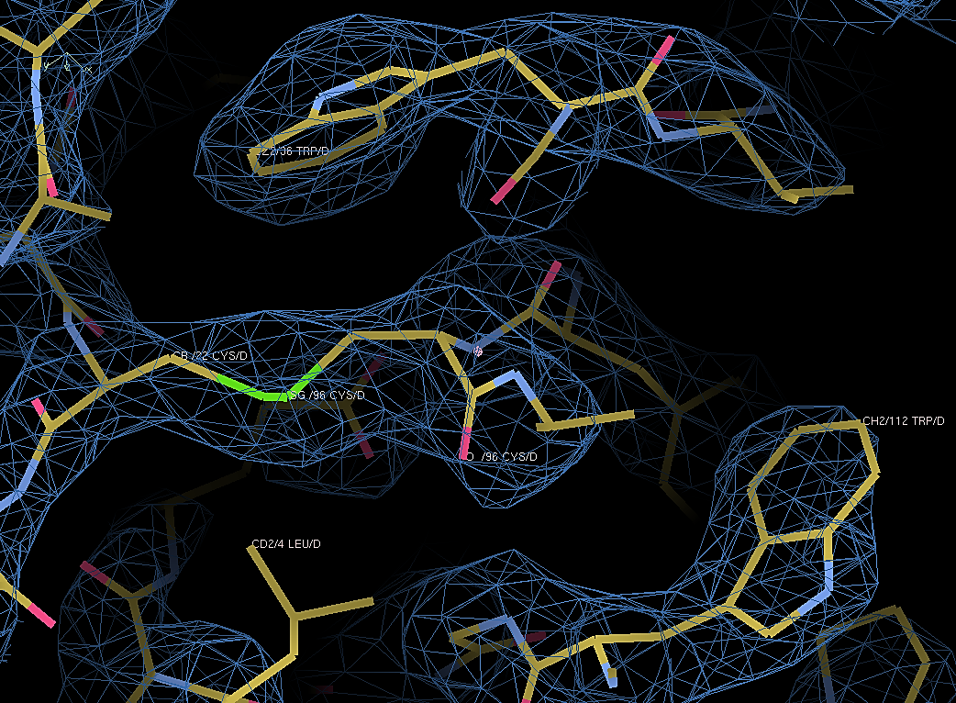
electron density map of NF-CU
  data processing
    space group H32
  molecular replacement using the crystal structure of UCHT1 (1XIW) as a template

Slide 13
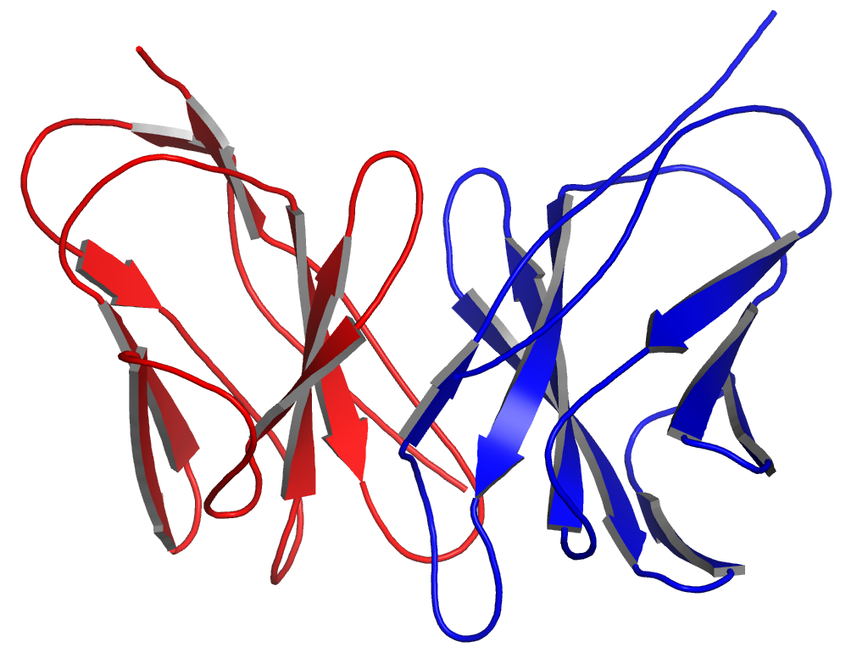
Preliminary model of NF-CU crystal structure
UCHT1 light chain
UCHT1 heavy chain

Slide 14
Summary
NF-CU is a novel bispecific antibody for the treatment of AML.
first structural analysis of a bispecific antibody
  obtained nice diffracting NF-CU protein crystals (2.8 Å)
  preliminary model of crystal structure
co-crystallization of NF-CU with its antigens CD3 δ/ε and FLT3
  NF-CU binds recombinantly expressed CD3 δ/ε as well as FLT3 D₁₋₅
  → co-crystallization plates under observation
  refinement and model evaluation of NF-CU structure model
  determination of NF-CU binding affinities to its antigens as well as epitope mapping

Slide 15
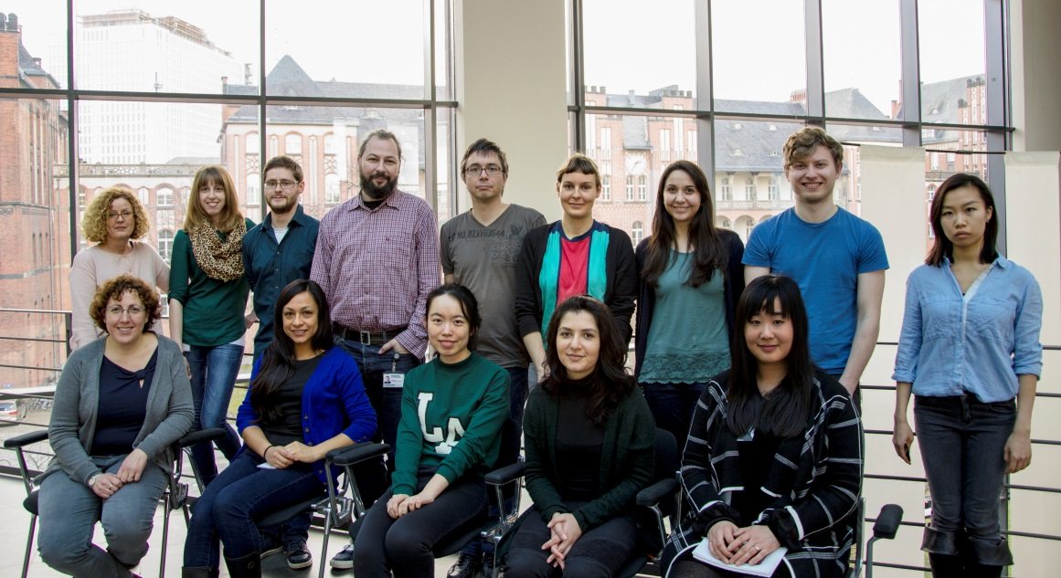

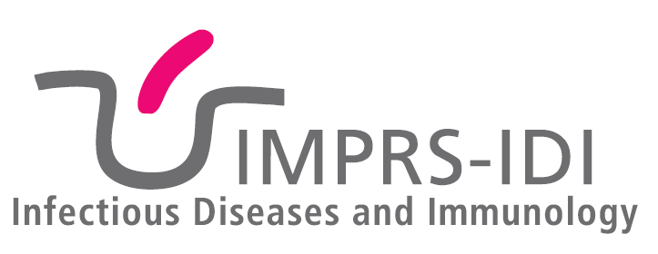
Acknowledgements
Structural Systems Biology SYNIMMUNE Tübingen
Dr. Ludger Grosse-Hovest
Dr. Gregor Neumann
… and for your
attention!

