Slide 1
TBI: Missed cause of Dementia
Anne Felicia Ambrose, MD, MS
Medical Director, Traumatic Brain Injury Program
Mount Sinai School of Medicine
New York , NY

Slide 2
NY-TBI Model Systems
Notes:
I am also the Co-Direstor of Model Systems center –There are 14 such centers in the US, goal to be centers of excellence for clinical care and research.
We recruit patients and maintain the national TBI database,We monitor the patients for the rest of their lives, studying the effects of variousinterventions and thieir outcomesWe also carry out interventional studies, in collabration with DOD , CDC and several BI foundations on joint projects
The impact of traumatic brain injuries: a global perspective.
The TBIMS NDB is a multicenter, longitudinal study of TBI outcomes funded by the U.S. Department of Education National Institute on Disability and Rehabilitation Research. Detailed information about the database such as enrollment, variables, participating centers, data collection techniques etc. can be found at tbindsc.org. Participants have sustained eitherpenetrating or non-penetrating TBI with at least one of the following characteristics: Glasgow Coma Scale (GCS) score less than 13 on emergency admission (not due to intubation, sedation o rintoxication); loss of consciousness greater than 30 minutes (not due to sedation or intoxication);post-traumatic amnesia (PTA) greater than 24 hours; or trauma-related intracranial abnormality on neuroimaging. All TBIMS NDB enrollees are age 16 or older at the time of injury, receive medical care in a TBIMS-affiliated trauma center within 72 hours of injury, are transferred to an

Slide 3
Case
63 year old man
Accountant
Mild cognitive impairments 3 years ago following a cardiac stent
Recently rapid deterioration in cognition, behavior and mood

Slide 4
DEFINITION
Traumatic Brain injury
Notes:
More than most, pts with TBI are involved in lawsuits so it is important to have a strong definition

Slide 5
Definition
1. Traumatically induced physiologic disruption of brain function
2. One or more of the following
a. Any period of loss of consciousness
b. Any loss of memory of the event immediately before or after the accident, with posttraumatic amnesia
c. Any alteration in mental state at the time of the accident (eg, feeling dazed, disoriented, or confused).
d. Focal neurological symptoms
ACRM, 2003
Notes:
The important points are
It is a clinical diagnosis
There has to be an external force, not necessary to the head(the head being struck, striking an object, and undergoing an acceleration/deceleration movement (ie,whiplash) without direct external trauma to the head.
Only one of the 4 criteria has to be present
Mild TBI or concussions-additional criteria
GCS>13, LOC-<30min and all other clinical signs have to resolve within 24 hrs

Slide 6
Definition-Mild TBI
1. Traumatically induced physiologic disruption of brain function
2. One or more of the following
a. Any period of loss of consciousness (<5minutes)
b. Any loss of memory of the event immediately before or after the accident, with posttraumatic amnesia (<24hrs)
c. Any alteration in mental state at the time of the accident (eg, feeling dazed, disoriented, or confused).(<24hrs)
d. Focal neurological symptoms(<24hrs)
3. GCS 13-15
ACRM, 2003
Notes:
The important points are
It is a clinical diagnosis
There has to be an external force, not necessary to the head(the head being struck, striking an object, and undergoing an acceleration/deceleration movement (ie,whiplash) without direct external trauma to the head.
Only one of the 4 criteria has to be present
Mild TBI or concussions-additional criteria
GCS>13, LOC-<30min and all other clinical signs have to resolve within 24 hrs

Slide 7
Post concussive Symptoms
Physical symptoms of brain injury
eg nausea, vomiting, dizziness, headache, blurred vision ,sleep disturbance, quickness to fatigue, lethargy, or other sensory loss
Cognitive Symptoms
concentration, perception, memory, speech/language, or executive functions
Behavioral changes and/or alterations in degree of emotional responsivity
eg, irritability, quickness to anger, disinhibition, or emotional lability

Slide 8
Epidemiology
Traumatic Brain Injury
Notes:
Increasing public awareness of how commonly TBI occurs. This was highlighted by incidence Among the vetrans of the Iraq-afganistan war,l football athletes, the focus now is on high school athletes.

Slide 9
Global Estimates
WHO (2011) -Global incidence rate of TBI
Estimated at 200 per 100 000 population/ year
Estimated deaths – 1.2 million/Year
70 percent fatalities (850,000) < 45 years of age
Global Burden of Health (2010)
Disabilty adjusted life years (DALY) from road traffic accidents increased by 33% from 1990 to 2010,
Notes:
The WHO global burden of disease (GBD) measures burden of disease using the disability-adjusted life year (DALY). This time-based measure combines years of life lost due to premature mortality and years of life lost due to time lived in states of less than full health. The DALY metric was developed in the original GBD 1990 study to assess the burden of disease consistently across diseases, risk factors and regions.
Road traffic injuries claimed nearly 3500 lives each day in 2011 – about 700 more than in the year 2000 – making it among the top 10 leading causes in 2011.
the incidence rate of TBI in South Africa has been
estimated at 1.5 to 3.5 times

Slide 10
Annual Incidence: TBI in the General Population (1.7-3.8 M)
5.3million living with TBI related disabilities
1.7million Emergency Room visits
1.4 million discharged within 24 hours
275,000 Hospitalizations (16%)
50,000 deaths
Annual cost-$76m
CDC 2006

Slide 11
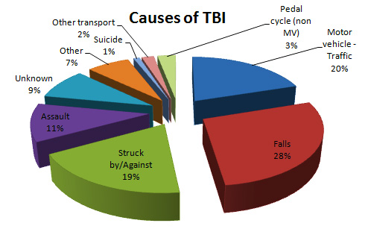
Epidemiology-Causes
Sports/work
Violence
Falls
MVA
CDC 2006
WHO 2009
Notes:
Difficulty in estimating TBI
minor TBI, only few receive medical treatment.
2) caused by war and civil unrest, occurs in the context of multi-trauma, and is usually under-reported or rolled up into other causes of death and injury statistics.
3) under-represented given its silent nature and the absence of injury surveillance or reporting systems in many part of the world.
4) No WHO defined parameters internationally accepted method of defining severity orlongevity of childhood disability from TBI,
A.A. Hyder et al. / The impact of traumatic brain injuries: A global perspective

Slide 12
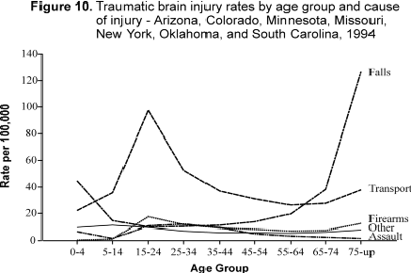
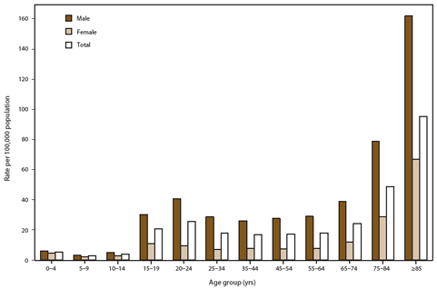
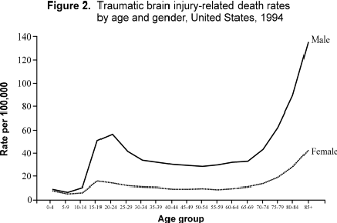
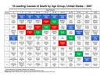
Mortality
Average annual rates for traumatic brain injury deaths, by age group and external mechanism of injury --- United States, 1997--2007
Notes:
line graph showing the average annual rates for traumatic brain injury (TBI) deaths, by age group and external mechanism of injury, in the United States during 1997-2007. Firearm-related TBI death rates were highest among persons aged 20-24 and ≥75 years. Motor vehicle-related TBI death rates were highest among persons aged 15-24 years. Fall-related TBI death rates were highest among adults aged ≥75 years and increased significantly with age. In each age group and for each external cause, males had higher rates of TBI-related death than females.

Slide 13
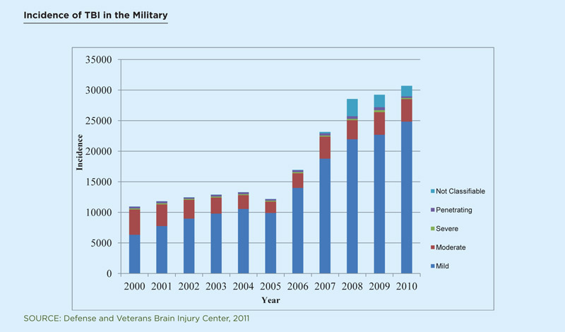
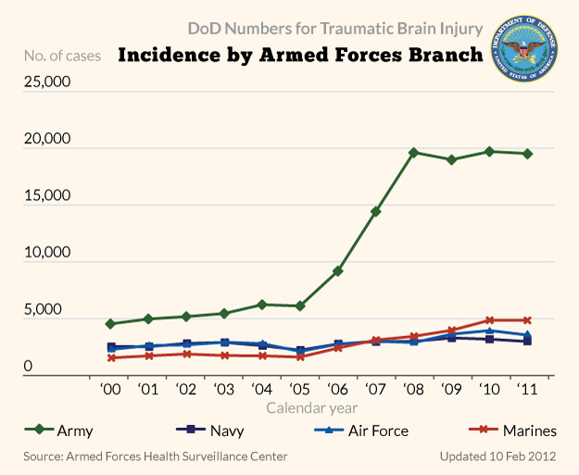
Military
More than 2.5 million Americans have been deployed to
OEF/OIF,

Slide 14
PATHOPHYSIOLOGY
Traumatic Brain Injury

Slide 15
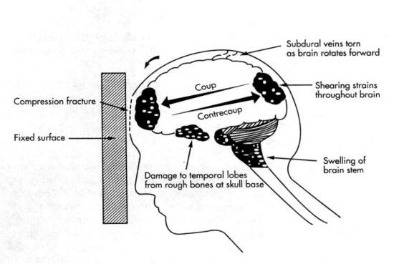
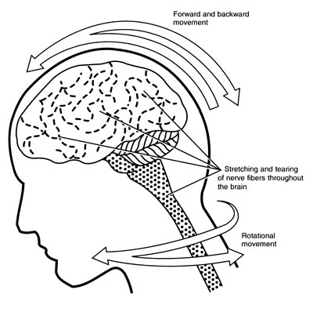
Mechanisms of Injury
Acceleration-decleration
Rotational

Slide 16
Intracranial hematoma (TARN study)
13,962 patients between 2001 and 2008 with a Glasgow Coma Score (GCS) less than 15 at presentation or any head injury with Abbreviated Injury Scale (AIS) severity code 3 and above.
Intracranial hematoma-46%
Epidural hematoma-22%
Subarachnoid hemorrhage_22%
Subdural hematomas-30%
Intracerebral and
Intracerebellar hematomas
Perel1 et al, BMC Emergency Medicine 2009,
Notes:
Trauma Audit & Research Network (TARN), a large European trauma registry, to evaluate the association between the size of IB and, mortality and haematoma evacuation, in patients with TBI.
Abbreviated injury Score
AIS-Code Injury Example AIS % prob. of death
1 Minor superficial laceration 0
2 Moderate fractured sternum 1 – 2
3 Serious open fracture of humerus 8 – 10
4 Severe perforated trachea 5 – 50
5 Critical ruptured liver with tissue loss 5 - 50
6 Maximum total severance of aorta 100
9 Not further specified (NFS)

Slide 17
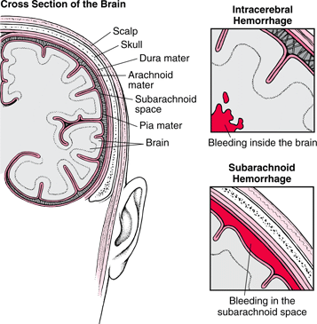
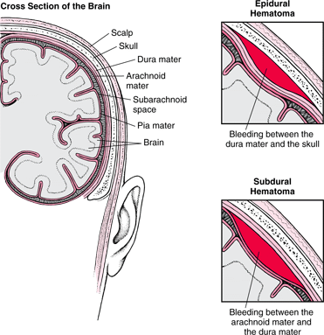

Slide 18
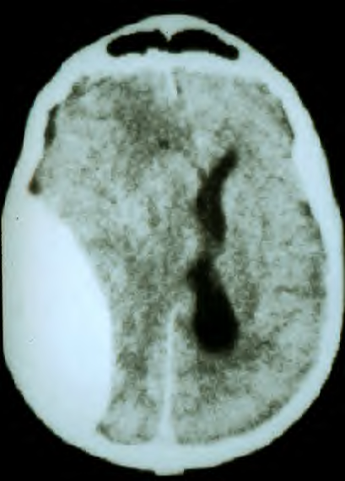
Epidural hematoma (EDH)
Natasha Williams
Lucid interval
Associated skull fracture (squamous part of temporal bone)
Most commonly arterial (middle meningeal artery)
Enlarges fairly rapidly ,causing mass effect
Appears biconvex on CT scan
Even with appropriate care, 15 – 20% will die.

Slide 19
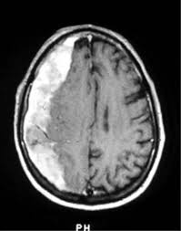
Subdural Hematomaral Hematomas
Crescent-shaped, hyperdense, extra-axial collection spreading diffusely over one hemisphere and can extend along the falx and tentorium-rupture of veins that bridge the subdural space due to sudden change in velocity of the head
Can be seen in elderly with “minor” trauma
Brain atrophy; tension on bridging veins
Anticoagulants More common in alcoholics, fallers
Notes:
Clinically, SDHs are seen in 10 to 20% of all head trauma. Acute traumatic subdural hematoma has an estimated morality rate ranging from 50% to 85%. They are common in the elderly as brain atrophy is a contributing factor, however a definite history of trauma may not be present as in this case. SDHs can also be seen in children, and bilateral SDHs or mixed-age hemorrhages should raise the suspicion for nonaccidental trauma. Most patients with acute SDHs present with a Low Glasgow Coma Score, although some patients may be asymptomatic with an initial "lucid" interval. It is also common to see other lesions, such as traumatic subarachnoid hemorrhage in greater than 70% of cases. 10% to 30% of chronic SDHs rebleed, as cortical veins are stretched by the SDH itself in addition to the formation of friable vascular neomembranes. Treatment is surgical drainage if the SDH is growing or symptomatic, although they can spontaneously resolve.
Subdural hematomas (SDHs) are due to stretching and tearing of the bridging cortical veins which cross the subdural space to drain into the adjacent dural venous sinuses. The subdural space is a potential space between the inner layer of the dura mater and arachnoid mater. The rupture is due to a sudden change in head velocity. SDHs can cross sutures, but not the dural attachments, where as the opposite is true in epidural hematoma. Therefore the location is important in differentiating the two. In addition, the arachnoid mater may be torn, which can create a mixture of blood and CSF in the subdural space. SDHs are categorized into acute, subacute, and chronic forms.

Slide 20
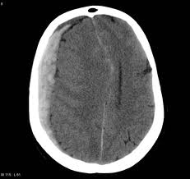
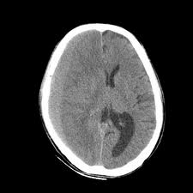
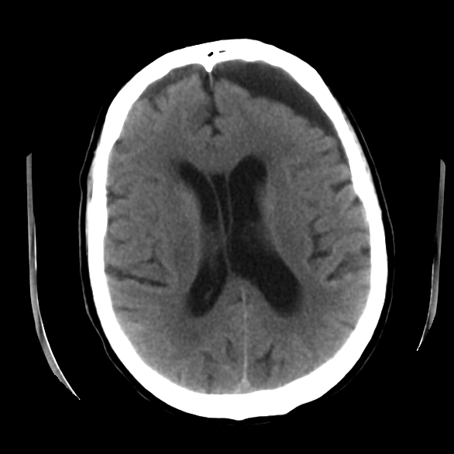
Acute SDH
6 hours to 3 days.
50% – 80% mortality rate
Subacute SDH
2-10 days.
25% mortality rate
Chronic SDH
after 2 weeks.
20% mortality rate.
Notes:
Acute SDH-6 hours to 3 days.
Hyperacute SDH is mostly hypodense on NECT, as fresh hemorrhage is unclotted.
SDHs undergo clot lysis and organization, they being to form membranes composed of granulation tissue and rich in capillaries.
NECT findings demonstrate isodense to hypodensee extra axial fluid collection
Further organization of Clot-crescent shaped , multi septated, extraxial collection with enhancing membranes
NECT-hypodense collection
Any increased density suggest rebleeding seen in 10-30%
Resorption after 3 months as outer mebrane stabilizes

Slide 21
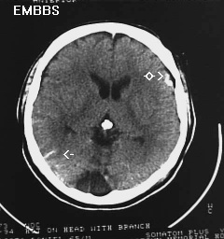
Subarachnoid Hemorrhage
Seen to a degree in most serious
TBI brain injuries
Increased risk of NPH
Prognosis is grim, with mortality and permanent disability a common result of subarachnoid hemorrhage.
Mortality-35%

Slide 22
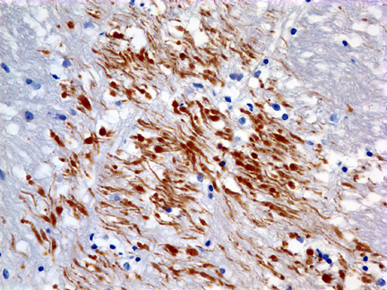
Diffuse Axonal Injury
Axonal Shearing
Cerebral hemispheric gray-white matter
interface and subcortical white matter, body
and splenium of corpus callosum, basal ganglia, dorsolateral aspect of brainstem, and cerebellum.
Serum marker-S-100B, Neuron specific enolase (NSE)
H &E stain
MRI-flair
CT
Notes:
with MR imaging, because both hemorrhagic and non-hemorrhagic lesions (gliotic scars) can be detected. The MR appearance of DAI lesions depends on several factors, including age of injury, presence of hemorrhage or blood-breakdown products (e. g., hemosiderin), and type of sequence used. Non-hemorrhagic lesions can be detected with fluid attenuated inversion recovery (FLAIR), proton-density-, or T2-weighted images, whereas gradient echo sequences with long TE increase the visibility of old hemorrhagic lesions.
two serum and cerebrospinal fluid (CSF) markers of central nervous system (CNS) injury have been studied in Europe. S-100B is an acidic calcium binding protein found in glial and Schwann cells with high specificity for CNS white matter. Neuron specific enolase (NSE) is an isoenzyme located in neurons, neuroendocrine cells, smooth muscle fibers, and adipose tissue. Both markers have been tentatively linked to the severity of the TBI and outcome predictability, particularly with severe injuries. The evidence for S-100B is considerably stronger than for NSE. Most authors agree that initial levels should be measured within 6 hours of the injury, certainly within the first day. Levels fall rapidly over the next few days. Levels have been measured in both CSF and, most commonly, in serum. A recent study suggests that to be strictly relevant to TBI, levels in CSF must be measured, as serum levels are affected by nonnervous system sources.11 In addition, another study has shown that serum levels of S-100B peak 2 days after CSF levels.12 As with most new research areas in medicine, the initial work has been with small groups of patients, study designs differ, studies have not controlled for the same preexisting factors, and outcome has generally been measured within 6 months of injury. Additionally, the primary outcome measure has been the Glasgow Outcome Scale (GOS), an 8-point scale that marks global states such as vegetative, dependency on others for activities of daily living, return to work, and minor deficits. It does not include in-depth neuropsychological or psychiatric testing.13
A recent comparison was done of CSF and serum S-100B and NSE levels to two immunological markers (sICAM-1 and Il-6; associated with CNS inflammatory response) and to clinical outcome and initial computed tomographic (CT) contusion size in 13 patients with Glasgow coma scale (GCS) scores of ≤ 8, as compared to 17 controls.14 Levels were measured over 14 days. Both CSF S-100B and NSE strongly correlated with contusion size. With the serum markers, only S-100B correlated with clinical outcome and contusion size in all 13 patients. Serum NSE correlated with the release of the immune factors only

Slide 23
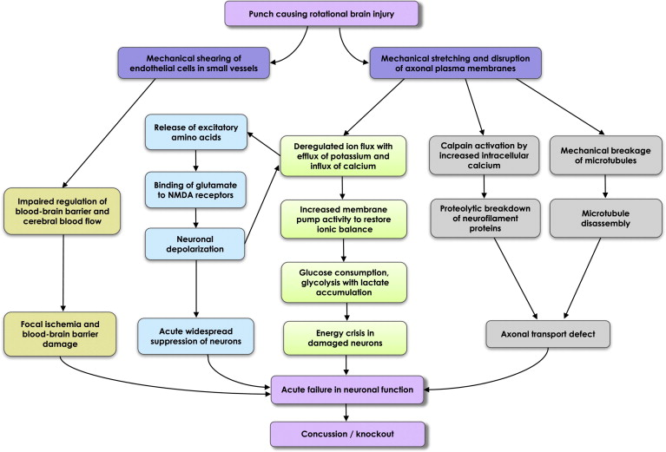
Secondary Pathology
Notes:
Pathophysiology
Concussion in athletes is typically produced by acceleration/
deceleration forces (e.g., helmet-to helmet contact in football
or helmet-to-ice contact in hockey), with the injuries
occurring along a continuum of severity dependent on
the mechanical forces that caused them.1,2
The complex cellular and vascular changes that occur
following concussion have been described as a multilayered
neurometabolic cascade.3 The primary mechanisms include
ionic shifts, abnormal energy metabolism, diminished
cerebral blood flow (CBF), and impaired neurotransmission.
A brief summary of this process, derived from several
sources,3,4 is provided in the following two paragraphs:
The stretching of an axon results in an indiscriminate release
of neurotransmitters and uncontrolled ionic fluxes. When
ionic gradients are disrupted, cells respond by activating
ion pumps in an attempt to restore the normal membrane
potential. Pump activation increases glucose use. This
contributes to dramatic increases in the local cerebral
metabolic rate for glucose. This hypermetabolism occurs
in tandem with mildly decreased CBF, which contributes
to the disparity between glucose supply and demand.
There also appears to be impaired oxidative metabolism and
diminished mitochondrial function, resulting in the overuse
of anaerobic energy pathways and elevated lactate as a
by-product. Moreover, intracellular magnesium levels appear
to decrease significantly and remain depressed for several
days following injury. This is important because magnesium
is essential for the generation of adenosine triphosphate
(ATP; energy production). Magnesium is also essential for
the initiation of protein synthesis and the maintenance of the
cellular membrane potential. A sustained initial influx of
Ca2 can result in mitochondrial accumulations of this ion
Advancements in Assessment, Management, and Rehabilitation 3
UPMCPhysicianResources.com/Ortho For consults and referrals, please call UPMC’s 24-hour physician OnDemand service at 1-866-884-8579.
contributing to metabolic dysfunction and energy failure.
High intracellular Ca2 levels, combined with stretch injury,
can initiate an irreversible process of destruction of
microtubules within axons.

Slide 24
Complications
Cerebral edema
Disruption of the blood-brain barrier, with impairment of vasomotor autoregulation leading to dilatation of cerebral blood vessels,
Hydrocephalus
Communicating type-More common. Results from the presence of blood products that cause obstruction of the flow of the cerebral spinal fluid (CSF) in the subarachnoid space and the absorption of CSF through the arachnoid villi.
The non-communicating type of hydrocephalus is often caused by blood clot obstruction of blood flow at the interventricular foramen, third ventricle, cerebral aqueduct, or fourth ventricle.
Brain herniation
3 major types-Subfalcine herniation. Uncal herniation Cerebellar herniation -

Slide 25
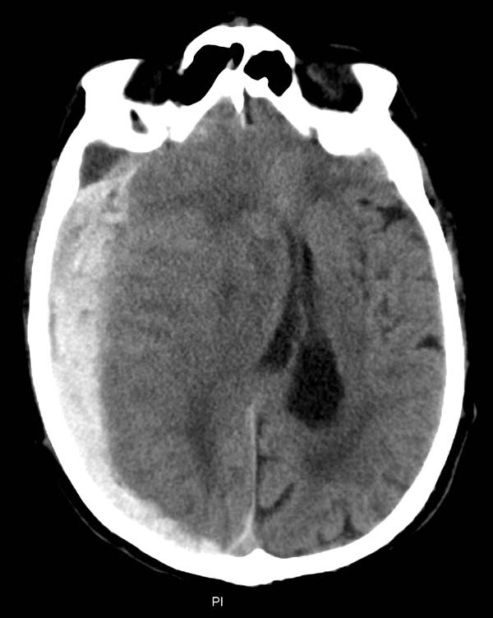
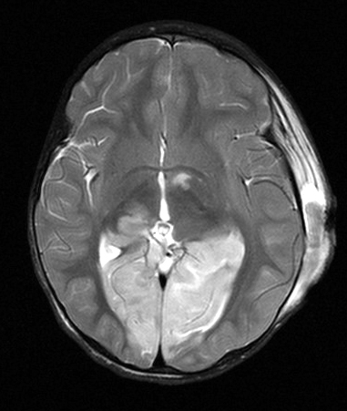
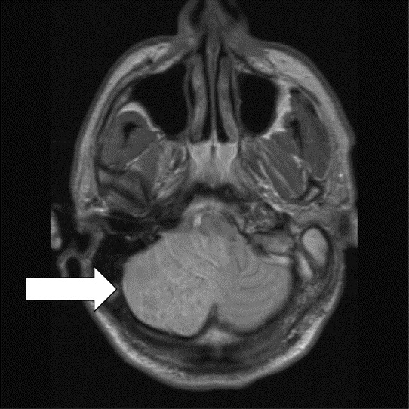
Herniations
Sub-falcine
Uncal herniation
Cerebellar herniation
Displacement of the medial edge of the uncus and the hippocampal gyrus medially and over the ipsilateral edge of the tentorium cerebelli foramen,
Causing compression of the midbrain; the ipsilateral or contralateral third nerve may be stretched or compressed
This injury is marked by an infratentorial herniation in which the tonsil of the cerebellum is pushed through the foramen magnum and compresses the medulla, leading to bradycardia and respiratory arrest.
Cingulate gyrus of the
frontal lobe is pushed beneath
the falx cerebri . Most common type of herniation. Often clinically silent.

Slide 26
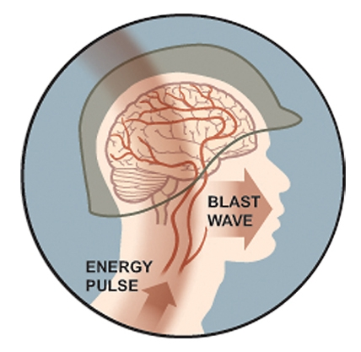
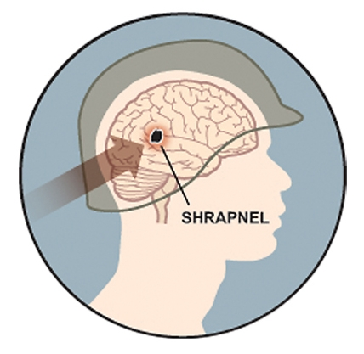
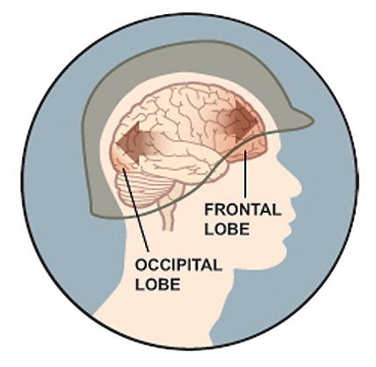
Blast Injuries
Primary Blast Injury
Secondary Blast Injury
Tertiary Blast Injury
Quaternary Blast injury
Notes:
Primary Blast wave
An explosion generates a blast wave traveling faster than sound and creating a surge of high pressure immediately followed by a vacuum.
Blast wave shoots through armor and soldiers' skulls and brains, even if it doesn't draw blood.
blast wave's pressure has been show to compress the torso, impacting blood vessels, which then send damaging energy pulses into the brain.
The pressure can also be transferred partially through the skull, interacting with the brain.
Secondary
Shrapnel and debris propelled by the blast can strike a soldier's head, causing either a closed-head injury through blunt force or a penetrating head injury that damages brain tissue.
Tertiary
The kinetic energy generated and released by an explosion can accelerate a soldier's body through the air and into the ground or nearby solid object.
Once the body stops, the brain continues to move in the direction of the force, hitting the interior of the skull and then bouncing back into the opposite side, causing a coup-contrecoup injury.

Slide 27
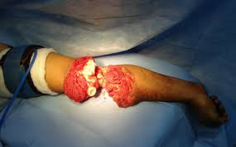
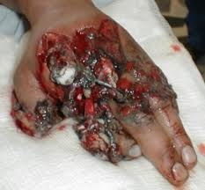
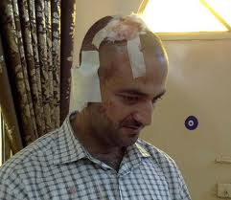
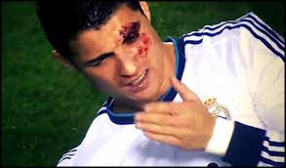
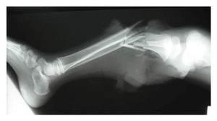
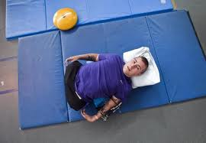
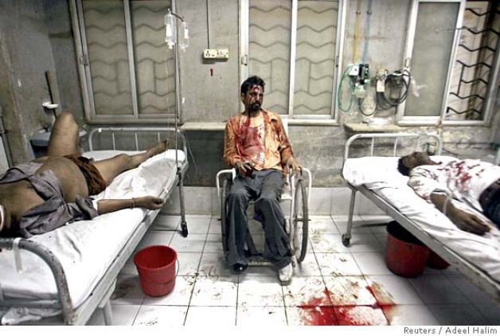
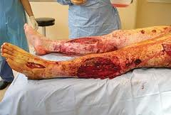
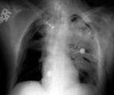
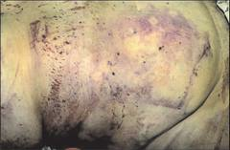
EARS Degloving, TM haemorhages, perforation, choleastoma, ossibular bone disruption vestibular damage
EYES corneal abrasions, Open globe injuries, Eyelid laceration, traumatic cataract, vitreous hemorrhage, retinal detatchment, choroidal rupture, optic nerve injuries
Hypotension ,
Third spacing,
compartment syndrome,
Renal Failure ,
Rhabdomyolysis ,
Metabolic abnormalities
Hypocalcemia ,
hyperkalemia
Lactic acidosis ,
life-threatening cardiac arrhythmias
LUNGS
hemorrhage, contusion, edema, bronchopleural fistula, air emboli,
ABODOMEN hemorrhage, perforation Trauma to liver, spleen, aortic, illiac vessels
Notes:
Hypotension ,Third spacing,compartment syndrome,
Renal Failure ,Rhabdomyolysis ,Metabolic abnormalities
Hypocalcemia , hyperkalemia ,Lactic acidosis ,life-threatening
cardiac arrhythmias
Hypotension
Massive third spacing occurs, requiring considerable fluid replacement in the first 24 hours; patients may sequester (third space) >12 L of fluid in the crushed area over a 48-hour period
Third spacing leads to compartment syndrome,
Renal Failure
Rhabdomyolysis Myoglobinuria ->tubular necrosis
Metabolic abnormalities
Calcium flows into muscle cells through leaky membranes, causing systemic hypocalcemia
Potassium is released from ischemic muscle into systemic circulation, causing hyperkalemia
Lactic acid is released from ischemic muscle into systemic circulation, causing metabolic acidosis
Imbalance of potassium and calcium may cause life-threatening cardiac arrhythmias, including cardiac arrest; metabolic acidosis may exacerbate this situation

Slide 28
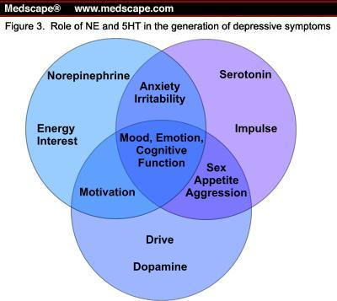
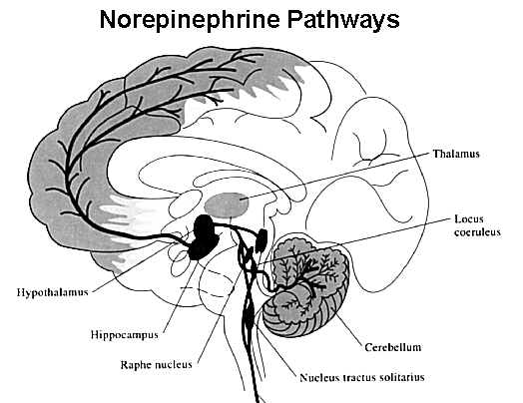
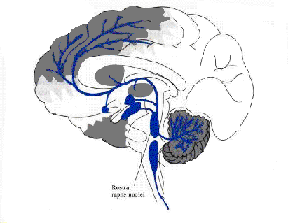
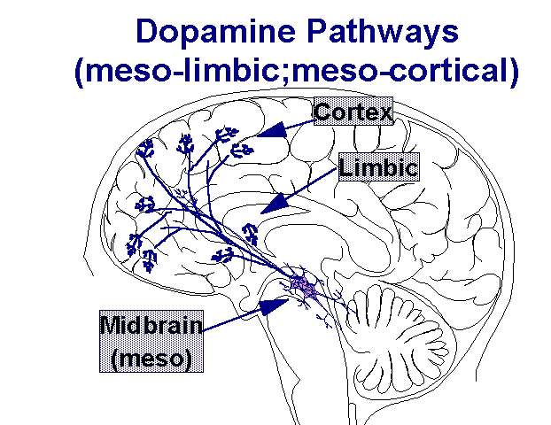
Role of Neuro-transmiters
Norepienephrine
Pathways
Serotonin
Pathways
Dopamine Pathways

Slide 29
Clinical Manifestations
Traumatic Brain Injury

Slide 30
Post Concussive Symptoms
Physical
Headache
Dizziness
Balance
problems
Nausea/Vomiting
Fatigue
Visual disturbances
Sensitivity to
light/noise
Ringing in the ears
Emotional
Anxiety
Depression
Irritability
Mood lability
Cognitive
Slowed processing
Decreased attention
Poor Concentration
Memory Problems
Verbal dysfluency
Word-finding
Abstract reasoning
Notes:
30

Slide 31
Process of Memory
Attention
Encoding
Storage
Retrieval
Notes:
Amnesia. The clinical hallmark of diffuse injury is retrograde
amnesia. Retrograde loss begins with and includes the
head blow8—a boxer glazed in a standing count or a knock-out
to the floor will not afterward remember the delivering punch.
Typically, in mild injury, the retrograde amnesia lasts for a
period of minutes, shrinking later to seconds. More valuable
than retrograde amnesia as a measure of severity of injury is
PTA.8 Unlike retrograde amnesia in which there is impaired
retrieval, the postevent amnesia does not later shrink, because
the memory dysfunction is not a dysfunction of retrieval but
encoding.16 Islands of recollection may exist within PTA,
which is defined as the interval between injury and return of
continuous recall. Until out of PTA, the individual is confused,
but to a bystander can appear normal and be able to continue a
sporting activity. From the patient’s perspective, the time spent
unconscious is equal to the PTA.

Slide 32
Attention
Simple attention
Selective attention
Sustained attention
Divided attention
Supervisory control
Notes:
Most agreement-red information
Choice RT paradigms, requires decision making among number of alternate responses, Very sensitive to brain injury, can be used to discriminate between grades of TBI, and demonstrate improvement over time
Paced Auditory Serial Addition Task-study processing efficiency, given series of single digit numbers verbally and asked to add each new digit to the one preceeding it. Task difficulty- vary the intervals; co-relates with TBI severity: track recovery, predict return to vocational activities (Lezak 1995)

Slide 33
Memory
Sensory memory
(<1s)
Short term
Long term
Explicit
Implicit memory
Procedural memory
DeclarativeMemoryfacts, events)
Strategic memory, Prospective memory, Metamemory, Source memory
Semantic memory(facts, general knowledge)
Episiodic memory
Priming

Slide 34
TBI Executive Dysfunctions
Difficulty problem solving
Difficulty prioritizing
Difficulty planning/ setting goals
Difficulty being flexible
Decreased self awareness and self monitoring
Difficulty organizing
Notes:
The frontal lobe is the home of our “executive functioning” skills. As previously discussed, frontal lobe abilities are more likely to be disrupted following a traumatic brain injury.
In this slide, you will see the types of executive difficulties a person can experience after a TBI. It is these executive impairments, which often exist in various combinations, that create the most difficulties in day-to-day functioning for individuals after TBI.
The person will still function under the idea of who they were before the injury without the same functioning abilities.

Slide 35
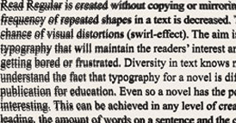
Post-trauma vision syndrome
Injury to Cranial Nerves II,III, IV,V,VI and VII (7%)
Accommodation (41 %)
Tear film integrity (70%)
Ocular motility-vergence(56.3%) and version(51%-deficit in saccades)
Visual-vestibular interaction
Light-dark adaptation
Visual fields integrity
Speed and nature of visual processing
Ciuffeda et al, Optometry 2007
Notes:
In TBI pts with visual symptoms

Slide 36
EVALUATIONS
Traumatic Brain Injury

Slide 37
HISTORY
History of event-date, time, circumstances
MVA-driver vs passenger, front vs back seat, seat belt, helmet
Fall-previous falls, syncope, trip, orthostatic, vertigo/ medication(type and number)
Sports injury-describe play, other concussions
Memory of events preceding or following injury
Anoxic events (CPR, pneumothorax,hypotension)
PMH- other TBI

Slide 38
HISTORY-ROS
Persistent headache,
Confusion,
Pain,
Cognitive and/or memory problems,
Fatigue,
Changes in sleep patterns,
Mood changes, and/or
Sensory problems such as changes in vision or hearing (post-concussion syndrome).

Slide 39
Cognitive Screening
GCS
MMSE
ACE
SCAT
Impact
ANAM
Notes:
Neuropsychologic testing carries greatest precision in severe
injury and in gauging serial progress. It is also sensitive to the
effects of mild TBI and is of value in obtaining a more
objective evaluation of subjective cognitive complaints. However,
brain injury does not produce a unique pattern of neuropsychologic
deficits.15,19,50 Similar results may occur because
of cognitive difficulty from other injury-related factors, including
insomnia, stress, pain, and mood disturbances.15,50-52 Test
results can also be confounded by premorbid psychologic or
learning difficulties or by previous head injuries, issues that all
have to be taken into account in the final analysis. A major
drawback is potential lack of motivation and effort on the part
of the patient who essentially has control of the test outcome
and may not have the incentive to perform well. Promising
methods for detecting nonneurologic factors influencing psychometric
test results are being developed, including TOMM53
(Test of Memory Malingering) and other methods of validity
testing.54

Slide 40
Definitions-GCS
 | Motor response | Eye opening | Verbal response
1 | No response | No response | No response
2 | Extensor (decerebrate) posturing | To painful stimulation | Says incomprehensible sounds
3 | Flexor (decorticate) posturing to pain | To speech | Says inappropriate words
4 | Makes withdrawal movements to pain | Spontaneous | Converses but is disoriented
5 | Makes localizing movements to pain |  | Oriented to person, place, and date
6 | Follows commands
Notes:
The Glasgow Coma scale is frequently employed at time of injury by Emergency Medical Technicians and during acute admission for brain injury. It consists of a 1-5 rating of three areas: best occular response, speech, and movement/response to pain resulting in a best possible score of 15
Glasgow Coma Scale:
13-15 mild;
8-12 moderate;
< 7 = severe head trauma, poor prognosis
Glasgow Coma Scale. Originally devised in 197417 as a
clinical flow sheet and as a way to compare research data, the
GCS was later adapted by others to classify degree of head
injury, a score of 13 to 15 signifying mild injury. The scale was
not intended by its original authors to distinguish milder types
of injury, and in this context the scale shows a number of
weaknesses. First, the level of alertness can be so rapidly
improving that a concussed and unconscious individual may be
initially comatose and “severely” injured by GCS definition
(GCS score, 8), yet may quickly attain a “mild” GCS score
of 13 to 15 within minutes of injury. To meet this objection,
classification by standardized timing of GCS score at 30 minutes
postinjury has been suggested,18 6 hours postinjury in
states of intoxication.19 Second, the GCS is not sensitive
enough in mild injury—a perfect score of 15 will be of no help
in determining whether brain injury has occurred. Last, the
GCS does not take into account the presence or absence of
focal neurologic injury, which leads to a common misconception
that a score of 15 means a normal examination—it may
not.

Slide 41
MINI MENTAL STATE EXAMINATION
Orientation to time (5)
Orientation to place (5)
Registration of 3 words:(3 )
Attention And Calculation (5)
Recall of 3 words (3)
Language (2)
Repetition (1)
3 Stage Command.(1)
Write A Sentence ()
Copy The Design.(1)
------------------------------
Total Score (30)
-----------------------------
-Folstein MF. et al
Notes:
Folstein

Slide 42
MMSE | Alzeihmer’ | Vascular | Lewy Body | mTBI
1-5 Orientation to time | X
6-10 Orientation to place | X
11 Repeat three objects
12 Spelling WORLD backward |  |  | X | X
13 Recall three objects | X | X | X
14,15 Recognize objects |  | X
16 Recognize idiom eyes |  | X
17 Close your eyes
18 Copy a design |  | X | X
19 Write a sentence |  | X
20 Three-step command |  | X
Vertesi et al;CanFamPhyOct2001

Slide 43
Acute concussion evaluation (ACE)
Injury Characteristics
Date/Time of Injury /Injury Description and Cause
Amnesia-before and after/ Early signs/Seizures/LOC
Symptom checklist
Risk Factors for Protracted Recovery
RED FLAGS
Diagnosis
Follow up plan
Notes:
A. Injury Characteristics Date/Time of Injury Reporter: __Patient __Parent __Spouse __Other________ 1. Injury Description 1a. Is there evidence of a forcible blow to the head (direct or indirect)? __Yes __No __Unknown 1b. Is there evidence of intracranial injury or skull fracture? __Yes __No __Unknown 1c. Location of Impact: __Frontal __Lft Temporal __Rt Temporal __Lft Parietal __Rt Parietal __Occipital __Neck __Indirect Force
2. Cause: __MVC __Pedestrian-MVC __Fall __Assault __Sports (specify) Other 3. Amnesia Before (Retrograde) Are there any events just BEFORE the injury that you/ person has no memory of (even brief)? __ Yes __No Duration 4. Amnesia After (Anterograde) Are there any events just AFTER the injury that you/ person has no memory of (even brief)? __ Yes __No Duration 5. Loss of Consciousness: Did you/ person lose consciousness? __ Yes __No Duration 6. EARLY SIGNS: __Appears dazed or stunned __Is confused about events __Answers questions slowly __Repeats Questions __Forgetful (recent info) 7. Seizures: Were seizures observed? No__ Yes___ Detail _____ B. Symptom Check List* Since the injury, has the person experienced any of these symptoms any more than usual today or in the past day? Indicate presence of each symptom (0=No, 1=Yes). *Lovell & Collins, 1998 JHTR PHYSICAL (10) COGNITIvE (4) SLEEP (4) Headache 0 1 Feeling mentally foggy 0 1 Drowsiness 0 1 Nausea 0 1 Feeling slowed down 0 1 Sleeping less than usual 0 1 N/A Vomiting 0 1 Difficulty concentrating 0 1 Sleeping more than usual 0 1 N/A Balance problems 0 1 Difficulty remembering 0 1 Trouble falling asleep 0 1 N/A Dizziness 0 1 COGNITIvE Total (0-4) _____ SLEEP Total (0-4) _____ Visual problems 0 1 EMOTIONAL (4) Exertion: Do these symptoms worsen with: Fatigue 0 1 Irritability 0 1 Physical Activity __Yes __No __N/ASensitivity to light 0 1 Sadness 0 1 Cognitive Activity __Yes __No __N/A Sensitivity to noise 0 1 More emotional 0 1 Overall Rating: How different is the person acting Numbness/Tingling 0 1 Nervousness 0 1 compared to his/her usual self? (circle) PHYSICAL Total (0-10) _____ EMOTIONAL Total (0-4) _____Normal 0 1 2 3 4 5 6 Very Different (Add Physical, Cognitive, Emotion, Sleep totals) Total Symptom Score (0-22) _____ C. Risk Factors for Protracted Recovery (check all that apply) Concussion History? Y ___ N___ √ Headache History? Y ___ N___ √ Developmental History √ Psychiatric History Previous # 1 2 3 4 5 6+ Prior treatment for headache Learning disabilities Anxiety Longest symptom durationHistory of migraine headache Attention-Deficit/ Depression Days__ Weeks__ Months__ Years__ __ Personal Hyperactivity Disorder Sleep disorder __ Family___________________If multiple concussions, less force ____________________ Other developmental Other psychiatric disorder caused reinjury? Yes__ No__ disorder_____________ _____________ List other comorbid medical disorders or medication usage (e.g., hypothyroid, seizures) D. RED FLAGS for acute emergency management: Refer to the emergency department with sudden onset of any of the following: * Headaches that worsen * Looks very drowsy/ can’t be awakened * Can’t recognize people or places * Neck pain * Seizures * Repeated vomiting * Increasing confusion or irritability * Unusual behavioral change * Focal neurologic signs * Slurred speech * Weakness or numbness in arms/legs * Change in state of consciousness E. Diagnosis (ICD): __Concussion w/o LOC 850.0 __Concussion w/ LOC 850.1 __Concussion (Unspecified) 850.9 __ Other (854) ______________ __No diagnosis F. Follow-Up Action Plan Complete ACE Care Plan and provide copy to patient/family. ___ No Follow-Up Needed ___ Physician/Clinician Office Monitoring: Date of next follow-up ___ Referral: ___ Neuropsychological Testing ___ Physician: Neurosurgery____ Neurology____ Sports Medicine____ Physiatrist____ Psychiatrist____ Other ___ Emergency Department ACE Completed by:______________________________ © Copyright G

Slide 44
SCAT 2
Symptom Score (22-symptom )
Physical Signs Score
Glasgow Coma scale
Sideline Assessment-Maddocks Score
Cognitive assessment (SAC)-orientation, immediate memory, concentration, delayed memory
Balance assessment-Double leg/single leg and tandem stance
Coordination assessment-finger to nose
Overall score(out of 100)

Slide 45
Impact
Most widely used by sporting bodies
NFL, NHL, FIFA 10,000 high schools and1,000 colleges.
There are two parts to the test,
the Symptom Score component
six part neurocognitive test component.
Both component scores should return to baseline or normal before an athlete is allowed to resume playing a contact sport.
Generally, the symptoms of a concussion disappear before the neurocognitive findings return to normal, although occasionally, this can be reversed.
Migraine symptoms following concussion are associated with a longer recovery time.

Slide 46
Automated Neuropsychological Assessment (ANAM)
Computer-based tool designed to detect speed and accuracy of attention, memory, and thinking ability.
It is being conducted prior to deployment and can be used to identify and monitor changes in function. It takes about 20 minutes to complete. It does not diagnose any medical condition.
Notes:
ANAM is a computer based tool that takes about 20 minutes to complete.
The purpose of this process for pre-deployment is to collect baseline information on performance that can be used if a Service Member has an injury that may affect attention, memory, and thinking ability.
The pre-deployment baseline may help healthcare providers determine if there are any changes after an mTBI/concussion.
ANAM assessment results are considered protected health information and placed in the electronic medical record.
The assessment results will be securely stored electronically in accordance with the Privacy Act of 1974 and the Health Insurance Portability and Accountability Act (HIPAA) of 1996.
Automated Neuropsychological Assessment Metrics (ANAM) Brochure

Slide 47
Post Traumatic Amnesia
Galveston Orientation Amnestic Test
Orientation Log
Total 100 points
>76 on 2 consecuitive days, 24 hours apart
Requires trainning for administration
Total 30 points
>25 on 2 consecutive days, 24 hours apart
More robust tool
No special training required
Can be used for non-TBI

Slide 48
Imaging

Slide 49
CT SCAN
Most common test, >550,000 in ED
Most important first-line tool to detect lesions that require emergent neurosurgical intervention, such as depressed skull fractures, large hematomas, or massive brain edema.
Useful in monitoring size of bleeds, midline shifts, herniation, hydrocephalus
Notes:
Neuroimaging-mild TBI
In most instances of mild injury, imaging by computed
tomography (CT) or conventional magnetic resonance imaging
(MRI) discloses no abnormality. Published CT positivity rates
(which are as low as 9.4%)29 are generally inflated because
they are derived from trauma centers or neurosurgical care
units.

Slide 50
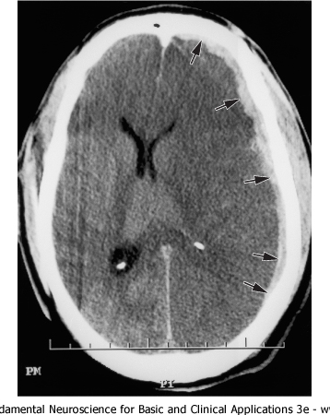
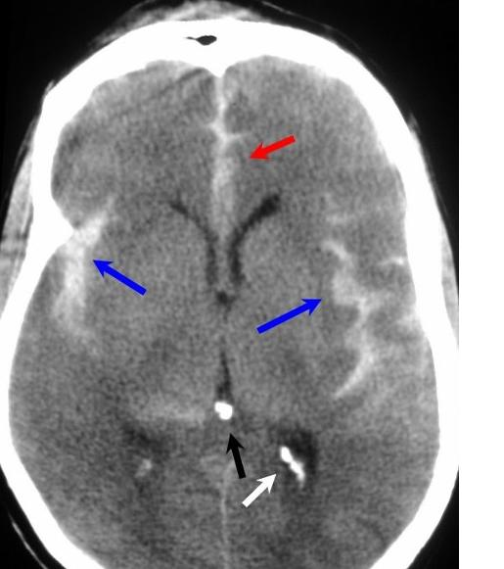
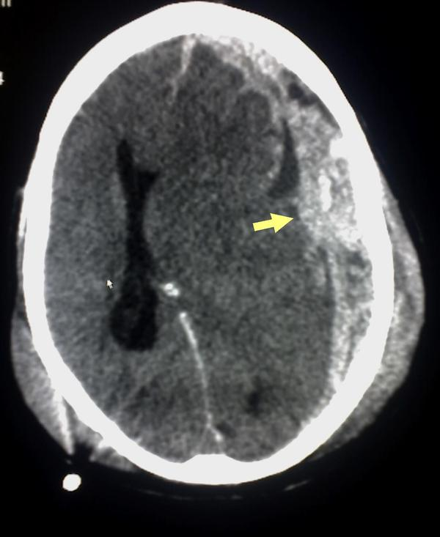
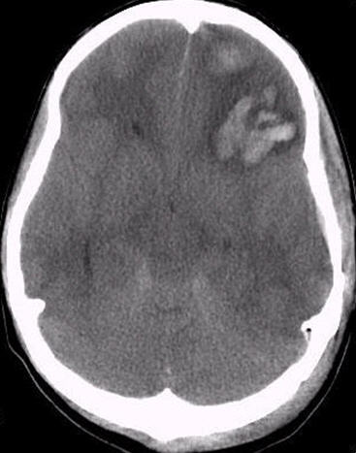
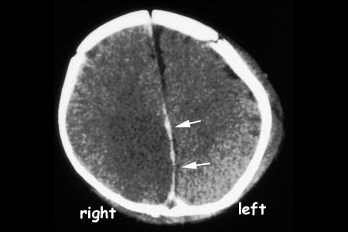
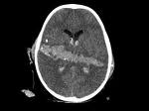
Hematomas
EDH
SAH
SDH
Notes:
Epidural hematomas are accumulations of blood between inner part of skull and outer part of dura (outer layer of meninges). Ask class about soft tissue swelling in Image A.

Slide 51
MRI
Detecting diffuse axonal injury (DAI) and infarction, often invisible on conventional CT or MRI
Subtle micro hemorrhages , 1-2mm in size, hemosederin
Susceptibility-weighted imaging (SWI).
Gradient Echo(GRE)
Chemical markers of injury
MR spectroscopy
Non hemorrhagic shearing injuries
Flair, DTI
Embolic infarcts
MR diffusion-weighted imaging (DWI).
Measuring disturbances in blood flow
PET, CT perfusion, or MR perfusion.
Metabolic and cognitive dysfunction
PET and functional MRI,
Notes:
MRI may also identify areas of focal cortical edema that
clear in 1 to 3 months.31 Petechiae, after they disappear, will
leave a permanent imprint of hemosiderin deposition on MRI.32
Except in certain locations (eg, corpus callosum), nonhemorrhagic
white matter foci may be unconnected to trauma. Abnormal
white matter signals can be shown in up to 30% of
healthy middle-aged individuals, depending on MRI weighting. Typical imaging findings when present are (1) hemorrhagic
cortical contusion, or (2) white matter shear injury
shown on MRI as small foci of altered signal or as petechial
hemorrhages visualized both by CT and MRI.14 Detection rates
for shear are considerably higher with MRI, more so by conventional
T2-weighted gradient echo, which reveals shear injury
in up to 25% to 30% of CT-negative instances of mild
TBI14 and double the incidence compared with CT for cortical
contusions.30
MRI may also identify areas of focal cortical edema that
clear in 1 to 3 months.31 Petechiae, after they disappear, will
leave a permanent imprint of hemosiderin deposition on MRI.32
Except in certain locations (eg, corpus callosum), nonhemorrhagic
white matter foci may be unconnected to trauma. Abnormal
white matter signals can be shown in up to 30% of
healthy middle-aged individuals, depending on MRI weighting.
33
Positive findings in mild injury are more readily depicted by
using newer, more sophisticated but less readily available MRI
technologies. These include diffusion-weighted and fluid-attenuated
inversion recovery MRI,34 magnetization transfer imaging,
35 magnetic source imaging,36 and magnetic resonance
spectroscopy,37 all of which currently fall far short of 100%
sensitivity in detection of mild injury.
Functional MRI (fMRI) within 1 month of injury shows
different patterns of regional brain activation in response to
working memory loads in patients with mild TBI compared
with controls.38 Likewise, positron emission tomography
(PET) will disclose abnormalities specific to the trauma within
the first month.39 Those PET abnormalities (cortical and of
global distribution) are not present in chronic postconcussional
states in which regional frontotemporal hypometabolism exists,
40 a finding not unique to brain injury and more consistent
with depression.41
Functional blood flow studies by single photon emission
computed tomography42,43 (SPECT) and transcranial Doppler44
may be abnormal after mild injury. However, abnormal SPECT
findings do not always relate to injury and can be caused by
vascular headache states, altered mood, and other variables.42
The present searches identified only 1 SPECT study,43 which
was blinded for interpretation as an extra assurance of quality:
the authors found that SPECT abnormalities correlated poorly
with focal CT or MRI findings as well as with the clinical
outcome. The American Academy of Neurology (AAN) does
not support the routine use of SPECT in the evaluation of
patients with closed head injury or postconcussion syndrome.

Slide 52
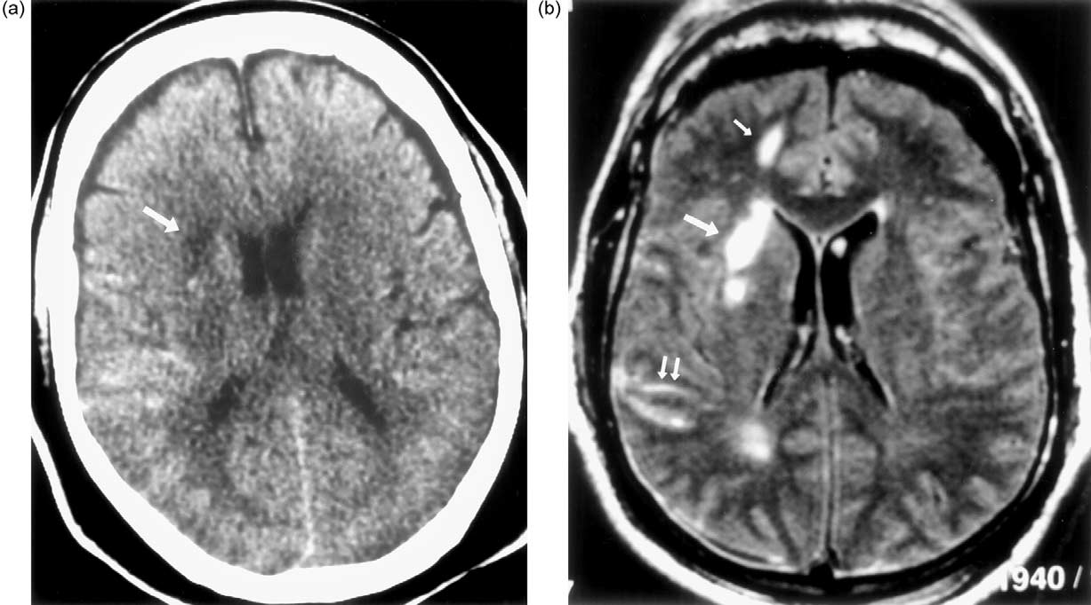
Fluid-Attenuated Inversion Recovery MRI
Fluid-Attenuated Inversion Recovery (FLAIR) MRI is also sensitive to water content in brain tissue.

Slide 53
Diffusion Tensor Imaging (DTI)
Torn or missing white
matter fiber will allow
perpendicular
movement of the
water molecules.

Slide 54
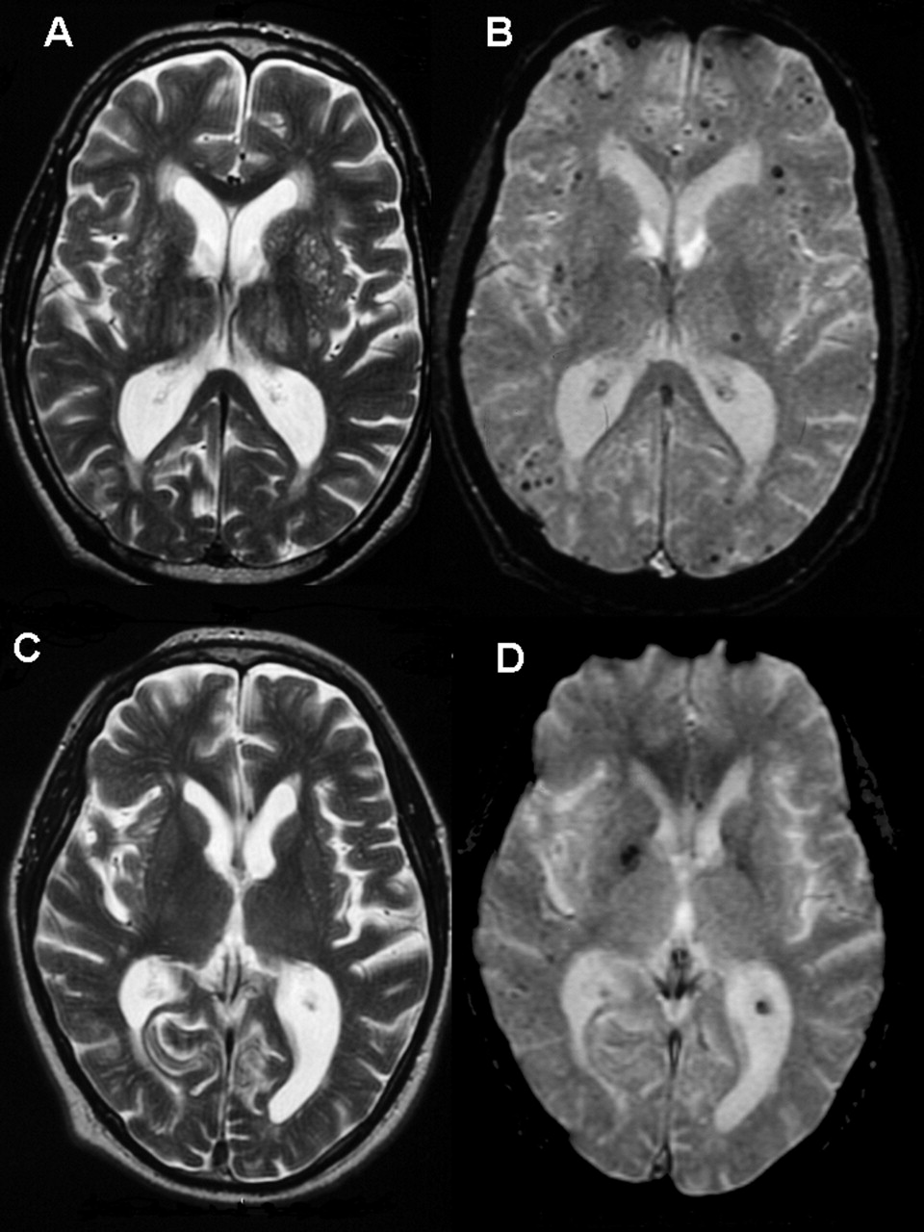
Gradient Echo MRI (GRE)
Shows micro-bleeds that can be missed by CT scans
A and B-
63 yr old with TBI
C and D
81 year old with TBI
Notes:
In images A–D the right of the brain is on the left side of the panel. T2 And B (B) T2*-weighted gradient-echo MRI of a 63-year-old male patient with executive dysfunction. The T2*-weighted gradient echo
(B) shows numerous microbleeds (low-signal intensity foci), particularly in the frontal regions but also in the parietal-occipital regions; these are not visible on the standard T2-weighted FSE.
(C) Axial T2-weighted FSE and (D) T2*-weighted gradient-echo MRI of an 81-year-old male patient with executive dysfunction. Two microbleeds are visible in the basal ganglia on the right on the T2*-weighted gradient echo (D), but not the T2-weighted FSE (C).

Slide 55
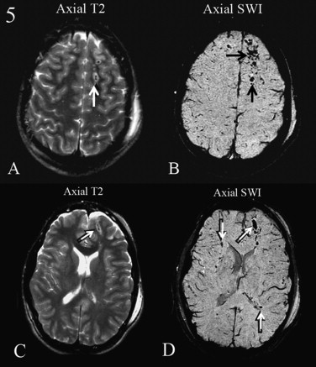
Susceptibility Imaging
High-spatial-resolution susceptibility MR
Images more lesions and details greater volume of lesions than GRE
Greater sensitivity to small hemorrhages (<10mm²) than GRE in a study of acute TBI patients.
Longer acquisition time increases potential for motion artifact
Tong KA, et al.: Radiology 2003;227:332-9
Notes:
Tong: Pediatric study of 7 subjects, imaged 5 +/- 3 days post trauma with varying GCS. In the acute phase, deoxy-hemoglobin and methemoglobin result in signal loss on T2 images, and hemosiderin in chronic phases. High spatial resolution takes nearly 3 times longer than GRE to acquire the images. SW GRE revealed approx 5X the number of hemorrhagic lesions than GRE and a twofold increase in the volume of hemorrhagic DAI lesions. May be useful only for deoxyhemoglobin, but I’m not sure. SW MRI first used for venography as it detects the paramagnetic properties of dexyhemoglobin.

Slide 56
MANAGEMENT

Slide 57
Management
Rest /Symptomatic treatment
Improve Sleep Quality
PT/OT/Vestibular/Vision rehabilitation
Assessment of cognitive and Behavioral Impairments
Cognitive remediations
Medications
Return to School/Work/play

Slide 58
Cognitively impairing Medication
Antibiotics-Keflex, Flagyl, Anti-Tb
Anticholinergics-Atropine, TCA,
Anticonvulsants-Phenytoin, Phenobarital
Antiemetics-Promethazine
Antihistamines-Cimetidine, Promethazine
Anti-inflamatory- Corticosteroids, NSAIDs
Analgesics- Opiates, Salicylates, Narcotics
Cardiac-β-blockers- Clonidine, Digitalis, Lidocaine, Quinidine, Procainamide
Drug withdrawls-Alcohol, Barbituarates, Benzodiazepine
Sympathomimetics-Amphetamines, Theophylline
Over the counter-Excedrin PM, Sleep-Eze, Compoz

Slide 59
Sleep
Comprehensive medical evaluation, Sleep logs,
Sleep hygiene, Environmental alterations
Pharmacology
Benadryl-confusion
Zolpidem (ambien)-confusion, impaired balance;
flurazepam- confusion, addiction, withdrawl
Trazodone (Deyrel), nightmares
Notriptyline (Pamelor),
Anticonvulsants-Neurontin
Antipsychotics

Slide 60
Treatment of impaired arousal
Optimize cardiopulmonary status
Minimize sedating medications
Improve sleep
Cognitive exercises
Medications
Neurostimulants-Methylphenidate(√),Amphetamines(x)
Dopaminergic agents-Amantadine(√), Bromocriptine (√)
Antidepressant-Sertaline (√), Amitriptline (√)
Modafanil (√)
Zolpidem (+/-)

Slide 61
Treatment of Impairment in Attention
Environmental control
Medications
Psycho stimulants
-methylphenidate, (√)
dextroamphetamine(√)
Dopminergic
Amantadine(√)
Provigil, (√)
Bromocriptine(√)
Cholinesterase inhibitor -donepezil
Notes:
Cholinergic agents
Cholinesterse inhibitor (donepezil)- trials in TBI,mixed results
Catecholamines
Psychostimulants-imp processing speed, attention
Amantadine- reduced arousal, pre and pst synaptic dopaminergic
Bromocriptine
Others
TCA
Serotonin

Slide 62
Treatment of Behavioral Instability
Avoid Haldol, Benzodiazepam
Depakote (valproic acid)
Carbamezine
Tegretol
Seroquel
Propranolol

Slide 63
KEY POINTS
Establishing diagnosis
History
Neuropsychological Assessment
Imaging
Management
Stimuli management
Sleep and pain
Cognitive remediation
Behavioral interventions
Medications

