Slide 1



Silesian University of Technology, Poland
Recoverable and recyclable catalysts for sustainable chemical processes
Anna Chrobok

Slide 2
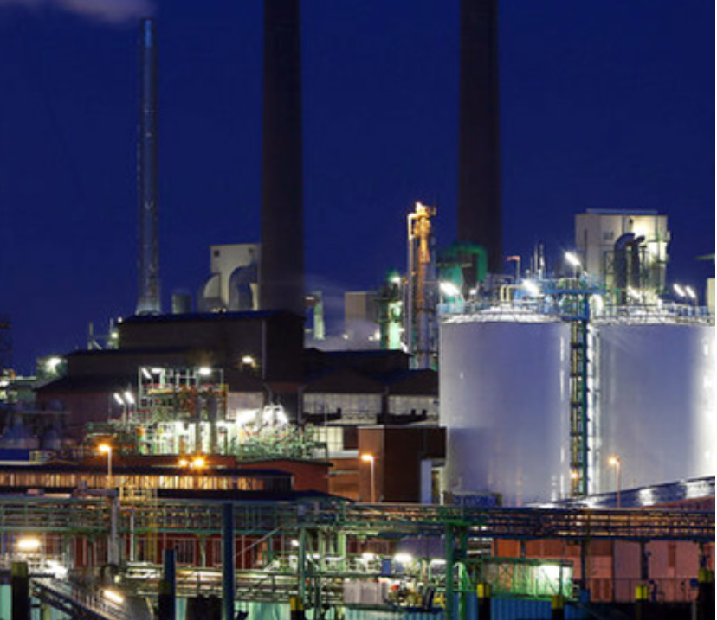
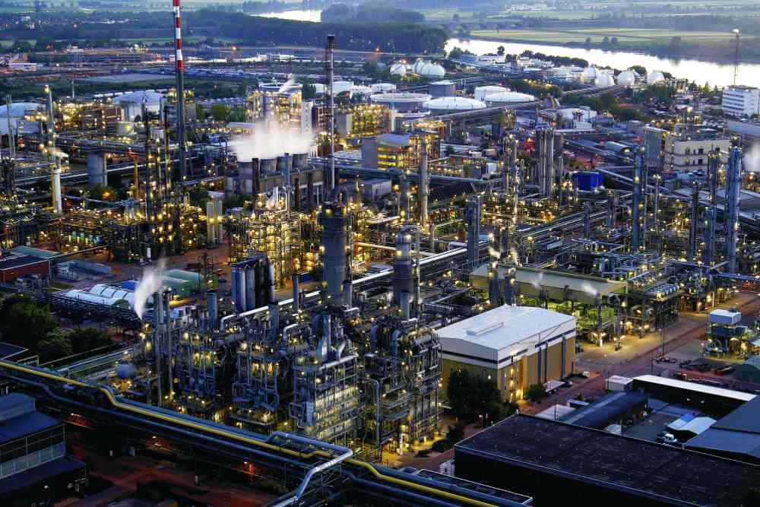
What are the challenges for the sustainable chemical industry today?
reduce chemical waste,
improve the selectivity and
efficiency of synthetic processes
The design and synthesis of recoverable and recyclable catalysts
Ludwigshaven in Germany

Slide 3


What are the challenges for the sustainable chemical industry today?
The need to implement green chemistry principles is a driving force towards the development of recoverable and recyclable catalysts.
Recyclability can either be achieved:
by bounding the catalyst to a solid phase,
by modification of solubility characteristics.
CATALYST
CATALYST e.g. acid or base is bounded to a solid phase
Filtration
Regeneration
Recycle
M. Benaglia, Recoverable and Recyclable Catalysts, 2009 John Wiley & Sons Ltd., 2009

Slide 4

Green Chemistry
„Green chemistry is the design, development and implementation of chemical products and processes to reduce or eliminate the use and generation of substances hazardous to human health and the environment.“
(U.S. Environmental Protection Agency)
Notes:
12 Principles of Green Chemistry*
It is better to prevent waste than to treat or clean up
waste after it has been created.
1. Prevention -
Synthetic methods should be designed to maximize the
incorporation of all materials used in the process into
the final product.
2. Atom Economy -
Wherever practicable, synthetic methods should be
designed to use and generate substances that possess
little or no toxicity to human health and the environment.
3. Less Hazardous Chemical Synthesis -
Chemical products should be designed to effect their desired
function while minimizing their toxicity.
4. Designing Safer Chemicals -
The use of auxiliary substances (e.g., solvents, separation
agents, etc.) should be made unnecessary wherever possible and innocuous when used.
5. Safer Solvents and Auxilaries -
Energy requirements of chemical processes should be
recognized for their environmental and economic impacts and should be minimized. If possible,
synthetic methods should be conducted at ambient temperature and pressure.
6.Design for Energy Efficiency -
A raw material or feedstock should be renewable rather
than depleting whenever technically and economically practicable.
7. Use of Renewable Feedstocks -
Unnecessary derivatization (use of blocking groups, protection/
deprotection, temporary modification of physical/chemical processes) should be minimized or
avoided if possible, because such steps require additional reagents and can generate waste.
8. Reduce Derivatives -
Catalytic reagents(as selective as possible) are superior to stoichiometric
reagents.
9. Catalysis –
Chemical products should be designed so that at the end of their
function they break down into innocuous degradation products and do not persist in the
environment.
10. Design for Degradation -
Analytical methodologies need to be
further developed to allow for real-time, in-process monitoring and control prior to the formation of
hazardous substances.
11. Real-Time analysis for Pollution Prevention -
Substances and the form of a
substance used in a chemical process should be chosen to minimize the potential for chemical
accidents, including releases, explosions, and fires.
12. Inherently Safer Chemistry for Accident Prevention -
*- (Anastas, P. T.; Warner, J. C. Green Chemistry: Theory and Practice, Oxford University Press: New York, 1998, p.30)

Slide 5
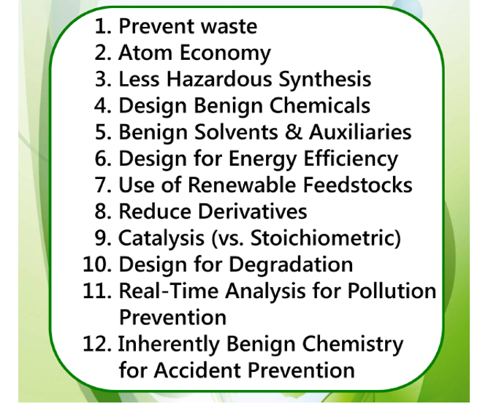
http://www.acs.org/content/acs/en/greenchemistry.html

Slide 6
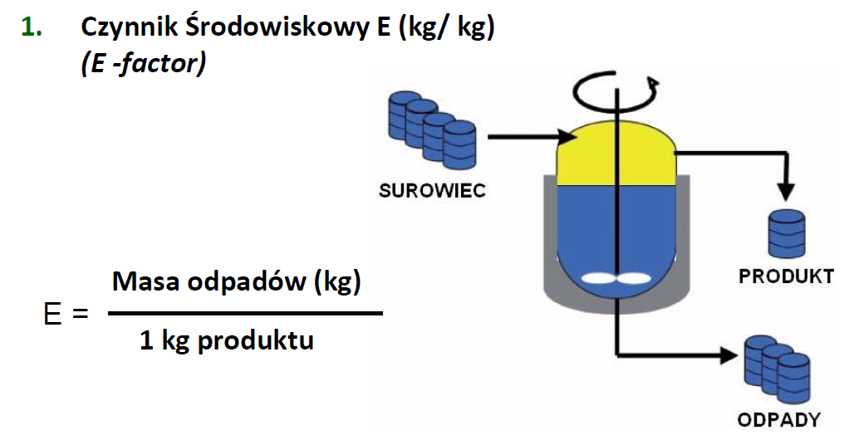

Green Chemistry
E-factor (kg/kg)
raw material
E = kg waste/kg product
product
waste
Product | tons p.a. | kg waste/ kg product
Oil refining | 10⁶ - 10⁸ | ca 0.1
Bulk Chemicals | 10⁴ - 10⁶ | < 1 - 5
Fine Chemicals | 10² - 10⁴ | 5 - 50
Pharmaceuticals | 10 - 10³ | 25 - 100+
R. A. Sheldon “Consider the Environmental Quotient”, ChemTech, 1994, 38.

Slide 7
Examples
Case studies:
the recoverable and recyclable catalysts for chemical processes like:
esterification,
Diels-Alder reaction,
oxidation of alcohols and ketones.
IONIC LIQUIDS as homogeneous and heterogeneous catalysts
Recycling of ionic liquids prevents them from:
- ending up in the aquatic environment,
- release into the atmosphere (low volatility).
Ionic liquids from biomass.

Slide 8
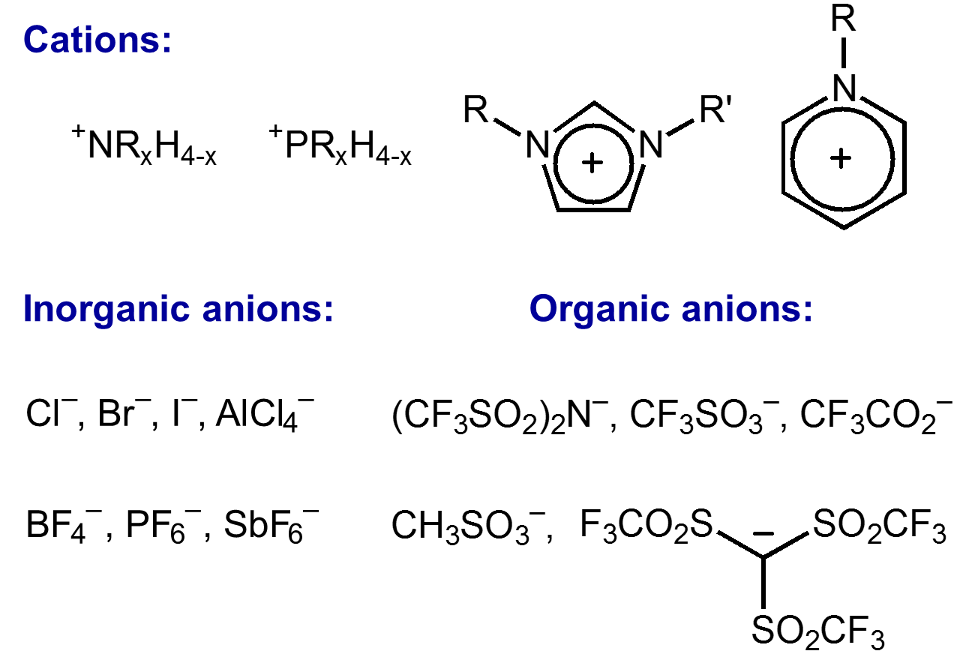
Ionic Liquids Basic Structures

Slide 9
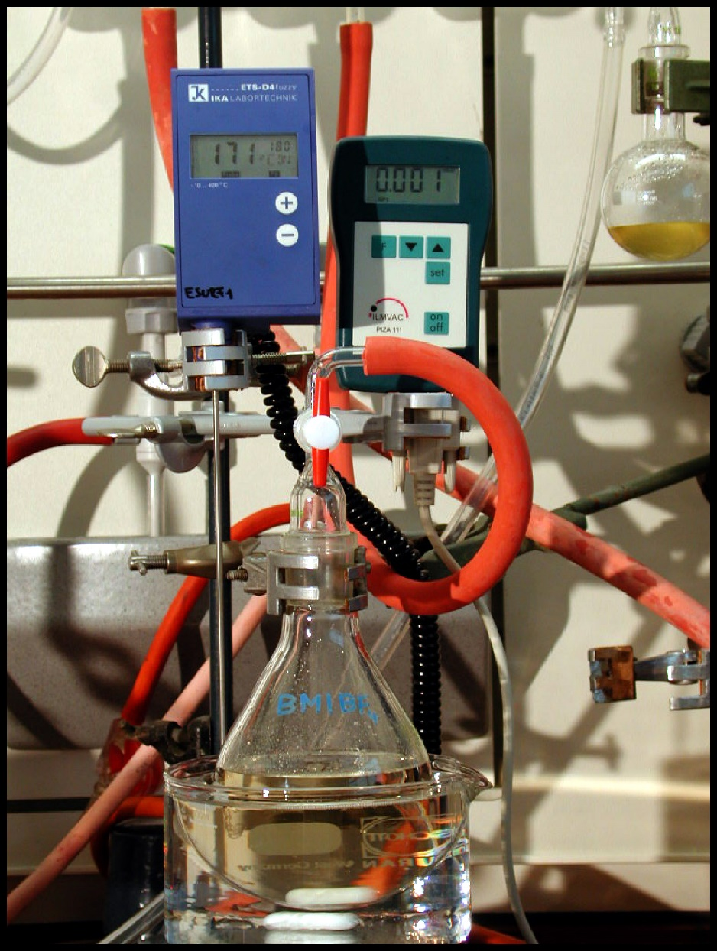
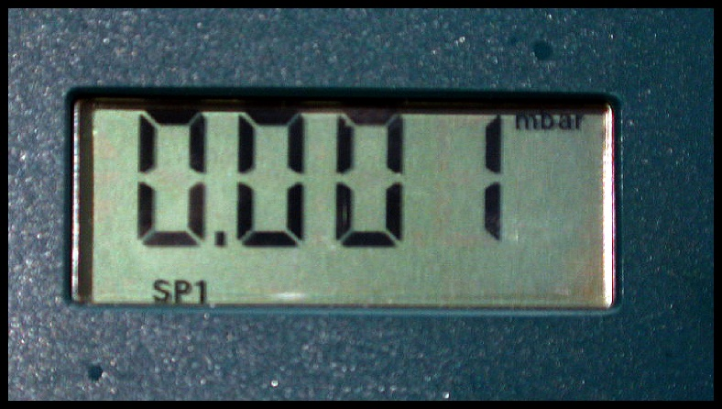
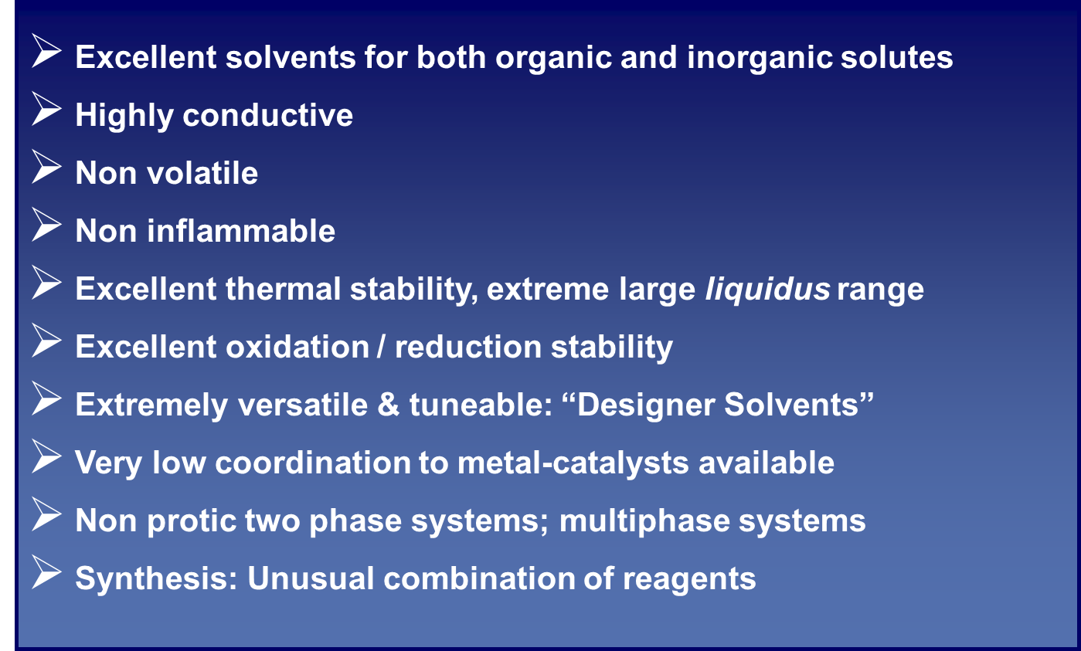
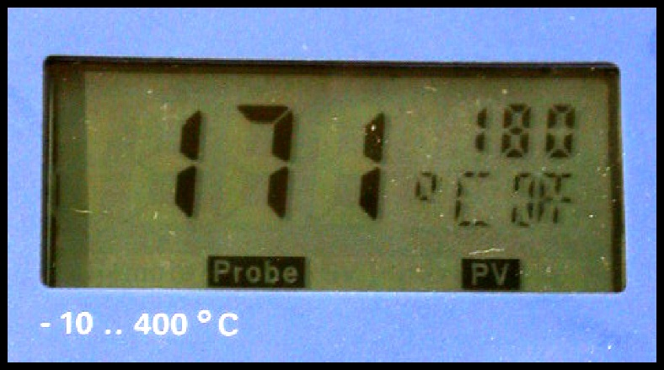
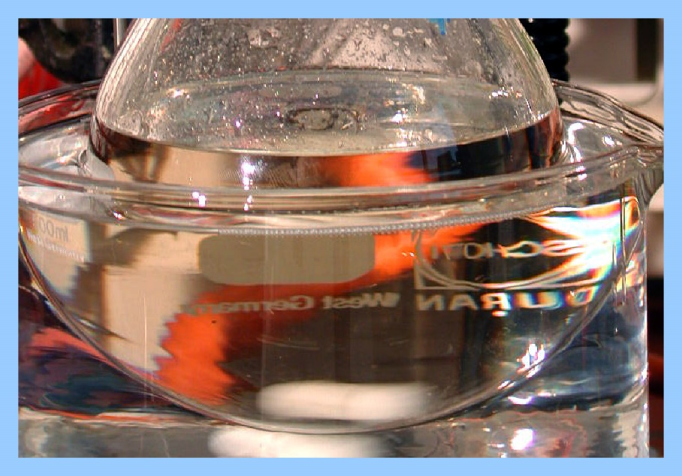
Ionic Liquids Properties

Slide 10
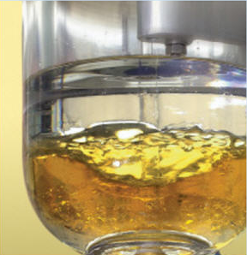
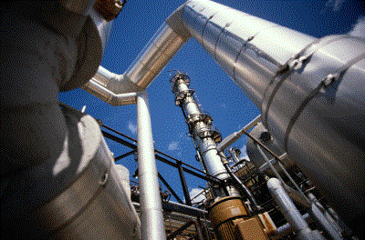
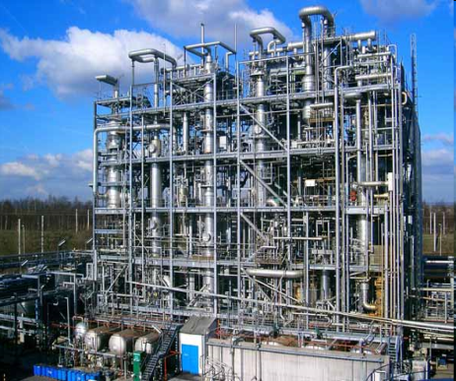
Ionic liquids as catalyst and solvent
for esterification reaction
Modification of solubility characteristics

Slide 11
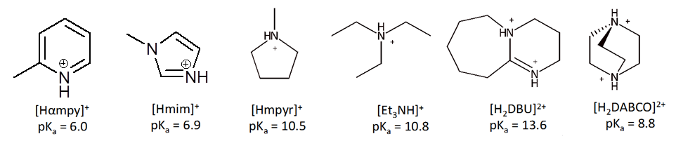
Complex hydrogen-bonded anionic clusters
[(HSO₄)(H₂SO₄)_{χ}]⁻(χ = 0, 1, or 2)
H₂SO₄ + B → [HB][HSO₄] χ_{H2SO4} = 0.50
2H₂SO₄ + B → [HB][(HSO₄)(H₂SO₄)] χ_{H2SO4} = 0.67
3H₂SO₄ + B → [HB][(HSO₄)(H₂SO₄)₂] χ_{H2SO4} = 0.75
m. p. < 100°C
RT ILs, T_{g} < 0°C
K. Matuszek, A. Chrobok, F. Coleman, K. R. Seddon, M. Swadźba‑Kwaśny, Green Chem., 2014, 16 , 3463

Slide 12
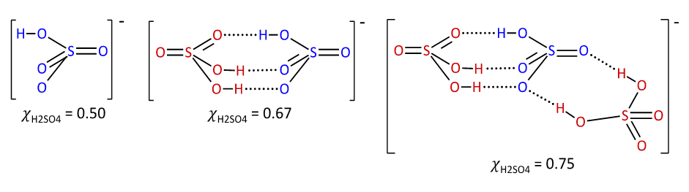
Complex hydrogen-bonded anionic clusters
[(HSO₄)(H₂SO₄)_{χ}]⁻(χ = 0, 1, or 2)
Atoms of the hydrogensulfate anion are represented in blue,
Atoms of the sulfuric acid are in red.
K. Matuszek, A. Chrobok, F. Coleman, K. R. Seddon, M. Swadźba‑Kwaśny, Green Chem., 2014, 16 , 3463

Slide 13
Model esteryfication reaction
Catalyst acidity
Reactants ratio 1÷ 1,5 mol
Catalyst loading 1÷ 15 % mol
Catalyst recycle
K. Matuszek, A. Chrobok, F. Coleman, K. R. Seddon, M. Swadźba‑Kwaśny, Green Chem., 2014, 16 , 3463

Slide 14
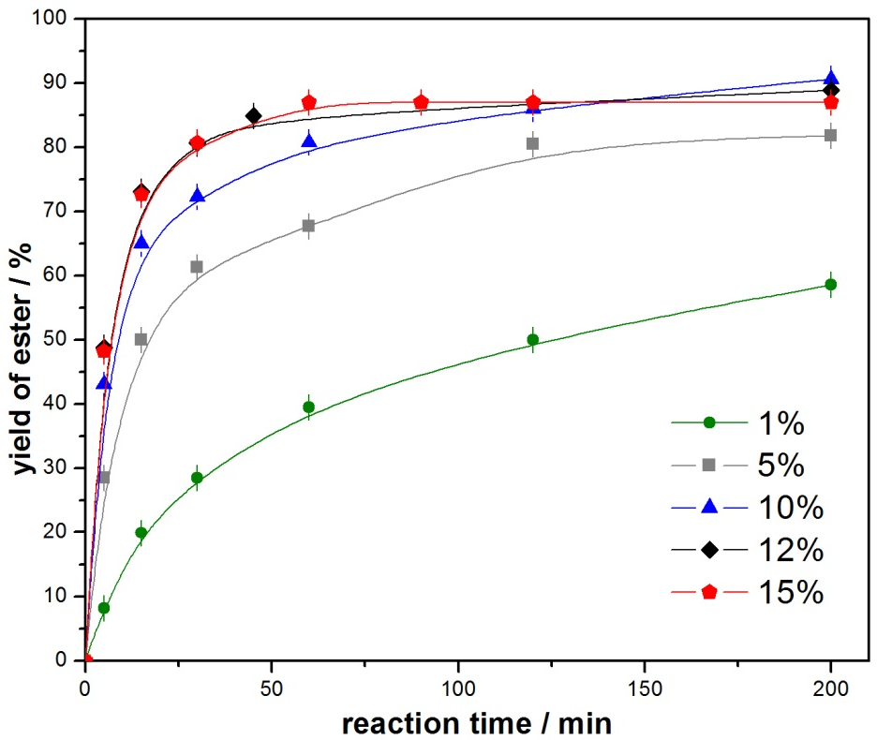
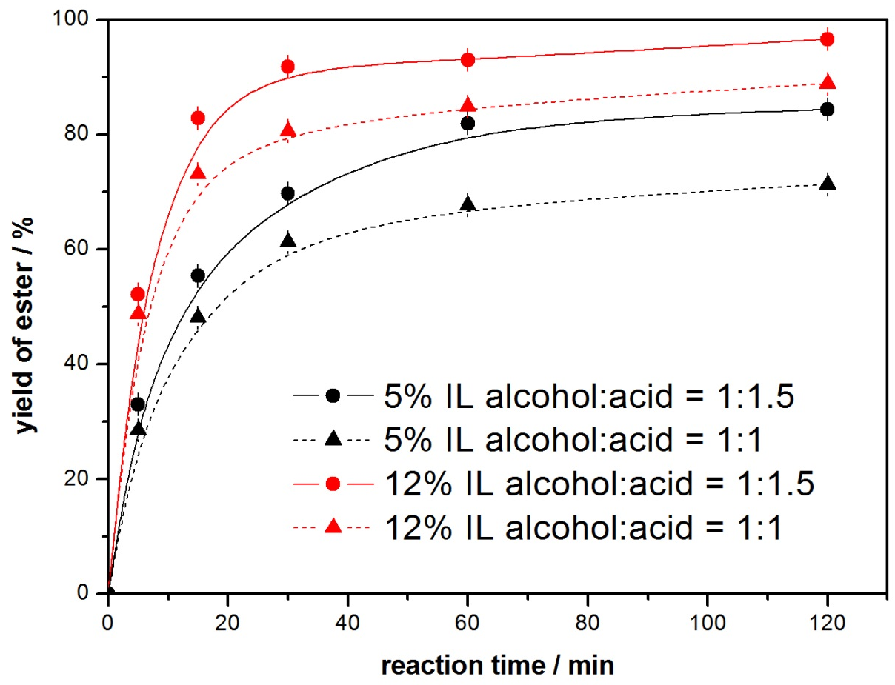
Complex hydrogen-bonded anionic clusters
Catalyst loading, %mol
Reactants ratio
BuOH : MeCOOH = 1:1; Temp. 30ºC
Temp. 30ºC
[Et₃NH][(HSO₄)(H₂SO₄)₂]

Slide 15
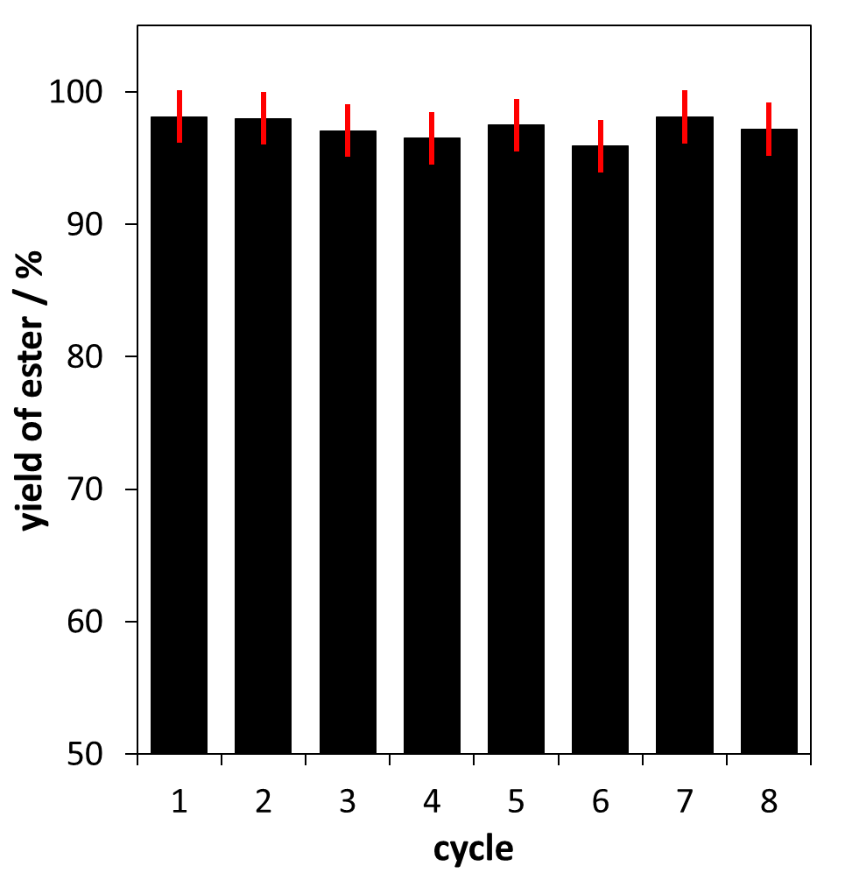
Recycling study
BuOH : MeCOOH = 1:1.5; IL =12% mol; t= 2h; Temp. 30ºC
[Et₃NH][(HSO₄)(H₂SO₄)₂]

Slide 16
Summary
Synthesis of a new family of protonic ionic liquids
Formation of hydrogen-bonded anionic clusters [(HSO₄)(H₂SO₄) _{χ}]- (χ= 1 or 2)
High acidity of new ionic liquids (AN up to 121)
New catalysts for esterification
Key parameters effecting the
reaction: miscibility of reagents,
catalyst acidity
Possibility to reuse catalyst
without the lost of activity

Slide 17
Ionic liquids as catalyst and solvent
for Diels-Alder reaction
Designing of recyclable biocatalysts

Slide 18
Ionic liquids from the biomass
Glucose-derived ionic liquids: exploring biodegradable, low-cost sources
K. Erfurt, I. Wandzik, K. Walczak, K. Matuszek, A. Chrobok, Green Chem., 2014, 16, 3508

Slide 19
Diels-Alder reaction
K. Erfurt, I. Wandzik, K. Walczak, K. Matuszek, A. Chrobok, Green Chem., 2014, 16, 3508

Slide 20
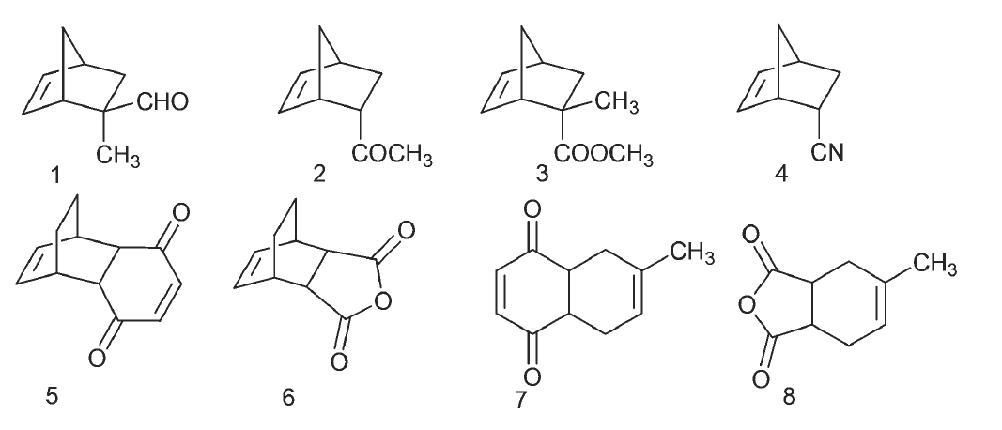
Diels-Alder reaction
K. Erfurt, I. Wandzik, K. Walczak, K. Matuszek, A. Chrobok, Green Chem., 2014, 16, 3508

Slide 21
Ionic liquids as catalyst
for ketones oxidation
Bounding the catalyst to a solid phase

Slide 22
Immobilized Catalysts
Bounding ionic liquid to a solid phase
Scanning Electron Microscopy micrograph of bimodal structured silica
A. Chrobok, S. Baj, W. Pudlo, A. Jarzębski, Appl. Catal. A: General, 2009, 366, 22

Slide 23
Immobilized Catalysts
Bounding the catalyst to a solid phase
3 recycles, 89-91% of catalyst recovery
A. Chrobok, S. Baj, W. Pudlo, A. Jarzębski, Appl. Catal. A: General, 2009, 366, 22

Slide 24
Ionic liquids as catalyst and solvent
for alcohols oxidation
Supported Ionic Liquid Phase SILP

Slide 25
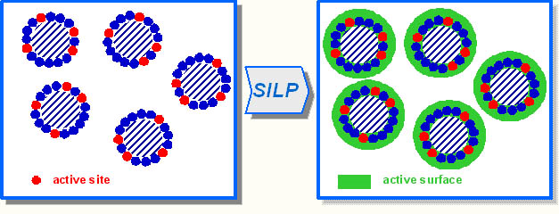
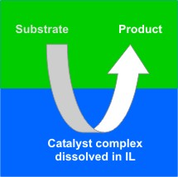
Supported Ionic Liquid Phase SILP
- materials science engineering with economic and environmental objectives
A. Chrobok, S. Baj, W. Pudlo, A. Jarzębski, Appl. Cat. A: General, 2010, 389, 179

Slide 26
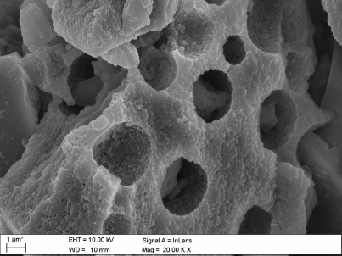
Supported Ionic Liquid Phase SILP
Scanning Electron Microscopy
micrograph of the ionogel
A_CuCl₂/[bmim]OSO₃Oc_{sup}
A. Chrobok, S. Baj, W. Pudlo, A. Jarzębski, Appl. Cat. A: General, 2010, 389, 179

Slide 27
Supported Ionic Liquid Phase SILP
reaction conditions: alcohol (1 mmol), TEMPO (0.1 mmol), 0.025 mmol of CuCl₂ included in A_CuCl₂/[bmim]OSO₃Oc_{sup}, dibutyl ether as solvent, oxygen at atmospheric pressure, 65 ºC
A. Chrobok, S. Baj, W. Pudlo, A. Jarzębski, Appl. Cat. A: General, 2010, 389, 179

Slide 28
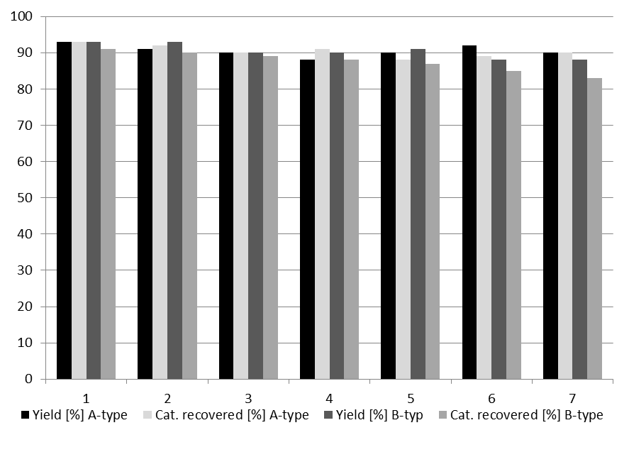
Reusability of the A_CuCl₂/[bmim]OSO₃Oc_{sup} and B_CuCl₂/[bmim]OSO₃Oc_{sup} catalysts
reaction conditions: benzyl alcohol (5 mmol), TEMPO (0.5 mmol), 0.35g of catalyst containing 0.075 mmol of CuCl₂, oxygen at atmospheric pressure, 65 ºC; isolated yields after 7 h with 98% conversion of benzyl alcohol

Slide 29
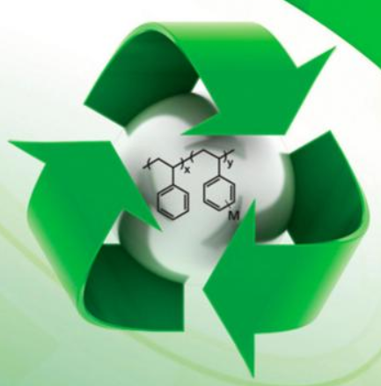
Summary
The development of recyclable catalysts
represents a big challenge.
It is interdisciplinary field,
where pure chemistry is connected to
material science, or engineering and where even business and economy-related issues play an important role in:
determining the planning, the design and the realization of a project in the area.
It is a field where many technologies and opportunities are offered to successfully realize an easy recoverable and, what is more important, reusable catalytic system.

Slide 30
Acknowledgment
Karolina Matuszek
Agnieszka Drożdż
Magdalena Sitko
Karol Erfurt
Professor Andrzej Jarzębski
Dr Katarzyna Szymańska
Professor Kenneth Seddon
Dr Małgorzata Śwadźba
Dr Fergal Coleman
Financing:
HARMONY Grant no. UMO-55 2012/06/M/ST8/00030

