Slide 1
Does In With The Good Equal Out With The Bad? Application of Nutrition Support Research Ann-Marie Brown, PhD, CPNP-AC/PC, CCRN, FCCM Asst Professor, The University of Akron PICU Nurse Practitioner, Akron Children’s Hospital

Slide 2
Disclosures
Grants
Corpak MedSystems® – unrestricted grant
Manuscript in process.
Sigma Theta Tau International, Delta Omega Chapter
Manuscript in process
I am not advocating for any particular device or manufacturer
All photographs used with written permission

Slide 3
Objectives
Describe incidence and risks of malnutrition in the hospitalized patient in the PICU
Discuss available methodologies to determine nutrition needs in the PICU population
Describe challenges and current best practices in nutrient delivery in the critically ill child

Slide 4
Pediatric Malnutrition
“an imbalance between nutrient requirements and intake that results in cumulative deficits of energy, protein, or micronutrients that may negatively affect growth, development and other relevant outcomes” (p. 478)
Domains of chronicity, etiology, mechanisms of nutrient imbalance, severity of malnutrition and impact on outcomes
Emphasis on etiology of malnutrition as a primary driver for nutrition support
(Mehta et al., 2013)

Slide 5
Epidemiology of the Problem
More than 30% children requiring mechanical ventilation were severely malnourished upon admission to the PICU
BMI Z score > 2 (13.2%) or < 2 (17.1%)
Inadequate delivery of nutrition during hospitalization results in cumulative energy (kcal/kg/day) and/or protein (grams/kg/day) deficits which contribute to delayed recovery (Mehta et al., 2012; Mikhailov et al., 2014)
(Nilesh M. Mehta et al., 2012)
Notes:
500 patients, 31 units, 8 countries

Slide 6
Epidemiology of the Problem
Cohort study of children ages 3.9 to 63.3 months admitted to the PICU over a 2 year period (n=385)
46% (n=175) were malnourished on admission, assoc with longer duration of MV (p=0.003)
Only 35% of energy needs and 0% of protein needs were met for AKI/renal failure vs 55% and 19% in those without
Likely due to fluid restrictions and reluctance to provide needed protein in patients with kidney injury
(de Souza Menezes, Leite, & Koch Nogueira, 2012).
(Kyle, Akcan-Arikan, Orellana, & Coss-Bu, 2013).

Slide 7
A.S.P.E.N. Nutrition Support Recommendations for the Critically Ill Child
Nutrition screening for all patients
Energy expenditure should be assessed throughout course of illness
Insufficient data to make standard recommendation for macronutrient intake, total or composition
(Mehta, Compher, et al., 2009)
Notes:
Note Date of 2009

Slide 8
A.S.P.E.N. Nutrition Support Recommendations for the Critically Ill Child
EN preferred mode of nutrition delivery
Routine use of immunonutrition not recommended
Specialized Nutrition Support Teams and aggressive feeding protocols may enhance delivery of EN, minimizing use of PN and decreasing nutritional deficits
(Mehta, Compher, et al., 2009)
Notes:
Note these are 5 years old and most poorly supported by the evidence at the time of publication

Slide 9
Measuring Energy Needs
Best practice – Indirect Calorimetry (IC)
Calculates a respiratory quotient (RQ), the ratio of CO2 elimination to oxygen uptake, partly determined by endogenous substrate use
Target is 0.87
higher increased CHO burden
lower increased fat burden
Can direct nutrition therapy for not only energy needs, but composition
(Dokken M, Rustoen T & Stubhaug A., 2013)
Notes:
1 = glucose, 0.7 = fat, 0.85 protein

Slide 10
Measuring Energy Needs
Challenges of IC
Often not tolerated by critically ill patients
Use on infants < 10kg
Alternatives
RDA
Standardized equations
Many available, with modifications employed account for REE variation in the PICU environment
(Dokken M, Rustoen T & Stubhaug A., 2013; Mehta NM, 2009; Irving, SY, et. al., 2009)
Notes:
1 = glucose, 0.7 = fat, 0.85 protein

Slide 11
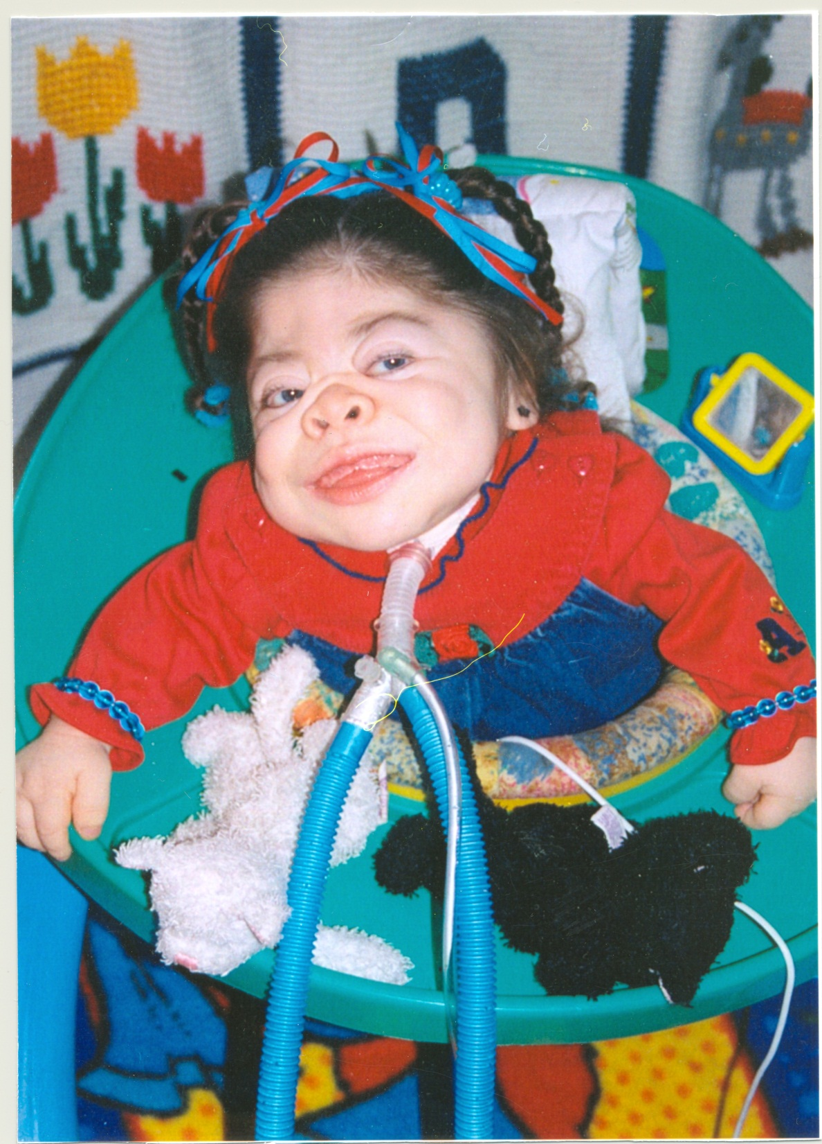

Slide 12
Measuring Energy Needs
Re-assess every 3-4 days
Early inflammatory phase associated with catabolism, lower energy but higher protein needs
Biomarkers??
Convalescent phase is anabolic with increased energy needs along with adequate protein
When unable to achieve target daily energy and protein, supplementation to target protein while sacrificing calorie intake may still confer an outcome benefit for the patient
(Larsen, 2012; Larsen et al., 2012)
Notes:
1 = glucose, 0.7 = fat, 0.85 protein

Slide 13
Impact of EN on Outcomes in the PICU
Mean (SD) attainment of target nutrition via EN was 38% (34) for energy and 43% (44) for protein
Higher levels of EN (66.6% compared to 33.3%) resulted in a lower mortality rate (OR 0.27 [0.11-0.67], p = .002)
Subjects receiving parenteral nutrition had a higher mortality rate (OR 2.61 [1.3 – 5.3], p = .008)
Analyses controlled for hospital site and severity of illness
(Mehta et al., 2012)
Notes:
In Mehta 2012 international 500 subject, 31 PICU, 8 countries study

Slide 14
Impact of EN on Outcomes in the PICU
Retrospective study of 8 PICUs (n=5105) compared those on MV who did and did not achieve early EN (25% goal calories within 48 hours of admission)
27.1% (mean) of subjects (range 15.6%-45.1%) achieved early EN
Those achieving EN had lower mortality
(odds ratio 0.51; 95% CI 0.34-0.76; p =.001)
Adjusted for age, severity of illness, clinical site, and propensity score
(Mikhailov et al., 2014)
Notes:
The propensity score was calculated by using logistic regression to derive the probability of receiving EEN based on the patient’s characteristics and was then added as a covariate in the analysis of mortality to address the possibility that sicker patients were less likely to receive EEN. No between group differences were found for length of stay or duration of mechanical ventilation

Slide 15
Barriers to Delivery of Adequate EN
Hemodynamic instability
Feeding intolerance
Feeding interruptions
Variation in feeding practices/lack of feeding protocols

Slide 16
Barriers – Hemodynamic Instability
Hemodynamic instability
Hypoxia, ischemia or both
Compensatory vasoconstriction shunts blood away from GI tract and skin toward the heart, lungs and brain
Gut vulnerable to alterations in motility, secretion, digestion, and absorption.
Concomitant fluid restriction
(Mentec et al., 2001).

Slide 17
Barriers – EN During Vasopressor Infusion
Feeding tolerance evaluated during administration of vasopressors adult ICU patients (n=259)
Overall tolerance of EN 74.9%
Adult ICU patients (n=1174) 2 groups:
those given EN within 48 hours of starting MV (n=707) and those who did not (n=467)
Those receiving early EN had lower ICU (p=.003) and hospital mortality (p=< .001)
Greatest benefit of early EN was seen in those who received multiple vasopressor agents
Mancl and Muzevich (2013)
(Khalid, Doshi, & DiGiovine, 2010)

Slide 18
Barriers – EN During Vasopressor Infusion
Feeding intolerance evaluated in PICU patients (n=339) on vasoactive medications who were fed vs not fed, comparing incidence of adverse GI events
Increased incidence of adverse GI events, e.g. emesis, diarrhea, abdominal distension, GI bleeding noted in fed group
The fed group had lower risk of mortality [6.9% vs 15.9%; OR 0.39 (0.18-0.84;p<.01)]
Consistent with the findings of Mancl, et al (2013), patients can tolerate EN while on vasopressor support with the advantages of EN maintained
(Panchal et al., 2013).

Slide 19
Barriers – Feeding Intolerance
Lack of consensus on measures/thresholds
Emesis
Gastric Residual Volumes
Abdominal Distension
Diarrhea
Abdominal Pain
Constipation

Slide 20
Barriers – Feeding Interruptions
Avoidable/Unavoidable
28 day observational PICU study
58% interruptions avoidable
3x more likely to receive PN
Feeding tube issues
Placement issues
Radiologic confirmation current best practice
Unplanned tube or dysfunction
Recommend protocols to minimize interruptions
(Mehta et al., 2010)
Notes:
Use of PN increases risk of mortality

Slide 21
Barriers - Variation in Feeding Practices/Lack of Feeding Protocols
Higher caloric formula advancement protocol for post op CHD infants
Improved delivery of target energy 98% vs 78% in control (p=.01), weight gain vs LOSS (p<.03)
Shorter hospital LOS 5 vs 6 days (p<.05)
Continuous NG protocol initiated for post Stage 1 Palliation in HLHS infants
Shorter duration of PN (p = .03) & time to goal feeds (p=/01)
no incidence of NEC in the intervention group compared to 11% in the control
(Pillo-Blocka, Adatia, Sharieff, McCrindle, & Zlotkin, 2004)
(Braudis et al., 2009)

Slide 22
Barriers - Variation in Feeding Practices/Lack of Feeding Protocols
Numerous studies demonstrate improved delivery of EN with implementation protocol in PICU
Varied protocols
No best feeding approach yet defined
Early RD documentation in MR of EER improves higher daily intake
(Petrillo-Albarano, Pettignano, Asfaw, & Easley, 2006)
(Tume, Latten, & Darbyshire, 2010)
(Horn & Chaboyer, 2003)
(Brown, Forbes, Vitale, & Tirodker, 2012)
(Wakeham, et. al., 2013)

Slide 23
Continuous vs Bolus
Adult studies (5) show NO increased pulmonary risk occurred with bolus feeding (Chen et al., 2006)
All demonstrate same or increased delivery of prescribed nutrition (Chen et al., 2006; Rhoney et al., 2002)
Increased protein synthesis in muscles of different fiber types and visceral tissues in the bolus fed group compared to the continuously fed group (p<.05)
(El-Kadi et al., 2013)

Slide 24
Continuous vs Bolus ACH PICU Nutrition Research
COBO Study
Compare continuous (CGF) vs. bolus (BGF) NG feeding approaches time to reach goal feeds, cumulative energy/protein deficits, intolerance events and feeding interruptions
Mechanically ventilated infants and children 1 month corrected gestational age through 12 years of age.

Slide 25
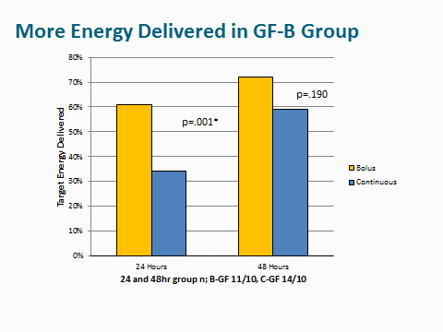

Slide 27
Changing the Paradigm
From Nutrition Support
Preserve lean body mass
Avoid metabolic complications
To Nutrition Therapy
Attenuate the metabolic response
Down-regulate inflammation
Reverse loss of lean body mass
Prevent oxidative stress
Immunomodulation
Micronutrient specific

Slide 28
Translation to Practice
Recommendations
Use indirect calorimetry when possible
Enteral as default approach unless contraindicated
Avoid PN for 5-7 days except in special cases
Protocolized approach, regardless of setting
Include intolerance criteria
Minimize interruptions
Individualized NT care plan with interdisciplinary team

Slide 29
Directions for Future Research
Defining feeding intolerance measures and thresholds that predict risk of adverse events
Defining best feeding protocols
Minimizing Interruptions
Improved techniques to measure energy needs on an interval basis

Slide 30
Directions for Future Research
Biomarkers to demarcate catabolic/inflammatory transition to anabolic/healing state
Prospective evaluation of post-pyloric vs continuous gastric versus bolus gastric feeding
EN for the patient with non-invasive ventilation
High flow nasal cannula
NIV
BiPAP

Slide 31
Thank You!!

Slide 32
References
Braudis, N. J., Curley, M. A. Q., Beaupre, K., Thomas, K. C., Hardiman, G., Laussen, P., . . . Thiagarajan, R. R. (2009). Enteral feeding algorithm for infants with hypoplastic left heart syndrome poststage I palliation. Pediatric Critical Care Medicine, 10(4), 460-466. doi: 10.1097/PCC.0b013e318198b167
Brown, A.-M., Forbes, M. L., Vitale, V. S., Tirodker, U. H., & Zeller, R. (2012). Effects of a gastric feeding protocol on efficiency of enteral nutrition in critically ill infants and children. ICAN: Infant, Child, & Adolescent Nutrition, 4(3), 175-180.
Horn, D., & Chaboyer, W. (2003). Gastric feeding in critically ill children: a randomized controlled trial. American Journal of Critical Care, 12(5), 461-468.
Horn, D., Chaboyer, W., & Schluter, P. J. (2004). Gastric residual volumes in critically ill paediatric patients: a comparison of feeding regimens. Aust Crit Care, 17(3), 98-100, 102-103.
Khorasani, E. N., & Mansouri, F. (2010). Effect of early enteral nutrition on morbidity and mortality in children with burns. Burns (03054179), 36(7), 1067-1071. doi: 10.1016/j.burns.2009.12.005
Larsen, B. M. (2012). Resting energy expenditure after fontan surgery in children with single-ventricle heart defects. JPEN J Parenter Enteral Nutr, 36(6), 630-631. doi: 0148607112449357 [pii]
Larsen, B. M., Goonewardene, L. A., Field, C. J., Joffe, A. R., Van Aerde, J. E., Olstad, D. L., & Clandinin, M. T. (2012). Low Energy Intakes Are Associated With Adverse Outcomes in Infants After Open Heart Surgery. JPEN J Parenter Enteral Nutr. doi: 0148607112463075 [pii]

Slide 33
References
Mehta, N. M. (2009). Approach to enteral feeding in the PICU. Nutrition in Clinical Practice, 24(3), 377-387. doi: 10.1177/0884533609335175
Mehta, N. M., Bechard, L. J., Cahill, N., Wang, M., Day, A., Duggan, C. P., & Heyland, D. K. (2012). Nutritional practices and their relationship to clinical outcomes in critically ill children-An international multicenter cohort study*. Critical Care Medicine, 40(7), 2204-2211.
Mehta, N. M., Compher, C., & Directors, A. S. P. E. N. B. o. (2009). A.S.P.E.N. Clinical Guidelines: nutrition support of the critically ill child. JPEN J Parenter Enteral Nutr, 33(3), 260-276. doi: 33/3/260 [pii]
Mehta, N. M., McAleer, D., Hamilton, S., Naples, E., Leavitt, K., Mitchell, P., & Duggan, C. (2010). Challenges to optimal enteral nutrition in a multidisciplinary pediatric intensive care unit. JPEN J Parenter Enteral Nutr, 34(1), 38-45. doi: 0148607109348065 [pii]
Mikhailov, T. A., Kuhn, E. M., Manzi, J., Christensen, M., Collins, M., Brown, A. M., . . . Goday, P. S. (2014). Early Enteral Nutrition Is Associated With Lower Mortality in Critically Ill Children. JPEN J Parenter Enteral Nutr. doi: 10.1177/0148607113517903
Moore, T. A., & Wilson, M. E. (2011). Feeding intolerance: a concept analysis. Advances In Neonatal Care: Official Journal Of The National Association Of Neonatal Nurses, 11(3), 149-154.
Panchal, A., Manzi, J., Connolly, S., Christensen, M., Wakeham, M., Goday, P., & Mikhailov, T. (2013). Safety of Enteral Feedings in Critically Ill Children on Vasoactive Agents. Paper presented at the Society of Critical Care Medicine's Annual Congress, San Juan, Puerto Rico.

Slide 34
References
Poulard, F., Dimet, J., Martin-Lefevre, L., Bontemps, F., Fiancette, M., Clementi, E., . . . Reignier, J. (2010). Impact of not measuring residual gastric volume in mechanically ventilated patients receiving early enteral feeding: a prospective before-after study. JPEN Journal of Parenteral & Enteral Nutrition, 34(2), 125-130. doi: 10.1177/0148607109344745
Reignier, J., Mercier, E., Le Gouge, A., Boulain, T., Desachy, A., Bellec, F., . . . Group, C. R. i. I. C. a. S. C. (2013). Effect of not monitoring residual gastric volume on risk of ventilator-associated pneumonia in adults receiving mechanical ventilation and early enteral feeding: a randomized controlled trial. JAMA, 309(3), 249-256. doi: 10.1001/jama.2012.196377
Saps, M., & Di Lorenzo, C. (2011). Gastric motility disorders. In R. Wylie, J. S. Hyams & M. Kay (Eds.), Pediatric Gastrointestinal and Liver Disease (4th ed., pp. 309-318). Philadelphia: Elsevier/Saunders.
Schindler, C. A., Mikhailov, T. A., Kuhn, E. M., Christopher, J., Conway, P., Ridling, D., . . . Simpson, V. S. (2011). Protecting fragile skin: nursing interventions to decrease development of pressure ulcers in pediatric intensive care. American Journal of Critical Care, 20(1), 26-35. doi: 10.4037/ajcc2011754
Shimizu, K., Ogura, H., Asahara, T., Nomoto, K., Morotomi, M., Nakahori, Y., . . . Sugimoto, H. (2011). Gastrointestinal dysmotility is associated with altered gut flora and septic mortality in patients with severe systemic inflammatory response syndrome: a preliminary study. Neurogastroenterol Motil, 23(4), 330-335, e157. doi: 10.1111/j.1365-2982.2010.01653.x

Slide 35
References
Skillman, H. E. (2011). Monitoring the efficacy of a PICU nutrition therapy protocol. JPEN J Parenter Enteral Nutr, 35(4), 445-446. doi: 0148607111409046 [pii]
Skillman, H. E., & Mehta, N. M. (2012). Nutrition therapy in the critically ill child. Current Opinion in Critical Care, 18(2), 192-198.
Solana, M. J., Sánchez, C., López-Herce, J., Crespo, M., Sánchez, A., Urbano, J., . . . Carrillo, A. (2013). Multichannel intraluminal impedance to study gastroesophageal reflux in mechanically ventilated children in the first 48 h after PICU admission. Nutrition. doi: 10.1016/j.nut.2013.01.004
Tume, L., Carter, B., & Latten, L. (2012). A UK and Irish survey of enteral nutrition practices in paediatric intensive care units. Br J Nutr, 1-19. doi: S0007114512003042 [pii]
Ukleja, A. (2010). Altered GI motility in critically ill patients: current understanding of pathophysiology, clinical impact, and diagnostic approach. Nutrition in Clinical Practice, 25(1), 16-25. doi: 10.1177/088453360935756

