Slide 1
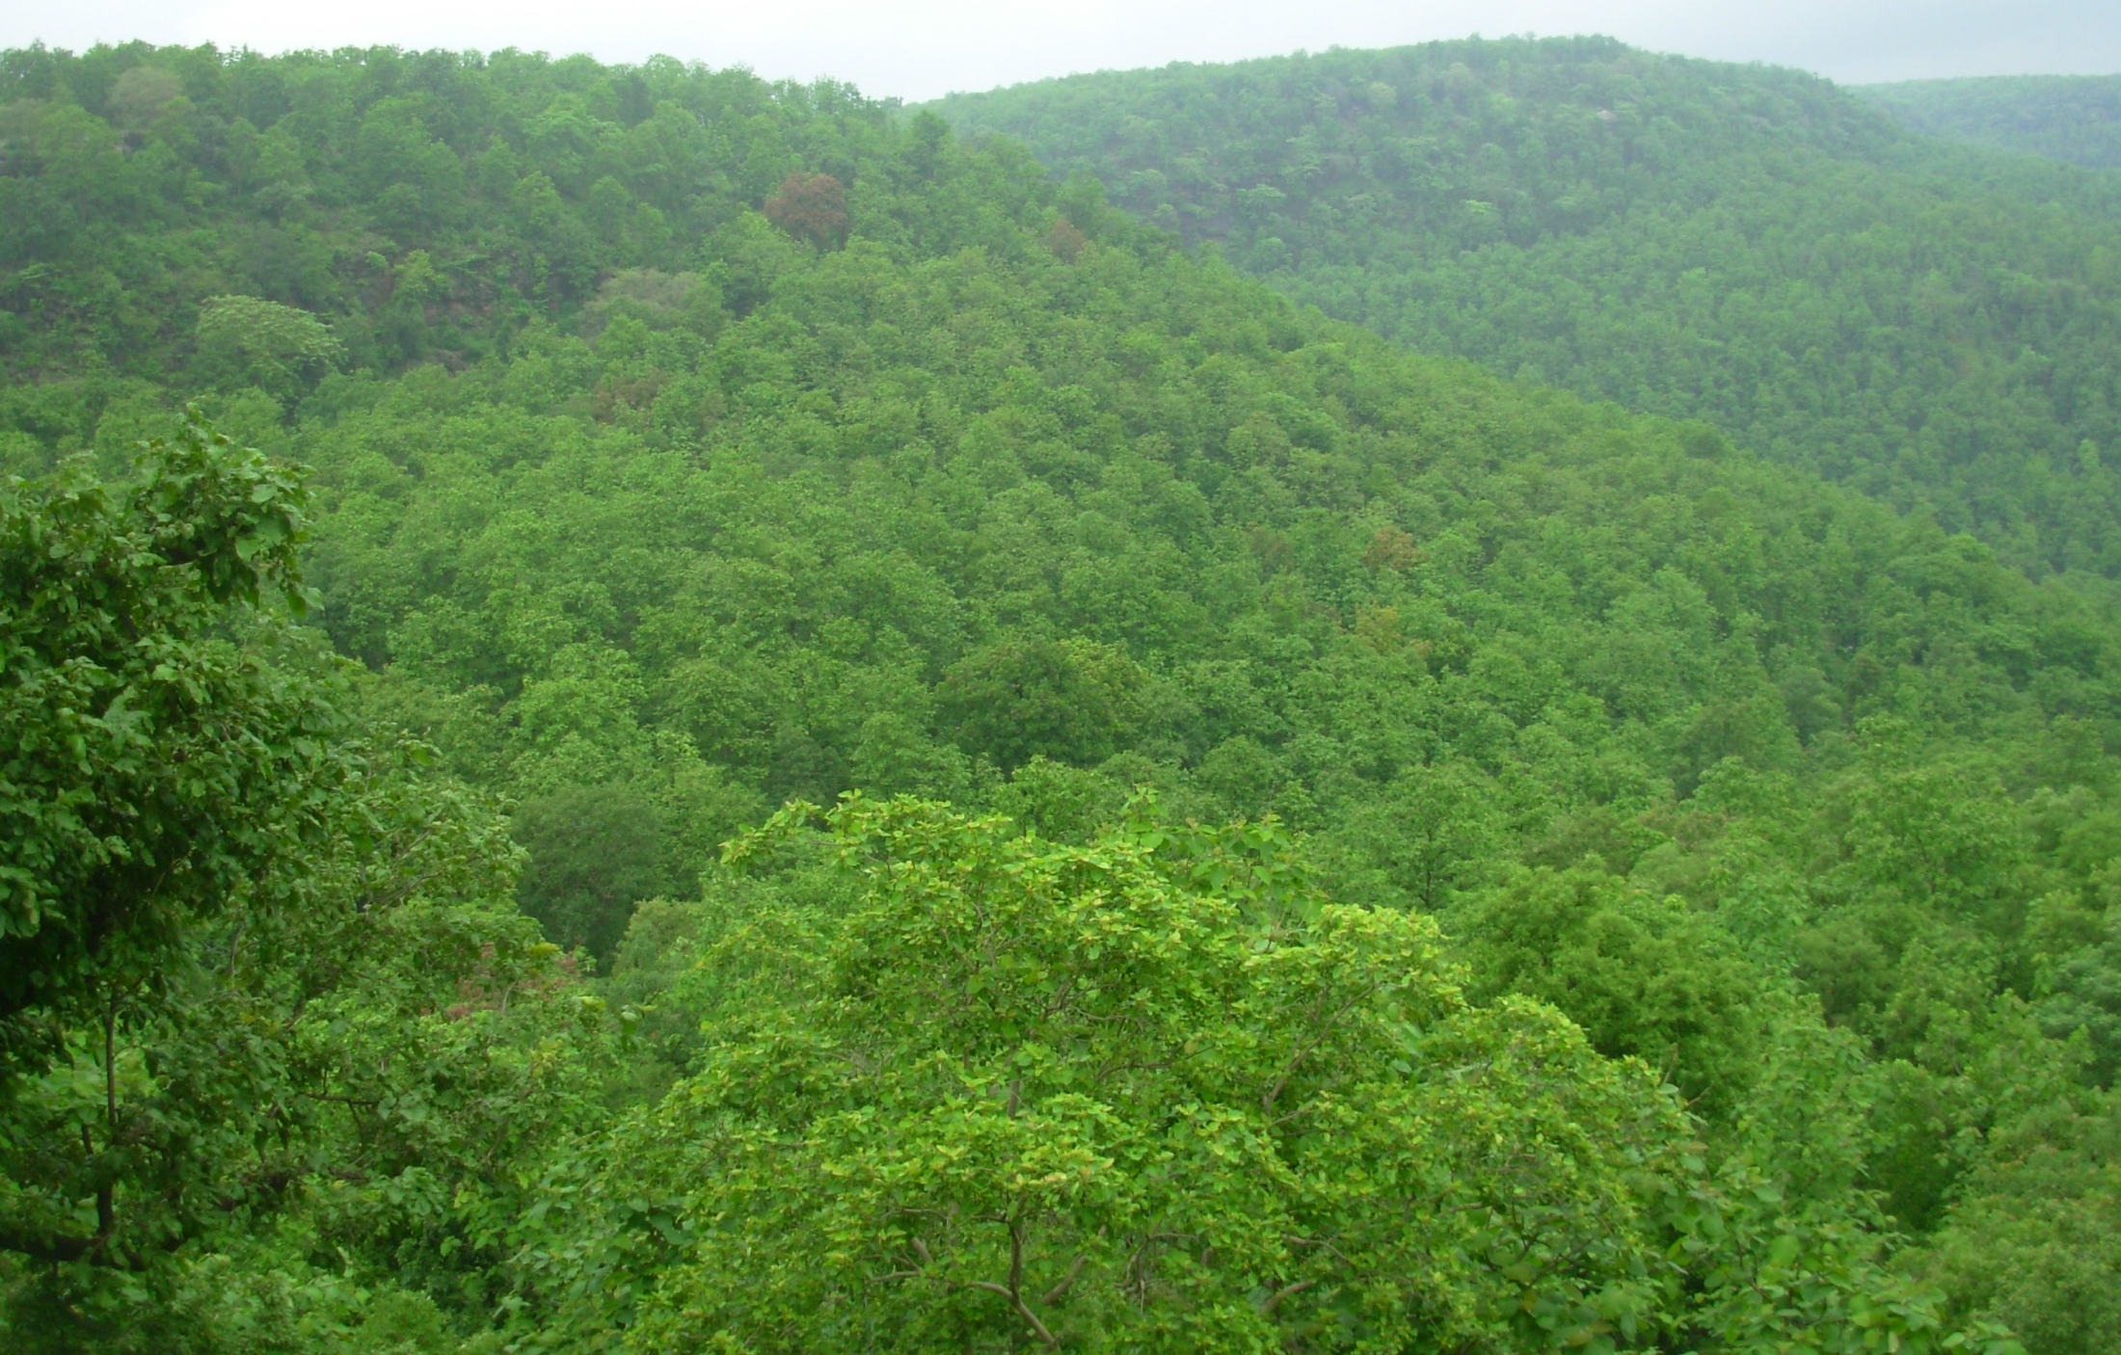
6th International Conference on Biodiversity & Conservation, 27-28 April 2017, Dubai, UAE
Conservation of Superior Phenotypes of Teak (Tectona grandis)
in Central India
Dr. Anjana Rajput
STATE FOREST RESEARCH INSTITUTE
JABALPUR, MADHYA PRADESH, INDIA

Slide 2
Among Indian tree species, teak is the most valuable timber tree species with a lot of variations existing in nature.
Value of teak timber is attributed to nice grains which is due to differential growth conditions created in a year with extreme temperature range.
The fast grown teak of Nilambur in Kerela fetches a lower price than the slower grown teak of central India.
There is a lot of scope for improvement in this species, due to lots of variations and which is nearly untouched for manipulations.

Slide 3
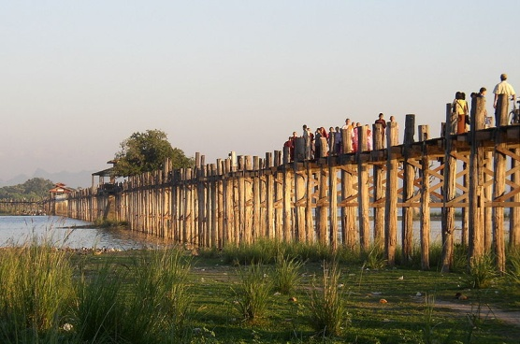
In any species different kinds of genetic variation is govern by five major evolutionary process, in natural forest stands.
i.e. mutation,
migration,
hybridization,
selection
and genetic drift.
It may be:
geographical variation
stand to stand variation
individual tree variation.
In teak, individual tree variation is an important source of practical breading program.

Slide 4
Teak is justly famous for its durability. In Karla Caves near Lonavla in Maharashtra state, there is a set of ‘ribs’ that line the ceiling of the main caves; such ribs are over 2000 years old and are still sound in every sense.
Teak timber is impregnated by a large quantity of resinous matter which fills up every pore of the wood; for this reason it resists the action of water, and at the same time is not attacked by termites or white ants.

Slide 5
Source of Indian Teakwood Imports

Slide 6
Global Tropical Hardwood Exporters

Slide 7
Global Tropical Hardwood Importers

Slide 8
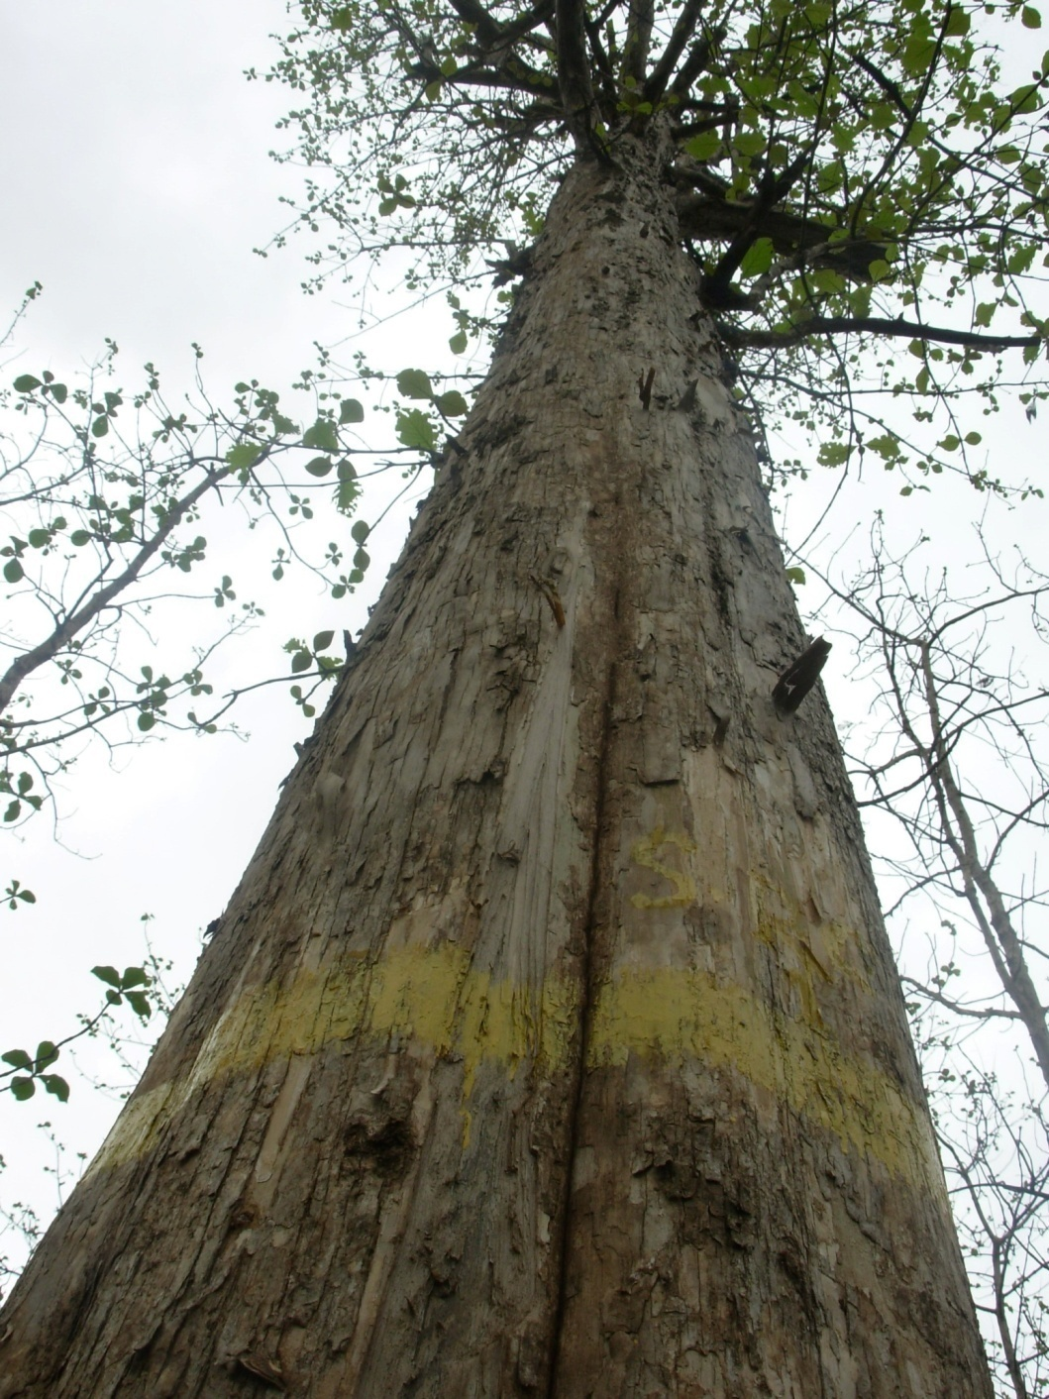
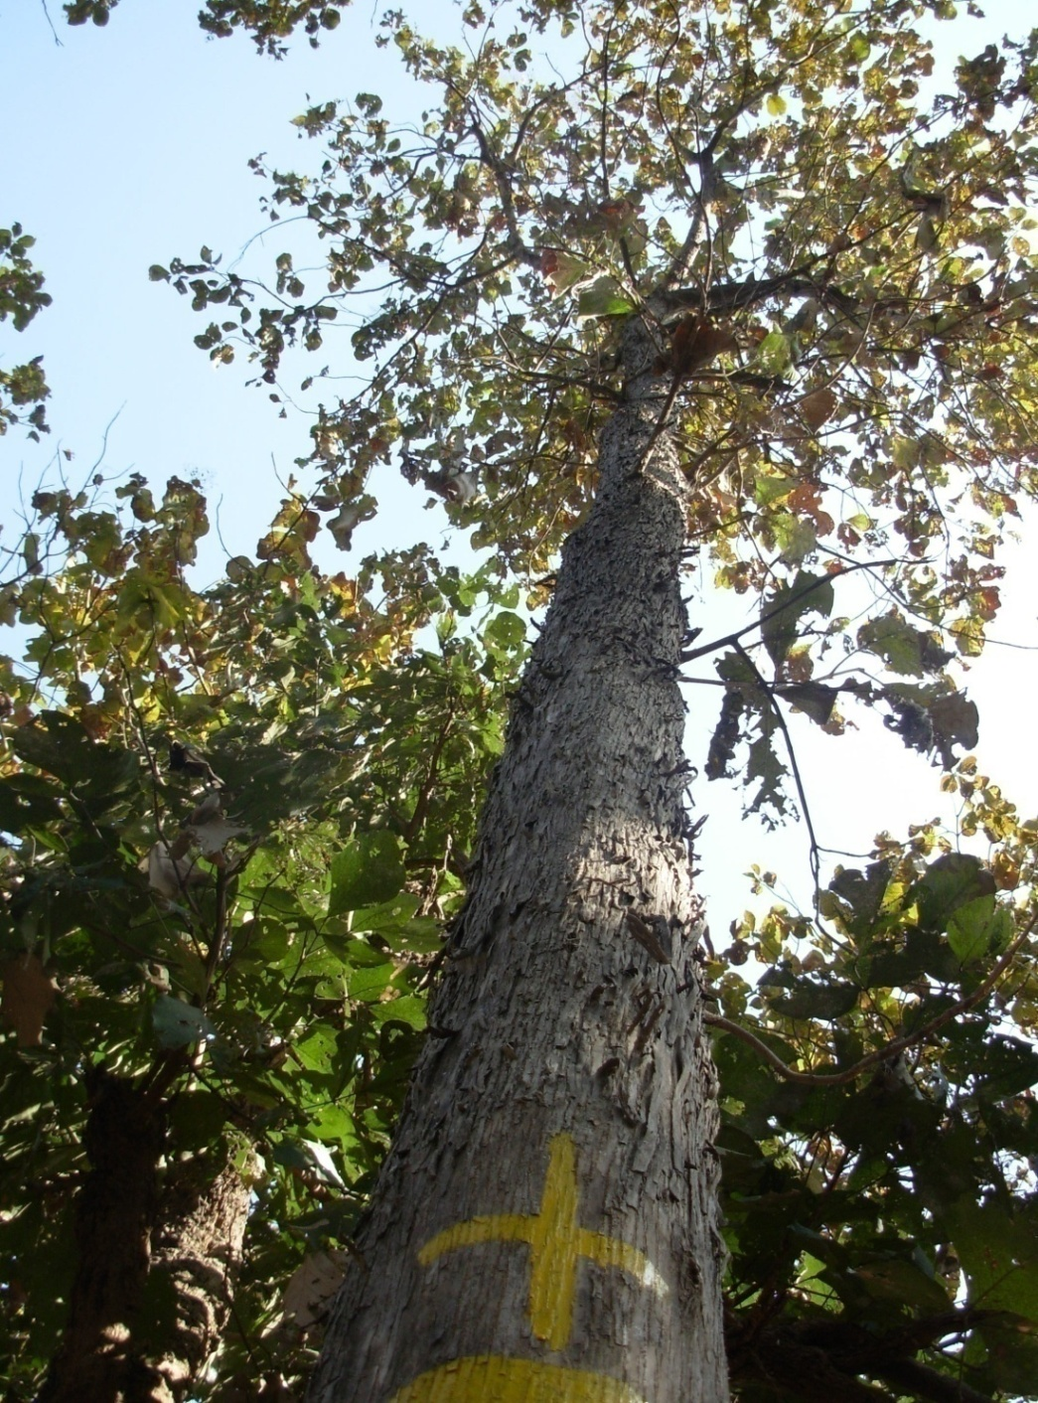
Teak (Tectona grandis):A very large sized deciduous tree

Slide 9
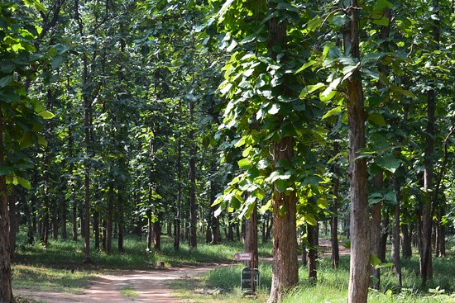
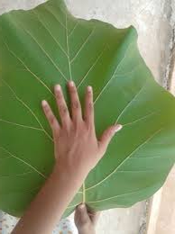
Young branches quadrangular, downy or hairy.
Leaves opposite, 30-60 cm. long and 15-30 cm. broad;
In young seedlings the leave are much larger, the size of a small umbrella. The leaves are rough but hairless above, densely covered with reddish down beneath.

Slide 10
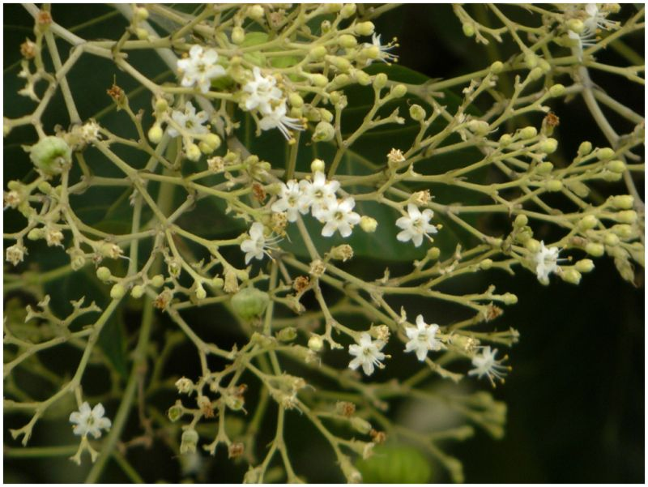
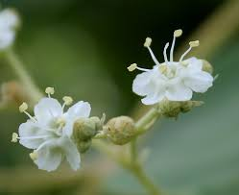
Flowers: in monsoon, flowers come in lax clusters at the ends of branches, white and small (about 6mm. across) and very fragile
leaves fall off in November to January, tree is leafless throughout the hot season.
New leaves appear with the flowers during the monsoon

Slide 11
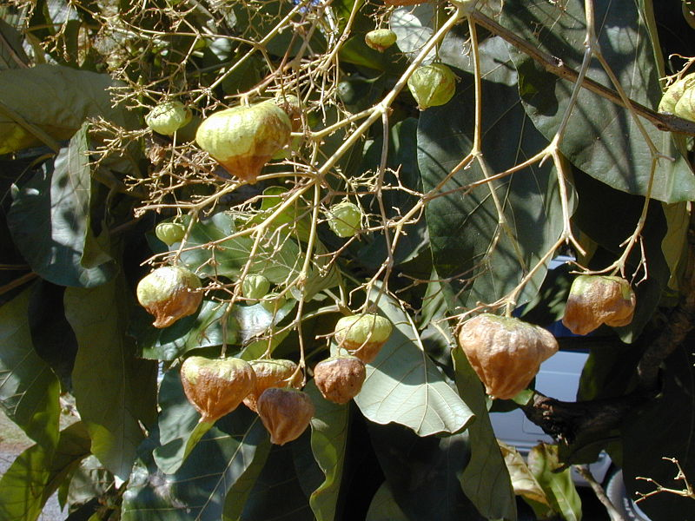
Fruit: 15mm across, spongy, enclosed in the persistent calyx, ripens in winter;

Slide 12
In Madhya Pradesh, teak is found on variety of formations.
In MP -Rich teak forest found in the district of Hoshangabad, Harda, Betul, Chhindwada, Seoni, Mandla, Balaghat, Dewas Khandwa etc.
Although, it occurs naturally but being cultivated for its timber. Therefore this species has been taken for Tree Improvement Programme

Slide 13
Selection of plus tree is the basic need for any tree improvement programme, based on the phenotypic characteristics.
For timber species the characteristic i. e. fast growth rate, good pruning ability, straight stem, horizontal branches with small diameter, small crown, disease resistance and wood properties appropriate for end use.

Slide 14
Since the inception of tree improvement programme in India (1977), 306 Candidate Plus Trees were selected in Madhya Pradesh by State Forest Research Institute, Jabalpur
Establishment of clonal seed orchards has been done and presently teak CSO are in 154.38 ha
Present paper deals with the evaluation of those existing plus trees for their present status and wood charateristics

Slide 15
Candidate Plus Trees of Teak in different 14 Divisions
East Mandla 13 Chhindwara 29
West Mandla 14 Sehore 31
North Betul 46 Khandwa 20
Damoh 70 Dewas 10
Jhabua 07 Indore 01
South Seoni 18 South Balaghat 19
Hoshangabad 22 Harda 06
Total trees = 306

Slide 16
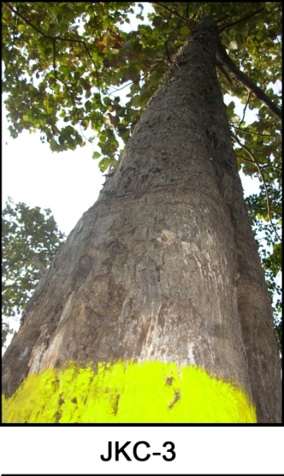
Methodology for evaluation

Slide 17
Individual tree location with their GPS Coordinates has been also recorded with its photograph
Information was recorded on prescribed format
Tree Evaluation of all the Candidate Plus Trees of Teak was done based on the following parameter:
Tree Vigour
Girth
Height

Slide 18
Bole form
Branching habit
Crown Diameter
Apical Dominance
Self Pruning Ability
Tree Health
Wood Properties
Heart Wood Percentage
Specific gravity of wood

Slide 19
Points allotted for scoring- (followed by Mandal , 2001 with some modifications)
1. Vigour- 25
(a) Height – 15
(b) Girth - 10
2. Bole form – 20
3. Branching habit
(a) Branch angle -15
(b) Branch thickness- 10
4. Crown diameter – 5
5. Apical dominance - 10
6. Self pruning ability - 5
7. Tree health - 10
8. Wood properties – 30
(a) Specific Gravity - 20
(b) Heartwood percentage – 10
Total - 130

Slide 20
Vigour: Total points – 25 | values | Values and allotting points
Height: Points= 15 | Ave 24.4 m | < 20.5 | 1
0-4 Less than average | Max 36.5 m | 21.5 | 2
5-10 More than average | Min 12.0 m | 22.5 | 3
11-12 More than average but shorter than tallest check trees |  | 23.5 | 4
13-15 For taller than tallest check tree |  | 24.5 | 5
 |  | 25.5 | 6
 |  | 26.5 | 7
 |  | 27.5 | 8
 |  | 28.5 | 9
 |  | 29.5 | 10
 |  | 30.5 | 11
 |  | 31.5 | 12
 |  | 32.5 | 13
 |  | 33.5 | 14
 |  | 34.4 & < 34.5 | 15
Girth at breast height: Points = 10 | Ave. 126.5 cm | <80- | 1
0-2 Smaller than average | Max. 270cm | 80 | 2
3-5 equal to average | Min. 69cm | 95 | 3
6-8 between average and largest check tree |  | 110 | 4
9-10 more than the largest check trees |  | 125 | 5
 |  | 140 | 6
 |  | 155 | 7
 |  | 170 | 8
 |  | 185 | 9
 |  | 200 & > 200 | 10

Slide 21
 | values | Values and allotting points
Bole form: Total points = 20
(Deduct)
1-3 for basal sweep | -- | Ideal bole form | 20
1-5 for trunk bends, spiral bole
1-5 for trunk corves & knots
1-3 for cross section not circular
1-3 for detectable bole swelling
Branching habit: Total points = 25
Branch Angle from bole- 15 |  | > 90° | 10
 | 40 to 100° | 80°- 90° | 15
 |  | 70°- 80° | 13
 |  | 60°- 70° | 10
 |  | 50°- 60° | 6
 |  | 40°- 50° | 2
 |  | <40° | 0
Branch thickness- 10 | --
Less than 1/4 of main stem - 10 |  |  | 10
1/4 to 1/3 of main stem - 7-9 |  |  | 7-9
1/3 to 1/2 of main stem - 4-6 |  |  | 4-6
more than 1/2 of main stem - 0-3 |  |  | 0-3

Slide 22
 | values | Values and allotting points
Crown diameter: Total points = 5
Balanced narrow and perfect- 5 | Ave 7.6 | 2-5 m | 5
Average- 3 | Max- 17.5 | 6-10 m | 3
Wide - 2 | Min - 2.6 | 11- 15 m | 2
Very wide - 1 |  | >15 | 1
Apical dominance Total points = 10
100-70 % 10 | Avg 98.39 | 100-70% | 10
69- 55 % 7-9 | Max- 100 | 69 - 55 % | 7-9
54 - 40 % 4-6 | Min -70 | 54 - 40 % | 4-6
39 - 25 % 1-3 |  | 39 - 25% | 1-3
<25% 0 |  | < 25 % | 0
Self pruning Ability: Total points = 5 | Ave 14.4
Branching above 20 m | Max 27 | above 20 m | 5
Branching between 15 to 20 m | Min 3.5 | 15 to 20 m | 4
Branching between 10 to 14 m |  | 10 to 14 m | 3
Branching between 5 to 9 m |  | 5 to 9 m | 2
Branching below 5 m |  | below 5 m | 1

Slide 23
Tree Health: Total points = 10
Disease tree - 10 | - | - | 10
Leaf infected - 5 | - | - | 5
Bole infected - 3 | - | - | 3
Wood Property: Total points 30
 |  | 0.4 | 8
(a) Specific gravity - 20 | 0.7 | 0.5 | 10
15-20 above average | 1.0 | 0.6 | 12
10-14 average | 0.5 | 0.7 | 14
5-9 light |  | 0.8 | 16
0-4 very light |  | 0.9 | 18
 |  | 1.0 | 20
(b) Heartwood % - 10 | 89.3 | 82 & <82 | 1
5-10 above average | 99.2 | 84 | 2
3-4 average | 75.9 | 86 | 3
0-2 short |  | 88 | 4
 |  | 90 | 5
 |  | 92 | 6
 |  | 94 | 7
 |  | 96 | 8
 |  | 98 | 9
 |  | 99 & > 99 | 10
Total Marks 130

Slide 24
Information on following characteristic were also recorded:
Fruit bearing Capacity
Wood Moisture content
Wood Oil %
Age (No. of rings)
Growth rate

Slide 25
Fruit bearing capacity vary clone to clone.

Slide 26
Nos. Of CPTs found exists on the site = 219
East Mandla 13 Chhindwara 11
West Mandla 08 Sehore 31
North Betul 29 Khandwa 19
Damoh 70 Dewas 04
Jhabua 04 Indore 0
South Seoni 08 South Balaghat 04
Hoshangabad 15 Harda 03
Total trees = 219

Slide 27
Trees excluded in plus tree list due to following deformities:
Very old
Top dying

Slide 28
Trees excluded in plus tree list due to following deformities:
Top broken
Hollowing

Slide 29
Trees excluded in plus tree list due to following deformities:
Rotten wood sample
Heavy termite attack

Slide 30
Nos. Of trees found up to the mark to be declared as plus trees= 136
East Mandla 09 Chhindwara 08
West Mandla 04 Sehore 19
North Betul 16 Khandwa 08
Damoh 38 Dewas 04
Jhabua 04 Indore 0
South Seoni 06 South Balaghat 03
Hoshangabad 10 Harda 01
Total trees = 136

Slide 31
Tree code | Points allotted | Parameters recorded | Points Scored | %
DPC -1 | 1. Vigour- 25
 | (a) Height - 15 | 31.5 m | 12
 | (b) Girth - 10 | 146 cm | 6.5
 | 2. Bole form - 20 | Straight Cylindrical | 18
 | 3. Branching habit- 25
 | (a) Branch angle -15 | 90° | 15
 | (b) Branch thickness- 10 | 15-20 cm | 10
 | 4. Crown diameter – 5 | 5.7 m | 4
 | 5. Apical dominance - 10 | 100% | 10
 | 6. Self pruning ability - 5 | CBH -22 m | 5
 | 7. Tree health - 10 | Bole healthy, leaves infected | 5
 | 8. Wood properties – 30
 | (a) Specific Gravity - 20 | 0.74 | 11
 | (b) Heartwood percentage – 10 | 94.87 | 7.5
 | Total - 130 |  | 104 | 80.00

Slide 32
Cumulative scores obtained by the tree and their grading
S.No. | Tree code | Points Scored out of 130 | Percentage
1 | HBPT - 9 | 113 | 86.92
2 | KPC - 11 | 111 | 85.38
3 | BLC - 09 | 111 | 85.38
4 | KPC - 1 | 110.5 | 85.00
5 | KPC - 9 | 110.5 | 85.00
6 | BLC - 07 | 108 | 83.08
7 | BLC - 10 | 107.5 | 82.69
8 | CSC - 24 | 107 | 82.31
9 | BBC - 56 | 107 | 82.31
10 | KPC - 2 | 106 | 81.54

Slide 33
Trait-wise Grading of all the CPTs
Height
Name of Candidate Plus Tree | Height (m)
DPC-3 | 36.5
KPC-4 | 35.5
CSC-28 | 33
BLC-10 | 33
KPC-1 | 32.5
KPC-2 | 32
KPC-7 | 32
KPC-9 | 32
BLC-7 | 32
DPC-1 | 31.5

Slide 34
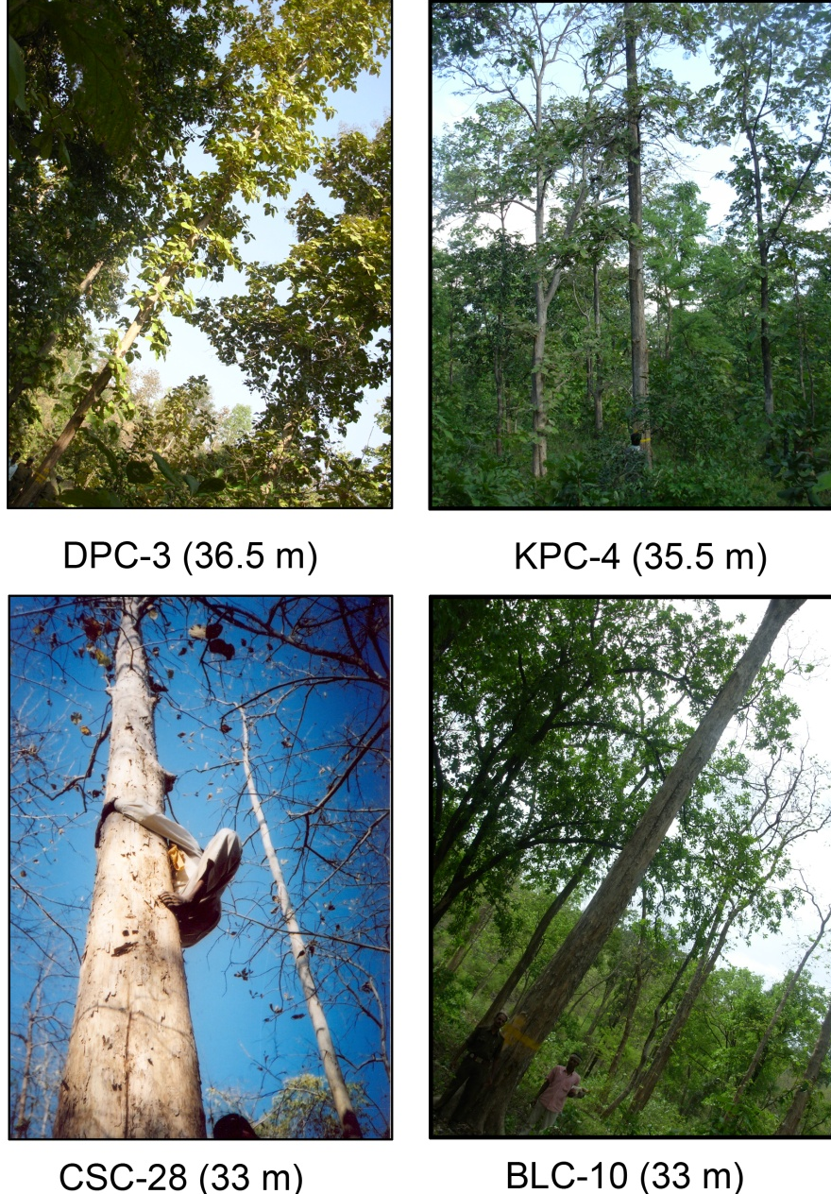

Slide 35
Girth at Breast Height
Name of Candidate Plus Tree | GBH (cm)
HBPT-9 | 270
HBC-6 | 226
HBPT-14 | 215
BBC-56 | 210
MJC-18 | 209
MJC-19 | 206
MJC-21 | 195
BSC-06 | 192
MJC-22 | 192
SRC-1 | 190

Slide 36
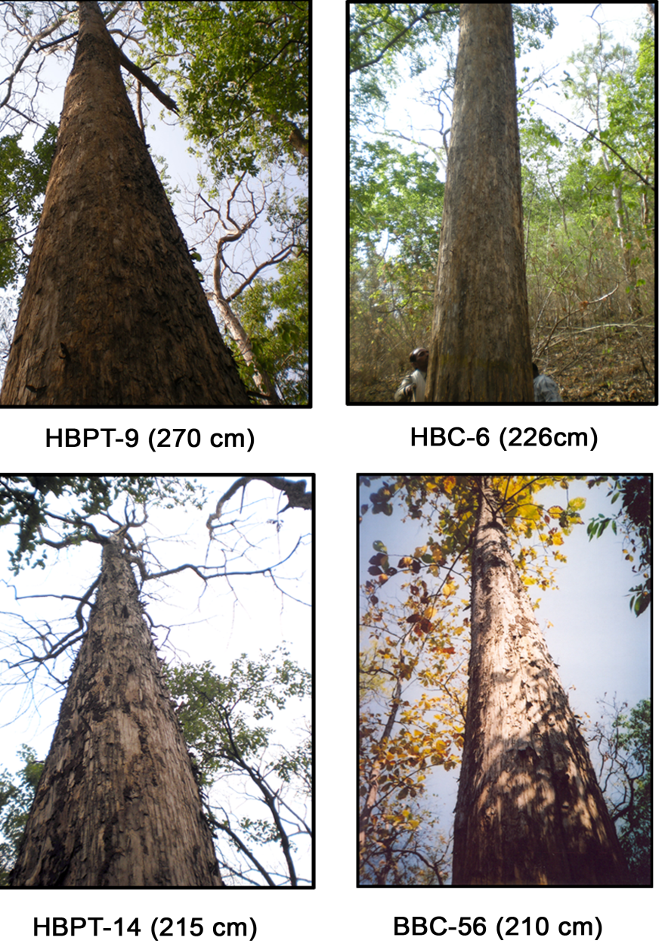

Slide 37
Clear Bole Height
Clear bole height wise grading of candidate plus trees
S.No. | Name of Candidate Plus Tree | CBH. in Meter | Ht. in Meter
1 | BLC-9 | 27 | 31.5
2 | DHC-57 | 25 | 28
3 | DPC-1 | 22 | 31.5
4 | BBC-54 | 21.5 | 28
5 | BLC-7 | 21.5 | 32
6 | KPC-18 | 21 | 29
7 | DHC-7 | 21 | 24
8 | DHC-52 | 21 | 21
9 | DHC-54 | 21 | 21
10 | DHC-62 | 21 | 23

Slide 38
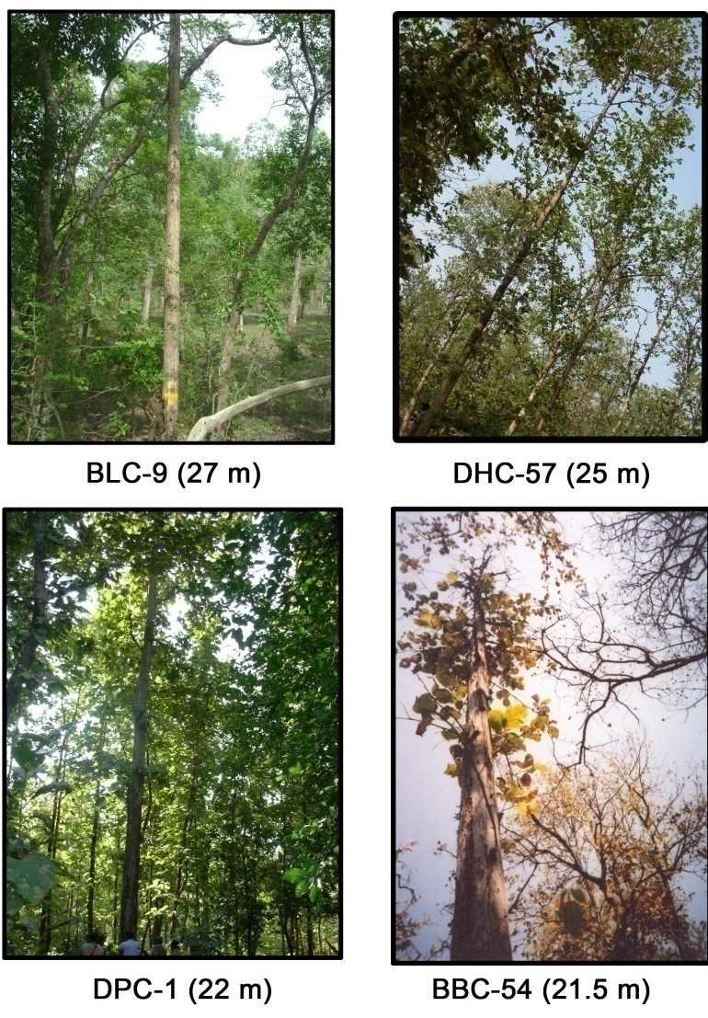

Slide 39
Crown Diameter
Code | Crown dia (m)
DHC-60 | 2.6
DPC-2 | 2.9
DHC-63 | 3.3
DHC-14 | 3.5
SRKC-14 | 3.5
SRKC-19 | 3.5
BLC-09 | 3.6
DHC-20 | 3.6
DHC-15 | 3.7
DHC-59 | 3.9

Slide 40
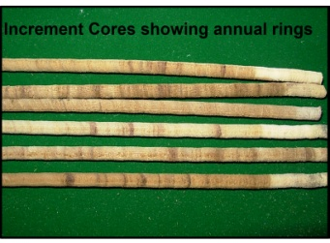
Estimated Volume
Code | Volume (cum) | Age (no. of annual rings)
HBPT-9 | 2.744 | 159
BBC-56 | 2.077 | 164
MJC-18 | 1.987 | 141
BLC-10 | 1.941 | 131
MJC-19 | 1.929 | 157
HBC-6 | 1.924 | 156
HBPT-14 | 1.742 | 133
BSC-6 | 1.735 | 164
MJC-21 | 1.727 | 163
MJC-22 | 1.674 | 156

Slide 41
Growth Rate in terms of Mean Annual Increment
Growth rate wise grading of candidate plus trees
S. No. | Name of Candidate Plus Tree | Mean Annual increment (cum)
1 | HBPT-9 | 0.0173
2 | BLC-10 | 0.0148
3 | MJC-18 | 0.0141
4 | BLC-7 | 0.0140
5 | HBPT-14 | 0.0131
6 | BBC-56 | 0.0127
7 | HBC-6 | 0.0123
8 | MJC-19 | 0.0123
9 | BBC-60 | 0.0110
10 | MJC-22 | 0.0107

Slide 42
Heart wood percentage
Heart-wood percentage wise grading of candidate plus trees
S.No. | Name of Candidate Plus Tree | Heart wood % | Age (no. of annual ring)
1 | BLC-9 | 99.16 | 98
2 | HBPT-9 | 98.37 | 159
3 | BBC-43 | 98.20 | 156
4 | KPC-3 | 98.09 | 106
5 | BSC-17 | 97.87 | 102
6 | KPC-7 | 97.32 | 90
7 | BBC-57 | 97.20 | 120
8 | CSC-30 | 97.19 | 121
9 | MJC-22 | 97.07 | 156
10 | KPC-11 | 97.02 | 100

Slide 43
Variation in Heartwood/Sapwood

Slide 44
Specific Gravity
Name of Candidate Plus Tree | Specific Gravity
CSC-26 | 1.010
KPC-9 | 0.945
BShC-03 | 0.941
KPC-1 | 0.933
BLC-7 | 0.906
KPC-11 | 0.901
KPC-20 | 0.876
DHC-29 | 0.862
DHC-40 | 0.858
DHC-65 | 0.847

Slide 45
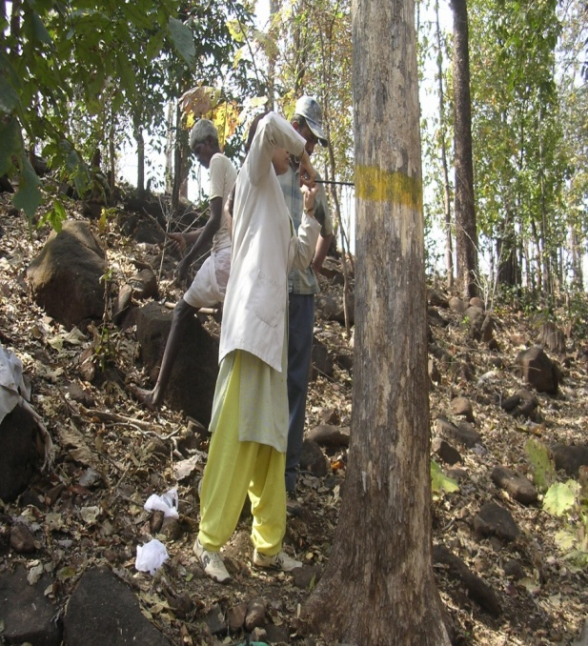
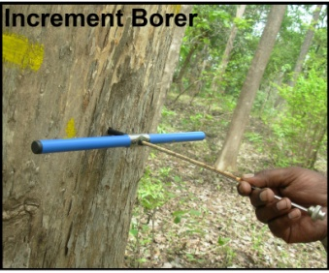

Slide 46
Degree of resistant/ susceptibility of candidate plus trees
S. No. | Name of Candidate Plus Tree | Infected leaves % | Scoring | Degree
1 | DPC-1 | 15 | 1 | Most Resistant
2 | DPC-2 | 20 | 1 | Most Resistant
3 | DPC-3 | 50 | 2 | Least Resistant
4 | DPC-4 | 40 | 2 | Least Resistant
5 | CSC-05 | 0 | 0 | Immune
6 | CSC-11 | 0 | 0 | Immune
7 | CSC-20 | 0 | 0 | Immune
8 | CSC-22 | 0 | 0 | Immune
9 | CSC-24 | 0 | 0 | Immune
10 | CSC-26 | 0 | 0 | Immune

Slide 47
Damage Rating for Tree Assessment
Score | Damage (% defoliation)
0 | No damage
1 | 1-25
2 | 26-50
3 | 51-75
4 | 76-100
Degree of Resistance /Susceptibility
S. No. | Degree | Scoring average | Indices
1 | Immune | 0 | I
2 | Most resistant | 1.00 | MR-1
3 | Highly resistant | 1.25 | HR
4 | Resistant | 1.50 | R
5 | Moderately resistant | 1.75 | MR2
6 | Least resistant | 2.00 | LR
7 | Moderately susceptible | 2.25 | MS1
8 | Susceptible | 2.50 | S
9 | Highly susceptible | 2.75 | HS
10 | Most susceptible | 3.00 | MS2
Followed by Roychoudhary et.al. (2003) One side of tree was considered as one replicate and average value of the four sides was calculated to estimate the degree of resistance.

Slide 48
Trees found completely disease free amongst heavy infested surrounding area
S. No | Name of trees | Division | Range
1 | MKC-25 | West Mandla | Kalpi
2 | MJC-21 | East Mandla | Jagmandal
3 | MJC-30 | East Mandla | Jagmandal
4 | DHC-20 | Damoh | Hathani
5 | DHC-29 | Damoh | Hathani
6 | DHC-44 | Damoh | Hathani
7 | JKC-1 | Jhabua | Katthiwada
8 | SRKC-16 | Sehore | Rehti

Slide 49
CONCLUSION
Only 136 trees were found up to the mark out of 306. There is need to select some more plus trees of teak form the natural population.
Trees of excellent height, girth, clear bole height, ideal circular bole with less tapering, self pruning ability are exist in natural population of Madhya Pradesh, which may be used as reproductive source material for plantation purposes.

Slide 50
Wood characteristics like higher specific gravity, higher heartwood percentage which show high inheritance pattern, should be strongly considered along with all the phenotypic characteristics i.e. height, girth, bole form, crown habit, branching pattern etc.
Wide range (0.5 to 1.01) of specific gravity concluding great variation in genetic make of the trees

Slide 51
Specific trait-wise trees were identified during present study. They may be used in future tree breeding programmes.
A special protection should be provided to conserve those superior genetic resources.
It is also requisite to multiply them through original seeds or through micro-propagation technique to sustain the unique creations of the nature.

Slide 52
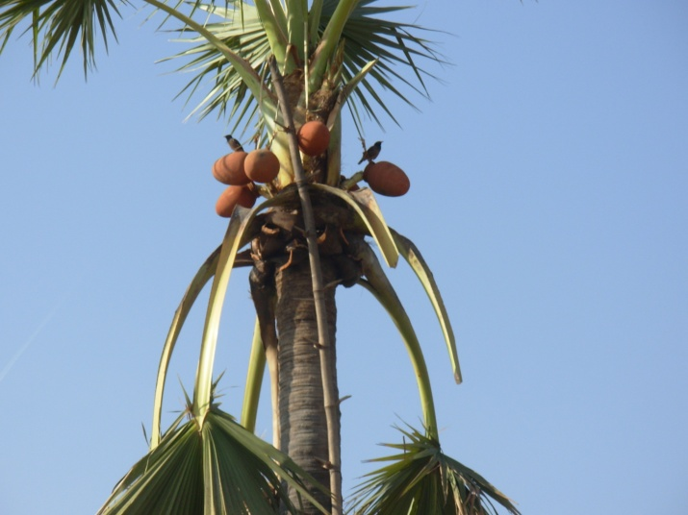
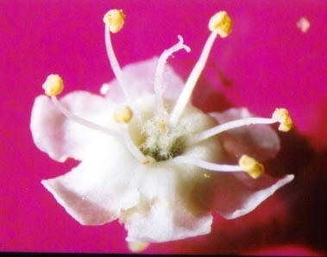
Thanks

