Slide 1
About OMICS Group
OMICS Group is an amalgamation of Open Access publications and worldwide international science conferences and events. Established in the year 2007 with the sole aim of making the information on Sciences and technology ‘Open Access’, OMICS Group publishes 500 online open access scholarly journals in all aspects of Science, Engineering, Management and Technology journals. OMICS Group has been instrumental in taking the knowledge on Science & technology to the doorsteps of ordinary men and women. Research Scholars, Students, Libraries, Educational Institutions, Research centers and the industry are main stakeholders that benefitted greatly from this knowledge dissemination. OMICS Group also organizes 500 International conferences annually across the globe, where knowledge transfer takes place through debates, round table discussions, poster presentations, workshops, symposia and exhibitions.

Slide 2
About OMICS International Conferences
OMICS International is a pioneer and leading science event organizer, which publishes around 500 open access journals and conducts over 500 Medical, Clinical, Engineering, Life Sciences, Pharma scientific conferences all over the globe annually with the support of more than 1000 scientific associations and 30,000 editorial board members and 3.5 million followers to its credit.
OMICS Group has organized 500 conferences, workshops and national symposiums across the major cities including San Francisco, Las Vegas, San Antonio, Omaha, Orlando, Raleigh, Santa Clara, Chicago, Philadelphia, Baltimore, United Kingdom, Valencia, Dubai, Beijing, Hyderabad, Bengaluru and Mumbai.

Slide 3
Identifying new targets to improve skeletal formation in human
Anja Nohe, PhD,
University of Delaware

Slide 4
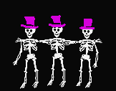


Slide 5


Slide 6
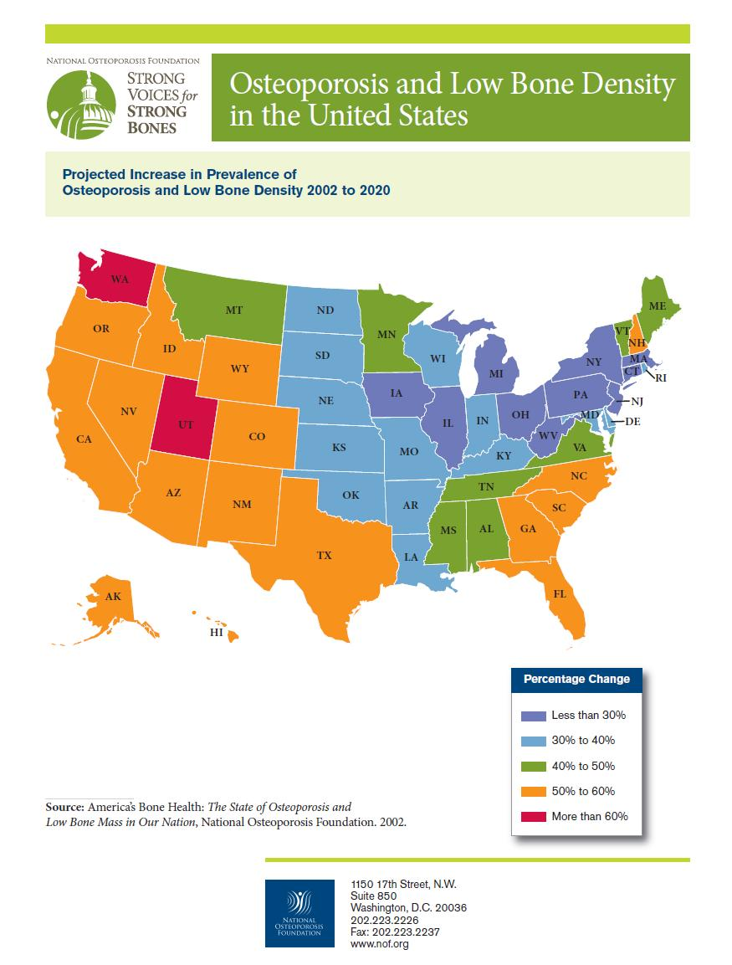
Facts about Osteoporosis
Osteoporosis is a disease characterized by weak and porous bones with a low bone mass density (BMD) level. The World Health Organization defines osteoporosis as having a BMD at or below -2.5 on the BMD T-score test and having a fracture
One in two women and one in four men will be affected.
Costs: above $18 billion in America and are expected to double by 2050.
Most common fractures: hip and vertebrae.
Hip fractures have a mortality rate between 12 and 20 percent after six months, and affect women more often than men by a ratio of nearly three to one. Hip fractures severely compromise a person’s quality of life.
90 percent of adult bone mass is developed by age 18 in women and age 20 in men, meaning early years are critical for healthy bones.
Only 35 percent of adults in America receive the daily recommended value of calcium

Slide 7
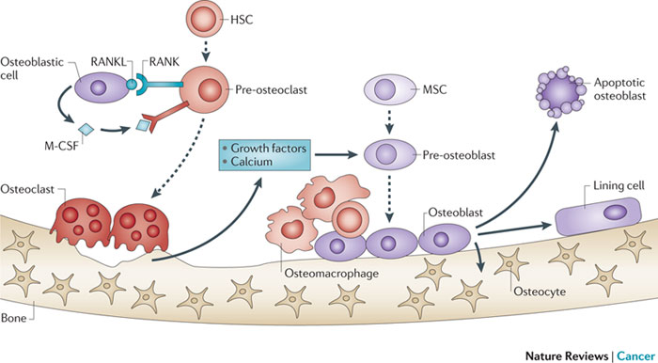
Bone Re-modelling
Nature Reviews Cancer. 2011 11, 411-425
Current Opinion in biotechnology 2012, 4, (23), Pages 570–578

Slide 8
Strategy: To Reduce Adipocytes Number and Increase Osteoblasts
Adipocytes
Osteoblast

Slide 9
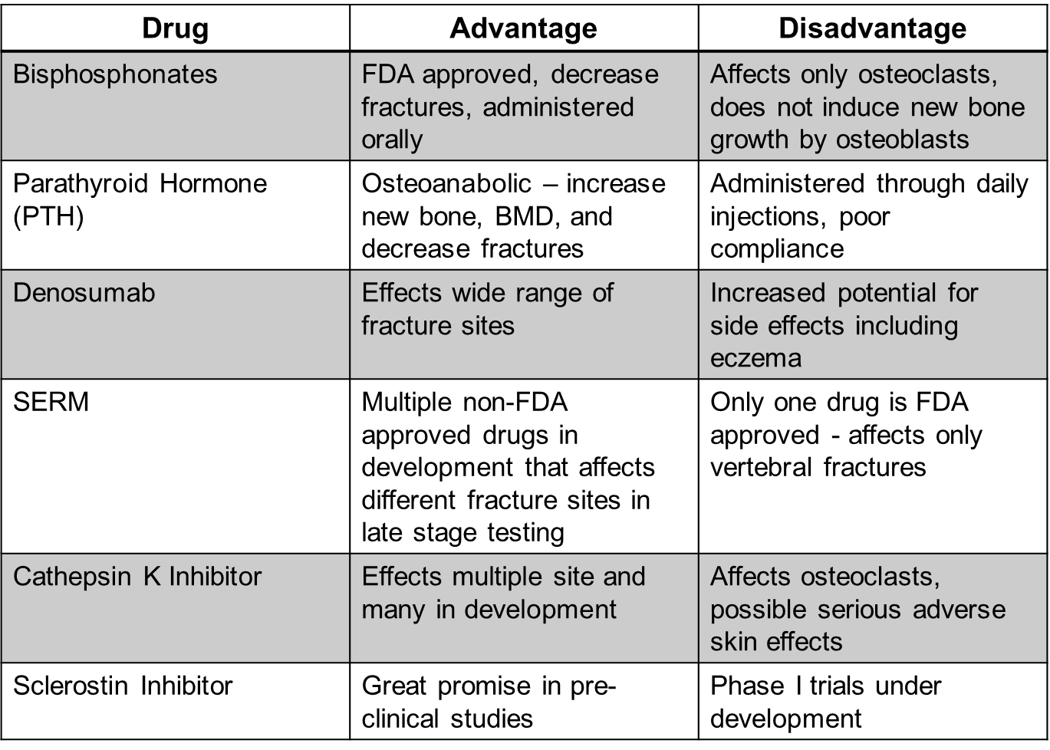
Strategy: to Reduce Osteoclast Activity or Number and Increase Osteoblasts
Osteoclast
Osteoblast

Slide 10
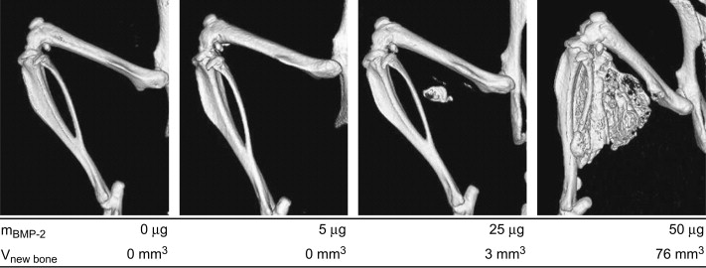
Dose-Dependent Effect of Keratose-Delivered BMP-2 for Induction of Ectopic Bone in Mouse Leg Muscles.
Roche C. de Guzman et al., 2013. Biomaterials, 34, (6), 1644-1656.

Slide 11
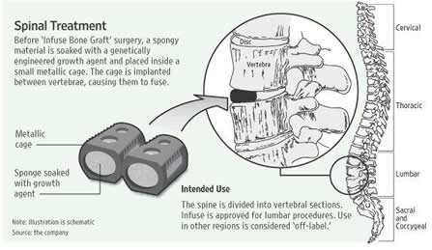
BMP2: The Bad: Example Infuse
Side Effects
Dysphagia
Infection
Nerve damage
Retrograde ejaculation
Male sterility
Osteolysis
Cancer risks
Medtronic’s Infuse No Better Than Bone Graft With Risk

Slide 12
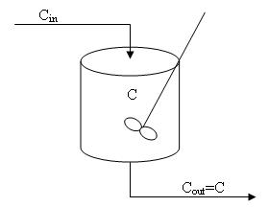

PBPK
Modelling
of the
Distribution of BMP2
Blood
BMP2
Brain
Lung
Heart
Liver
Kidney
Pancreas
Uterus
Bone
Fat
40nM-100nM BMP2
Notes:
Slide 30 half time should be 10.00-10.05

Slide 13
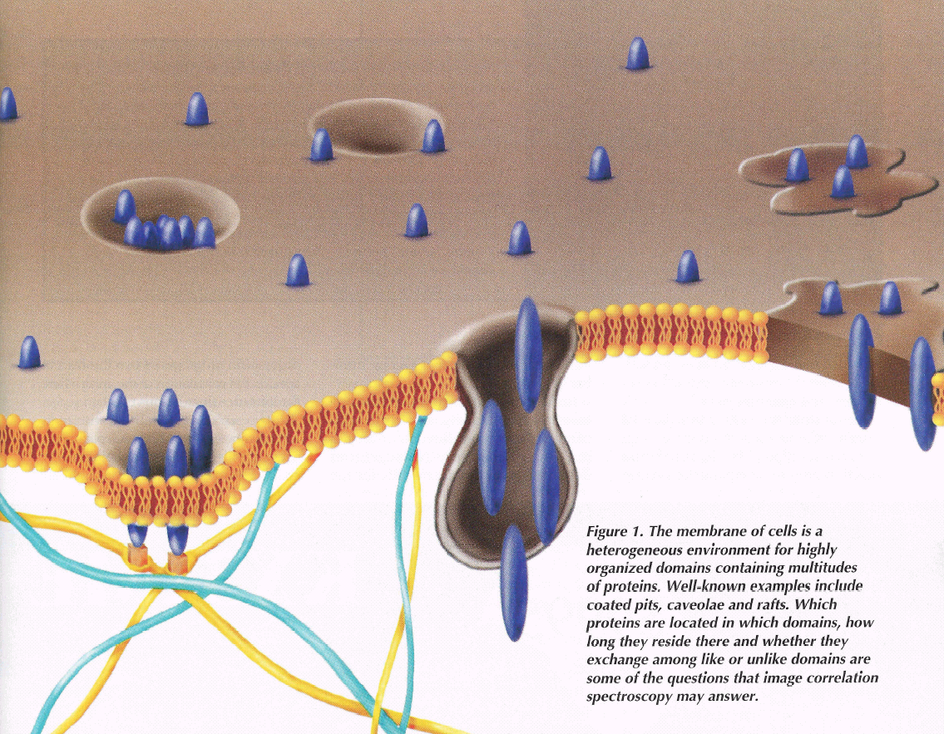
Multiple effects on BMP2 on cells. Why?
Coated Pits: AP-2
Nohe A. and Petersen NO. Biophotonics 2002, 9:39-52.
Moseychuck et al., JCCS, 2013

Slide 14
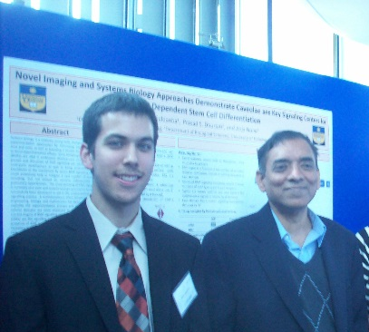
BMP -2
F1
Cav-ß
F2
Cav-αß
CCP
F3
Surface
F4
∑(BMP induced-signal_{i})
Signal
[+BMP]
∑ Knockout-Signal_{i}
Cav-ß
Cav-αß
CCP
[-BMP]
Knockout Pit
S. Saldanha, et al.,(2013). Journal of Cellular Physiology, 228 (5): 1060-1069.

Slide 15
 | CCP | caveolae
BRIa | 3.35 | 1.79
BRII | 4.67 | 1.50
 | Co-localized with | -BMP | +BMP
BRIa | CCP | 45 | 66
 | cav-αß | 12 | 25
 | cav-ß | 12 | 8
 | other | 31 | 0
BRII | CCP | 75 | 76
 | cav-αß | 11 | 19
 | cav-ß | 13 | 5
 | other | 1 | 0
CCP | BRIa | 31 | 40
 | BRII | 44 | 52
 | other | 25 | 8
CAV-ß | BRIa | 8 | 0
 | BRII | 6 | 4
 | other | 87 | 96
CAV-αß | BRIa | 20 | 30
 | BRII | 14 | 16
 | other | 66 | 54
Cluster Density | -BMP | +BMP
BRIa | 7.45 | 4.71
BRII | 6.23 | 2.66
cav-ß | 2.65 | 0.90
cav-αß | 7.82 | 12.2
CCP | 14.2 | 14.2
SMAD signal | -BMP | +BMP
No disruption | 0 | 1.3
CCP | 1.7 | 2.7
CAV | 1.4 | 0.8
CAV+CCP | 3.1 | 2.8

Slide 16
Distribution of BMP Receptors in
Membrane Domains
 | Value | % contribution
A_{ccp} | 4.1504 | 35.10
A_{cav} | 7.6737 | 64.90
A_{cav-αß} | 101.6842
A_{cav-ß} | -25.5712
S. Saldanha, et al.,(2013). Journal of Cellular Physiology, 228 (5): 1060-1069.

Slide 17
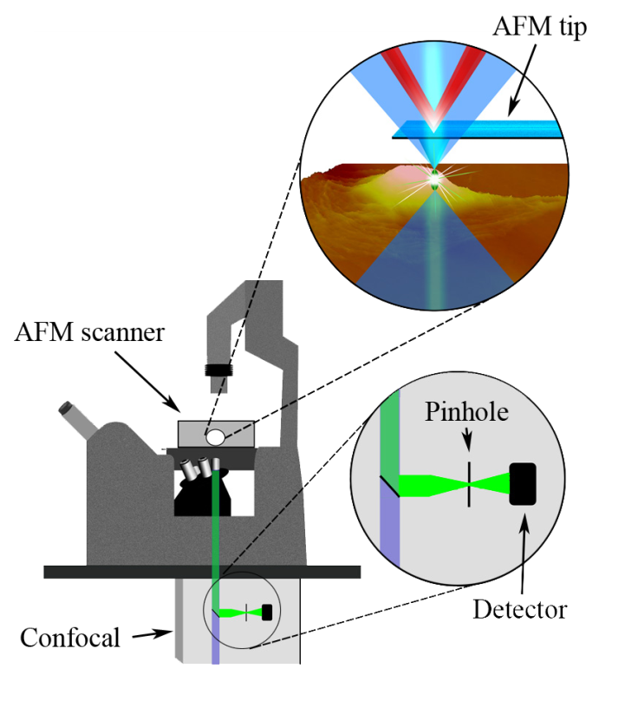
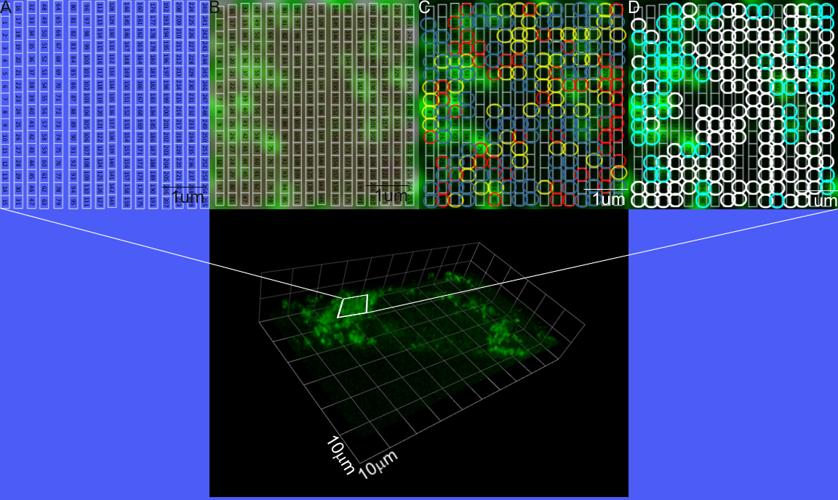
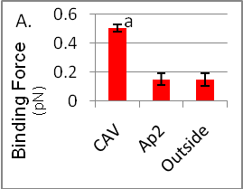
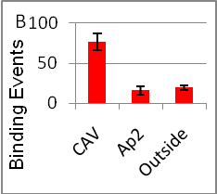
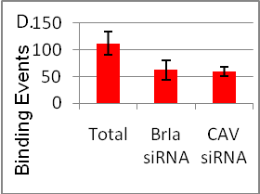
J. Bonor, E. L. Adams, B. Bragdon, O. Moseychuk, K. J. Czymmek, and A. Nohe. J Cell Physiol. 2012 Jul;227(7):2880-8. doi: 10.1002/JCP23032

Slide 18
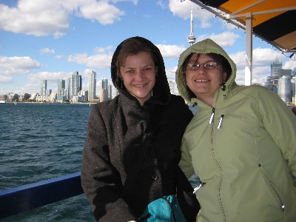
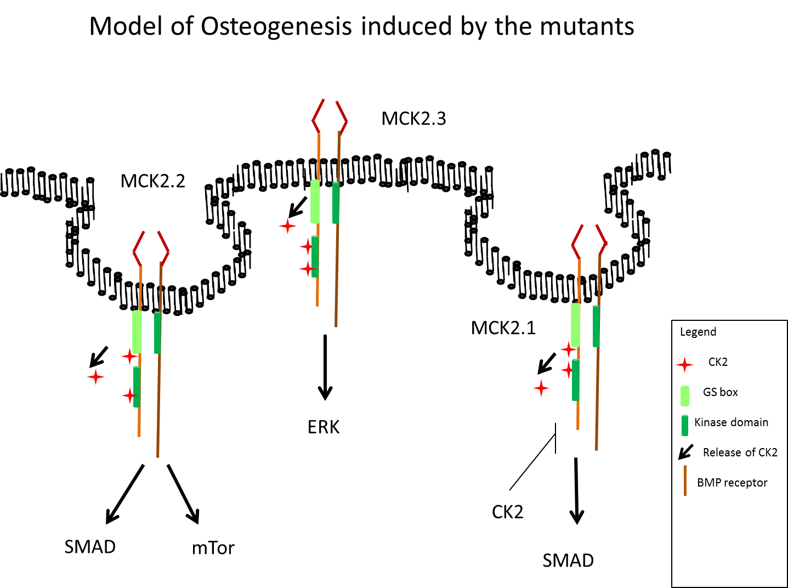
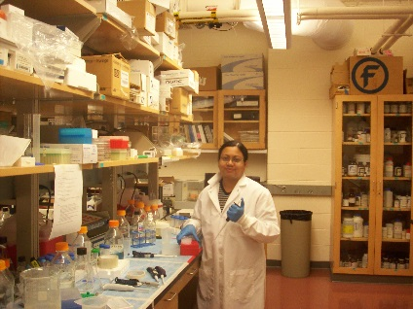
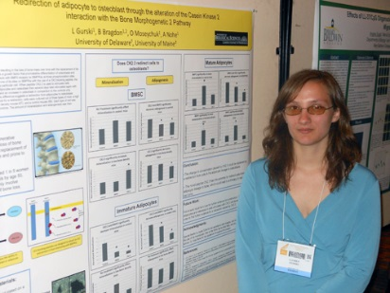
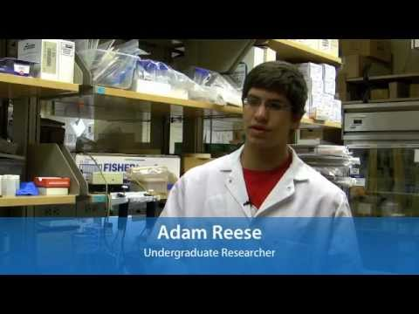
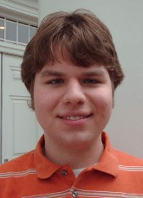
BMP2 Signaling Pathway
Bragdon B, et al. Biophysical Journal, 2010
Bragdon et al., Bone, 2011
Moseychuck et al., JCCS, 2013
Akkiraju et al., in preparation

Slide 19
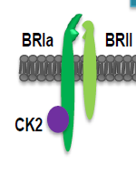
CK2 is a Key Switch of BMP2 Dependent Stem Cell
Differentiation
(213-217)CK2.3
Osteogenesis (Smad and Caveolin-1 independent, MEK dependent)
Osteogenesis/Adipogenesis (Smad, Caveolin-1 mTOR/MEK)
Osteogenesis/Chondrogenesis (Smad, Caveolin-1/?, MEK/?)
GS BOX
(324 -328) CK2.2
(475-479) CK2.1
Bragdon B, et al. Biophysical Journal, 2010
Bragdon et al., Bone, 2011
Moseychuck et al., JCCS, 2013
Akkiraju et al., in preparation

Slide 20
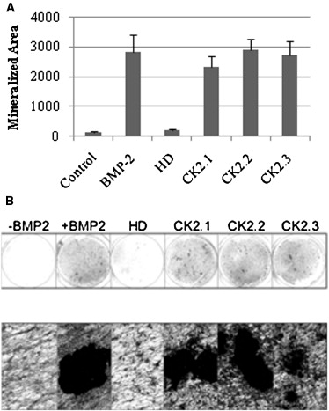
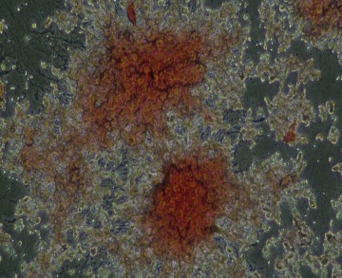
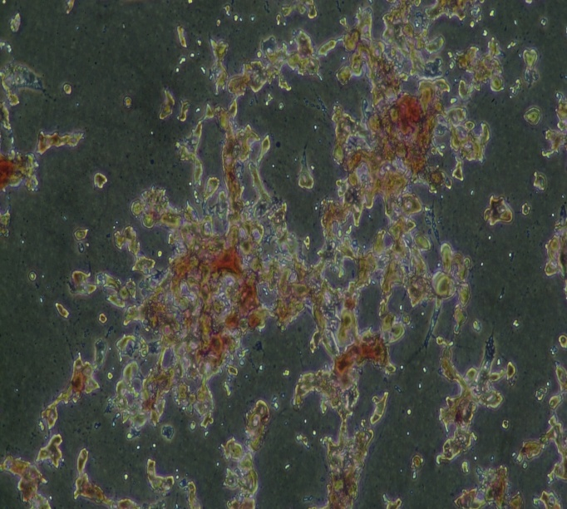
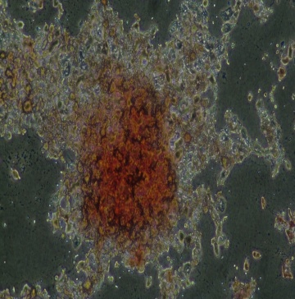
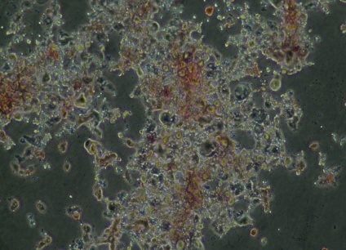
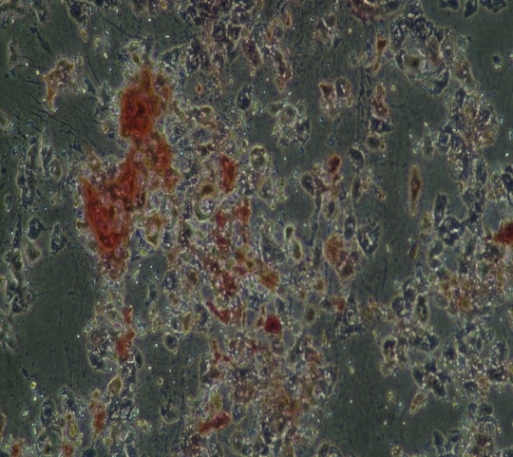
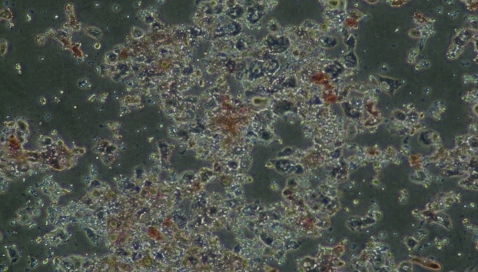
Loss of CK2 interaction with BRIa regulates osteogenesis and adipogenesis
- BMP2 +BMP2 HD CK2.2 CK2.3 CK2.1
Bragdon B, et al. Biophysical Journal, 2010
Moseychuck et al., JCCS, 2013

Slide 21
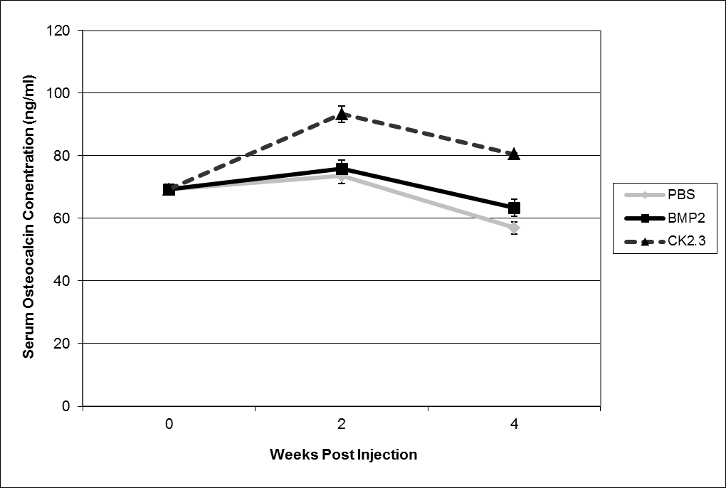
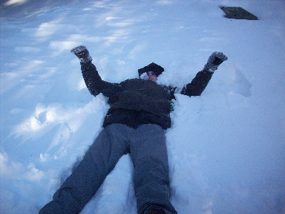
Serum Markers for Osteoblast Differentiation are Increased and Decreased for Osteoclast Activity

Slide 22
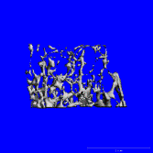
Trabecular Bone Mineral Density is Increased
PBS CK2.3
 | BV/TV in % | TB.N (1/mm) | Tb.Th (mm) | Tb.Sp (mm) | MAR mm/day
PBS | 23.3+/- 3.8 | 2.67+/-0.16 | 0.042+/-0.004 | 0.38+/-0.026 | 0.6+/-0.3
CK2.3 | 38.9+/-0.35* | 3.19+/-0.13* | 0.048+/-0.003 | 0.32+/-0.010* | 2.2+/-0.3

Slide 23
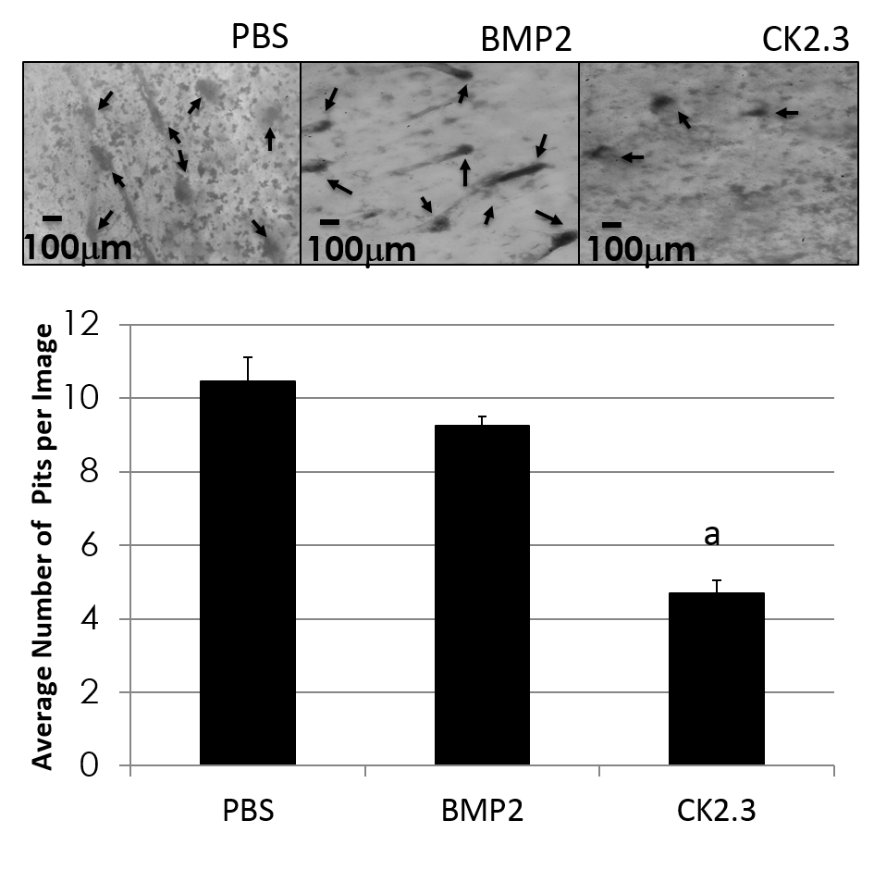
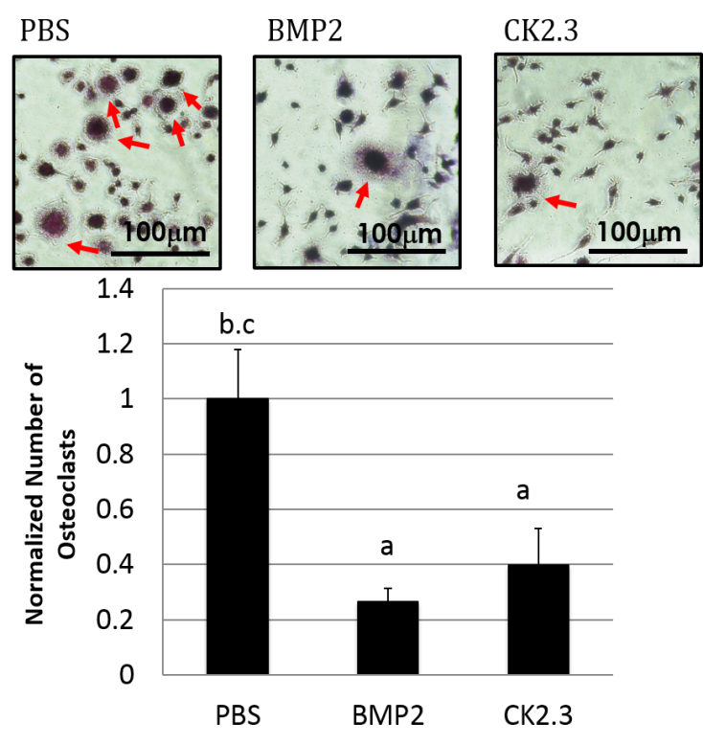
Osteoclast Number and Activity is Decreased in Mice Injected with CK2.3

Slide 24
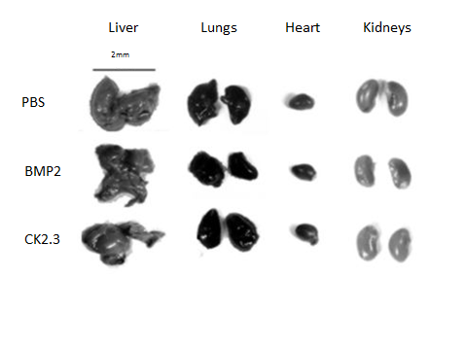
 | PBS | BMP-2 | CK2.3 | Mean Range
Chol (mg/dl) | 107 | 103 | 98 | 55-164[21]
TRG (mg/dl) | 108 | 133 | 116 | 75-289[20]
ALT (u/l) | 30 | 30 | 28 | 27-195[21]
AST (u/l) | 80 | 105 | 98 | 43-397[21]
ALK (u/l) | 117 | 101 | 94 | 44-235[18]
GLU (mg/dl) | 162 | 180 | 167 | 93.7-219.8[22]
PHOS (mg/dl) | 7.7 | 6.4 | 5.9 | 4.5-7.8[23]
TRP (g/dl) | 5.9 | 5.4 | 5.8 | 4.8-7.2[21]
CAL (mg/dl) | 9.1 | 9.3 | 9.2 | 8.5-9.4[19]
BUN (mg/dl) | 21 | 25 | 19 | 5-26[21]
CRE (mg/dl) | 0.2 | 0.3 | 0.2 | 0.2-0.5[21]
ALB (g/dl) | 3.4 | 3.6 | 3.6 | 2.4-4.3[21]

Slide 25
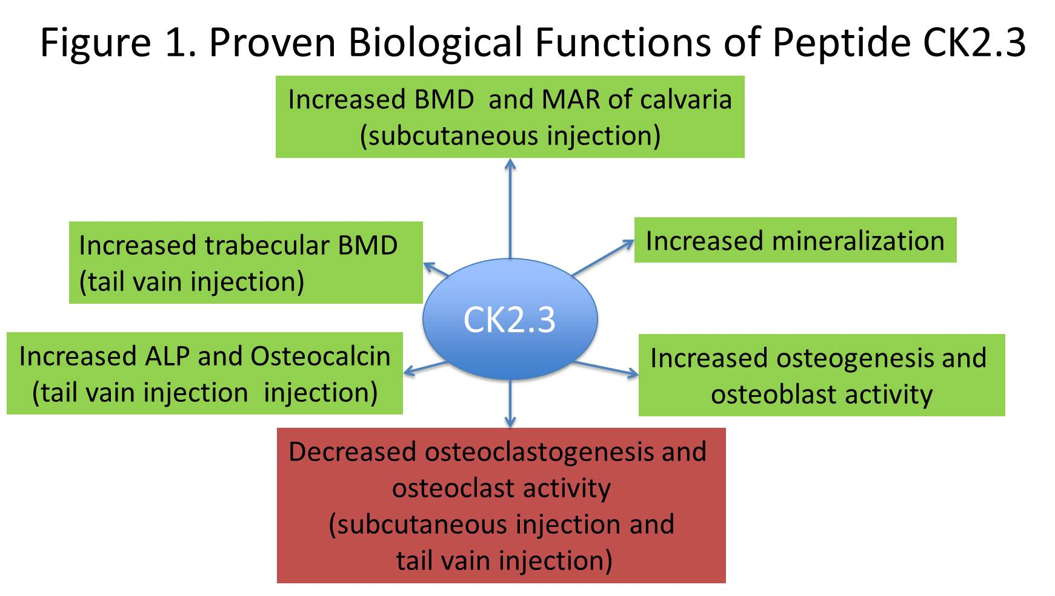
Proven Biological Functions of CK2.3

Slide 26
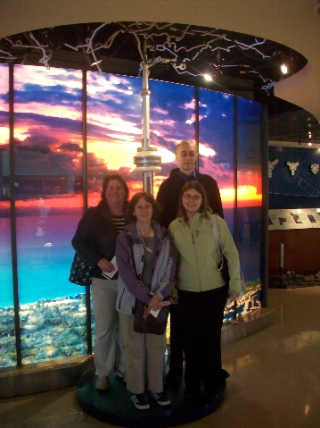

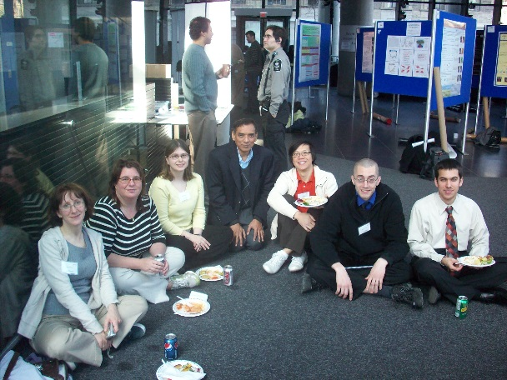


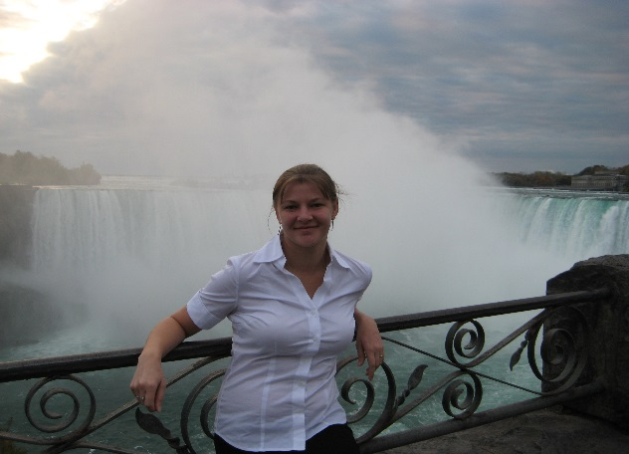
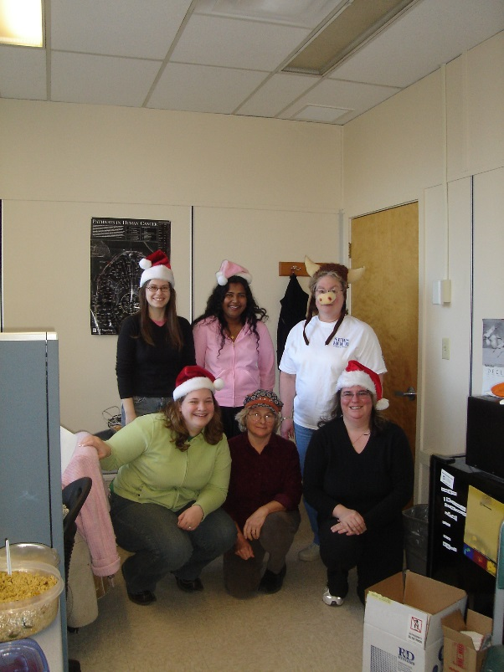
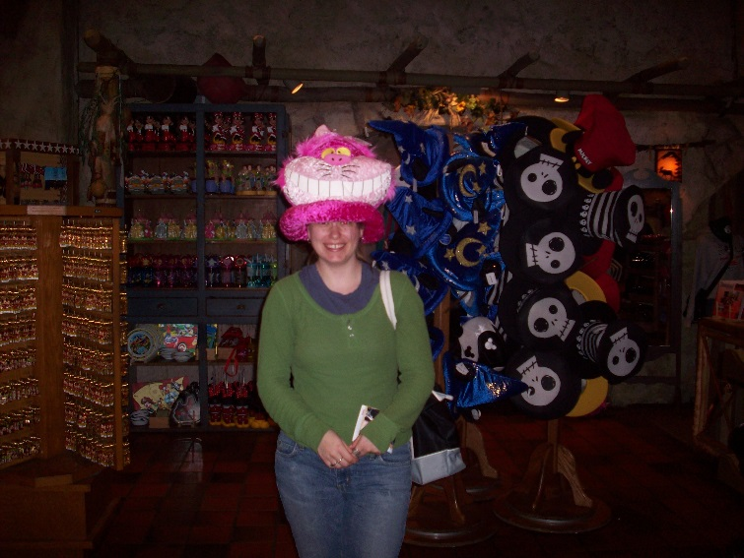

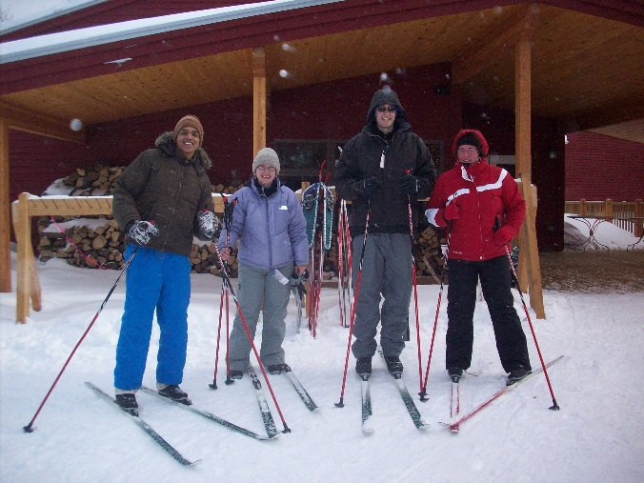
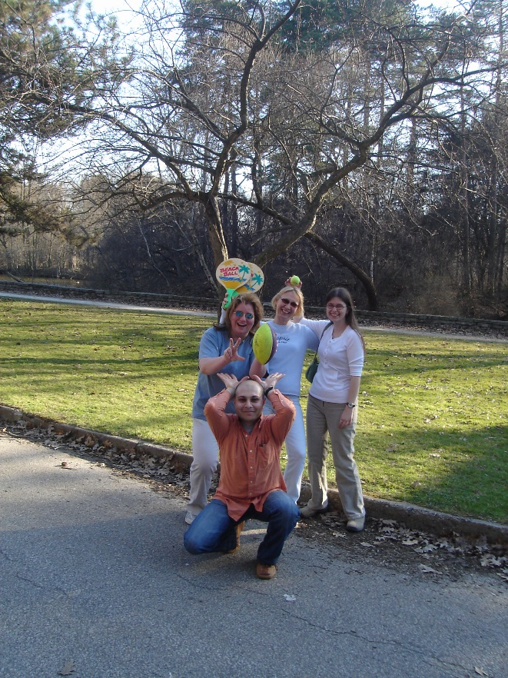
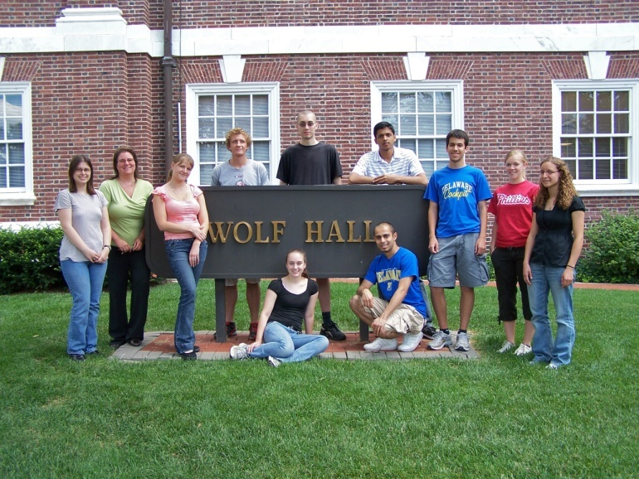

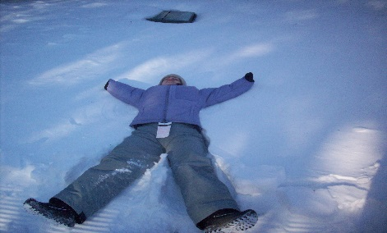
5 | R01 | AR064243 | 02

Slide 27
Let Us Meet Again
We welcome you all to our future conferences of OMICS International
Please Visit:
http://integrativebiology.conferenceseries.com/
http://conferenceseries.com/
http://www.conferenceseries.com/genetics-and-molecular-biology-conferences.php

