Slide 1
MANIFESTATIONS OF INFLUENZA IN ROMANIA
Dr. Constanta-Angelica Visan, Prof. Dr. Adrian Streinu-Cercel,
Dr.Anca-Cristina Draganescu, Dr.Anuta Bilasco, Dr.Magda Vasile,
Dr. Daniela Pitigoi, Dr. Diana-Maria Slavu, Assoc. Prof. Dr. Monica Luminos
National Institute of Infectious Diseases
’’Prof. Dr. Matei BALS’’ Bucharest Romania
© ArcDia International Oy Ltd 2012

Slide 2
AGENDA:
Supervising the influenza infection - a priority for the medical authorities in our country;
Official data reported at the level of the Ministry of Health;
The situation of the influenza cases at the level of INBI Matei Balş;
Cases of influenza in children: 0 - 14 years;
The diagnosis of influenza infections: Mari-POC rapid tests, the results of these tests; a comparative analysis between 2013 – 2014;
Neurological complications of influenza: Guillain – Barre Syndrome, encephalitis;
Conclusions.
National Institute of Infectious Diseases
’’Prof. Dr. Matei BALS’’ Bucharest Romania
© ArcDia International Oy Ltd 2012

Slide 3
SUPERVISING INFLUENZA INFECTION constitutes a priority for health authorities in Romania.
Influenza surveillance system in Romania
In Romania, the National Centre for Surveillance and Control of Communicable Diseases (NCSCCD) within National Institute of Public Health (NIPH), Bucharest coordinate the influenza surveillance system.
Data is collected by sentinel physicians and NIPH compiles and analyze information on influenza activity at national level and produces the weekly report during the influenza season.
National Institute of Infectious Diseases
’’Prof. Dr. Matei BALS’’ Bucharest Romania
© ArcDia International Oy Ltd 2012

Slide 4
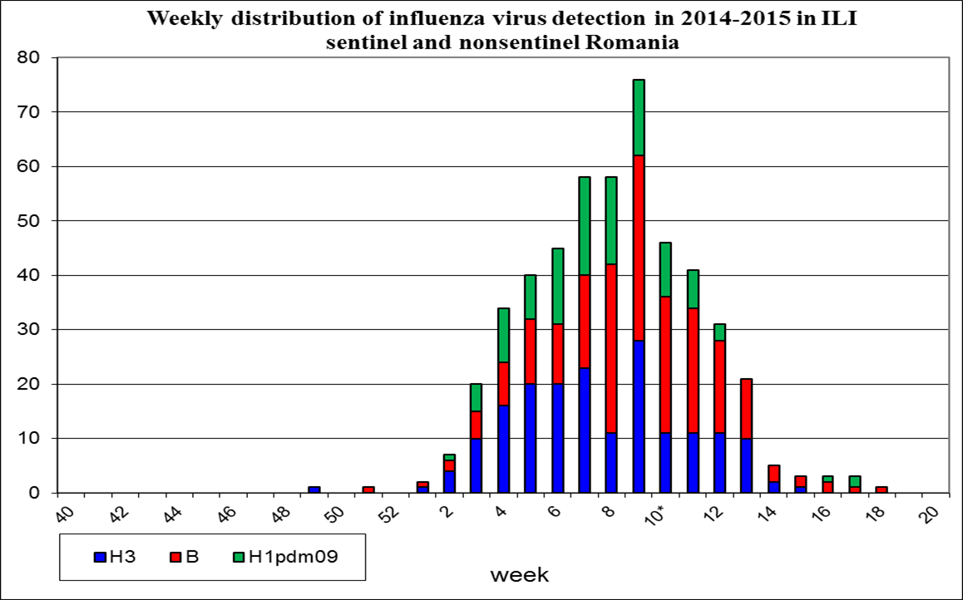
Influenza activity during 2014-2015 season
Influenza activity was higher during all the 2014-2015 season, compared to the last two seasons and the season was characterized by co-circulation of influenza A(H3N2), A(H1N1)pdm09 and B viruses.
National Institute of Infectious Diseases
’’Prof. Dr. Matei BALS’’ Bucharest Romania
© ArcDia International Oy Ltd 2012

Slide 5
National surveillance of influenza virus infection during the season 2014-2015
Number of Influenza infections confirmed by Institute Cantacuzino: 1103. 507 cases of influenza A ( 283 - subtype H3, 180 - subtype H1 pdm09, 44 unclassified), 592 cases of influenza B, 3 coinfections AH3 + B, 1 coinfection AH1 + B.
National Institute of Infectious Diseases
’’Prof. Dr. Matei BALS’’ Bucharest Romania
© ArcDia International Oy Ltd 2012

Slide 6
National surveillance of deaths related to influenza virus infection
There were recorded 33 deaths.
There were recorded 40 deaths.
National Institute of Infectious Diseases
’’Prof. Dr. Matei BALS’’ Bucharest Romania
© ArcDia International Oy Ltd 2012

Slide 7
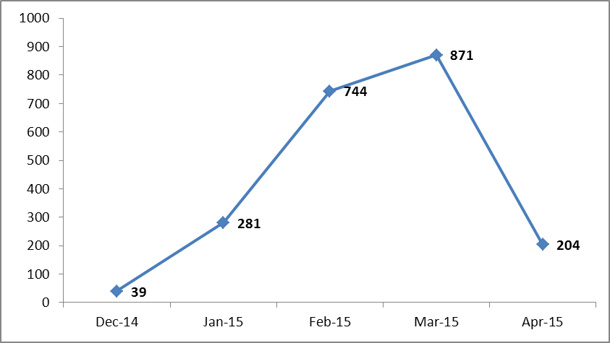
The situation of influenza cases recorded between December 2014 and April 2015 in INBI
Dec. 14 | Ian.15 | Feb.15 | Mar.15 | Apr.15 | Total
39 | 281 | 744 | 871 | 204 | 2139
National Institute of Infectious Diseases
’’Prof. Dr. Matei BALS’’ Bucharest Romania
© ArcDia International Oy Ltd 2012

Slide 8
The number of cases according to age groups
Age groups | Number of cases | %
0-14 | 360 | 17%
>14 | 1779 | 83%
Total | 2139
National Institute of Infectious Diseases
’’Prof. Dr. Matei BALS’’ Bucharest Romania
© ArcDia International Oy Ltd 2012

Slide 9
The Diagnosis of respiratory infections by using mari POC rapid tests:
mariPOC - multianalyte point-of-care testing of respiratory tract infections
fully automated immunoassay test system
detects Ag of influenza A and B, RSV , hMPV, Adenovirus Parainfluenza 1,2,3 and optionally Streptococcus pneumoniae Ag
uses fluorophore labeled antibodies
the detection of the fluorescence signal is carried out by a laser with optical separation of unbound and bound tracer fractions
preliminary results in 20 min, final results in 2 h
National Institute of Infectious Diseases
’’Prof. Dr. Matei BALS’’ Bucharest Romania
© ArcDia International Oy Ltd 2012

Slide 10
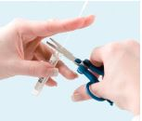
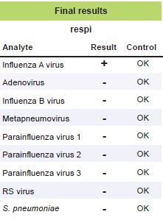
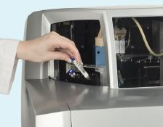
mariPOC
National Institute of Infectious Diseases
’’Prof. Dr. Matei BALS’’ Bucharest Romania
© ArcDia International Oy Ltd 2012

Slide 11
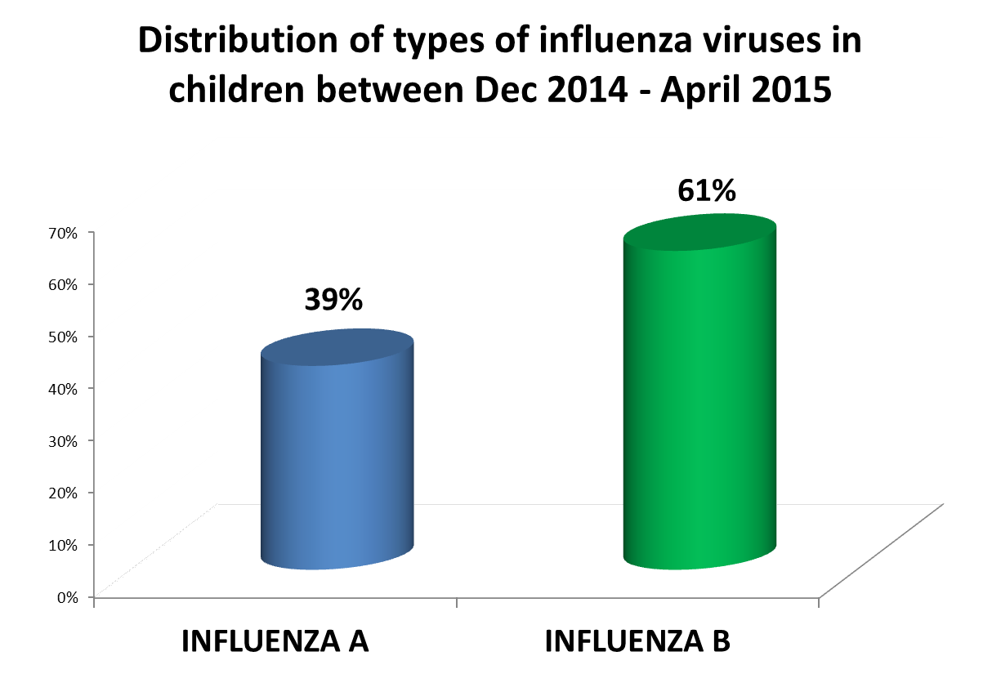
The results of mariPOC tests in INBIMB
National Institute of Infectious Diseases
’’Prof. Dr. Matei BALS’’ Bucharest Romania
© ArcDia International Oy Ltd 2012

Slide 12
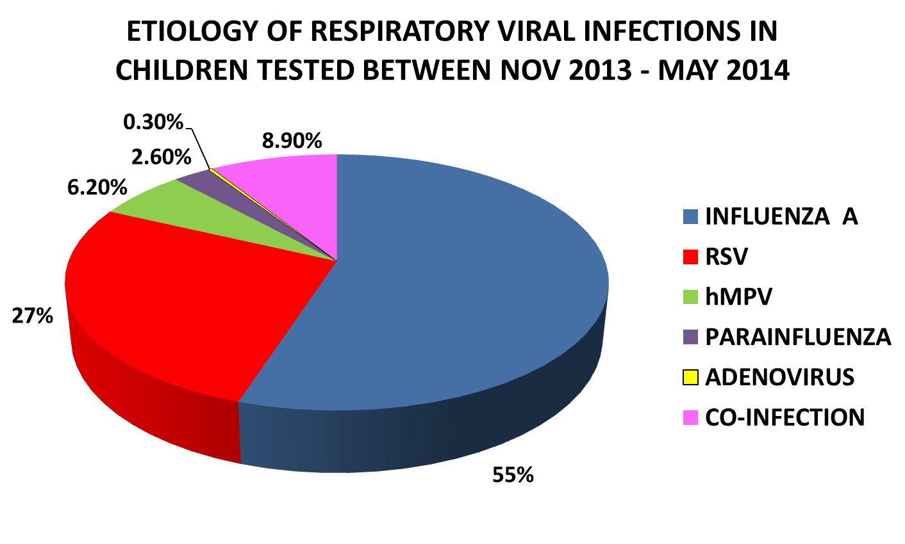
The results of mariPOC tests in the previous 2 seasons
National Institute of Infectious Diseases
’’Prof. Dr. Matei BALS’’ Bucharest Romania
© ArcDia International Oy Ltd 2012

Slide 13
Dynamics of PCR negativity by day of illness
No. patients
Day of illnes
National Institute of Infectious Diseases
’’Prof. Dr. Matei BALS’’ Bucharest Romania
© ArcDia International Oy Ltd 2012

Slide 14
06.Feb
14.Feb
27.Feb
3 yo boy
territorial hosp
INBI
Encephalitis
Guillain-Barre sdr
fever, rhinoreea and cough
headache, photophobia, pain in the lower limbs, gait disturbance
unfavorable evolution:
neurological serial exams:
abolished tendon reflexes
fever, cough, dyspneea, weakness of the lower limbs and gait unsteadiness
Lab findings:
MariPOC INFLUENZA A
RT-PCR – AH3
CSF: protein-271mg/dl, 2cells/mm
Paraclinic:
Electromyography-demyelinating neuropathy with secondary axonal suffering
37C
IGIV - 400mg/kg/day – 5 days
Oseltamivir – 60 mg/day – 10 days
Dexamethasone – 0,5 mg/kg/day – 3 days – with decreasing doses
Dexamethasone
Mannitol Ceftriaxone
National Institute of Infectious Diseases
’’Prof. Dr. Matei BALS’’ Bucharest Romania
© ArcDia International Oy Ltd 2012

Slide 15
10 Feb
territorial
8 yo boy
INBI
Encephalitis
Fever
Seizure
neurological exams: confused, perplex,
aphasic, right central facial paresis, right hemiparesis
Lab findings: mariPOC: INFLUENZA A.
RT-PCR- AH3
CSF – normal PCR –CSF negativ
Paraclinic
EEG – slow, asymetric, left>reight;
IRM - normal
Upon discharge:
Slight right – central facial paresis
Discrete pronation – upper right limb
Sleepiness, confusion, right hemiparesis
37C
Oseltamivir 10 days
Dexamethasone 10 days
Mannitol 5 days
IGIV 5 days
National Institute of Infectious Diseases
’’Prof. Dr. Matei BALS’’ Bucharest Romania
© ArcDia International Oy Ltd 2012

Slide 16
CONCLUSIONS
mariPOC represents an important tool in the diagnosis of respiratory infections;
neurologic impairment is one of the main complications of influenza infections;
Due to the prolonged persistence of the virus in the airways, we recommend to extend the antiviral treatment for up to 10 days.
National Institute of Infectious Diseases
’’Prof. Dr. Matei BALS’’ Bucharest Romania
© ArcDia International Oy Ltd 2012

