Slide 1
About OMICS Group
OMICS Group is an amalgamation of Open Access Publications and worldwide international science conferences and events. Established in the year 2007 with the sole aim of making the information on Sciences and technology ‘Open Access’, OMICS Group publishes 500 online open access scholarly journals in all aspects of Science, Engineering, Management and Technology journals. OMICS Group has been instrumental in taking the knowledge on Science & technology to the doorsteps of ordinary men and women. Research Scholars, Students, Libraries, Educational Institutions, Research centers and the industry are main stakeholders that benefitted greatly from this knowledge dissemination. OMICS Group also organizes 500 International conferences annually across the globe, where knowledge transfer takes place through debates, round table discussions, poster presentations, workshops, symposia and exhibitions.

Slide 2
OMICS International Conferences
OMICS International is a pioneer and leading science event organizer, which publishes around 500 open access journals and conducts over 500 Medical, Clinical, Engineering, Life Sciences, Pharma scientific conferences all over the globe annually with the support of more than 1000 scientific associations and 30,000 editorial board members and 3.5 million followers to its credit.
OMICS Group has organized 500 conferences, workshops and national symposiums across the major cities including San Francisco, Las Vegas, San Antonio, Omaha, Orlando, Raleigh, Santa Clara, Chicago, Philadelphia, Baltimore, United Kingdom, Valencia, Dubai, Beijing, Hyderabad, Bengaluru and Mumbai.

Slide 3
EU - Risk Management Plan
Angela van der Salm, Director PV
17 August, 2015

Slide 4
Disclaimer
The views and opinions expressed in the following Power Point slides are those of the individual presenter.
A number of the slides have been graciously shared by Dr. Lambert Creuwels, H. Lundbeck A/S
These Power Point slides are the intellectual property of the individual presenter and are protected under the copyright laws of the Netherlands and other countries. Used by permission. All rights reserved.
17 August, 2015

Slide 5
Topics
Background
When is an RMP required?
How to prepare an RMP
Special situations
Take home messages
17 August, 2015

Slide 6
Risk Management Background
ICH:
Pharmacovigilance planning E2E (ICH Harmonised Tripartite Guideline (18 nov 2004)
Europe: (previously Volume 9A)
Guideline on Good Pharmacovigilance practices (GVPs):
    Module V – Risk Management Systems, rev 1 (EMEA/838713/2011)
    Module XVI – Risk Minimisation measures: selection of tools and effectiveness indicators, rev 1 (EMEA/204715/2012)
    Guidance on format of the risk management plan (RMP) in the EU – in integrated format (EMA/718034/2012)
FDA (March 2005):
  Guidance for Industry: Development and Use of Risk Minimization Action Plans
  Guidance for Industry: Good Pharmacovigilance Practices and Pharmaco-epidemiologic Assessment
  Guidance for Industry: Premarketing Risk Assessment
CIOMS:
  CIOMS IV (1998) – Benefit Risk balance for marketed drugs
  CIOMS IX (2014) – Risk Minimisation Measures
17 August, 2015

Slide 7
Despite the required investigations, studies etc …
Risks become apparent after approval of the drug:
  clinical studies are limited in size and duration (efficacy)
  subgroups at risk are not studied (age, ethnicity, co-morbidity)
  better detection systems, awareness what to look at
➔ initiation of a risk management system
Chance that a very rare side effect (0.01%) will NOT be observed
# of patients treated | Chance of missing (%)
500 | 95.1
1000 | 90.5
5000 | 60.7
10000 | 36.8
20000 | 13.5
30000 | 5.0
Amery: Pharmacoepidemiology and Drug Safety 1999, 8:61-64
17 August, 2015

Slide 8
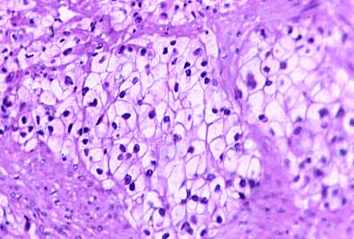
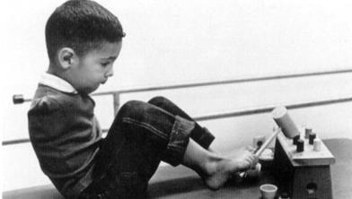
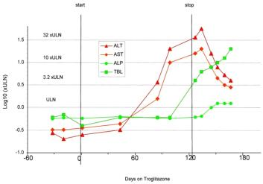
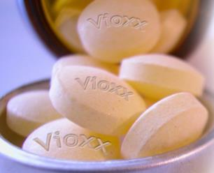
Examples
Thalidomide: teratogenicity
Di-ethyl-stilbestrol (DES): clear cell adenocarcinoma
Rofecoxib
(Vioxx): myocardial infarction
Watkins:Toxicol Pathol. 2005, vol 33, p1-5
Troglitazone:
hepatotoxicity
17 August, 20152015
17 August, 2015
Notes:
Diethylstibestrol
Vioxx: 80 miljoen exposed

Slide 9
Risk Management Background
Risk management system: a set of activities and interventions designed to identify, characterize, prevent or minimize risks relating to medicinal products, including the assessment of effectiveness of those interventions
Risk management is a continuing process throughout the lifetime of a medicinal product.
Written down in an EU-RMP (EU-Risk Management Plan)
17 August, 2015

Slide 10
Risk management (visual)
Clinical trials, post-marketing data, literature etc.
Risk identification
Actions effective?
Risk characterization and monitoring
Risk minimisation
17 August, 2015

Slide 11
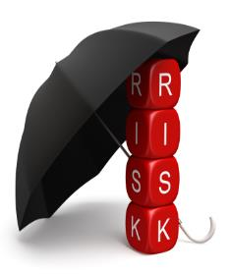
Purpose Risk Management
… to ensure that the benefits for a particular drug exceed the risks by the greatest achievable margin for the individual patient and for the target population as a whole
Note:
  Risk Management Plan focuses on minimisation of risks (but this might also be done by increasing the benefits)
  RM is relative and considered as a balance between risk(s) and benefit(s)
    ‘benefit-risk management’
17 August, 2015

Slide 12
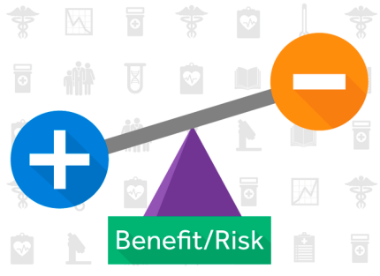
Risk Management Background
Risk is balanced by Benefit and this balance should be positive at the time of granting of the MA.
  The greater the benefit, the greater the risks?
17 August, 2015

Slide 13
When is an EU-RMP required?
An EU-RMP may need to be submitted at any time of a product’s life-cycle
(i.e. during both the pre-authorisation and post-authorisation phases)
In particular an EU-RMP should be submitted:
for all new marketing applications, an RMP including a summary thereof should be submitted:
(e.g. any product containing a new active substance, a similar biological medicinal product, a generic/hybrid medicinal product*)
* certain sections of the RMP may be omitted
17 August, 2015

Slide 14
When is an EU-RMP required?
with an application involving a significant change to an existing marketing authorisation
(e.g. new dosage form, new route of administration, new manufacturing process of a biotechnologically-derived product, pediatric indication, other significant change in indication)
at the request of the Competent Authority (both pre- and post-authorisation).
with a submission of final study results impacting the RMP or when a PSUR identifies (a change to) safety concerns for which the RMP should be updated
17 August, 2015

Slide 15
Templates: EU
MHRA: draft template for a RMP (2004)
Template for EU Risk Management Plan (EU-RMP) (EMEA/192632/2006)
(old template; still on website although it is obsolete)
Guidance on format of the risk management plan (RMP) in the EU – in integrated format (EMA/465932/2013 Rev.1)
17 August, 2015

Slide 16
How to prepare an RMP
To indicate what we do know, and what we do not know about our product (“the safety specification”)
To define actions to increase our knowledge about the safety of our product (“the pharmacovigilance plan”)
To define actions to minimize the known or potential risks of our product (“risk minimisation measures”)
17 August, 2015

Slide 17
Post-authorisation efficacy studies
Safety specification
Clinical trials, post-marketing data, literature etc.
Pharmacovigilance plan
Risk identification
Actions effective?
Risk characterization and monitoring
Risk minimisation
Risk minimisation plan
17 August, 2015

Slide 18
EU-Risk Management Plan
As per Module V of the GVP: 14 modules
Part I Product Overview
Part II Safety Specifications (more detail: SI-SVIII)
Part III Pharmacovigilance Plan
Part IV Post-authorisation efficacy studies
Part V Risk minimisation measures (including evaluation of effectiveness of these measures)
Part VI Summary of RMP (public, in lay language)
Part VII Annexes
17 August, 2015

Slide 19
Safety Specification
A summary of the safety profile. This includes (module SI-SVI):
- epidemiological data (on the indication)
- non-clinical data
- clinical trial exposure
- populations not studied in clinical trials
- post-authorisation experience
- additional EU requirements (overdose, transmission infectious agents, misuse, medication errors, off-label use, etc)
Identification of important adverse events that are (possibly) related to the drug (“the risks”) (Module VII)
  Identified risk
  Potential risk
17 August, 2015

Slide 20
Safety concerns: definitions
(Important) Identified risk:
  An untoward occurrence for which there is adequate evidence of an association with the medicinal product of interest
(Important) Potential risk:
  An untoward occurrence for which there is some basis of suspicion of an association with the medicinal product of interest, but where this association has not been confirmed
Missing information:
  Information about the safety of a medicinal product which is not available at time of submission of the RMP and which represents a limitation of the safety data with respect to predicting the safety of the product in the marketplace
Safety concern: IIR + IPR + MI
17 August, 2015
Notes:
First explain Identified; tell that these will go into 4.8. Only in RMP if Important . Example nausea

Slide 21
Safety Specification: beware …
  Safety concern: event that could impact on the risk-benefit balance of the product or have implications for public health.
  Rule of thumb:
  Identified risks all end up in ‘Undesirable effects’ (4.8; are not necessarily important)
  Potential risks end up in ‘Warnings & Precautions’ (4.5; only if important)
17 August, 2015

Slide 22
Safety Specification: beware …
For ‘identified risk’ / ‘potential risk’ info is needed about:
  seriousness
  outcome
  Severity and nature of risk
  frequency with 95% CI
  background incidence/prevalence
  risk groups or risk factors
  potential mechanisms
  preventability
  potential public health impact of safety concern
  evidence source
  regulatory action taken
17 August, 2015

Slide 23
Safety Specification: beware …
For ‘Missing information’, info is needed about:
  Populations not studied in the Pre-Approval Phase
    children
    elderly
    pregnant or breast feeding women
    patients with relevant co-morbidity such as hepatic or renal impairment (or cardiovascular, immuno-compromised, etc)
    patients with disease severity different from that studied in clinical trials
    sub-populations carrying known and relevant genetic polymorphisms
    patients of different racial and/or ethnic origins
17 August, 2015

Slide 24
Safety Specification: beware …
  Missing data: e.g.
    The CCDS mentions: “Long-term safety data in children and adolescents concerning growth, maturation and cognitive and behavioral development are lacking.” ➔ missing data
    “During clinical development no pregnancies were allowed.” ➔ missing data
    “The clearance of <drug>may be decreased in patients with mild renal impairment (creatinine clearance <40 ml/min).” ➔ missing data (about moderate to severe renal impairment)
17 August, 2015

Slide 25
Pharmacovigilance Plan
Describes actions with the purpose to characterise and monitor each safety concern (+ to gain more knowledge)
Actions could be:
  Routine pharmacovigilance:
  Gathering information on AE’s (incl. questionnaires) and reporting of individual cases, continuous monitoring of the safety profile, PSURs, signal detection, other requirements (local regulations)
  Additional pharmacovigilance:
  when routine pharmacovigilance is not deemed sufficient
    Intensive monitoring (example: Using Addenda)
    Comparative observational studies
    Active surveillance programs
    Registries
17 August, 2015

Slide 26
Post-authorisation efficacy study
Are there gaps in the knowledge about efficacy in target population?
    (e.g. 98% of all patients studied were caucasian)
    Long term efficacy
    Variability in benefits for sub-population?
This should NOT include efficacy studies done to get an extra indication !
17 August, 2015

Slide 27
Risk Minimisation Measures
Describes actions: purpose to prevent or minimise risks
  Routine risk minimisation: legal status of medicine, product information (SmPC, PIL), pack size limitation
  Additional risk minimisation activities, such as:
    Additional education:
      Educational programs for physicians, pharmacists
      Patient information leaflets, or brochures
    Control of the conditions under which a drug may be made available to reduce risk of use or misuse: who may prescribe, dispense or receive the drug ?
      Restricting prescribing and dispensing
      Informed consent procedure
    Controlled distribution
    Other
17 August, 2015

Slide 28
Risk Minimisation Measures (1/2)
Pre-marketing:
  Revise inclusion / exclusion criteria
  Revise the Informed Consent form
  Conduct advisory board meetings
  Close PV monitoring
  Guidance documents
17 August, 2015

Slide 29
Risk Minimisation Measures (2/2)
Post-marketing:
  Label (change)
  (change) Dosage
  Increase monitoring frequency and increase awareness
  Registries
  Develop and distribute Dear Doctor Letter (DHPC)
  Informed consent procedure
  Supportive care medications
  Risk communication plan
  (change) Formulation (tablet to injections etc)
  Educational material
    Direct to patient/doctor education program
    Presentation slide kits/ printed materials
    Advertising/promotion; increase Rx awareness
    CME programs (CME= continuing medical education)
    Field force training
17 August, 2015

Slide 30
Evaluation (part of risk minimisation)
For each safety concern:
  Describe the Routine RMM
  If Additional RMMs are necessary: describe these
  Describe the effectiveness of the RMM
    Outcome indicators: measurement of overall level of risk control
    Process indicators: provide insight into what extent the programme has been executed as planned
17 August, 2015

Slide 31
Summary of activities (1/2)
Elements for summary tables in the EPAR
  Summary table of safety concerns
  Table of ongoing/planned PV studies/activities
  Summary of post-authorisation efficacy development plan
  Summary of risk minimisation measures
Elements for a Public Summary
17 August, 2015

Slide 32
Summary of activities (2/2)
Elements for a Public Summary (lay language!)
  Overview of disease epidemiology
  Summary of treatment benefits
  Summary of unknowns relating to treatment benefit
  Summary of safety concerns
  Summary of risk minimisation measures
  Planned post-authorisation development plan
  Studies which are a condition of the marketing authorisation (if applicable)
  Summary of changes to the RMP over time
17 August, 2015

Slide 33
Annexes
Annex 1: Interface between RMP and Eudravigilance/EPITT (electronic only)
Annex 2: Current (or proposed) local SmPC and package leaflet.
Annex 3: worldwide marketing authorisation status by country
Annex 4: Synopsis of on-going and completed clinical trial programme.
Annex 5: Synopsis of on-going and completed pharmacoepidemiological study programme.
Annex 6: Protocols for proposed and on-going studies in categories 1-3 in RMP part III.
Annex 7: Specific adverse event follow-up forms.
Annex 8: Protocols for proposed and on-going studies in RMP part IV.
Annex 9: Synopsis of newly available study reports for RMP parts III-IV.
Annex 10: Details of proposed additional risk minimisation activities (if applicable).
Annex 11: Mock up examples of the material provided to HCPs and patients
Annex 12: Other supporting data (including referenced material).
17 August, 2015

Slide 34
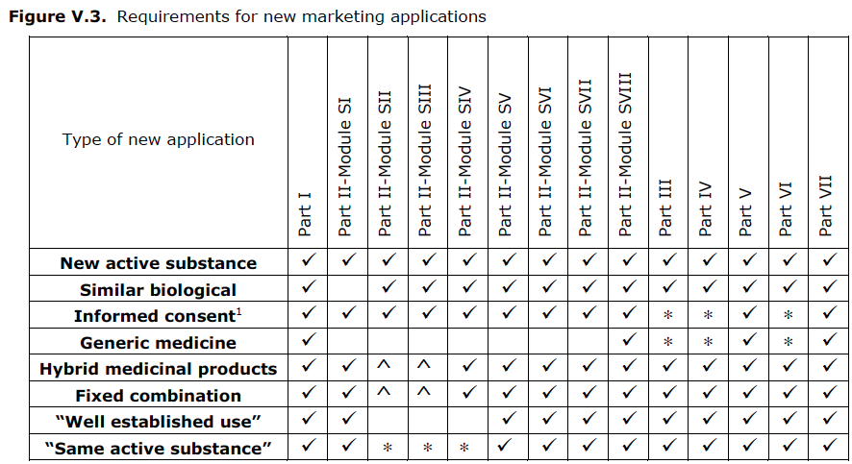
Specific content requirements
Are depending on the type of new application:
8(3) 10(4) 10c 10(1) 10(3) 10b 10a
17 August, 2015
Notes:
Content is in modular format, but modules should be read as stand alone documents (limit cross-linking), Content is in modular format, but modules should be read as stand alone documents (limit cross-linking) Disadvantage: lots of repetition, Advantages:
to facilitate submission to different regulatory authorities
to facilitate update of the RMP
ability to re-use parts of the content in DSUR, PSUR and other regulatory documents
Challenge is to handle all these separate parts (14 plus around 12 appendices)

Slide 35
How to prepare the RMP?
Follow the SOP / procedure from your company …
… but use the EU RMP template (http://www.ema.europa.eu/ema/index.jsp?curl=pages/regulation/document_listing/document_listing_000199.jsp&mid=WC0b01ac05800250b3)
17 August, 2015

Slide 36
How to prepare the RMP?
What’s changing? – draft GVP V soon open for consultation*:
Replaced table with detailed description
Expanded guidance regarding modified requirements for generic medicines (considering data on CMDh website http://www.hma.eu/464.html)
Addressed all types if initial MAAs: informed consent, hybrids, fixed combinations, well established use, herbal products, new products with substances authorised for more than 10 years
Detailed guidance on requirements for parts and modules: what is needed when?
  Further guidance is included in the RMP template for the MAHs. i.e. when a section is required and when there is a limited scope or can be omitted
Reshaped module SVII:
  Rationale for including safety concerns in the initial MAA RMP
  Update of the safety concerns
  Details of important identified potential risks and missing information
* Public consultation planned for autumn 2015: GVP V and RMP template (at the same time and in parallel
Emil Cochino (EMA), DIA EMA RMP information day dd 30-Jun-15
17 August, 2015
Notes:
Three layers for risk identification discussion:
ADRs–observed in the clinical development
Risks–events associated with the product, association supported by evidence
Important risks (potential & identified) and missing information –consider:The strength of scientific evidence suggesting an association (including when relevant a causality assessment)
Seriousness
Frequency
Clinical and benefit/risk impact

Slide 37
In practice:
  Come up with a team with relevant representation of departments
  Discuss within “the team” who will prepare and maintain the RMP
  Agree who will be the leader of “the team” (often for practical reasons PV)
  Discuss and agree within “the team” the safety concerns, and the actions to address the safety concerns
  Input needed from many departments
  Start well in advance
17 August, 2015

Slide 38
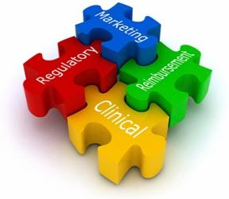
Who should be in the team? (1/2)
Safety: safety profile, risks
Regulatory: what regulatory procedure followed; submission
Clinical: study info; clinical trial report; therapeutic area expertise (benefits)
Biometrics; tables upon specified request
Communications: to review text in lay language
17 August, 2015
Notes:
eCTD = common technical document; safety: identification of risks

Slide 39
Who should be in the team? (2/2)
Toxicology: chapter non-clinical
Marketing!!!: get sample of product including packaging, marketing strategy, marketing activities, non-study post-authorisation exposure and off-label use
Medical writer
Medical affairs: liability input, efficacy input
Epidemiologist: many parts of the RMP
1 or 2 assistants: layout, subtopics, references, etc
17 August, 2015

Slide 40
More practical issues
Align the documents: RMP should be aligned with
  expectedness table / labeling
  IB
  CDP
  Reference Safety Information
  DSUR
  (PSUR)
Lay language section: look at PIL, use help of Communications, use help of proof-reading by a non-professional / patient.
17 August, 2015

Slide 41
RMP updates
MAA/MAH may request advice on the need for development or content of an EU-RMP through the scientific advice procedure.
Update of RMPs:
There is no longer an automatic requirement to update RMPs on a fixed-time basis (e.g. ‘annually until first renewal’). The Agency and the NCAs are now adopting a risk-based approach to RMP updates.
17 August, 2015
Notes:
But also for significant changes to an existing centralised marketing authorisation, the MAH should discuss the need for an EU-RMP with the EMEA at least two months in advance of the submission.

Slide 42
Versioning of RMP (1/2)
Versioning is described in Module V (section ‘Structure of the RMP’). Sections that cease to change -> ‘locked’.
  RMP version 4 may then hold (for example):
  Part 01 Product overview (version 4; since this is updated every time)
  Part 02 SI Epidemiology (version 2);
  Part 02 SII Non-clinical (version 1);
  Part 02 SIII Clinical (version 3);
  Etc ….
  Part 07 Annexes (version 4)
17 August, 2015

Slide 43
Versioning of RMP (2/2)
EMA website: Q&A on pre-submission guidance #42: how to submit the EU RMP in eCTD?
  Until further notice, companies have to send in all parts and modules of the RMP in one single PDF file so that a complete RMP is provided to the Agency. A cover letter stating which parts and modules of the RMP have actually been updated should be provided. Part I of the RMP also presents this information and should always be updated.
http://www.ema.europa.eu/ema/index.jsp?curl=pages/regulation/q_and_a/q_and_a_detail_000024.jsp&mid=WC0b01ac0580022715
17 August, 2015

Slide 44
Local versions?
After submission of the EU-RMP: you might receive requests to change the RMP.
If you submit the EU-RMP to other countries, they also might want to change the content.
Probably best solution is to have a core-RMP (with company position), plus local or regional versions
  E.g. core-RMP plus Annex for Canada
17 August, 2015

Slide 45
Special situations
Often an RMP will ‘grow’ along with the development of the product.
=> However: a product might be already on the market before an RMP is needed (e.g. a significant change for a ‘vintage product’ and it was requested to write an RMP, etc).
17 August, 2015

Slide 46
RMP for post-marketing product
  Benefits can be found in section pharmacodynamic properties (study results). If there are no study results mentioned you might report as benefit the indication(s) for the drug
Post-marketing RMP: align with the PSUR (section 16-18) !
17 August, 2015

Slide 47
So remember:
The EU-RMP has a modular structure
  Differing content for different application types!
  Allowing overlap with PSUR, facilitating (?!) report writing
It is required for each and every new MA application
Routine Risk minimisation measures include label, packaging, pack size and legal status
When additional Risk minimisation measures come in, measures of effectiveness should take place: define feasible criteria!
The bigger the company, the more people involved.
17 August, 2015

Slide 48

Questions?
17 August, 2015

Slide 49
Risk minimisation Plan
Routine Risk Minimisation
  SmPC: Summary of Product Characteristics
  PIL (patient information leaflet)
  Legal status of MP
Additional Risk Minimisation
  Educational material
  Limited prescription, or limited box size
  Restricted access
  Registries
  ….
17 August, 2015

Slide 50
Risk minimisation needed if…
  Serious adverse drug reactions
    E.g. immune system disorders, teratogenicity
New method of administration
    E.g. new patch in neuropathic pain
  High potential for abuse / off-label use
    E.g. risk for addiction
17 August, 2015

Slide 51
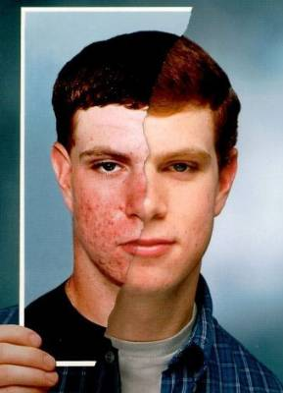
Isotretinoin (Roaccutane)
The benefits:
Highly effective in the treatment of cystic acne.
Often the only effective treatment in severe cases
17 August, 2015

Slide 52

Isotretinoin
The risks:
Causes birth defects: 30% risk of congenital malformation
Major congenital malformations reported:
- hydrocephalus
- microcephalus
- cardiovascular abnormalities
- ear and eye abnormalities
- facial dysmorphia
- cerebellar abnormalities
17 August, 2015

Slide 53
Pharmacovigilance activities
Possible activities to gain more information on isotretinoin and birth defects
  Routine pharmacovigilance
  Close monitoring of spontaneous reported cases (e.g. DCF procedure, use of questionnaires etc.)
  Use of a registry:
    FDA iPledge program: Physicians, pharmacists and patient prescribing, dispensing or using isotretinoin have to register on the iPledge website
    Information can be obtained via questions online
17 August, 2015

Slide 54
Risk minimization activities (1/3)
To prevent birth defects is to prevent pregnancies while using isotretinoin
Inform doctors and patients in the product labeling:
  Contraindication: Use in pregnancy
  Warning against birth defects
  Pregnancy test should be taken 2 weeks prior to start isotretinoin
  Compulsory use of contraception from 1 month prior to start – 1 month after discontinuation of isotretinoin
  Information in product labeling can be bold or boxed
Other methods to inform doctors and patient:
  iPledge website contains information and questions related to pregnancy tests, menstrual cycles etc.
  Special brochures, information folders for patient, physician and pharmacist
  “Dear doctor letters”
17 August, 2015

Slide 55
Risk minimization activities (2/3)
Restriction on prescribing and dispensing
  In many countries isotretinoin can only be prescribed by specialized health care professionals (e.g. consultant dermatologist)
  In the US prescription can only be dispensed when dermatologist, pharmacist and patient have registered on iPledge
  In certain countries: Physician may not prescribe more than 30 days supply. There is a 7 days window in which the prescription must be picked up from pharmacy.
17 August, 2015

Slide 56
Risk minimization activities (3/3)
Informed consent
  In many countries informed consent for the use of isotretinoin
  Patient is informed and consents to among others:
    The possible occurrence of birth defects when pregnant
    The use of at least 1 method of contraception
    Starting method of contraception at least 1 month prior to starting isotretinoin
    Confirmation of not being pregnant prior to the start of isotretinoin
  Informed consent is signed by patient
17 August, 2015

Slide 57
Isotretinoin risk minimisation activities in the Netherlands
Pharmaceutical companies producing isotretinoin have installed a “Pregnancy prevention programme” (mandated by the Dutch authorities)
  Special manual for physician
  Special manual for pharmacist
  Special manual for patient
  Informed consent form
17 August, 2015

Slide 58
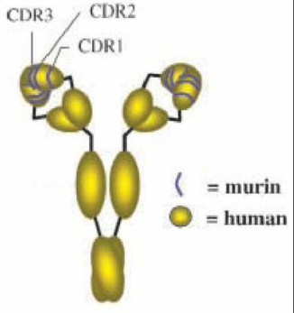
Natalizumab (Tysabri)
Natalizumab is a recombinant humanised IgG4 monoclonal antibody produced in murine myeloma cells
Specific binding: a4-Integrin
This binding reduces migration of activated inflammatory cells, including T-lymphocytes, from the vasculature into, for example, the brain parenchyma. This mechanism is thought that natalizumab manages to reduce plaque formation and relapse rates in patients with multiple sclerosis (MS).
17 August, 2015

Slide 59
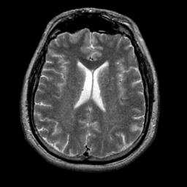
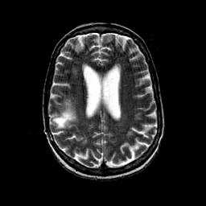
Tysabri
serious adverse drug reactions:
Progressive Multifocal Leucencephalopathy (PML)
(rare disease, usually associated with severe immunosuppression (HIV, chemotherapy, transplantation))
N= 3 cases pre-marketing: marketing suspended; re-introduction in 2006 with comprehensive RiskMAP
17 August, 2015

Slide 60
Tysabri risk minimisation
Clear-cut definition of the target population, i.e. restricted use only for patients with highly active disease without reasonable alternatives
Requirement for established MS
Escape rule for non-responders to avoid unnecessary exposure
Administration only in specialised centres by experienced physicians
Clear contraindications including a contraindication for combination with other immunomodulators
Patient alert card
Educational program for physicians including PML algorithm
17 August, 2015

Slide 61
Thalidomide
After the withdrawal as anti-nausea drug, it stayed on the market. Indications were:
  Lepra (1964)
  Behçet’s disease (1979)
  Graft-versus-host reaction (1988)
  HIV / aids complications (1989)
  Angiogenesis inhibitor (cancer treatment) (1994)
  Multiple myeloma (2008)
17 August, 2015

Slide 62
Thalidomide
After the withdrawal as anti-nausea drug, it stayed on the market. Indications were:
  Lepra (1964)
  Behçet’s disease 1979
  Graft-versus-host reaction (1988)
  HIV / aids complications (1989)
  Angiogenesis inhibitor (cancer treatment) (1994)
  Multiple myeloma (2008) approved in EU
Use of the drug only under very strict restrictions !
=> Even for a drug like thalidomide there might be a need
17 August, 2015

Slide 63
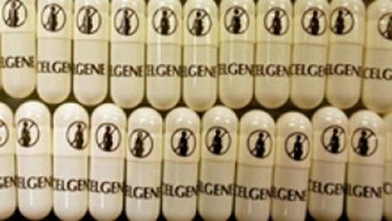
Thalidomide
Extensive additional risk minimisation programme:
  production, dispensing and prescription is strictly controled;
  women should use two forms of birth control;
  submit to regular pregnancy tests;
  dispensing rights to authorised pharmacies;
  thalidomide education to HCP;
  education to patients;
  limiting prescription;
  registry
17 August, 2015

Slide 64
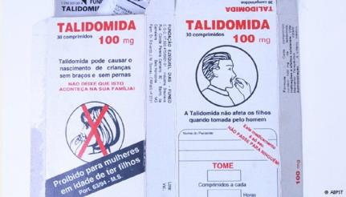
Thalidomide
Despite this: circa 100 cases of embryopathy in Brazil from 2005 to 2010.
Mainly in poor illiterate Brazilians, in areas with poor access to healthcare: misunderstanding of the warning symbol: they thought it was an abortion drug !
The use of extensive RMM
might not be enough
to safeguard the population
17 August, 2015

Slide 65
How many Risk Minimisation Actions?
Centrally authorised new active substances in the period January 1995 till January 2010: 391
Active substances with additional RM activities (of the 391): 57 => 14.6%
(ref: M. Lagendijk, CBG-MEB: http://www.ema.europa.eu/docs/en_GB/document_library/Presentation/2011/06/WC500107882.pdf)
Per 27 May 2015: List of medicinal products under additional monitoring: 240
(ref: http://www.ema.europa.eu/docs/en_GB/document_library/Other/2013/04/WC500142453.pdf)
17 August, 2015

Slide 66
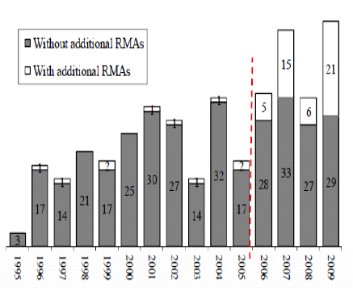
Additional RMA
17 August, 2015

Slide 67
Additional RMA
Provision of educational material | 57
To health care provider | 56
To patient | 31
Patient monitoring / screening | 18
Controlled distribution | 9
Pregnancy prevention activities | 5
Special packaging / extra label | 7
Others | 6
I.M. Zomerdijk, Medicines Evaluation Board, Erasmus Univ. Rotterdam
17 August, 2015

Slide 68
How effective are RMM?
Haloperidol: QT assessment at baseline
Example haloperidol: baseline ECG is recommended prior to treatment
Proportion of ECG’s:
  when haloperidol was initiated
  One year before (control)
Results: 3420 patients were prescribed haloperidol. ECG at treatment initiation: 1.8% versus 0.8% (control).
Patients with additional risk factors for QT prolongation: 1.9% versus 1.0% (control)
Compliance […] extremely low
Warnier, et al, Pharmacoepidemiuology and Derug Safety 2014; 23(S1): p228
17 August, 2015
Notes:
Ferquency of ECG measurements assessed in pat where haloperidol was initiated in primary care

Slide 69
How effective are RMM?
Glucose assessment in second-generation AP
In 2003, the FDA issued warnings about hyperglycemia and diabetes with SGA’s
Since 2004, this risk in product labels. Guidelines have recommended baseline metabolic screening.
Cohort: age 2 to 18 newly initiating SGA’s 1/1/2006-31/12/2011: n=16 304.
Results: 11% had glucose assessment in minus 90 to 3 days after treatment initiation (OLA > RIS, ARI, QUE)
=> Few children and adolescents starting SGA have baseline glucose assessed.
Raebel et al, Pediatrics 2014;134:e1308–e1314
17 August, 2015

Slide 70
How effective are RMM?
HHS report
Approved REMS 2008-2011:
FDA approved 199 REMS, 99 of which were still required in 2012. 49 REMS were reviewed.
What was found: nearly half did not include all info requested; 10 were not submitted within timeframe. FDA has not identified reliable methods to assess the effectiveness of REMS; FDA assessment review times exceeded its goal of 60 days for all but one.
=> Findings raise concerns about the overall effectiveness of the REMS program
17 August, 2015

Slide 71
How effective are RMM?
Added value of PASS / PAES
Study: new active substances in 2007 approved = 47
22/47 had minimal 1 PASS (in total 31 PASS)
2014: 313 safety variations in SmPC (in 41 products)
Source of deviations was investigated
4% of all safety variations resulted from requested PASS
Costs !
Escher report, http://escher.tipharma.com/fileadmin/media-archive/escher/Reports/Escher_report_IA.pdf
17 August, 2015

Slide 72
Let us meet again..
We welcome you all to our future conferences of OMICS International
5th International Conference & Exhibition on Pharmacovigilance & Clinical Trials
On
September 19 - 21, 2016 at Vienna, Austria http://pharmacovigilance.pharmaceuticalconferences.com/

