Slide 1
EXTERNAL FRONTO-ETHMOIDECTOMY IN MANAGEMENT OF SINUS DISEASE; TECHNIQUES FOR MAINTAINING FRONTO-NASAL DUCT PATENCY
COL DR ANDREW IMOGU MB;BS(IB), FWACS, FMCORL, FICS
PRESENTATION TO THE 2ND INTERNATIONAL CONFERENCE OF RHINOLOGY AND OTOLOGY DUBAI 2015

Slide 2
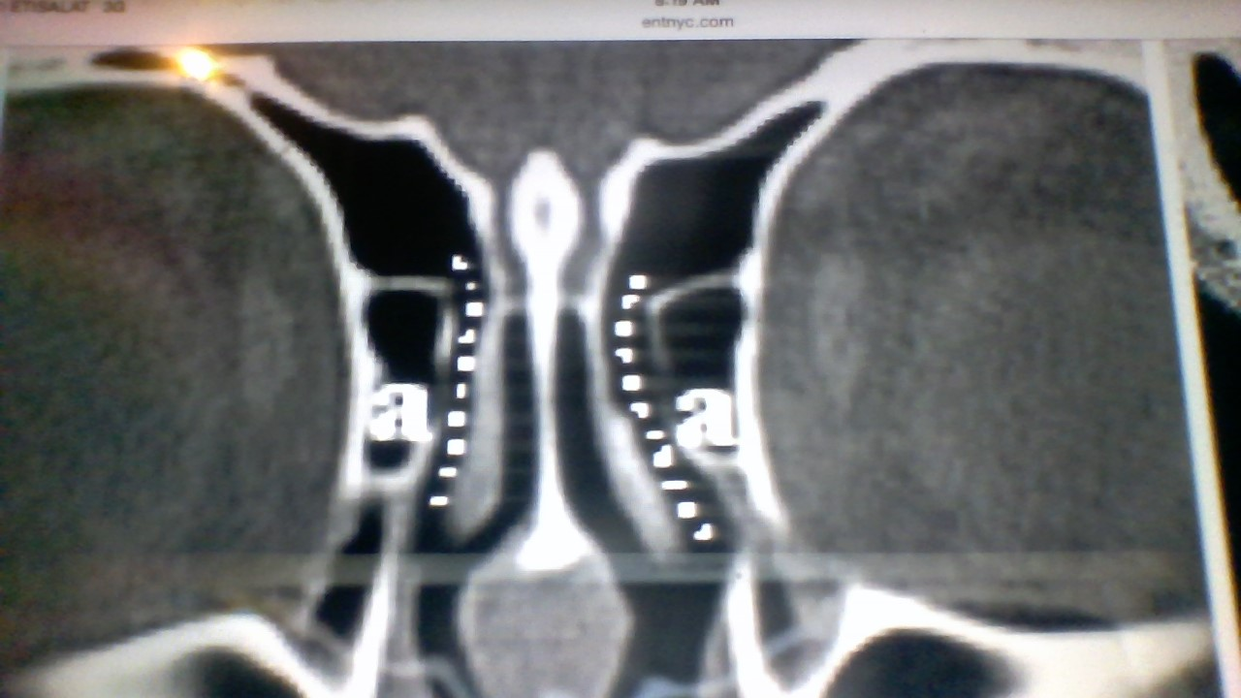
fronto-nasal duct
Hour glass shaped
-ostium of frontal sinus
-the duct
-ethmoidal infindibulum
Drains into hiatus semilunaris (middle meatus)
Ostium and frontal recess referred to as Fronto Nasal Duct(FND) or Frontal Outflow Tract(FOT)

Slide 3
Goals of Sinus Surgery
1. Eradication of disease e.g. Mucocele
2. Drainage
3. Ventilation of the involved Sinus
4. Minimum Morbidity
5. Prevention of Recurrence

Slide 4
Current Trend
Surgical Procedures Less Invasive
Emphasizing more of Surgical Drainage and Ventilation over Ablation
Maintenance of Function with Minimal Intervention
Better Cosmesis

Slide 5
Trans Nasal Endoscopic Fronto-Ethmoidectomy
Preservation of Frontal Sinus Mucosa
Preserves Sinus Architecture
Maintenance of Patent Frontal Recess
Better Clinical Outcome
Leaves no Facial Scarring

Slide 6
External Fronto-Ethmoidectomy (EFE)
Open procedure for removing disease in the fronto-ethmoidal sinus complex
Success limited by the common problem of maintaining fronto-nasal duct patency
Still relevant as a veritable tool in contemporary management of sinus disease

Slide 7
EFE in Contemporary Management of Sinus Disease
Failed Endoscopic Approach
Difficulty in using Endo Nasal Approach due to Nasal Pathology
Extensive Disease
Fistula Tract already present: Fronto-cutenous or Ethmoido-cutenous fistulae
Recurrence/Previous Surgeries-restricts endoscopic visualization and access
Combined approach-External approach under Endoscopic control

Slide 8
External Fronto-Ethmoidectomy; Techniques
Lynch-Howarth approach
Killian Method
Reidel Method
Lothrop or Chaput-Meyer approach
Advantage of open procedure: provides excellent visualization of interior of sinus-enables surgeon to correct a variety of problems

Slide 9
Techniques For Maintaining Fronto-Nasal Duct Patency
A. FLAPS
Sewell-Boyden Flap
-Rotating distal end of sinus mucosa laterally and superiorly on itself
-1-2 cm wide, 2-3cm long
Axillary Flap approach as advanced by Peter Wormald
Endoscopic approach
- Mucosa carefully wrapped around openinig of frontal sinus ostium

Slide 10
STENTS
Foley’s Catheter-Long or Amputated
Endotracheal Tube
Corrugated Rubber Tube
Silastic Tube
Rubber Tubbing+/- multiple side holes
Rolled Sheet
Balloon Catheter / dilator devices

Slide 11
Doubly Amputated Foley’s Catheter with Secured Balloon Channel-IMOGU’s TECHNIQUE
1st Presented@ West African Conference of Otolaryngologists 1998
Standard Lynch Ext Fronto-ethmoidectomy
Size 24FR self retaining Foley’s Catheter is introduced trans nasally and guided through the fronto-nasal duct created into the frontal sinus cavity

Slide 12
Imogu’s technique (cont)
Balloon tested to fit and fill the frontal sinus cavity
Balloon inflated with air/water
Balloon channel of catheter is identified as a white line along the edge and tied with 20 silk just above the level of the nasal vestible
Catheter doubly amputated- 1st at the tip and just below the ligature.
Removal after 6 weeks by removing ligature thus balloon deflates and tube pulled out

Slide 13
Characteristics of doubly amputated Foley’s catheter
Catheter body length:9cm
2.5cm of tip is amputated
New tip 0.5cm from upper edge of balloon section
Catheter working length: 5cm
Outer diameter: 8mm
Width of balloon @ widest point when fully inflated:3cm
Balloon volume:30mls
Inflation pressure resistance: 12 atmospheres
Balloon channel=white streak at medial edge
Catheter Material:latex silicon coated
Balloon: Semi-compliant

Slide 14
ADVANTAGES
Balloon fills frontal sinus cavity thus no haematoma collection
Balloon anchors stent into sinus cavity
Irrigation of sinus cavity done using 10 ml syringe via the intact irrigation channel of the catheter
Cosmeses and compliance- 6 weeks retention
Early Work Resumption
No need for re-positioning or re-insertion

Slide 15
Fronto-Nasal Duct Size Amongst Nigerians
STUDY DESIGN
Preliminary report
On going prospective study
Measuring length and latero-medial diameter of FND amongst consecutive adult Nigerians attending the National Hospital Abuja, Nigeria with no nasal pathology requiring CT scan of the scull/head & neck for other reasons other than sinus disease
Jan 2015- March 2015

Slide 16
Research Questions
Is there a difference in the length and diameter of FND between male and female Nigerians
Is there a difference in the length and diameter of FND in different age groups amongst Nigerians
Is there a difference in FND parameters in Africans compared to other reported Non-african races
Final size of FND attained 6-months post removal of stent and averages b/w 60-75% of size at removal -what size of catheter is necessary to create an adequate size FND on healing

Slide 17
Inclusion criteria
Adults 18yrs and above
Native Nigerian
No nasal symptoms on presentation
No nasal/sinus pathology on CT scan
EXCLUSION
Subjects below 18 years of age
Caucasians/Asians/non African race
Evidence of sinus disease

Slide 18
method
Axial/coronal views of ct scan showing paranasal sinuses
Length of FND measured in mm
Latero-medial diameter of FND measured in mm @ mid point
Measurements done using soft ware developed by dept of radiodiagnosis NHA

Slide 19
results
MEAN AGE
Male: 40.7 Years
Female: 36.3 Years
MEAN LENGTH OF FND
Male: 12.3 mm
Female: 11.4 mm
MEAN LATERO-MEDIAL DIAMETER OF FND
Male: 2.8 mm
Female: 2.6 mm
MEAN FRONTO NASAL DUCT LENTH AND LATERO-MEDIAL DIAMETER IN NIGERIANS
AGE | FND Length(mm) | FND Diameter(mm) | SEX | n
40.7 | 12.3 | 2.8 | MALE | n=12
36.3 | 11.4 | 2.6 | FEMALE | n=18
38.5 | 11.9 | 2.7 | MEAN | n=30

Slide 20
Distribution of FND length and lat-med diameter in age groups
AGE DISRTIBUTION AND MEAN FRONTO NASAL DUCT LENGTH(mm) AND LATERO-MEDIAL DIAMETER(mm)
AGE RANGE | Mean FND Length(mm) | Mean FND Diameter(mm)s | n= | p value
20-30 YRS | 11.9 | 2.6 | 11
31-40 YRS | 11.6 | 2.8 | 8
41-50 YRS | 12.1 | 2.8 | 7
51-60 YRS | 11.4 | 2.2 | 2
61-70 YRS | 10.6 | 2.4 | 2
TOTAL |  |  | 30

Slide 21
Fronto-nasal duct parameters amongst races
COMPARATIVE ANALYSIS OF FRONTO-NASAL DUCT PARAMETERS IN RACES
LITERATURE REVIEW
RACE | FND LENTH(mm) | Mean | Lat-Med DIAMETER(mm) | Mean | n=
CAUCASIANS | 3.2-14.9mm | 6.2mm | 1-5mm | 2.4mm | 60
JAPANESE | 2-10mm | 6mm | 2-3mm | 2.5mm | 42
NIGERIANS | 8.8-13.7mm | 11.7mm | 2-4.4mm | 2.7mm | 30

Slide 22
CONCLUSION
Minimal Difference in size of FND between male and female Nigerians
FND size not significantly different in age groups
FND lenght is same in caucasians and Japanese and longer in Africans
FND diameter is about same in all three compared races
Size 24FR Foley’s catheter adequate
More multi-lateral studies required in Africans to confirm FND parameters

Slide 23
REFERENCES
Imogu AO. External Fronto-Ethmoidectomy: Maintenance of Fronto-Nasal Duct Patency. West African J.ORL, Vol 1(1): 17-20
Suchi KA, Kranti B, Arun S. Frontal Sinus Mucocele with Orbital Complications:Management by Varied Surgical Approaches. Asian J Neurosurg.2012, 7(3):135-140
Diva S. Contemporary Indications for External Approaches to the Para nasal Sinuses. ENT.expert/in/file/documents
Fasula JA, Adeleye AO, Onokoya PA, Okolo CA, Nwaorgu GO. Recurrent Nasal Polyp and Pan Sinus Mucocele associated with bilateral blindnes.: a case report. Ghana Med. J 2010; 44(4):165-8
Baron SH, Dedo HH, Henry CR.The Mucoperiosteal flap in sinus surgery(The Sewall-Boyden-McNaught Operation). Laryngoscope 1973, Aug; 83(8):1266-80
Mur AH, Dedo HH. Fronto ethmoidectomy with Sewall-Boyden reconstruction: Indications, Technique, and Philosophy. Clin North Am,2001 Feb; 34(1):153-65
Wormald P. Surgery of the frontal recess and the frontal sinus. Rhinology 43, 2005: 82-85
Lynch RC. The technique of radical operation which has given me the best results. Laryngoscope 1921, 31:1
Howarth WG. A radical frontal sinus operation. Journal of Laryngol Otol 1921, 38: 341-343
Howarth WG. Some pionts in the technique of the fronto ethmoidal operation. Journal of Laryngol Otol, 1936(51): 387-390

Slide 24
11. Wormald P, Amanda A, Nair S. The modified endoscopic Lothrop procedure in treatment of complicated chronic frontal sinusitis. Clinical Otolaryngology and Allied Sciences 2003, 05: 20
12. Ijaduola TG. Use of a Foley catheter for short term drainage in frontal sinus surgery. J Laryngol Otol. 1989 Apr;103(4): 375-8
13. Freeman SB, BloED. Frontal sinus stents. The Laryngoscope, 2000 08 02
Stennert E. A combined intra-extra nasal approach for surgical treatment of severe disease of the frontal sinuses. Laryngoscope 2001 July,91(7): 1237-45
Murai Y. Anatomical study of the ethmoidal sinus in Japanese. Sei-i-Kai Med J 1937, 56: 205-2044
Hiroshi M. Rhinology-A State of the Art. Proceedings of the XVth Congress of the European Rhinological Society. Pp 3-5

Slide 25
Thank you
DR ANDREW IMOGU
MB;BS(IB), FWACS, FMCORL, FICS, MBA
CHIEF CONSULTANT EAR, NOSE AND THROAT/HEAD & NECK/FACIAL PLASTIC SURGEON
NATIONAL HOSPITAL ABUJA
CHIEF MEDICAL DIRECTOR, HI-FI HOSPITAL, 40 SUEZ CRESCENT, WUSE ZONE 4, ABUJA, NIGERIA
Tel: +234 8054379771. E-mail: otunny@yahoo.com

