Slide 1
About Omics Group
OMICS Group International through its Open Access Initiative is committed to make genuine and reliable contributions to the scientific community. OMICS Group hosts over 400 leading-edge peer reviewed Open Access Journals and organize over 300 International Conferences annually all over the world. OMICS Publishing Group journals have over 3 million readers and the fame and success of the same can be attributed to the strong editorial board which contains over 30000 eminent personalities that ensure a rapid, quality and quick review process.

Slide 2
About Omics Group conferences
OMICS Group signed an agreement with more than 1000 International Societies to make healthcare information Open Access. OMICS Group Conferences make the perfect platform for global networking as it brings together renowned speakers and scientists across the globe to a most exciting and memorable scientific event filled with much enlightening interactive sessions, world class exhibitions and poster presentations
Omics group has organised 500 conferences, workshops and national symposium across the major cities including SanFrancisco,Omaha,Orlado,Rayleigh,SantaClara,Chicago,Philadelphia,Unitedkingdom,Baltimore,SanAntanio,Dubai,Hyderabad,Bangaluru and Mumbai.

Slide 3

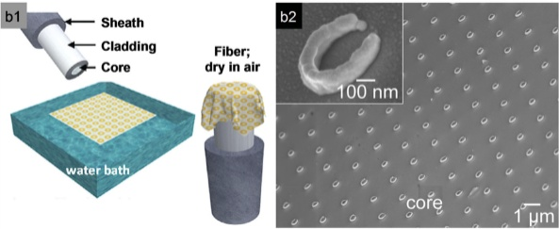
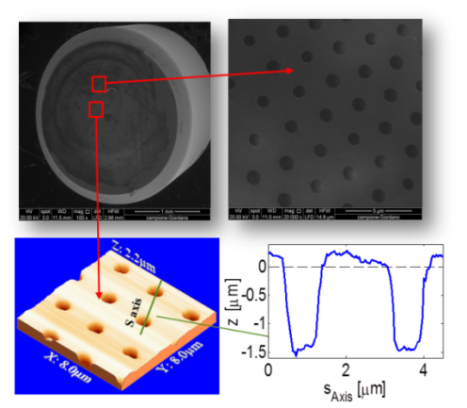
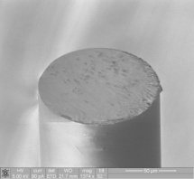
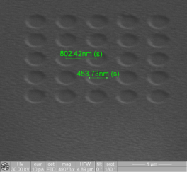
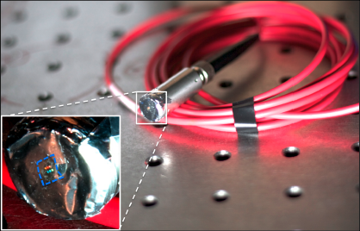
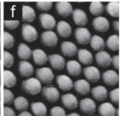
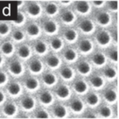
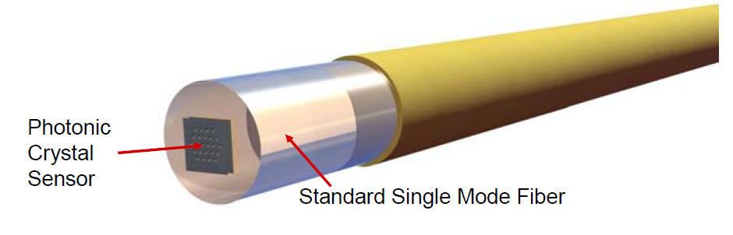
New Functionalities in Optical Fibers using
“Lab on Fiber” Technology
Andrea Cusano
Optoelectronics Division,
Engineering Department,
University of Sannio, Benevento, Italy

Slide 4
OUTLINE
LAB-ON-FIBER TECHNOLOGY
LAB ON FIBER AT UNIVERSITY OF SANNIO
FIBER OPTIC NANO-PROBES: PRINCIPLE OF OPERATION AND SENSING FEATURES
CONCLUSIONS

Slide 5
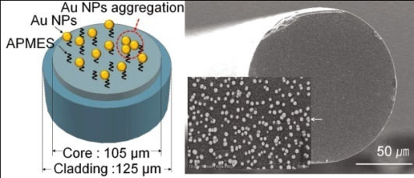
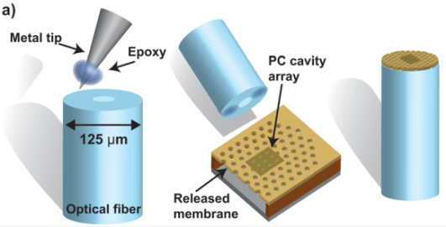

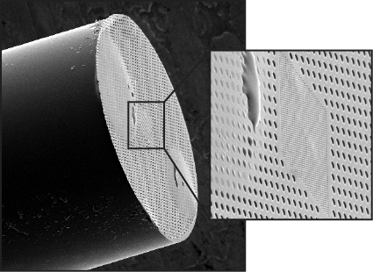
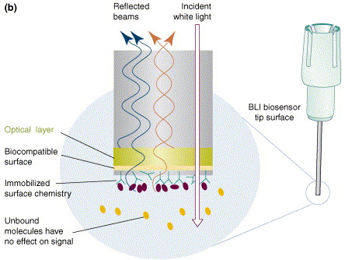
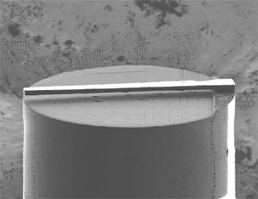
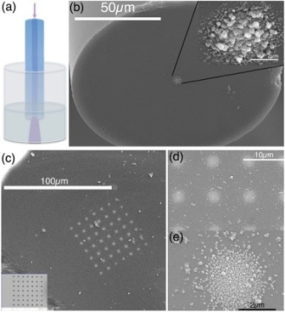
LAB ON FIBER TECHNOLOGY:
towards integrated and multifunctional nano-probes
Integration and patterning at micro and nano scale of different functional materials with desired optical, physical and chemical properties
Increased light matter interaction and creation of a technological world completely integrated within optical fibers with significant advantages in terms of functionality, performances, miniaturization, robustness, cost effectiveness and power consumption
MAIN ISSUE: Definition of a reliable fabrication procedure able to integrate and process, at micro- and nano-scale, several materials onto unconventional substrates such as the optical fibers.
Notes:
Il Gruppo di Optoelettronica da diversi anni lavora nell’ambito della sensoristica e delle nanotecnologie in stretta collaborazione sia con il mondo industriale che con prestigiosi enti di ricerca (nazionali ed internazionali).

Slide 6
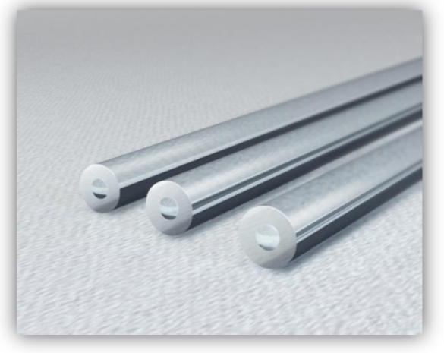
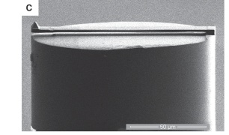
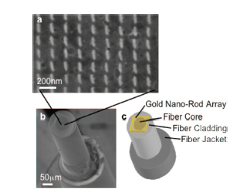
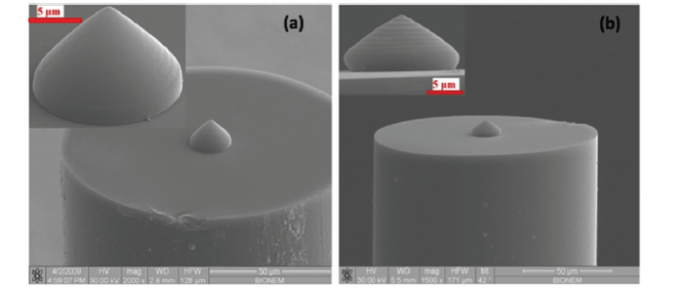
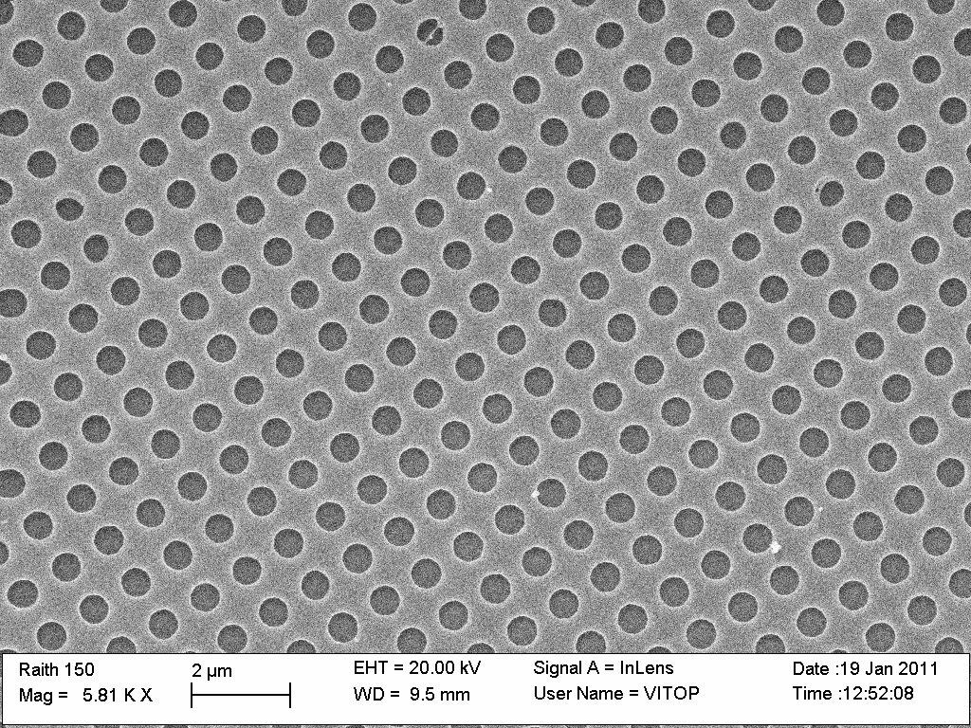
THE FIBER TIP: A UNIQUE LIGHT COUPLED PLATFORM
FOR MICRO AND NANO TECHNOLOGIES
  Unique and Uncoventional Platform
  Microscopic Cross Section and large aspect ratio
  Inherently Light Coupled
  Biocompatible
  Opto-mechanical Systems
  (AFM and near field probes,
  Pressure and
  Acoustic sensors)
  Micro-optics and Beam Shaping
  Nanophotonics
  (Nanodevices, diffractive filters, light manipulation)
  Biophotonics
  (Sers, Plasmonics, Optical tweezers, Nanosensors)

Slide 7





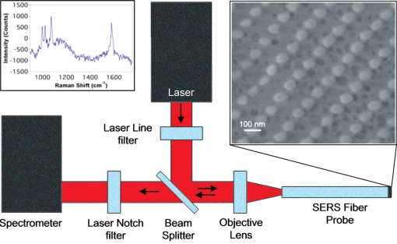
EARLIER DEVELOPMENTS DRIVEN BY SERS
Roughening by mechanical abrasion
Mullen 1991
Island growth during
thin film deposition
Viets and Hill, 1998
Self-assembly of
colloidal templates
Vo Dinh, 1995
Coating with metal nanoparticles
Sadler, 2000
Nanorods formed by
glancing angle deposition
Zhao , 2006
Interrogation of a fiber SERS probe in the optrode configuration
Gorgi Kostovski et al.
Advanced Materials 2014 DOI: 10.1002/adma.201304605
Technologies:
Earlier development mainly rely on the use of decoration and self assembly techniques
Advantages:
Simple and low cost fabrication techniques
Ready access to the nano-regime
Main Issue
Stochastic deposition affects the order and regularity of the final nanostructure

Slide 8
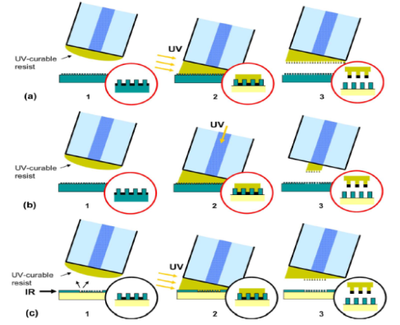
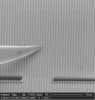
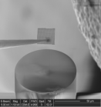

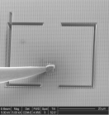

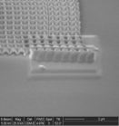

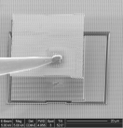

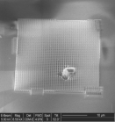

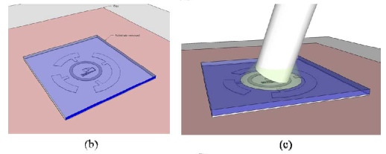
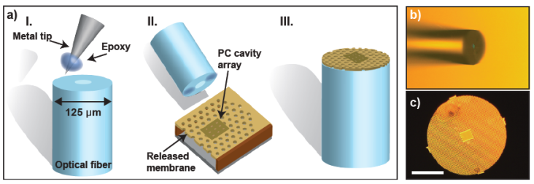
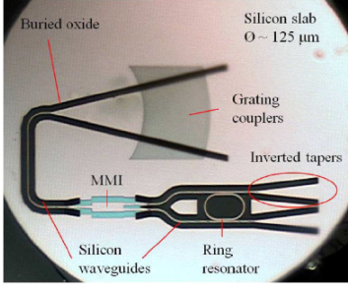
Towards engineered nanostructures integration
Nano-fabrication on planar substrates and transferring onto optical fibers
EBL and soft lithography
UV nano imprint and transfer lithography (NITL)
Monolithic silicon photonic crystal integration
(a)
(d)
(b)
(e)
E. J. Smythe, F. Capasso et al., ACS Nano, 2009, 3 (1), 59-65
S. Scheerlinck , R. Baets et al., J. Light. Tech., pp.1415-1420, 2009
(c)
(f)
Soft lithography, nano-skiving and dipping
O. Solgaard, I. W. Jung, et al., J. Light. Tech., 2011, 29(9), 1367-1374.
Soi microring resonator integrated on the fiber facet
Photonic crystal cavity transfer
P. Bienstman, C. L. Arce, et al., IEEE Photon. Techn. Lett., 2011, 23(13), 890-892
G. Shambat et al., Appl. Phys. Lett. 99(19), 191,102 (2011)
D. J. Lipomi, F. Capasso et al., Nano Lett. 2011, 11(2) 632-6

Slide 9
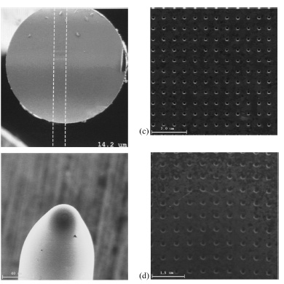
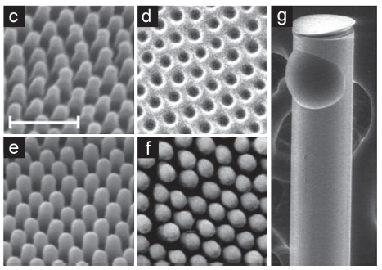
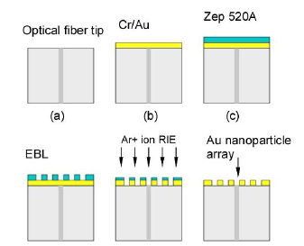
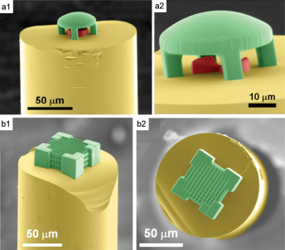
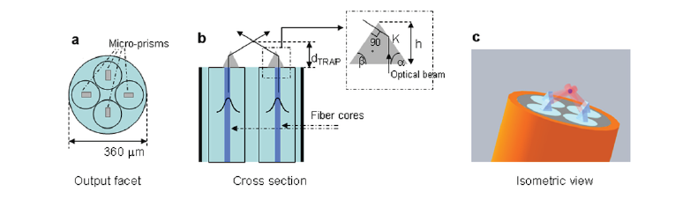
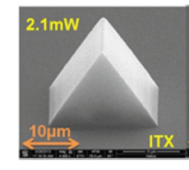
OVERCOMING THE TRANSFERRING APPROACH
FIB milling
Direct-writing
Nanoimprint lithography
EBL and Reactive Ion Etching
A. Dhawan et al., Sens. J. IEEE 2008, 8, 942-950
Y. Lin, R. G. Lindquist et al., Biomed Opt Express. 2011; 2(3): 478–484.
Micro-optics using two-photon direct laser writing
G. Kostovski , et al.,
Biosensors Bioelectron. 2009, 24 , 1531
Optical tweezers using two photon litography
H. E. Williams et al., Opt. Express 2011, 19, 22910
E. Di Fabrizio, Sci. Rep. 3, 1258 (2013)

Slide 10
EBL Direct writing
Electron-resist spin coating
2) EBL patterning
100-400nm thick (ZEP) overlay can be reproducibly obtained
3) Overlay deposition
Optical fiber tip
ZEP layer deposition
ZEP overlay
patterning
Au superstrate deposition
Different materials (metallic or dielectric) can be easily deposited
M. Consales, A. Ricciardi, A. Crescitelli, E. Esposito, A. Cutolo, A. Cusano, ACS Nano, 6 (4), pp 3163–3170 (2012).
Notes:
Il Gruppo di Optoelettronica da diversi anni lavora nell’ambito della sensoristica e delle nanotecnologie in stretta collaborazione sia con il mondo industriale che con prestigiosi enti di ricerca (nazionali ed internazionali).

Slide 11
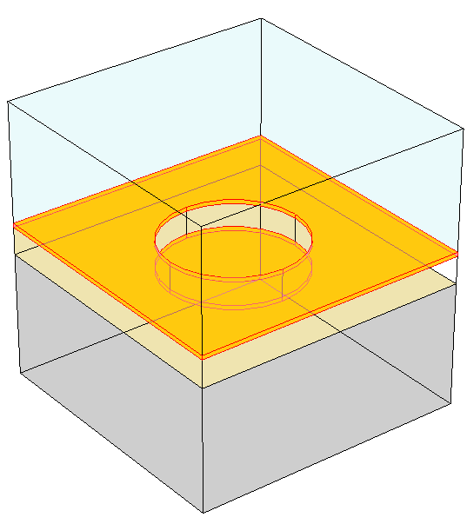
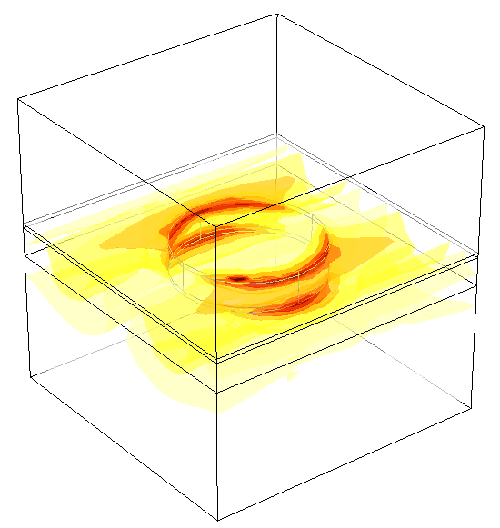
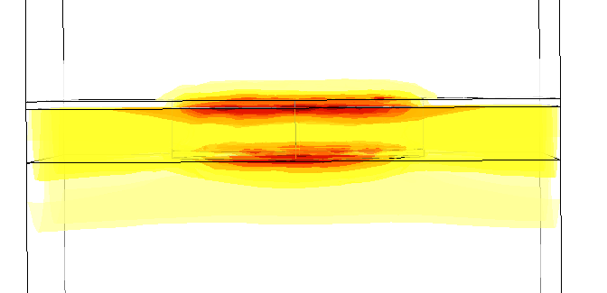
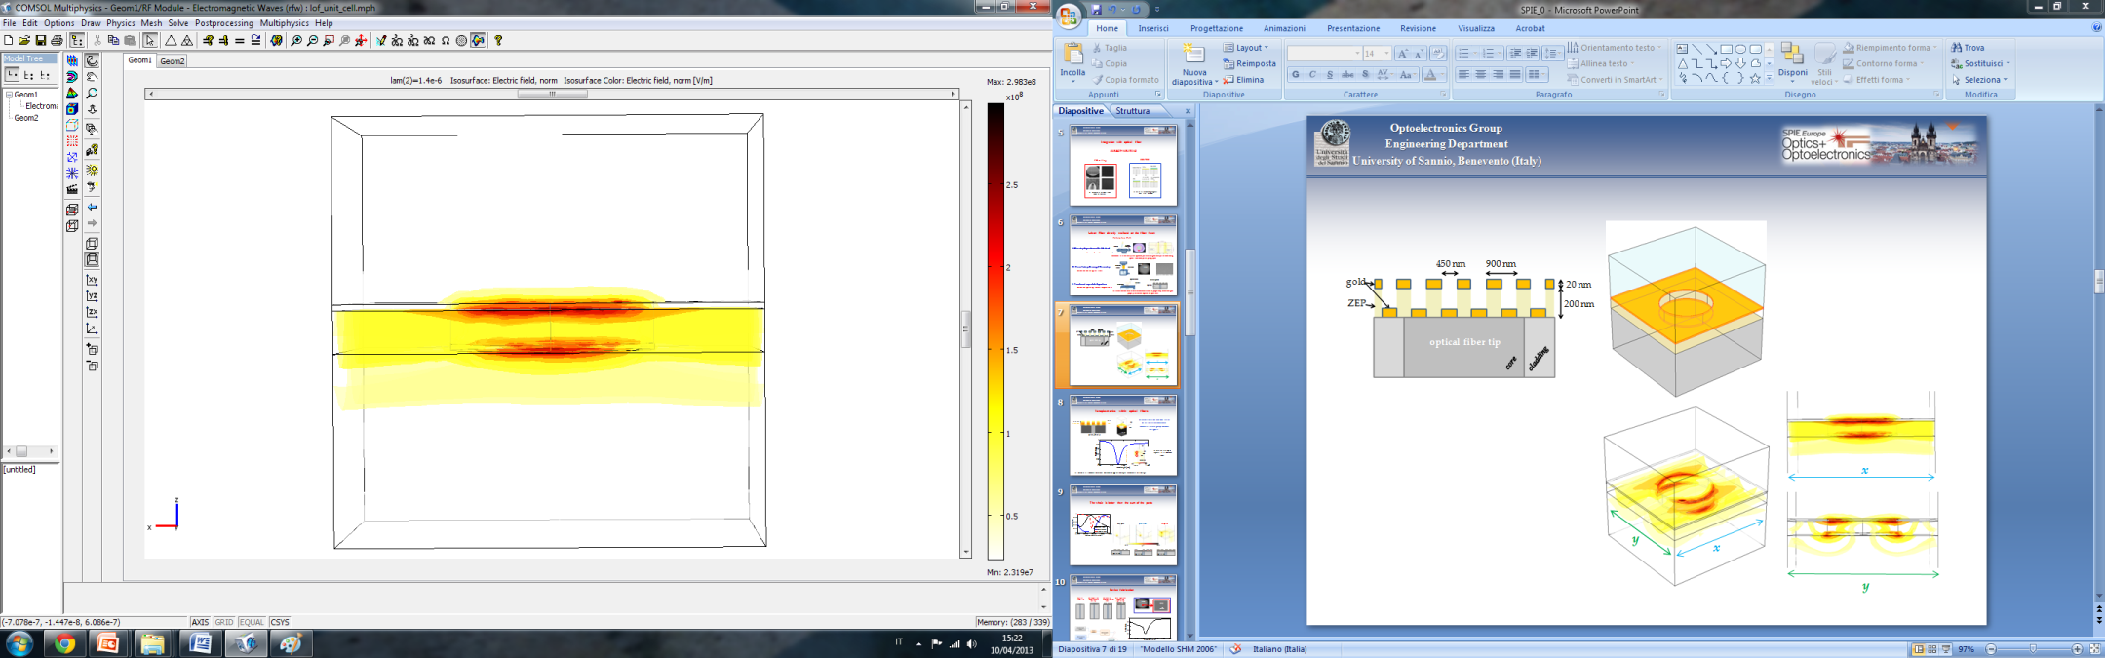
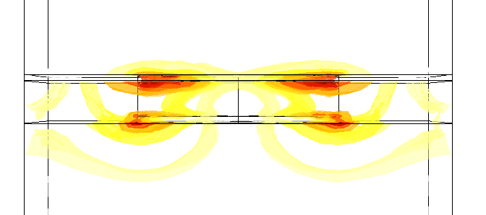
Nanoplasmonics within optical fibers
Cross section view
Reflectance spectrum
Period = 900 nm
Radius = 225 nm
3D computational domain (unit cell)
LSPR excitation
max
air
gold
x
450 nm
ZEP
900 nm
fiber
y
x
min
Full-wave simulations , COMSOL Multiphysics (RF Module)
|E|
y
Notes:
Il Gruppo di Optoelettronica da diversi anni lavora nell’ambito della sensoristica e delle nanotecnologie in stretta collaborazione sia con il mondo industriale che con prestigiosi enti di ricerca (nazionali ed internazionali).

Slide 12
THE WHOLE IS BETTER THAN THE SINGLE PARTS
Enhancement of Field Intensity up to 7 times
Optical fiber
Optical fiber
Optical fiber
Notes:
12

Slide 13
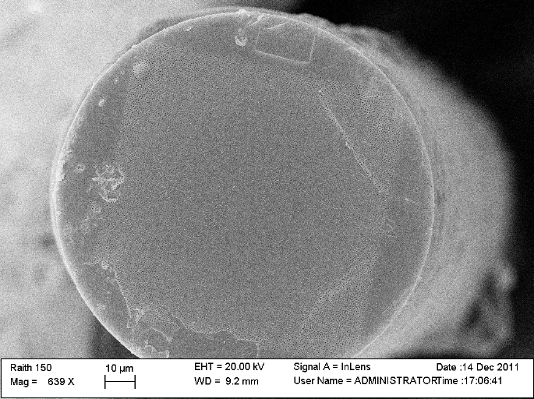
Experimental realization
top view
100 µm
t_{ZEP}=200 nm
t_{Au}=40 nm
Notes:
Il Gruppo di Optoelettronica da diversi anni lavora nell’ambito della sensoristica e delle nanotecnologie in stretta collaborazione sia con il mondo industriale che con prestigiosi enti di ricerca (nazionali ed internazionali).

Slide 14
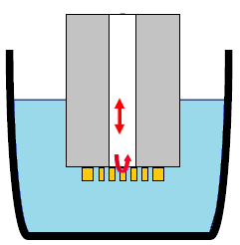
Refractive index (bulk) Sensitivity
Opt. Source
OSA
t_{Au} =20 nm
t_{Au}=20 nm
t_{Au}=30 nm
t_{Au}=40 nm
t_{ZEP} =200 nm
125 nm/RIU
3dB coupler
98 nm/RIU
fiber
36 nm/RIU
Water/Solvent
Further optimization margins exist acting on the large degree of freedom exhibited by the platform
By adjusting the gold and resist thickness, the lattice tiling, SRI sensitivities of the order of ~ 500nm/RIU are expected
Notes:
Il Gruppo di Optoelettronica da diversi anni lavora nell’ambito della sensoristica e delle nanotecnologie in stretta collaborazione sia con il mondo industriale che con prestigiosi enti di ricerca (nazionali ed internazionali).

Slide 15

Surface Sensitivity
Deposited silica layer thickness
d_{SiO2} = 100nm
experimental
∆λ ≈ 35 nm
The surface sensitivities (in terms of resonance shift per nanometer of SiO₂ overlay) is 0.35
Considering the typical sizes of biological molecules (3.8-5.2 nm), the binding of a single biological monolayer generates a resonance shift of ~ 1.3-1.8 nm, which may be easily detected.
Notes:
Il Gruppo di Optoelettronica da diversi anni lavora nell’ambito della sensoristica e delle nanotecnologie in stretta collaborazione sia con il mondo industriale che con prestigiosi enti di ricerca (nazionali ed internazionali).

Slide 16
The sensing area
Structural confinement has been done on the same sample by using a laser micromachining ablation process
The sensing area can be reduced down to 20 × 20 µm² without affecting the spectral features (and thus the sensitivity)
Notes:
Il Gruppo di Optoelettronica da diversi anni lavora nell’ambito della sensoristica e delle nanotecnologie in stretta collaborazione sia con il mondo industriale che con prestigiosi enti di ricerca (nazionali ed internazionali).

Slide 17
RI Sensitivity Enhancements with Quasicrystals
ZEP - 250nm Gold - 40nm
For a given filing factor and equivalent period, QC can outperform the periodic counterpart
A. Crescitelli, A. Ricciardi, M. Consales, E. Esposito, C. Granata, V. Galdi, A. Cutolo, and A. Cusano, Adv. Funct. Mater. 22, 4389-4398 (2012).
Notes:
Il Gruppo di Optoelettronica da diversi anni lavora nell’ambito della sensoristica e delle nanotecnologie in stretta collaborazione sia con il mondo industriale che con prestigiosi enti di ricerca (nazionali ed internazionali).

Slide 18
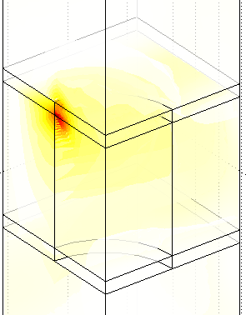
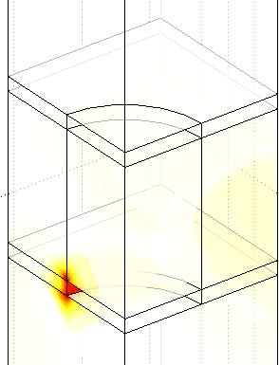
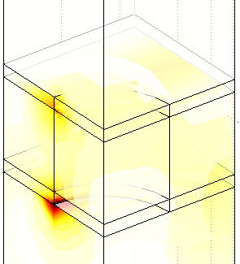
DIELECTRIC THICKNESS TUNING :
TOWARDS RESONANCES ENGINEERING
C
B
A
A. Cusano et al. Optical Fiber Technology 2013; 19 (6), Part B, pp. 772-784 (Invited Paper)

Slide 19
TOWARDS POLARIZATION SENSITIVE DEVICES
Hole ellipticity
Period Asymmetry
r_{y}= ηr_{x} , η = 1.5
r_{y}= ηr_{x} , η=1, r_{y} = 250 nm
a_{x} = a_{y} = 900 nm
a_{x} = 920 nm, a_{y} = 980 nm
Top view
Symmetric
r_{y}= η r_{x} , η=1 , r_{y} = 225 nm
a_{x} = a_{y} = 900 nm
t_{ZEP} = 100 nm
t_{Au} = 17 nm
A. Cusano et al. , ACS Photonics 2014 1 (1), 69-78

Slide 20
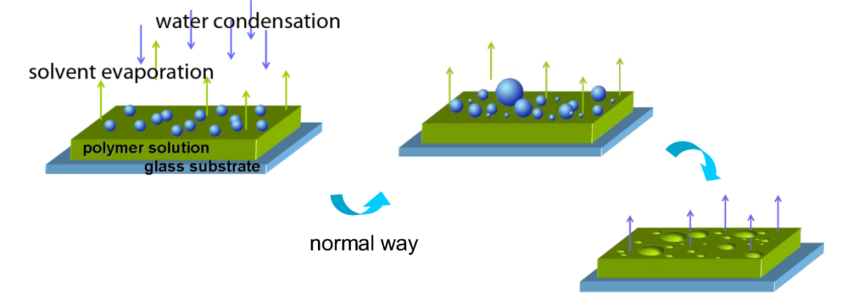
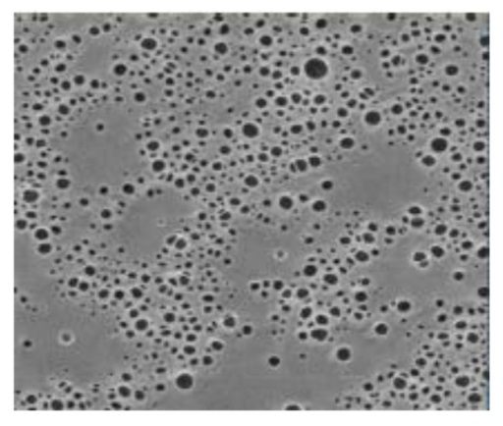
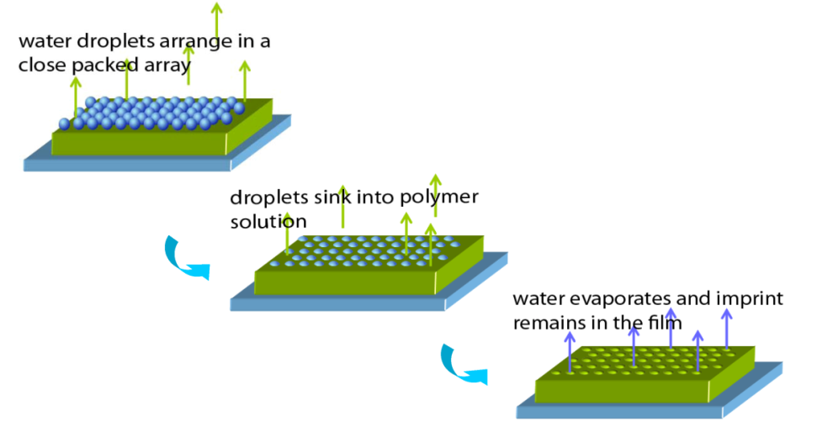
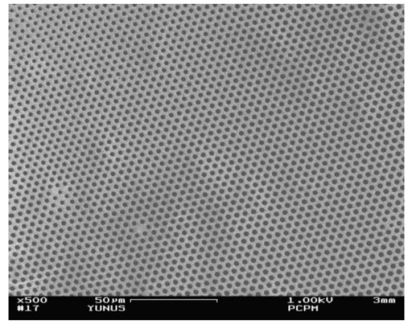
Breath Figure Technique FOR RAPID AND COST EFFECTIVE Prototyping
The Breath Figure Technique (Francois, Nature 1994, 369-387-9) relies on the precipitation of a polymer around condensed water droplets triggered by the fast evaporation of polymer solvent in a humid environment
…in controlled conditions
Process control (i.e. by adjusting polymer concentration, kind of solvent, evaporation rate, relative humidity) enables the manipulation of some morphology features in the final film (i.e. degree of order, distribution and size of the cavities)

Slide 21



Lab on Fiber by the Breath Figures Technique
We adapted the Breath Figures technique to operate on optical fiber substrates
so as to realize self assembled metallo-dielectric photonic crystals onto the optical fiber end facet
1. The optical fiber was embedded in a customized Al holder designed to house the ceramic ferule of the optical fiber
3. Water droplets grow
on polymer solution
4. Droplets assemble
in a close pack array
2. Polymer solution is cast onto fiber tip under N₂ flow
6. Gold is evaporated on top
Deposition conditions:
Polymer solution: 4mg/mL CS₂ solution of a fluorinated fluorescent dye-terminated linear polystyrene
Nitrogen Flow: moist N₂ at 75% R.H. and 25 °C
5. Solvent and water evaporate
A. Cusano et al. , ACS Photonics (TO BE PUBLISHED)

Slide 22


Experimental Results: Process Assessment
By the assessment of the fabrication process, we are now able to easily obtain well ordered and defect free patterns on the optical fiber tip
First repeatable and functional prototypes
30 µm
By changing the flow of humid nitrogen between 100 and 300 L/h, we obtained honeycomb arrays with cavities ranging from 2.5 to 1.0 µm
Notes:
In a very recent work
2
, spin coating combined with EBL nanotechnology, have been specialized to operate on the optical
fiber end facet for creating hybrid metallo-dielectric nanostructures, giving rise to resonant effects exploitable for labelfree chemical and biological sensing as well as for acoustic wave detection
2
.
However the direct writing approaches, while are able to efficiently provide nanostructured devices on the optical fiber,
are still very challenging by requiring complex and expensive fabrication procedures with a relatively low throughput .

Slide 23



Morphological Characterization
S
Schematic view
Half removing
via laser
Scanning Electron Microscopy (SEM) and Atomic Force Microscopy (AFM) analysis
have been carried out to accurately study the morphology of the created patterns
The optimized process ensures Order and Regularity of the polymeric template
Flow rate 300L/h – gold thickness 33nm)
Average values (Relative standard deviation)
Holes Diameter = 0.95 µm ( 3.2%)
Pitch = 2.67 µm (1.3%)
Hole depth = 1.78 µm (3.5%)
Structure height = 2.5 µm (2.3%)

Slide 24














Amplification + filtering
Tunable Laser
Photodiode
Acoustical Source
Acquisition + storing
Device under-test
Sensing Performances
1300nm
1400nm
1500nm
1600nm
1300nm
1400nm
1500nm
1600nm

Slide 25





LAB ON FIBER TECHNOLOGY: MORE THAN A VISION
Tilted Fiber Bragg gratings
Jacques ALBERT et al., Carleton University, Canada
Microstructured optical fiber
On the Tip
Andrea CUSANO et al., University of Sannio, Italy
Philip St. J. RUSSELL, Max Planck Institute for the Science of Light, Germany, Ole BANG, Technical University of Denmark et al.
Jacques Albert, IEEE Spectrum, April 2014

Slide 26

THE FIRST BOOK
Written by the world's leading experts in this field
First book on the lab-on-fiber technology
Explains concepts, methods and applications of the lab-on-fiber technology
This book focuses on a research field that is rapidly emerging as one of the most promising ones for the global optics and photonics community: the “lab-on-fiber” technology.
Inspired by the well-established "lab on-a-chip" concept, this new technology essentially envisages novel and highly functionalized devices completely integrated into a single optical fiber for both communication and sensing applications.
Based on the R&D experience of some of the world's leading authorities in the fields of optics, photonics, nanotechnology, and material science, this book provides a broad and accurate description of the main developments and achievements in the lab-on-fiber technology roadmap, also highlighting the new perspectives and challenges to be faced.
This book is essential for scientists interested in the cutting-edge fiber optic technology, but also for graduate students.

Slide 27

Thanks for
your kind attention
Thanks for your kind attention

Slide 28
Let Us Meet Again
We welcome all to our future group conferences of Omics group international
Please visit:
www.omicsgroup.com
www.Conferenceseries.com
http://optics.conferenceseries.com/

